Slide 1




Slide 2
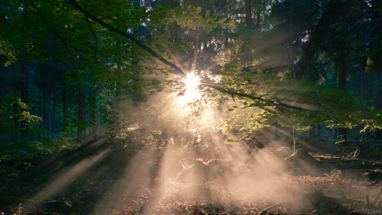
Unit 4
Thursday , 3-12-2020

Slide 3
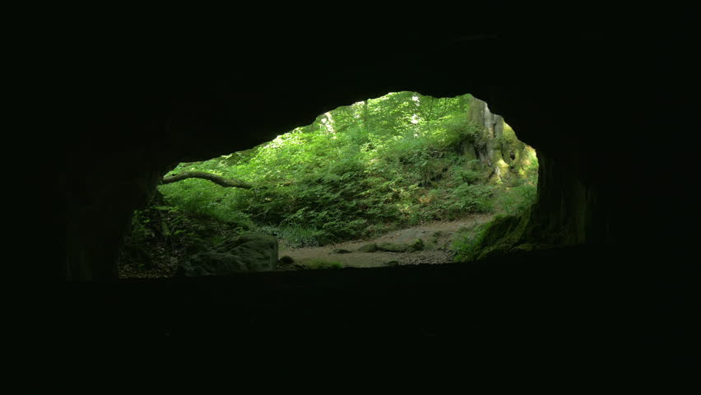
Opener!

Slide 4

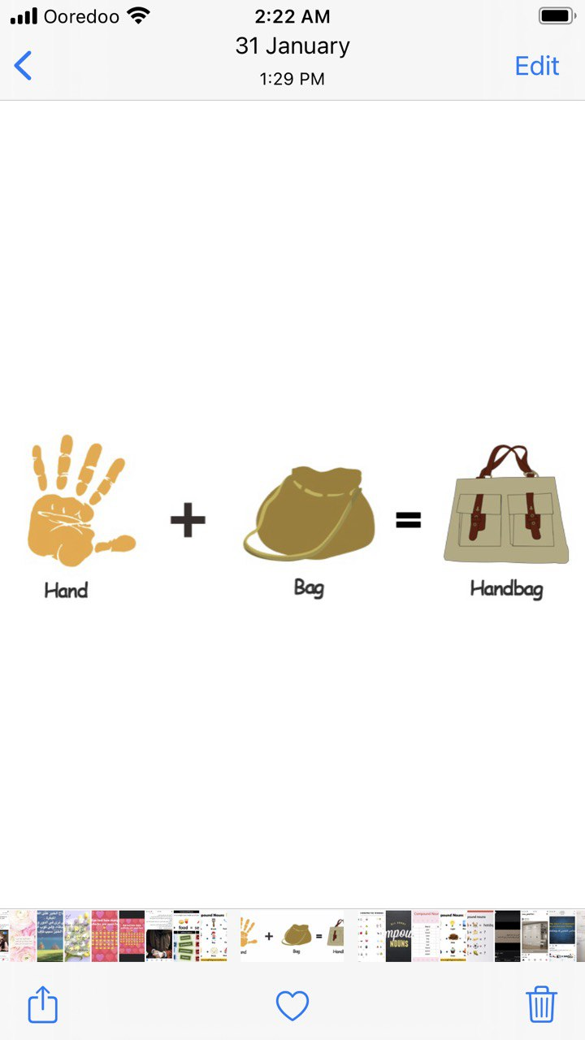

pan
Cake
pancake

Slide 5
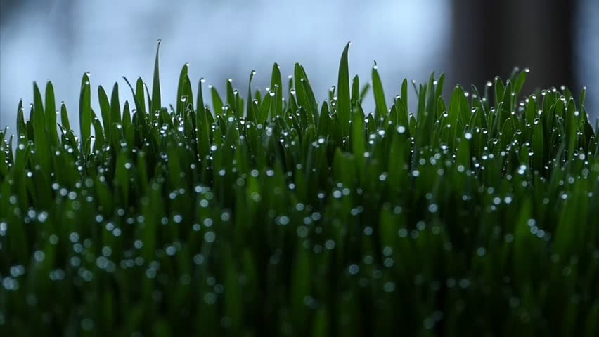
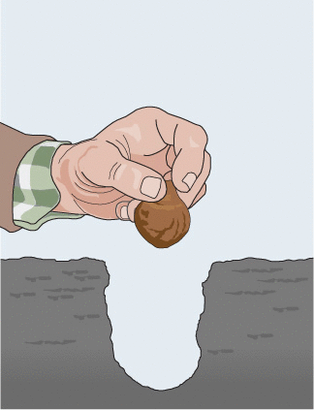
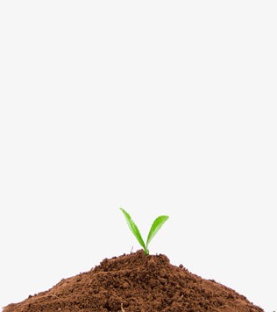
Why do people grow plants?

Slide 6
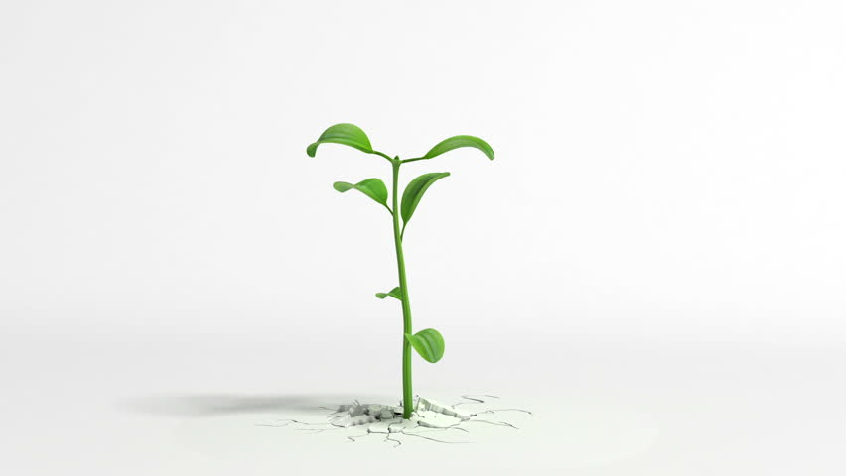
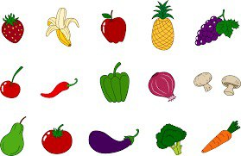
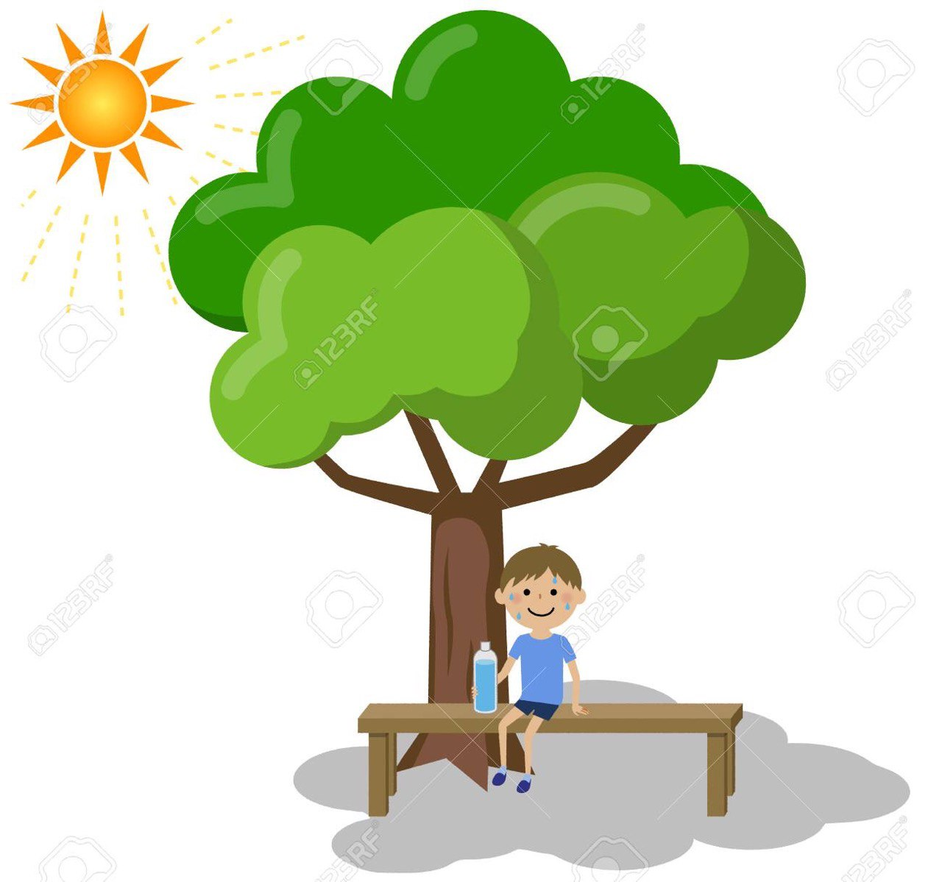
What do plants give us ?
Food
Shade

Slide 7
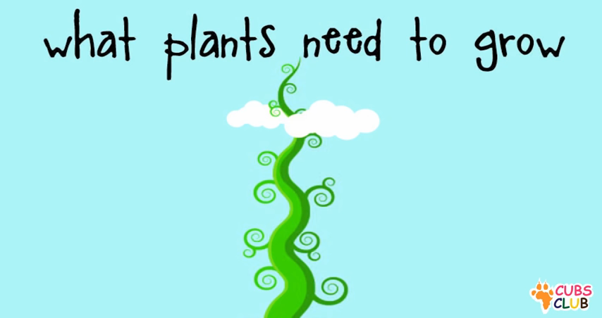

Slide 8
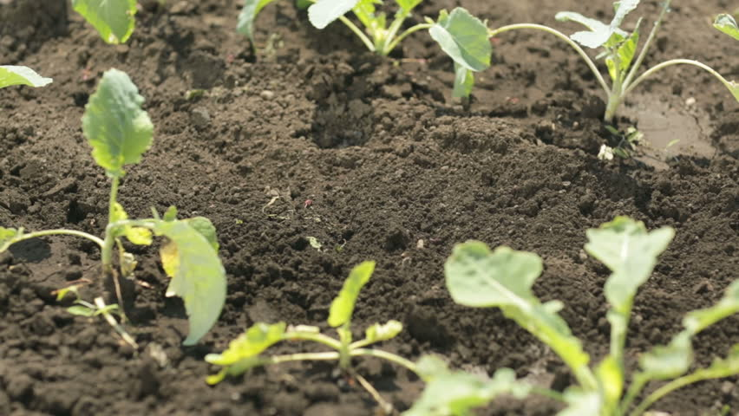
We need soil to grow plants.

Slide 9
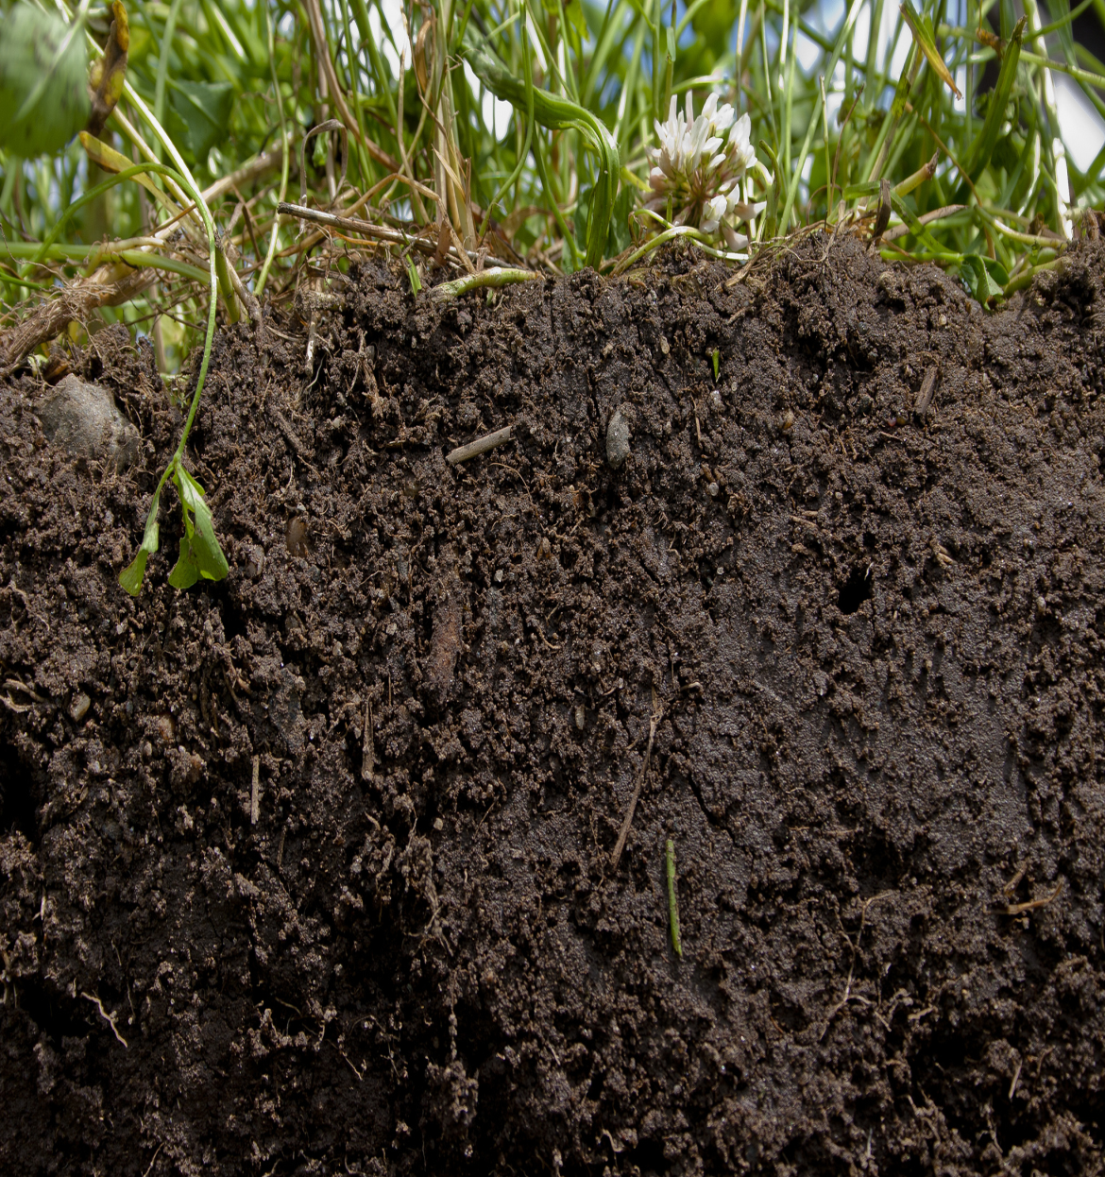
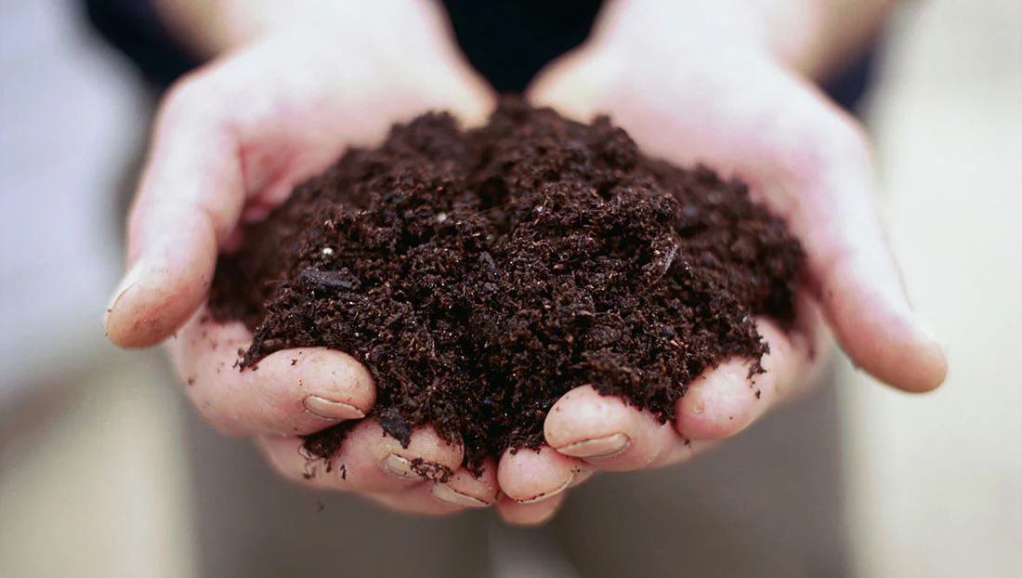

soil

Slide 10
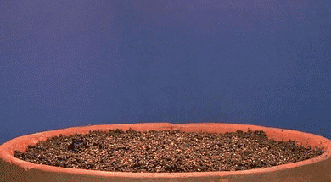
We need seeds to grow plants.

Slide 11
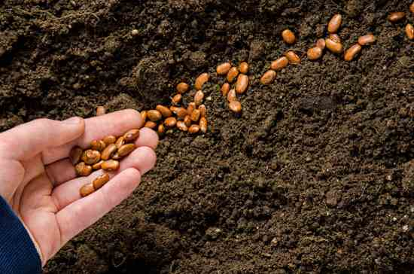
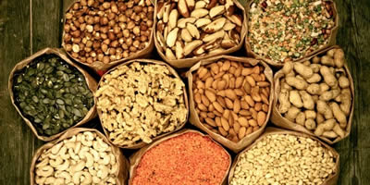
seeds

Slide 12
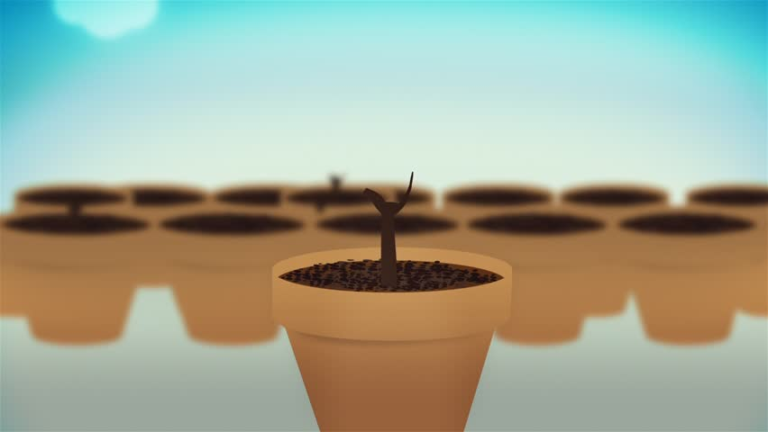
We need pots to grow plants in our gardens.

Slide 13
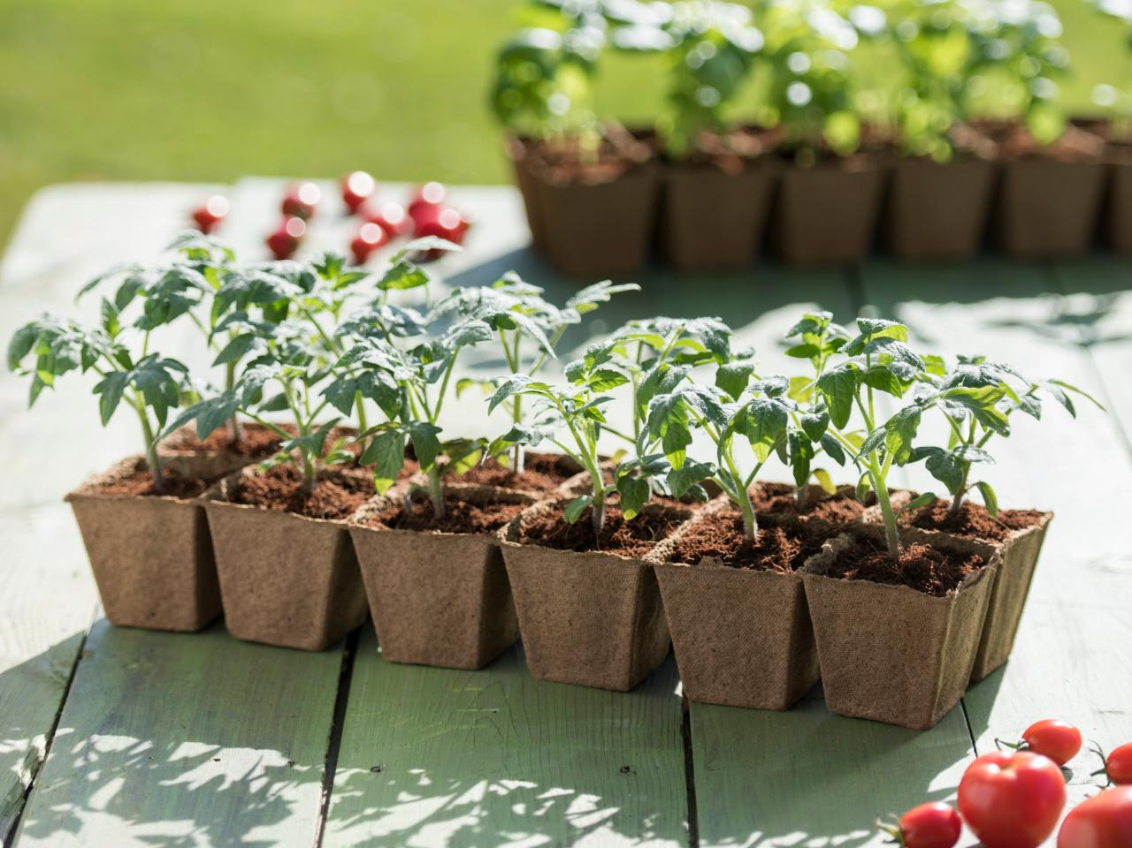
pot

Slide 14
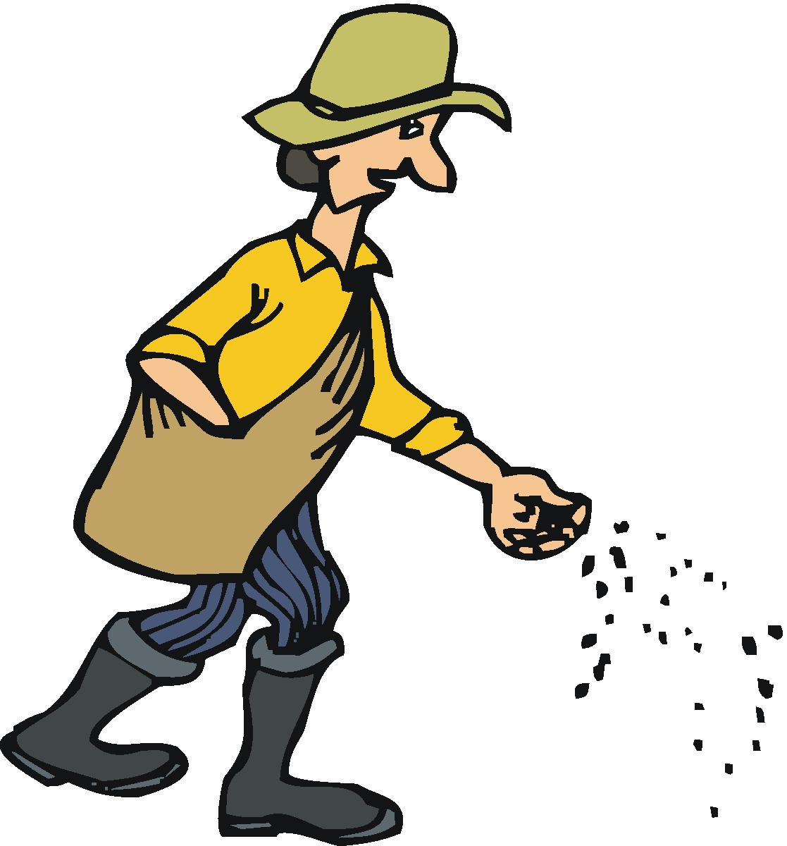
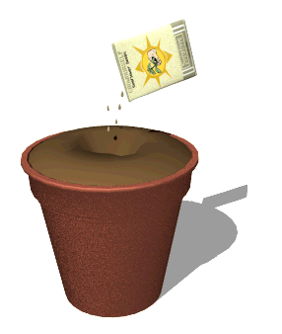
sprinkle
We must sprinkle seeds.

Slide 15
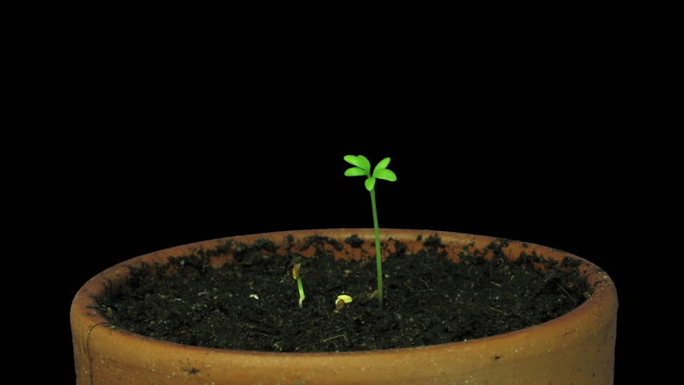
New Vocabulary

Slide 16
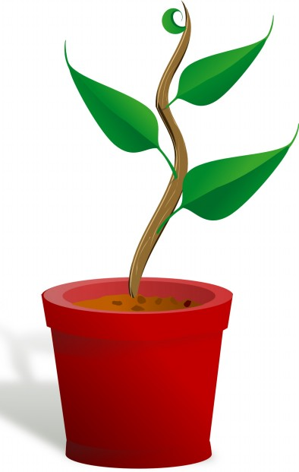
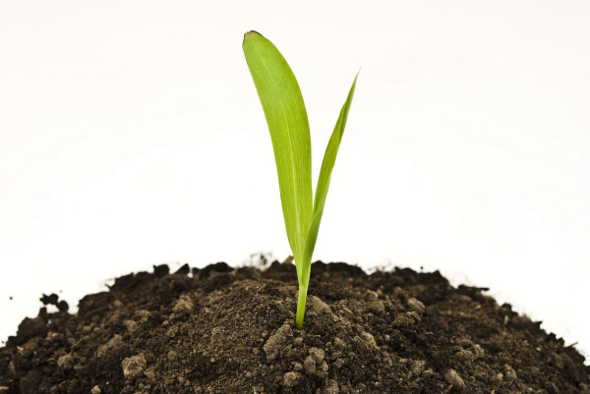

Sunday , 29 -10 -2023
Unit :- 4
Lesson :- 2
pot
seeds
soil
…………………………………
…………………..…………………
…………………..…………………
…………………..…………………
……………………………
…………………..…………………
sprinkle
………………………………
………………………………

Slide 17
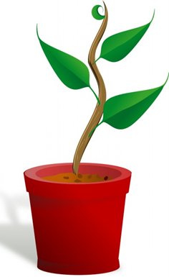
Choose the correct answer :-
1- We put the plant in a …………
a- seed
b- pot

Slide 18


Slide 19
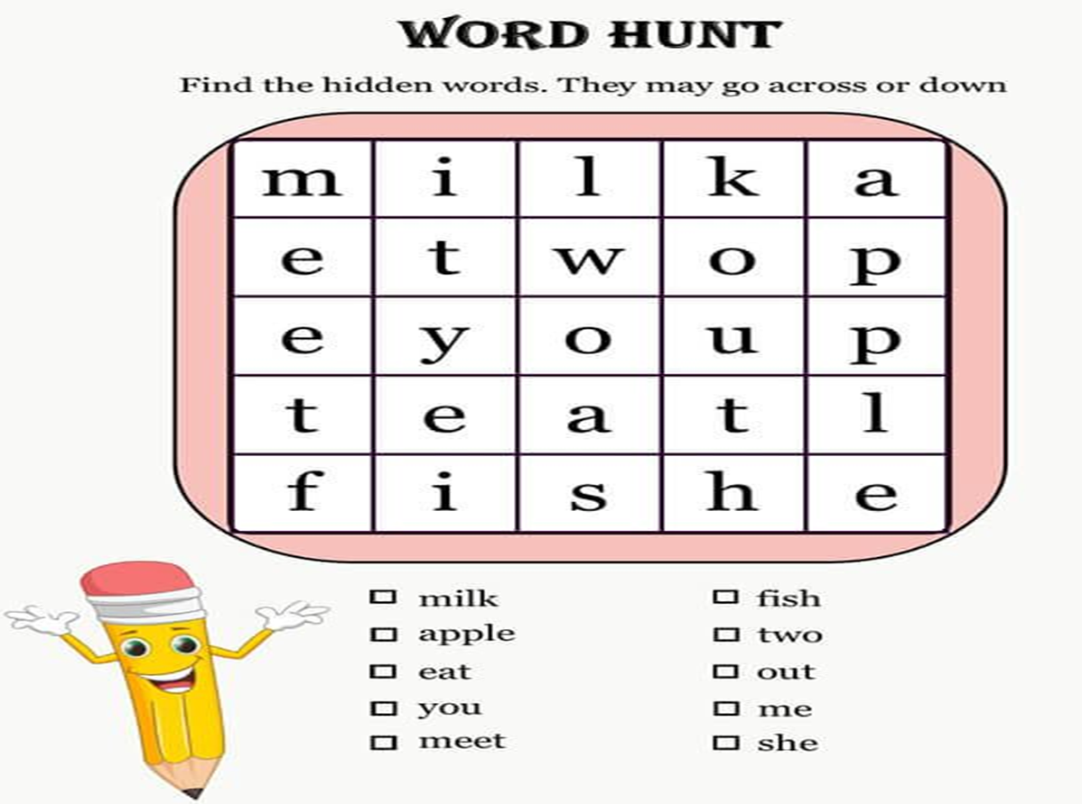

Slide 20


GRAMMAR
Sequence words

Slide 21
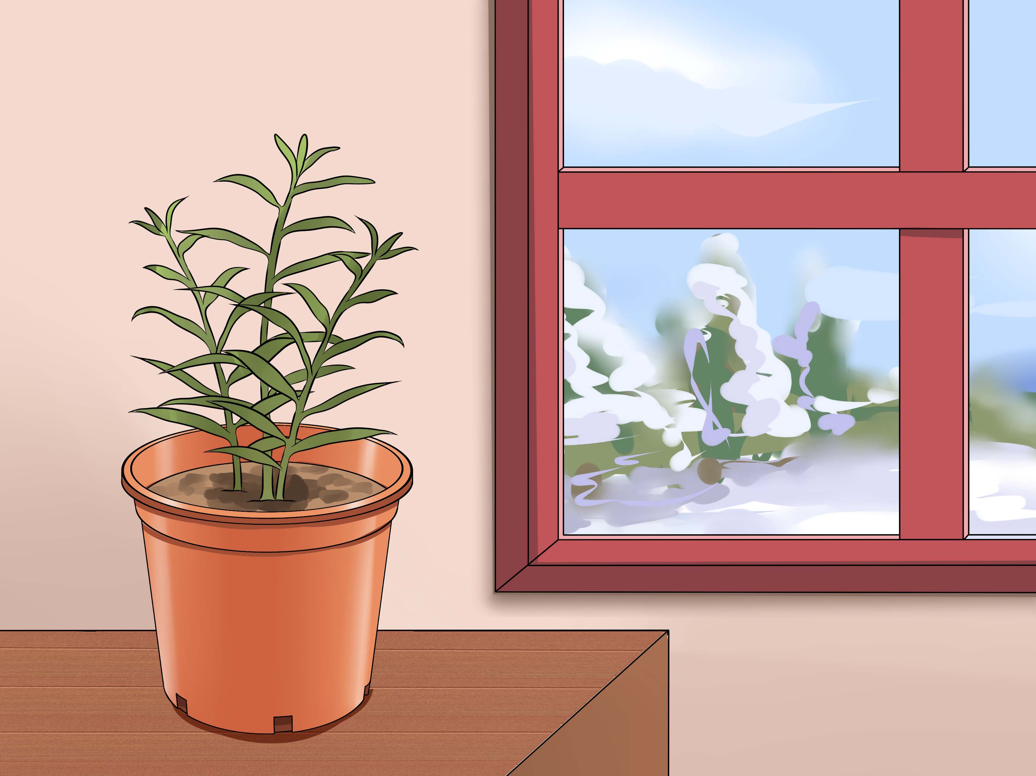

Slide 22

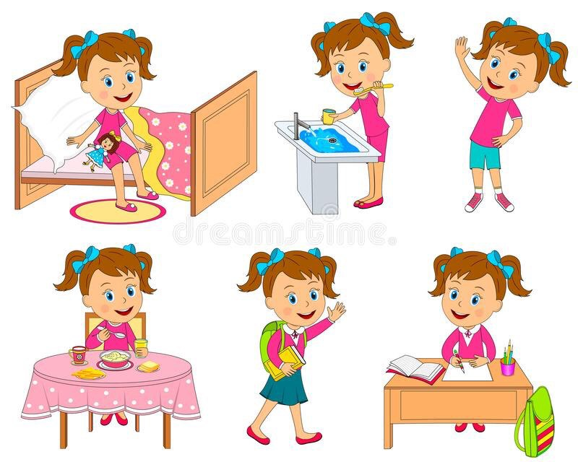

Slide 23



Slide 24
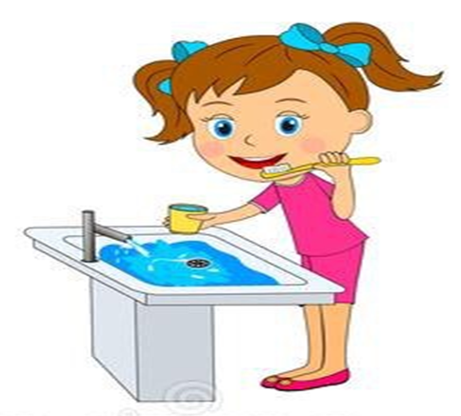

First , I wake up early .
Next , I brush my teeth and have a shower .
Then , I do some exercises .

Slide 25


Then , I eat my breakfast .
After that , I go to school .
Finally , I study my lessons .

Slide 26


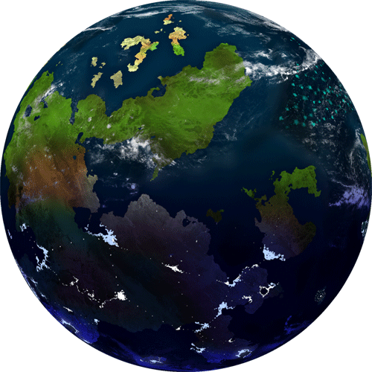
Student’s Book
Page 24
Ex. 5

Slide 27
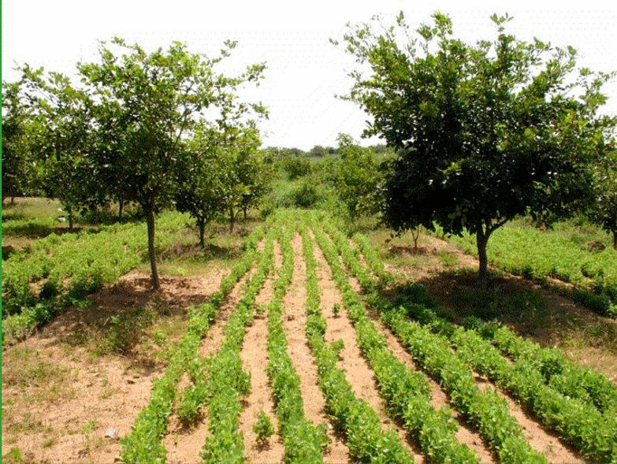
Student’s Book
Page 24

Slide 28
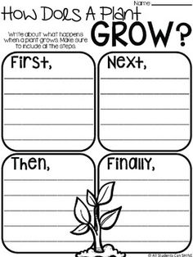

Slide 29


Slide 30

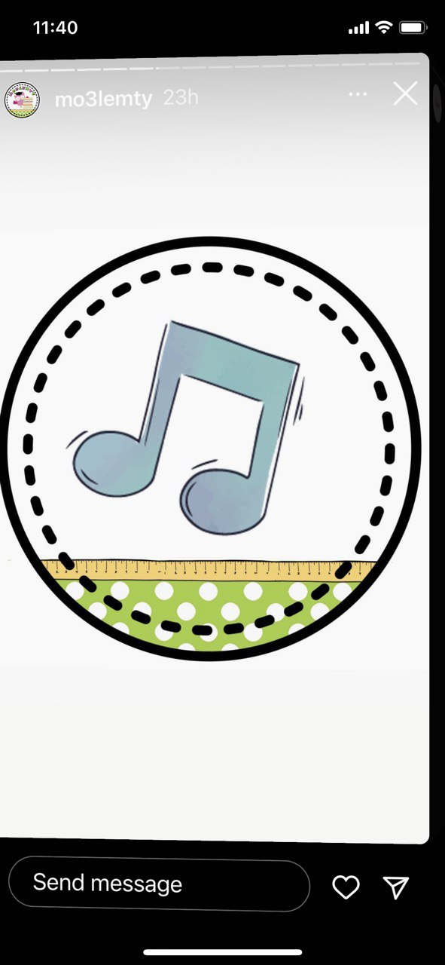

Slide 31
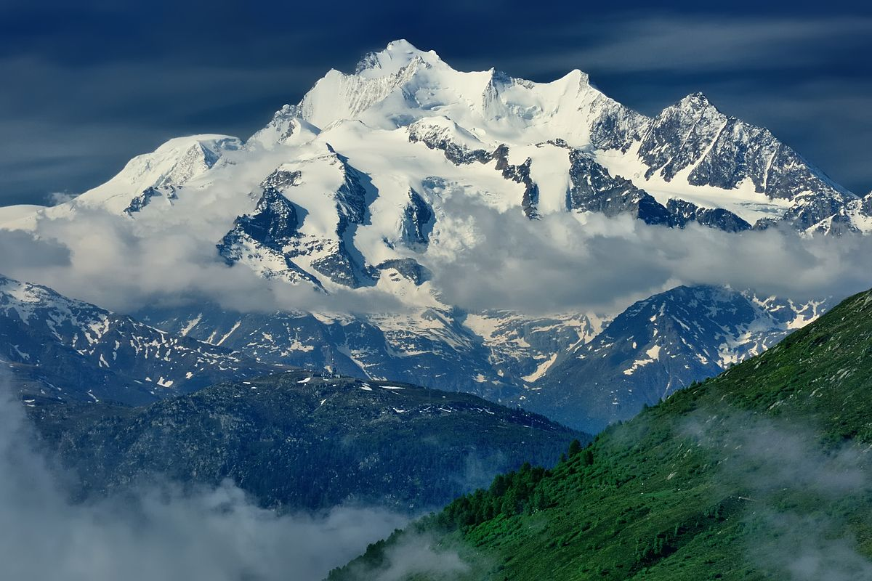
Check your answers.

Slide 32
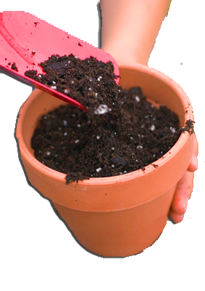
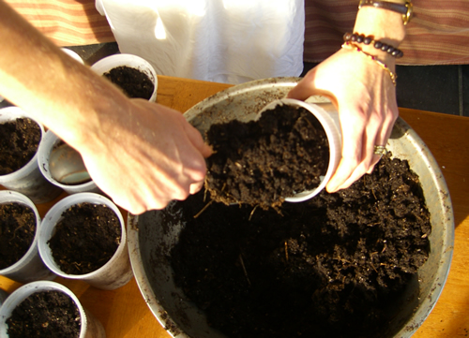
First, fill the pot with soil.

Slide 33

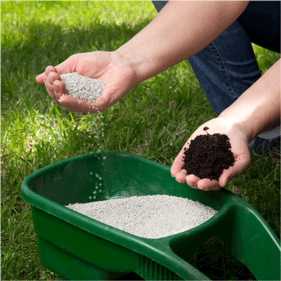
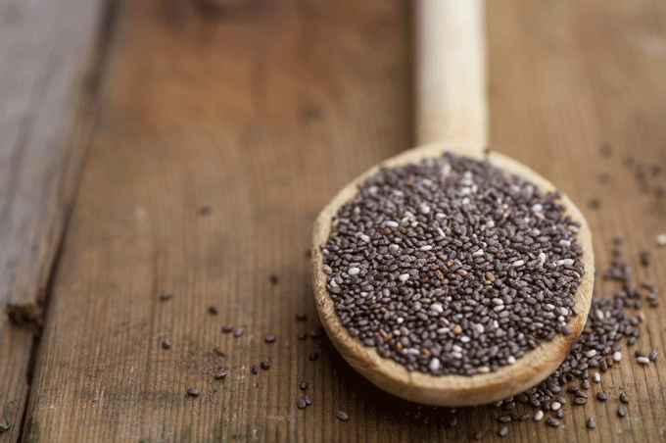

Slide 34
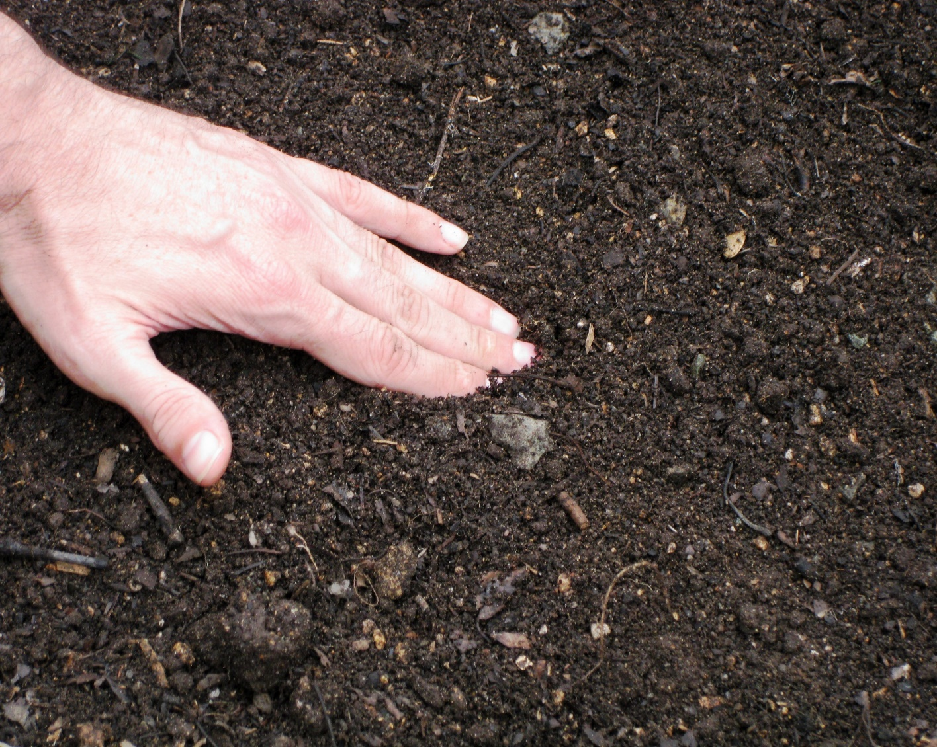
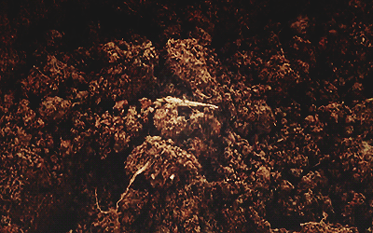
Then, cover the seeds with soil.

Slide 35
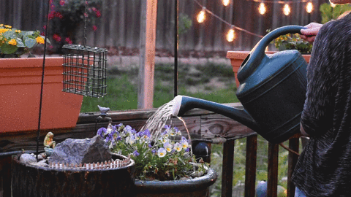
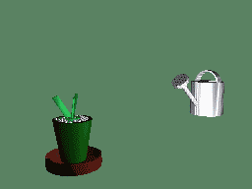
Then, water it from time to time.

Slide 36

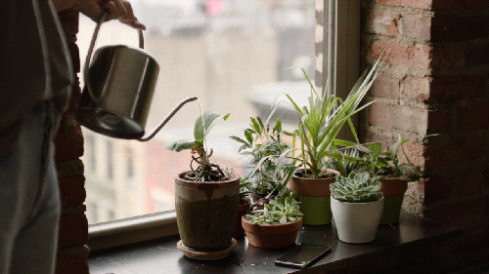

Slide 38
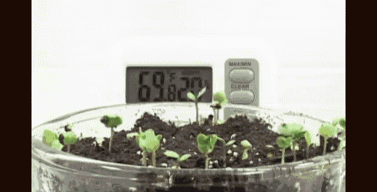
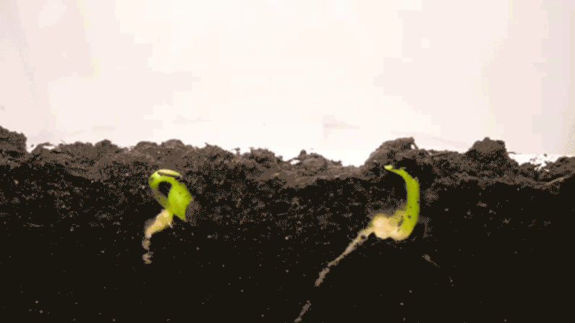
Finally, the plant will grow.

Slide 39
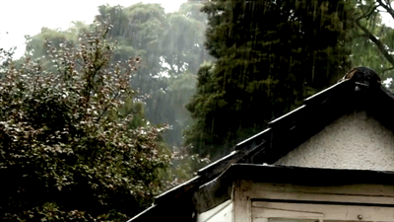
Closure

Slide 40


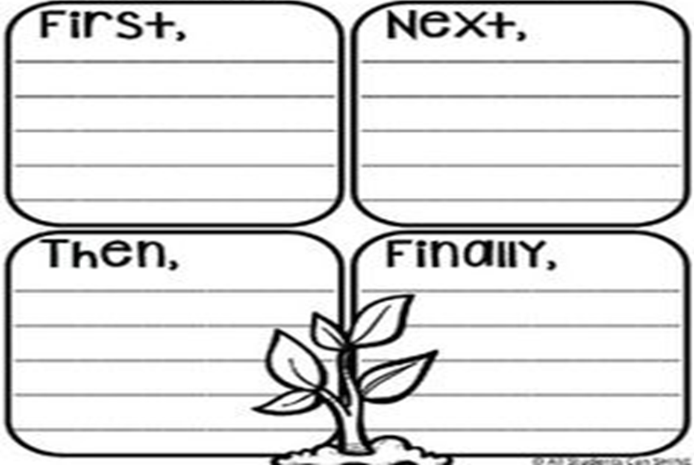

Slide 41



Slide 43
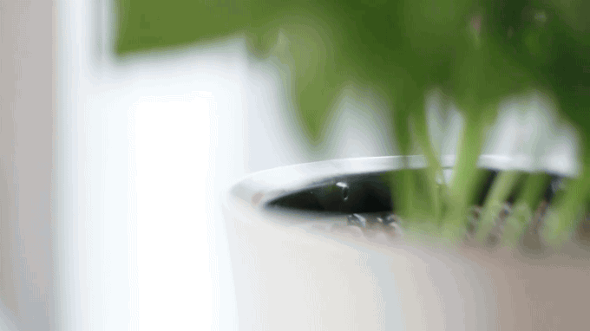
Read the instructions to the class.

Slide 44
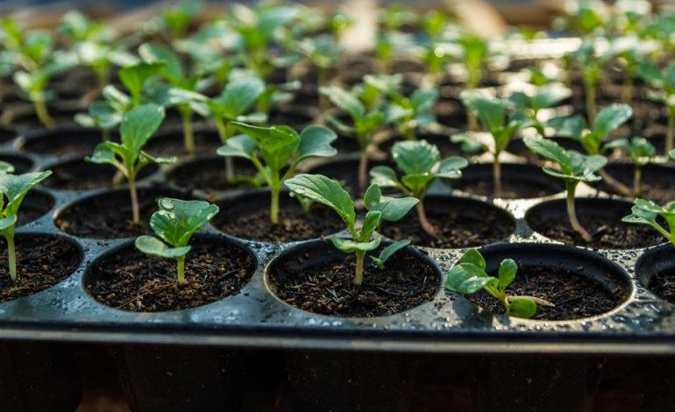
Listen to the song, and then say what you need to grow plants.

Slide 45


Slide 46
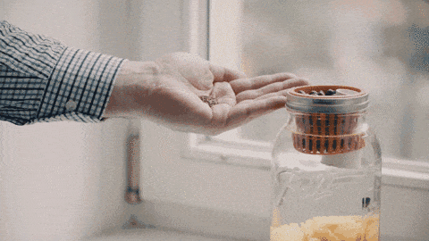
sprinkle (v.)
seeds (n.)
soil (n.)
pot (n.)

Slide 47
