Slide 1
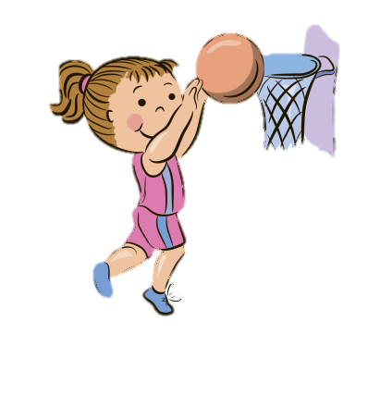
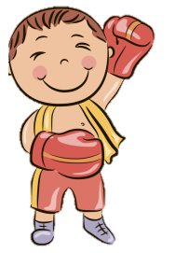
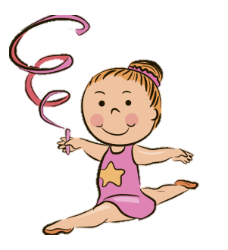
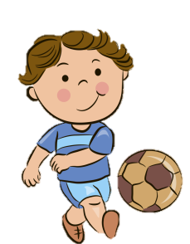
Unit 2
Lesson 4
Page:9
SPORTS AND ACTIVITIES

Slide 2
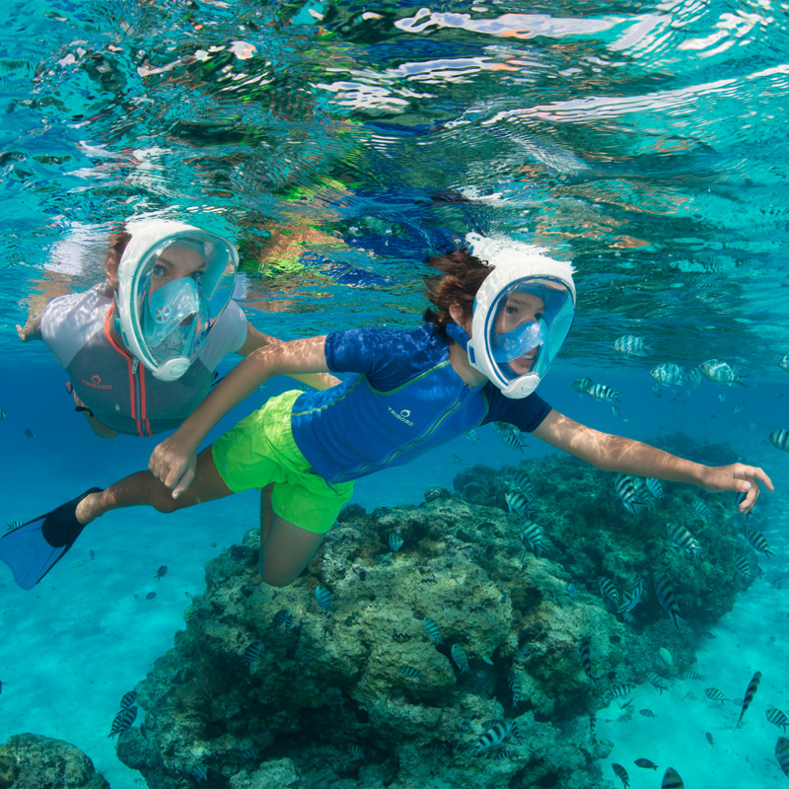
Can you snorkel?

Slide 3
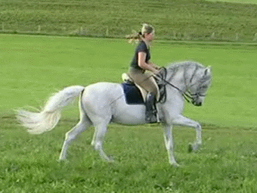
Can you ride a horse?

Slide 4


Who do you think is going to win the race?
1
2

Slide 5

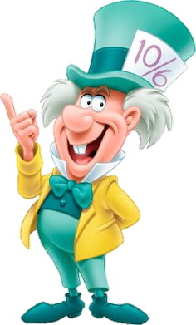


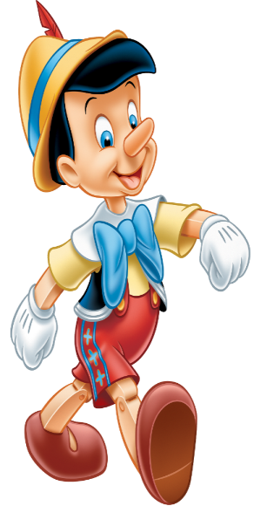

Correct the mistakes.
Can you
cave dive?
No, I can’t.
No, I don’t.

Slide 6
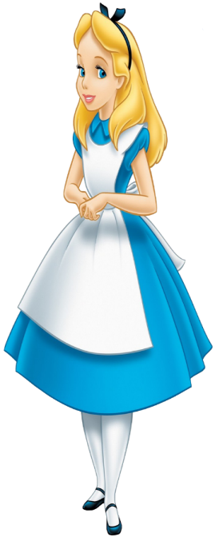
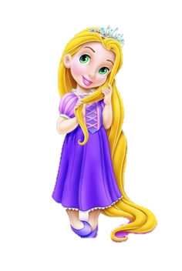
Correct the mistakes.
Can you
snorkel?
Can you
snorkelling?
Yes, I can.

Slide 7

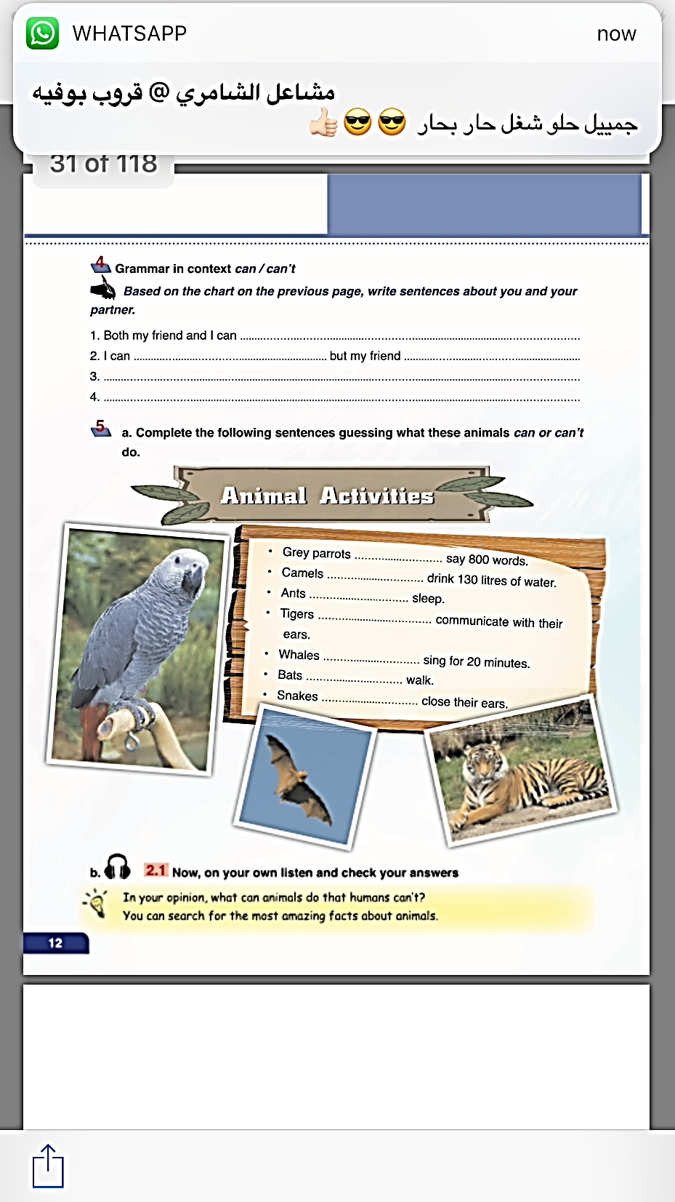
Page:12

Slide 8
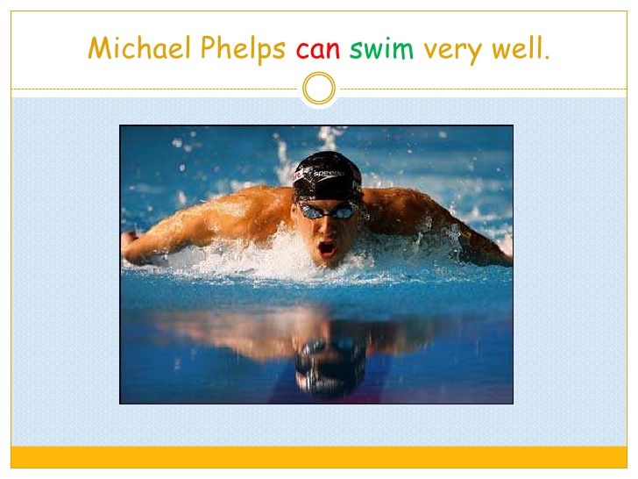
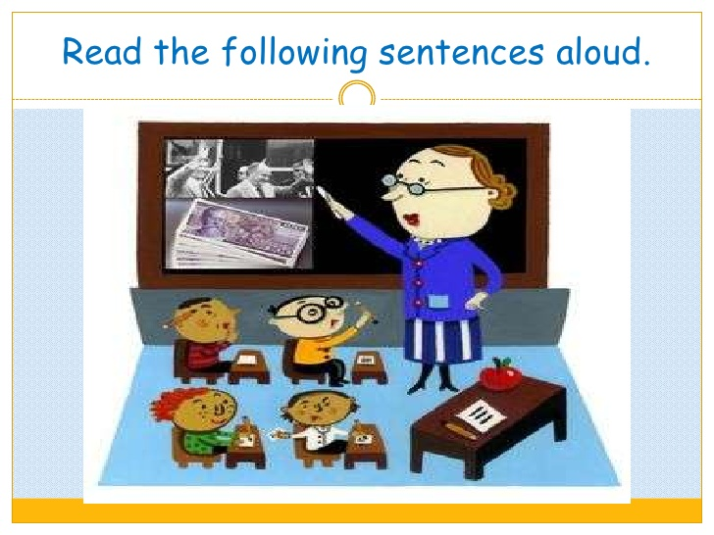
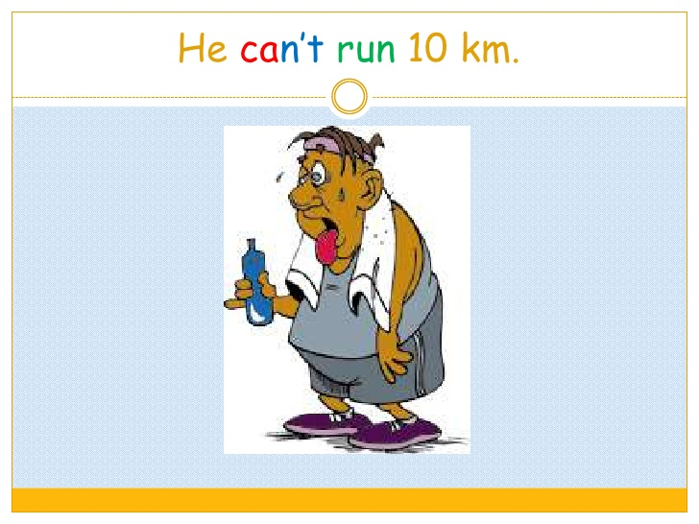
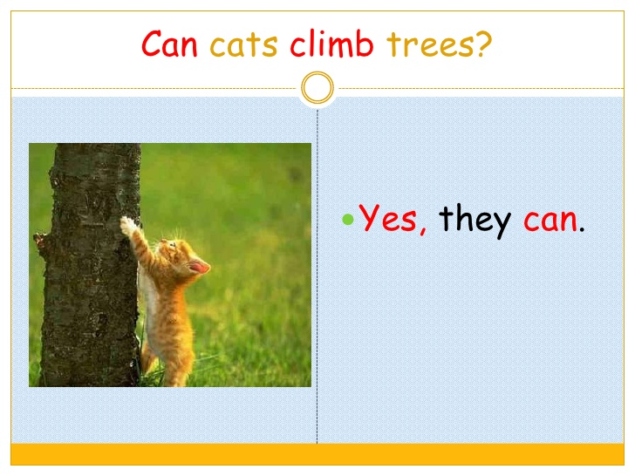
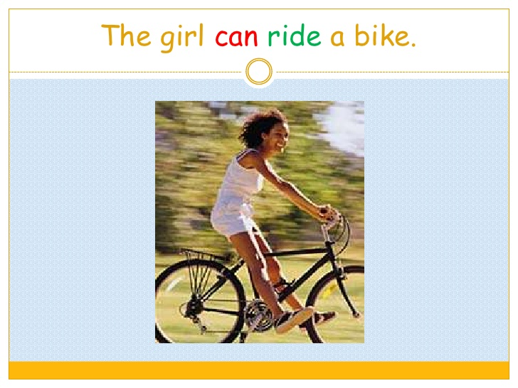
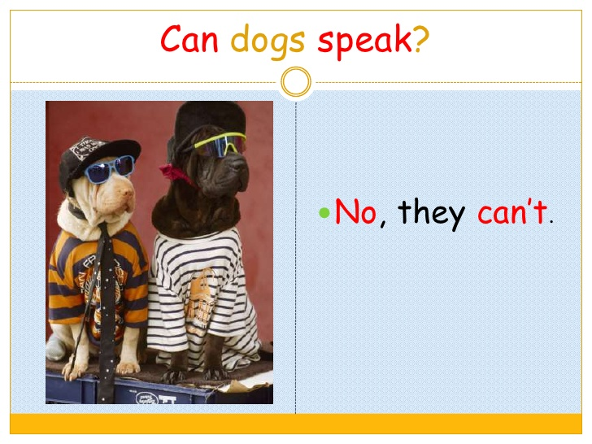

Slide 9
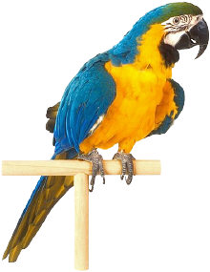
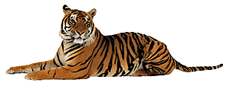

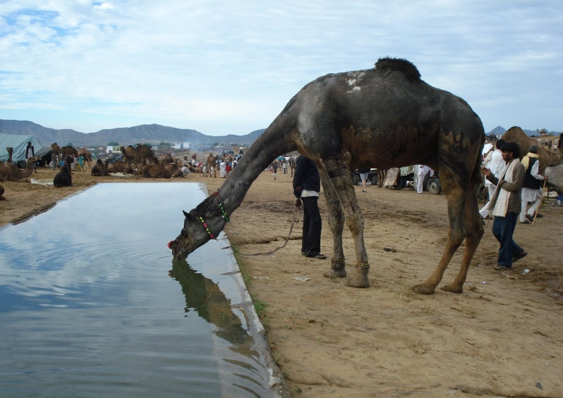
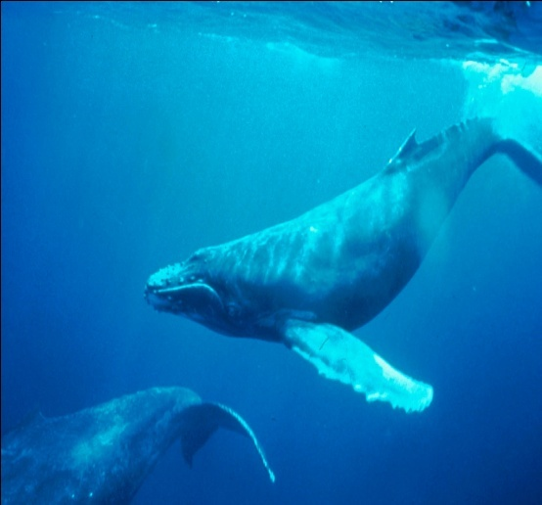
Animal Activities

Slide 10


Slide 11

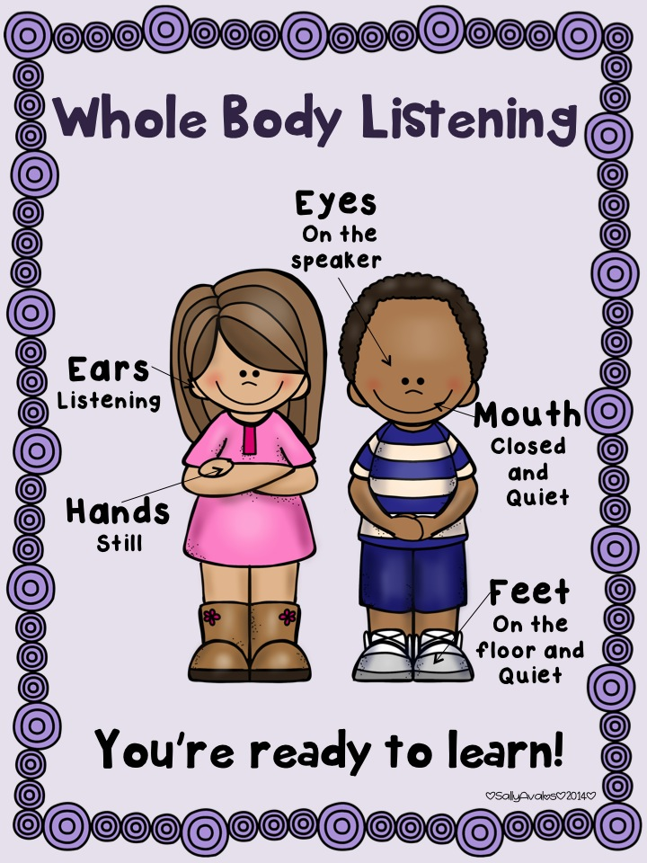


LISTENING
b. 2.1 Now, on your own listen and check your answers.

Slide 12
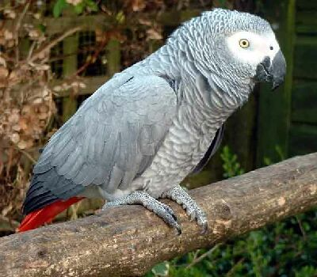
Grey parrots ---------- say 800 words.
can

Slide 13
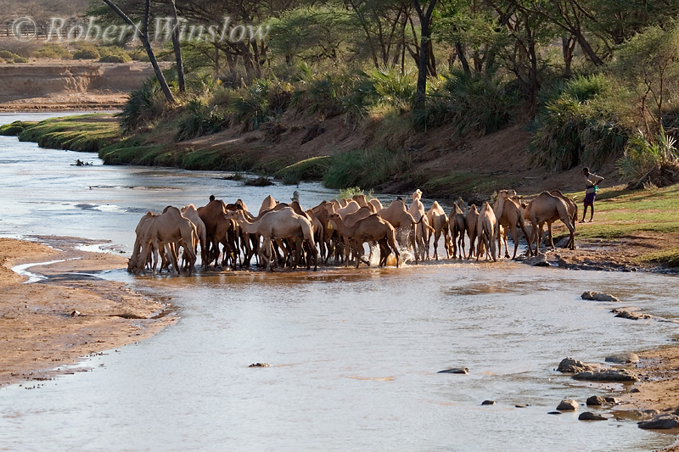
Camels --------------- drink 130 litres of water.
can

Slide 14
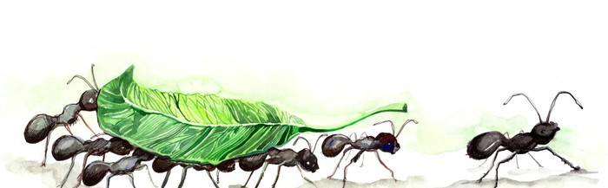
Ants ------------- sleep.
can’t

Slide 15
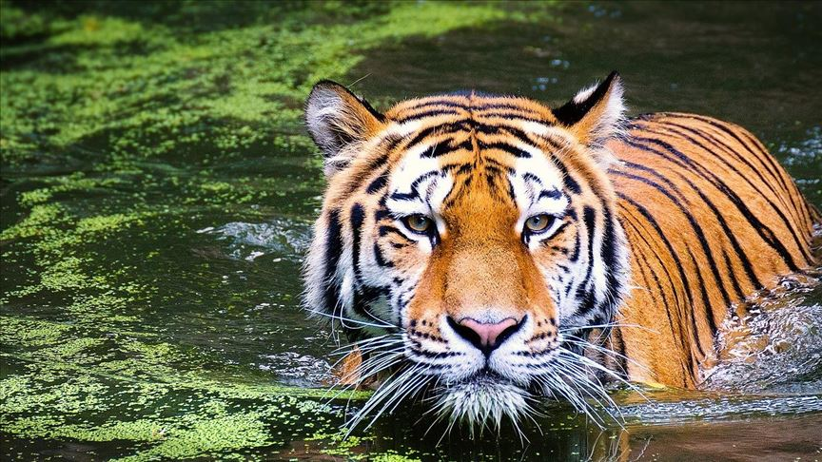
Tigers -------------- communicate with their ears.
can

Slide 16
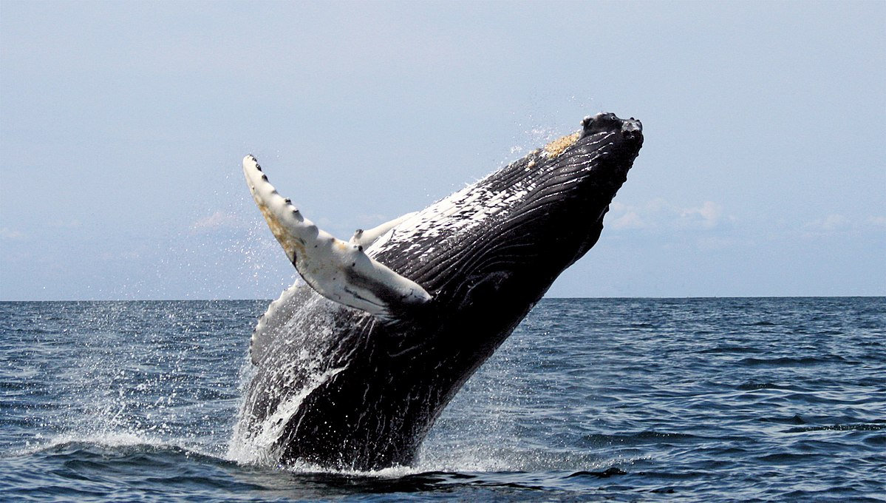
Whales ---------------- sing for 20 minutes.
can

Slide 17
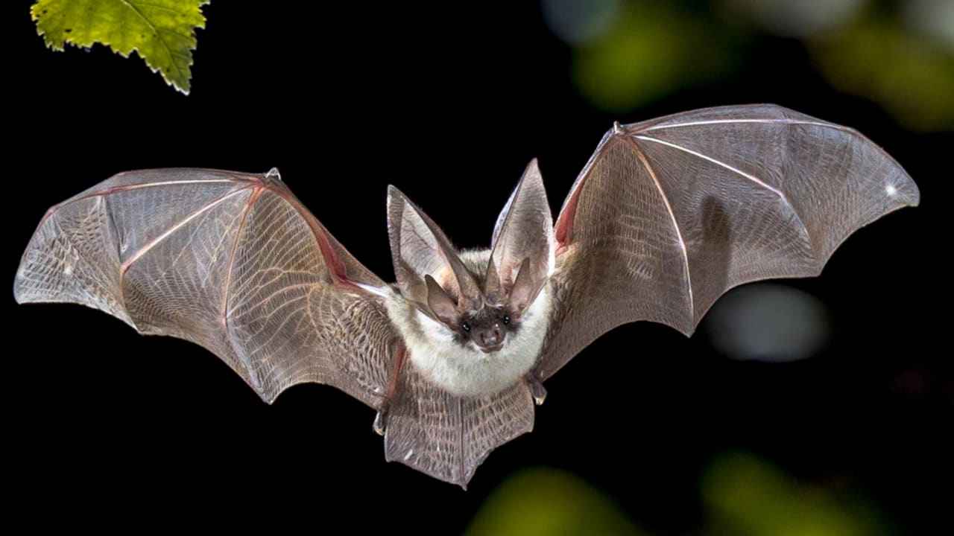
Bats ---------- walk.
can’t

Slide 18
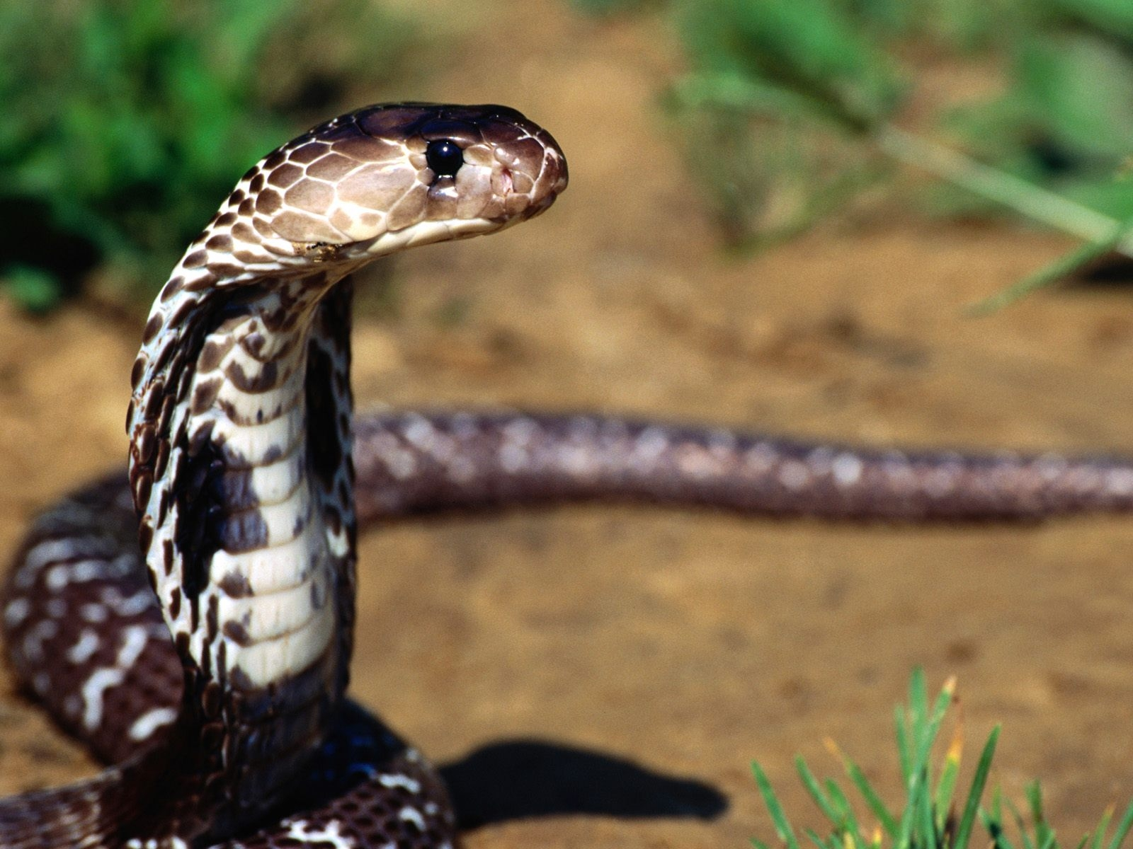
Snakes --------------- close their eyes.
can’t

Slide 19

listen to this song, and then write what the boy can do and what the girl can’t do.

Slide 20
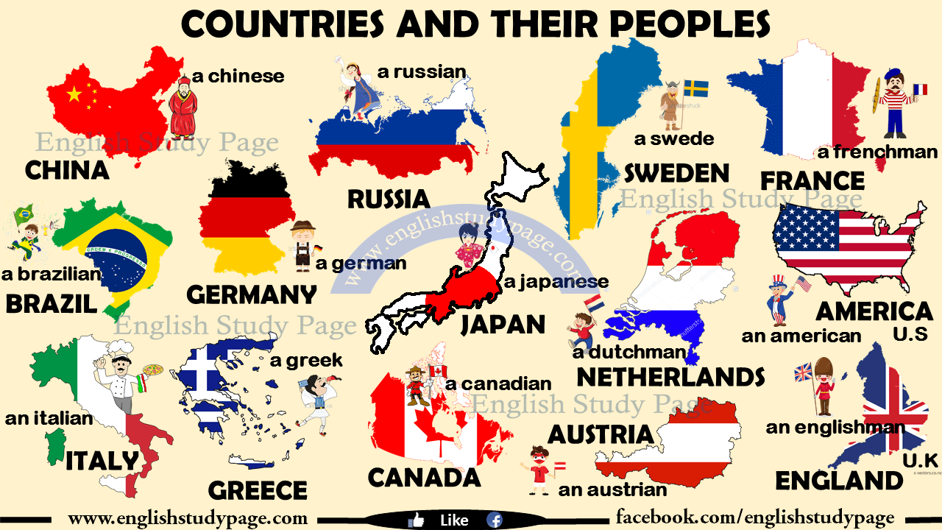
Watch the video and guess what our lesson is about

Slide 21


Slide 22
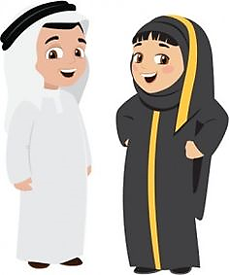


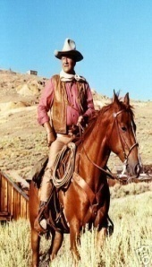
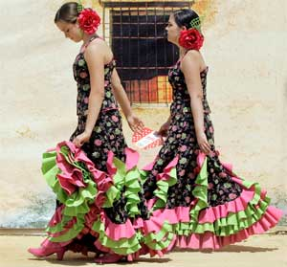


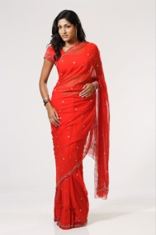
Let’s read about different people from different countries.

Slide 23
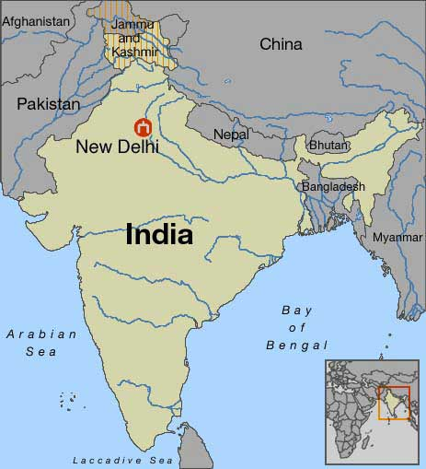
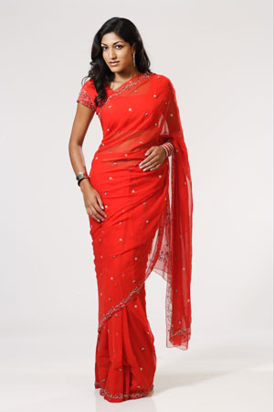
India
Nationality: Indian
nationality
What is her nationality?
I’m from India. I’m Indian.

Slide 24
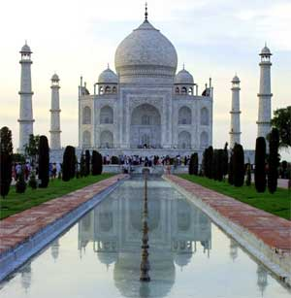
Have you ever visited Taj Mahal in India?

Slide 25
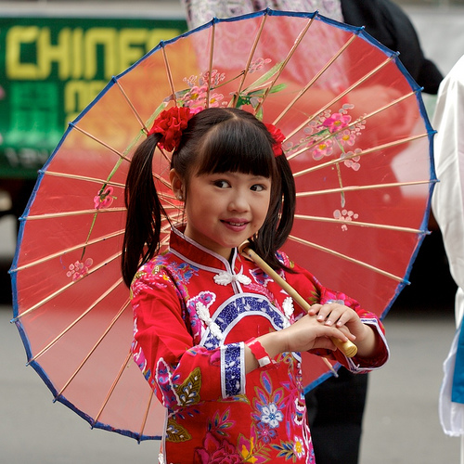
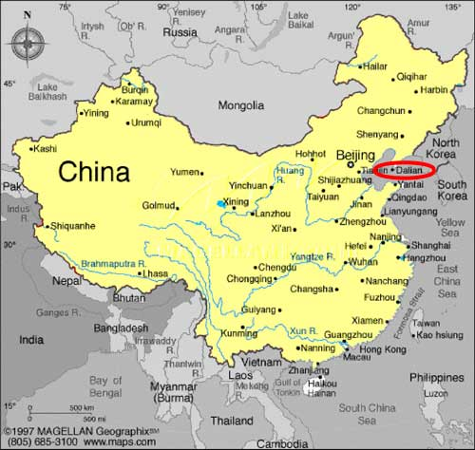
China
Nationality: Chinese
I’m from China. I am Chinese.

Slide 26
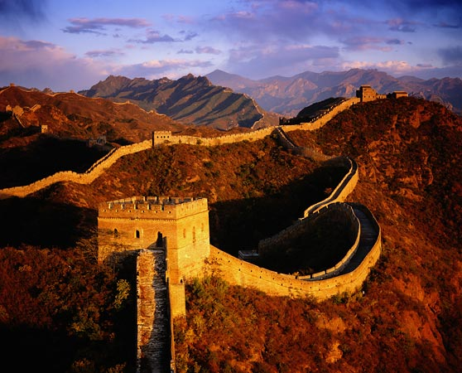
Have you seen the Wall of China yet?

Slide 27

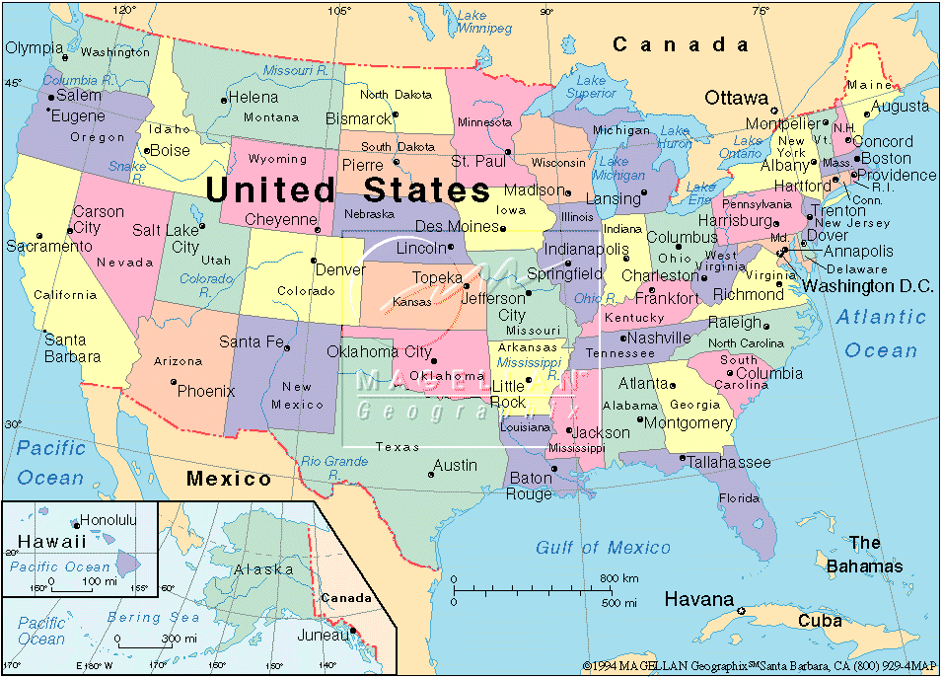
The USA
Nationality: American
I’m from the United States of America.
I’m American.

Slide 28
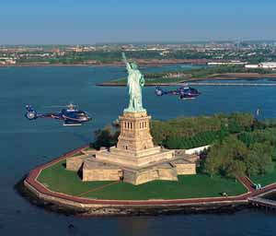
Have you ever been to New York?

Slide 29
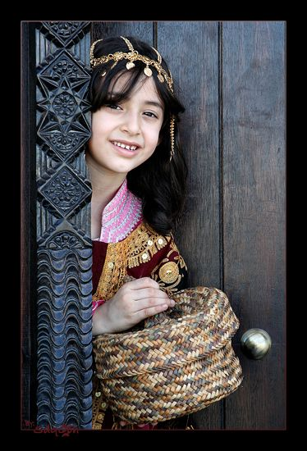
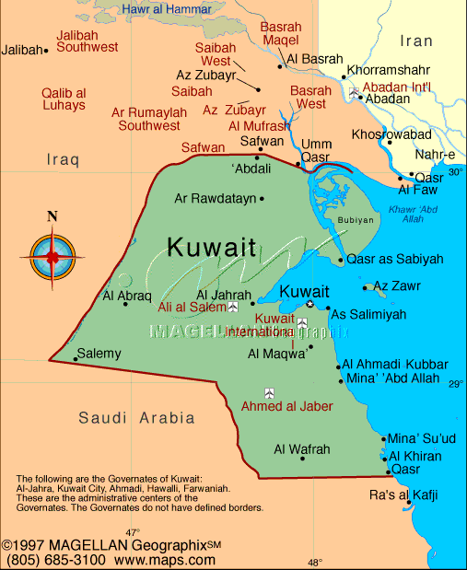
Kuwait
Nationality: Kuwaiti
I’m from Kuwait. I’m Kuwaiti.

Slide 30
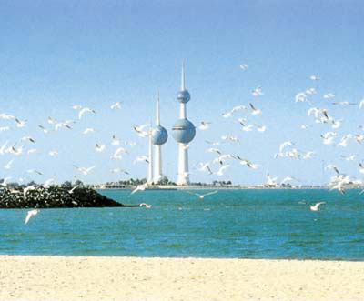
Have you ever seen Kuwait Towers?

Slide 31
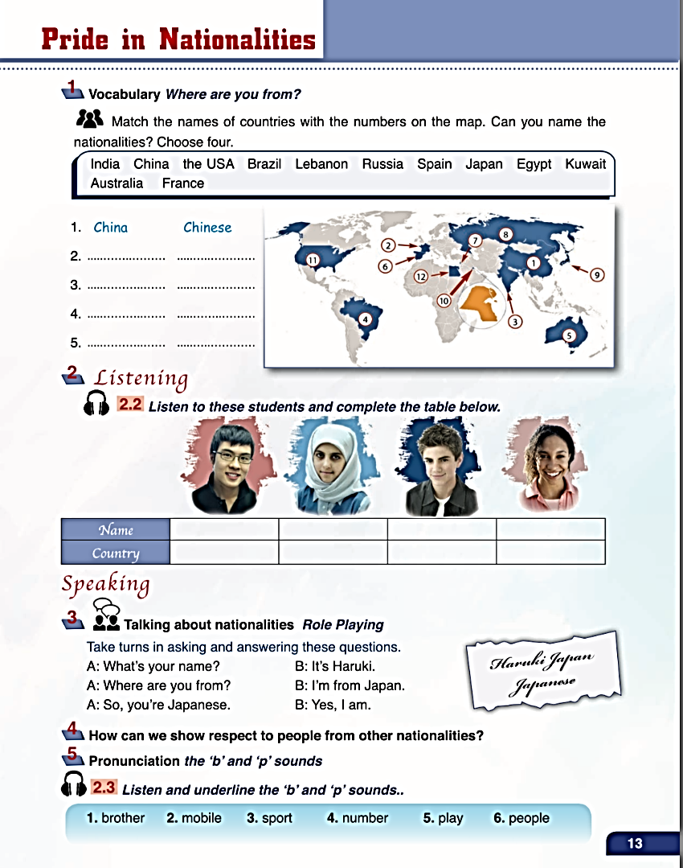
Page:13

Slide 33
France
French
India
Indian
Brazil
Brazilian
Australia
Australian

Slide 34
How can we show respect to people from other nationalities?

Slide 35

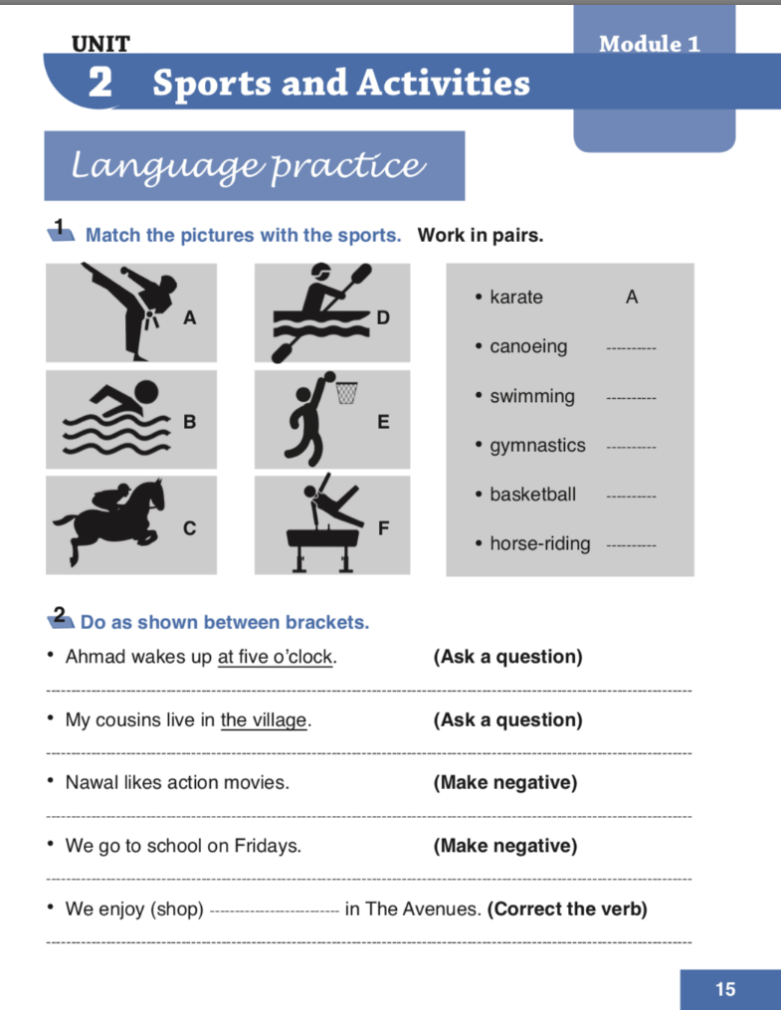
Page:15

Slide 36
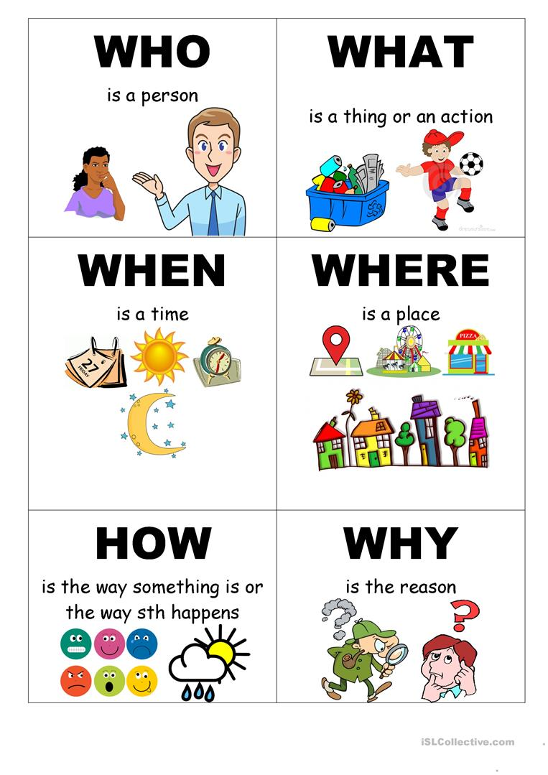

Slide 37
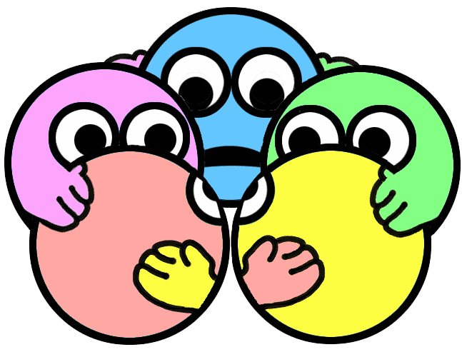
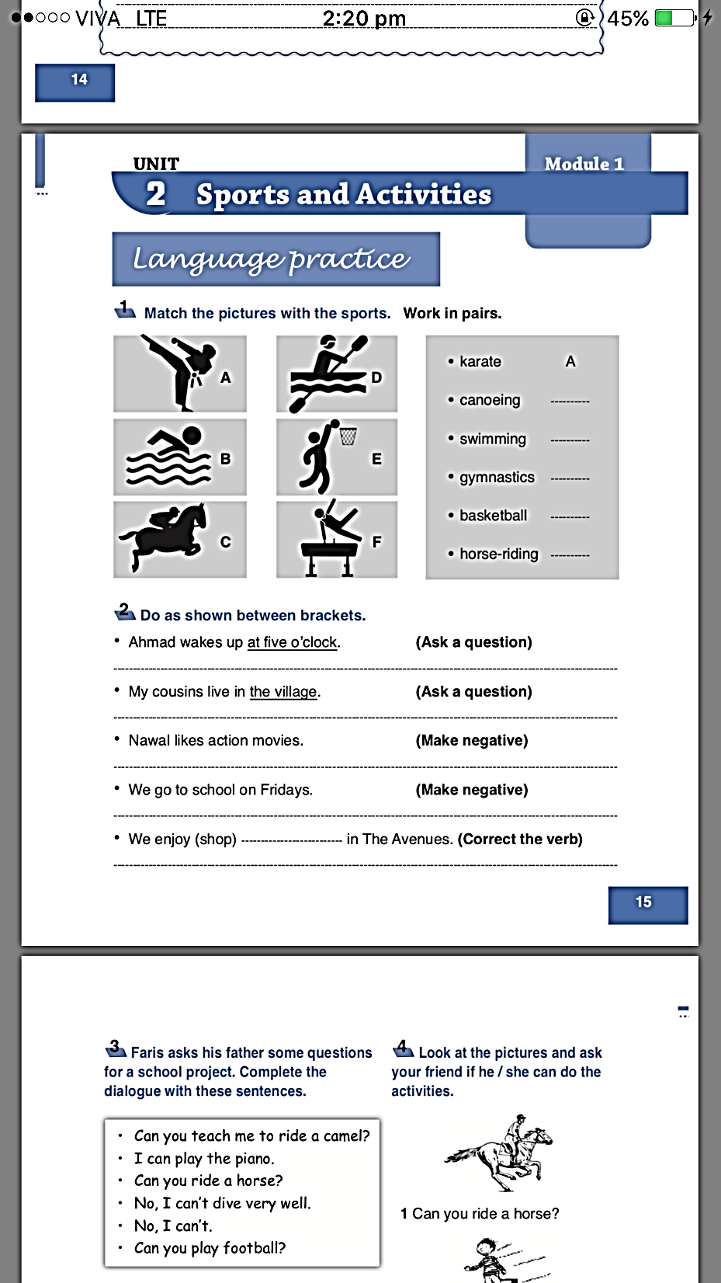

Slide 38


Ahmed wakes up at five o’clock.
Ask a question
When does Ahmed wake up?

Slide 39


My cousin live in the village.
Ask a question
Where does your cousin live?

Slide 40

Nawal likes action movies.
Make negative
Nawal doesn’t like action movies.

Slide 41

We go to school on Fridays.
Make negative
We don’t go to school on Fridays.

Slide 42

We enjoy (shop) in the Avenues.
correct the verb
We enjoy shopping in the Avenues.

Slide 43

Page: 9

Slide 44



Slide 45


A football player (play) -------------------------- in a team of eleven players.
one player
verb + s
plays

Slide 46



Footballers (not use) ---------------------- their hands to move the ball across the football pitch.
more than a player
don’t+ verb (infinitive)
don’t use

Slide 47

They (kick) ---------------------- it with their feet.
more than a player
verb (infinitive)
kick

Slide 48

If the footballer kicks the ball into the goal, his team (score) ---------------------- one point.
one team
verb + s
scores

Slide 49

The team with the most points (win)
----------------------.
one team
verb + s
wins

Slide 50

The referee (control) ----------------- the game.
one referee
verb + s
controls

Slide 51


Players (not argue) -------------- with the referee.
more than a player
don’t + verb (infinitive)
don’t argue

Slide 52

If they do, the referee (send) --------------------- them off the football pitch.
one referee
verb + s
sends

Slide 53

Workbook
Page 16

Slide 55
Can you play football?
Can you ride a horse?
No, I can’t.

Slide 56
Can you teach me to ride a camel?
No, I can’t dive very well. But I can swim.
I can play the piano.

Slide 57
Let’s watch the clip to know more about conjunctions!

Slide 58


Slide 59



Workbook
Page 18

Slide 60



Slide 61
and
also
but
but

Slide 62
Dr. Jones is staying at the Ritz hotel.
Professor Ahmed is Kuwaiti.
This book is about Japanese people.

Slide 63


Spot the difference

Slide 64


