Slide 1
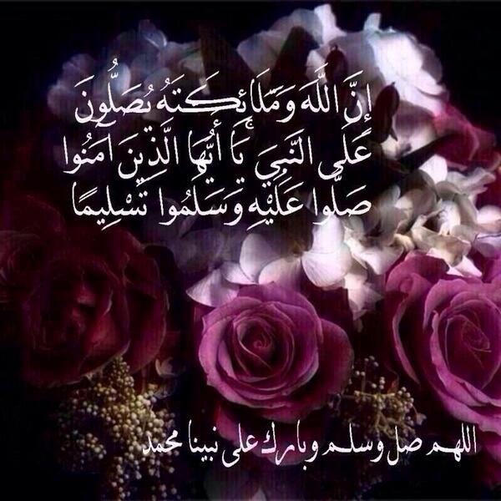


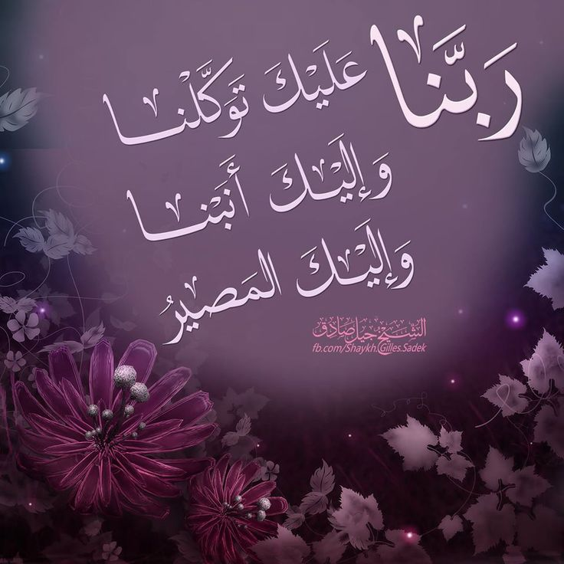



Slide 2
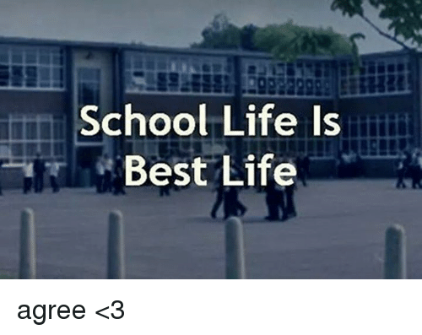
Unit 3
Tuesday , 1-11-2022

Slide 3
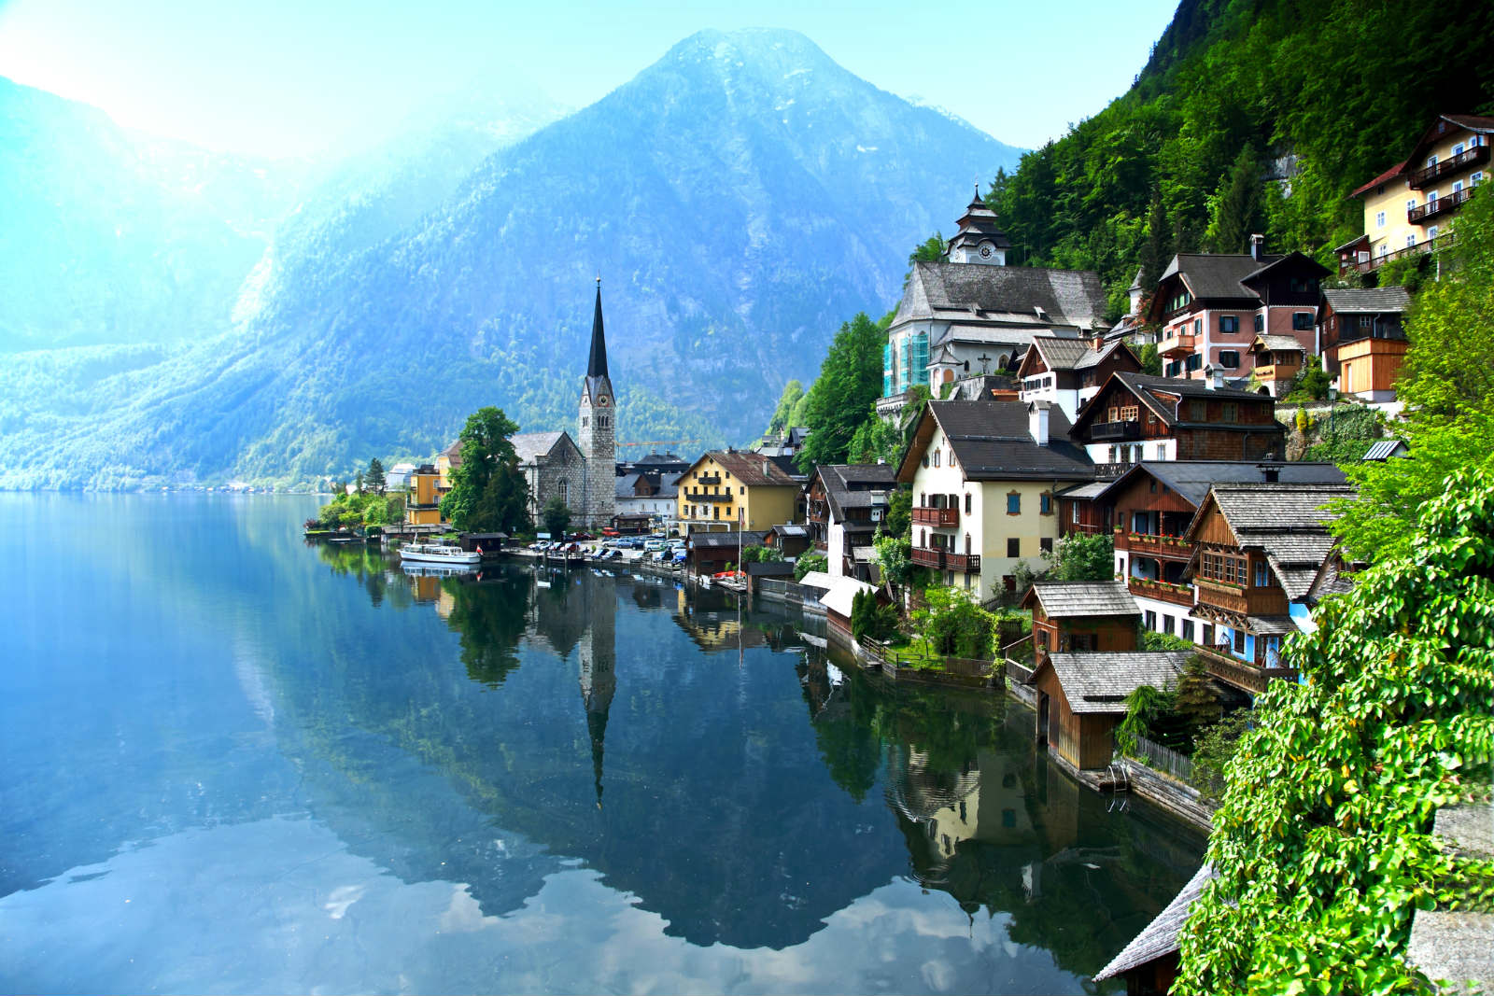
Opener!

Slide 4


Slide 5
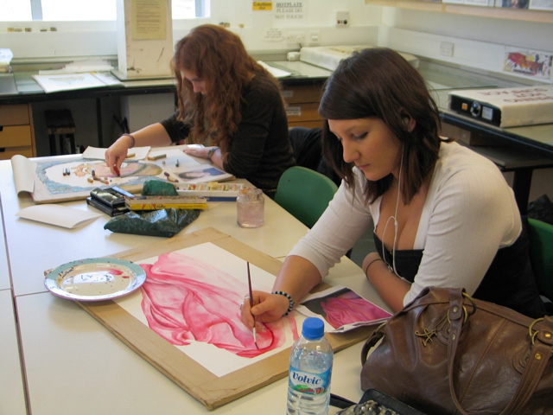
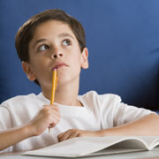

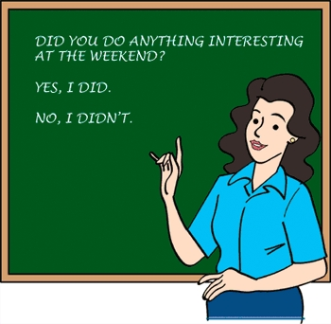

My School

Slide 6
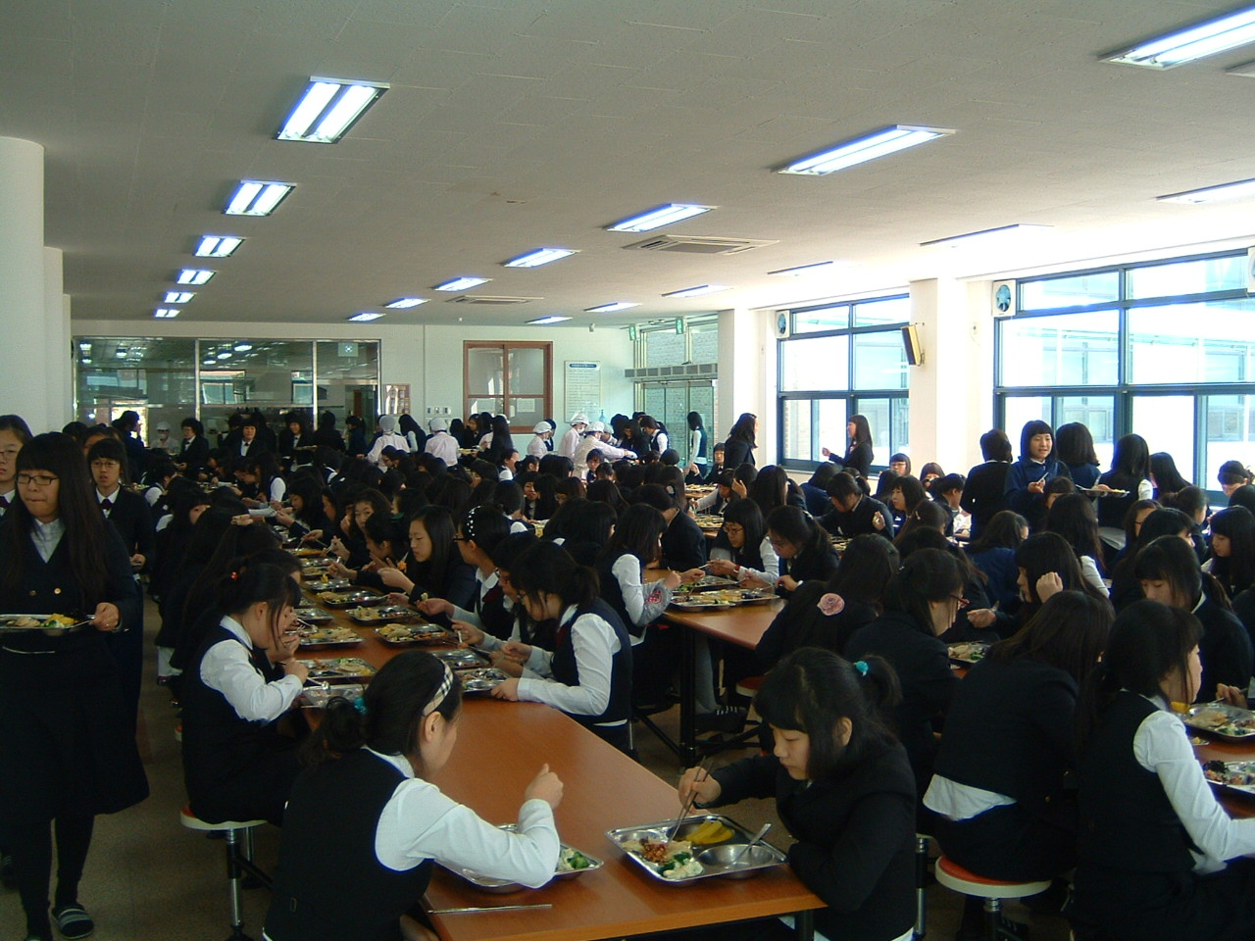
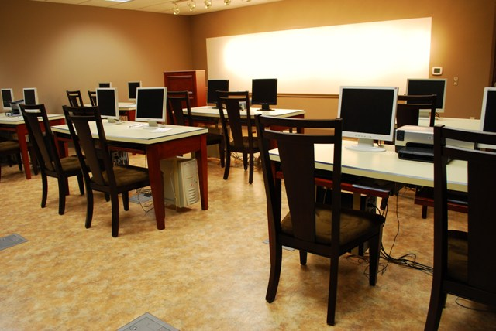
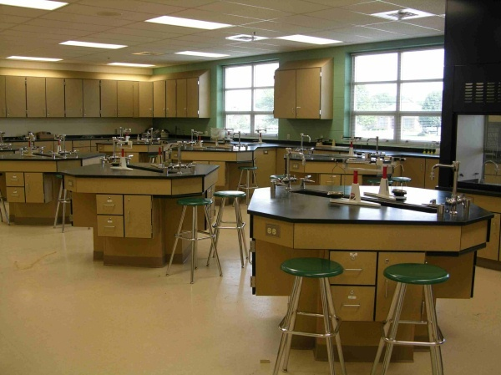
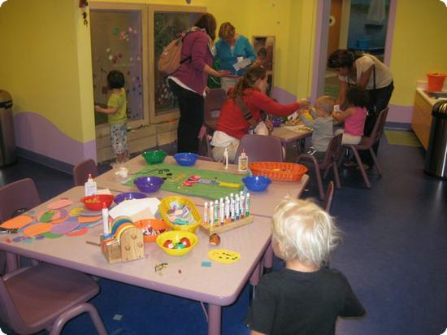
What is the best thing about your school? Why?

Slide 7
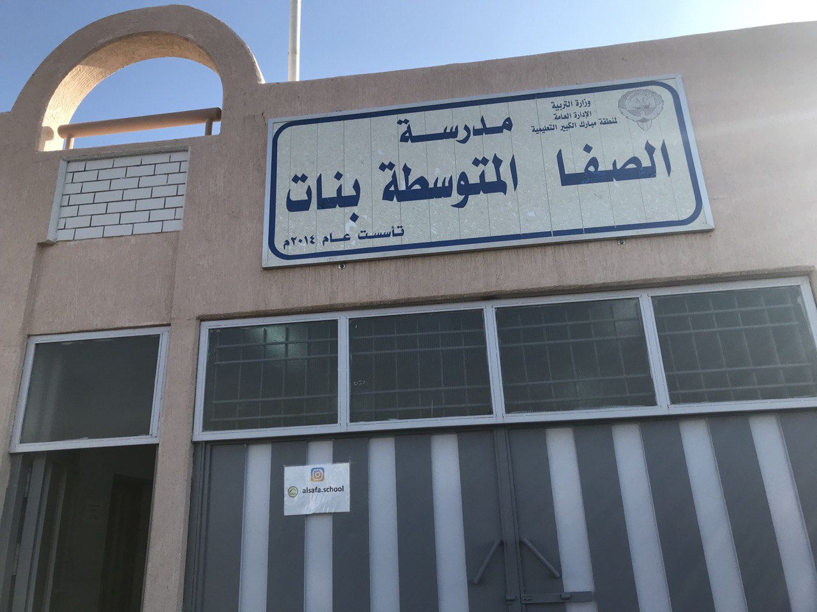

Slide 8
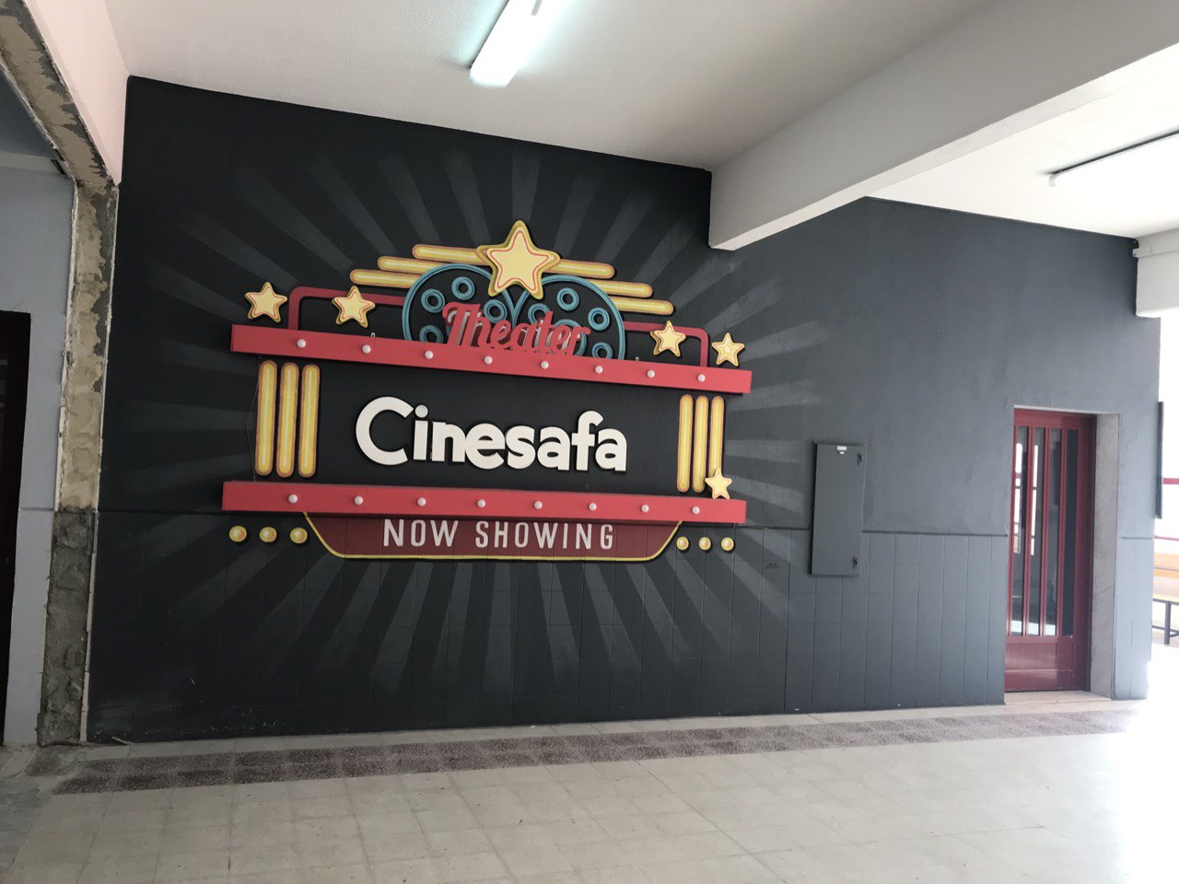
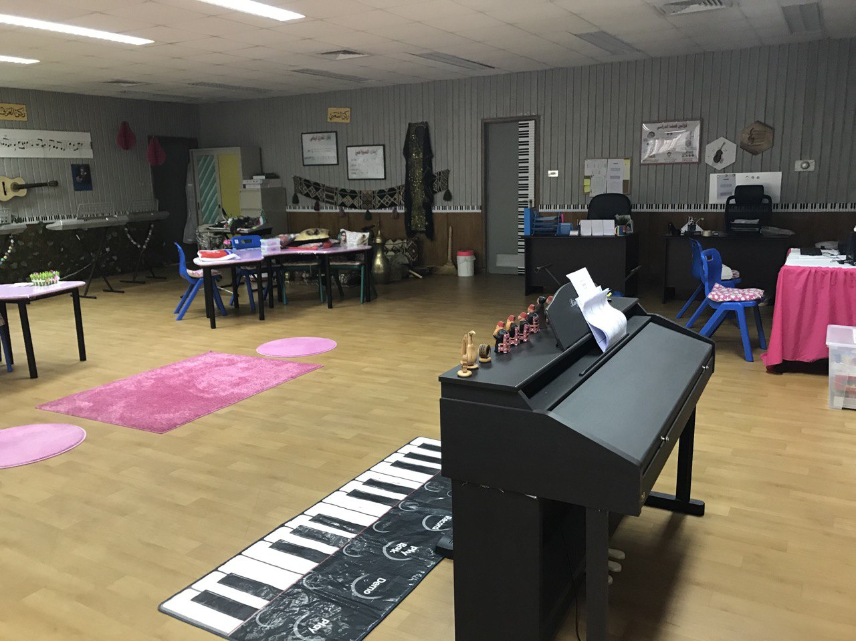
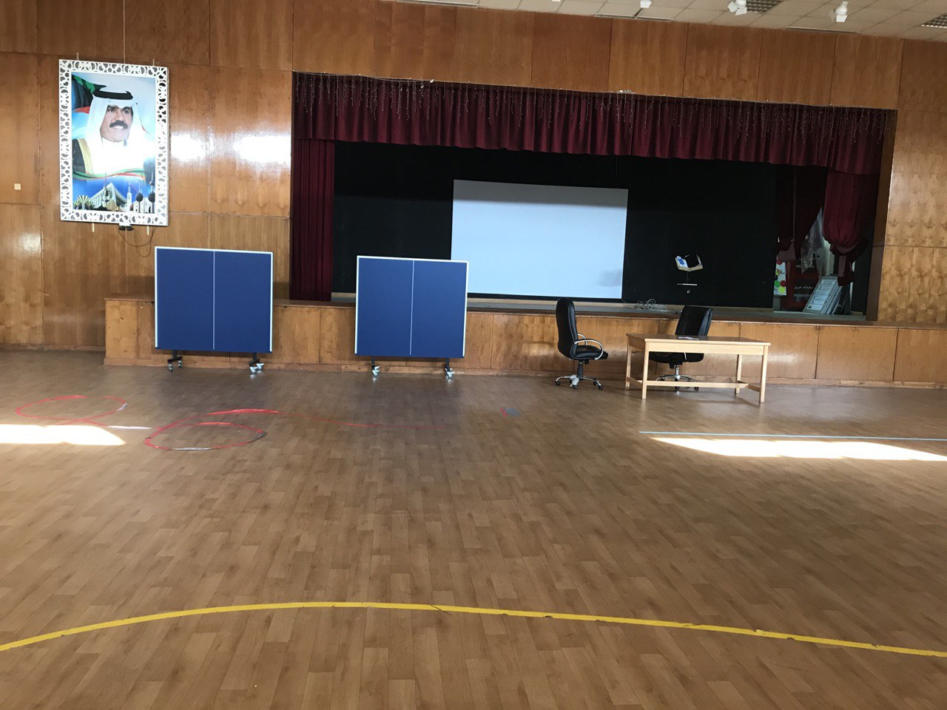
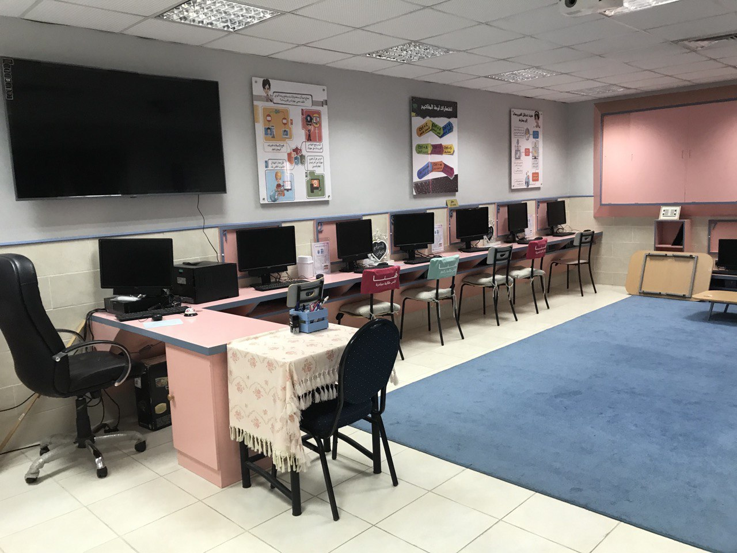
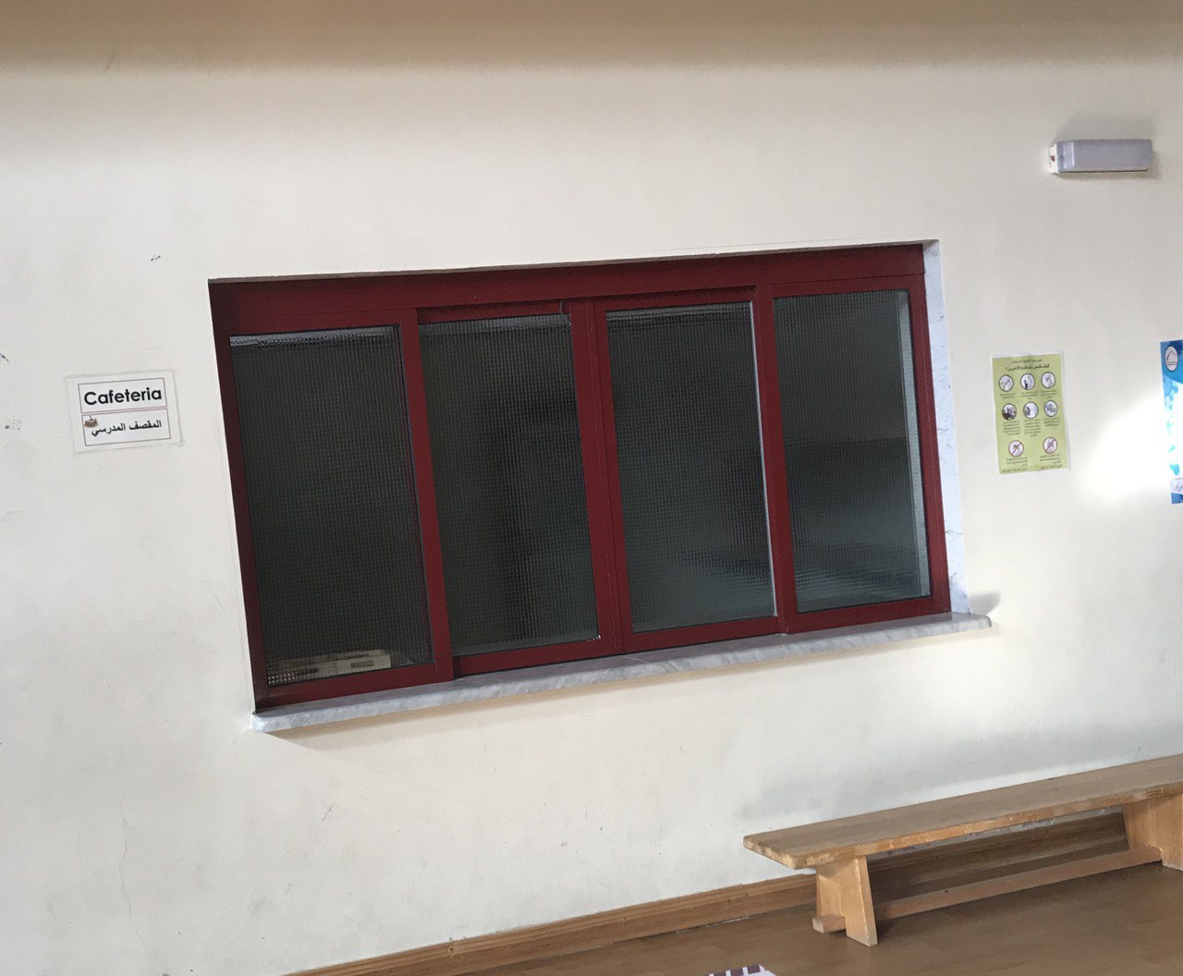
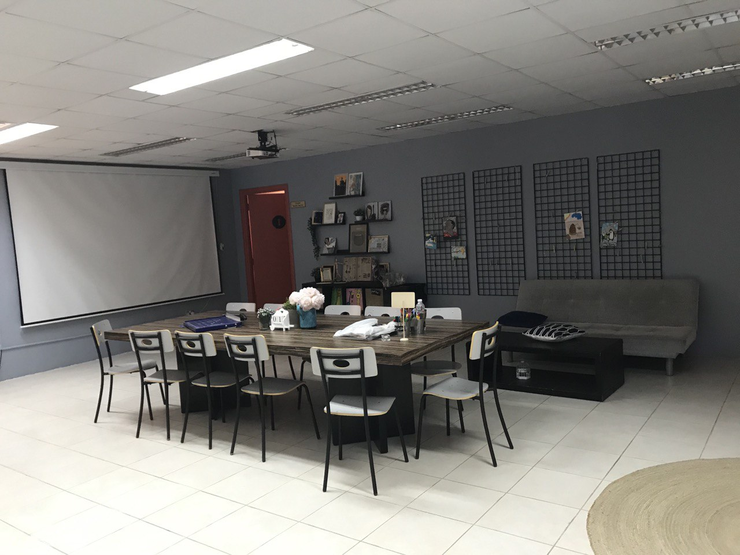

Slide 9
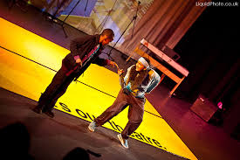
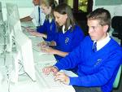
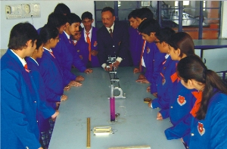
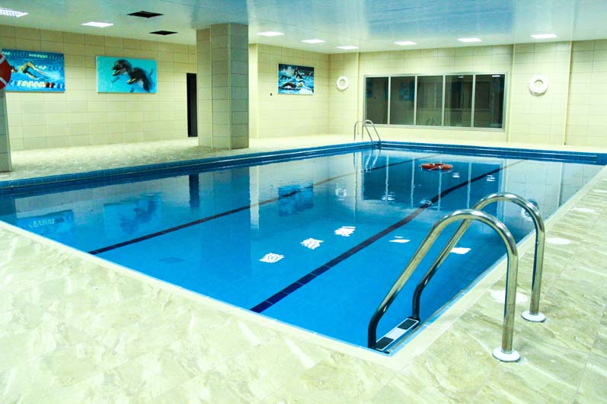
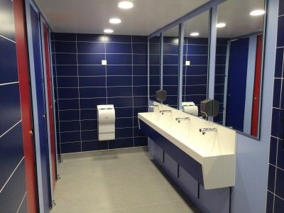
facility
an ability to do something easily or well

Slide 10
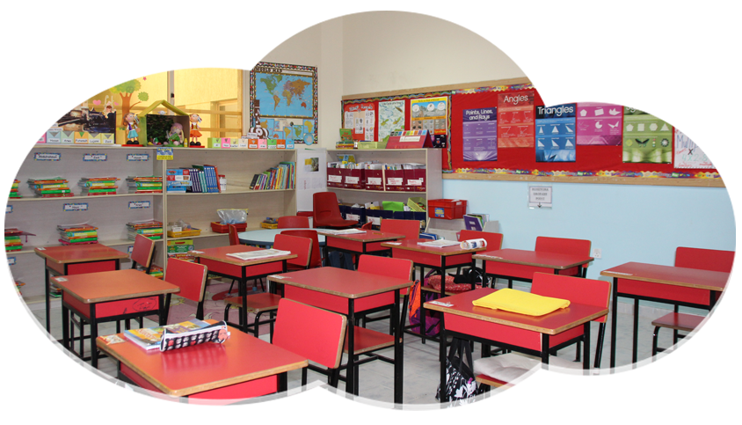
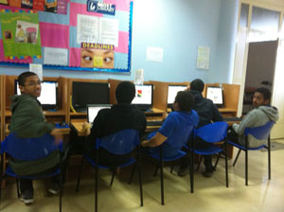
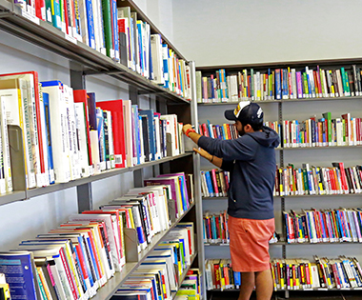

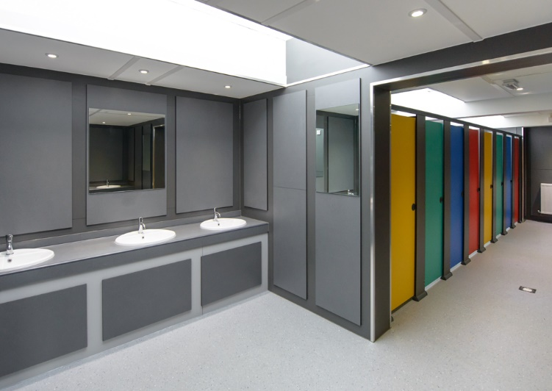
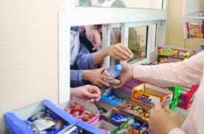
There are many facilities in our schools.
facility

Slide 11

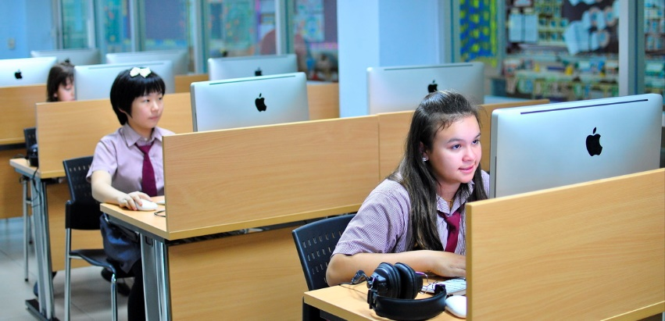

Would you like to have a chatroom in your school?
chatroom

Slide 12
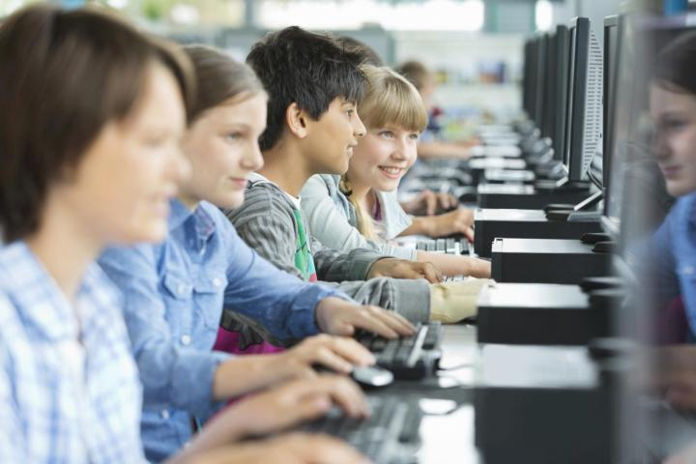
chatroom
a part of the internet where people can communicate by writing messages to each other, often on a particular subject

Slide 13
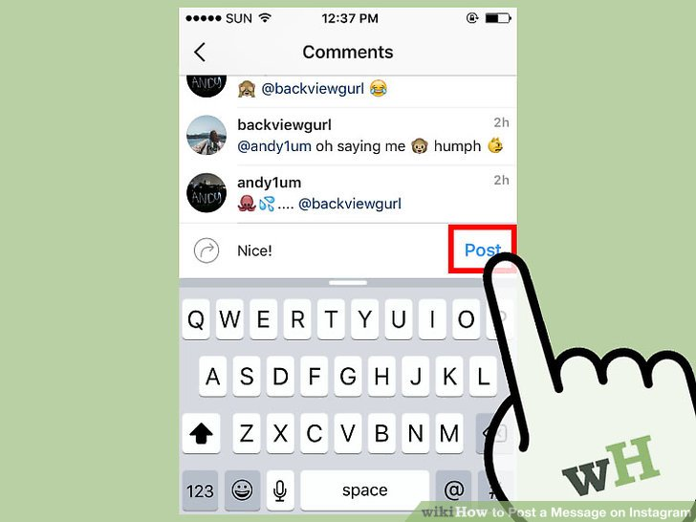
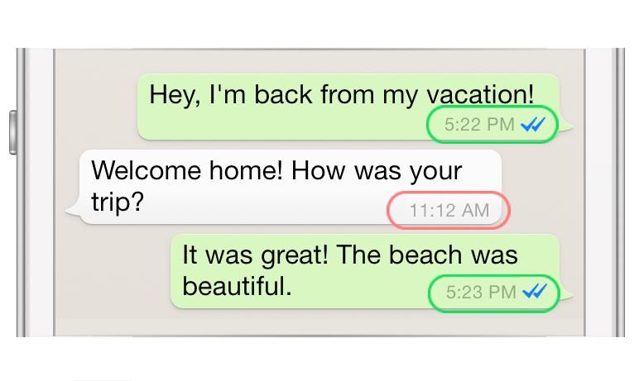
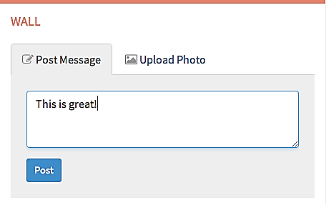
You can chat with your friends by writing messages in an online chatroom, and then you can post them.
post

Slide 14

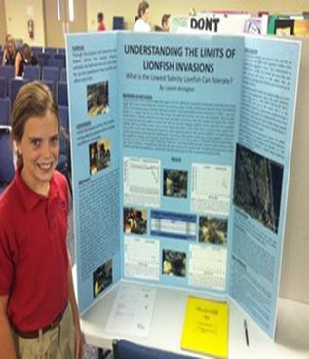
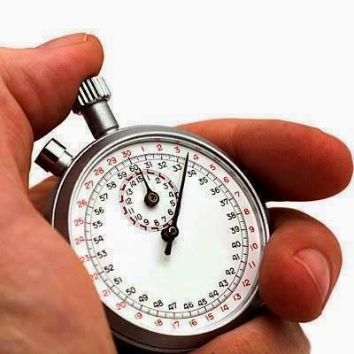

Work in groups and run a project about the main facilities of your school.
run
organise

Slide 15

Our school was running an open day on Thursday. Pink day

Slide 16
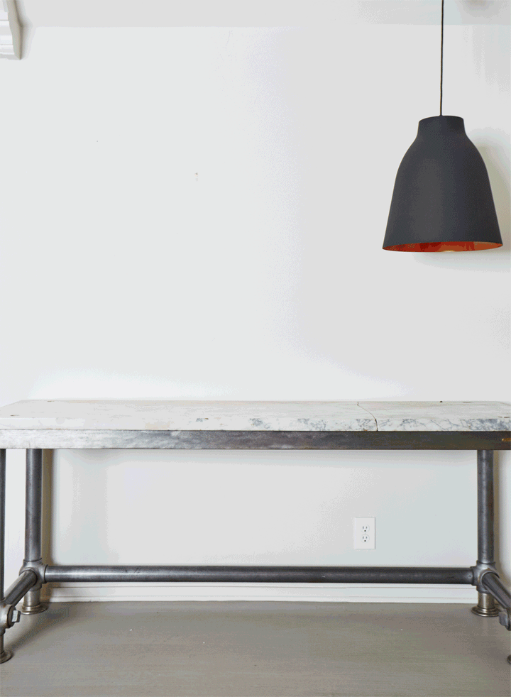
New Vocabulary
Look at the pictures and say the new words.

Slide 17
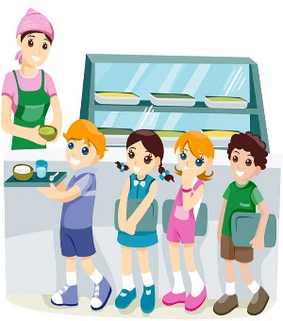
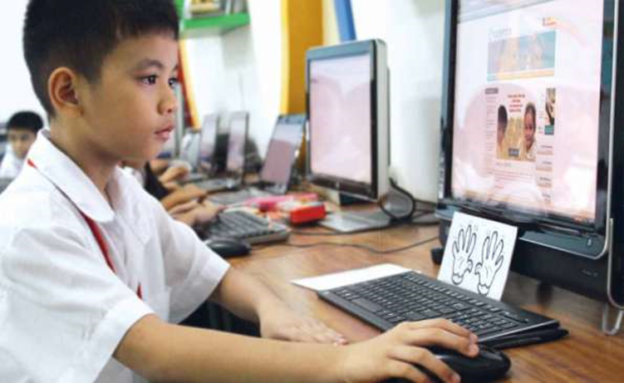
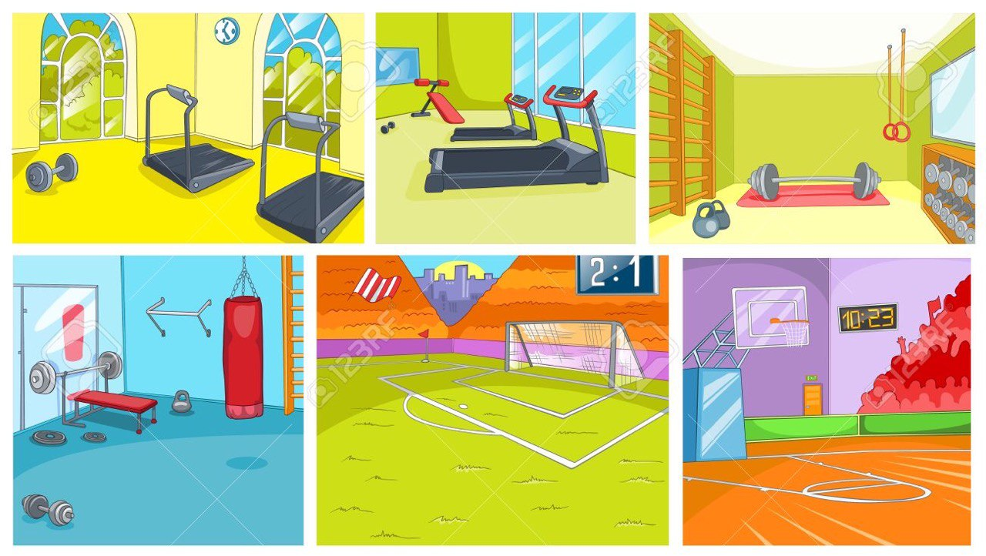


Thursday , 3 -11 -2022
Unit :- 3
Lesson :- 7
Chatroom
facility
…………………..…………………
…………………………………
……………………………
………………………………
Post
run = organise
……………………………
……………………………
……………………………
……………………………

Slide 18


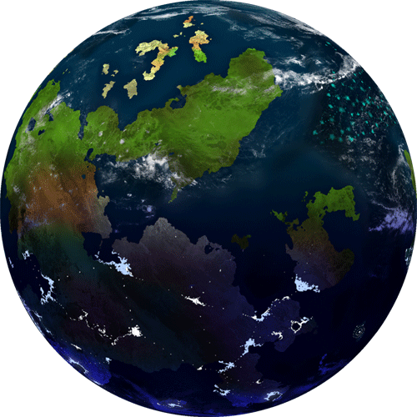
Student’s Book
Page 17
EX. 1 & 2

Slide 19
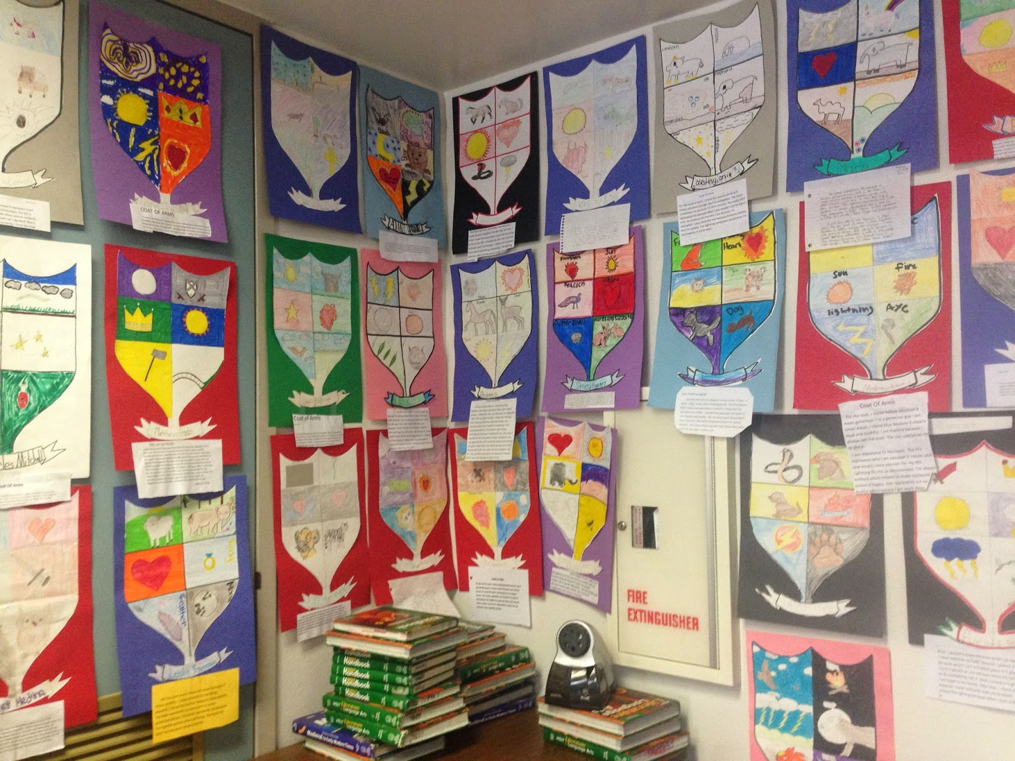
Students Book
Page 17

Slide 20


Slide 21




Slide 22
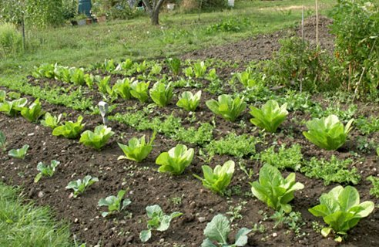

Slide 23

He likes gardening fruit and vegetables and watching them grow.

Slide 24
1
Narjes- Sheikha- Abyar – Maha
What is Sam making in the art studio ?

Slide 25
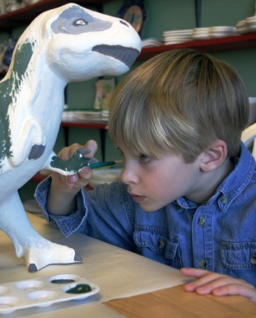
He likes it because he loves doing art in the classes and making models.

Slide 26
2
Dana- Shahed-Lulwa- Sara- Lujain
Why does Dexter like his school?

Slide 27
He likes his school because he loves chatting with his friends.

Slide 28
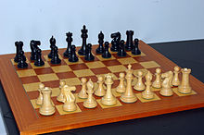
3
Hour- Nada – Alaa- Shomoukh
When does the chess club start ?

Slide 29
He likes his school because he loves playing chess.

Slide 31

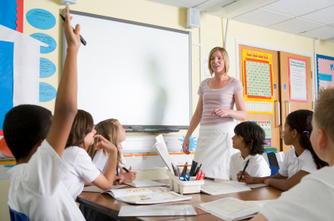
Listen to the teacher.
Tip

Slide 32
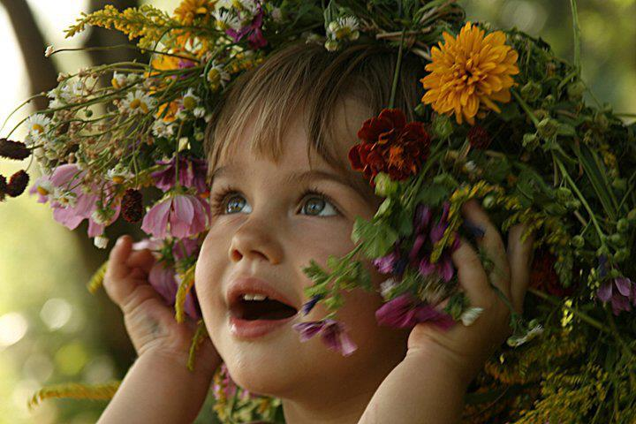
Closure

Slide 33
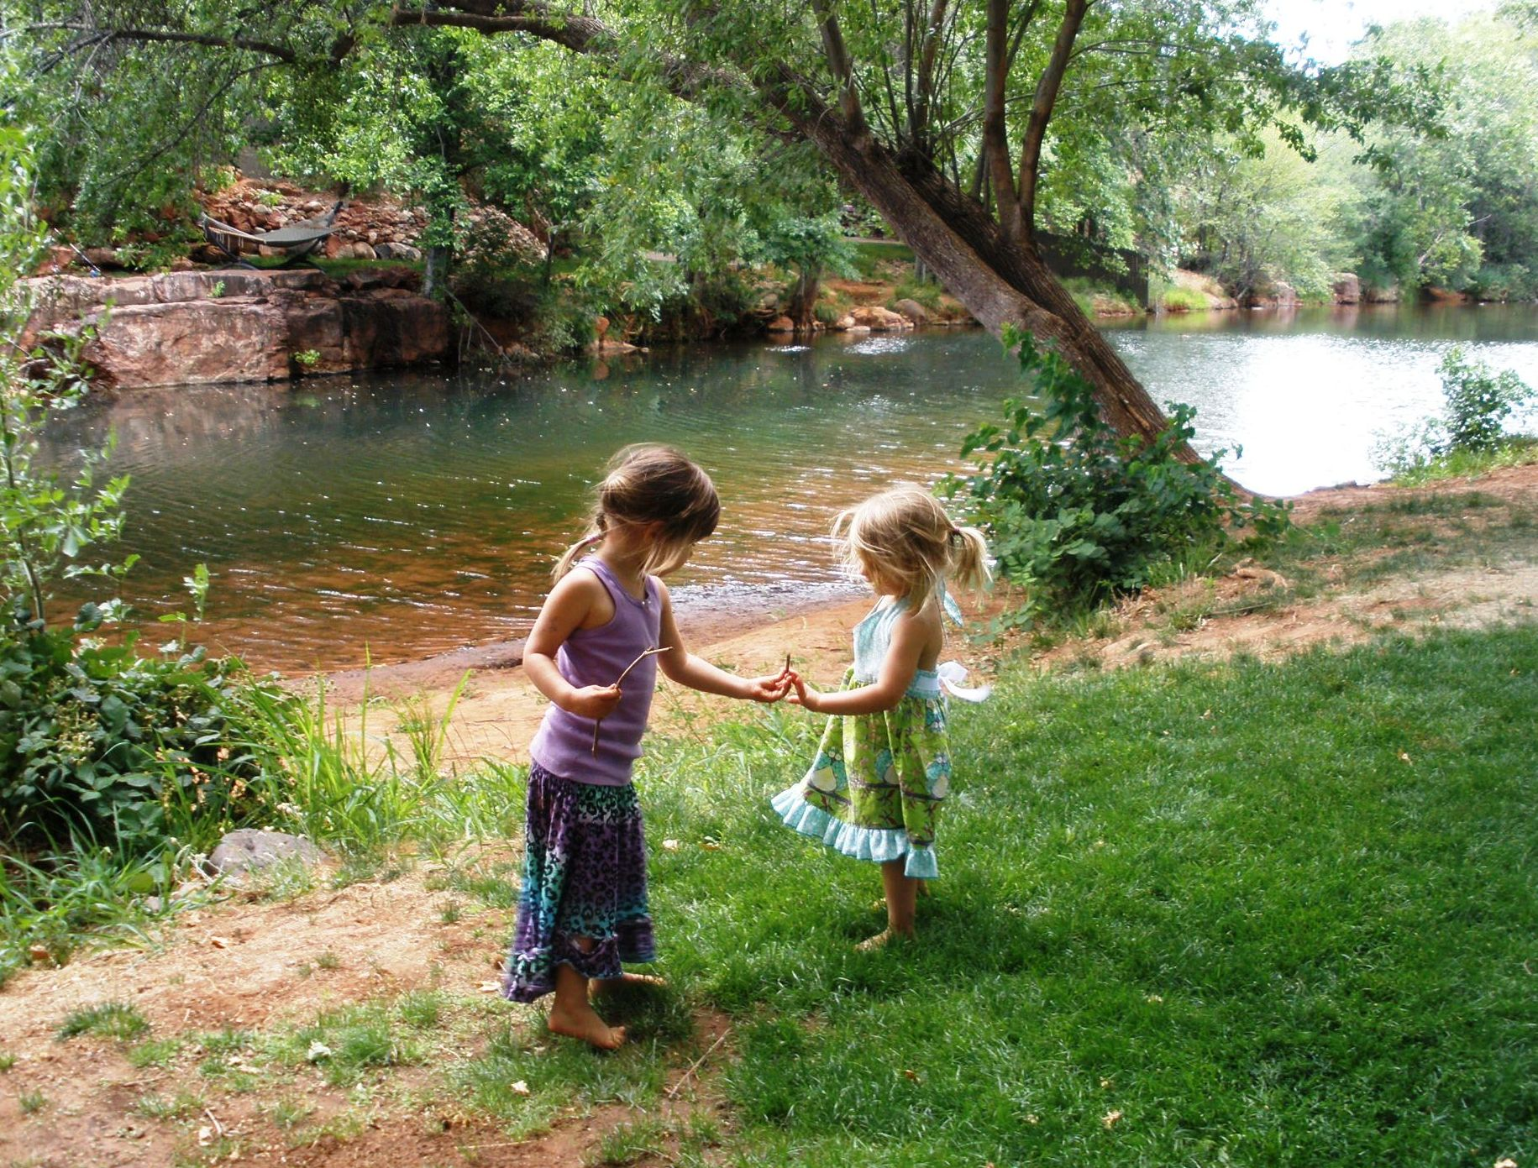
What else would you like to have in your school?

Slide 34
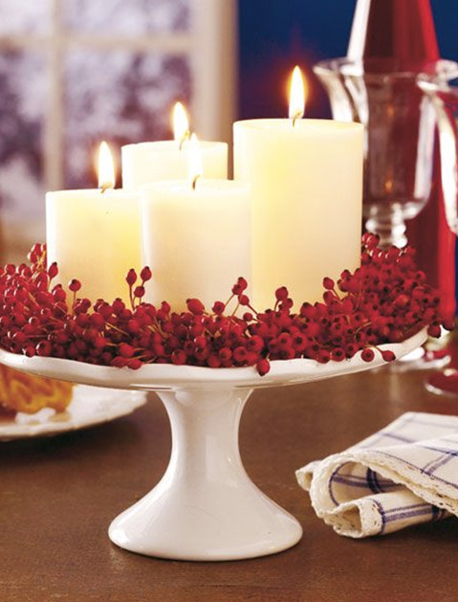
Thank you

Slide 35


Would you like to have a cinema at school?

Slide 36
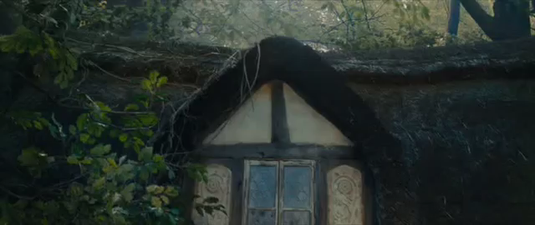

Slide 37


The main facilities of my school.

Slide 38
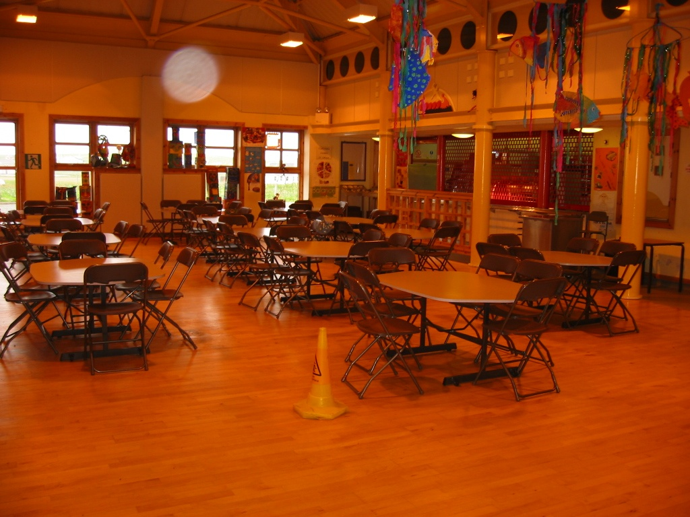

Slide 39


Welcome
Welcome
Welcome
T. Wafaa
T. Wafaa
T. Wafaa

Slide 40


Group 1
Group 3
Narjes *
Sheikha
Abyar
Maha
Dana *
Shahed
Lulwa
Sara
Lujain
Hour
Shomoukh
Nada
Alaa

