Slide 2
Show all
Fast
Medium
Slow
Hide all
tekhnologic
Notes:
Right-click on an image and select change picture.
Select your picture. Click on insert.
Start your presentation.
Click on Fast, Medium or Slow to show the series of images.
Click Show All to see all the images.
Click Hide All to hide all the images.

Slide 3
Show all
Fast
Medium
Slow
Hide all
tekhnologic
Notes:
Right-click on an image and select change picture.
Select your picture. Click on insert.
Start your presentation.
Click on Fast, Medium or Slow to show the series of images.
Click Show All to see all the images.
Click Hide All to hide all the images.

Slide 4
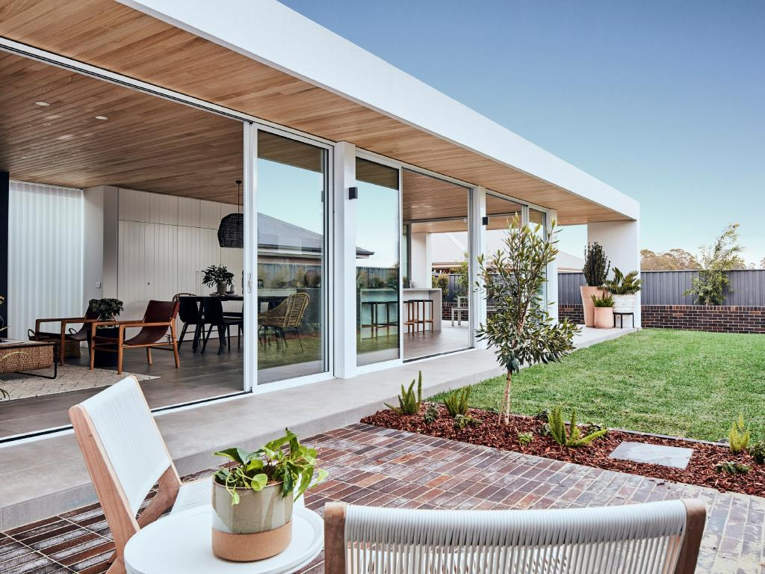
Types of Houses

Slide 5
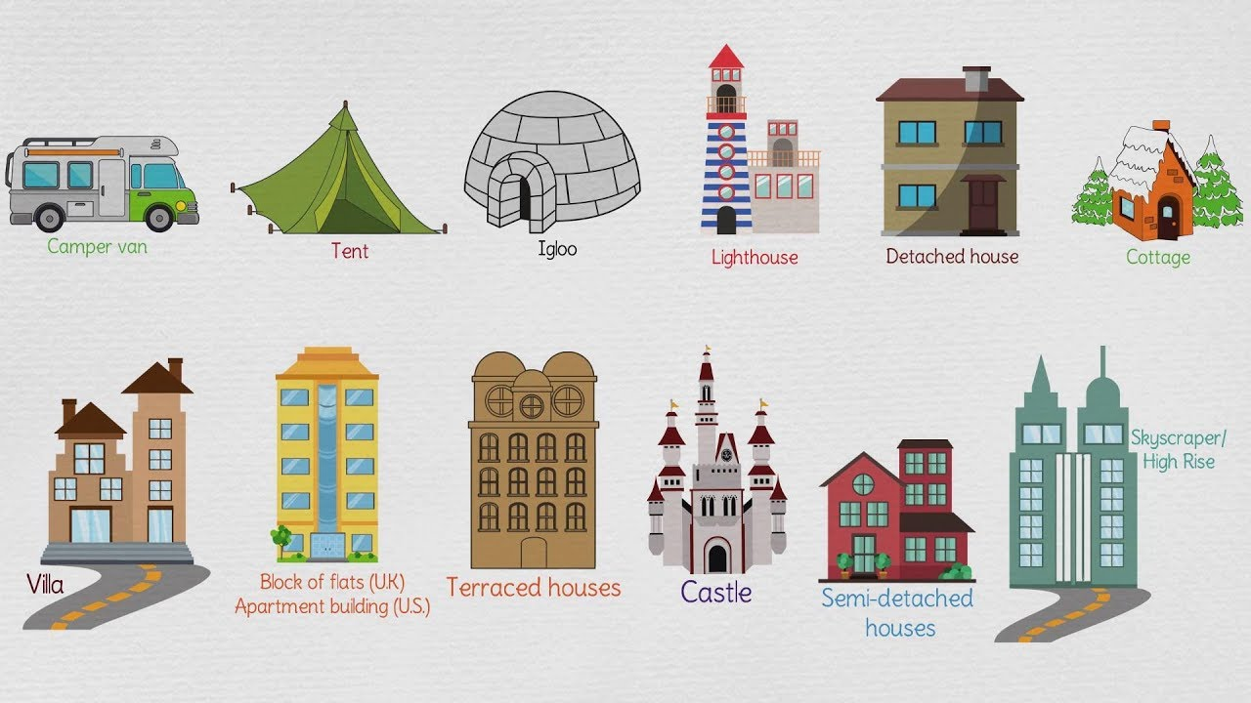
Open Discussion / Brainstorming Mention types of houses

Slide 6
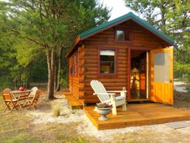
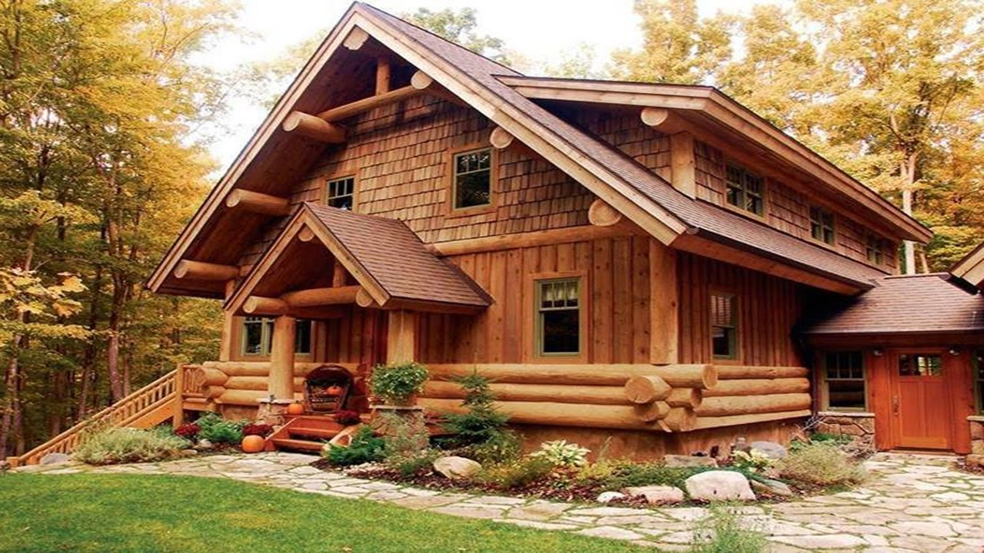
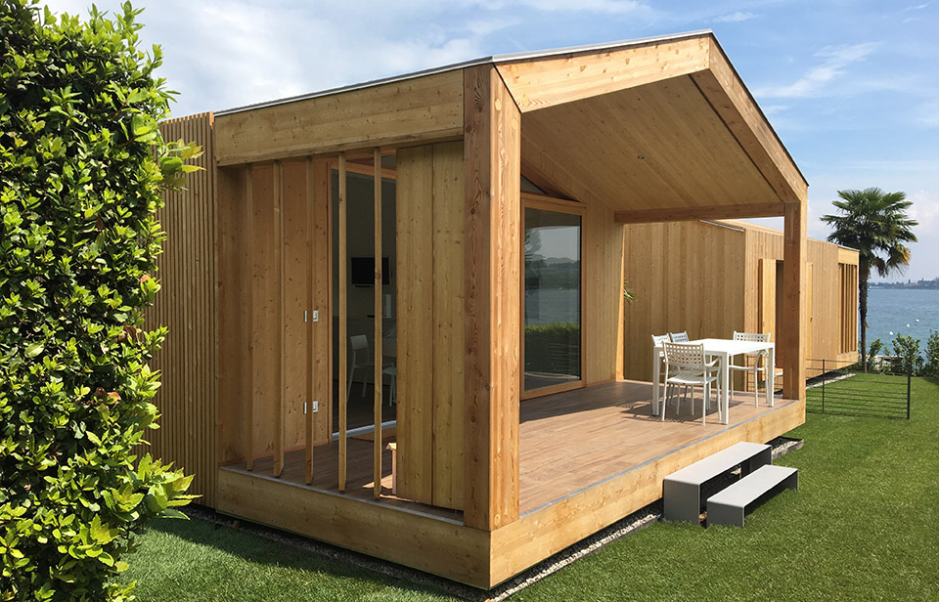
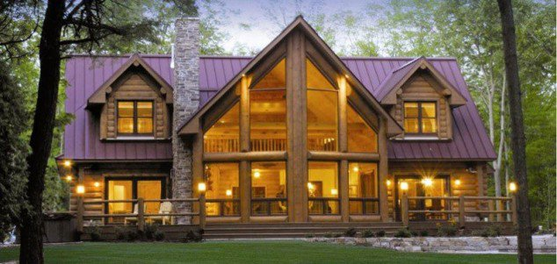
Wooden houses

Slide 7
Igloo house

Slide 8
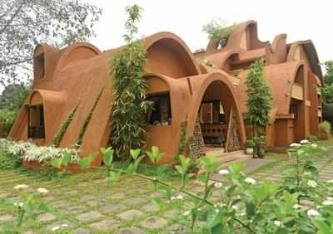
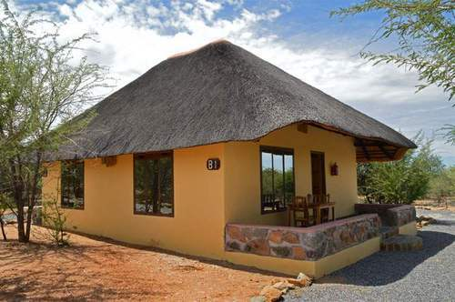
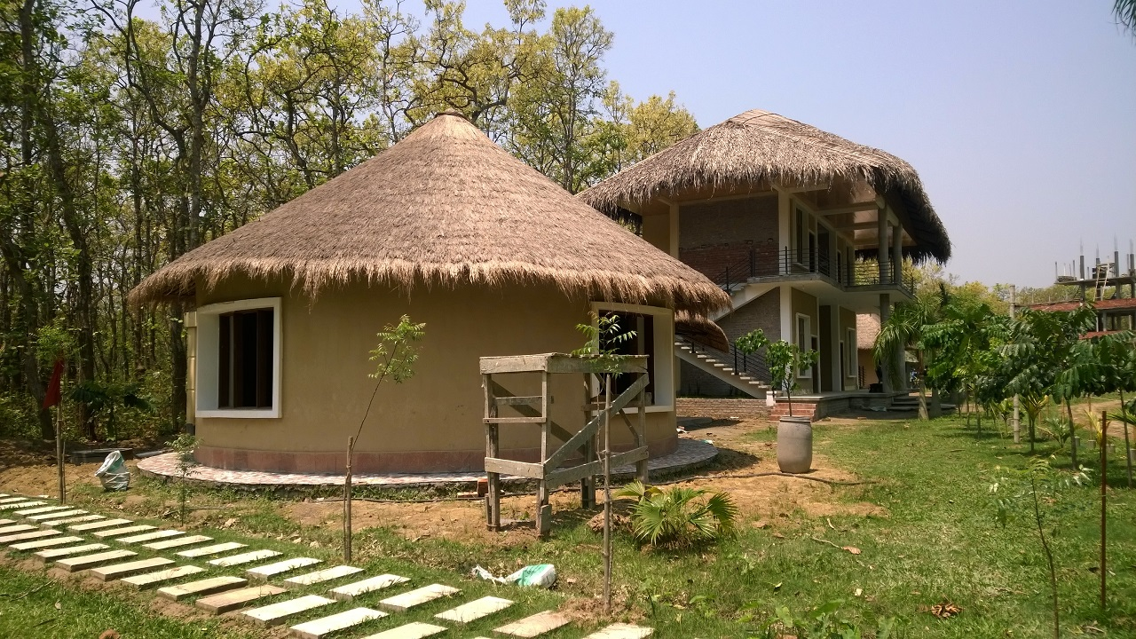
Mud houses

Slide 9
Modern houses

Slide 10
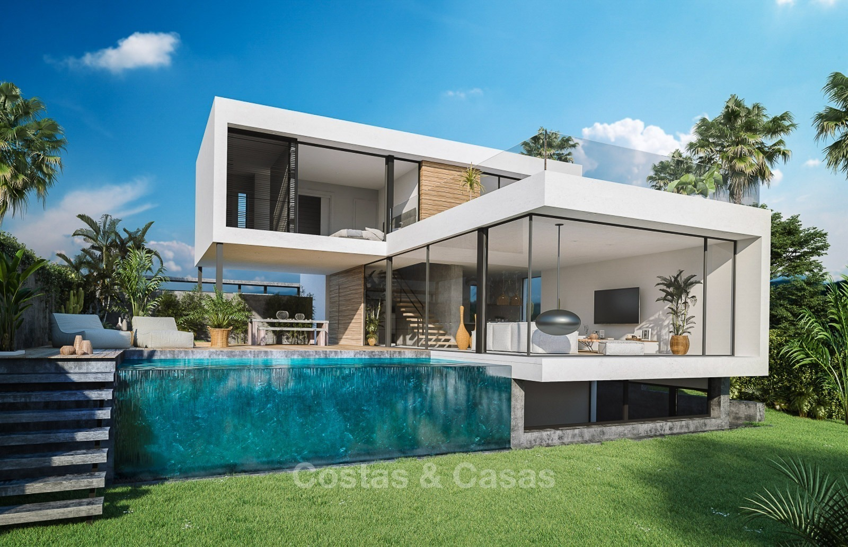
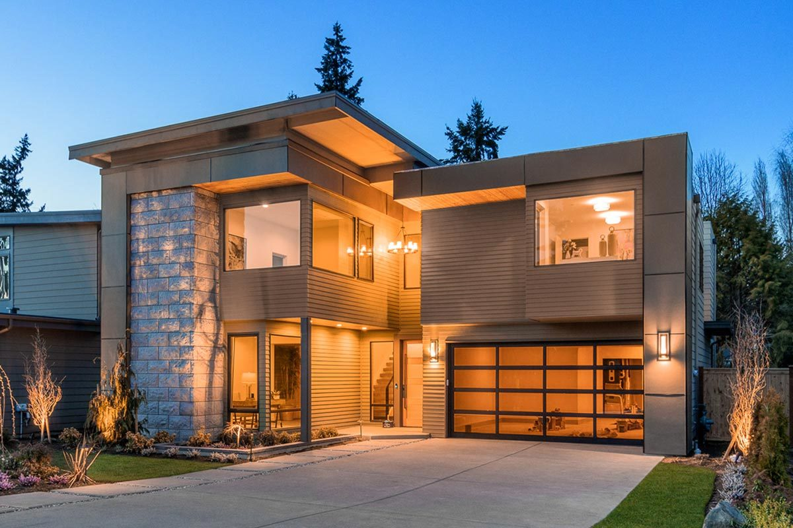
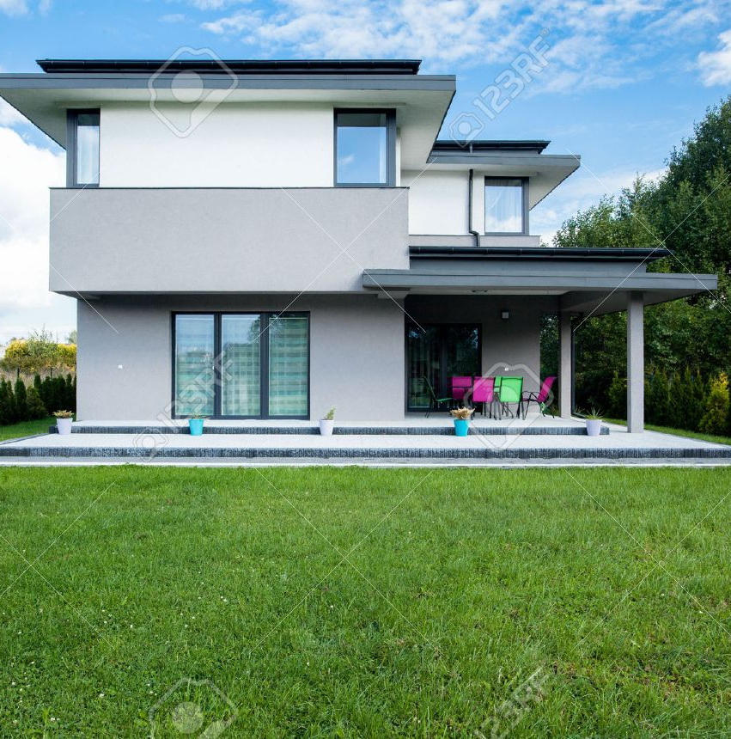
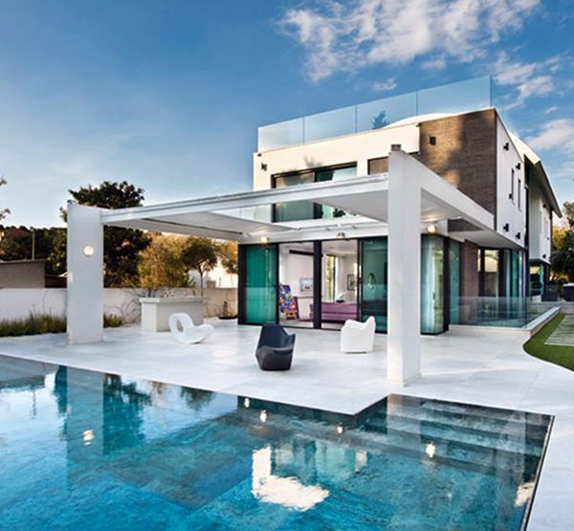

Slide 11
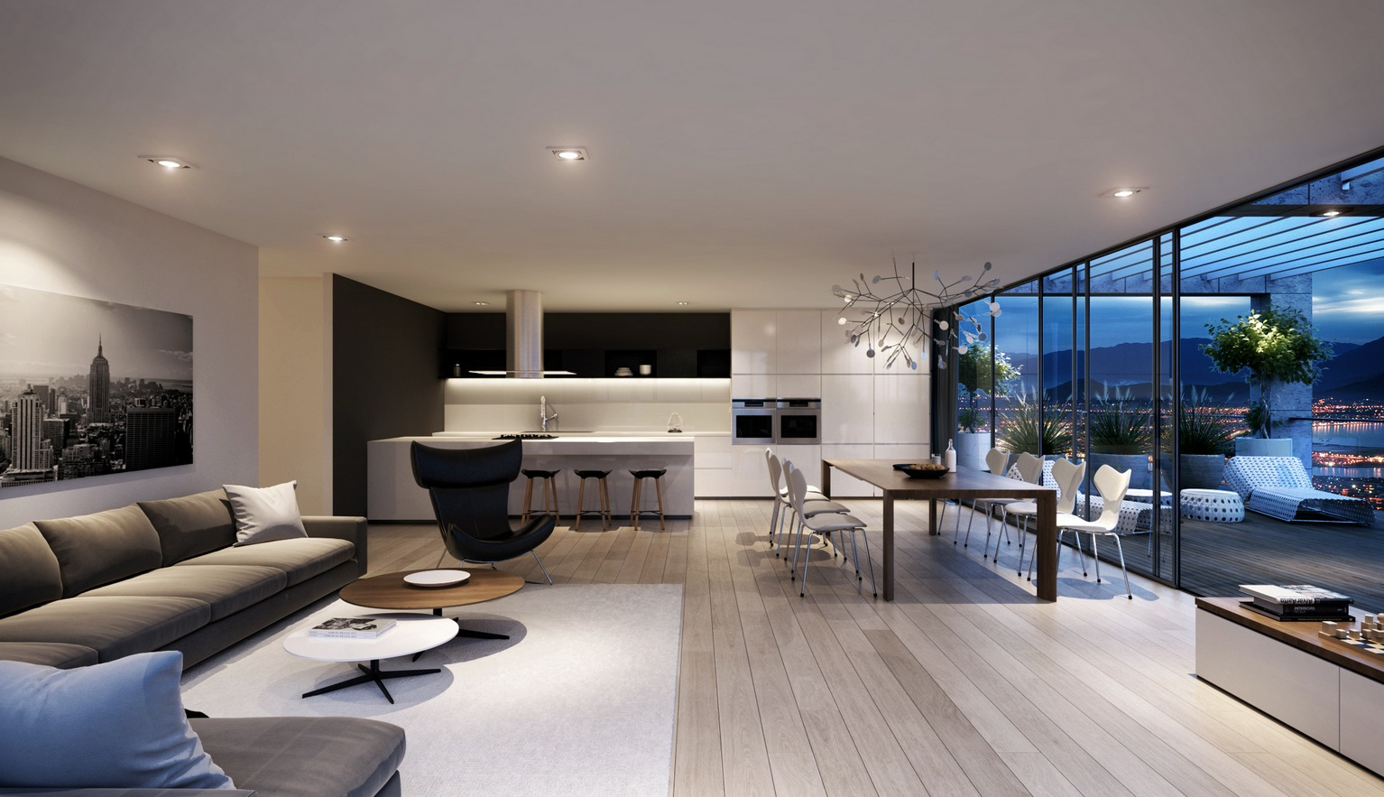

Slide 12
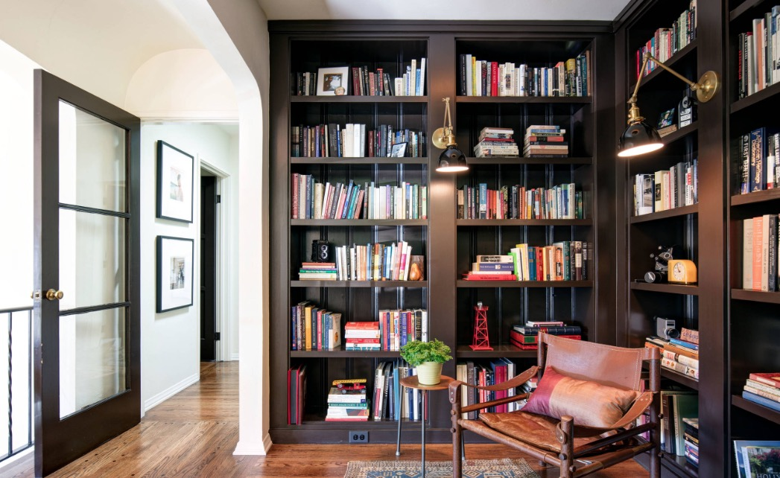

Slide 13
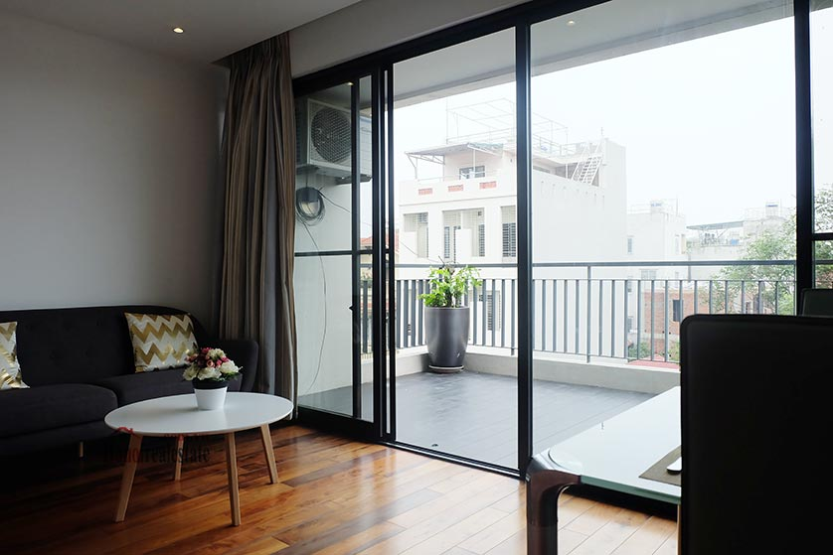

Slide 15
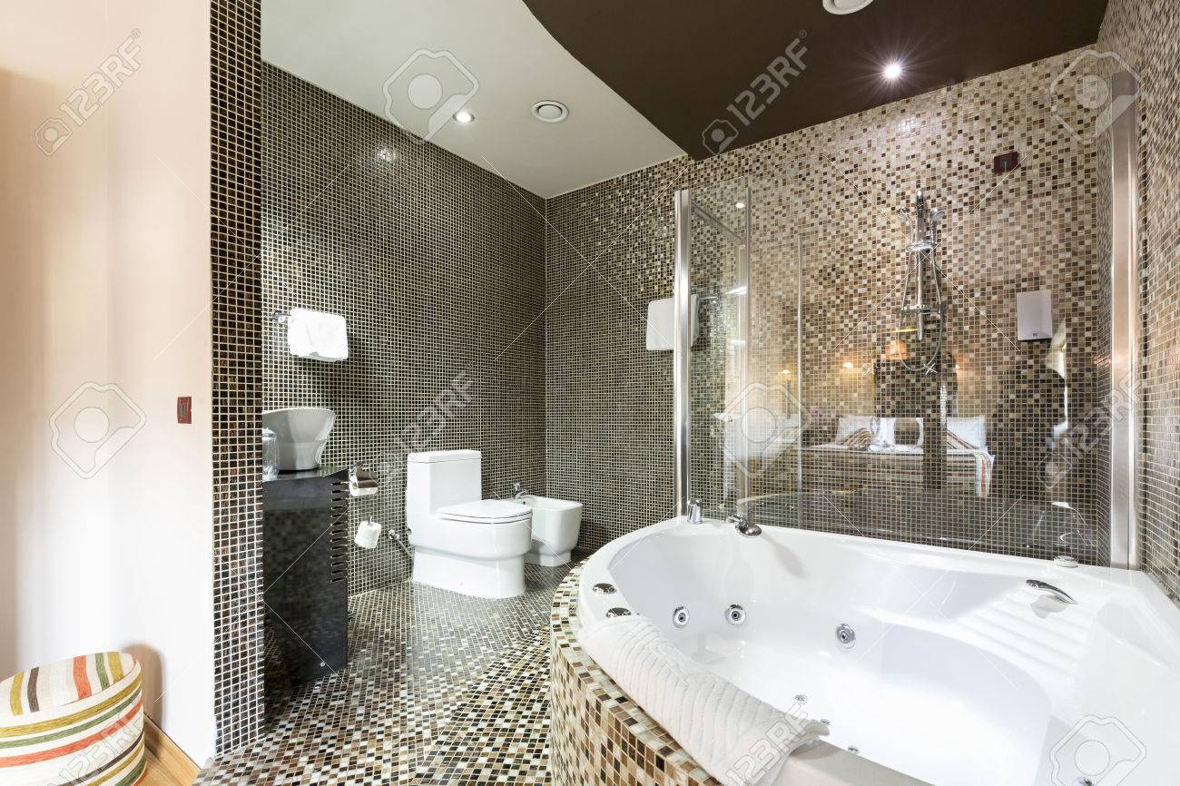

Slide 16
“There are different types of houses around the world.”
Plan and write a report of two paragraphs about the different
types of houses and what is your ideal home and why.

Slide 17
Write your own plan

Slide 18
" Houses are of different types, but you prefer a special one of them" Plan and write an article of two paragraphs (not less than 8 sentences) about "Houses", the different types of houses and your ideal house".
These guide words may help you:
(Wooden / mud / temporary / easy / rooms / sea / garden / swim)

Slide 19
The Plan
Paragraph 1
Paragraph 2

Slide 20
My ideal home
the different types of houses
Mud homes
Wooden
homes
Igloo homes

Slide 21
My ideal home
ideal house
Has a balcony
By the sea
Big and modern

Slide 22
Don’t
forget!

Slide 24
In the 1st paragraph, write about the different types of houses.

Slide 26
In the 2nd paragraph, write
about what is your ideal home and why.

