Slide 1
Unit 2 Lesson 2
Page:9
SPORTS AND ACTIVITIES

Slide 2
What can you do?

Slide 3
I can read

Slide 4
I can eat

Slide 5
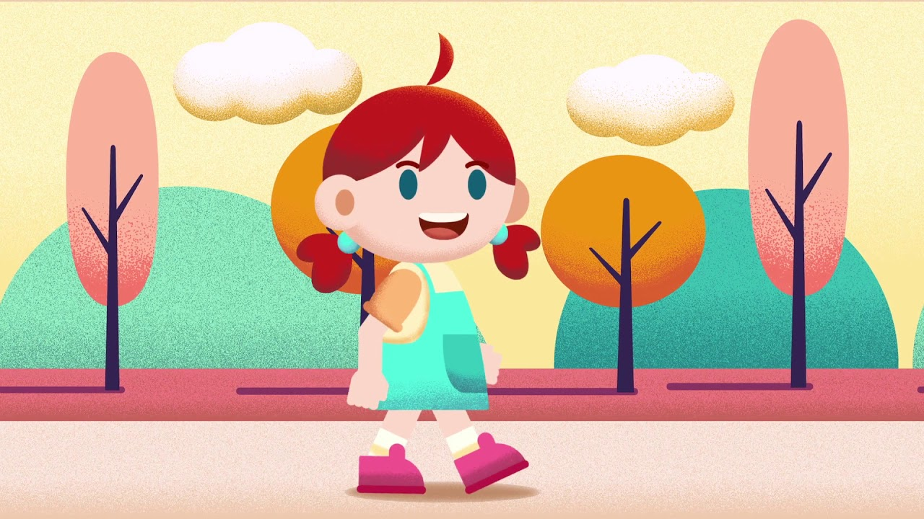
I can walk

Slide 6
I they we she you he it
Can
V1

Slide 7
I read

Slide 8
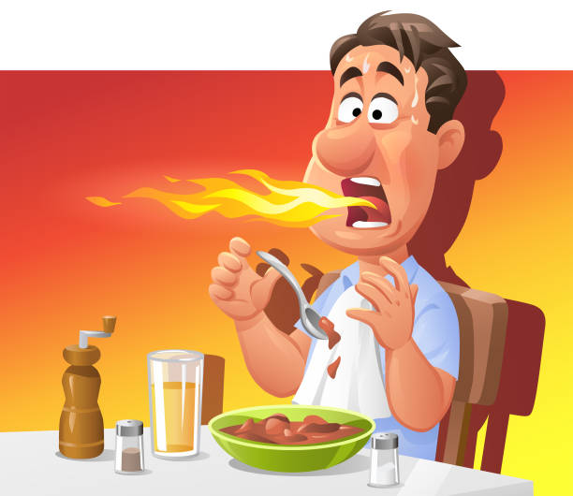
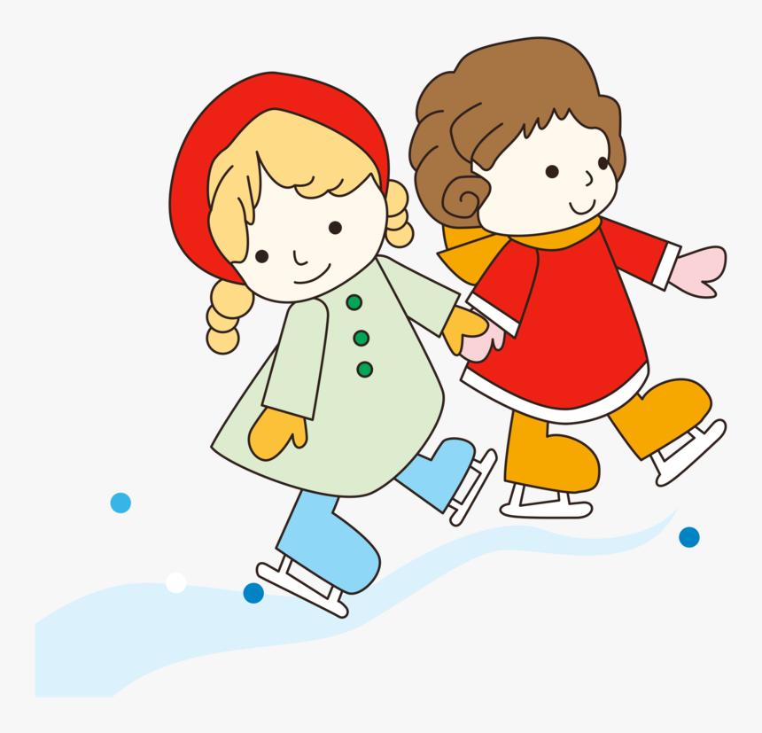
Look at the pictures and use I (can / can’t) to make meaningful sentences.

Slide 9
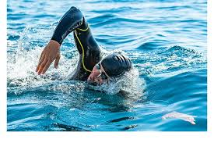
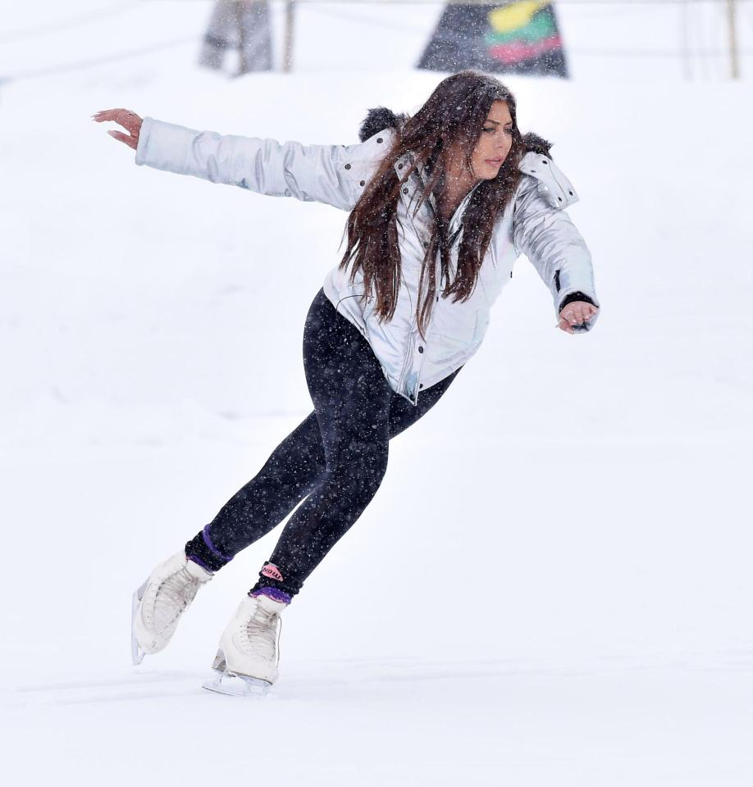
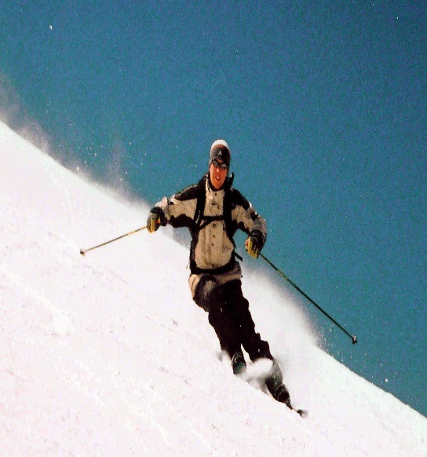
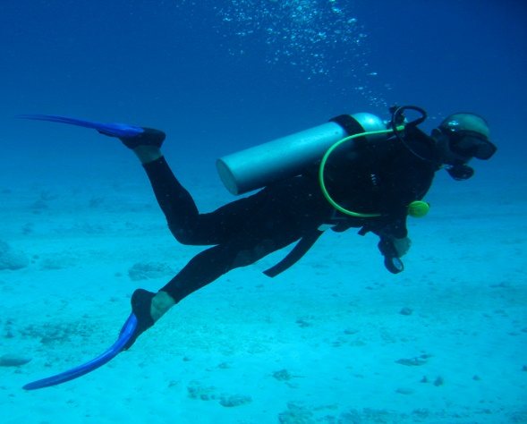
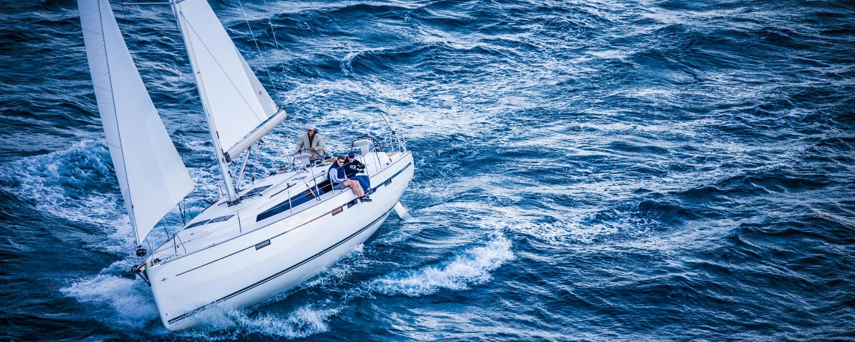
swimming
scuba diving
sailing
skiing
skating
3
5
1
2
4

Slide 10
New vocabulary

Slide 11
snorkel (v)
a tube that you hold in your mouth to help you breathe if you are swimming with your face underwater
Notes:
NOTE: To change images on this slide, select a picture and delete it. Then click the Insert Picture icon in the placeholder to insert your own image.

Slide 12
javelin (n)
Notes:
NOTE: To change images on this slide, select a picture and delete it. Then click the Insert Picture icon in the placeholder to insert your own image.

Slide 13
Can you throw the javelin?

Slide 14
quad bike (n)
Notes:
NOTE: To change images on this slide, select a picture and delete it. Then click the Insert Picture icon in the placeholder to insert your own image.

Slide 15
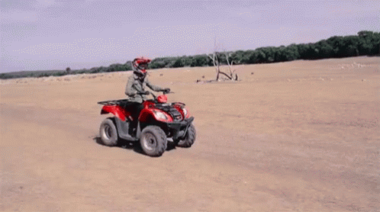
Where do you ride quad bike ?

Slide 16
waterski (v)
Notes:
NOTE: To change images on this slide, select a picture and delete it. Then click the Insert Picture icon in the placeholder to insert your own image.

Slide 17
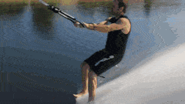
Can he waterski?

Slide 18
New vocabulary

Slide 19
New vocabulary
snorkel (v)
javelin (n)

Slide 20
New vocabulary
quad bike (n)
waterski (v)
Give me some sentences

Slide 21
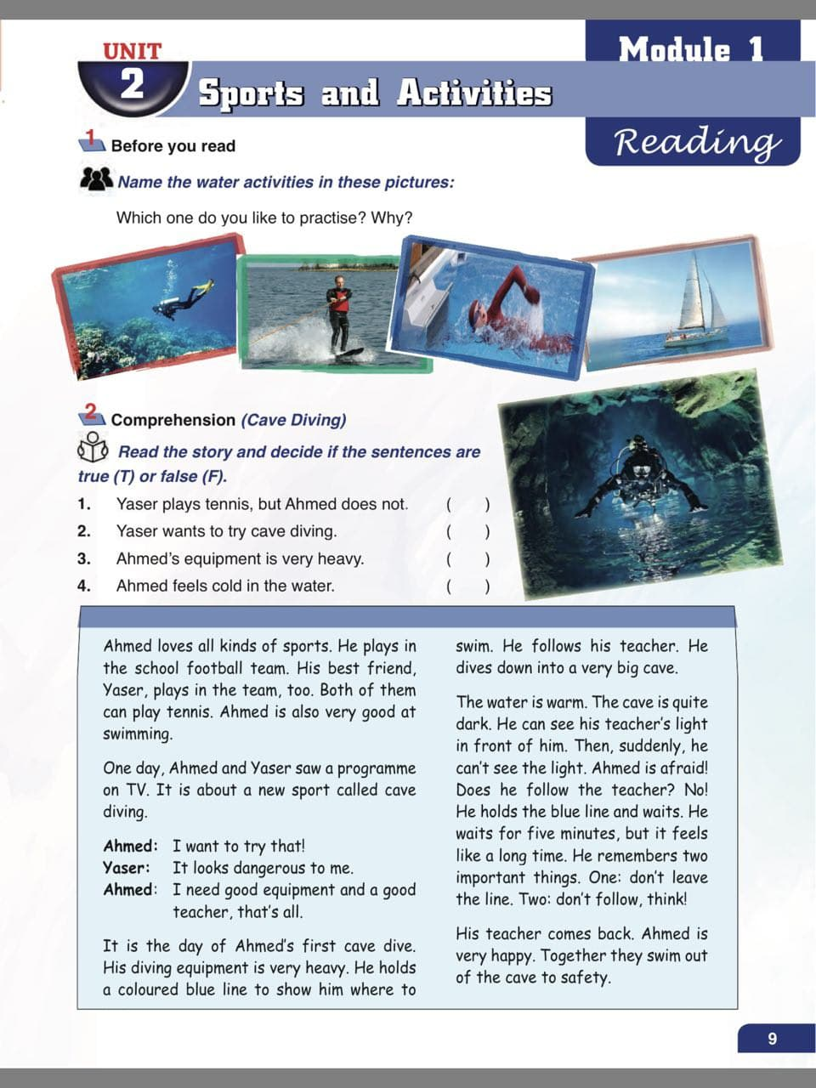
Page:11

Slide 22
Speaking

Slide 26
It’s time to perform mini-dialogues.
Speak up

Slide 28
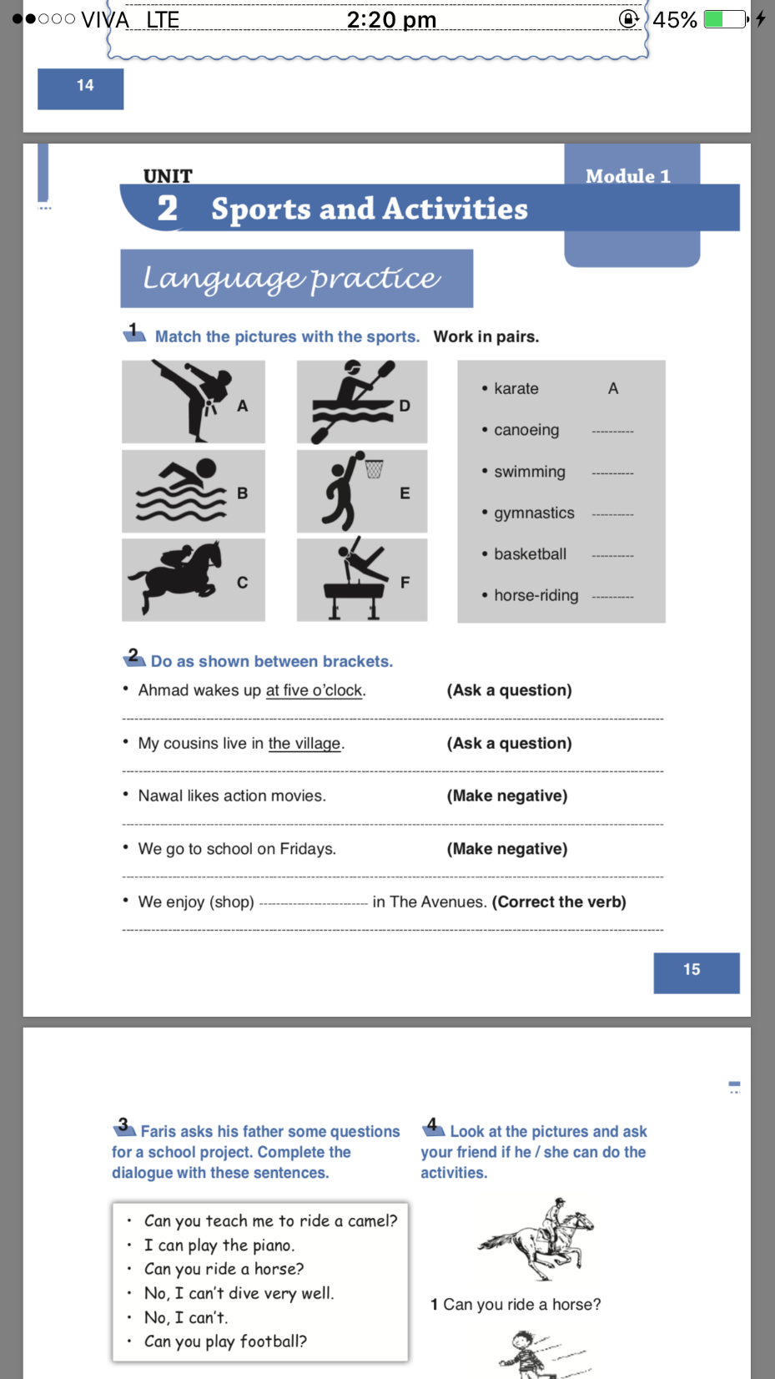
Page:15

Slide 29
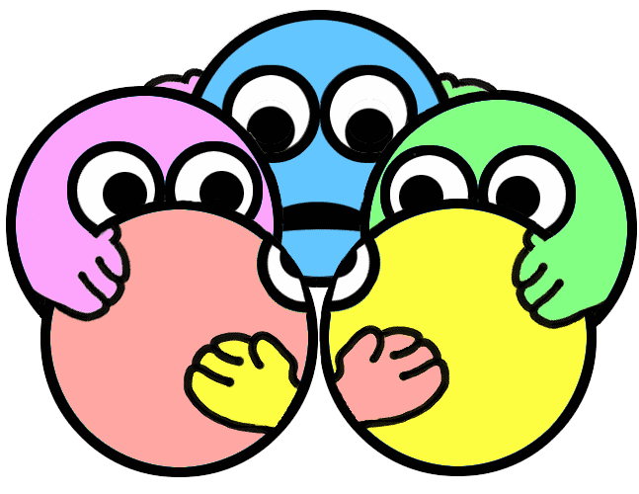

Slide 30
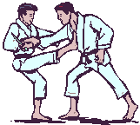
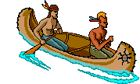
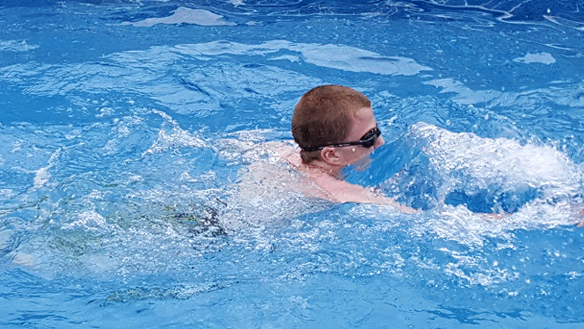
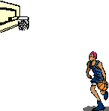
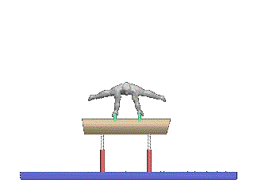
D
B
F
E
C

Slide 31
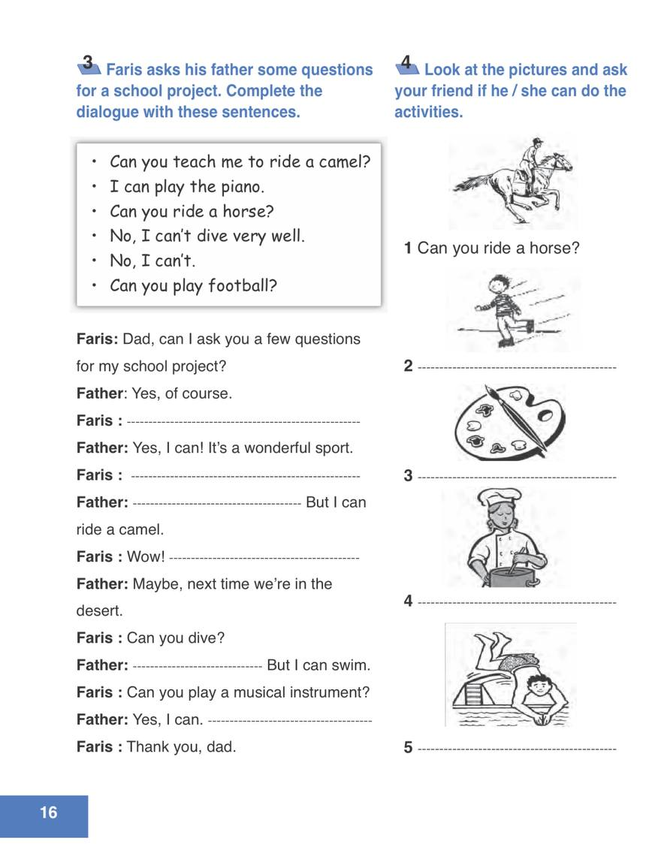
Page:16

Slide 32
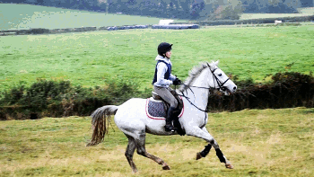
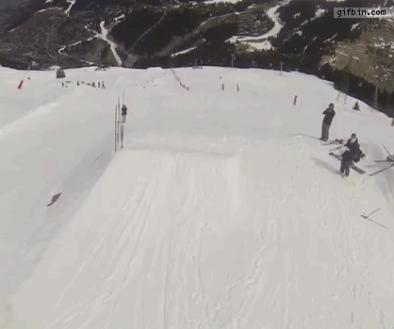
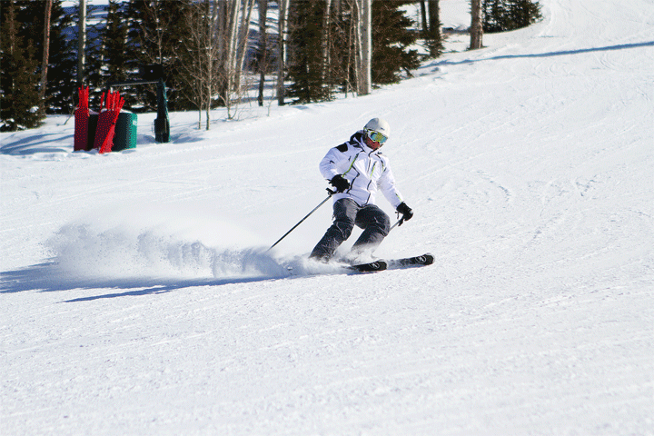
Can you ski?

Slide 33
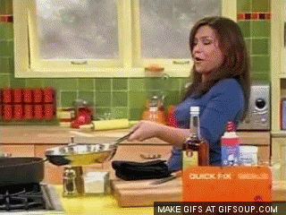
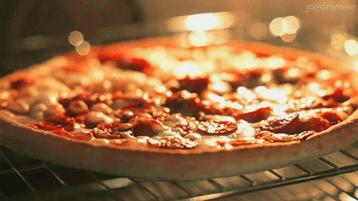
Can you paint?
Can you cook?

Slide 34
Can you swim?

Slide 35
Spot the difference

