Slide 1
Unit 2
Lesson 3
Page: 10
SPORTS AND ACTIVITIES

Slide 2






Form a word
q
u
e
i
t

Slide 3



It
he

Slide 4

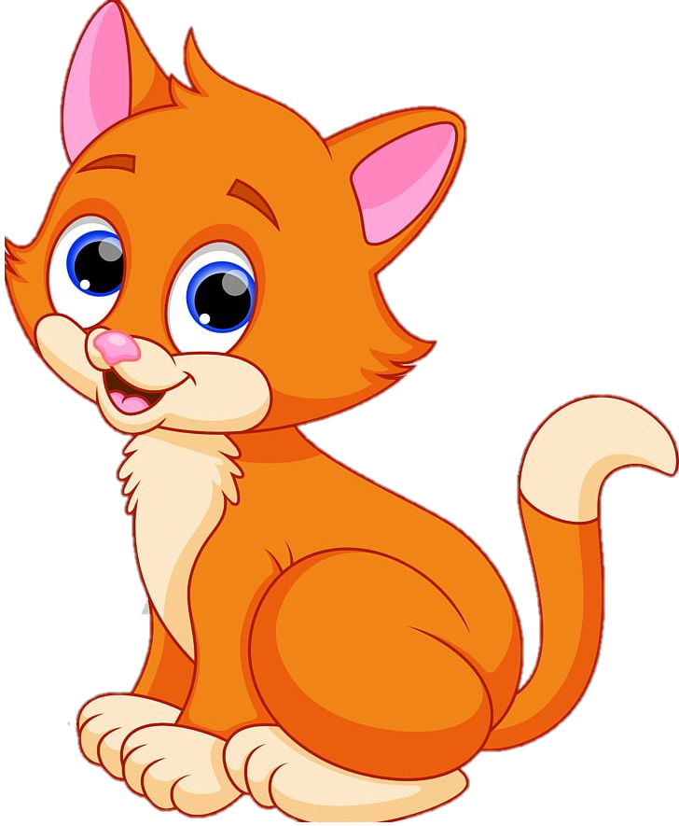
It
she

Slide 5


They
We

Slide 6
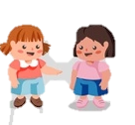

you
I

Slide 7



New Vocabulary

Slide 8
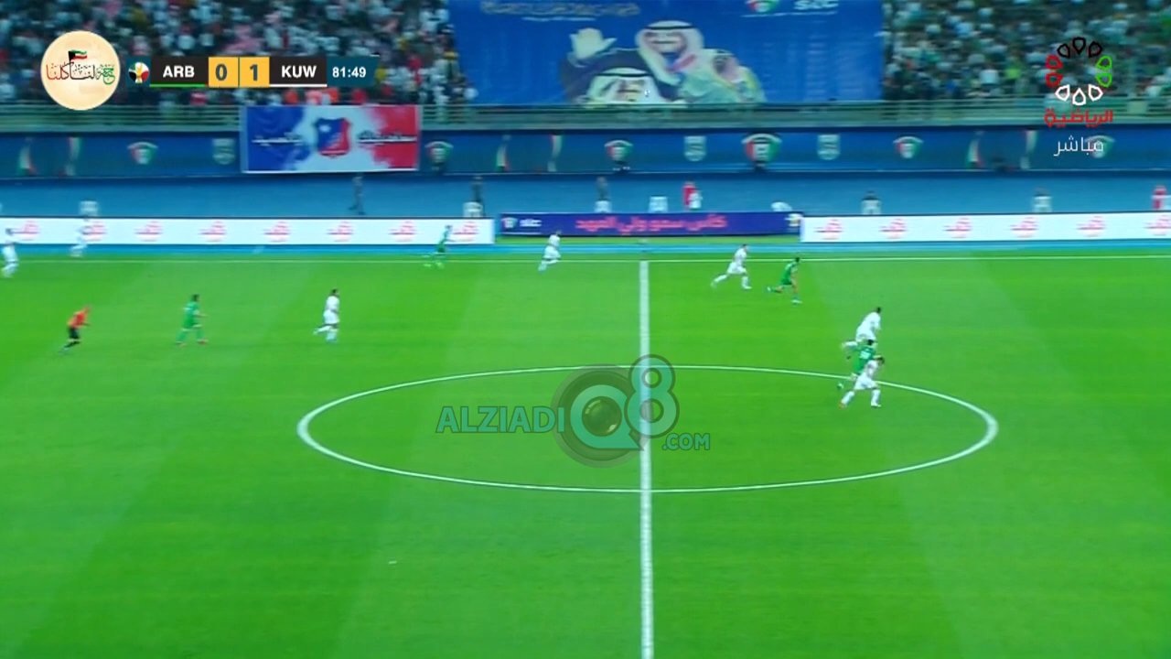
Watch the video and tell me what is about?

Slide 9
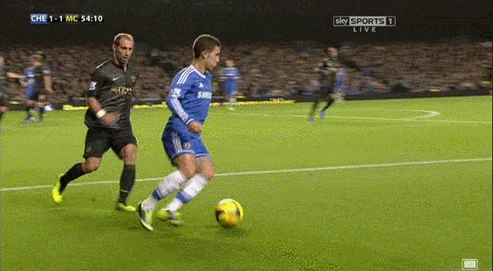
Footballers play in a football pitch.

Slide 10
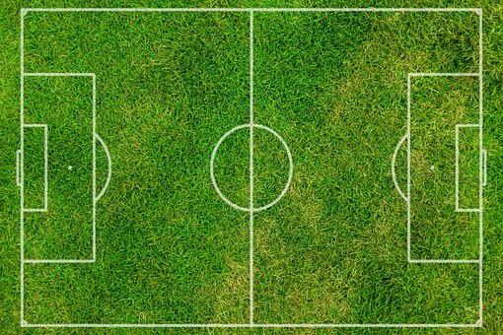

pitch (n)
An area painted with lines for playing football
Notes:
NOTE: To change images on this slide, select a picture and delete it. Then click the Insert Picture icon in the placeholder to insert your own image.

Slide 11
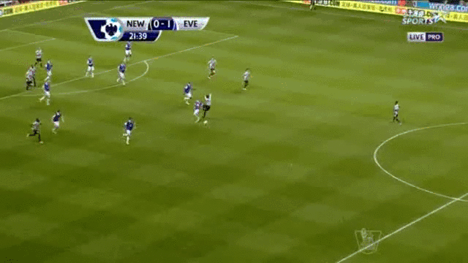
Do you think the player will score a goal?
Hooray! The football player has scored a goal.

Slide 12
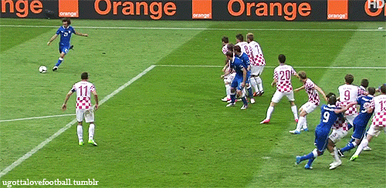
score (v)
Notes:
NOTE: To change images on this slide, select a picture and delete it. Then click the Insert Picture icon in the placeholder to insert your own image.

Slide 13
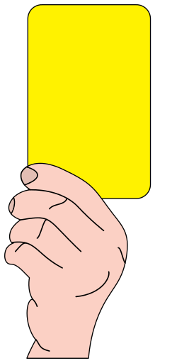
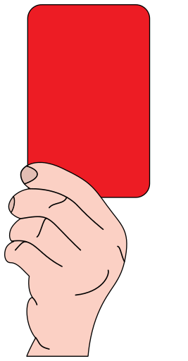

Slide 14
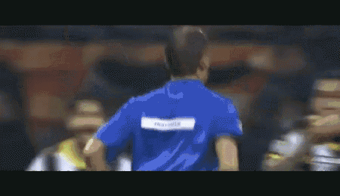
This time the referee gave a red card to the player.

Slide 15
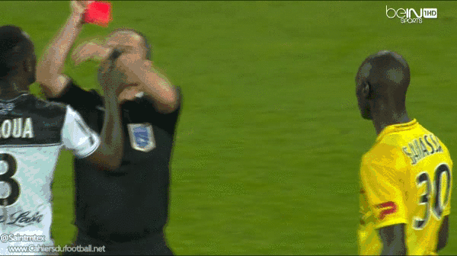
referee (n)
Notes:
NOTE: To change images on this slide, select a picture and delete it. Then click the Insert Picture icon in the placeholder to insert your own image.

Slide 16
New vocabulary

Slide 17
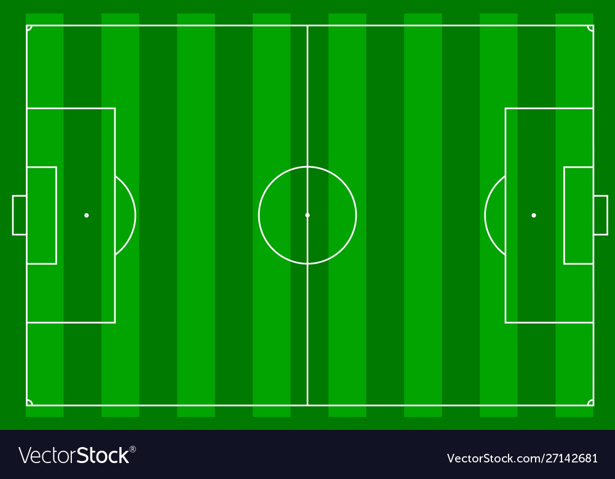
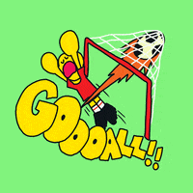
New vocabulary
pitch (n)
score (v)

Slide 18
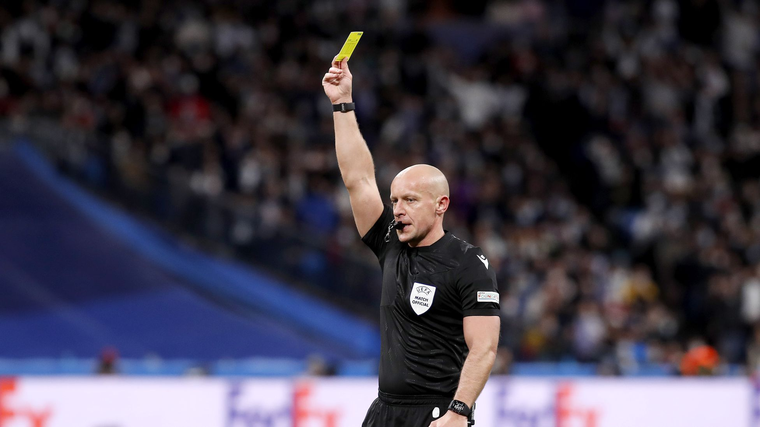
New vocabulary
referee (n)
Give me some sentences

Slide 19



Grammar
Present simple

Slide 20
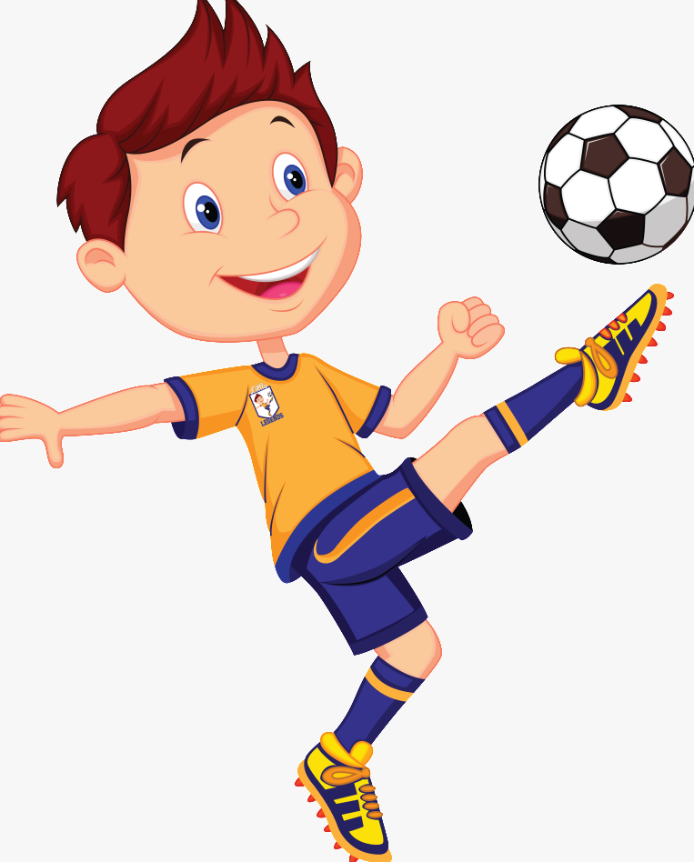


I always play football.
She sometimes eats Banana.

Slide 21




lives in a big house.
He
She
it
go to school .
Present
simple
tense
They
We
You

Slide 22

keywords
- every….
- usually
- always
- often
- sometimes
- never

Slide 23


  Zahra’a ................ English at alsafa school 5 times a week.

Slide 24
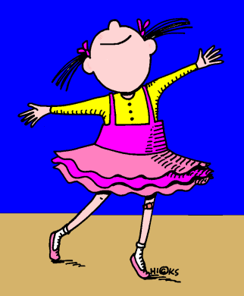

Maha ................. in the school hall.

Slide 25
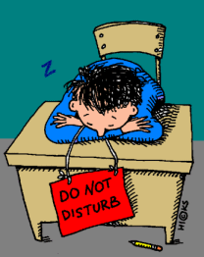
Ahmad always ................ during his Math class.

Slide 26
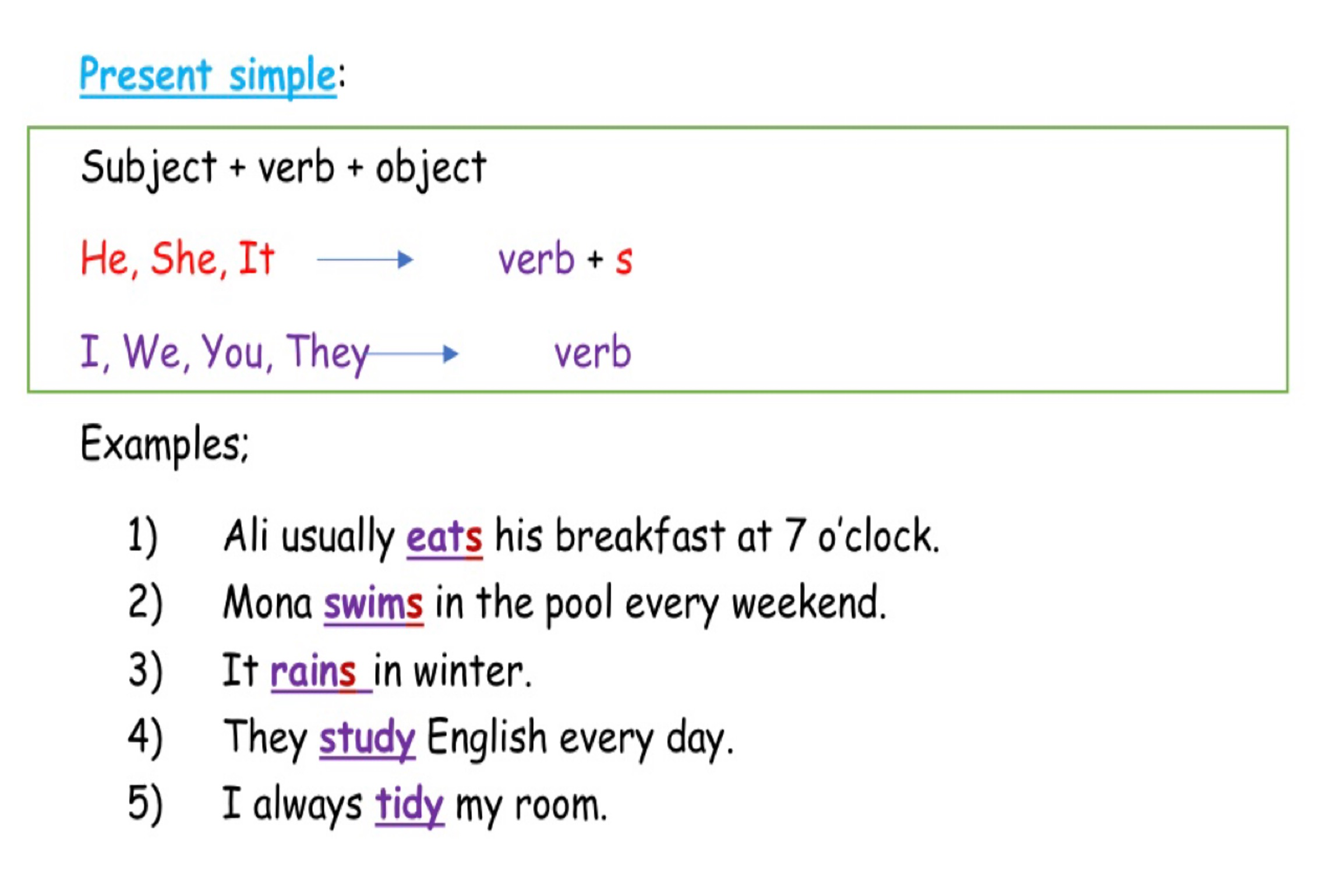

Slide 27

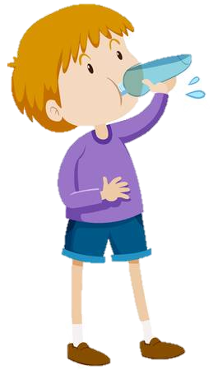

what does he do ?

Slide 28

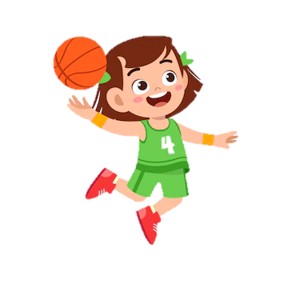


what does she do ?

Slide 29

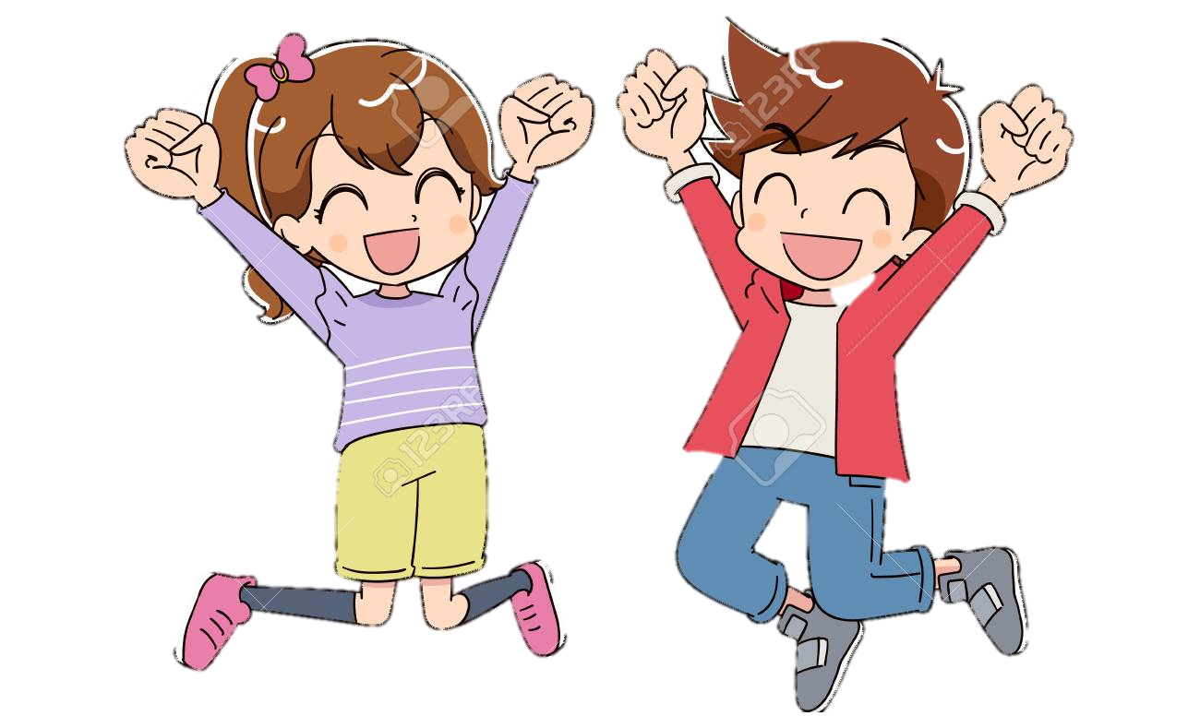
what do they do ?

Slide 31

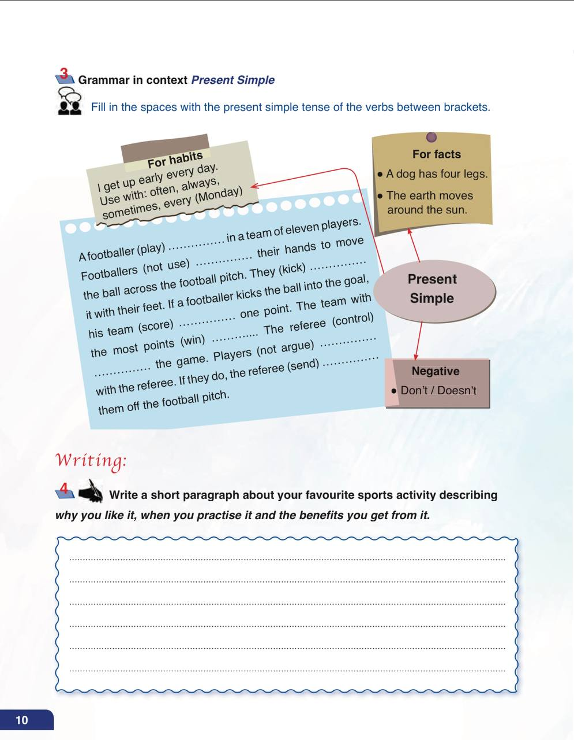
Page:10

Slide 32


Slide 33
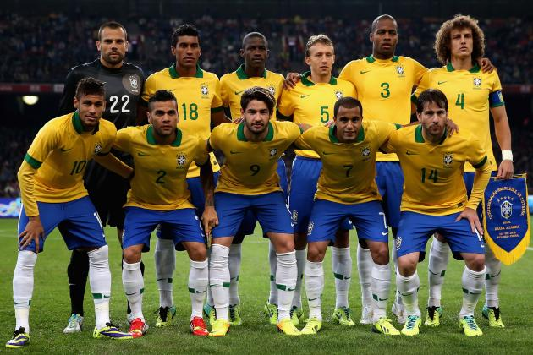

A football player (play) -------------------------- in a team of eleven players.
one player
verb + s
plays

Slide 34
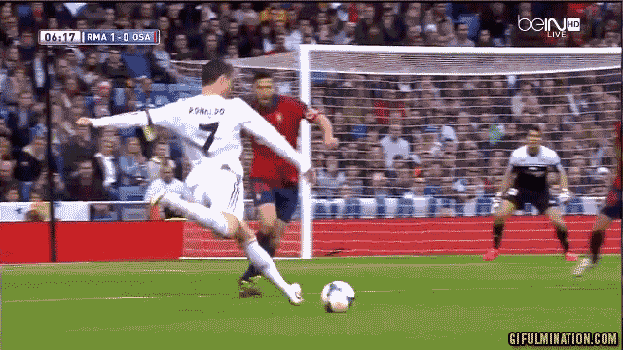


Footballers (not use) ---------------------- their hands to move the ball across the football pitch.
more than a player
don’t verb (infinitive)
don’t use

Slide 35
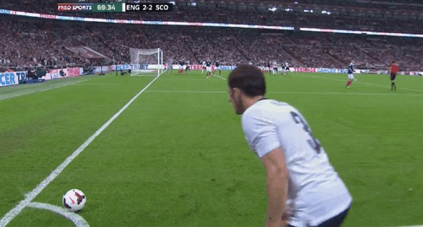
They (kick) ---------------------- it with their feet.
more than a player
verb (infinitive)
kick

Slide 36
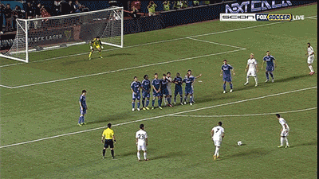
If the footballer kicks the ball into the goal, his team (score) ---------------------- one point.
one team
verb + s
scores

Slide 37
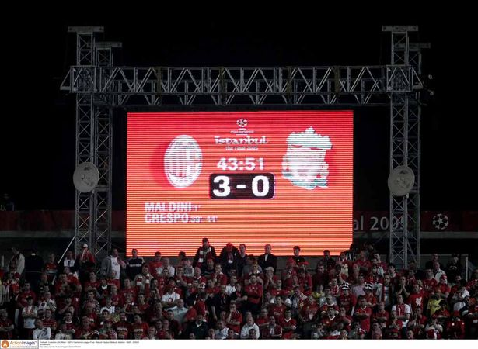
The team with the most points (win)
----------------------.
one team
verb + s
wins

Slide 38
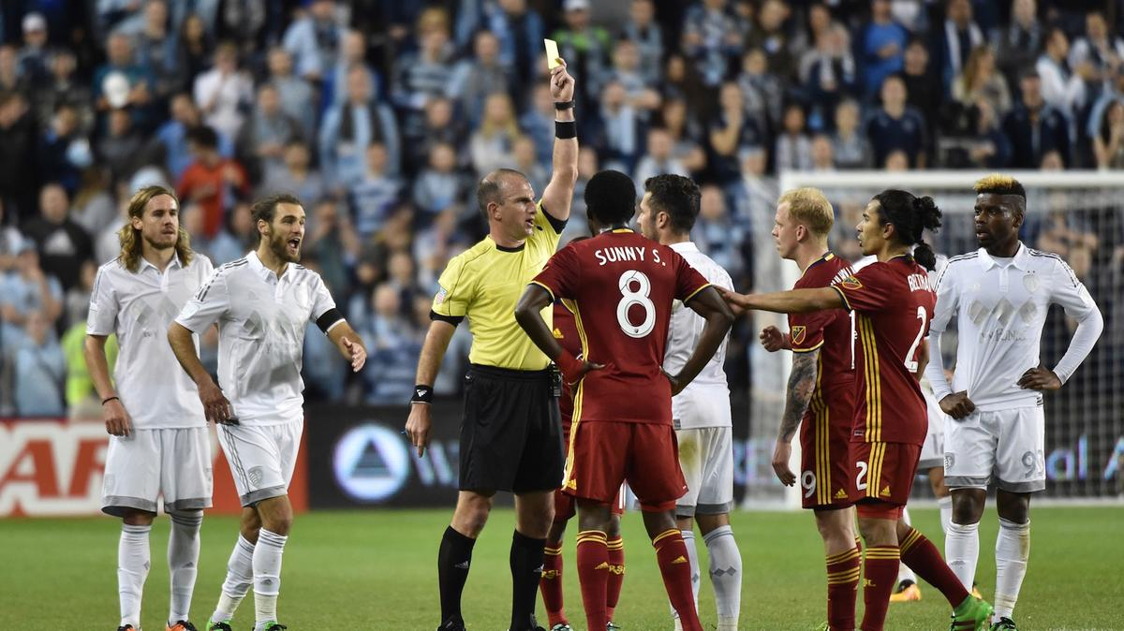
The referee (control) ----------------- the game.
one referee
verb + s
controls

Slide 39
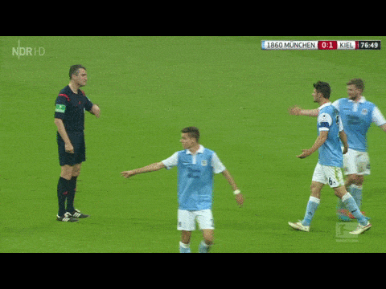

Players (not argue) -------------- with the referee.
more than a player
don’t verb (infinitive)
don’t argue

Slide 40
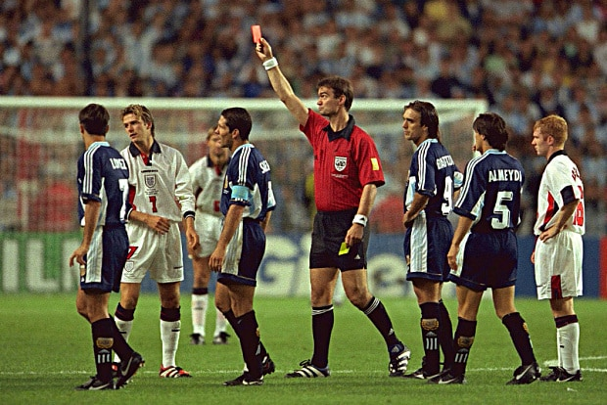
If they do, the referee (send) --------------------- them off the football pitch.
one referee
verb + s
sends

Slide 41

Talk about your daily routine:

Slide 42
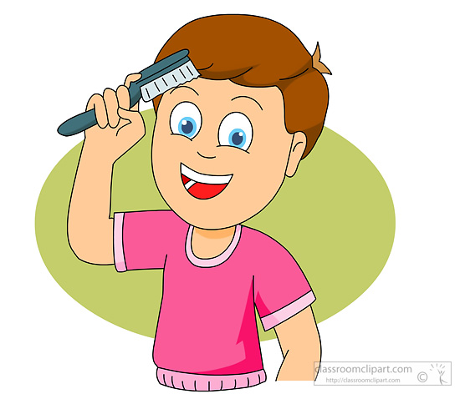
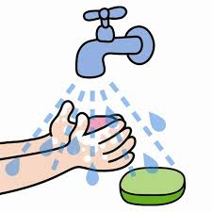
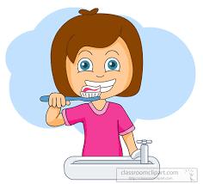


I brush my hair.
You wash your hands.
She brushes her teeth.
He eats his breakfast.
We do homework.

Slide 43


Slide 44
I always make a snowman in the winter.
I don’t.
I throw snowballs.
make
throw

Slide 45
I always brush my teeth.
I don’t.
eat
I always eat a lot of candy. Mmmm.
brush

Slide 46
2. The Simple Present is also used in facts.

Slide 47

The earth goes around the sun.

Slide 48

Birds fly.

Slide 49
Water freezes at 32 degrees.
32º
Triangles have three sides.

Slide 50
For example, the Simple Present of the verb to work
is conjugated as follows:
I work
you work
he works
she works
it works
we work
they work
The form of the verb used with the subjects he, she and it is generally referred to as the third person singular

Slide 51
The auxiliaries
DO and DOES
The auxiliaries DO and Does are used to make the Interrogative and Negative forms.

Slide 52
Negative form
I/You/We/They + do not (don’t) + bare infinitive (verb without “to”)
We do not (don’t) swim.
He/She/It + does not (doesn’t) + bare infinitive
She does not (doesn’t) swim

Slide 53
Interrogative form
Do + I/You/We/They +bare infinitive
Do they swim?
Does + He/She/It + bare infinitive
Does he swim?

Slide 54
Don’t forget!
The auxiliary DO is used with the pronouns I, YOU, WE and THEY
The auxiliary DOES is used with the pronouns HE, SHE and IT
When you use the auxiliary DOES (INTERROGATIVE AND NEGATIVE FORMS), put the verb in its bare infinitive (without “to”).

