Slide 1


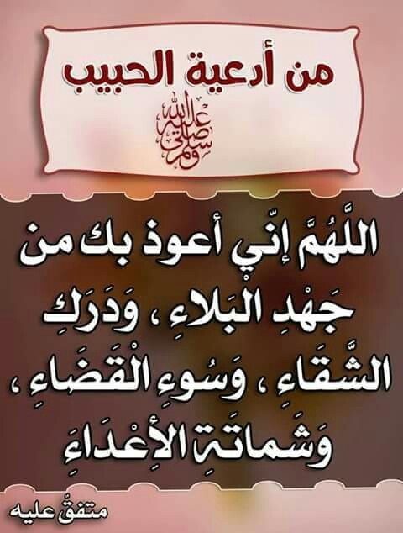

Slide 2


Unit 3

Slide 3

Opener
Sunday , 30 -10 - 2022

Slide 4


Slide 5
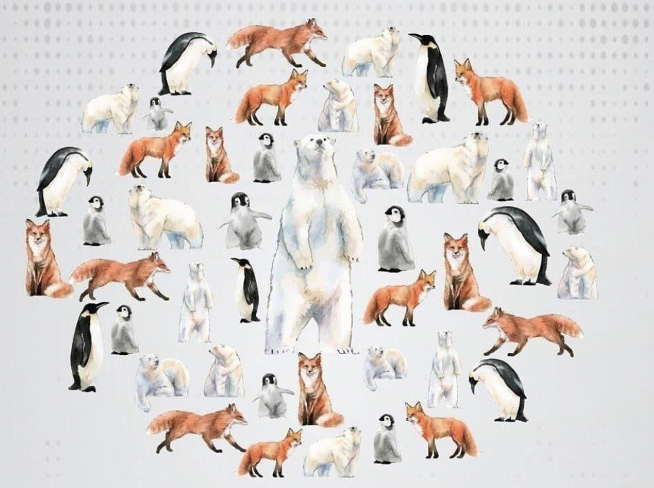
How many penguins are there ?
17

Slide 6
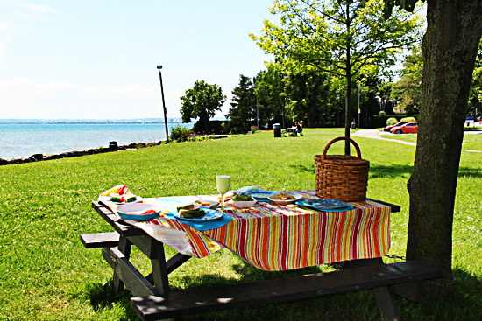
Listen to the song.
Guess what the boy is doing .

Slide 7


Slide 8
What is the boy doing now ?

Slide 9


GRAMMAR
Present Continuous tense

Slide 10
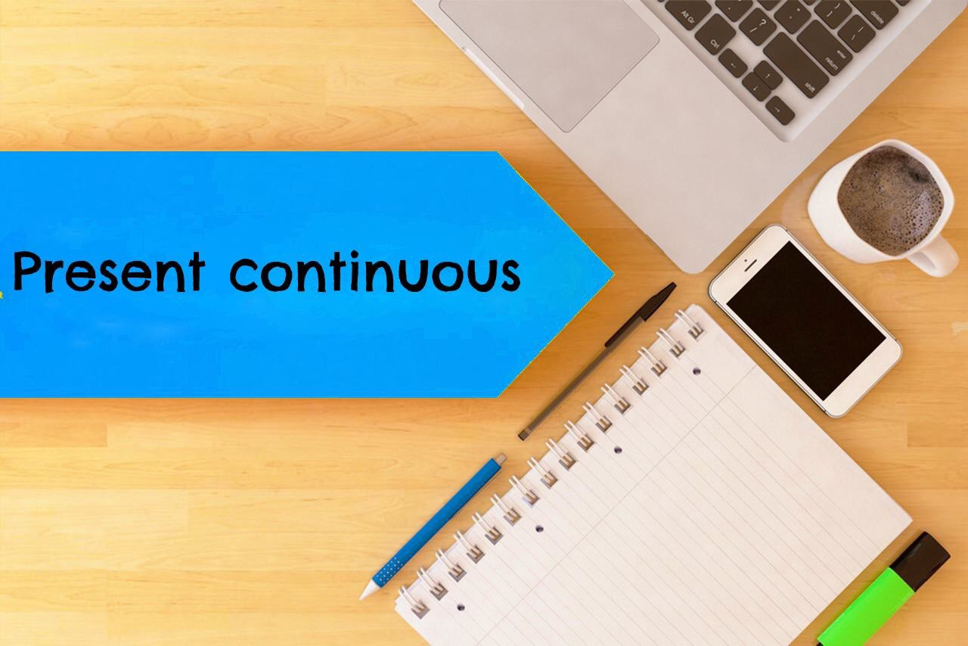
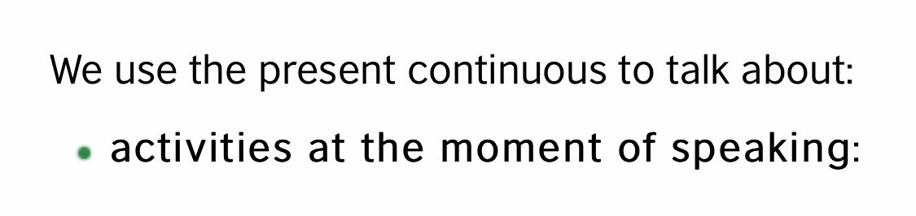

Slide 11

What are you doing now?
I am studying English now.

Slide 12

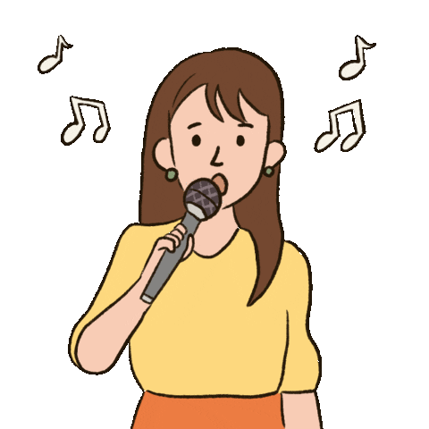
What is Sara doing at the moment ?
Sara is singing at the moment .

Slide 13
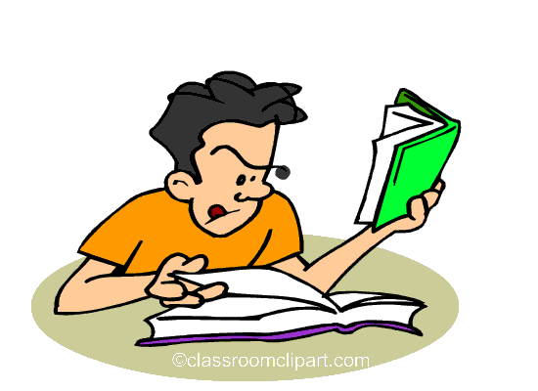
What is Ali studying now ?
Ali is studying English
now .

Slide 14

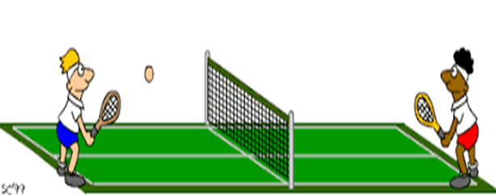
What are your friends playing now ?
Look ! They are playing tennis .

Slide 15
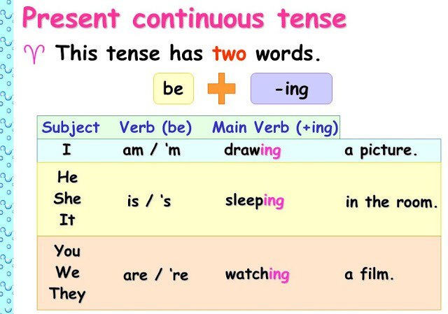
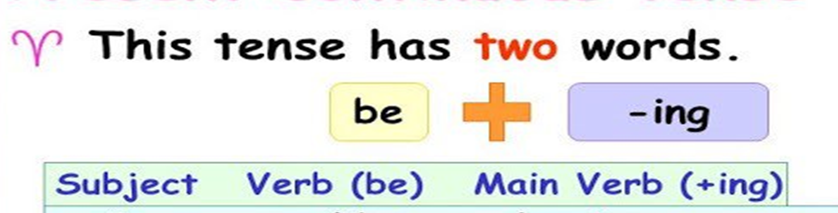

Slide 16
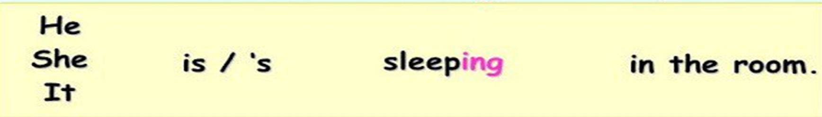


Slide 17
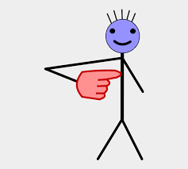
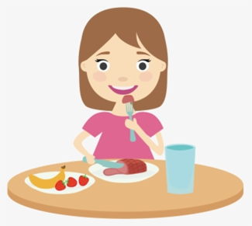
I
+
am + V+ (ing )
I am eating now

Slide 18
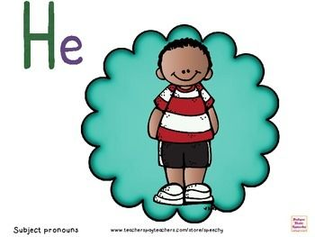

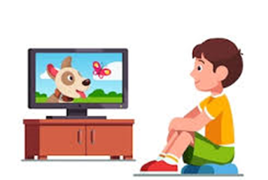

+
is + V+ (ing )
He is watching TV now.

Slide 19
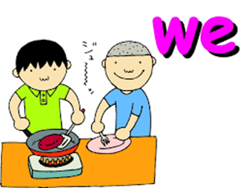

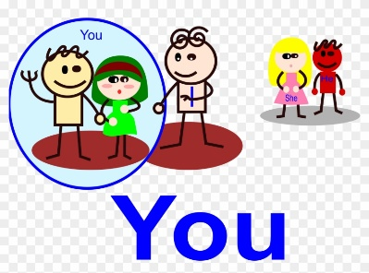
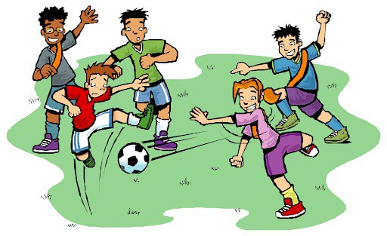
+
are + V+ (ing )
They are playing now

Slide 20


Slide 21


1- We ………..…….tennis now. .
A
are playing
B
play
C
is playing
D
plays
>
tekhnologic

Slide 22
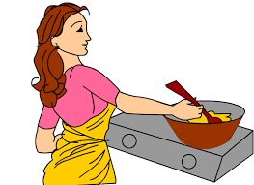
2-Hana………………at the moment. .
A
cooked
B
is cooking
C
cooks
D
are cooking
>
tekhnologic

Slide 23
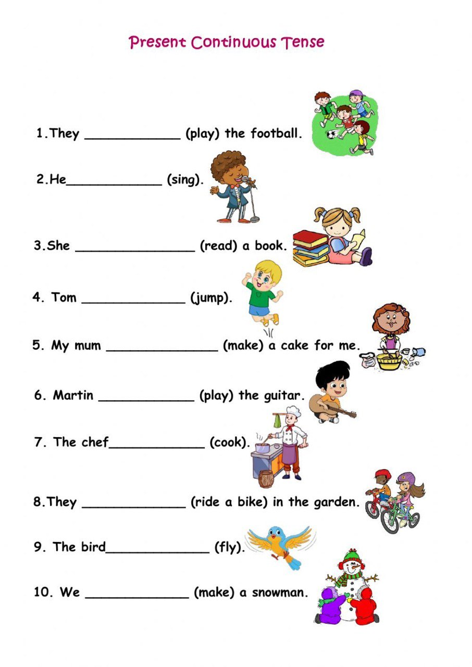

Slide 24
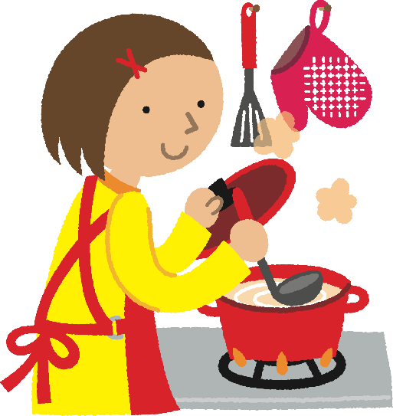


Hana is cooking now.
Make negative
Hana is not cooking now.

Slide 25
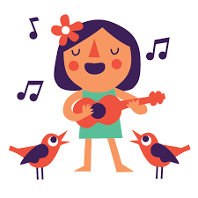
she is not crying at the moment.

Slide 26


What is he doing now ?
He is watching TV now .
Negative
He isn’t watching TV now .

Slide 27
What are they playing ?
They are playing football.
Negative
They aren’t playing football .

Slide 28



Time to role play!

Slide 29



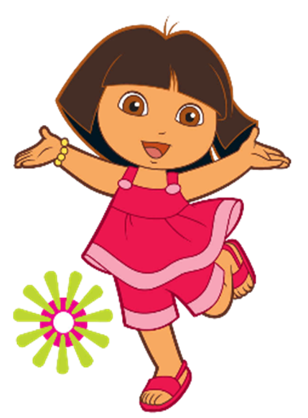
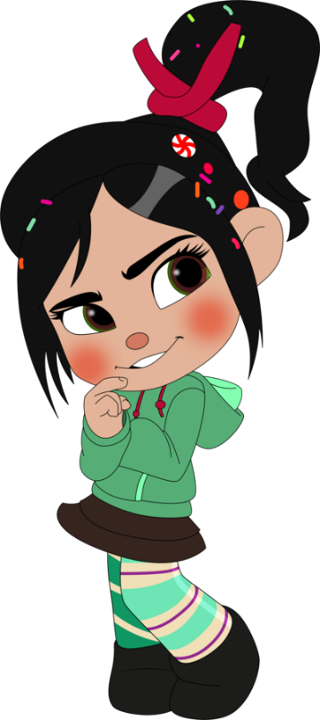

Ask your partner .
What is she doing now ?
She …. ……now .

Slide 30

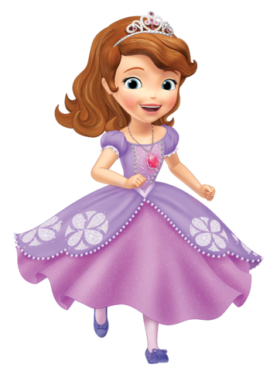

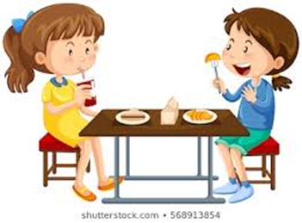
Ask your partner .
What are they doing at the moment ?
They ……at the moment.

Slide 31
Ask your partner .
What are they doing at the moment ?
They ……at the moment.

Slide 32
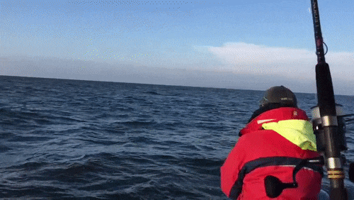
What is the man doing at
this moment?
He is fishing.

Slide 34
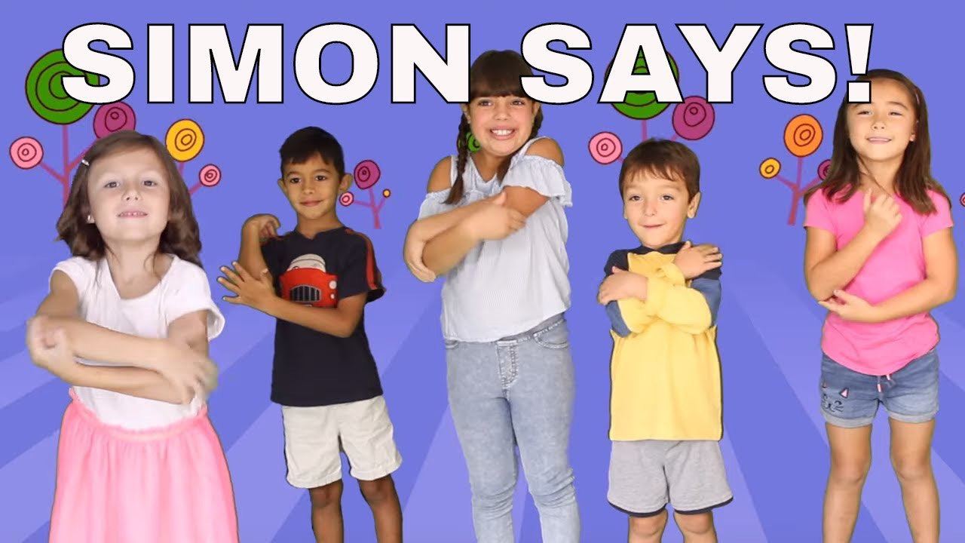

Slide 35


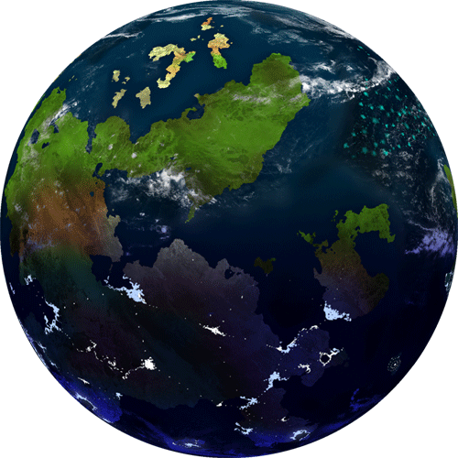
Student’s Book
Page 16
EX. 5

Slide 36

Students Book
Page 16

Slide 37

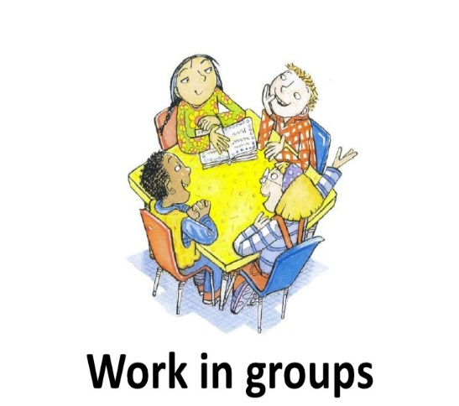

Slide 38
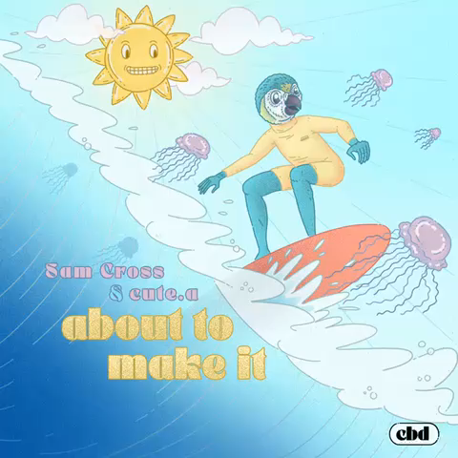
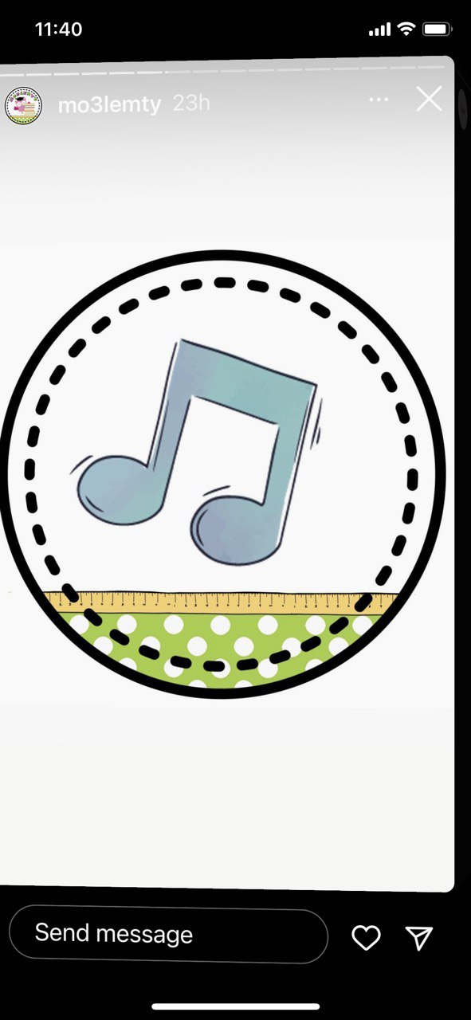

Slide 39
is having
are playing
is reading
is watching

Slide 40


Slide 41

Closure

Slide 42
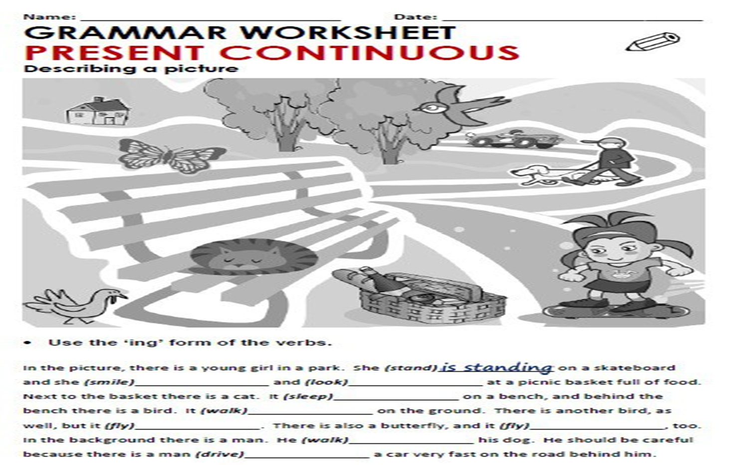

Slide 43

Workbook
Page 19

Slide 44
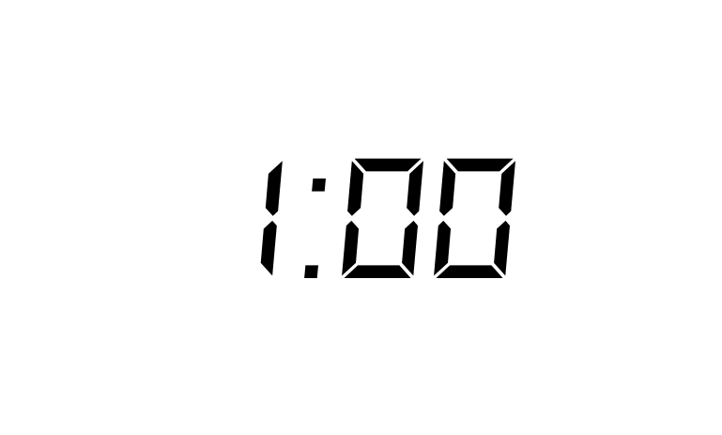

Slide 45
She is talking on the phone.
He is playing chess.
She is taking photos.

Slide 46


Slide 47

They are studying Maths.
They are studying Art.
They are studying Science.
They are studying IT.

Slide 48


Slide 49
are visiting
having
is talking
is looking
is drinking

Slide 50
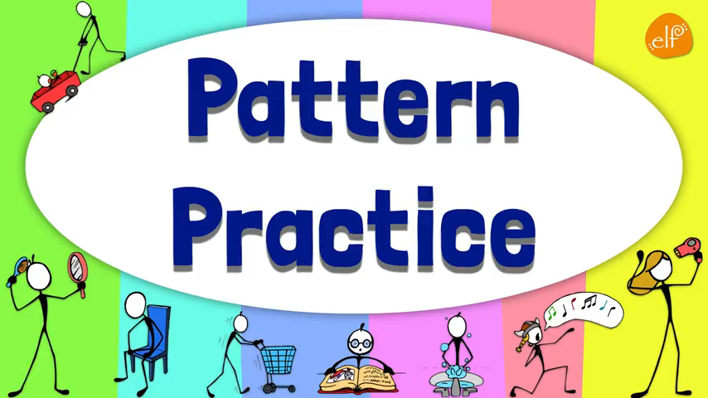

Slide 51
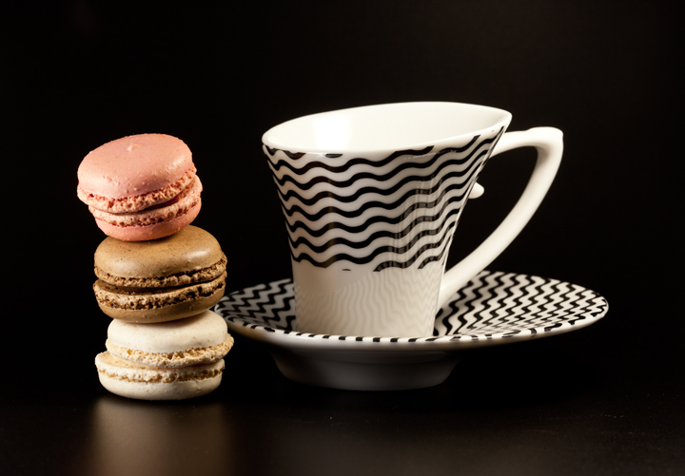
Thank you

Slide 52
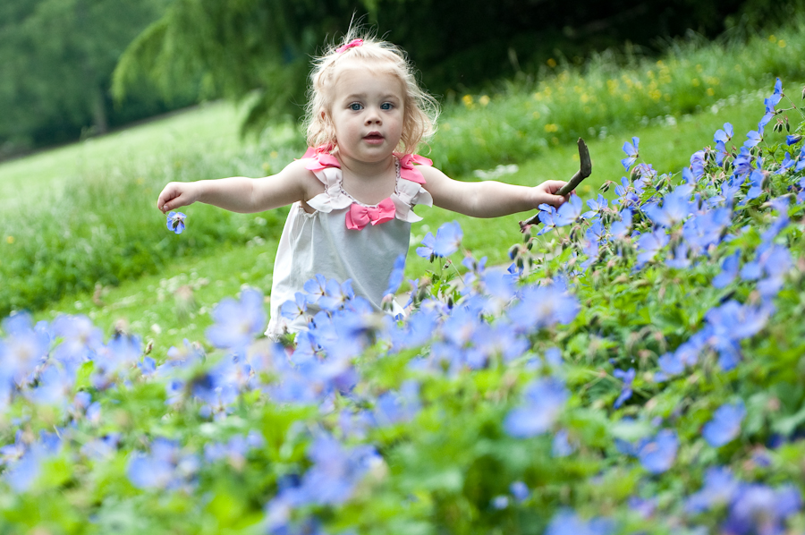

Check your answers.

Slide 53
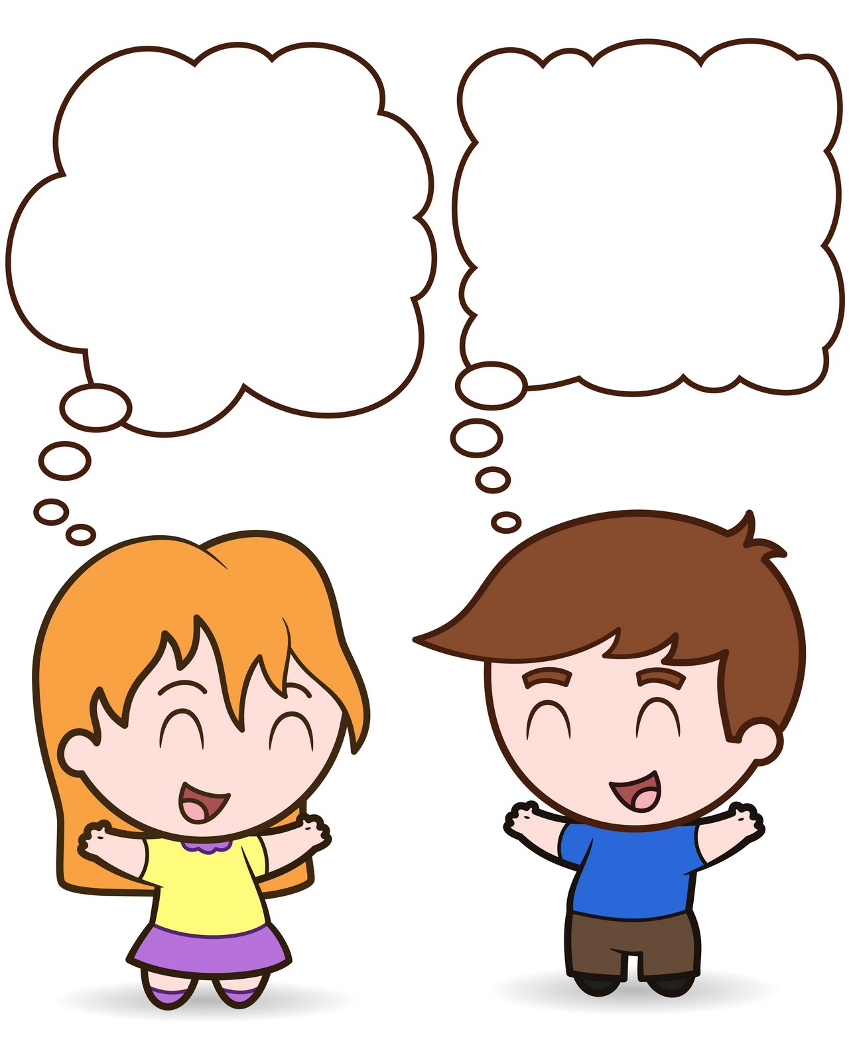
Pair work
Let’s talk.
OK. Let’s start.

Slide 54

What is your mother doing at this moment?
What is your sister doing now?
What is your brother doing at this moment?

Slide 55
Let’s sing to a song.
What are you doing?

Slide 57
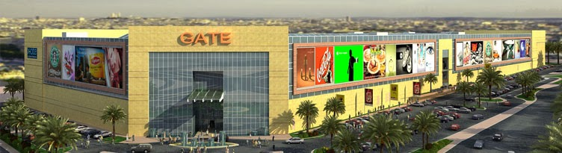





Let’s go shopping.
It’s a great idea!
I can’t. I have to do my homework.

Slide 58
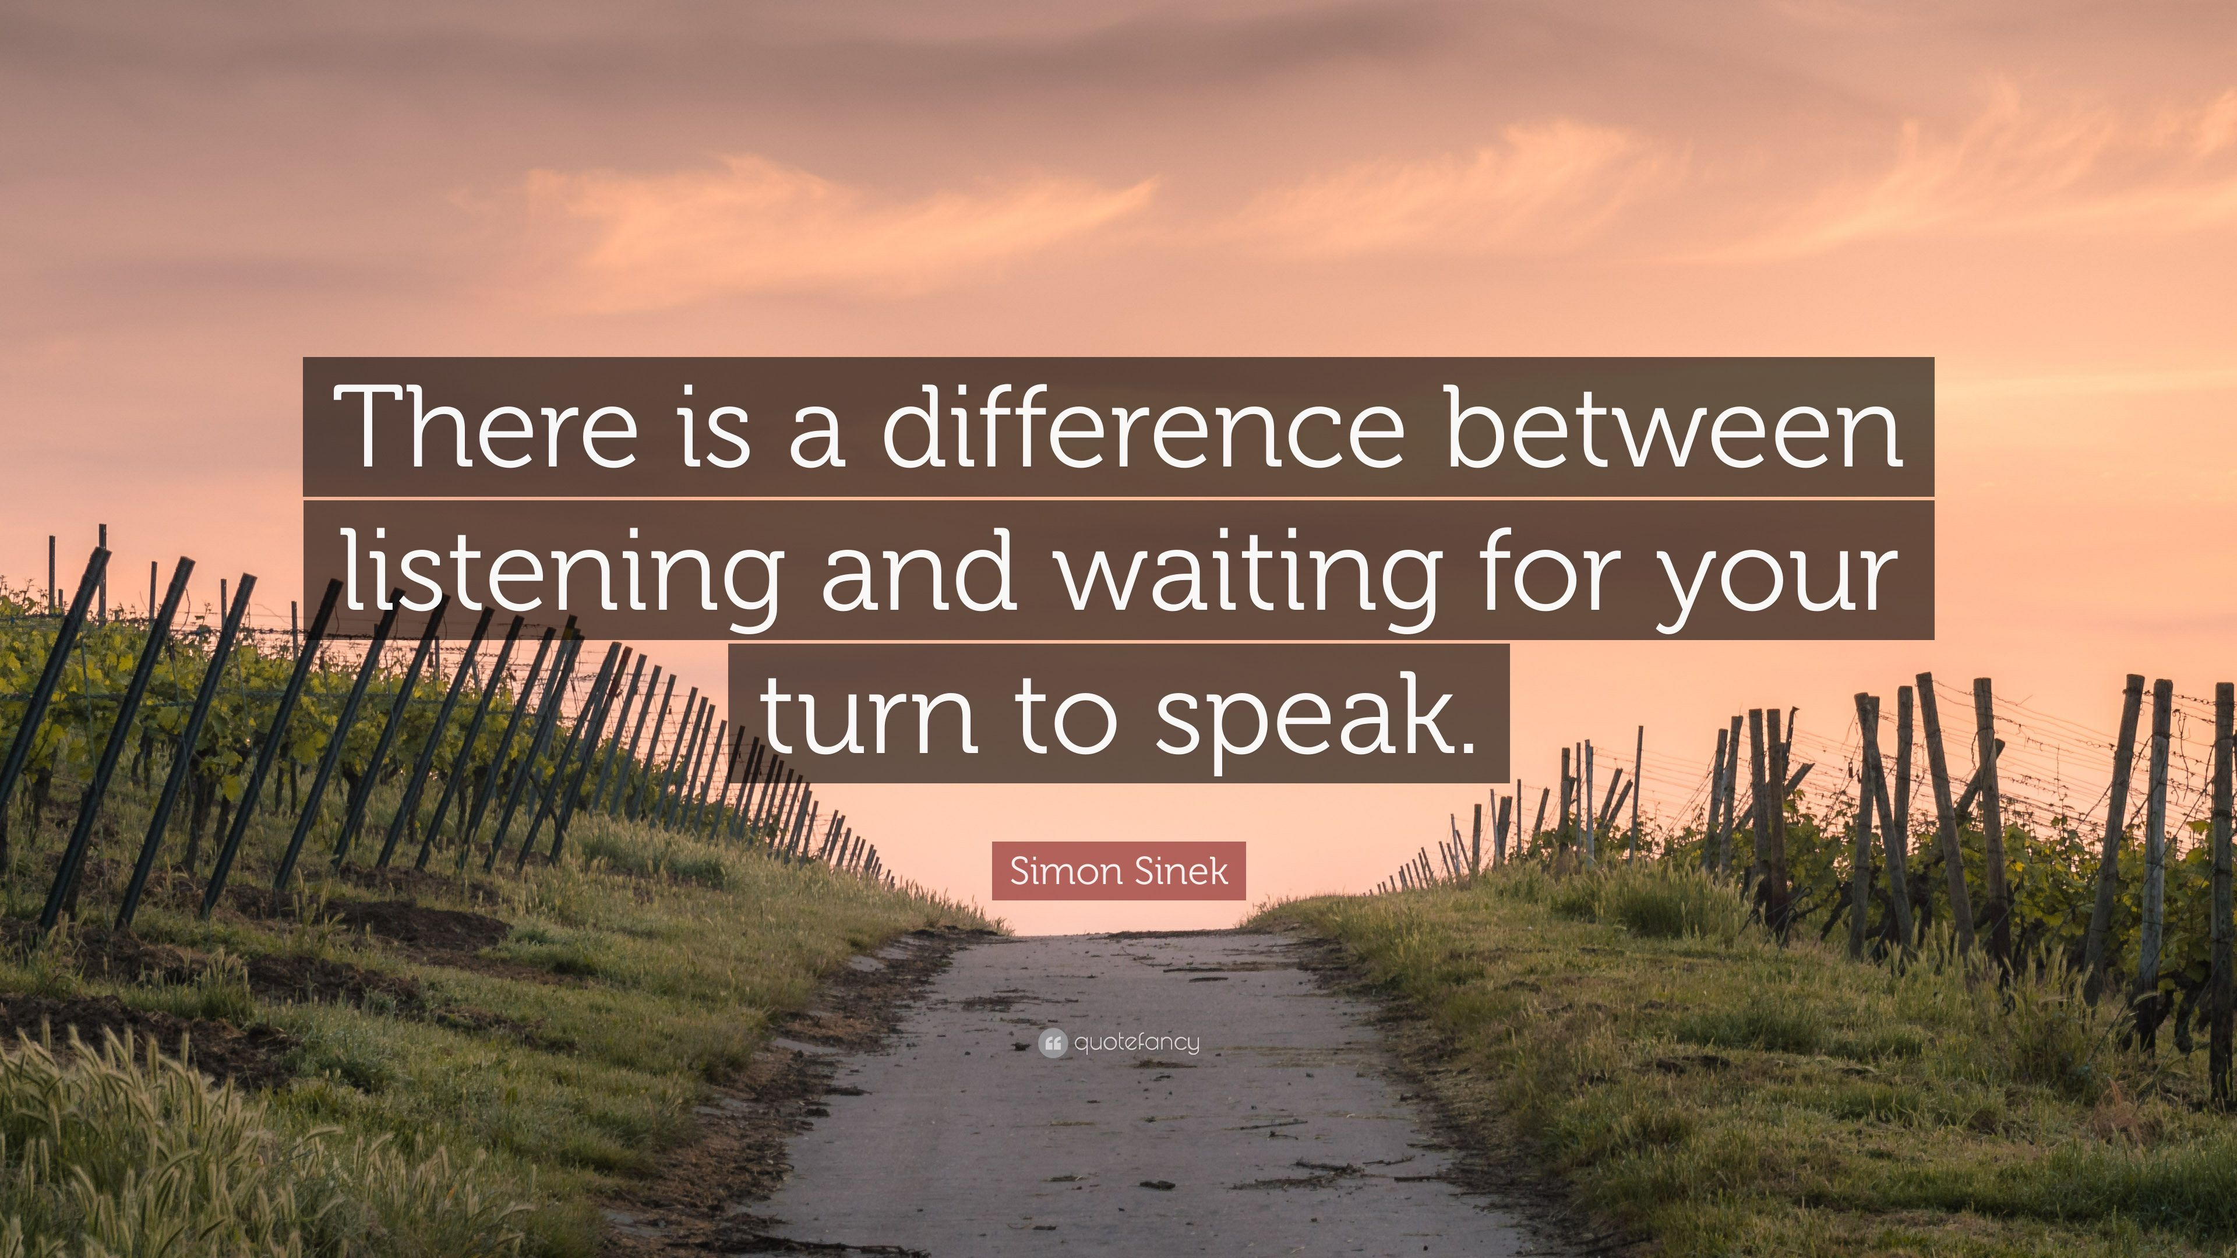


Slide 59





What subjects do you study at school?
Religion
Arabic
PE
IT

Slide 60
Which other subjects would you like to study at school?

Slide 61
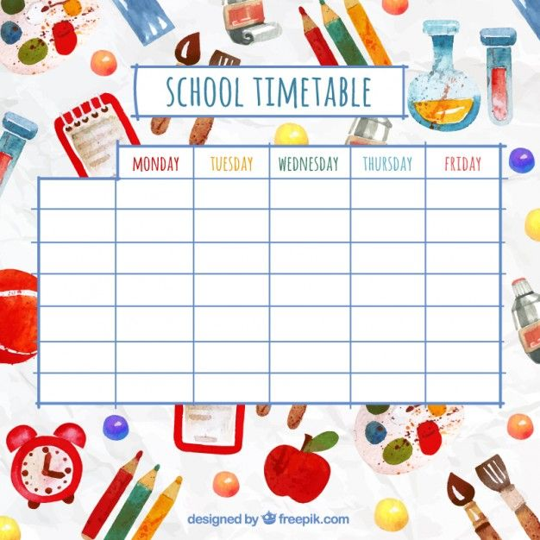

SUN

Slide 62
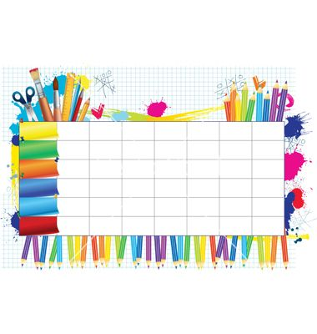
Speak up! Talk about your ideal timetable.

Slide 63
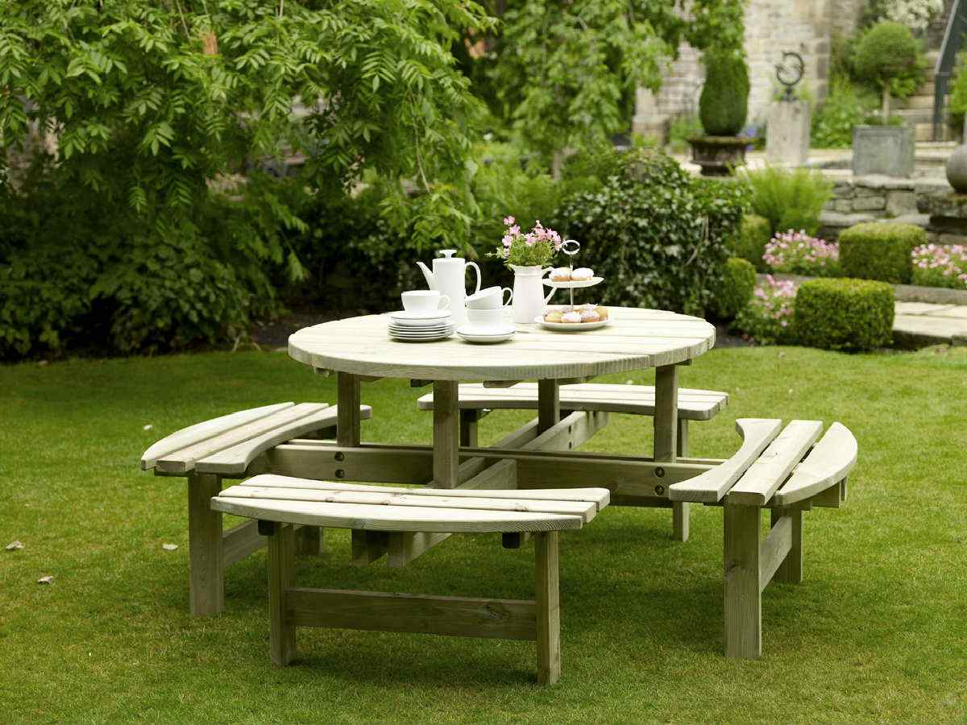
Check your answers.

Slide 64
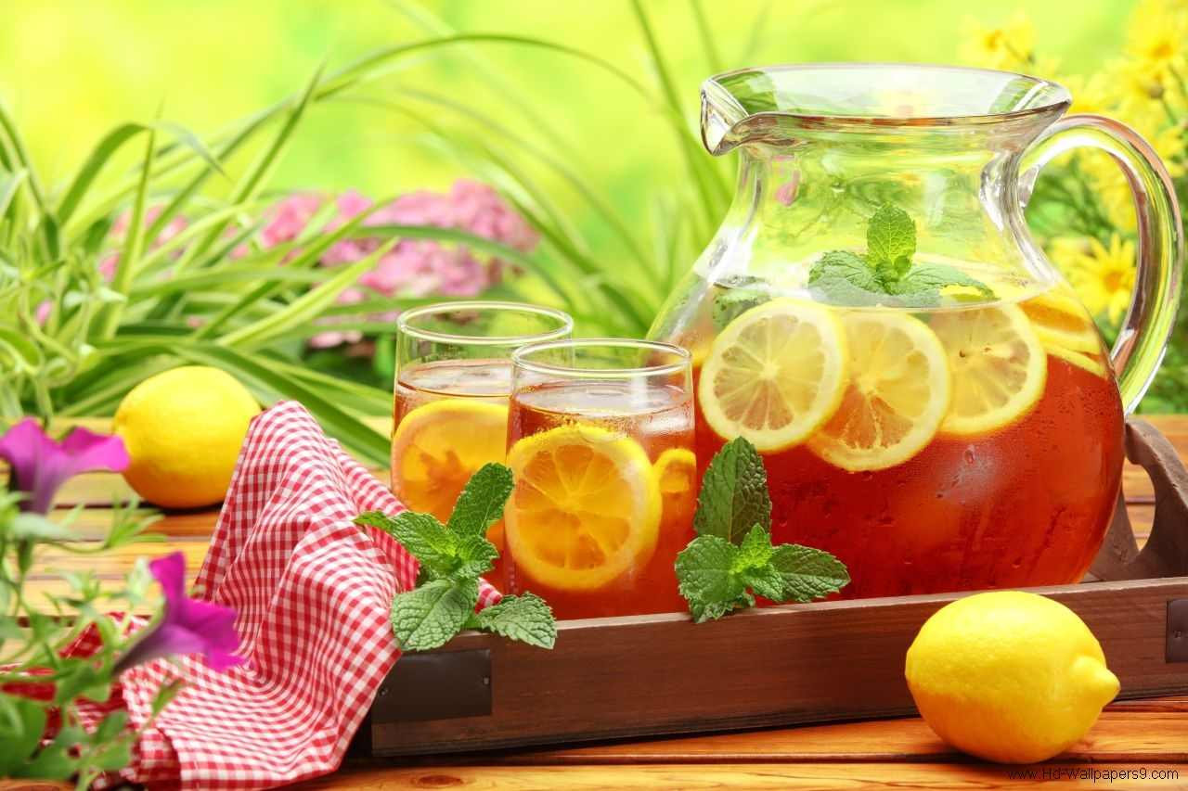
Check your answers.

Slide 65
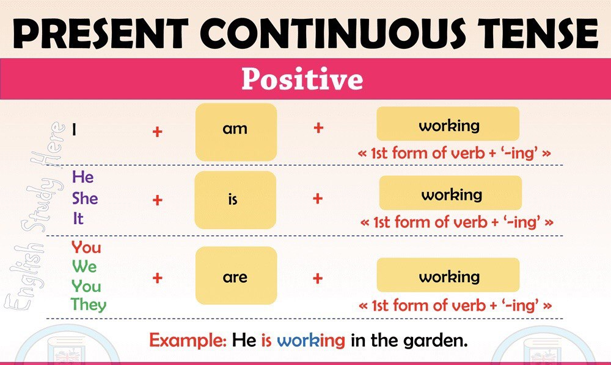

Slide 67

What is the boy doing now?
He is reading.

Slide 68
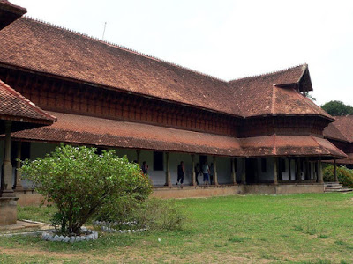
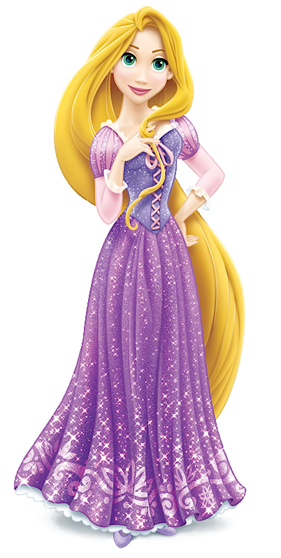
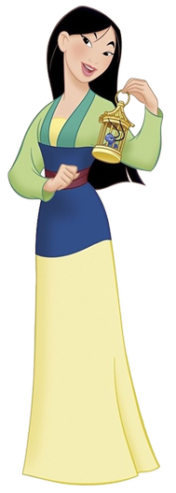
What are you doing now?
I am walking in the garden.

Slide 69
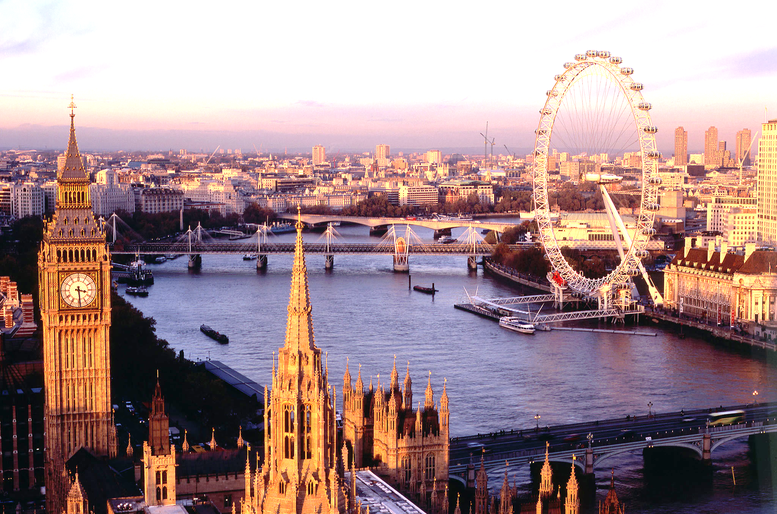
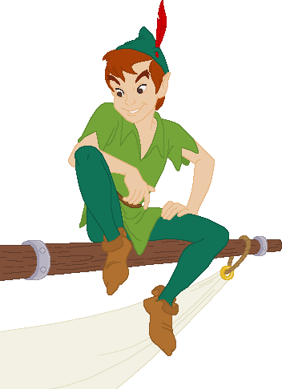

What are you doing now?
I am visiting London now.

Slide 70


Slide 71


