Slide 1


Unit 2

Slide 2




Slide 3

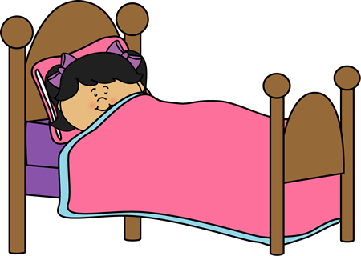
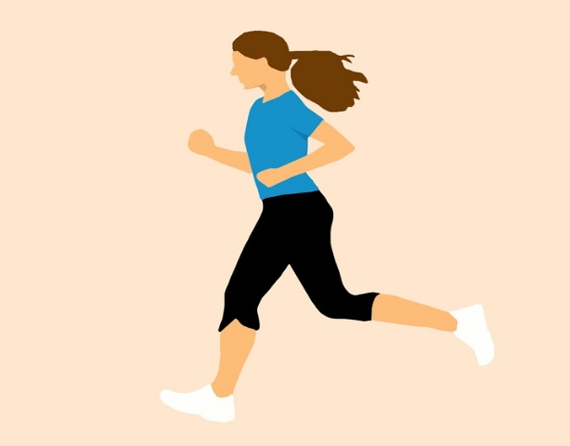
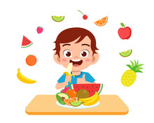
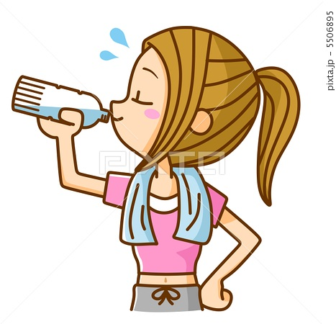
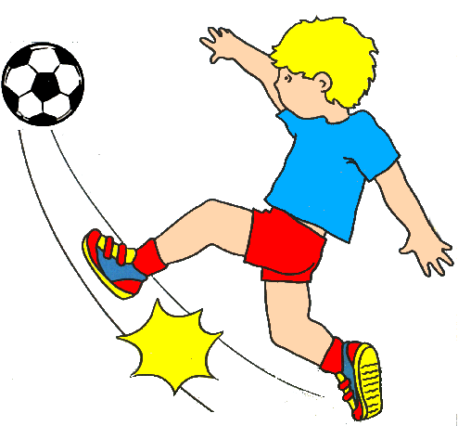

Show all
Fast
Medium
Slow
Hide all
tekhnologic
Notes:
Right-click on an image and select change picture.
Select your picture. Click on insert.
Start your presentation.
Click on Fast, Medium or Slow to show the series of images.
Click Show All to see all the images.
Click Hide All to hide all the images.

Slide 4

lets play a game
https://wordwall.net/play/5502/461/242

Slide 5
Writing

Slide 6
What are your favorite
sports?

Slide 7

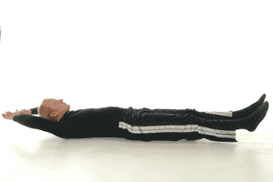
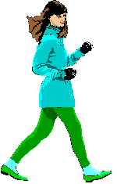
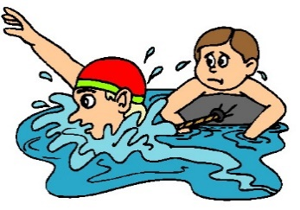
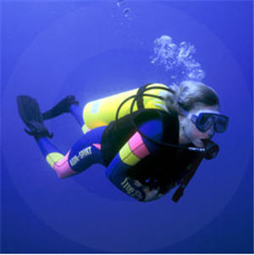
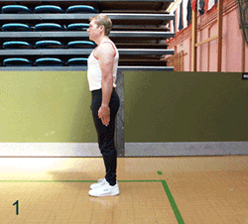
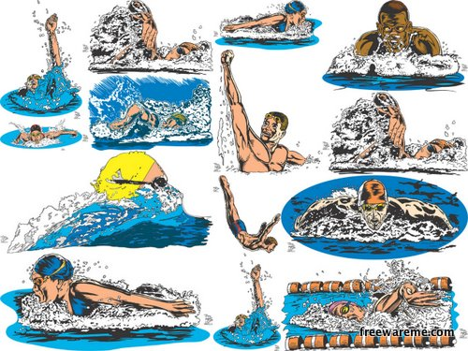
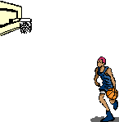
Sports and activities

Slide 8
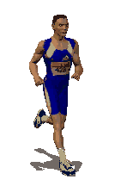
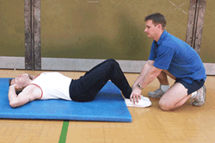
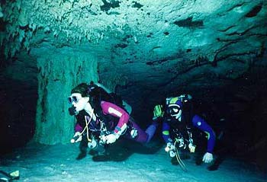
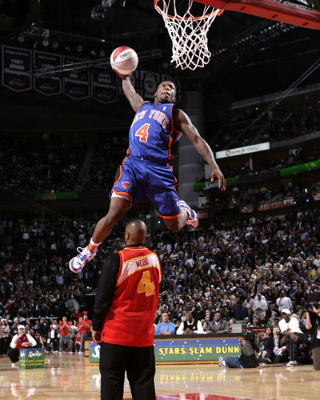
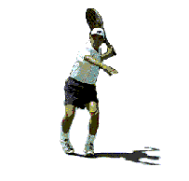
Mention some sports and activities

Slide 9
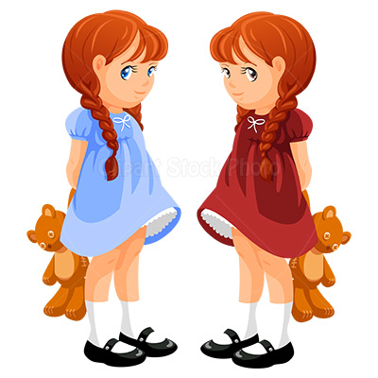

Name the water activities in these pictures:
Which one do you like to practice? Why?

Slide 10
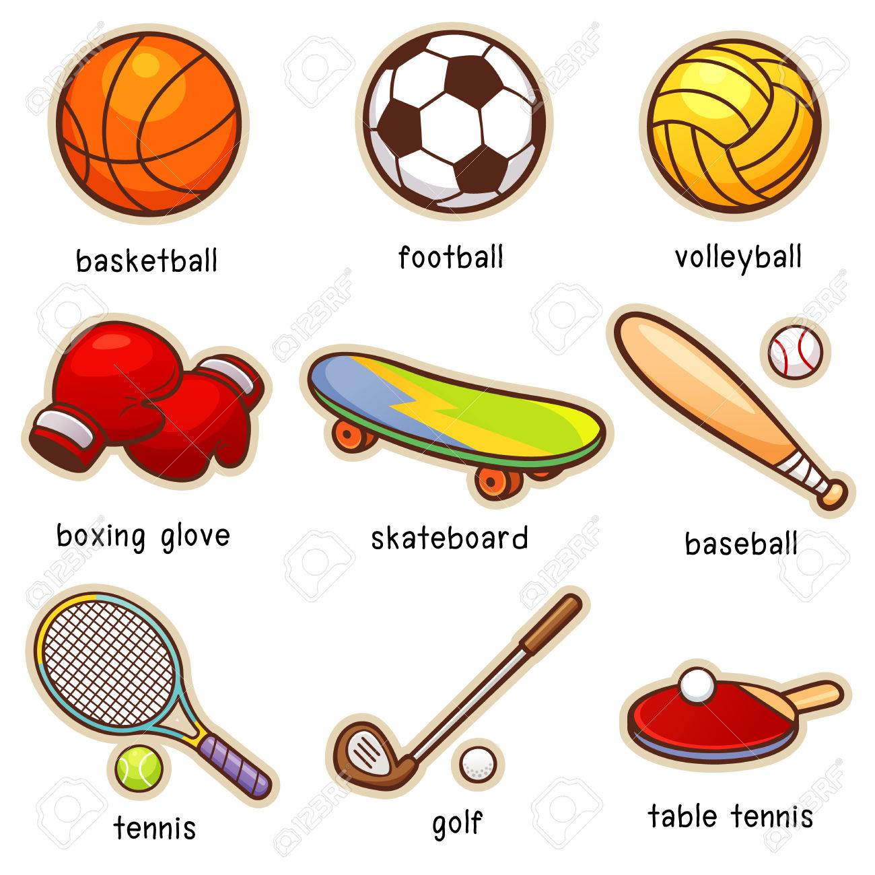
exercise equipment

Slide 11
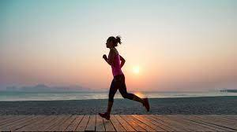
Where to exercise

Slide 12
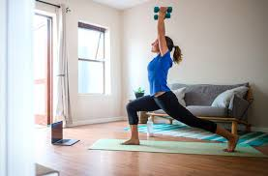
How often do you exercise

Slide 13
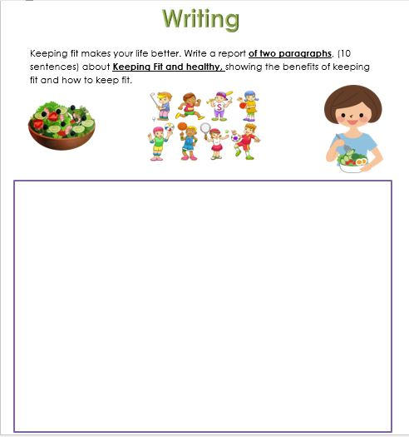
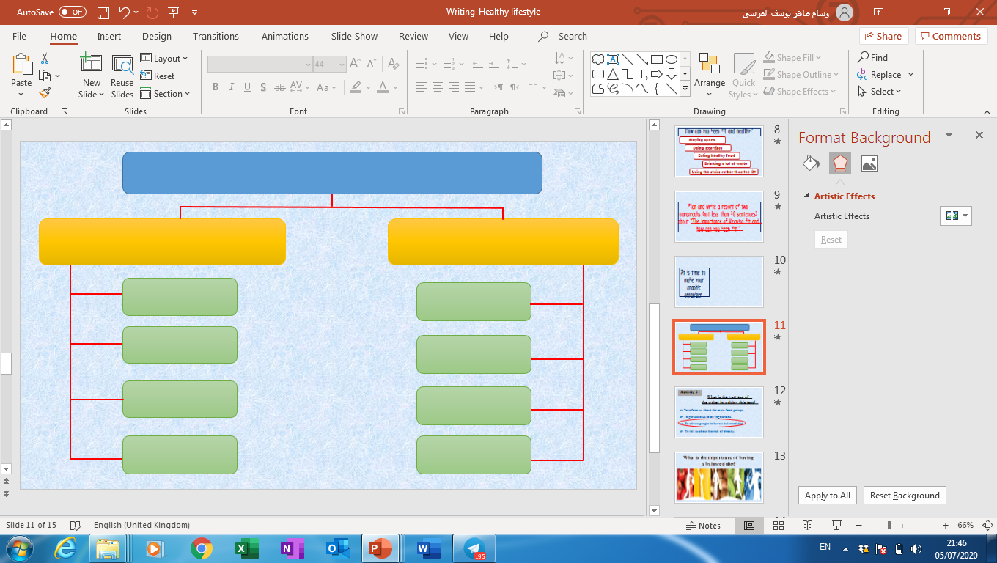
Planning
1
Title
2
Main ideas
1
2
2
Supporting ideas
3
3
3
3
3
3
3
3
3

Slide 14
My favorite sport
What I need to practice it
The importance of
Playing sports
Go to the gym
Fit
Equipment
Strong
Meet new friends
Study better
Live happily
Three times a week

Slide 15



Slide 16
My favorite sport
What I need to practice it
The importance of
Playing sports
Go to the gym
Fit
Equipment
Strong
Meet new friends
Study better
Live happily
Three times a week

Slide 17
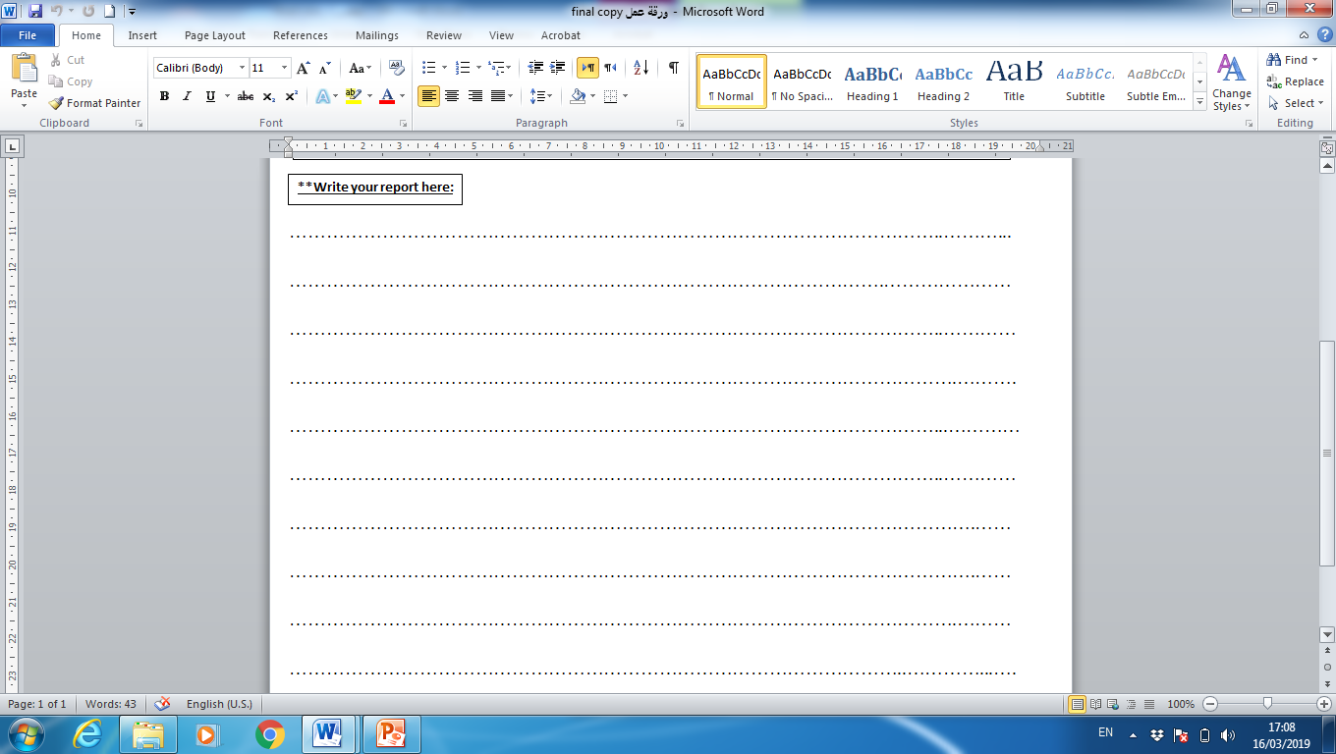


Slide 18
My favorite sport is _____ . I play my favorite sport at _____. To play my sport I need some
equipments like __________ . I sometimes like to play sports
with other people like _______ . I play sports _____ a week .

Slide 19
playing sports is very important . It helps me keep _____ . It also makes my body __________. I play sports because it also helps me study _____ . Playing sports makes me feel ________ .

Slide 20
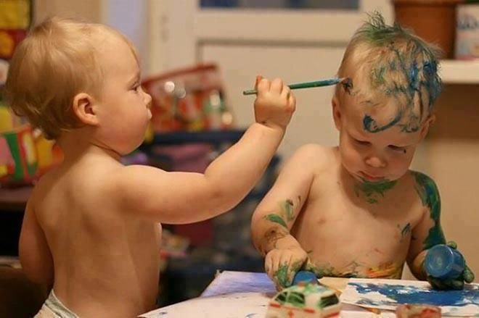
Look at the picture and choose
the best comment

Slide 21
Look at the picture and choose
the best comment
a- I am the best artist.
b- Green is my favorite color.
c- we are not twins any more.

Slide 22



Best ‘comment of the day’ winner

Slide 23
Goodbye

