Slide 1

Science in our life
Grade 6
Unit: 8
LESSON: 5
SB&WB

Slide 2
Give me a word that starts with the letter p .
petrol
put on
put off
purify
pipeline

Slide 3
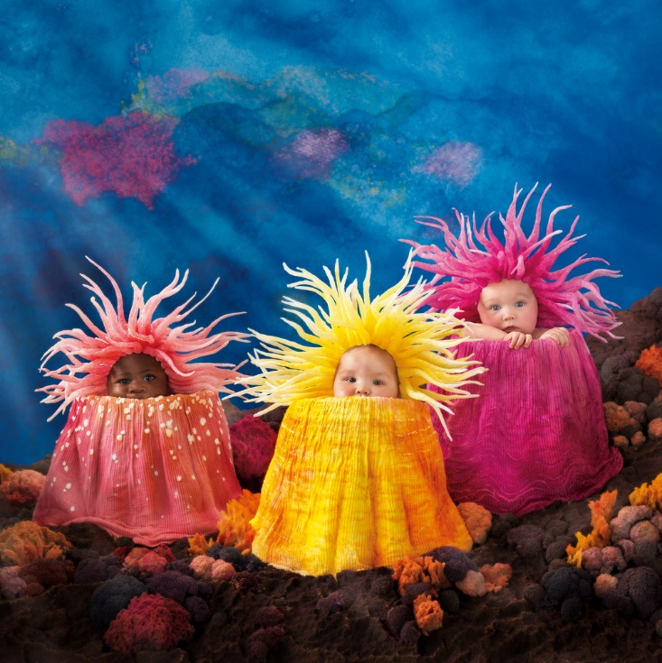
Student’s Book
Page 70

Slide 5

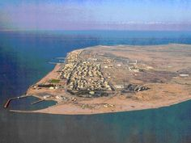
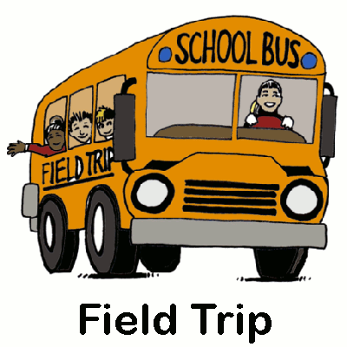

Slide 6

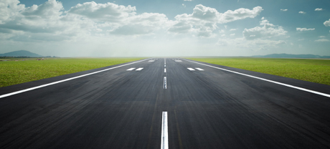
Read your answers.

Slide 7
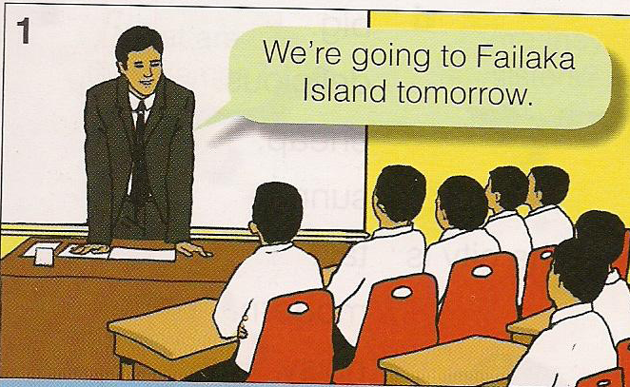
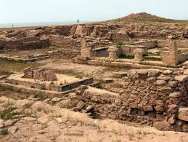
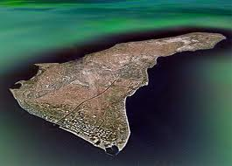
1. Where did the class go?
The class went to Failaka Island.

Slide 8
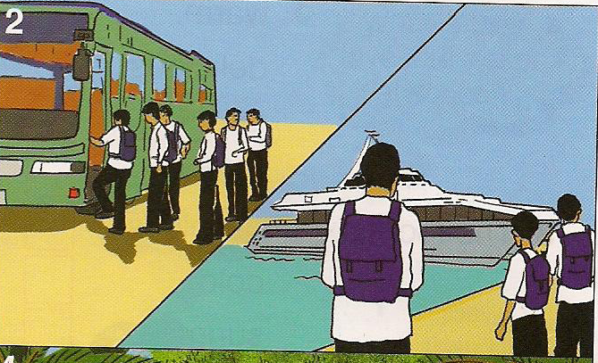
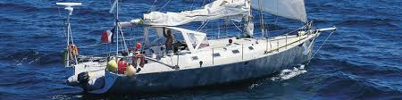
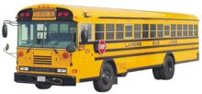
2. How did they get there?
They got there by boat.

Slide 9
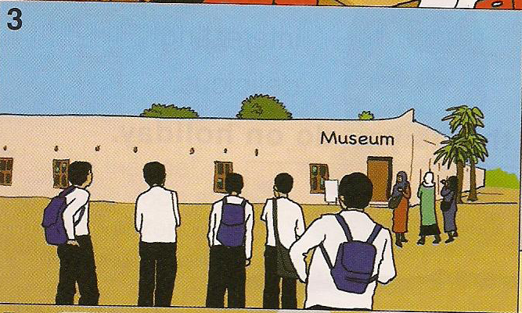
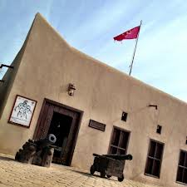
3. What did they do?
They visited the museum.

Slide 10
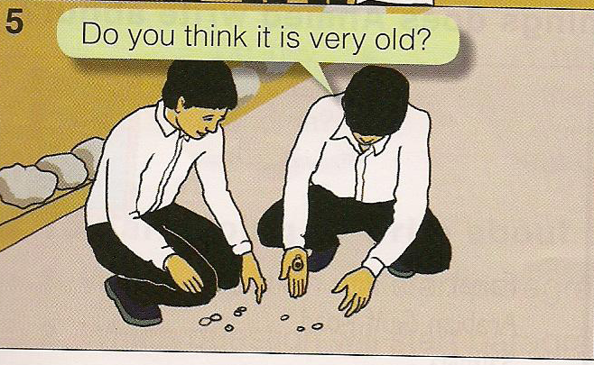
4. What did the boy find?
He found an earring.

Slide 11
6. What did he think it was?
He thought that it was old.

Slide 12
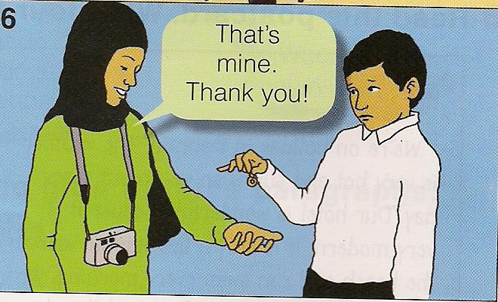
5. Who did it belong to?
It belonged to a woman.

Slide 13
6. How did the boy feel?
He was sad.

Slide 14
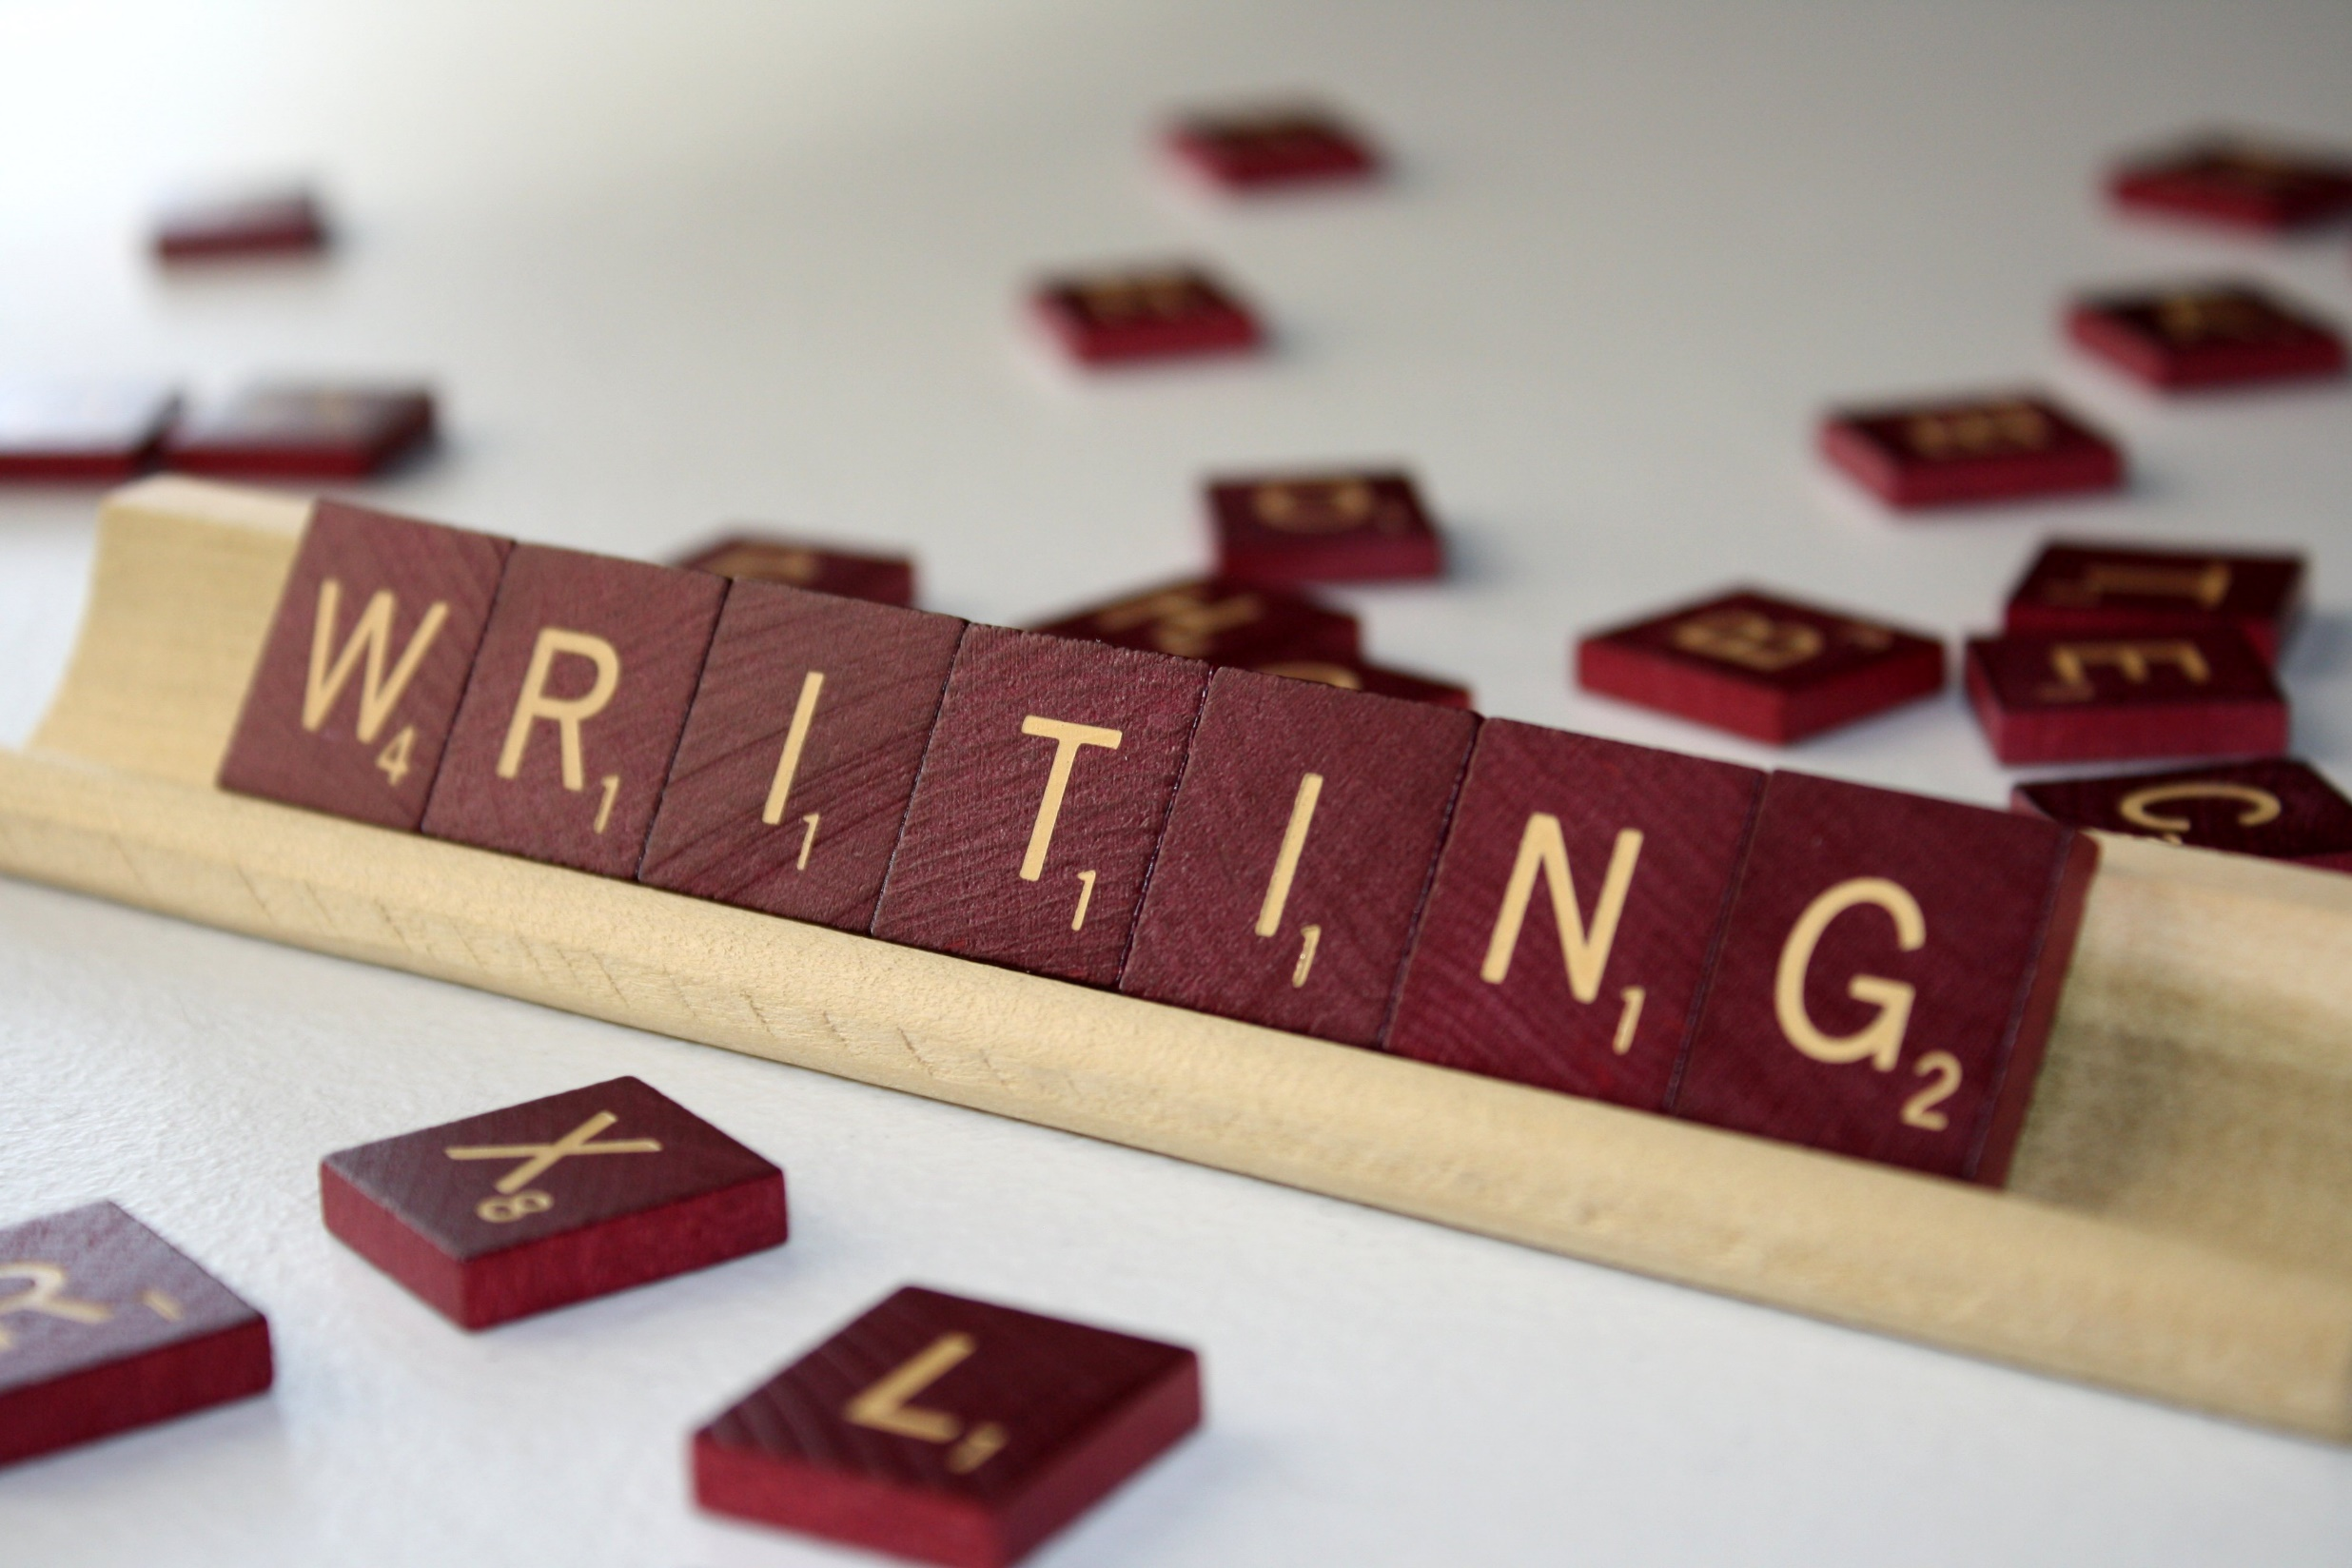
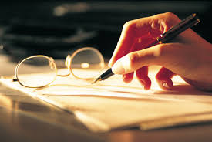


Slide 15
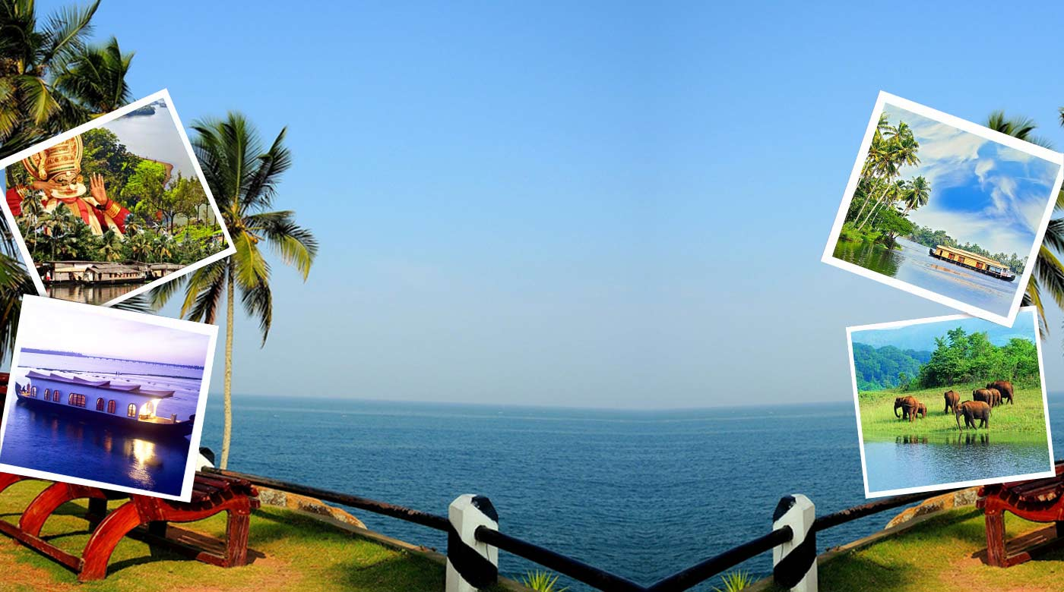

Slide 16

Read your paragraphs.

Slide 17

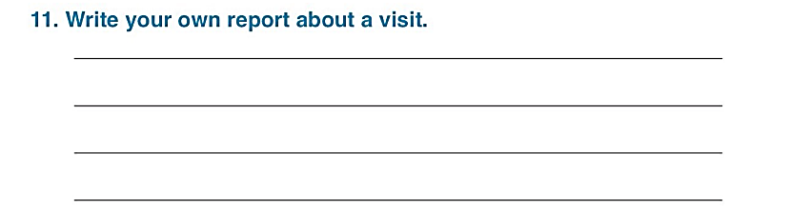
Workbook page 56

Slide 18

Read your reports!

Slide 19
Here is an example!
I like sea animals. Last weekend, I visited the Scientific Centre with my family. We went there by car. We saw whale , sharks, turtles and many kinds of fish in huge aquariums. Then, we went to the Imax and watched a fantastic film about animals. After that,we ate delicious meals in a restaurant. Finally, we drove back home. We enjoyed our visit a lot. I’d love to go there again.

Slide 20
I like playing games. I visited the Entertainment City with my family last weekend . We went there by car. We played many games. Next, I rode a white horse. Then, we went on scary rides. We watched fantastic boats sailing on a lake. After that, we ate delicious pizza in Pizza Hut restaurant. Finally, we drove back home. We enjoyed our visit very much. I’d love to go there again.
Here is another example!

Slide 21


