Slide 1
Science in our life
Grade 6
Unit: 8
Lesson: 1
SB

Slide 2
Unit: 8
Lesson: 1
in our life

Slide 3
Who
Am I ?

Slide 4
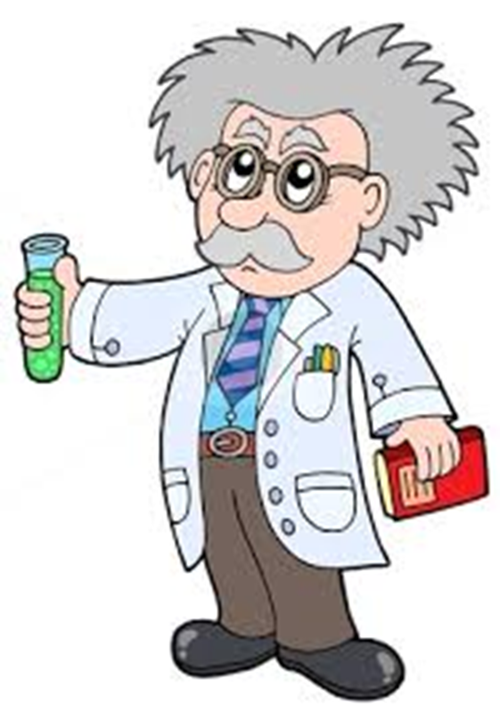
I am the ........
scientist

Slide 5
What does a scientist do?
Ask questions
Invent things
Use tools
Research
Collect data
Collect data
Explore
Observe

Slide 6
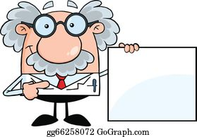
How does he help us ?
He invents things to make our life easier and more comfortable.

Slide 7
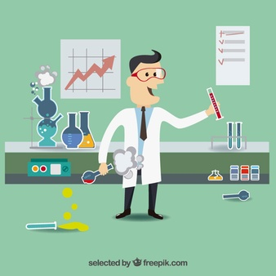
Where does a scientist work?
At
the
Laboratory

Slide 8
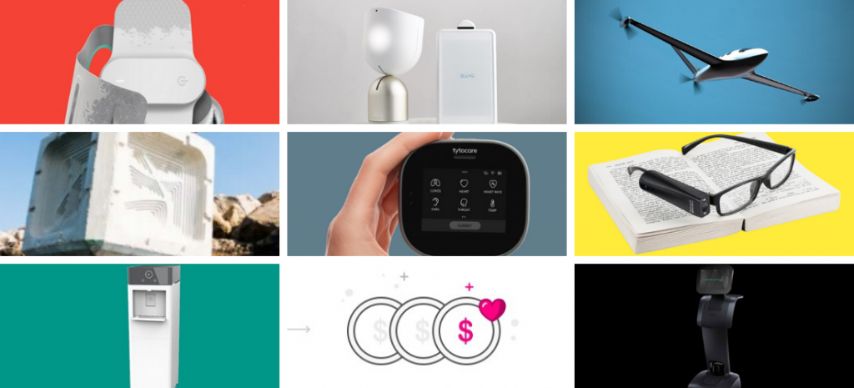
Name some inventions.

Slide 9
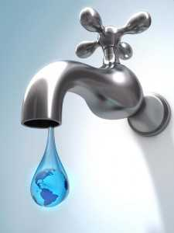
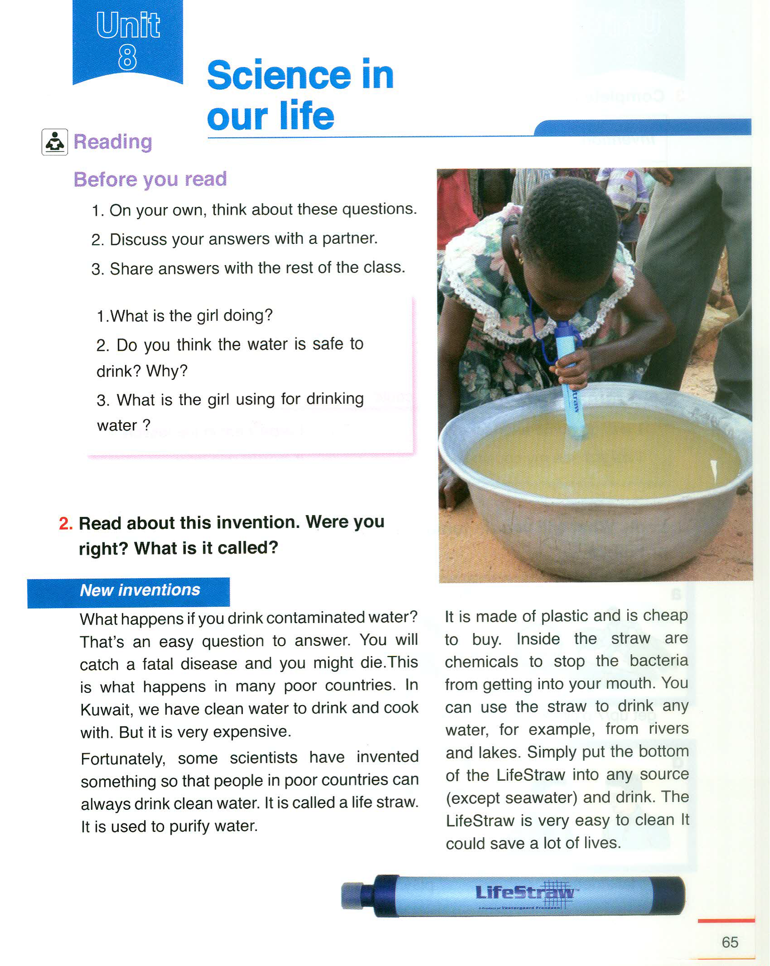
Student’s Book
Page 65

Slide 10
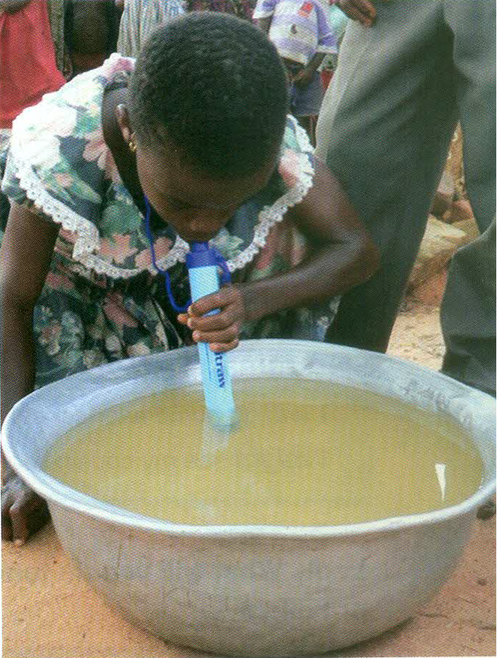
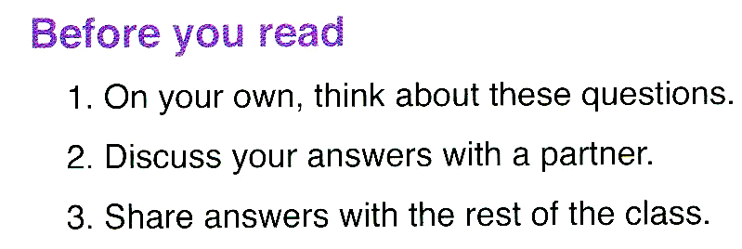

Slide 11
1- What is the girl doing?

Slide 12
2- Do you think this water is safe to drink? Why?

Slide 13
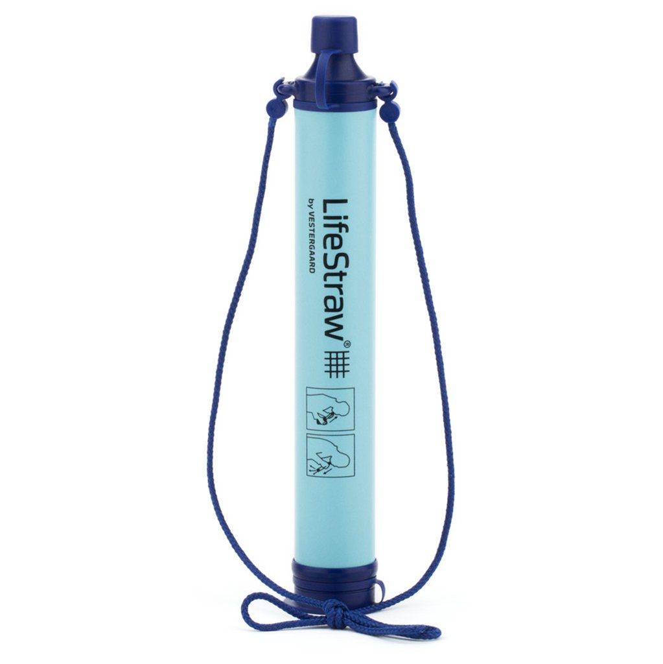
3-What is the girl using for drinking water?

Slide 14
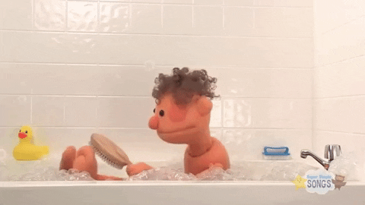
Mention different uses for water
Showering

Slide 15
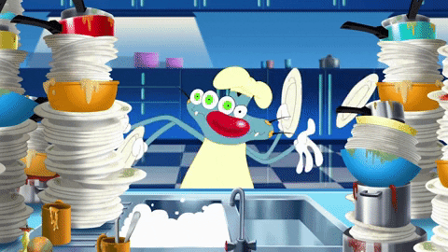
washing dishes

Slide 16
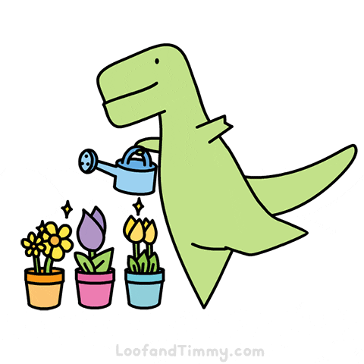
Watering plants

Slide 17
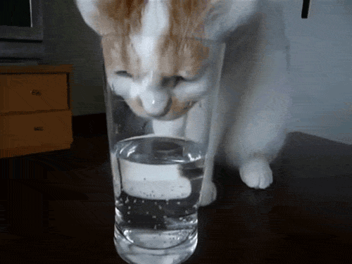
Drinking water

Slide 18
What are the sources of water?

Slide 19
source (n)
a point of origin.
In Kuwait, the sea is the main source of water.

Slide 20
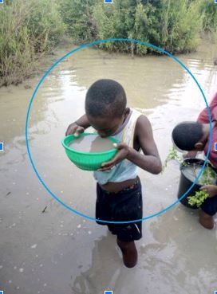
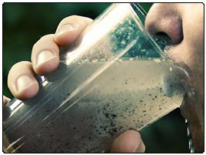
What could happen if you drink contaminated water?

Slide 21
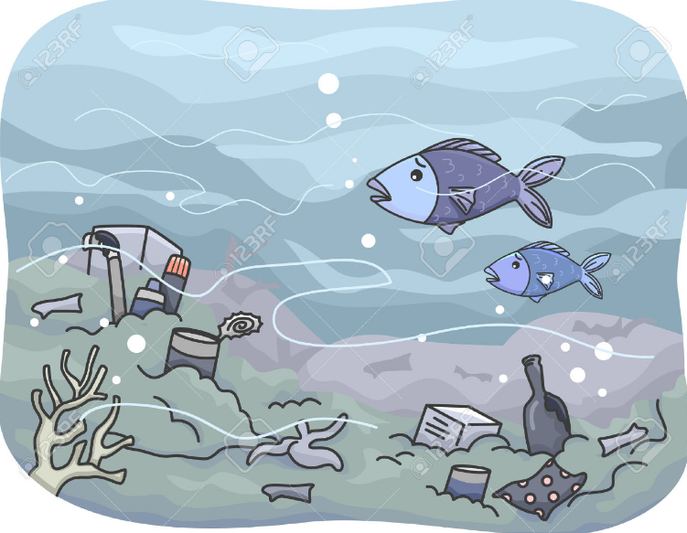
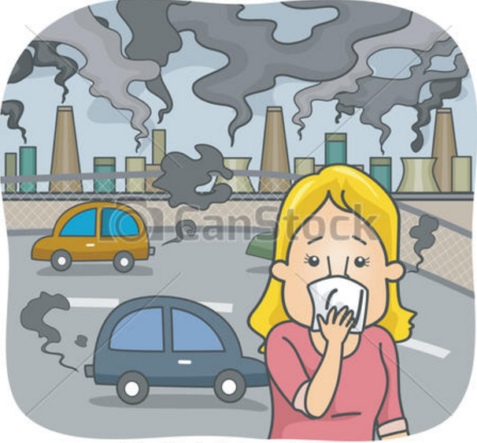
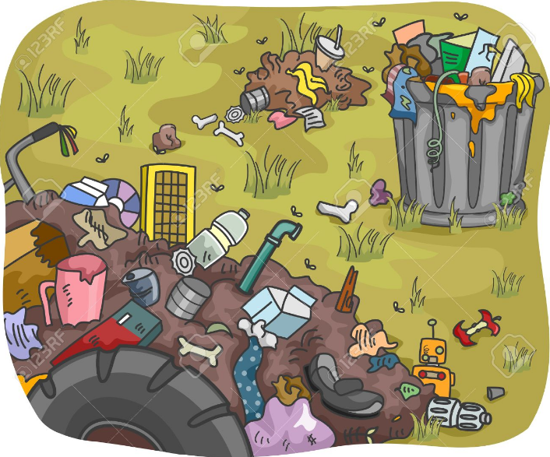
contaminated (adj)
to make something less pure or make it poisonous.
Contaminated sea water kills fish and other sea animals.

Slide 22
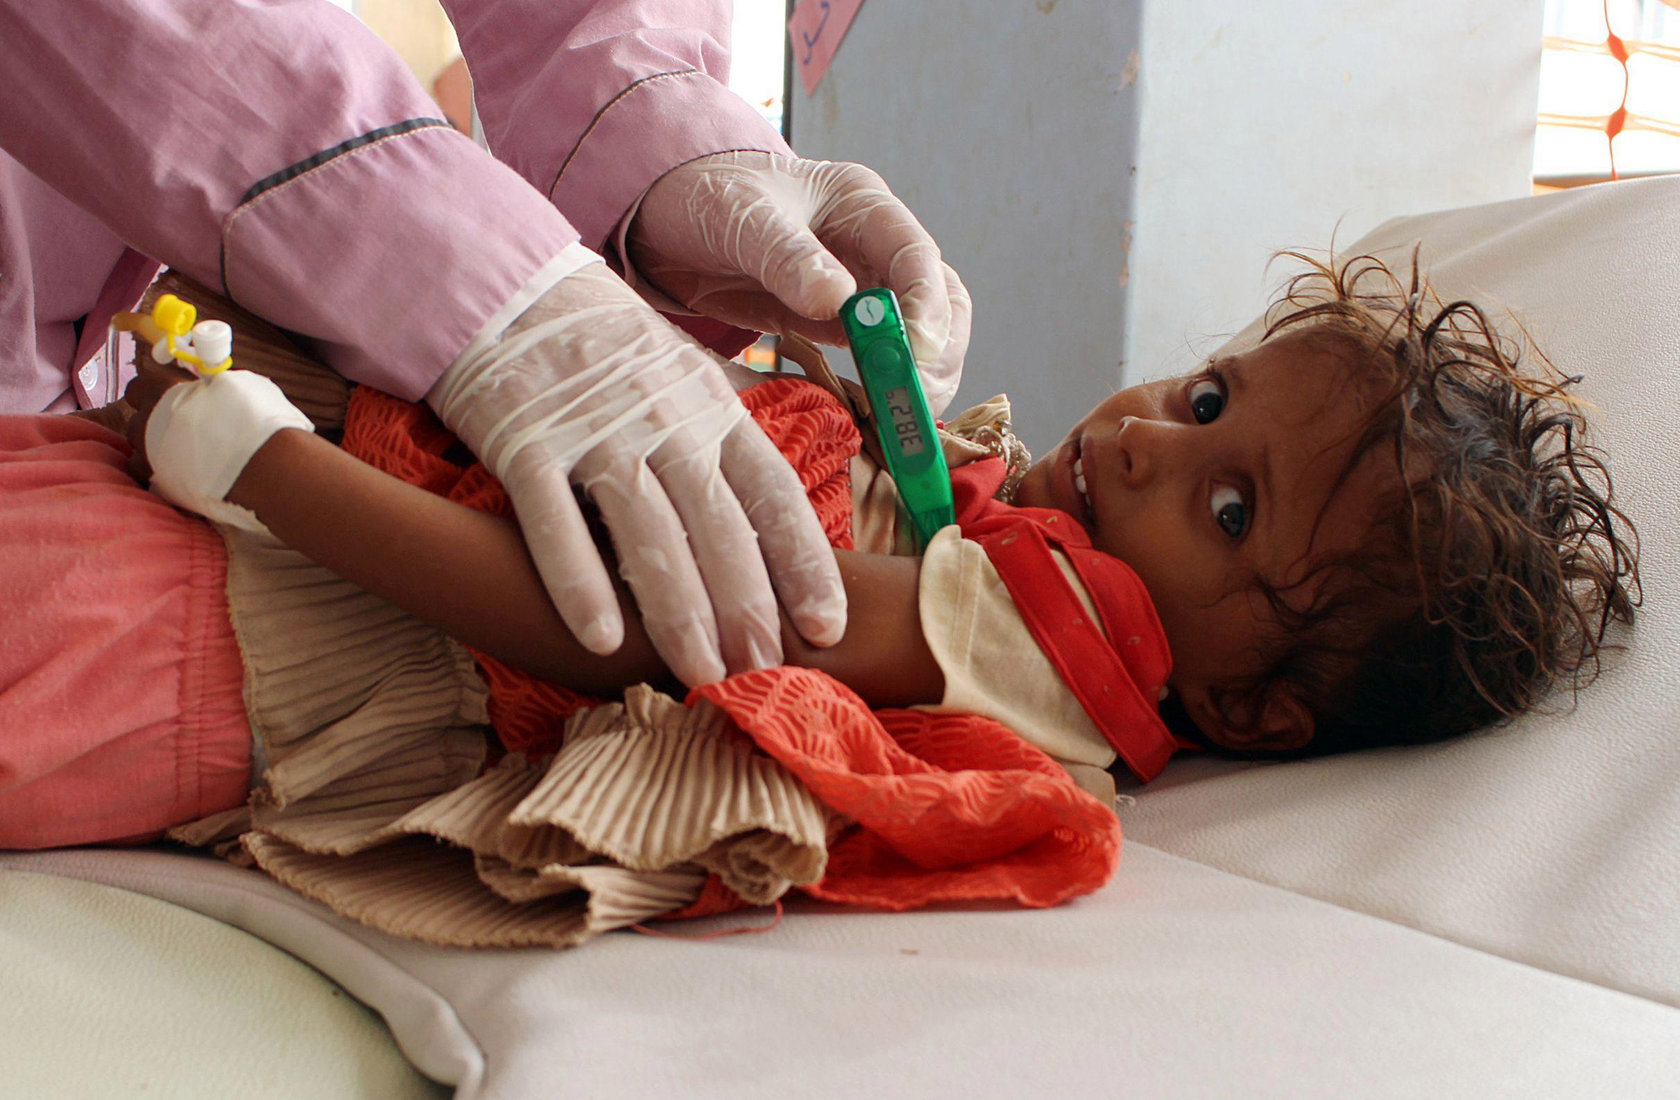
It could cause a fatal disease.

Slide 23
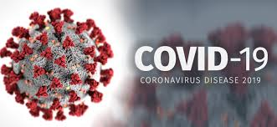
fatal (adj)
causing death
Covid-19 is a fatal disease.

Slide 24
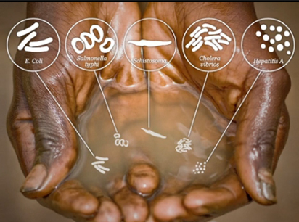
because it is full of bacteria.

Slide 25
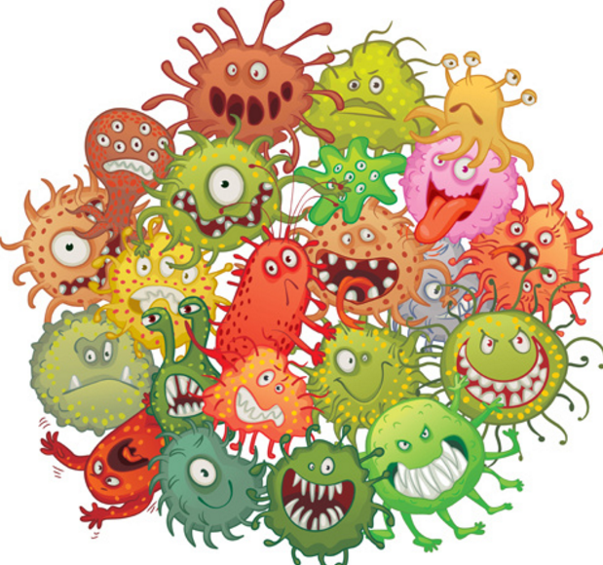
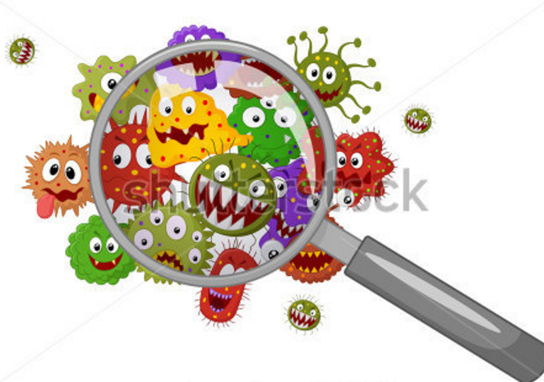
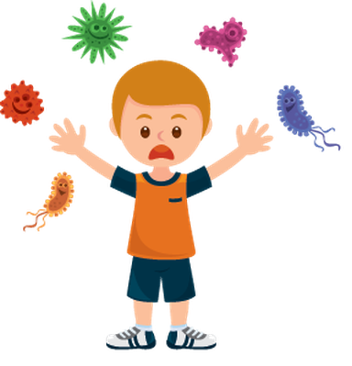
bacteria (n)
Bacteria are tiny little organisms that are everywhere around us.
Some bacteria are dangerous while others are useful.

Slide 26
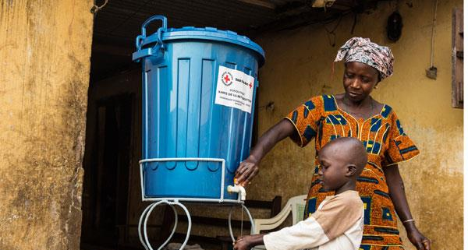
How can we help poor countries to get clean water?

Slide 27
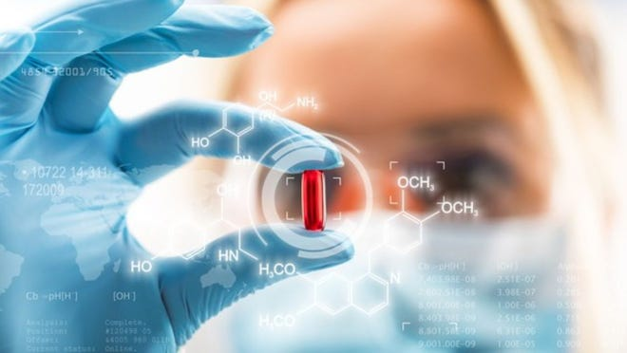
Fortunately, scientists can help poor countries.

Slide 28
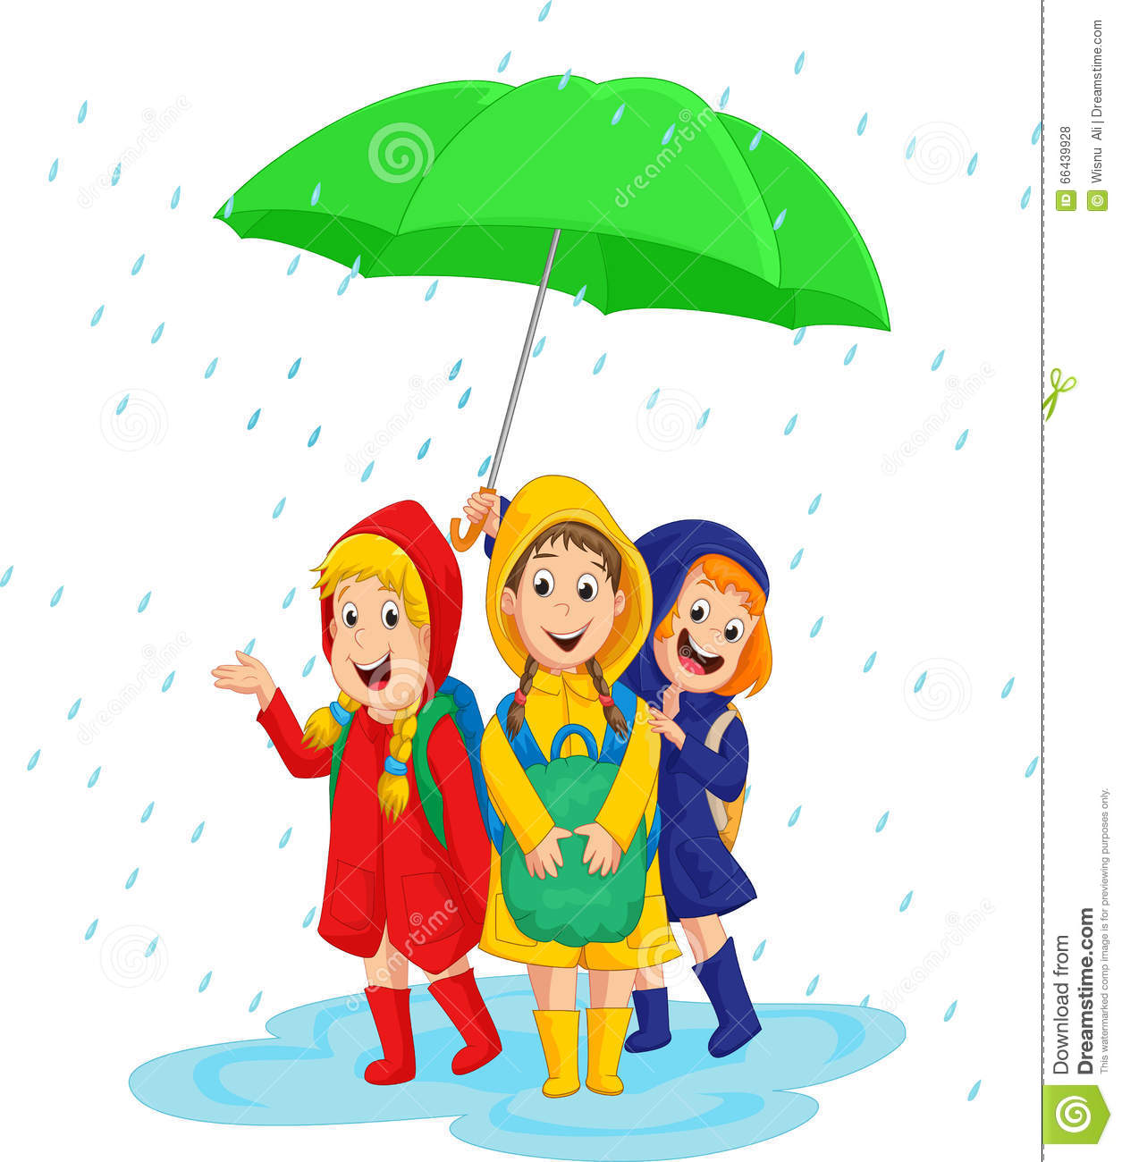
fortunately (adv)
happening because of good luck.
It was raining but fortunately, we got an umbrella.

Slide 29
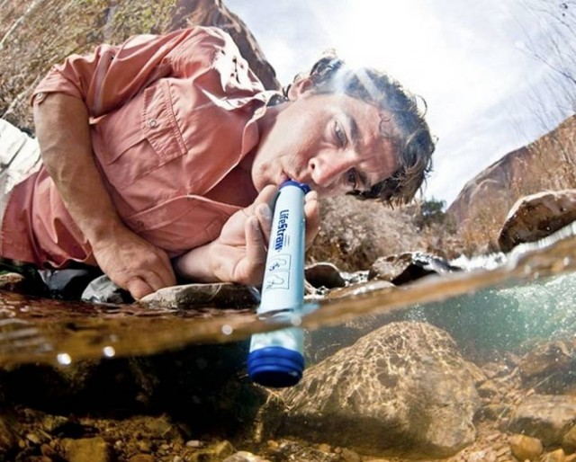
Scientists invented the life straw to help them drink clean water.

Slide 30
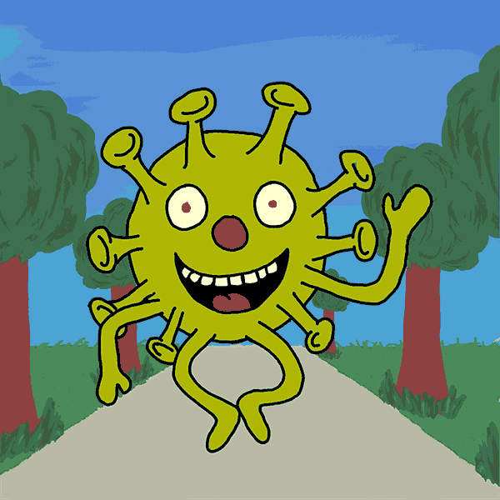
invent (v)
to design and/or create something that has never been made before.
Scientists work hard to invent a cure fo Corona Virus.

Slide 31
This invention is called the
Life straw

Slide 32
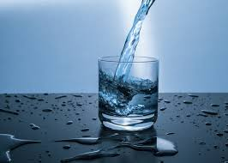
The life straw helps to purify the dirty water and makes it clean.

Slide 33
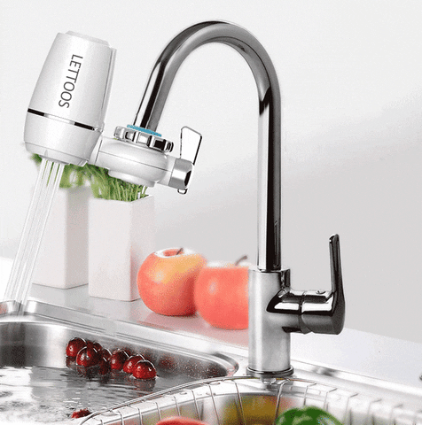
purify (v)
to make something clean from anythig that pollutes or contaminates.
People use water filters to purify dirty water.

Slide 34
How can life straw purify dirty water?

Slide 35
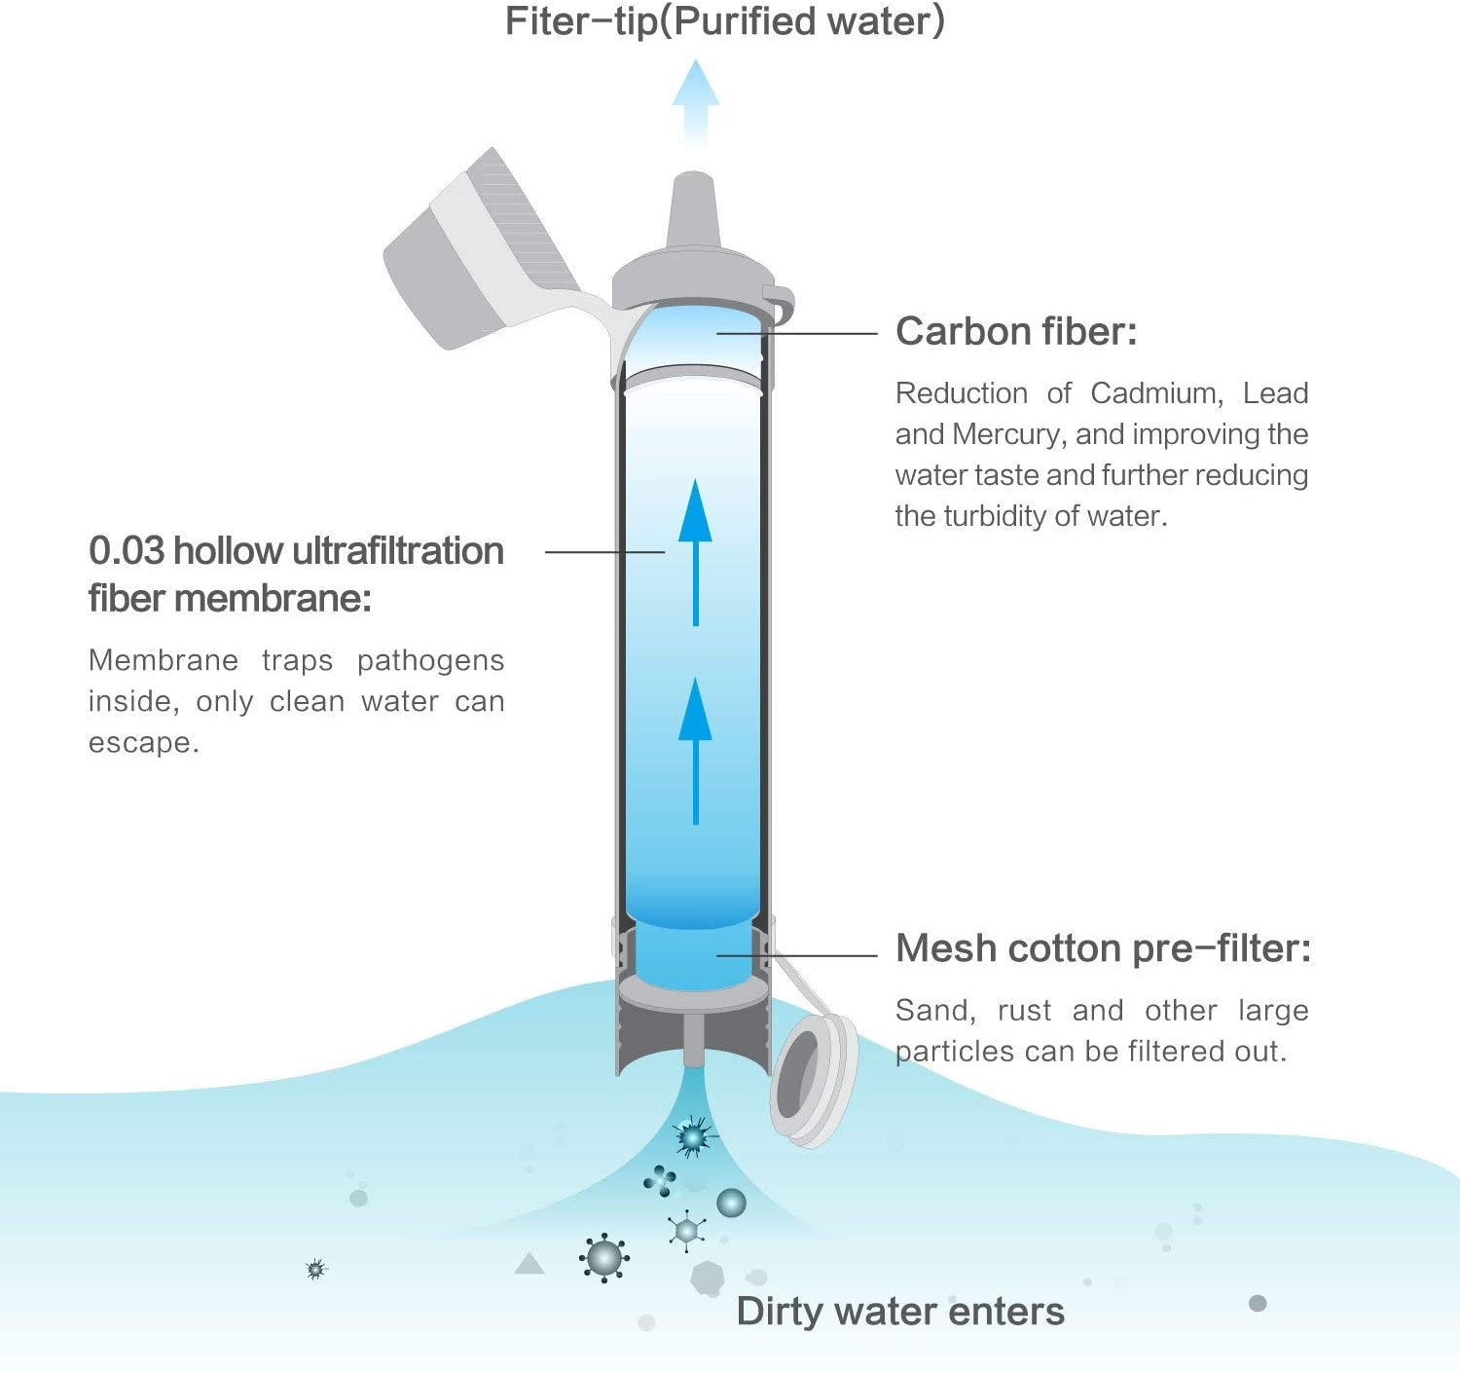
There are chemicals inside Life Straw which kill bacteria in dirty water.

Slide 36
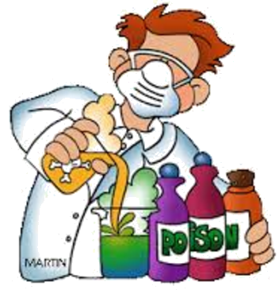
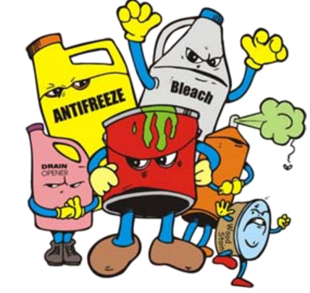
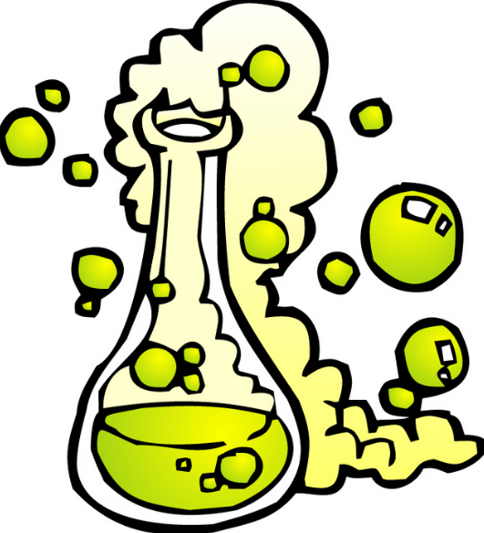
chemicals (n)
Relating to chemistry, or the interactions of substances as studied in chemistry.
Always keep chemicals away from children.

Slide 37
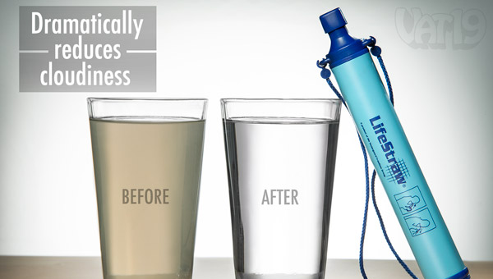
By the lifestraw you can simply drink from any source of water.

Slide 38
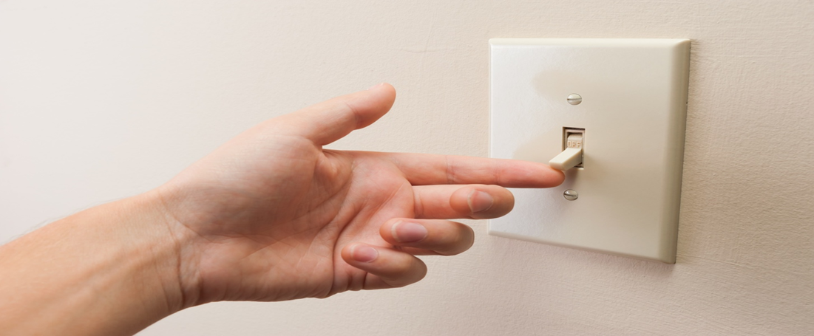
simply (adj)
in a simple manner; without difficulty.
To light the room, simply lift this up.

Slide 39
New vocabulary:
(n)
(adj)
(n)
(adj)
(adv)
(adj)
(v)
(v)
(n)

Slide 40
Fill the spaces with words from the list:
invent - cure - source - fortunately - simply
1- Water is an important ....................... of energy.
2- Scientists work hard to find ..................... for covid-19 virus.
3- I missed the bus but ...................... I arrived early.
4- Scientists ..................... many useful machines that makes our life easier.

Slide 41
Pre-reading questions:
What happens if you drink contaminated water?
How can life-straw purify dirty water?

Slide 42
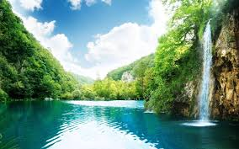

Slide 43
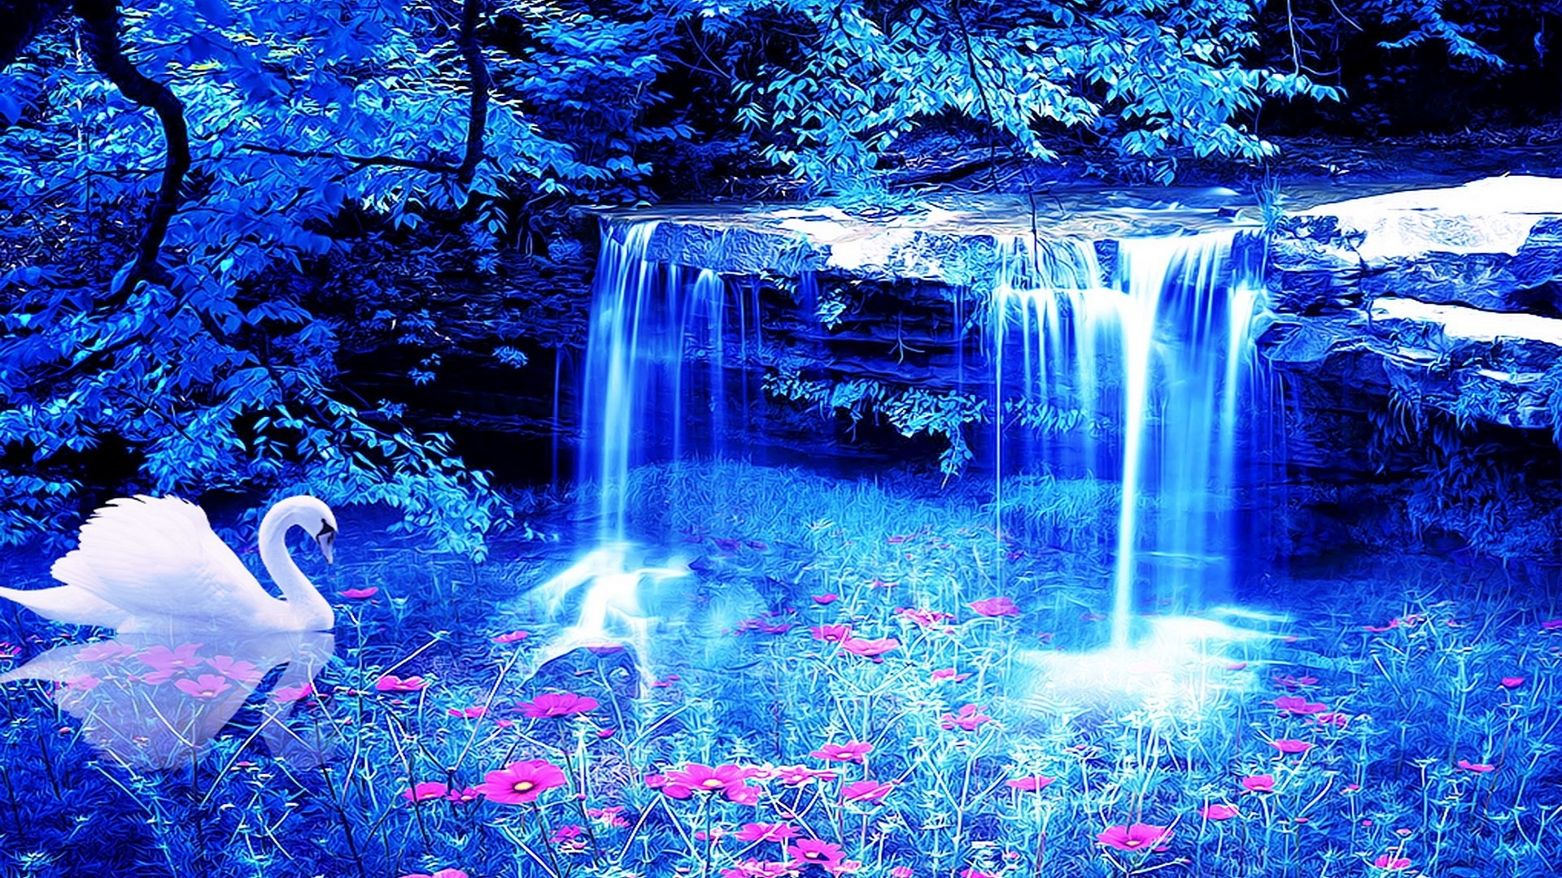
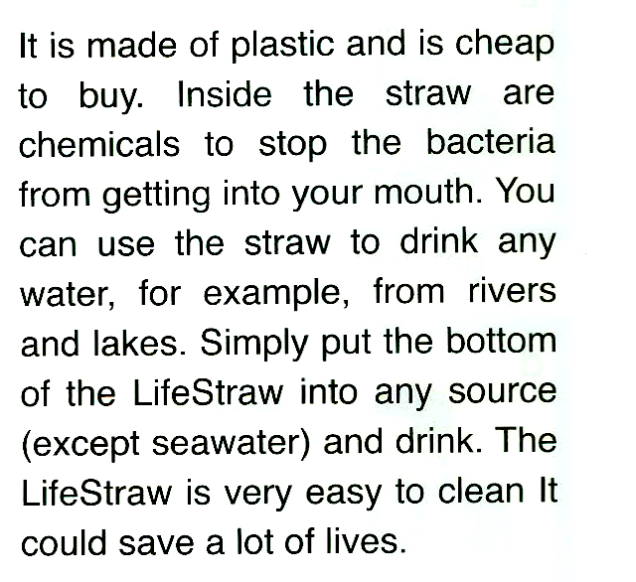

Slide 44
LifeStraw
It’s made of plastic and has chemicals
It’s used for purifying water
Science makes our life easy ,fast and comfortable .

Slide 45
Closure

Slide 46
Raise your card !
1- Ask the question.
2- Give 3 seconds to think.
3- Raise your card when you hear the word (raise it)!

Slide 47
Raise your card !
The life straw is made from
Wood
Plastic

Slide 48
Raise your card !
Contaminated water means:
Dirty water
Clean water

Slide 49
Raise your card !
The life straw is :
Expensive
Cheap

Slide 50
Raise your card !
What stops the bacteria from getting into your mouth when using the life straw?
Chemicals
The straw

