Slide 1

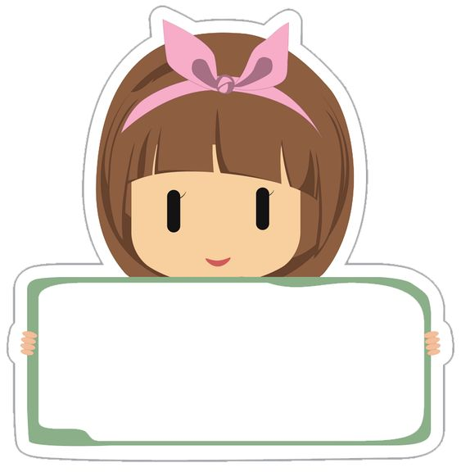
Class: 6-4
Monday,
15th October,2023
Unit: 3
Step: 1
A Local Television Programme

Slide 2
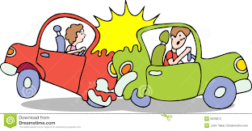
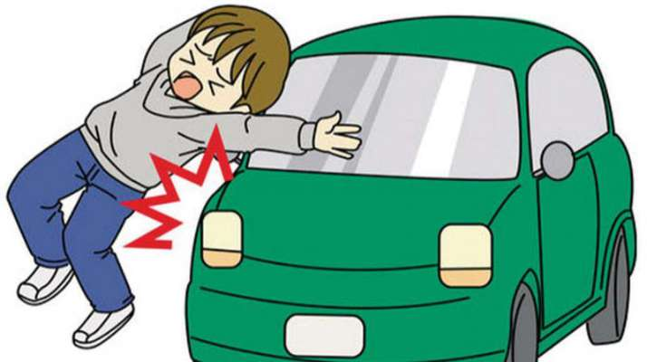

Slide 3
Why do people make car accidents?.

Slide 4

Student’s Book
Page 29

Slide 5


Slide 6
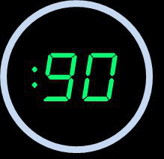
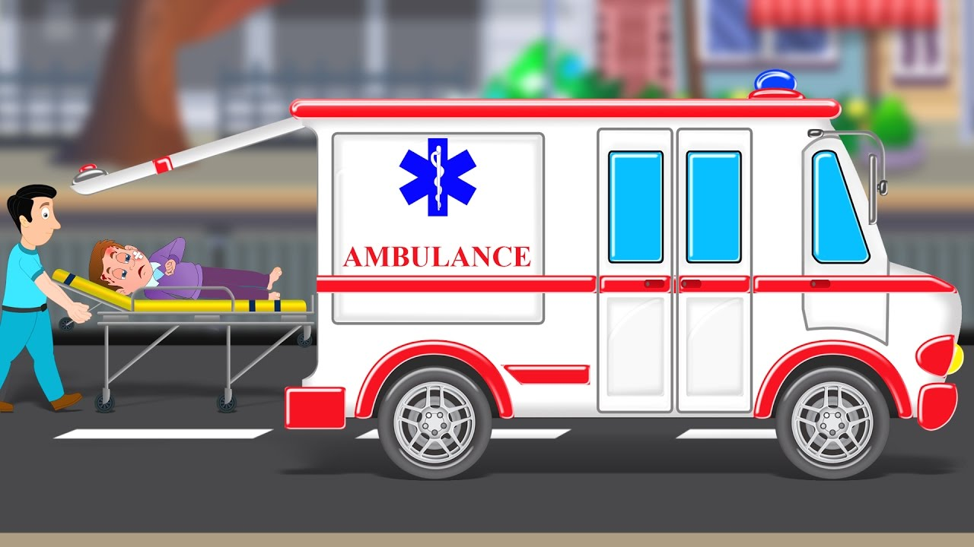


Slide 7
1. What can you see in the picture?

Slide 8
2. What has happened?

Slide 9
3. What will happen?

Slide 10

Do you like watching movies?

Slide 11
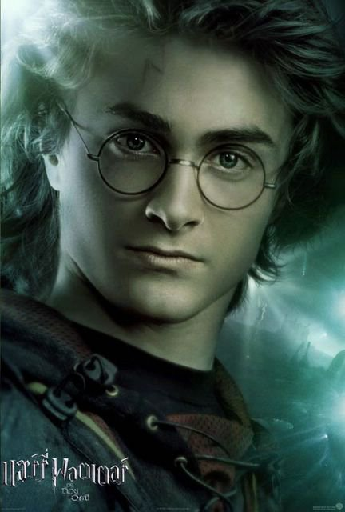
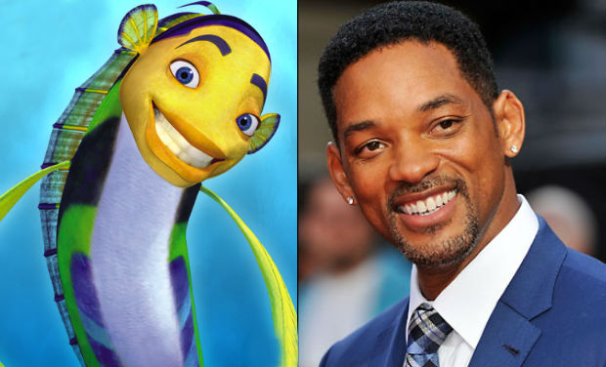
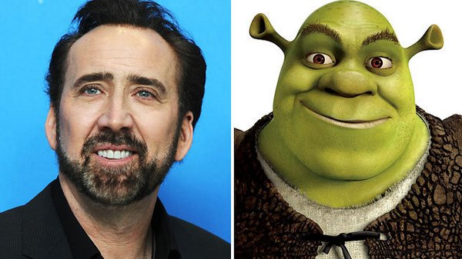
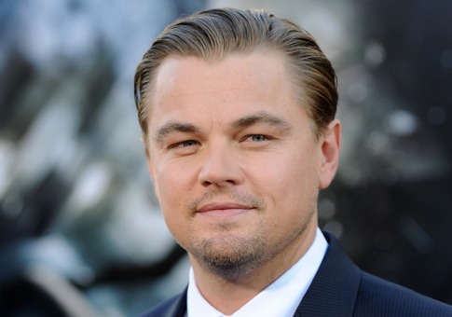
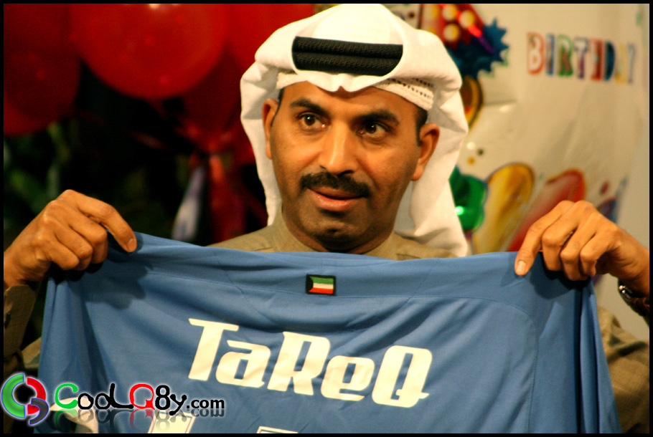
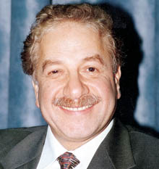
Who is your best actor?

Slide 12


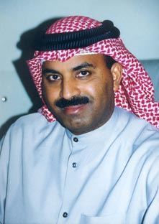
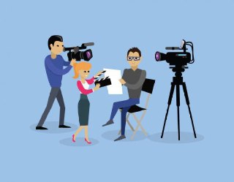

actor

Slide 13
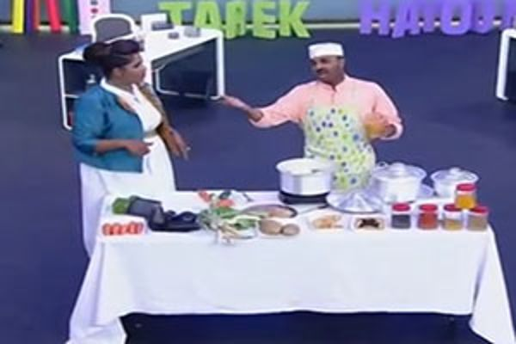
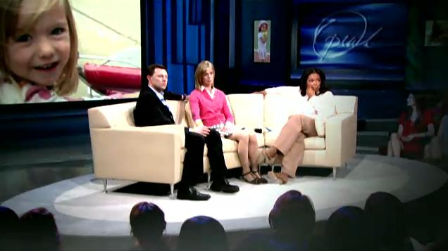
What is your best programme?
programme

Slide 14
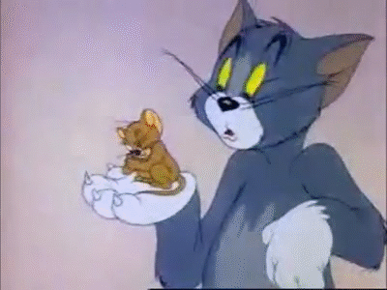
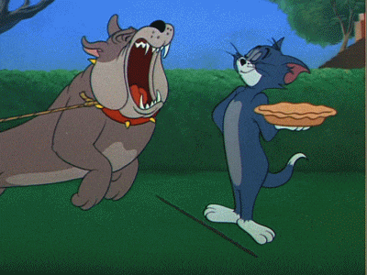
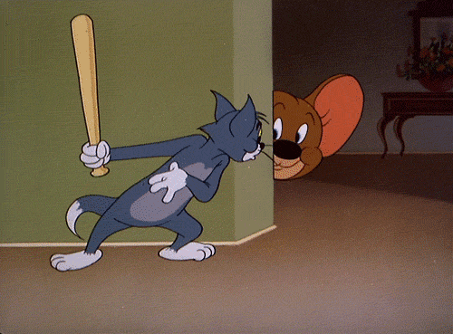
Tom and Jerry is a funny cartoon.
It has many episodes.
episode
Episode 2
Episode 1
Episode 3

Slide 15
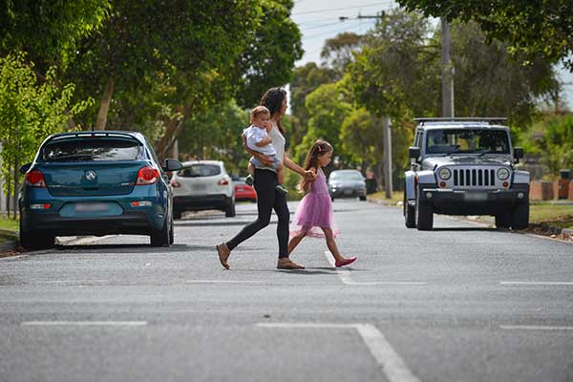

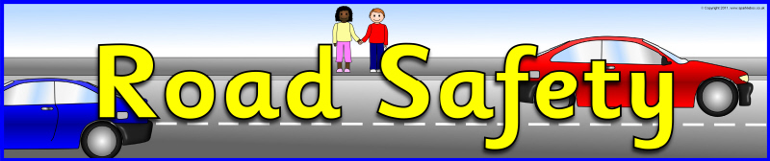
Actors are going to act in a programme called Road Safety.

Slide 16
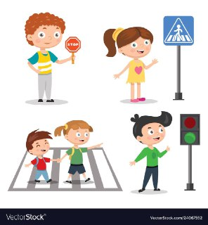

Slide 17
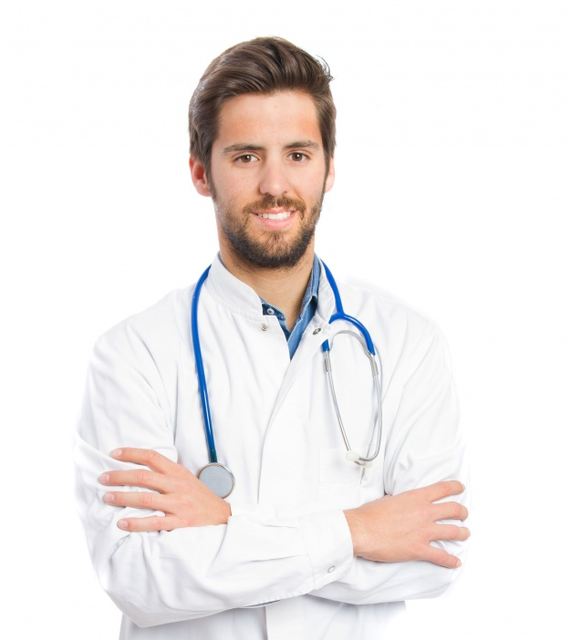

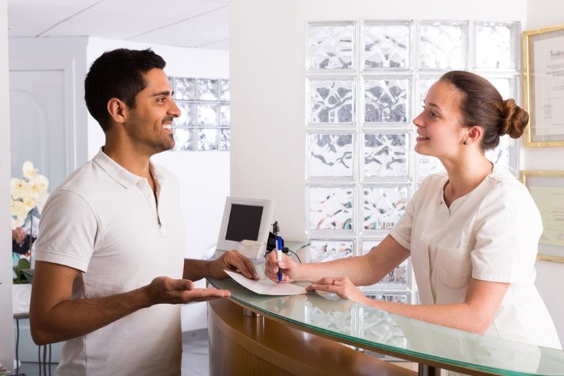
The main actors are:
the doctor
the nurse
and
the receptionist.

Slide 18
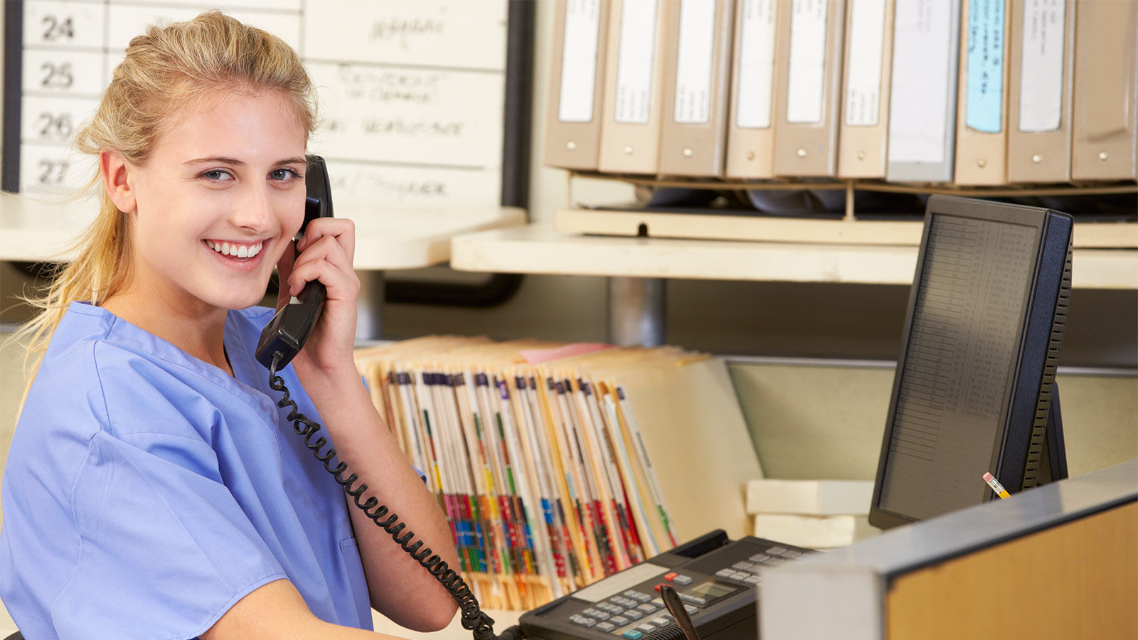
receptionist

Slide 19

Episode 1

Slide 20
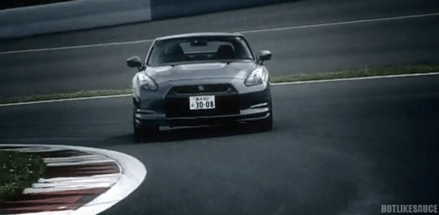
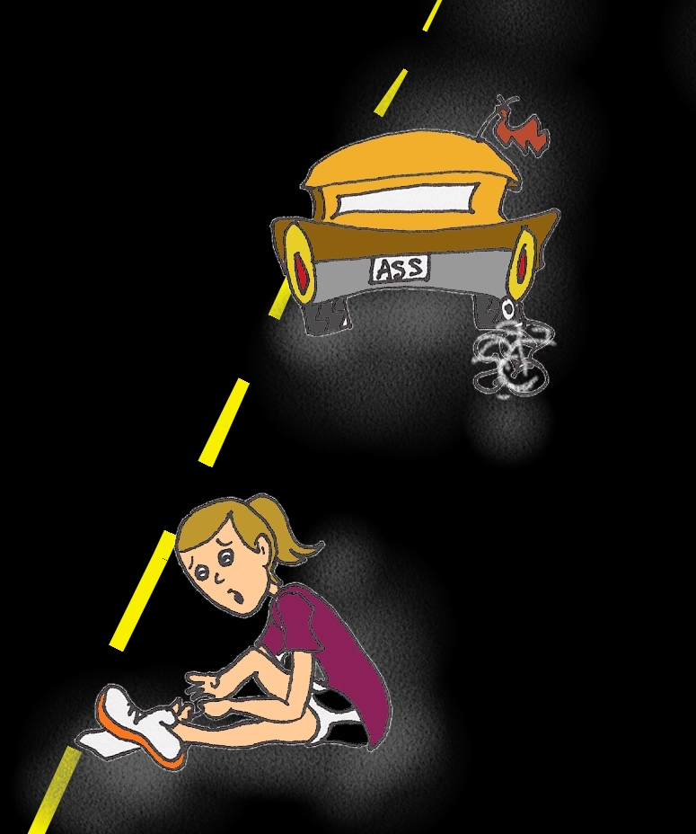
A driver who was driving very fast had an accident.
He hit a little girl.

Slide 21
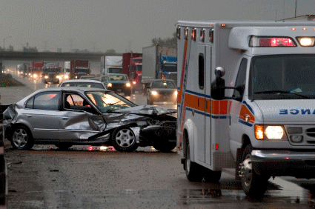
An ambulance took the girl to hospital.

Slide 22
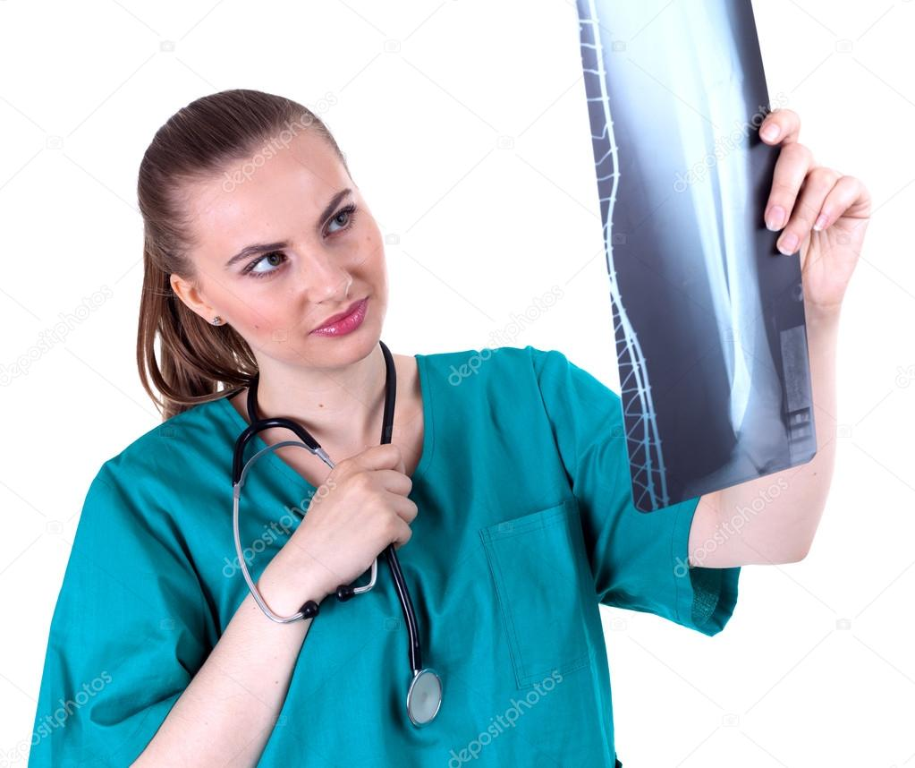
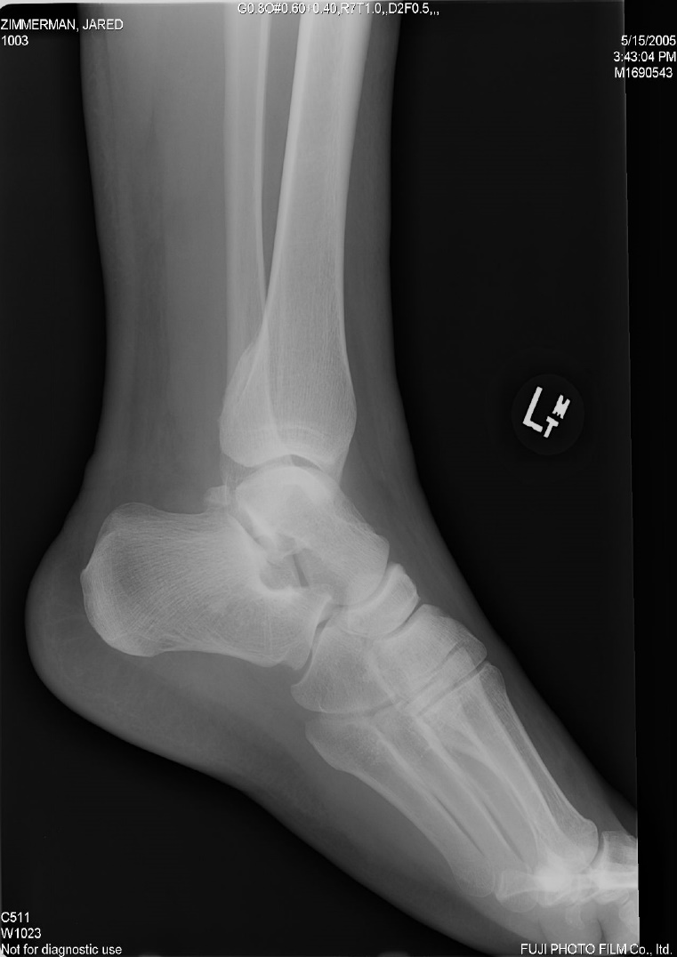
The doctor x-rayed her leg.
x-ray

Slide 23
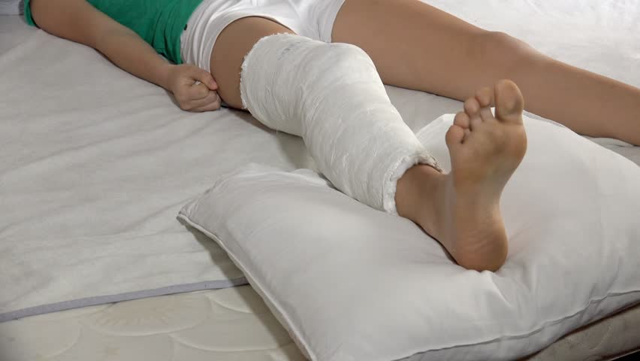
The girl’s leg was broken.
broken

Slide 24
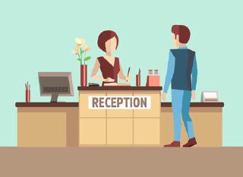
Sun, 15/10/2023
Lesson: 1
Unit: 3
actor
…………..
……….….
safety
….…...
…….….
receptionist
………..…...
………….….

Slide 25
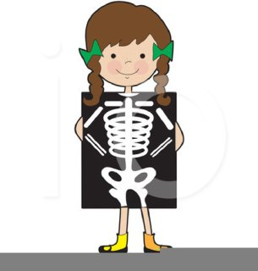
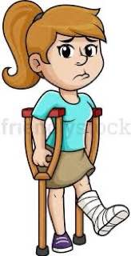
Sun, 15/10/2023
Lesson: 1
Unit: 3
episode
…………..
……….….
X-ray
….…...
…….….
broken
………..…...
………….….

Slide 26
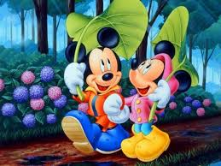
Student’s Book
Page 29

Slide 27
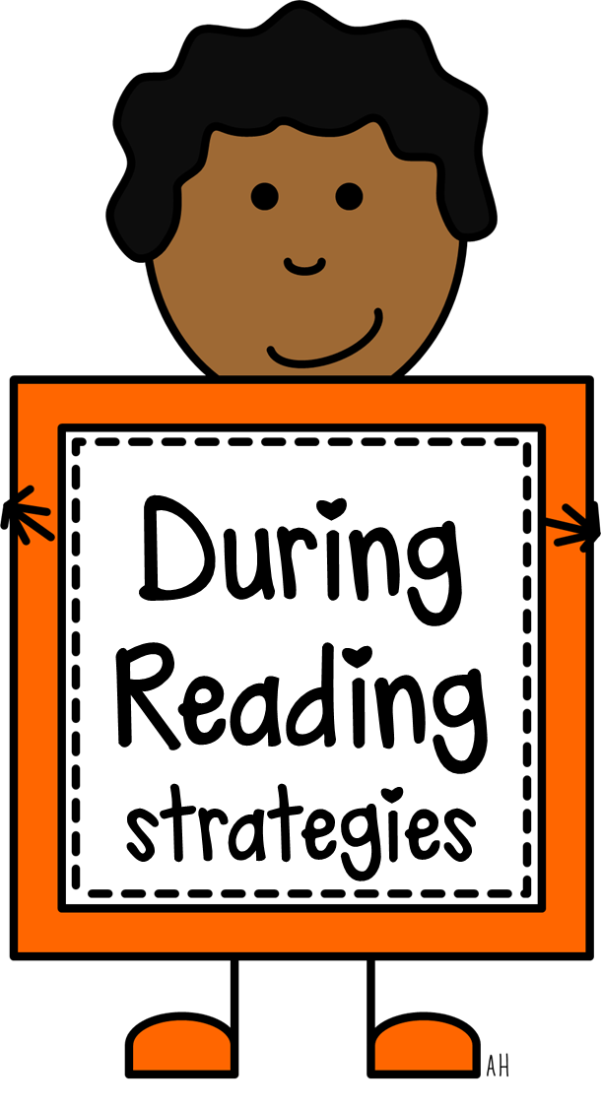

Slide 28
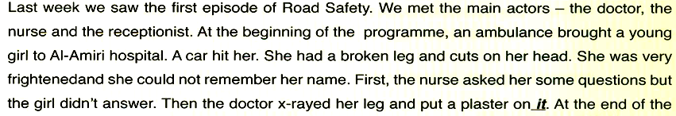

Slide 29
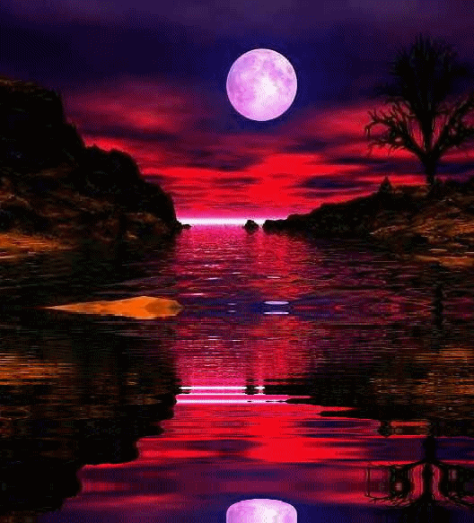

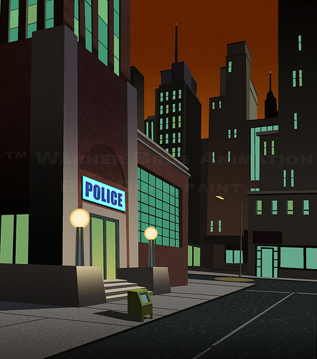
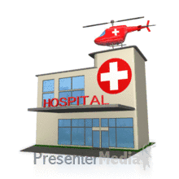
Read the text and answer this question.
Where is the television programme?
1 In a school
2 In a police station
3 In a hospital

Slide 30


Slide 31

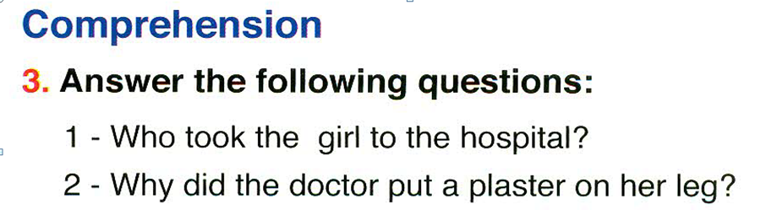

Slide 33
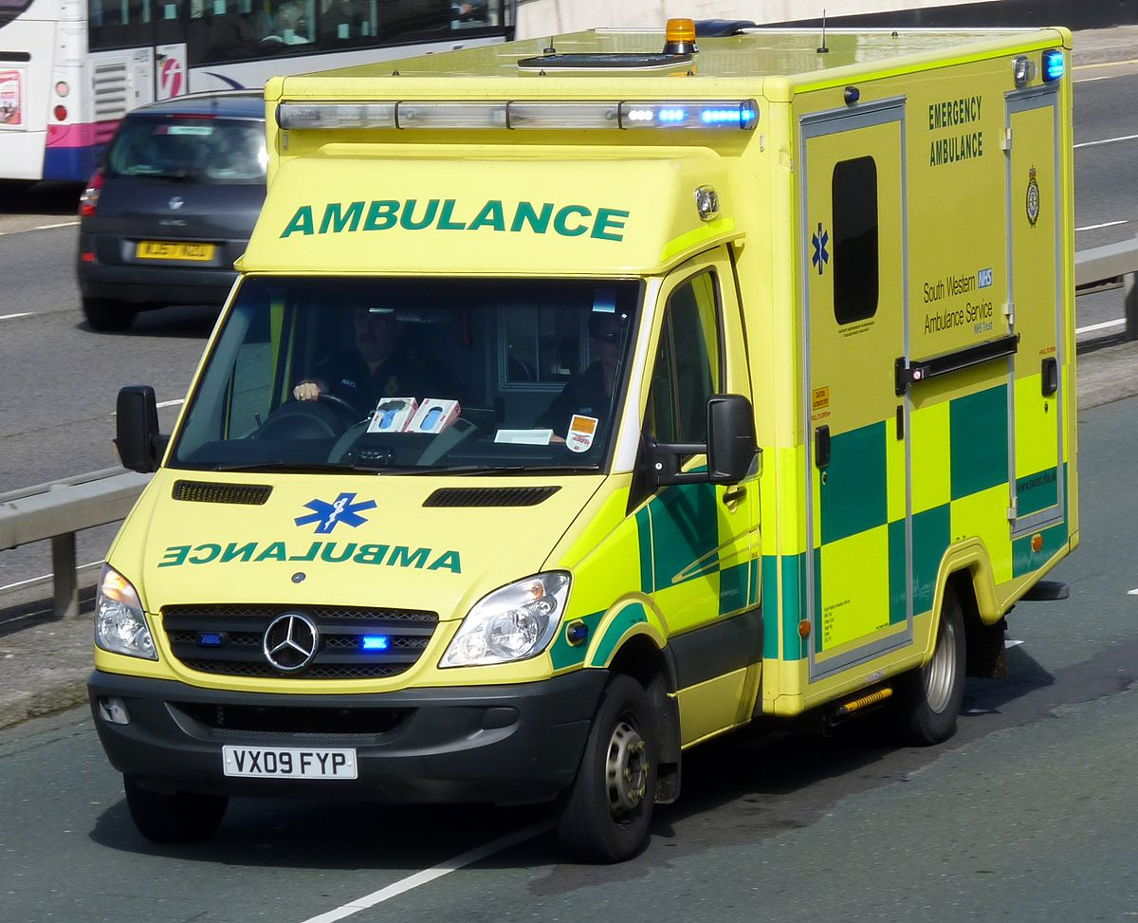
1- Who took the girl to the hospital?
The ambulance took the girl to the hospital.

Slide 34
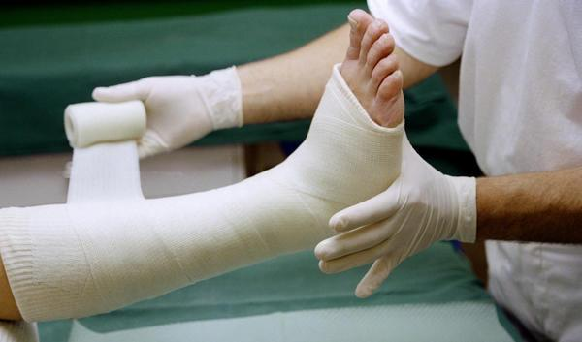
2- Why did the doctor put a plaster on her leg?
It was broken.

Slide 35
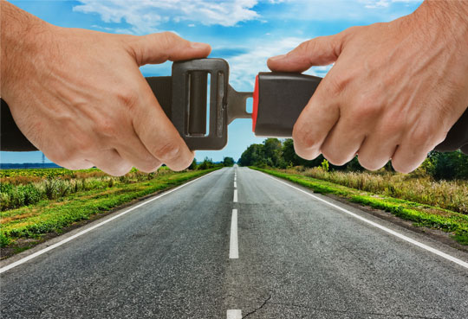
Closure

Slide 36
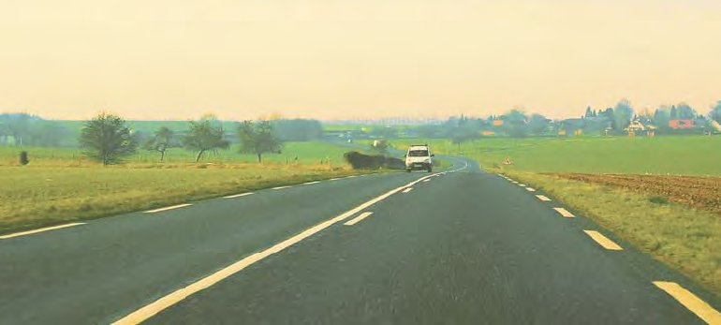
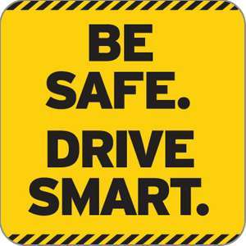
Keep your eyes on the road.
Never use your mobile phone.
Follow speed limits.
Follow traffic rules.
Don’t speed while driving.

