Slide 1
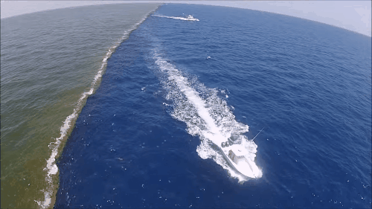
Unit 11
A Beautiful Country

Slide 2
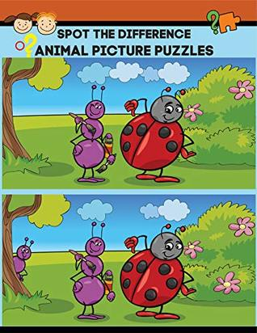

Slide 3
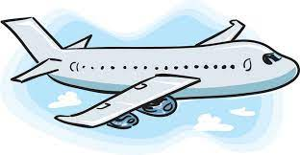
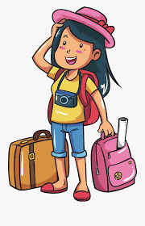
Do you like travelling?
Where do you like to travel?

Slide 4
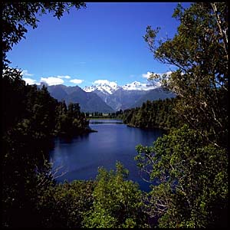
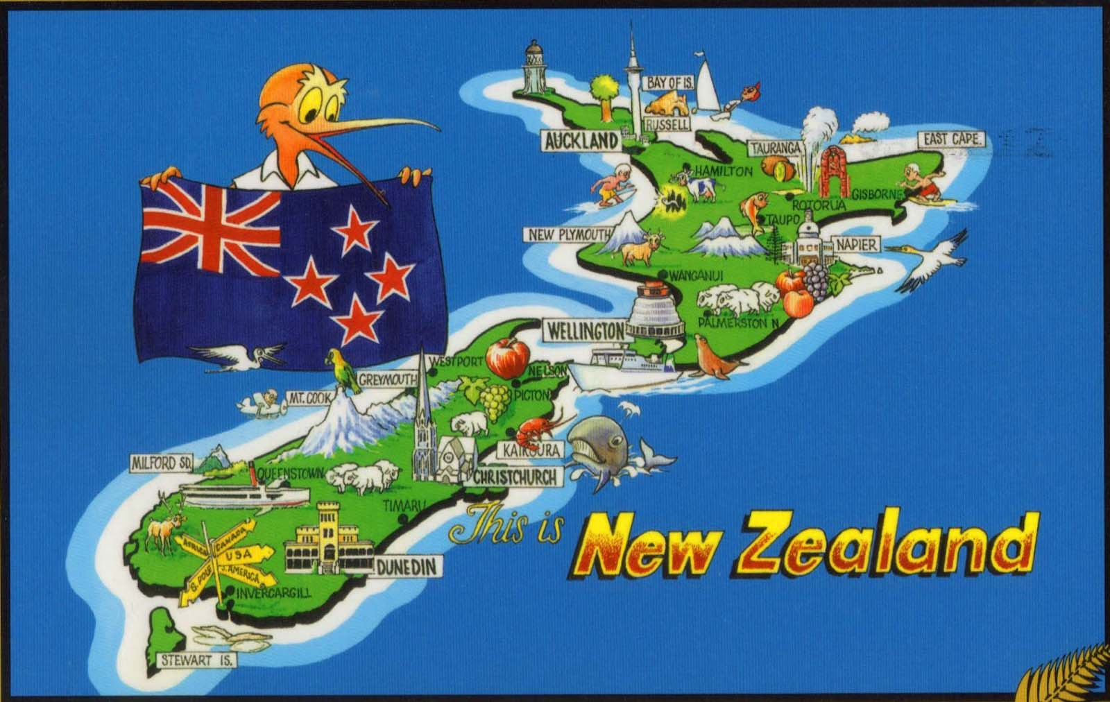
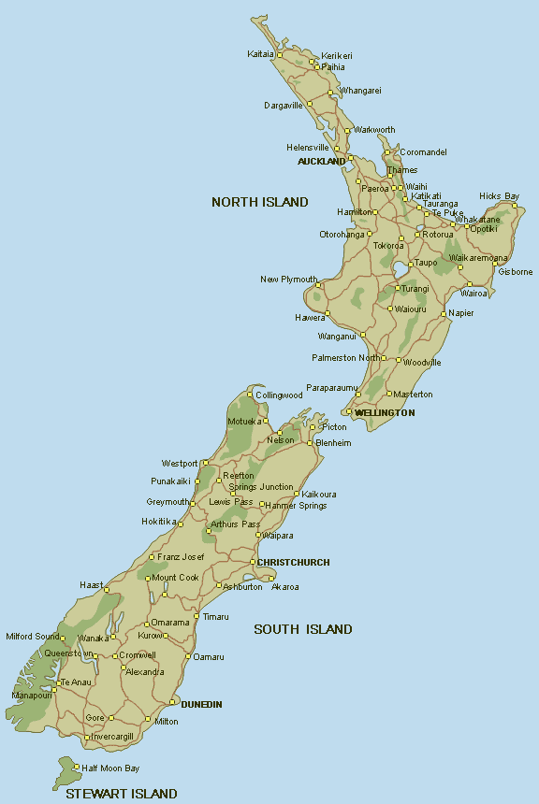

Let’s travel to New Zealand!

Slide 5
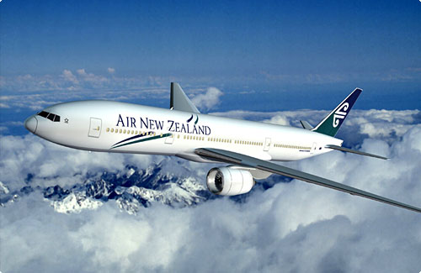
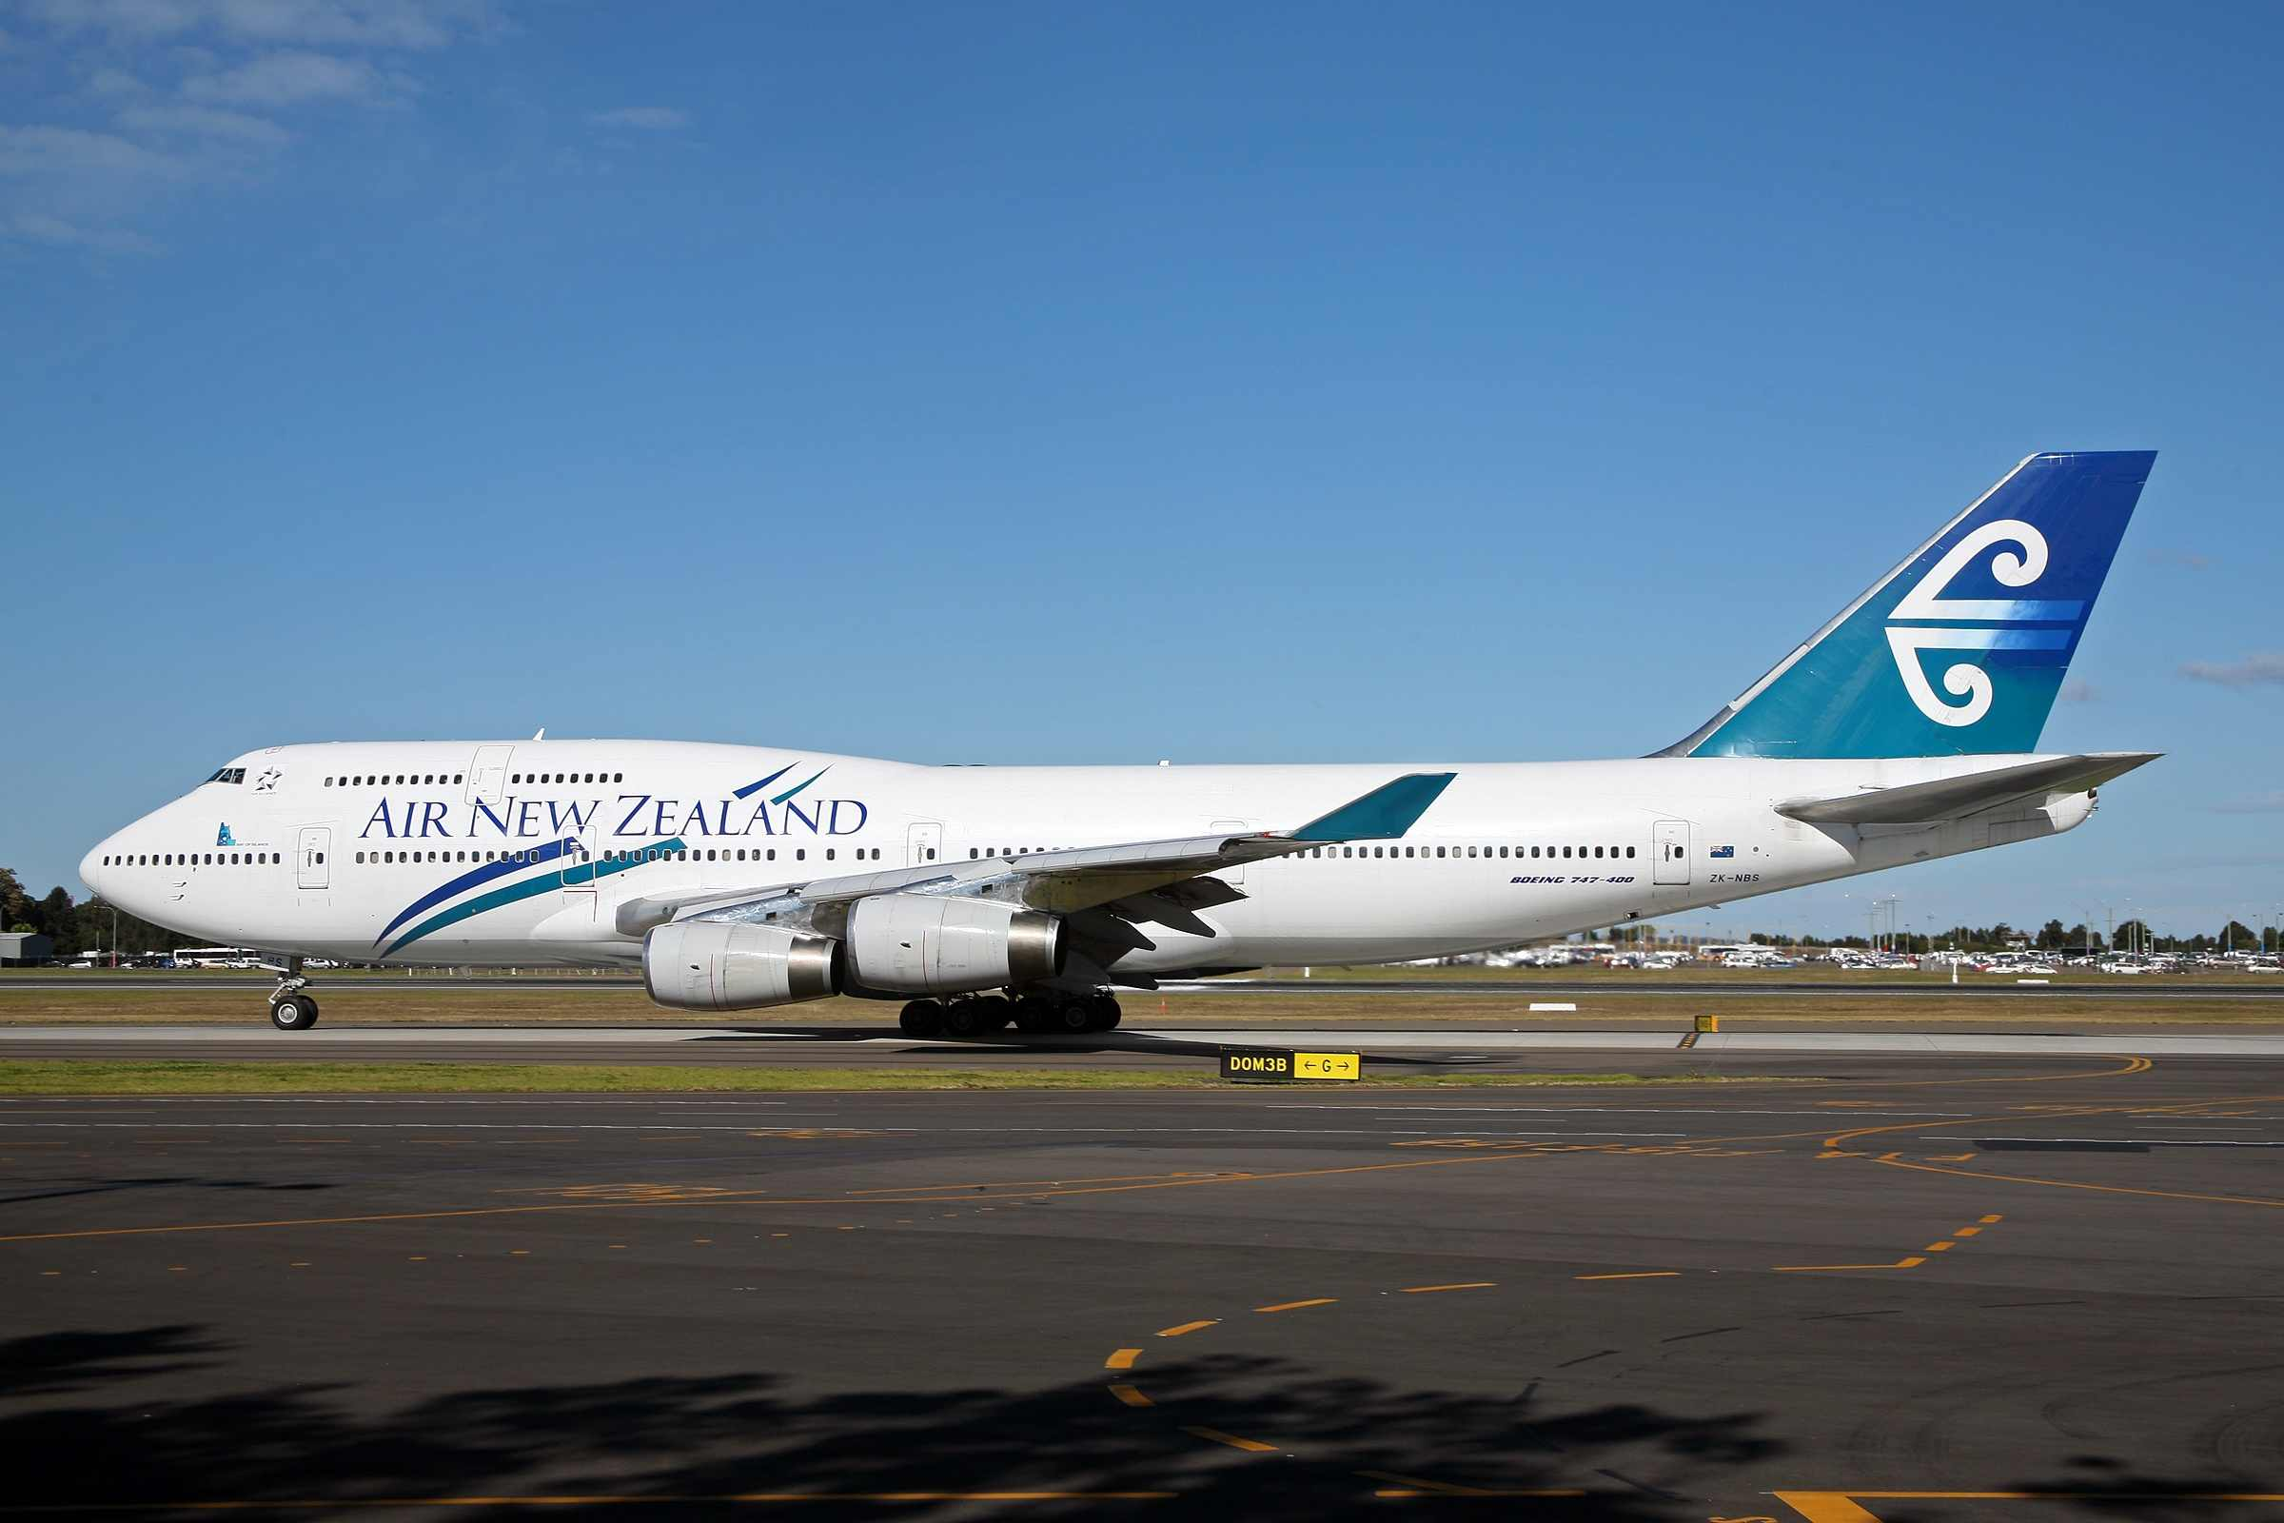
Welcome to New Zealand

Slide 6


Slide 7
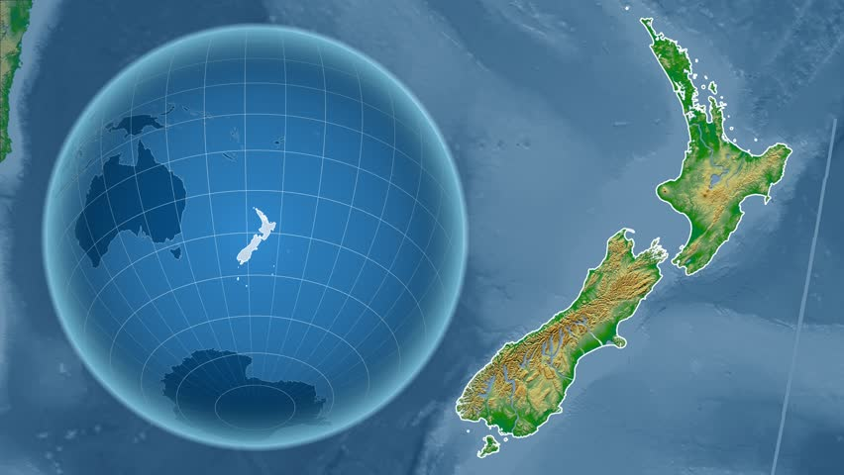

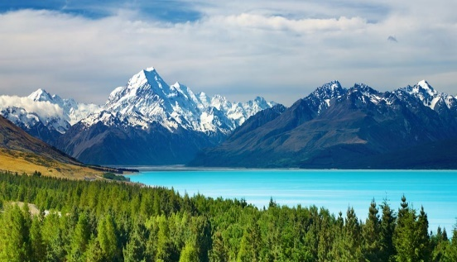
Unit
11
A Beautiful Country
Reading
2. Skim the text and then, with a partner, say what it is mainly about.
New Zealand is in the Southern western Pacific Ocean. It is a small country,
similar in size to Great Britain or Japan. It is 258,000 square kilometres. The population of New Zealand is approximately 4.6 million.
New Zealand is an island country. It has two main islands – North Island and South Island. North Island is smaller than South Island but the population of North Island is bigger. Auckland is the biggest city but Wellington is the capital.
The landscape of New Zealand is very varied. You can find every thing from high mountains with snow to volcanoes and rain forests. Also, there are long sandy beaches, rivers, lakes and farms.
Tourists visiting New Zealand can see many mountains. On south Island, there are the Southern Alphs. Mount Cook is there. It is the highest peak in New Zealand.
You can ski on it. North Island has fewer mountains, but it is known for its active volcanoes.
New Zealand is a land of lakes. It has about 3,820 lakes. The largest is Lake Taupo. It is in North Island. Hauroko, in South Island, is the deepest lake in New Zealand and the 16th deepest lake in the world.
Student’s Book
Page 84
84

Slide 8
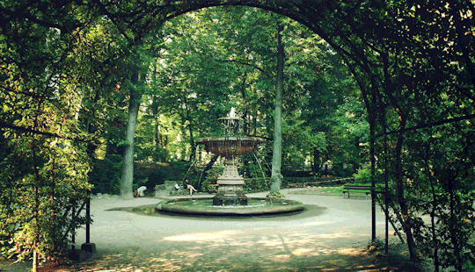


Slide 9
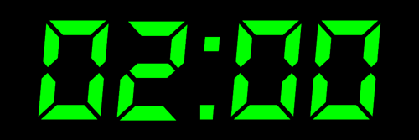


Slide 10
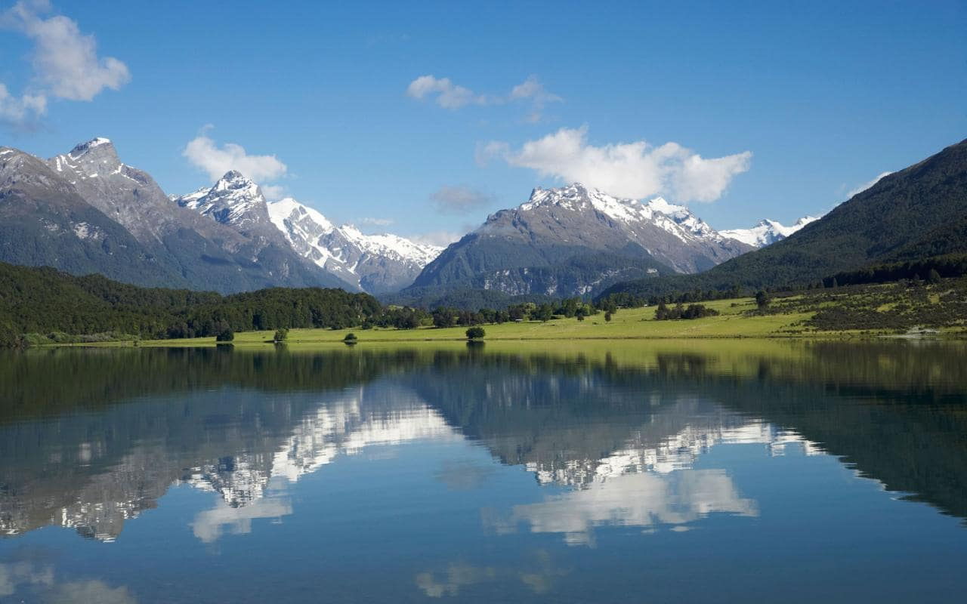

A Beautiful Country
1. Before you read
1. Discuss these questions in pairs.
2. Share your ideas with the class.
A. This isn’t a photo of Kuwait.
How do you know?

Slide 11
B. Where do you think it is?

Slide 12
C. Would you like to go there?
Why? Why not?

Slide 13
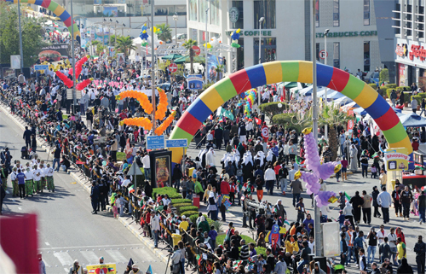
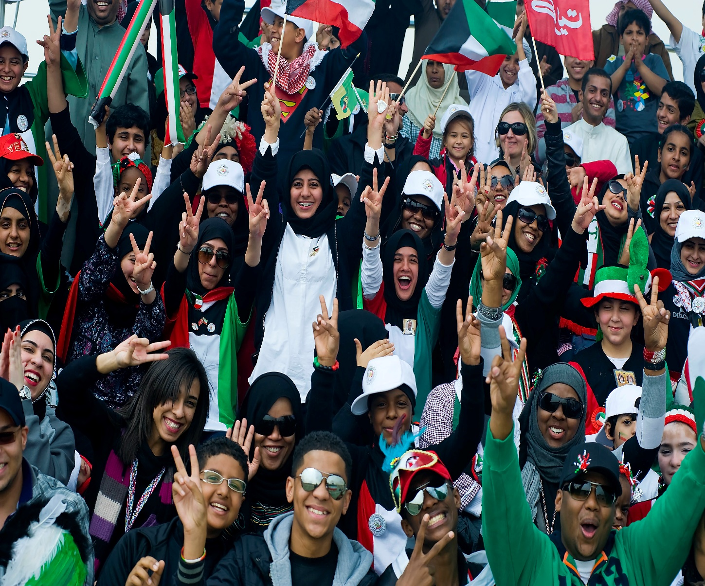
The population of Kuwait is approximately three million.

Slide 14
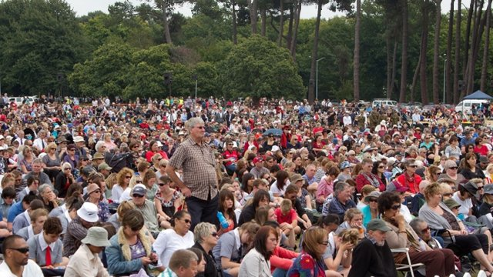
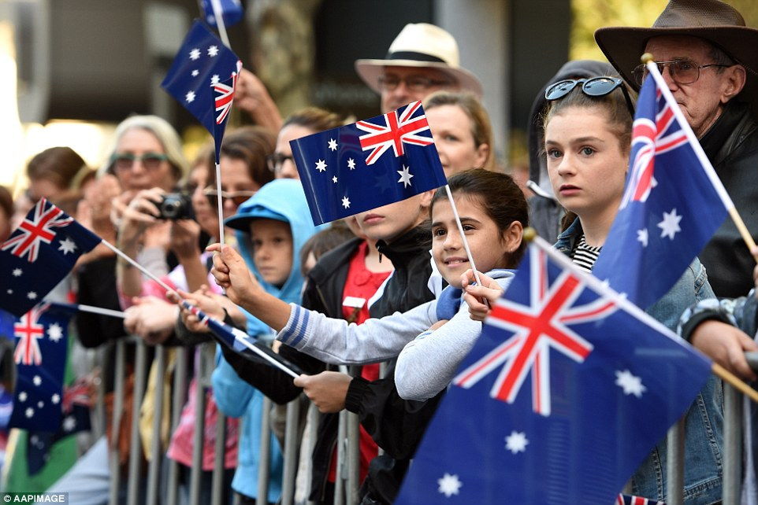
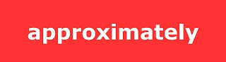

The population of New Zealand is approximately 4.6 million.

Slide 15

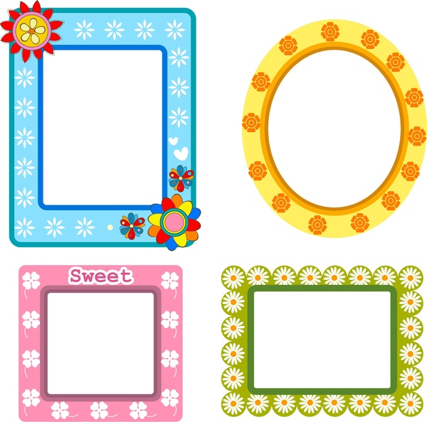
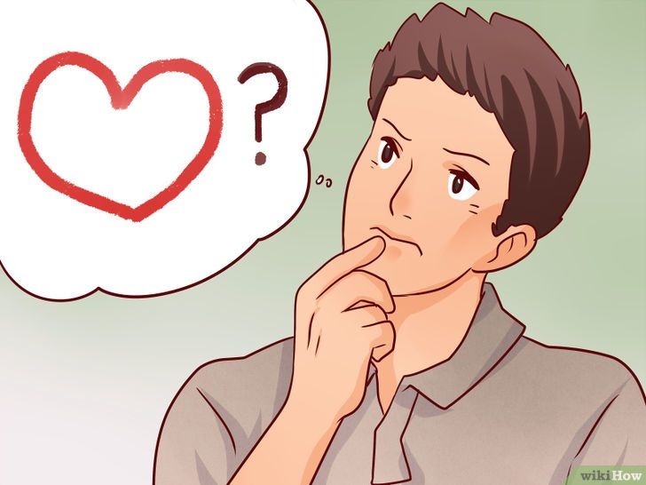
Approximately means ----------------.
a) nearly
b) simply
c) clearly
d) exactly

Slide 16
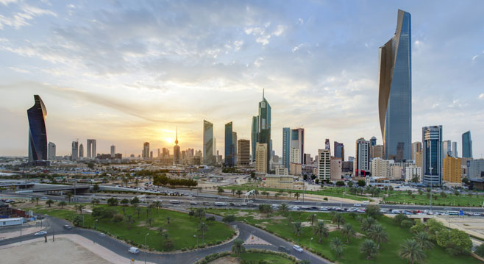
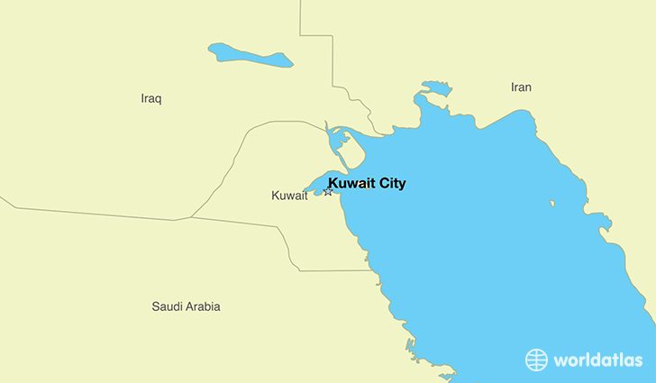
What is the capital of Kuwait?
Kuwait City

Slide 17


Who knows the capital of New Zealand?
It is a difficult question, isn’t it?

Slide 18
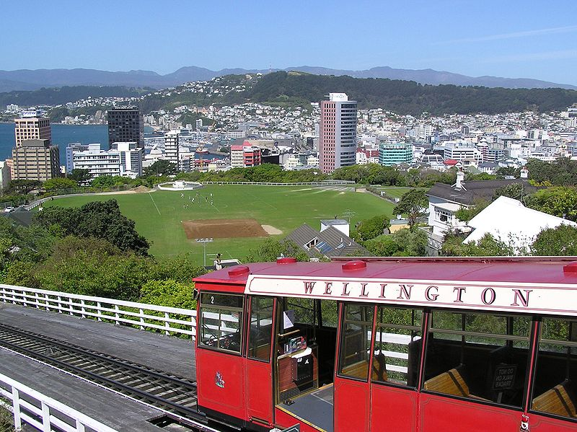
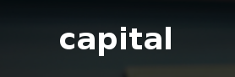
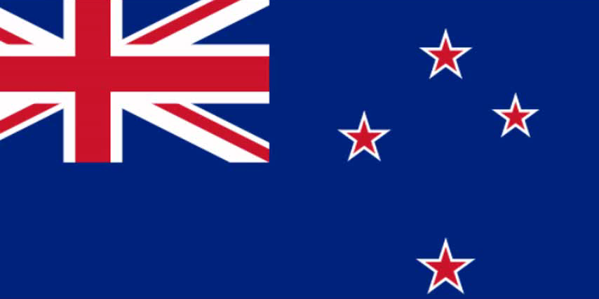
Wellington is the capital of New Zealand.

Slide 19
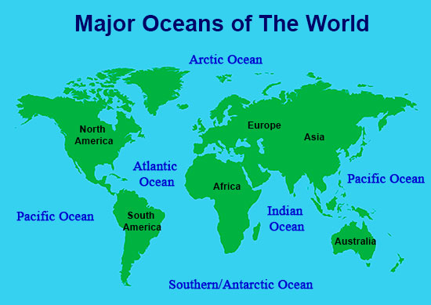

New Zealand is similar in size to Great Britain or Japan.
similar
Great
Britain
Japan
Kuwait
New Zealand

Slide 20
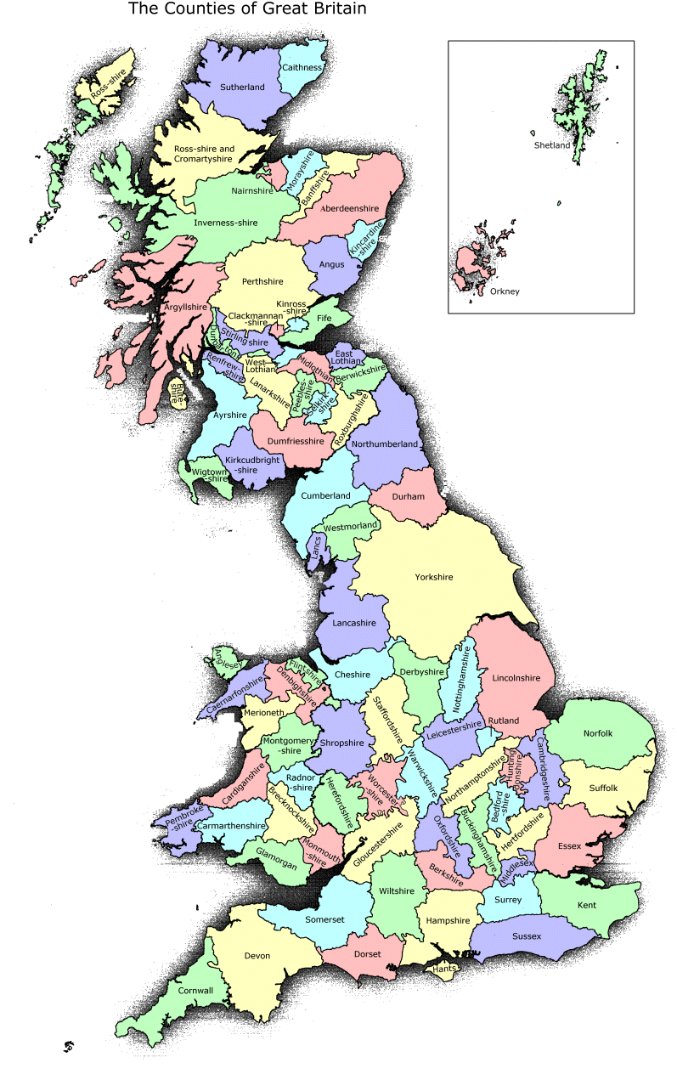
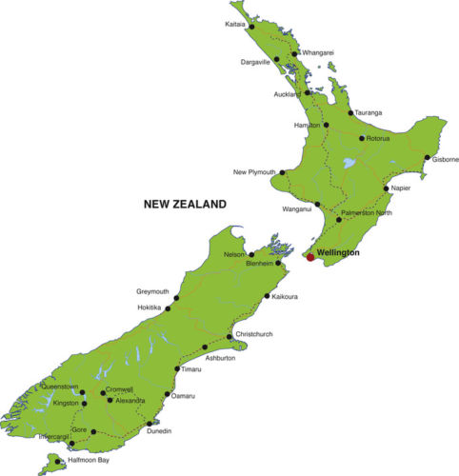
Similar in size means
------------------------.
a) bigger
b) smaller
c) nearly the same
d) different

Slide 21
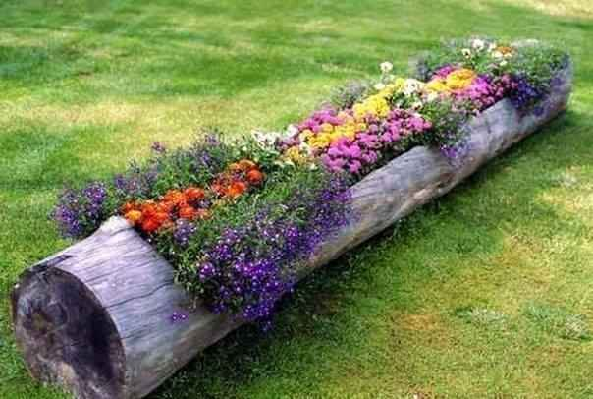
New Vocabulary

Slide 22
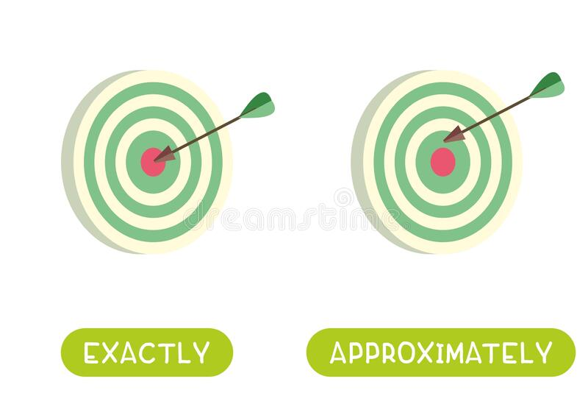
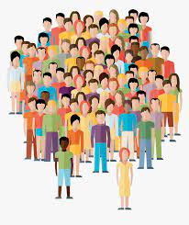
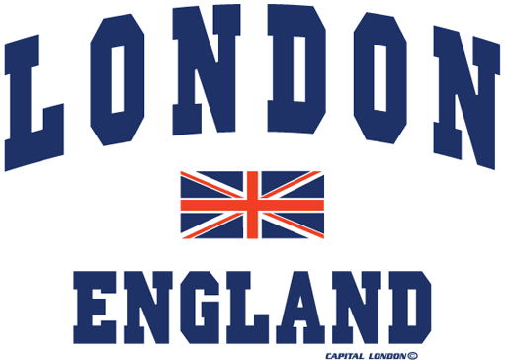

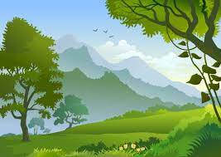
Sun, / /2024
Lesson: 1
Unit: 11
population
……………. …………….……………..
approximately
……..............
……...............
………………….
capital
…………
……………………
similar
…………
…………………….
landscape
…………
………………………….

Slide 23
Match the word with the correct picture:
population
landscape
similar
capital
approximately

Slide 24
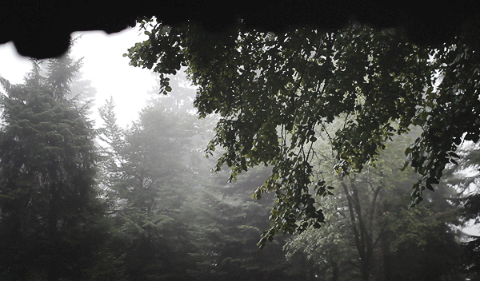


Slide 25
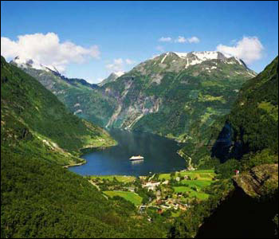

What is the text mainly about?

Slide 26
New Zealand is in the Southern western Pacific Ocean. It is a beautiful country .It is a small country, similar in size to Great Britain or Japan. It is 258,000 square kilometers . The population of New Zealand is approximately 4.6 million.
New Zealand is an island country. It has two main islands – North Island and South Island. North Island is smaller than South Island but the population of North Island is bigger. Auckland is the biggest city but it is not the capital .Wellington is the capital.

Slide 27
1. What is the best title for this passage? a. Britain b. Japan c. pacific ocean d. New Zealand

Slide 28
New Zealand is in the Southern western Pacific Ocean. It is a beautiful country .It is a small country, similar in size to Great Britain or Japan. It is 258,000 square kilometers . The population of New Zealand is approximately 4.6 million.
New Zealand is an island country. It has two main islands – North Island and South Island. North Island is smaller than South Island but the population of North Island is bigger. Auckland is the biggest city but it is not the capital .Wellington is the capital.

Slide 29
1. What is the best title for this passage? a. Britain b. Japan c. pacific ocean d. New Zealand
√

Slide 30
2. What is the meaning of the underlined word (approximately ) in the first paragraph? a. simply b. clearly c. nearly d. exactly

Slide 31
New Zealand is in the Southern western Pacific Ocean. It is a beautiful country .It is a small country, similar in size to Great Britain or Japan. It is 258,000 square kilometers . The population of New Zealand is approximately 4.6 million.
.

Slide 32
2. What is the meaning of the underlined word (approximately ) in the first paragraph? a. simply b. clearly c. nearly d. exactly
√

Slide 33
2. What is the meaning of the underlined word (approximately ) in the first paragraph? a. simply b. clearly c. nearly d. exactly
3. The underlined word (it ) in the second paragraph refers to: a. North Island b. Auckland c. Wellington d. South Island

Slide 34
New Zealand is an island country. It has two main islands – North Island and South Island. North Island is smaller than South Island but the population of North Island is bigger. Auckland is the biggest city but it is not the capital .Wellington is the capital.

Slide 35
2. What is the meaning of the underlined word (approximately ) in the first paragraph? a. simply b. clearly c. nearly d. exactly
3. The underlined word (it ) in the second paragraph refers to: a. North Island b. Auckland c. Wellington d. South Island
√

Slide 36
4.According to the text, all the following statement are TRUE except : a. New Zealand is a small country. b. New Zealand is an island country. c. New Zealand is a beautiful country. d. New Zealand is in the Indian Ocean.
√

Slide 37
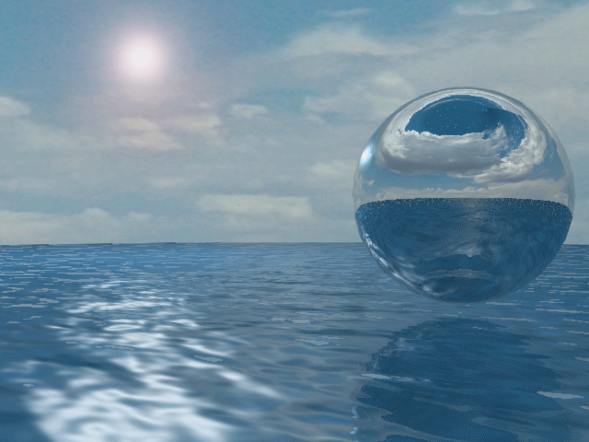
Closure

Slide 38
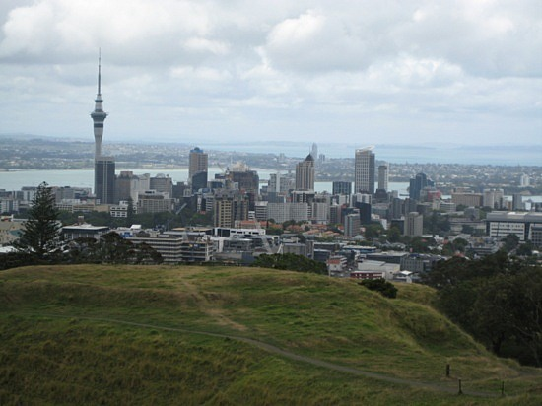
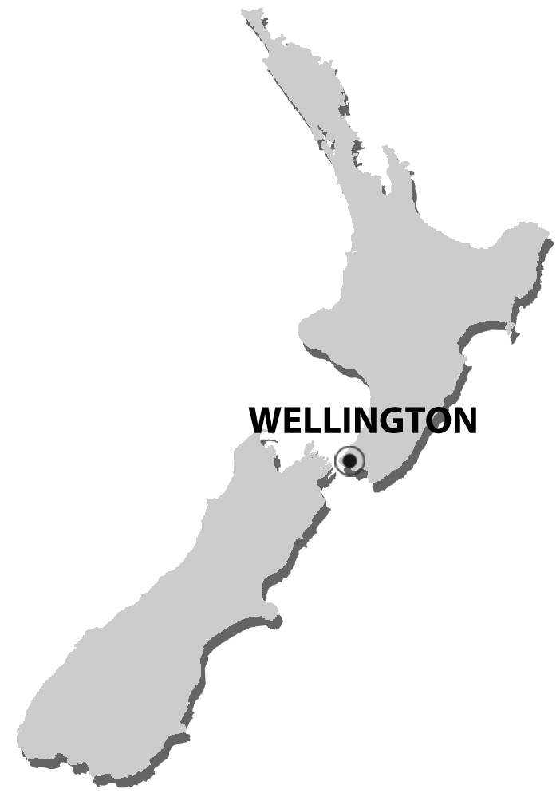
What else would you like to learn about New Zealand?

Slide 39
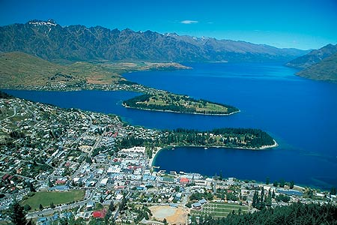
Thank you

