Slide 1
Unit: 7
Lesson: 2
Passive Voice
Grammar

Slide 2
Opener

Slide 3
Correct Me : Present simple
drinks
1- Sara drink milk every day .
eat
2- We usually ate pasta.
read
3- They sometimes reads books.

Slide 4
I’m a happy cat.
I drink milk every day.
milk

Slide 5
The milk is put in the dish every day.
milk

Slide 6
The milk is put in the dish.
milk

Slide 7
Who put the milk in the dish?
milk

Slide 8
Sara puts milk in the dish.
active
milk

Slide 9
Subject
verb
Object
Sara puts milk.
active
T.V
a monkey
cakes
Ali
I
We
watches
see
eat

Slide 10
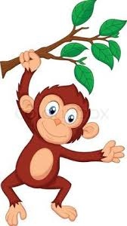
Passive
1. TV is watched at weekends.
2. The monkey is seen in the zoo.
3. Cars are made in Germany.
4. Cakes are eaten at birthdays.

Slide 11
1. Put the object in the beginning.
To make passive:
2. Put is / are .
3. Put the V 3 .
Passive Voice

Slide 12
1- Bees make honey.
change the following sentences into passive into passive:
Subject
verb
Object
is / are
V3
Honey
is
made
by bees.

Slide 13
1- Scientists do experiments.
Subject
verb
Object
is / are
V3
Experiments
are
done
by them.

Slide 14
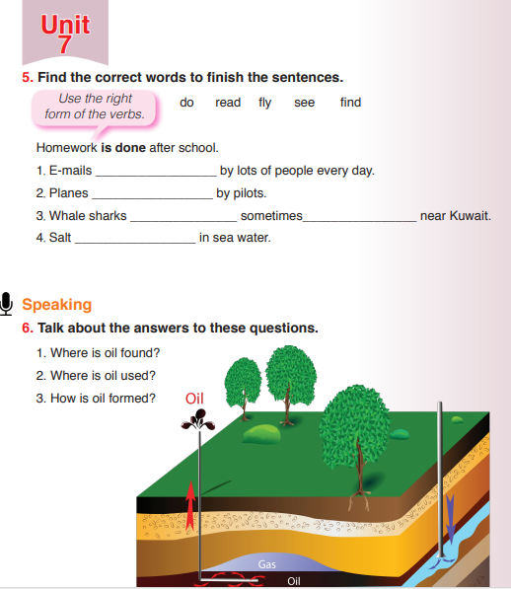
Student’s Book
Page 61

Slide 15
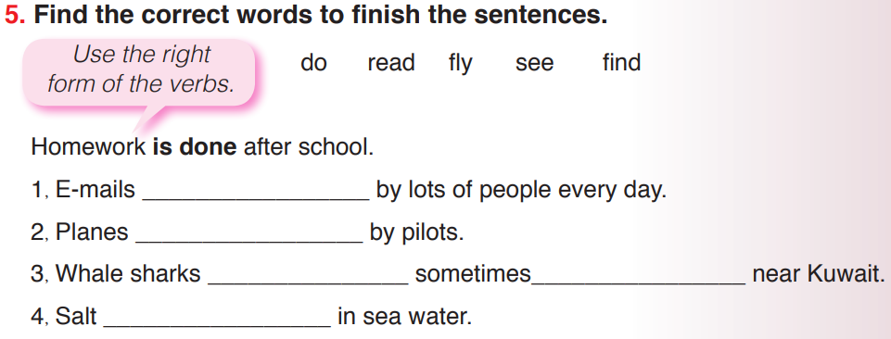

Slide 16
Work Sheet

Slide 17
Closure:

Slide 18
Change into passive:
- Ali plays football.
………………………………………………………………..
Football is played.

Slide 19
Thank You !

