Slide 1
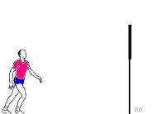
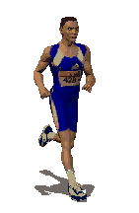
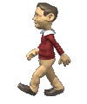
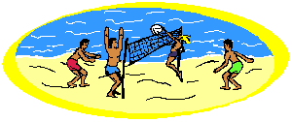
Unit 2

Slide 2
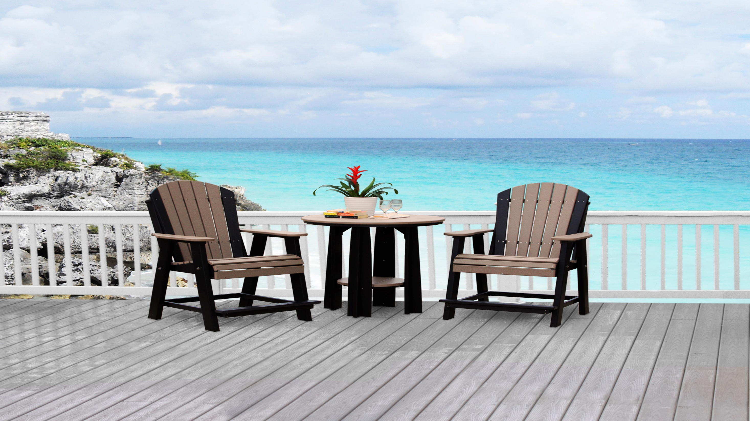
Opener!
Wednesday , 13 -10 -2021

Slide 4
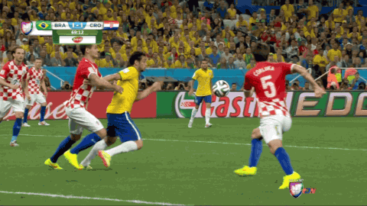
Where do footballers play?

Slide 5
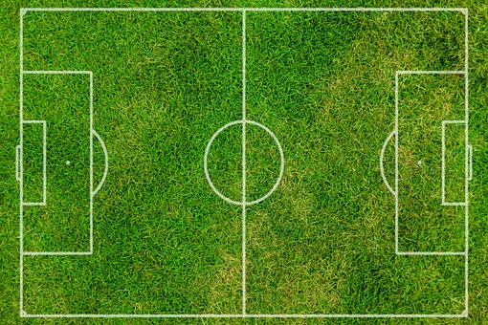
pitch
Footballers play in a football pitch.

Slide 6
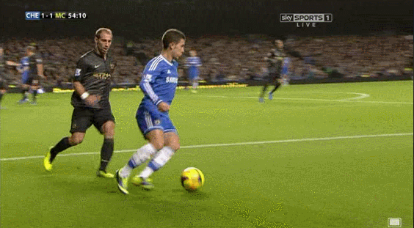
an area painted with lines for playing sports, especially football
pitch

Slide 7
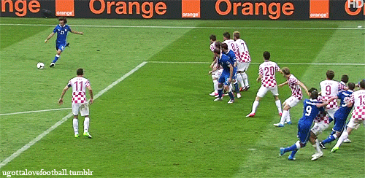
score
Hooray! The football player has scored a goal.

Slide 8
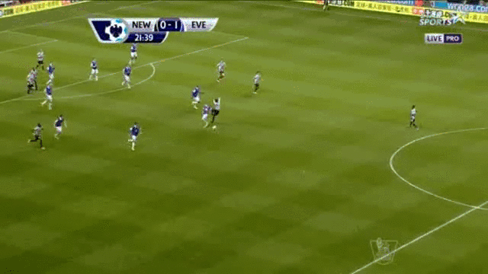
Do you think the player will score a goal?

Slide 9
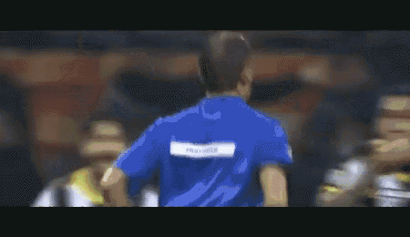
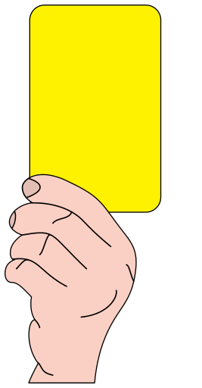
The referee gave a yellow card to the player.
referee

Slide 10
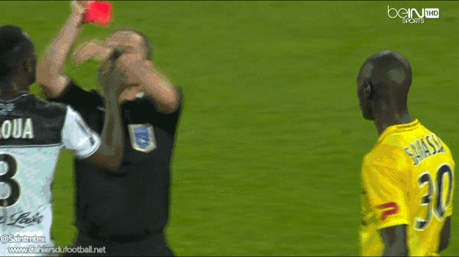
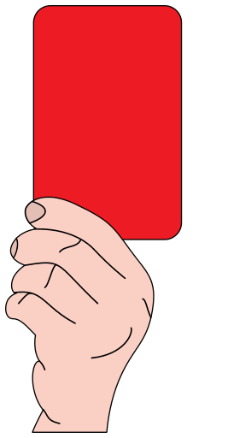
This time the referee gave a red card to the player.

Slide 11
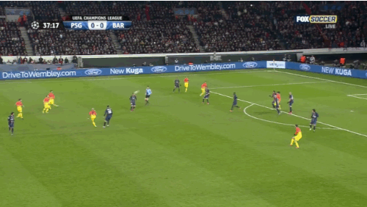
New Vocabulary
Look at the picture and say the word.
Test your memory!

Slide 12
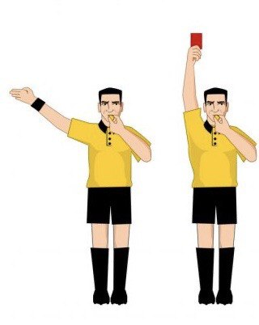
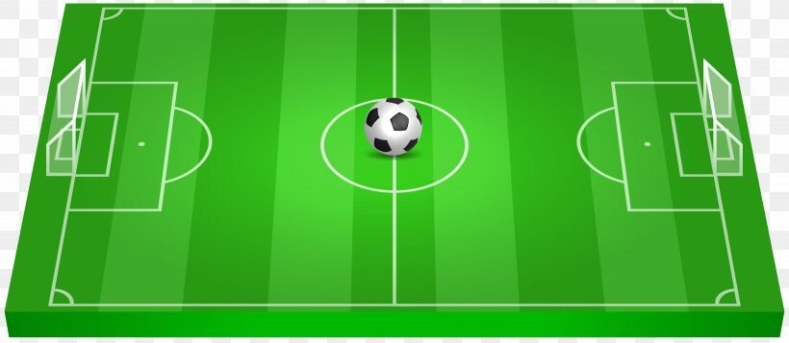
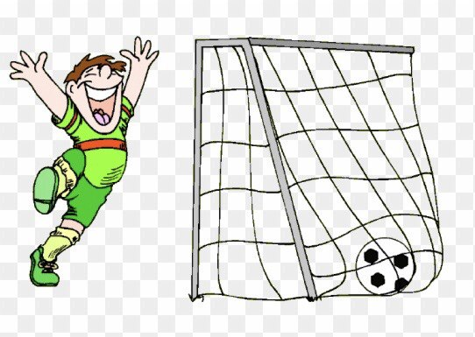
Wednesday , 13 -10 -2021
Unit :- 2
Lesson :- 6
pitch
referee
score
( v )
…………………..…………………
…………………..…………………
…………………………………
……………………………
…………………..…………………
………………………………

Slide 13
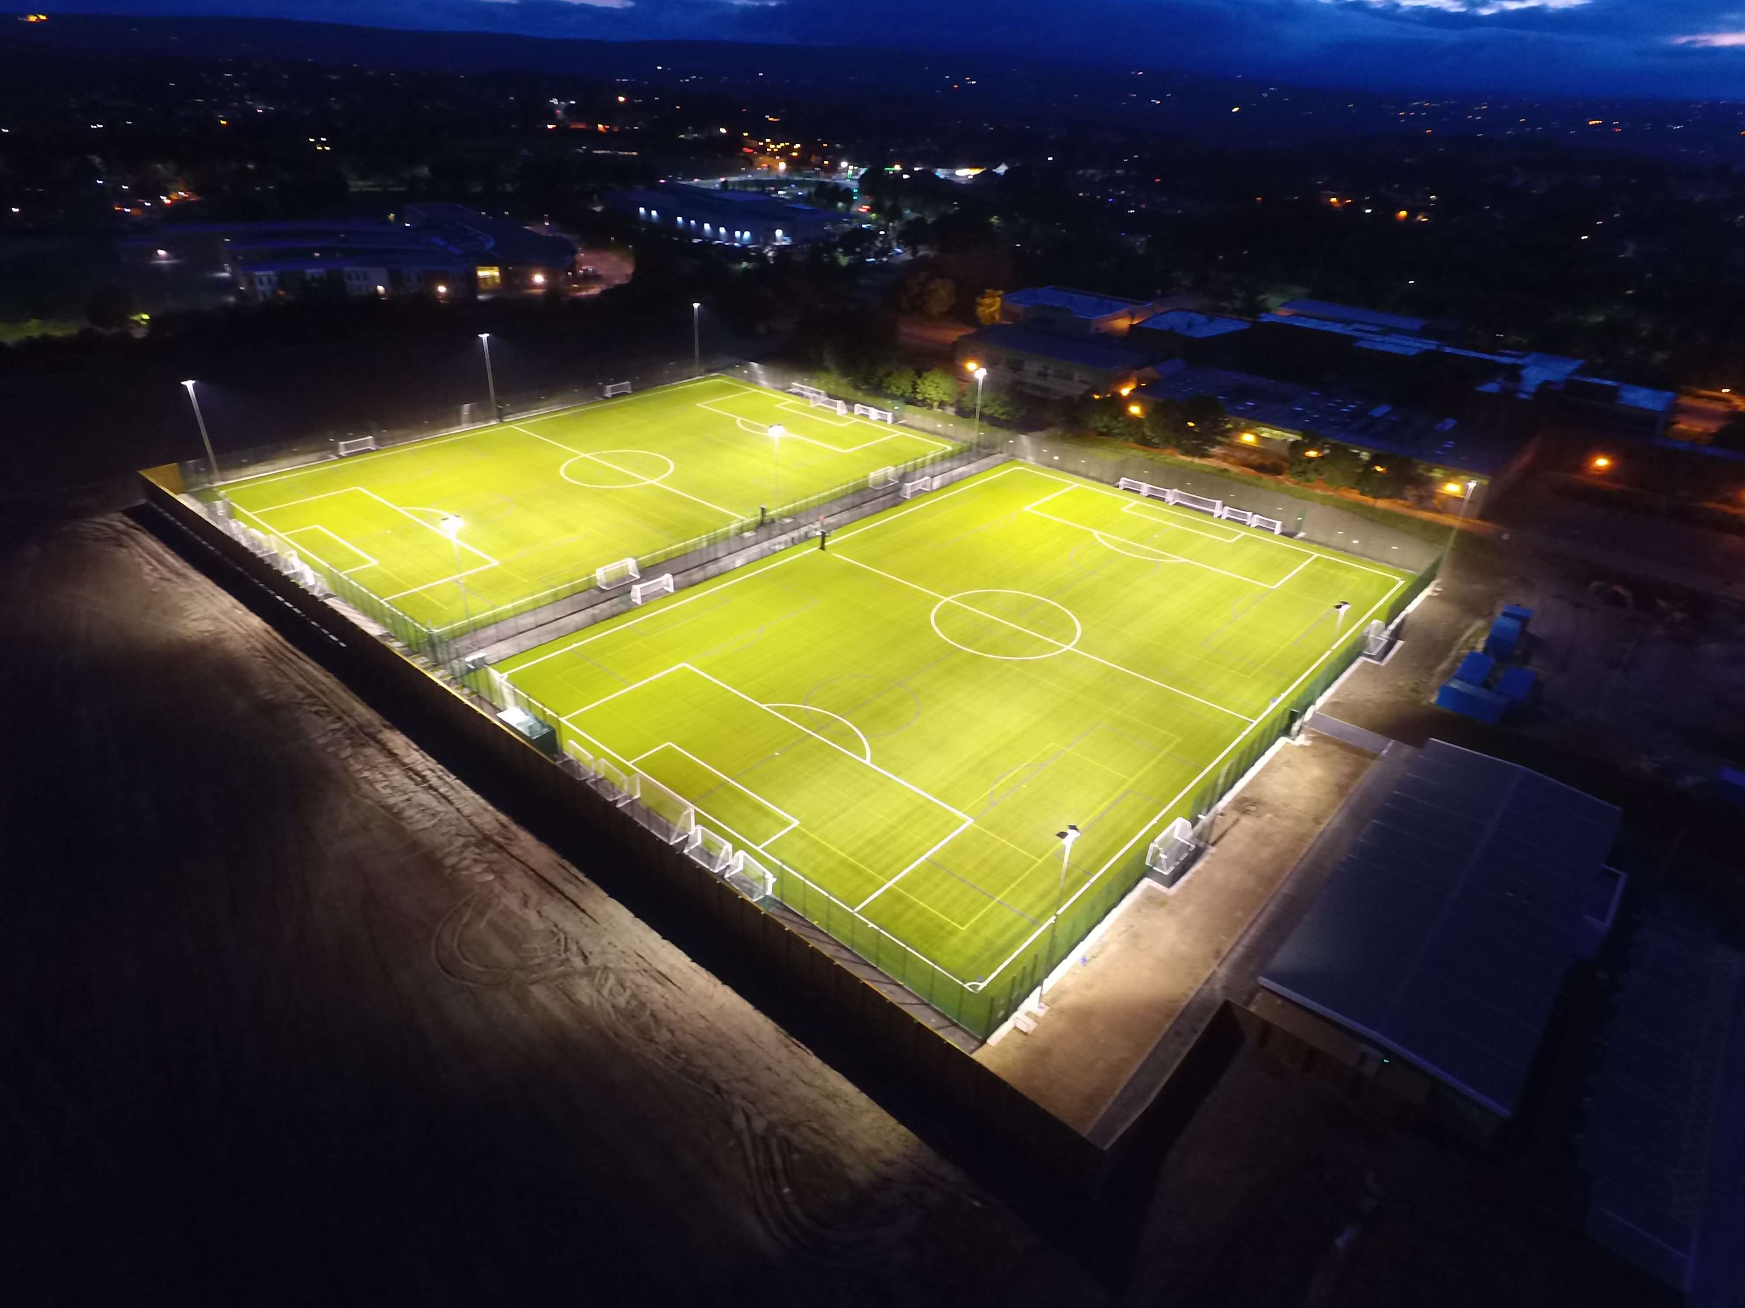
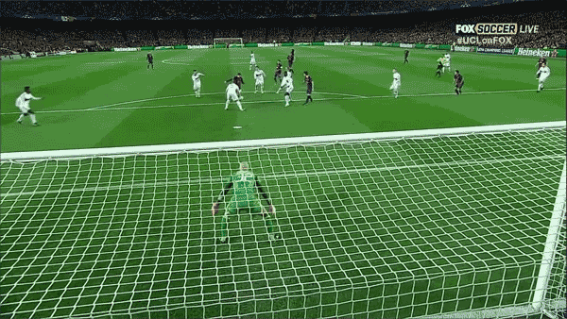
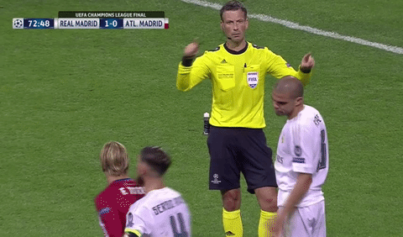
pitch (n.)
score (v.)
referee (n.)

Slide 14
GRAMMAR
Simple present tense

Slide 15
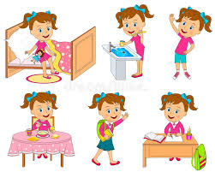
Watch the video
Then tell us : What does she do every day ?

Slide 17
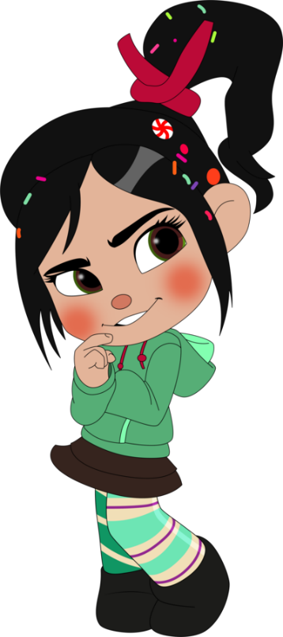
Ask your partner about what you do every day
What do you do everyday ?
I ………everyday .

Slide 18
Ask your partner about Omar’s and Ghada’s favourites.
What does she do everyday?
She ………eryday .

Slide 19
Masooma
I eat healthy food everyday.

Slide 20
Dana
She always eats healthy food .

Slide 21
Student’s Book Page 10
EX. 3

Slide 23
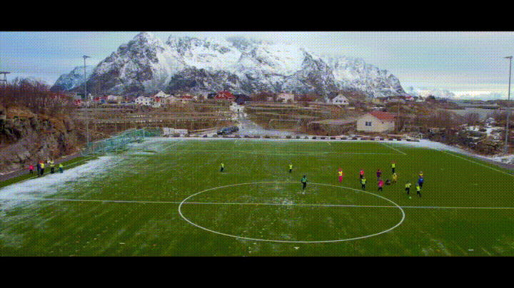
Check your answers.

Slide 24
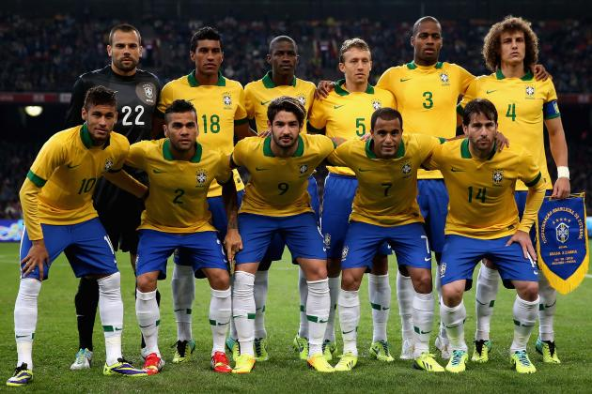
A football player (play) -------------------------- in a team of eleven players.
one player
verb + s
plays

Slide 25
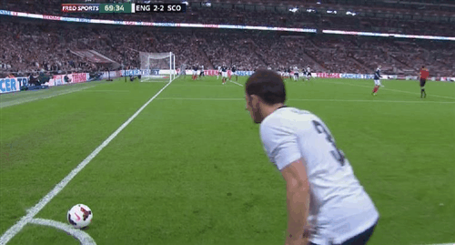
They (kick) ---------------------- it with their feet.
more than a player
verb (infinitive)
kick

Slide 26
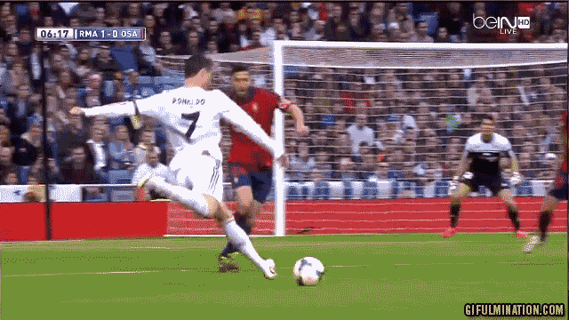
Footballers (not use) ---------------------- their hands to move the ball across the football pitch.
more than a player
don’t verb (infinitive)
don’t use

Slide 27
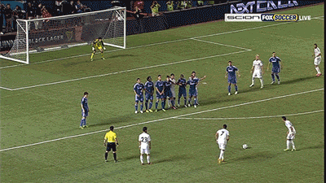
If the footballer kicks the ball into the goal, his team (score) ---------------------- one point.
one team
verb + s
scores

Slide 28
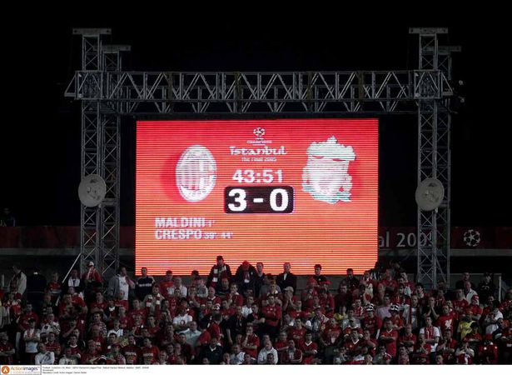
The team with the most points (win) ----------------------.
one team
verb + s
wins

Slide 29
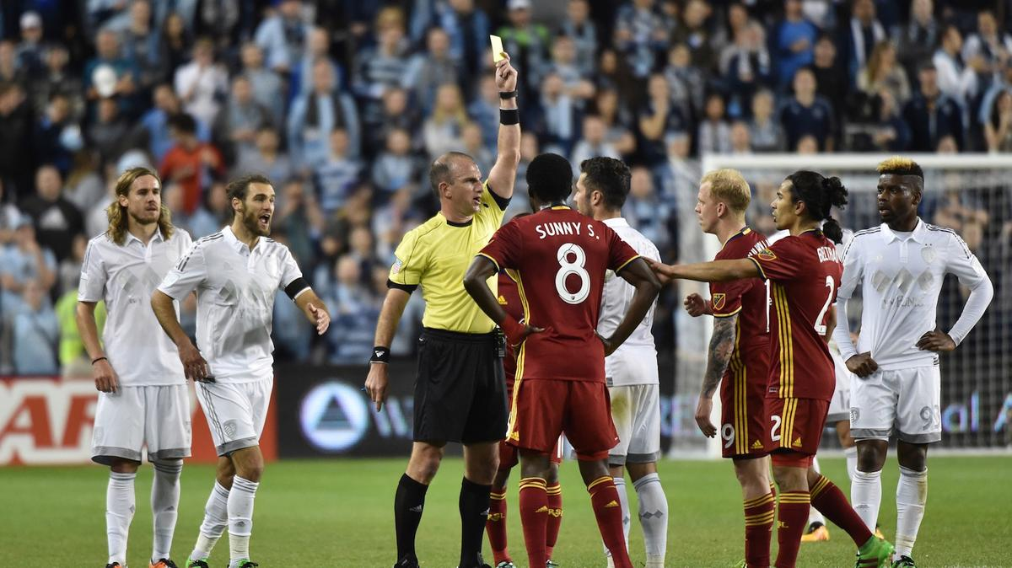
The referee (control) ----------------- the game.
one referee
verb + s
controls

Slide 30
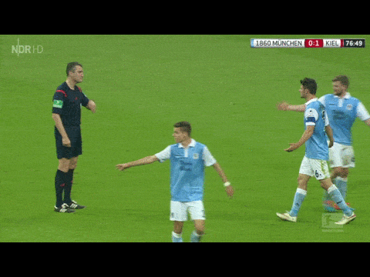
Players (not argue) -------------- with the referee.
more than a player
don’t verb (infinitive)
don’t argue

Slide 31
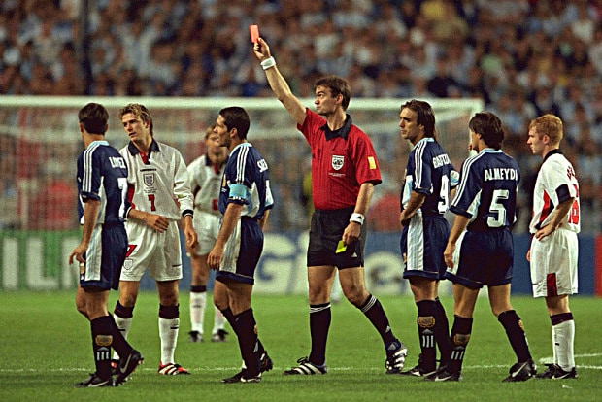
If they do, the referee (send) --------------------- them off the football pitch.
one referee
verb + s
sends

Slide 33
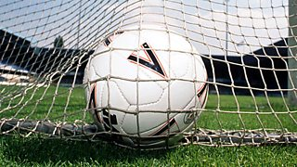
Closure
Enjoy watching a song about football, then mention sports which are played with a ball.

