Slide 1

Unit 7
Science Data
Student’s Book
Page 59

Slide 2

Let’s play
The Adjective Game.
Match the adjectives with the suitable nouns.

Slide 3

tasty
scientist
hot
ice cream
clever
sky
room
cloudy

Slide 4
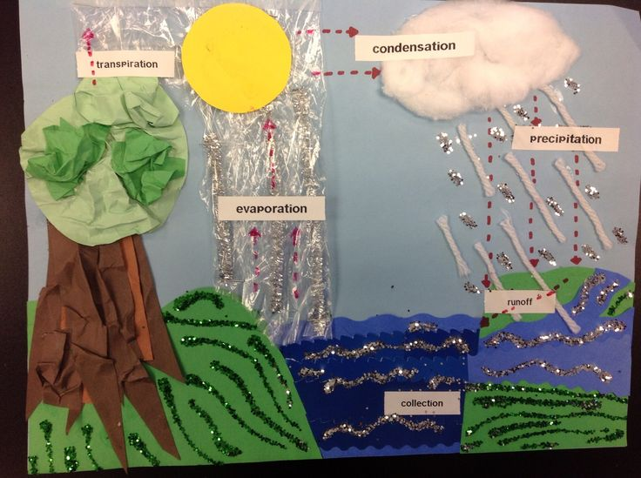
This project is about
water cycle.

Slide 5
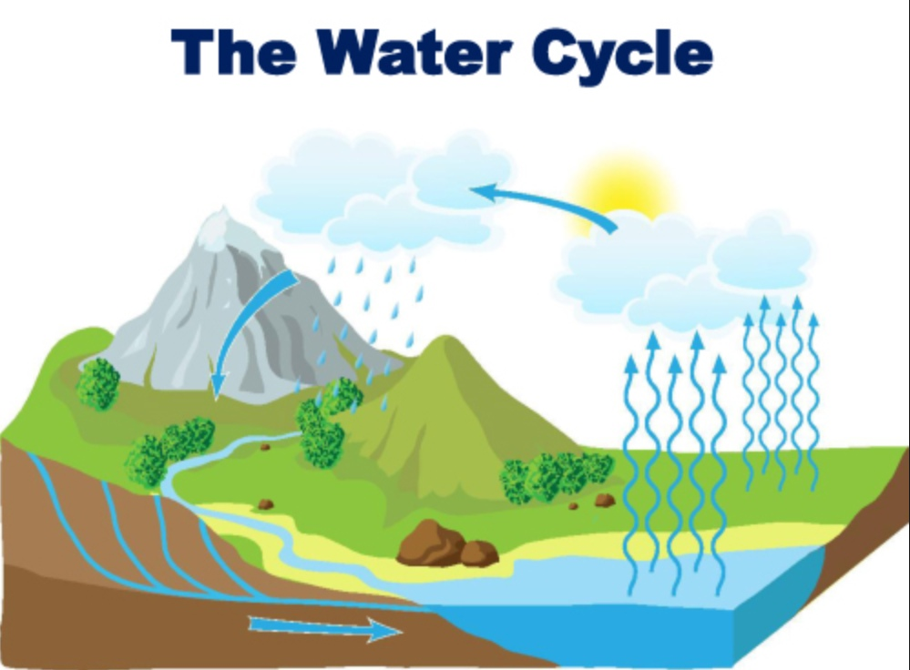
Water Cycle
The Water Cycle is the journey water takes
as it circulates from the land to the sky and back again.

Slide 6
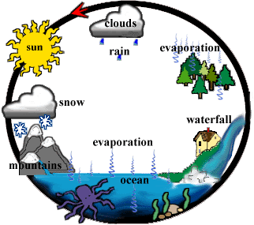
Water cycle (n.)

Slide 7

He does an experiment.
A scientist works in
a lab.

Slide 8

Experiment (n.)

Slide 9
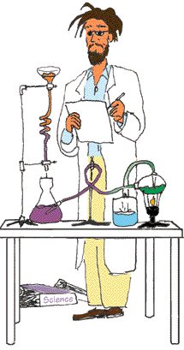
The scientist writes down the
result of the experiment.
Result (n.)

Slide 10


What will happen to the water ?
Do you think it will dry ?

Slide 11
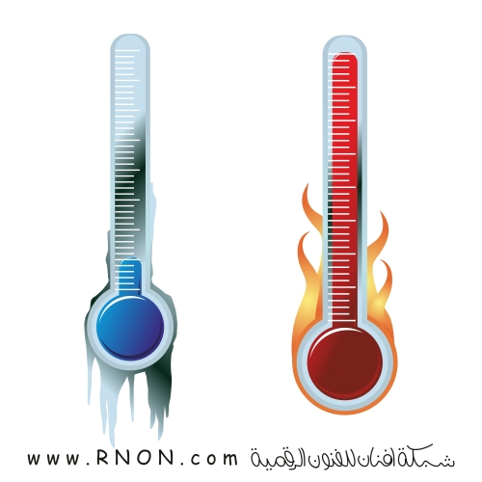
The temperature is very high.
high

Slide 12
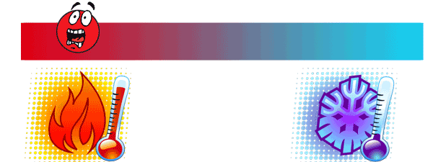
Temperature (n.)

Slide 13

The degree of the temperature is very high.
Degree (n.)

Slide 14
The nurse uses a thermometer to measure the temperature.
Measure (v.)

Slide 15
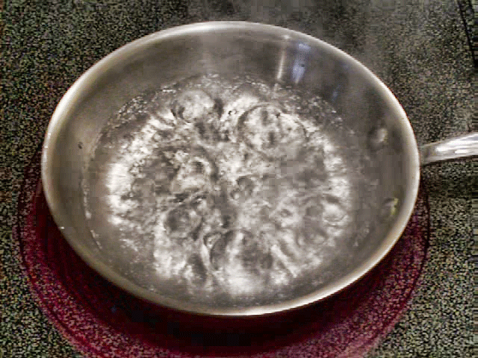
She's heating the water.
Heat (v.)

Slide 16
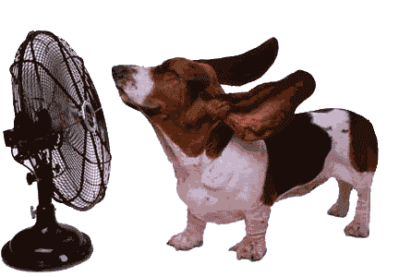
A fan blows cool air.
Blow (v.)

Slide 17
Page 59

Slide 18
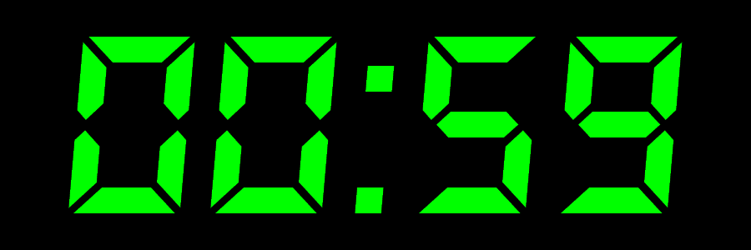

Slide 19
1.What is the picture about?
It’s about water cycle.

Slide 20
2. Reorder the stages in the water cycle.
3
2
4
1

Slide 22
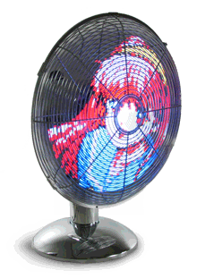
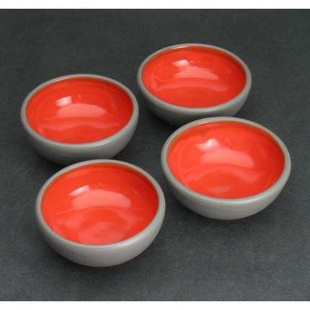
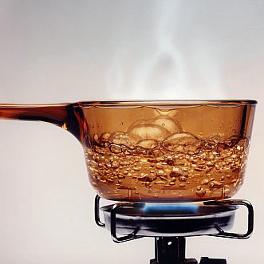
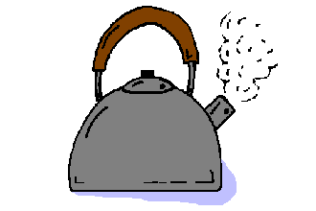
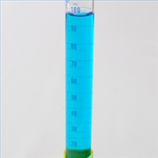
We will do an experiment to see if water changes or not.
For this experiment we will need:
* Four dishes
*A fan
* Water in 20 degrees
* Water in 60 degrees
*Measurements

Slide 23
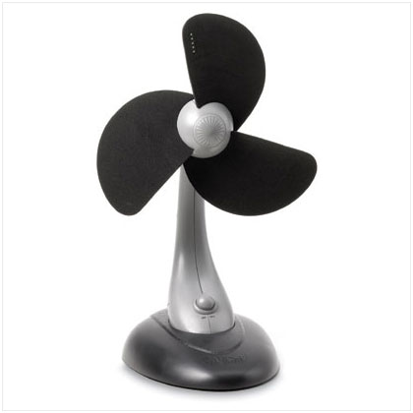
These things are used.
four dishes, all the same size and shape
fan

Slide 24
1-Four dishes- A, B, C, D.
B
A
D
C

Slide 25
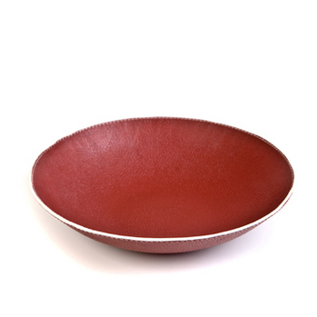
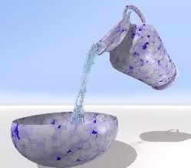
2- 40 ml of water is put in each dish.
40ml
40ml
40ml
40ml

Slide 26
3-The water in A and B is 20 degrees.
The water in C and D is heated to 60 degrees.
20°
20°
A
B
60°
60°
60°
C
D

Slide 27

4- A fan blows cool air on the water in dishes B and D.
20°
60°
B
D

Slide 28
5-The water is kept at the same temperature all the time. The temperature is measured every five minutes.
20°
60°
B
D

Slide 29

The dishes A and C are left without a fan.
20°
60°
A
C

Slide 30
6- The water in the dishes is measured every ten minutes for an hour to see how much there is.
A
C
B
D

Slide 31
Page 60

Slide 32

The result is written down.
Which dish will have no water first?
Water in ml after 40 minutes | Water in ml after 30 minutes | Water in ml after 20 minutes | Water in ml after 10 minutes | Temperature | Dish
 | 37 | 38 | 39 | 20° no fan | A
 | 28 | 32 | 36 | 20° with fan | B
 | 31 | 34 | 37 | 60° no fan | C
 | 22 | 28 | 34 | 60° with fan | D
36
24
28
16

Slide 33
Which dish will have no water first?
Water in ml after 40 minutes | Water in ml after 30 minutes | Water in ml after 20 minutes | Water in ml after 10 minutes | Temperature | Dish
 | 34 | 35 | 36 | 20° no fan | A
 | 16 | 20 | 24 | 20° with fan | B
 | 22 | 25 | 28 | 60° no fan | C
 | 4 | 10 | 16 | 60° with fan | D
32
12
19
0

Slide 34


