Slide 1


Class: 6-2
Monday,
2nd ,October,2023
Unit: 2
Step: 1
An Advertisement For Kuwait

Slide 2
Opener:
Guess the hidden picture

Slide 3
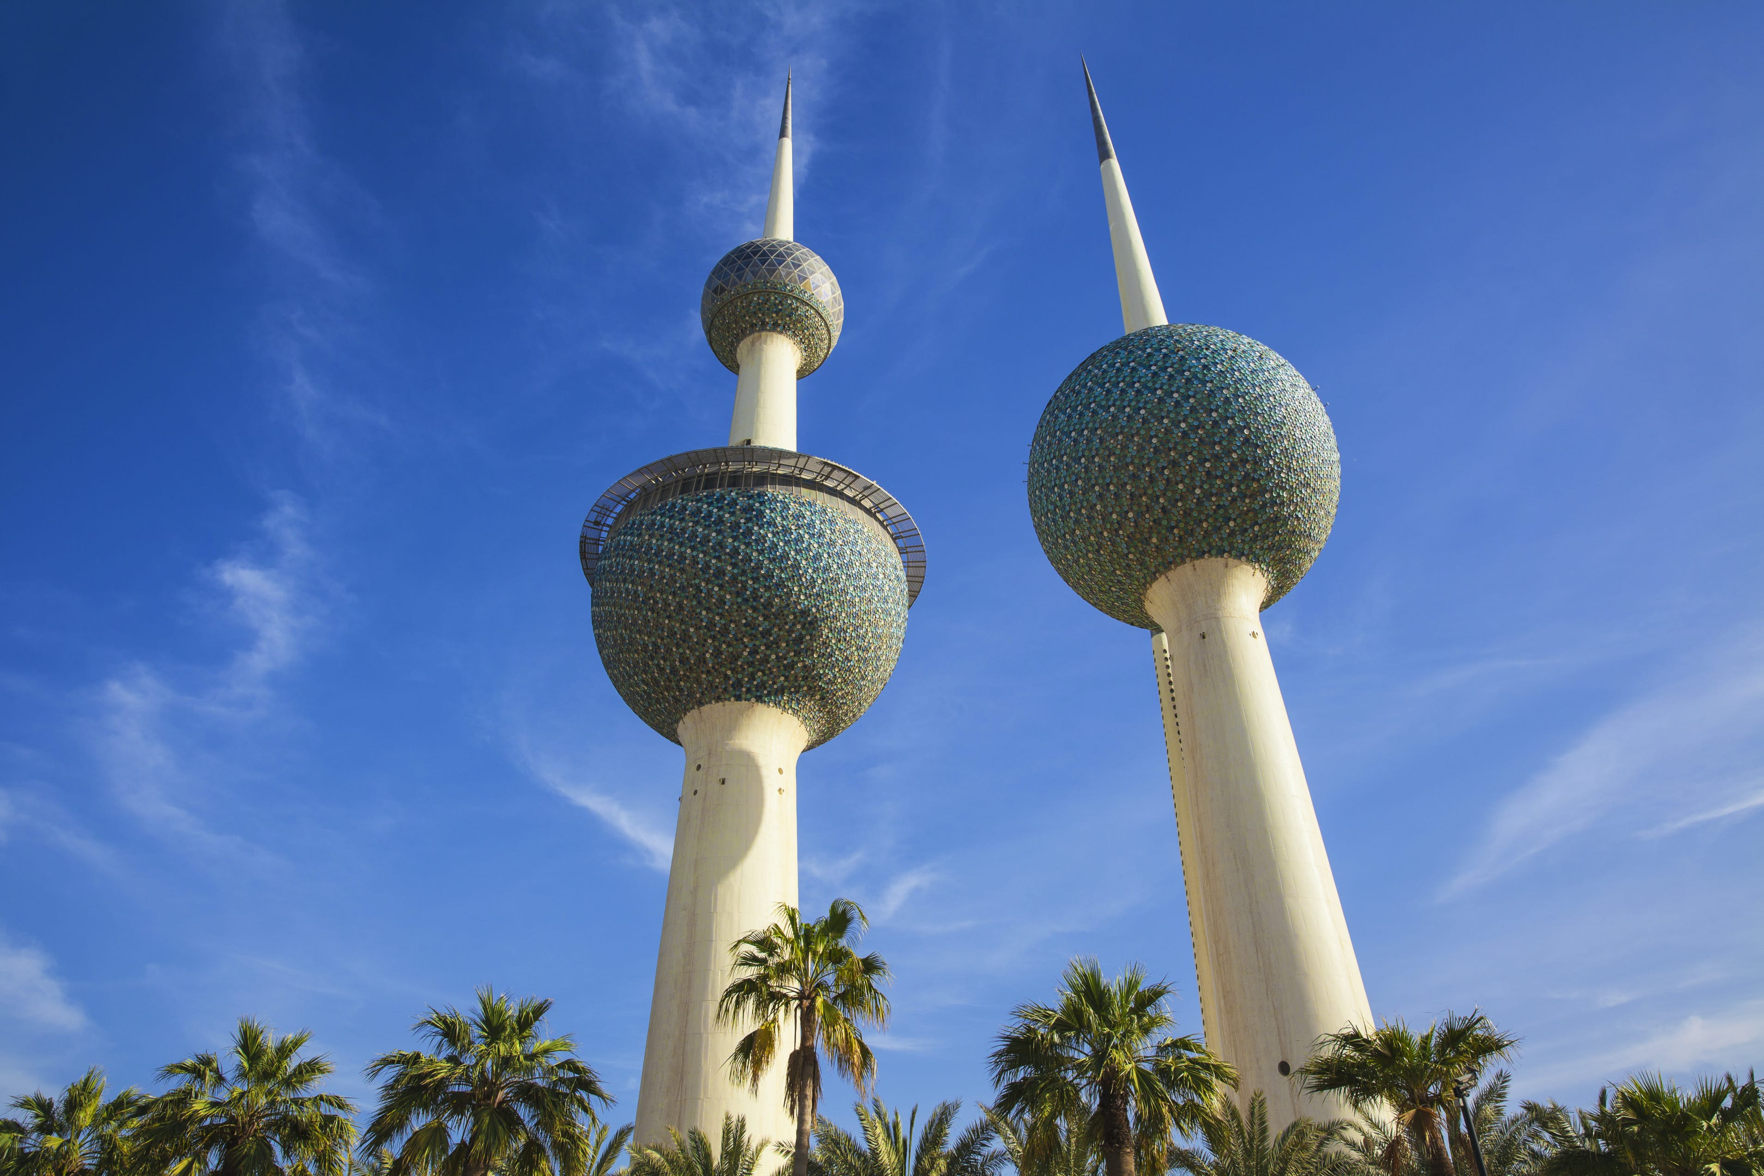
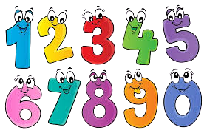
Say a word that starts
with:
1. C letter
2. D letter
3. O letter
4. R letter
5. T letter
6. W letter

Slide 4
Kuwait Towers
Mention more famous places in Kuwait

Slide 5
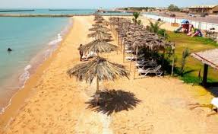
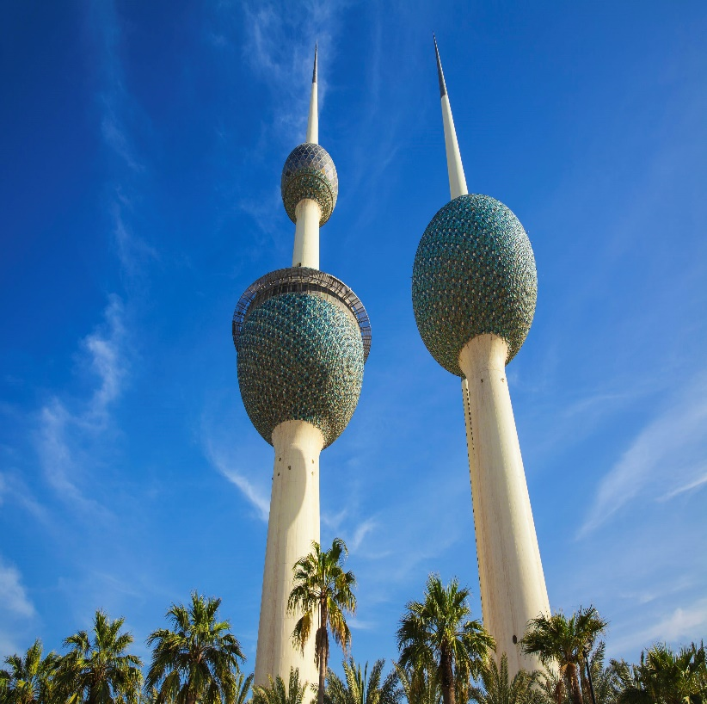
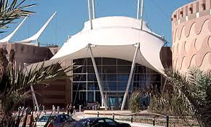
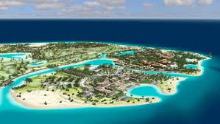
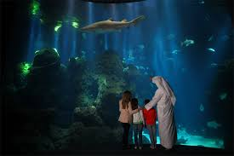
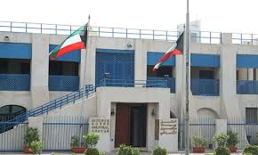
Kuwait Towers
Failaka Island
The scientific center
Dickson House
Mention more famous places in Kuwait

Slide 6

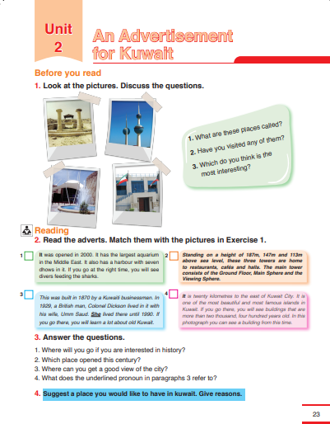
Unit - 2
SB- Page 23
An advertisement for
Kuwait

Slide 7
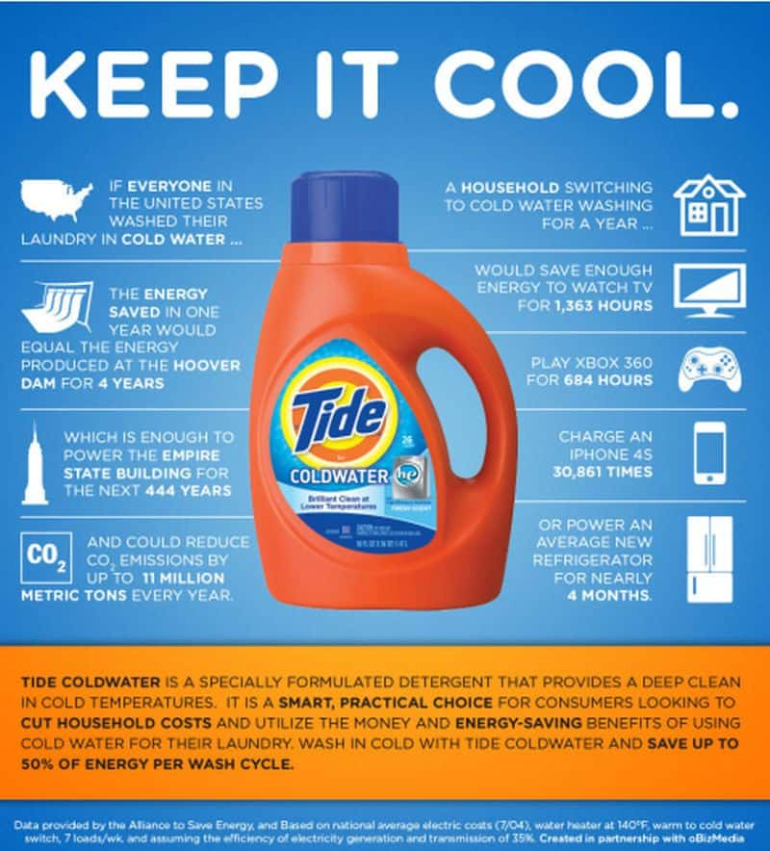
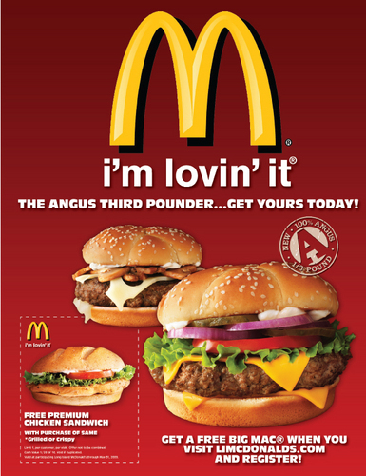

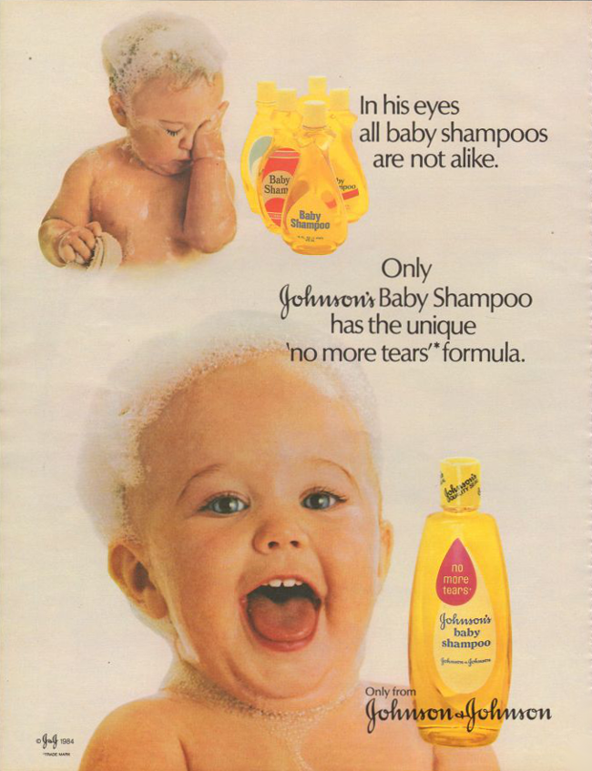
These are amazing advertisements.
advertisement

Slide 8
advertisement
n.
advert
A notice we use to describe a place, a thing ..

Slide 9
SB- Page 23

Slide 10
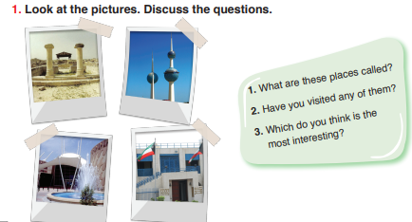
Pre-reading:

Slide 11
1.What are these places called?

Slide 12
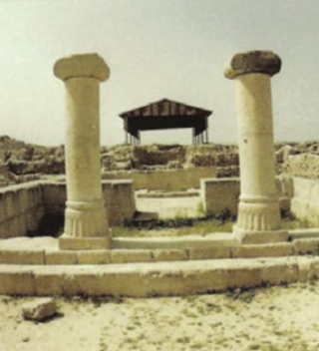
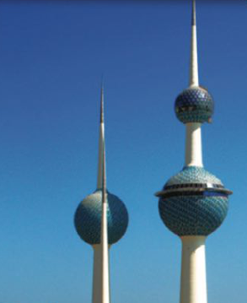
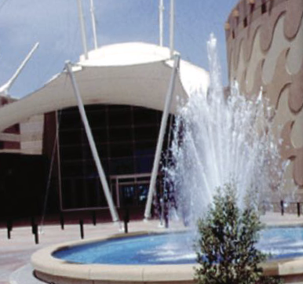
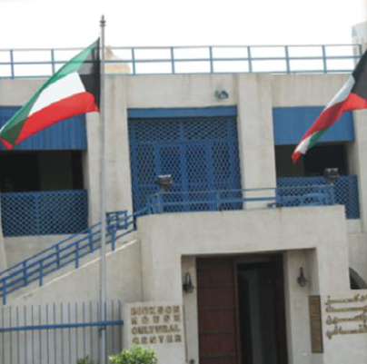
Failaka Island
Kuwait Towers
The scientific center
Dickson House

Slide 13
1. What are these places called?
2.Have you visited any of them?
Failaka Island
Yes, I’ve visited Dickson House.
Kuwait Towers
The scientific center
Dickson House

Slide 14
1. What are these places called?
3.Which do you think is the most interesting?
Failaka Island
I think The scientific center it has a wonderful aquarium.
Kuwait Towers
The scientific center
Dickson House

Slide 15
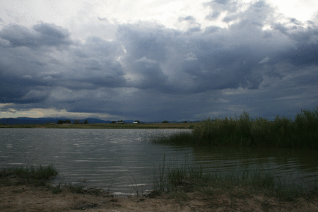
Watch the video, and then describe the place.

Slide 16
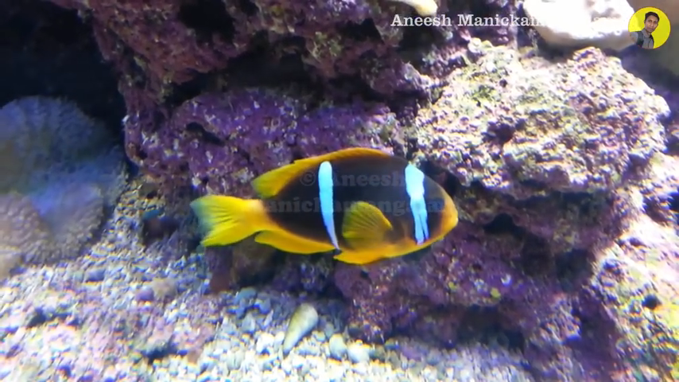

Slide 17
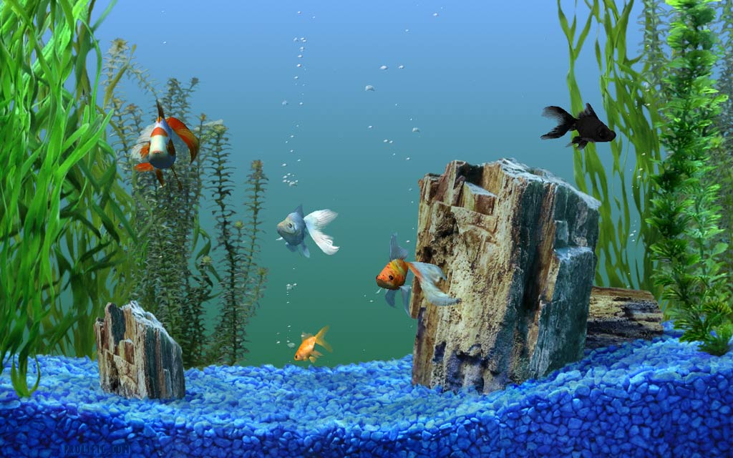
What can you see in the aquarium?
aquarium

Slide 18
aquarium
n.
A glass or a plastic container that fish live in.

Slide 19
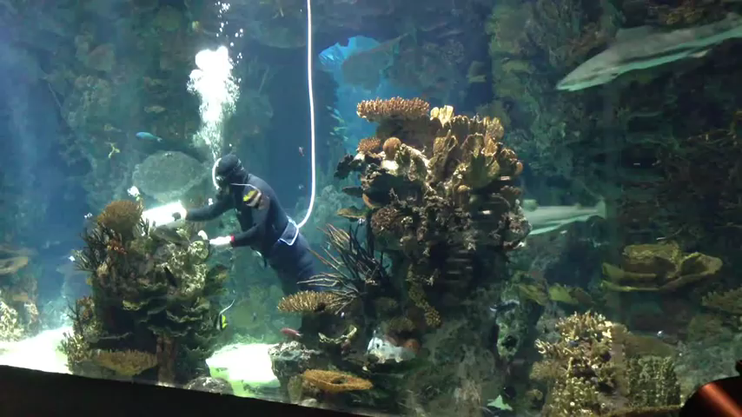
Kuwaiti divers feed sharks.
They give them food.
feed

Slide 20
Feed
v.
To give food

Slide 21
Mon, 2/10/2023
Lesson : 1
Unit: 2
advertisement ........................... ............................ ............................ | aquarium ........................... ........................... ........................... | Feed ....................... ....................... .......................

Slide 22
SB- Page 23

Slide 23


Slide 24
While-reading:
The Scientific Center
Dickson House

Slide 25
While-reading:
1. When was the scientific center opened?
a) In 2015
b) In 1995
c) In 2000
Let your eye catch a number

Slide 26
While-reading:
1. When was the scientific center opened?
The Scientific
Center

Slide 27
While-reading:
1. When was the scientific center opened?
a) In 2015
b) In 1995
c) In 2000

Slide 28
While-reading:
2. What does the underlined pronoun She in paragraph 2 refer to?
people
talk about
Ali likes Football. He plays football every day. He has a lot of balls in his bedroom.

Slide 29
While-reading:
2. What does the underlined pronoun She in paragraph 2 refer to?
Dickson House

Slide 30
While-reading:
2. What does the underlined pronoun She in paragraph 2 refer to?
a) A British man
b) Colonel Dickson
c) Colonel’s wife, Umm Saud.

Slide 31
Post-reading:
Which place do you like more? Why?
I like the scientific center because I can see fish in the aquarium.

Slide 32


