Slide 1
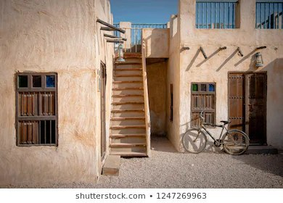

Module 2
Unit 4
Unforgettable past

Slide 2

Listening
SB./ P. 37
Folktales

Slide 3
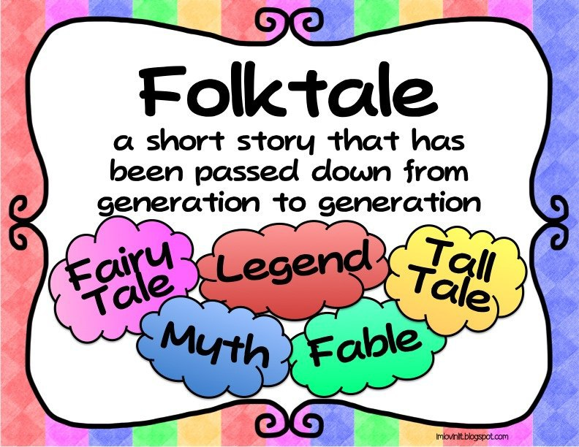
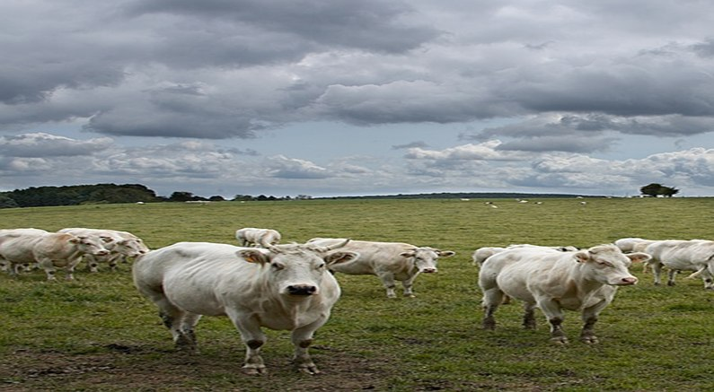
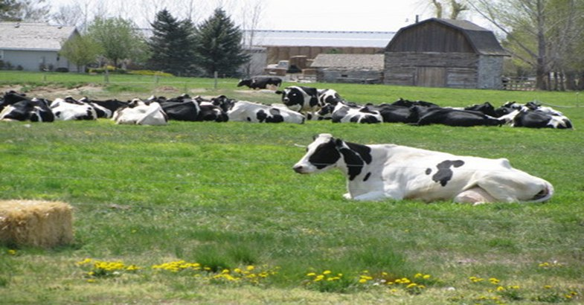
Describe the pictures & Guess the topic.

Slide 4



Slide 5


Activity 1 :
Listen and get the main idea
of the text:

Slide 6


Slide 7
humble (Adj)
not proud or not believing that you are important.
(poor / ordinary)

Slide 8
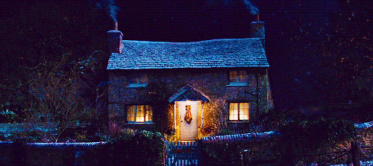
Example
The poor family lives
in a humble cottage.

Slide 9
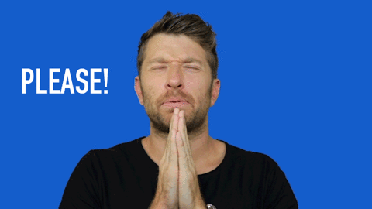
beg (V)
ask for something in
an anxious way.

Slide 10
Example
I begged my father to let
me visit my friends.

Slide 11
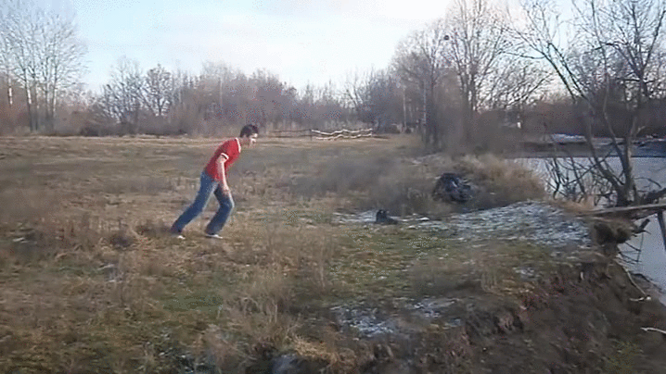
Plunge in (PhV)
jump or dive into water.

Slide 12
Example
It is a great fun to plunge
in water.

Slide 13
exceptionally (Adv)
in a way that is much greater than usual , specially in skill , intelligence , quality , etc.

Slide 14
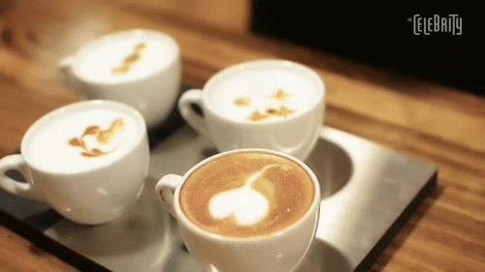
Example
The coffee is exceptionally
good today.

Slide 15
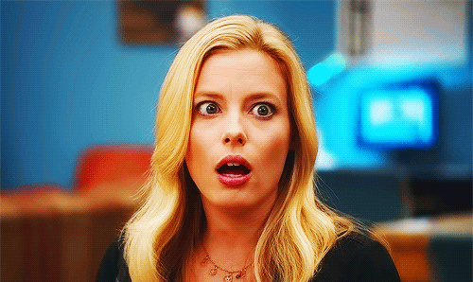
astonished (Adj)
very surprised.

Slide 16
Example
Her new dress astonished
me.

Slide 17
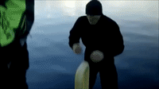
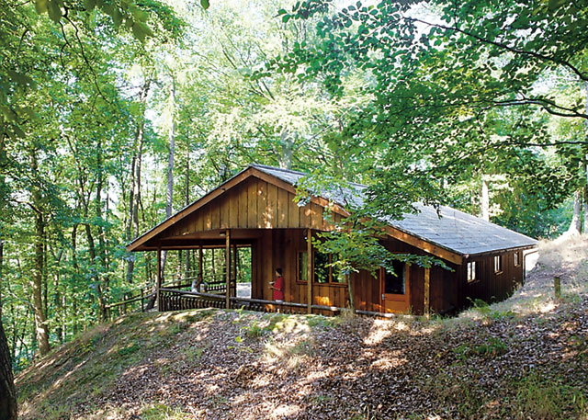
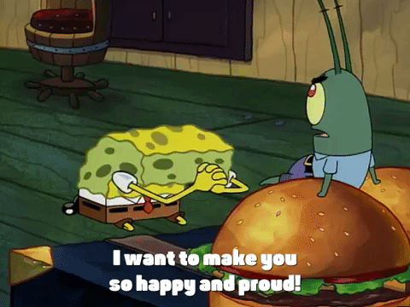
exceptionally (Adv)
humble
(Adj)
astonished
(Adj)
plunge in
(PhV)
beg (V)

Slide 18


Slide 19
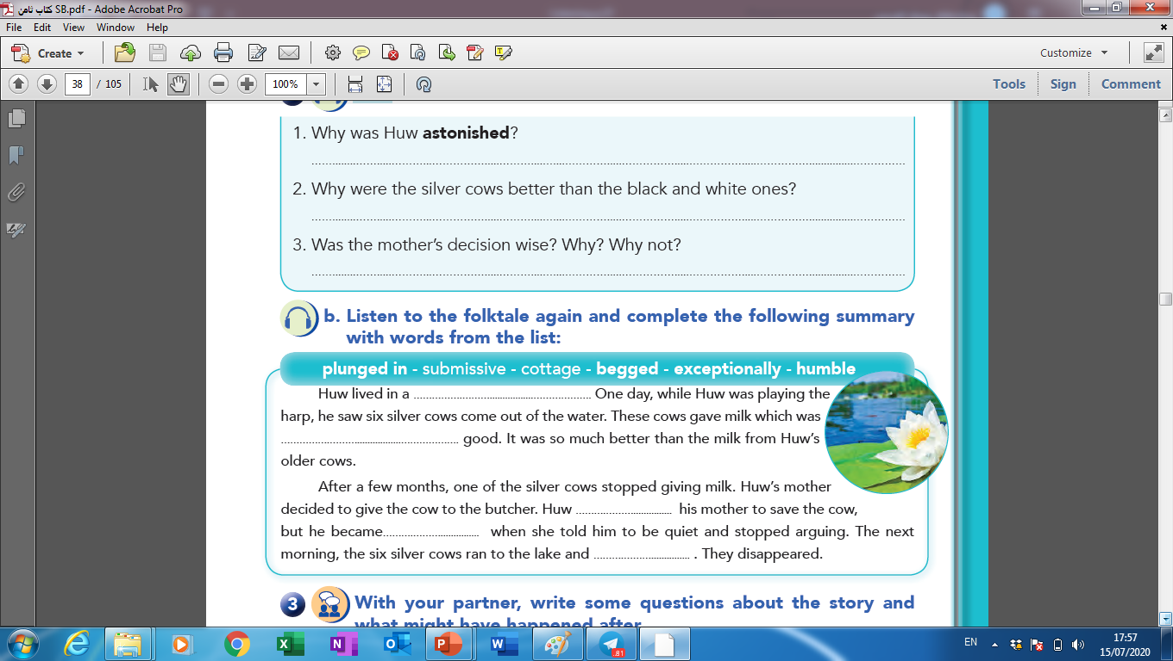
Activity 2 :

Slide 20



Slide 21
humble cottage
exceptionally
begged
submissive
plunged in

Slide 22
Activity 3 :

Slide 24
He was astonished because he saw six silver cows
rose out of the water.
Because the silver cows give twice as much milk as the black and white ones.
Test yourself !?

Slide 25
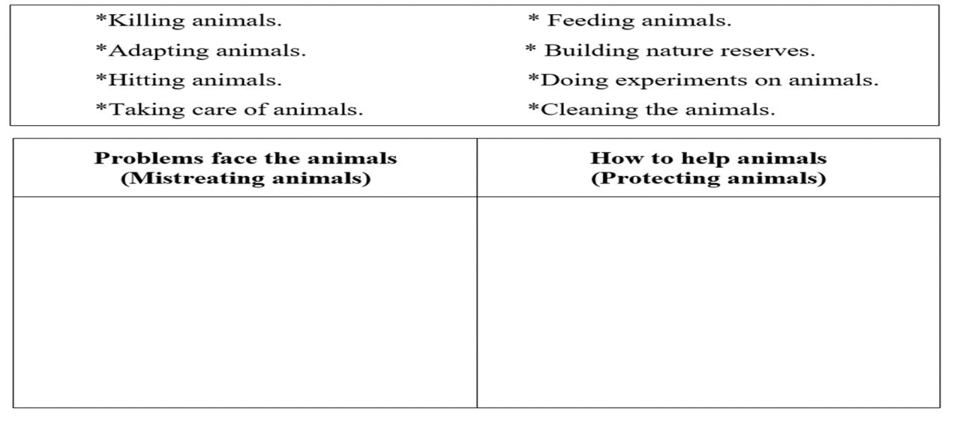
Activity 4 :
Fill in the following table with the given phrases about “Treating animals”.

Slide 26
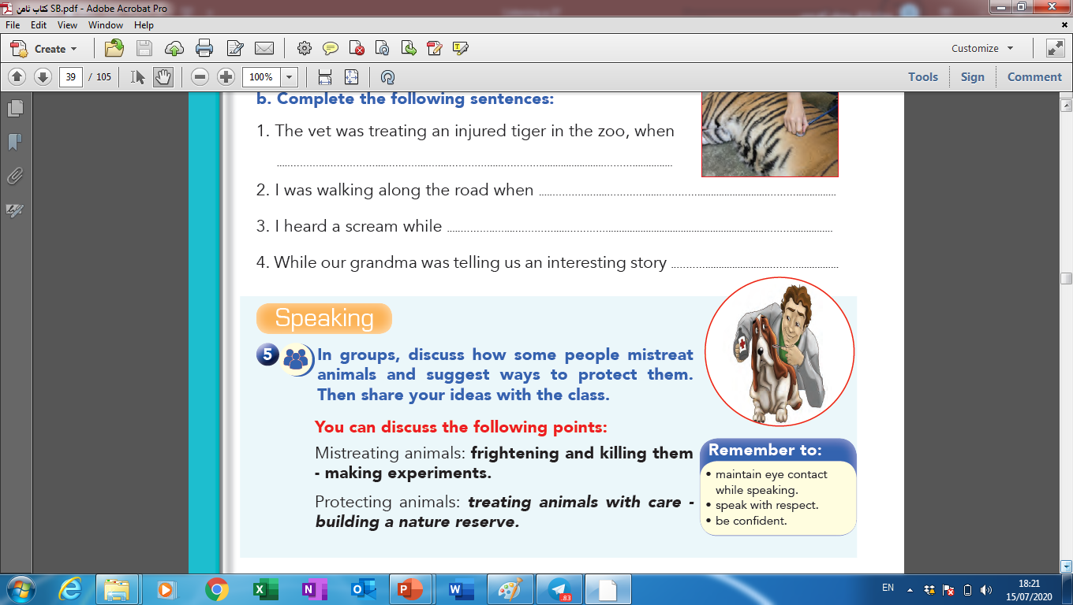

Slide 27


