Slide 1
Unit 8
Unit 7

Slide 2
البوابة الكويتية لصعوبات التعلم (redsoft.org)

Slide 4
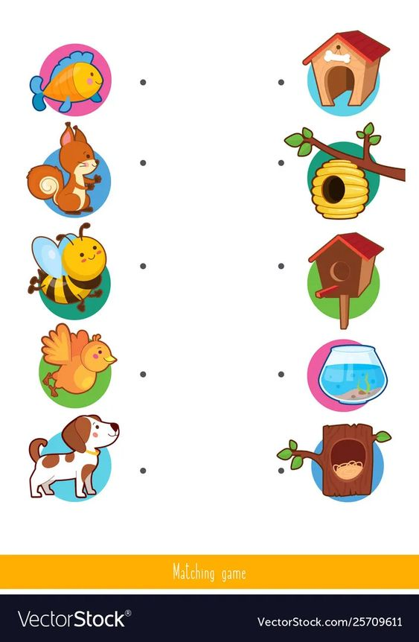

Slide 6
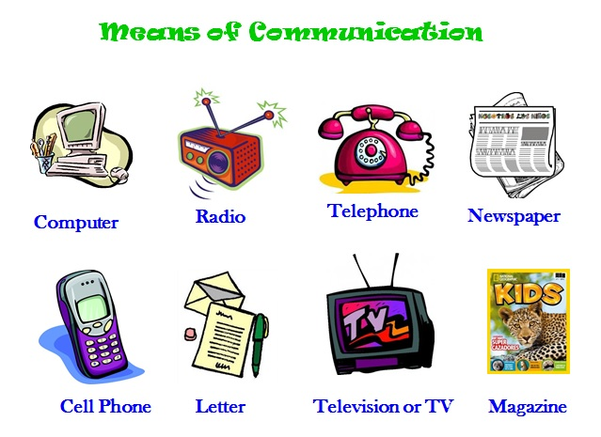
Mention means of communication.

Slide 7
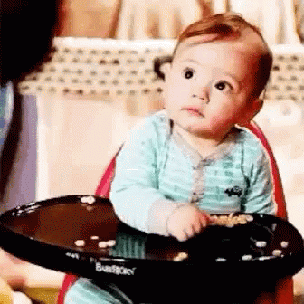
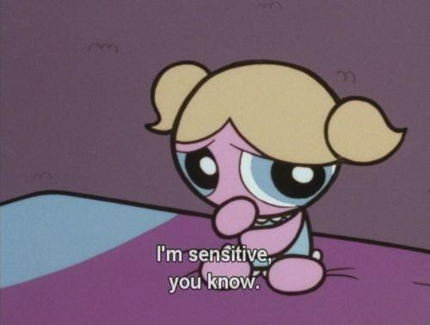
sensitive
easily upset by the things people say or do, or causing people to be upset, embarrassed, or angry

Slide 8
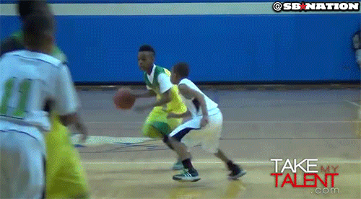
talented
with talent

Slide 9
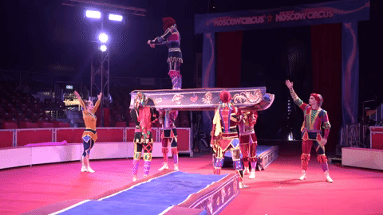
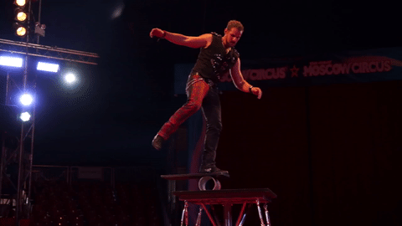
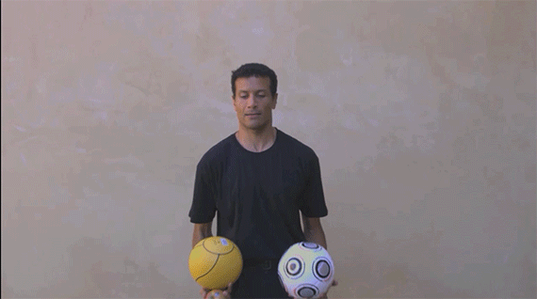
People who work in the circus are so skillful.

Slide 10
ورقة عمل الصف الثامن المتوسط مادةاللغة الانجليزية ::voc - revision 2 (redsoft.org)

Slide 11
Fill in the spaces with words from the list:
(talented – means- skillful - sensitive)
1- She is really ................................ as she has a touching voice.
talented

Slide 12
Fill in the spaces with words from the list:
(talented – means- skillful - sensitive)
2- Children are always ……….....……….. and cry easily.
sensitive

Slide 13
Fill in the spaces with words from the list:
(talented – means- skillful - sensitive)
3- There are many ..................................... for communication.
means

Slide 15
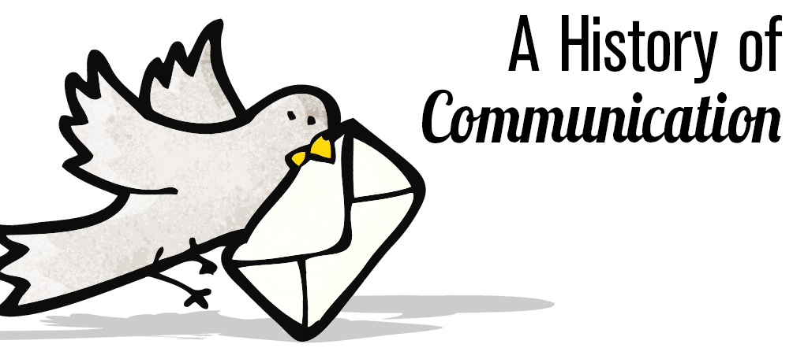
History of communication

Slide 16
Spin the wheel

Slide 18
How did people communicate in the past?

Slide 19
How do people communicate nowadays?

Slide 20
What is your best way to communicate with your friends?

Slide 21
What was the main source of information in the past?

Slide 22
Why is communication important?

Slide 23
What difficulties did people face?

Slide 26
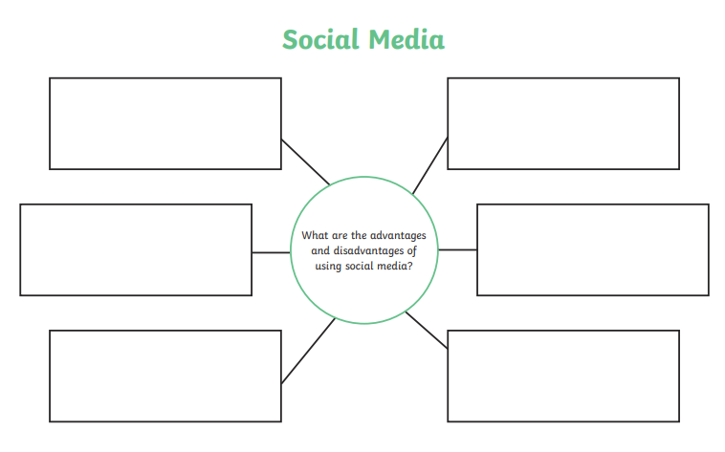
communication
Compare between communication in the past and nowadays?

Slide 27
Read your answers

Slide 28
Writing
“Communication in the past was totally different from communication nowadays.”
Plan and write two paragraphs of (not less than 10 sentences) about communication explaining how people communicated in the past and the means of communications nowadays.

Slide 30
Nowadays, the way we communicate has changed completely. It becomes faster and easier. People can communicate in different ways. They use mobile phones to make calls, and send messages. Communication is improving all the time.

Slide 31
Thank you

