Slide 1
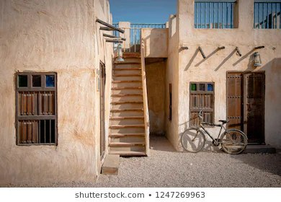

Module 2
Unit 4
Unforgettable past

Slide 2
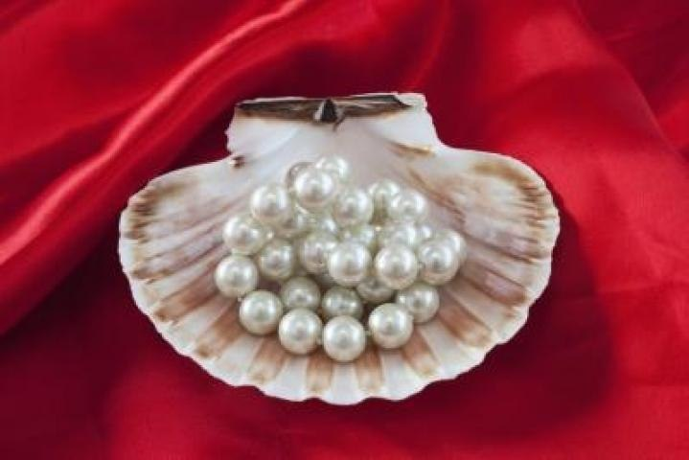
Reading …SB./ P. 39

Slide 3

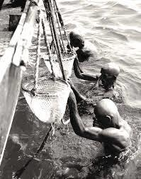
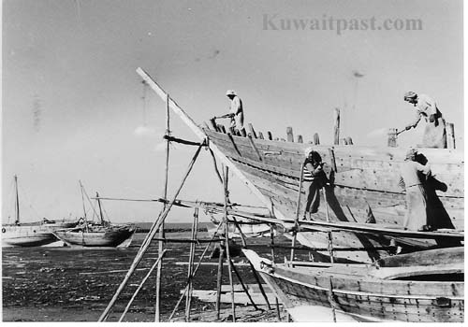
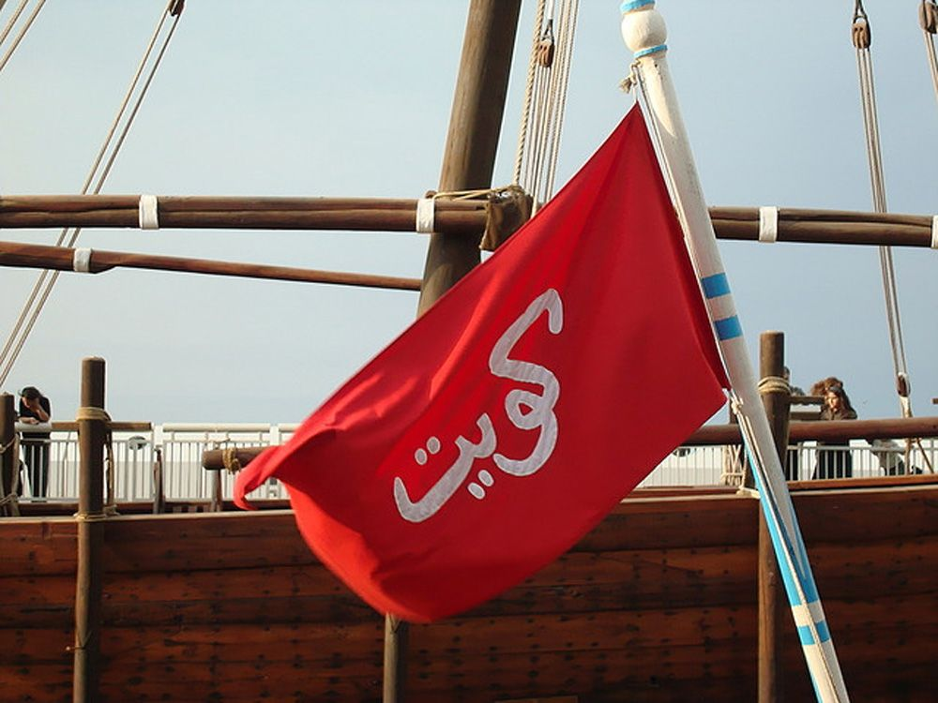
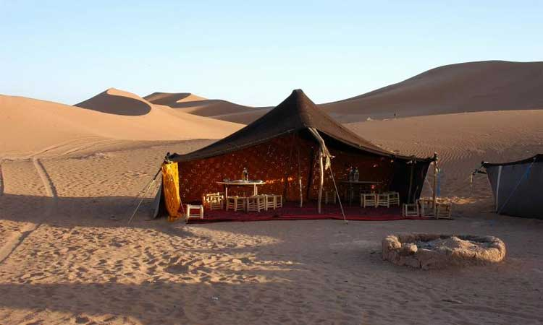
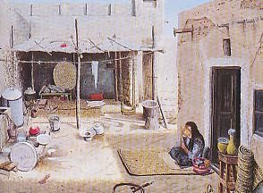
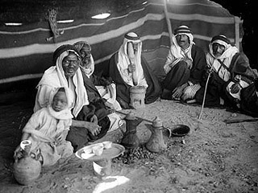
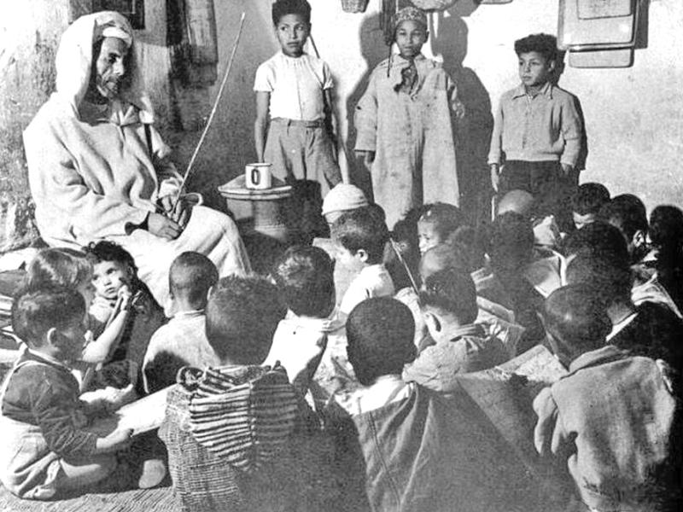
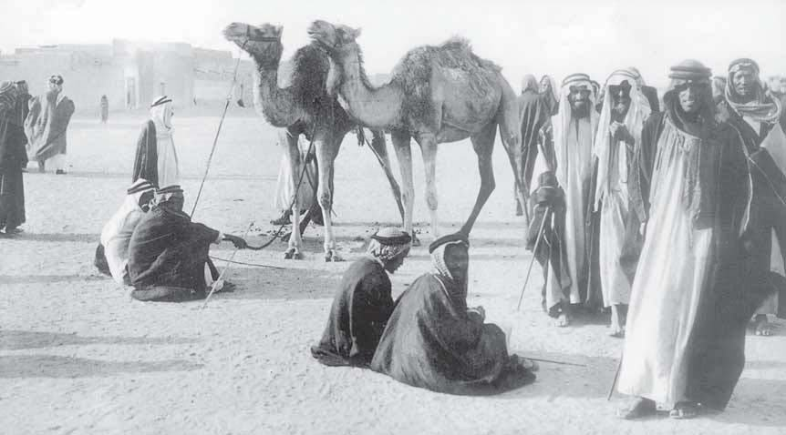

Describe the pictures & Guess the topic.

Slide 4

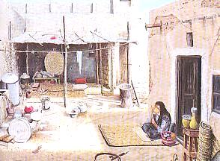
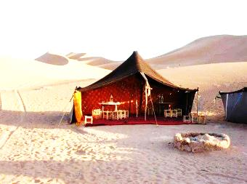
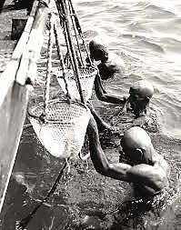
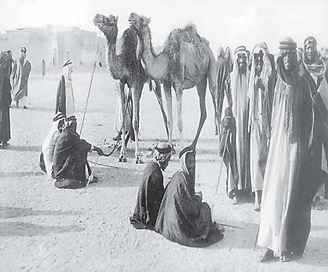
1- How was life in Kuwait in the past?
( hard / easy / simple / complex…..)
2- Where did people live in old Kuwait?
3- Discuss the jobs Kuwaiti people used
to work in the past.
4- List the difficulties they faced in these jobs.

Slide 5
Activity 1 :
Read the article and answer this question:
What is the main idea of the article ?
a- How people lived in the past.
b- The tradition of pearl diving in old Kuwait.
c- The different kinds of sea animals.
d- Building dhows and ships in the past.

Slide 6


Slide 7


hardship (N)
something bad causes difficult or unpleasant situation.

Slide 8
Example
Pearl divers faced many hardships
such dangerous sea animals.

Slide 9

securely (Adv)
protected.

Slide 10
Example
Pearl divers were tied securely
to the ship.

Slide 11

generation (N)
all people of about the same age.

Slide 12
Example
The tradition of pearl diving passed
from generation to another.

Slide 13
throughout (preposition)
in every part, or during the whole period of time.

Slide 14
Example
Divers held the rope throughout
the dive.

Slide 15
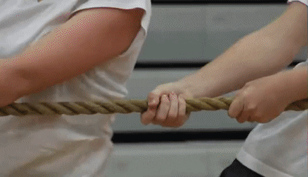
tug on (PhV)
to pull something quickly and usually with a lot of force.

Slide 16
Example
The divers tugged on the rope
to be pulled up to the surface.

Slide 17
heritage (N)
features belonging to the culture of a particular society, such as tradition.

Slide 18
Example
Pearl diving is still an important
part of the Kuwaiti heritage.

Slide 19
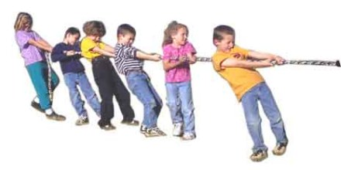

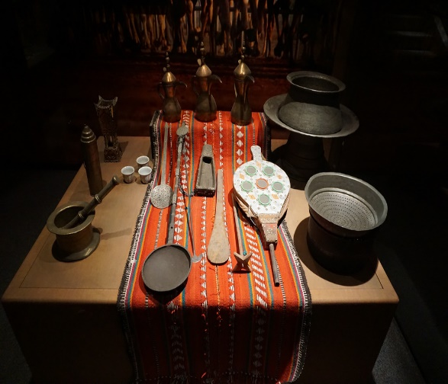
hardship (N)
generation (N)
securely (Adv)
throughout (Prep.)
tug on (PhV)
heritage (N)

Slide 20


Slide 21
Activity 2 :

Slide 22



Slide 23
4
1
2
3

Slide 24
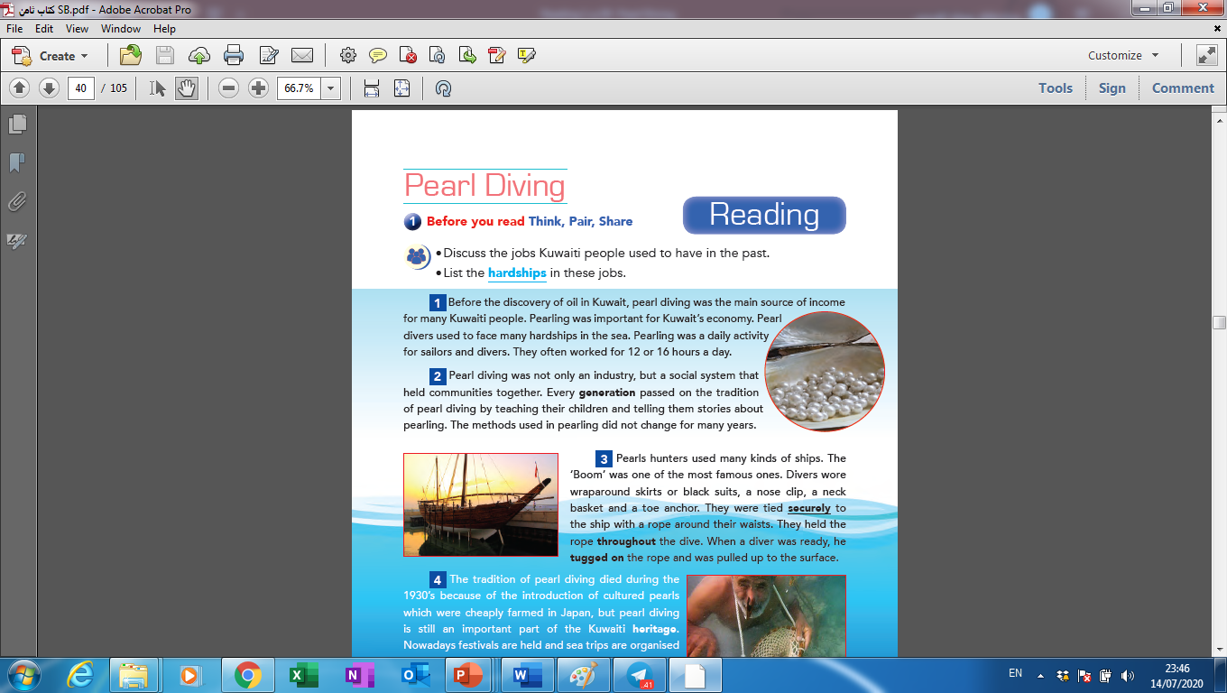
Activity 3 :
Read the article again and choose the correct answers:
1- The word “they” in the last line of the first paragraph refers to :
a- ships and hunters.
b- jobs and hardships.
c- pearls and fish.
d- sailors and divers.

Slide 25
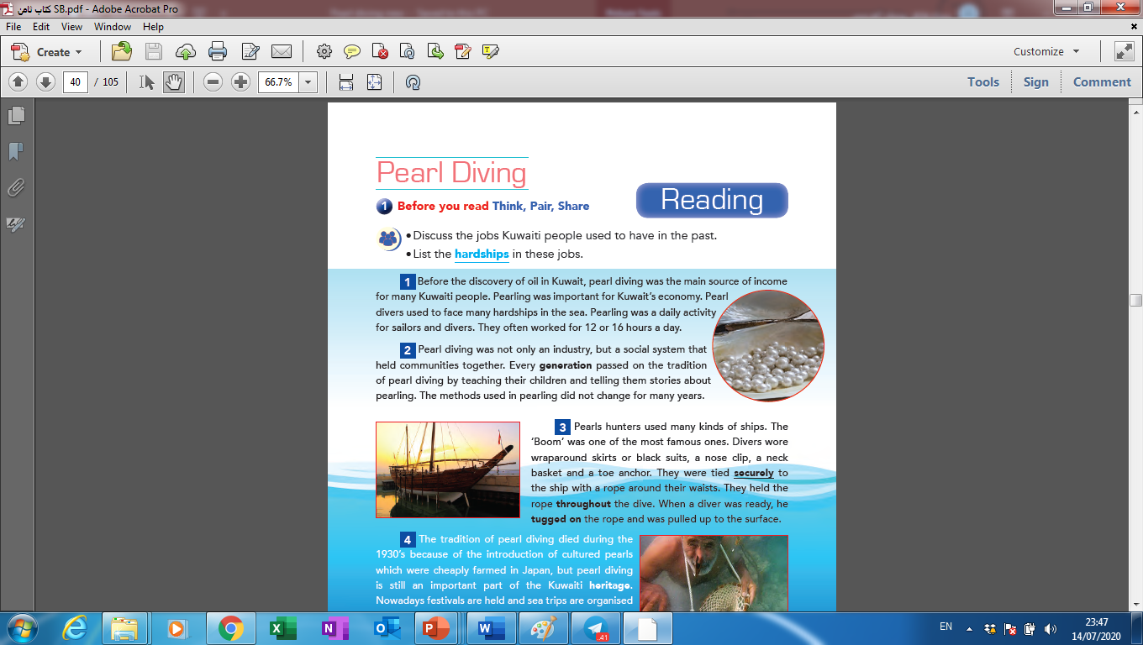
2- The opposite of the underlined word “securely” in the 3rd paragraph is :
a- quickly
b- nervously
c- dangerously
d- carefully

Slide 26
3- The purpose of the writer in writing this article is to:
a- describe the ships in the past.
b- inform us about the tradition of pearl diving.
c- talk about pearl diving festivals.
d- compare old Kuwait with modern Kuwait.

Slide 27
Activity 4 :
Read the article and answer the following question:
What equipment
did divers
need for
pearl diving?

Slide 29
What equipment
did divers
need for
pearl diving?
neck
basket
black
suit
nose
clip
toe
anchor

Slide 30

Do you think it is important to keep the tradition of pearl diving alive? Why?

Slide 31


