Slide 1

Unit 11
lesson 1
reading
S.B p82
W.B p31

Slide 2
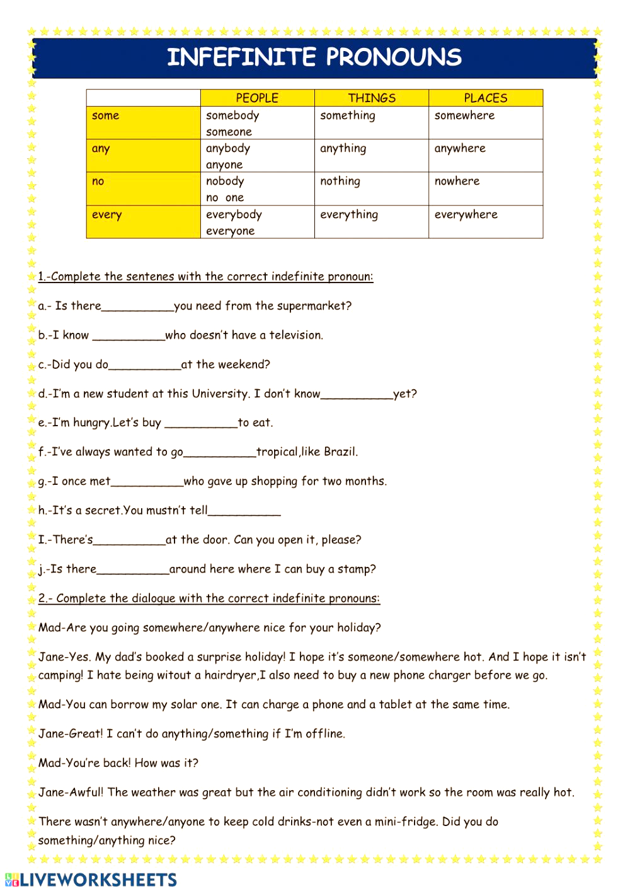

Slide 3
anything
somebody
anything
anybody
something

Slide 4


Slide 5


Slide 6
New voc:-
1. intended (adj)
purposed, expected, designed or planned

Slide 7
2. Original (adj)
existing since the beginning

Slide 8
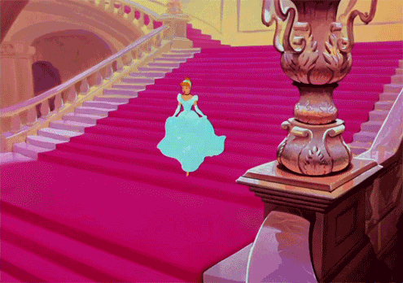
3.dramatic (adj)
Walt Disney is creative. His drawings are so dramatic.

Slide 9
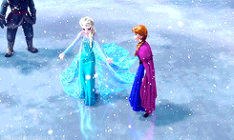

dramatic
very sudden or noticeable; or full of action and excitement

Slide 10
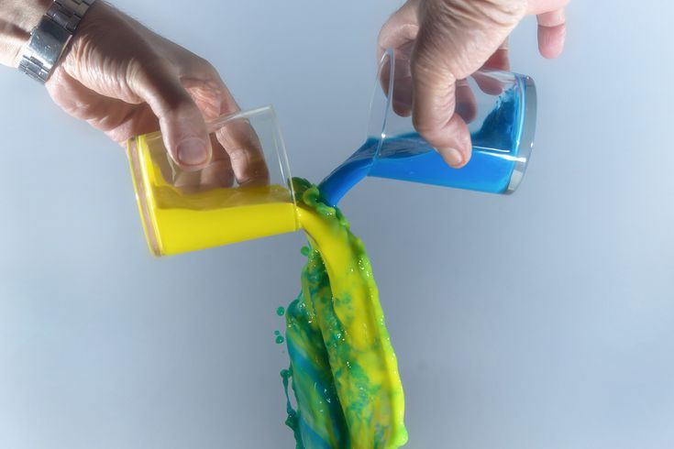
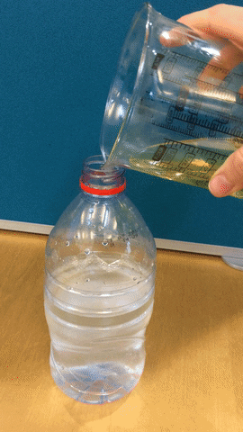
4. combined (v)
Combining yellow and
blue together.

Slide 11
4. combined (v)
Combine water and oil.

Slide 12

combine computer + network = Internet

Slide 13
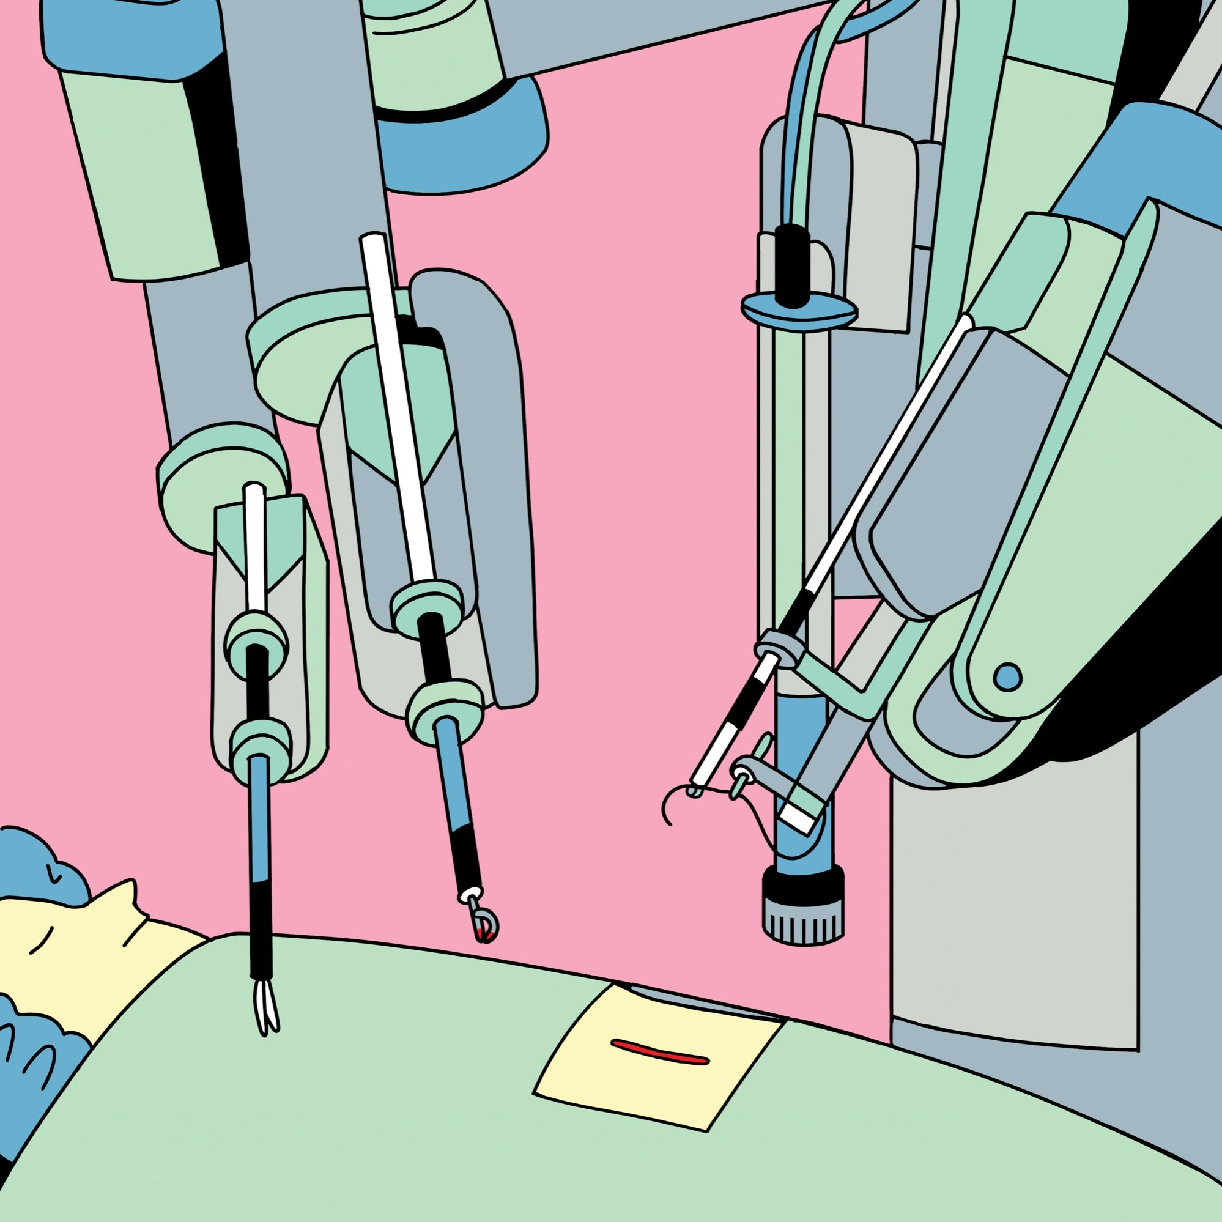
Many surgical operations involve many machines.

Slide 14
5. involve (v)
to make necessary

Slide 15
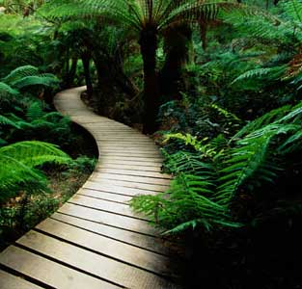
6. approach (n)
a way of doing something

Slide 16
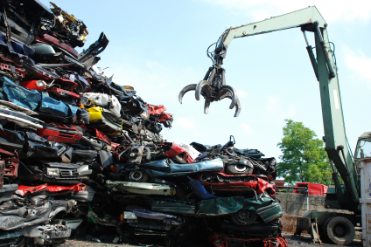
It’s a creative approach to take the old cars away for recycling.

Slide 17
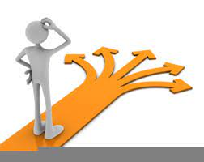
Focusing on solutions rather than problems is a great approach.

Slide 18
7. restriction (n)

Slide 19
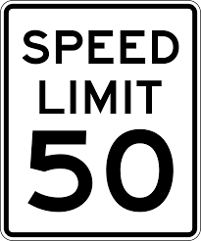
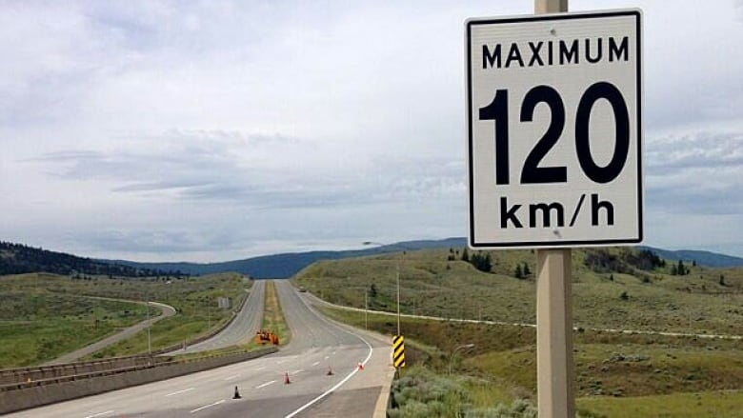
restriction
an official limit on something

Slide 20
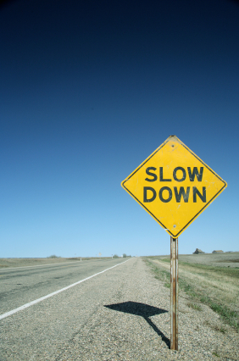
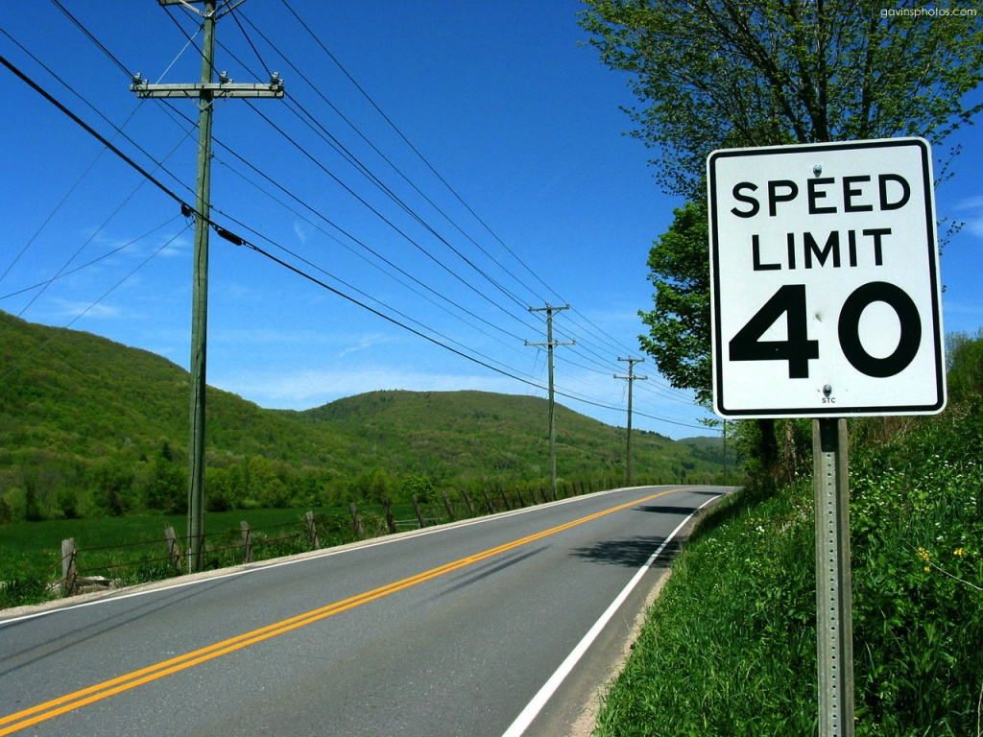
These are speed restrictions and signs.

Slide 21
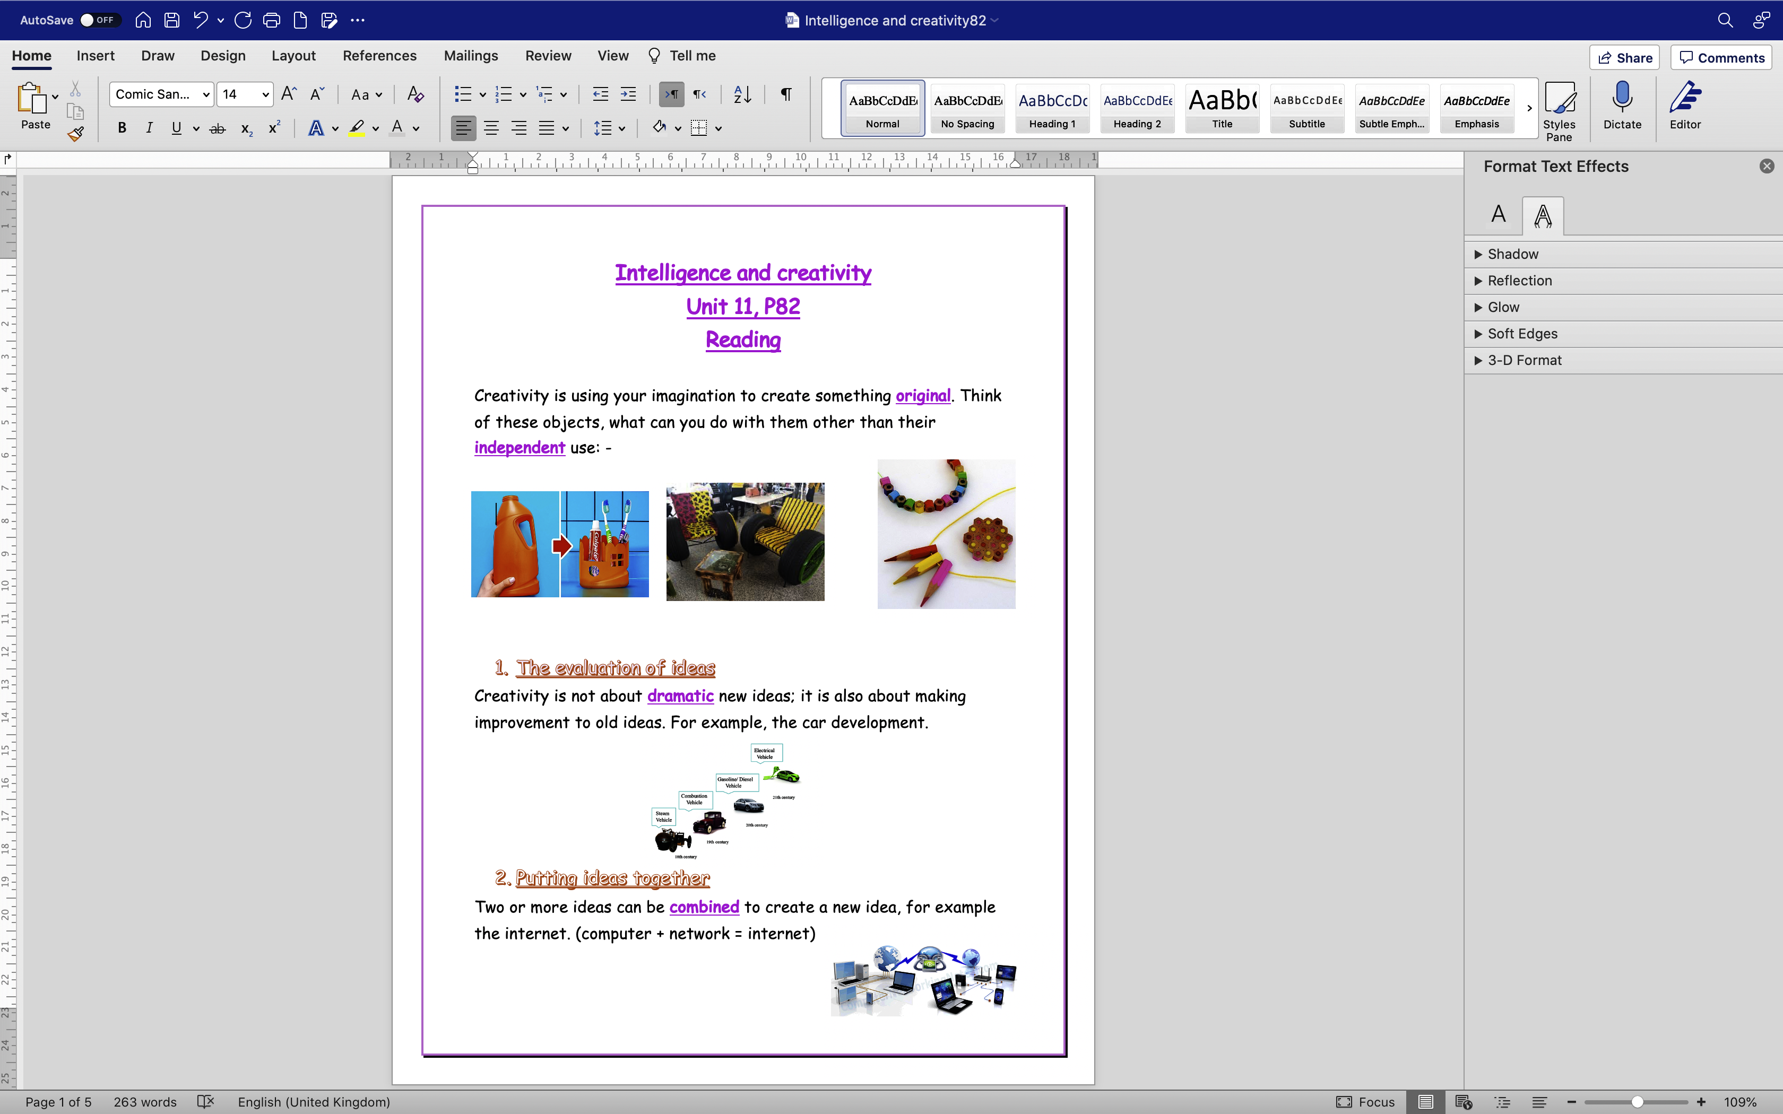

Slide 22
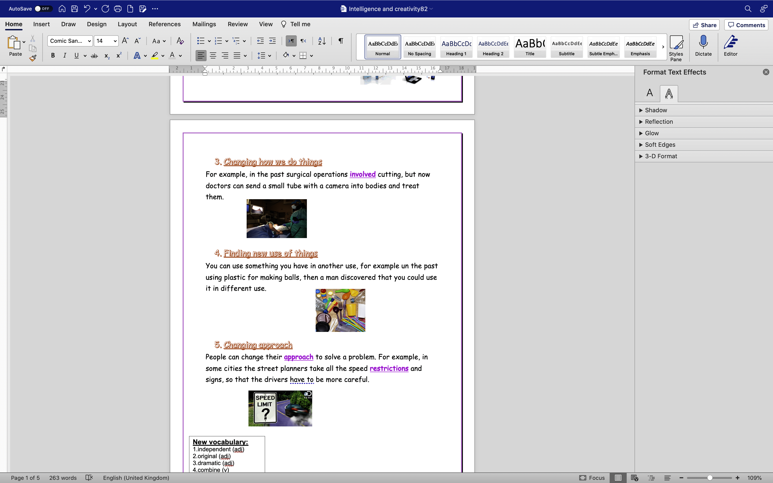

Slide 23
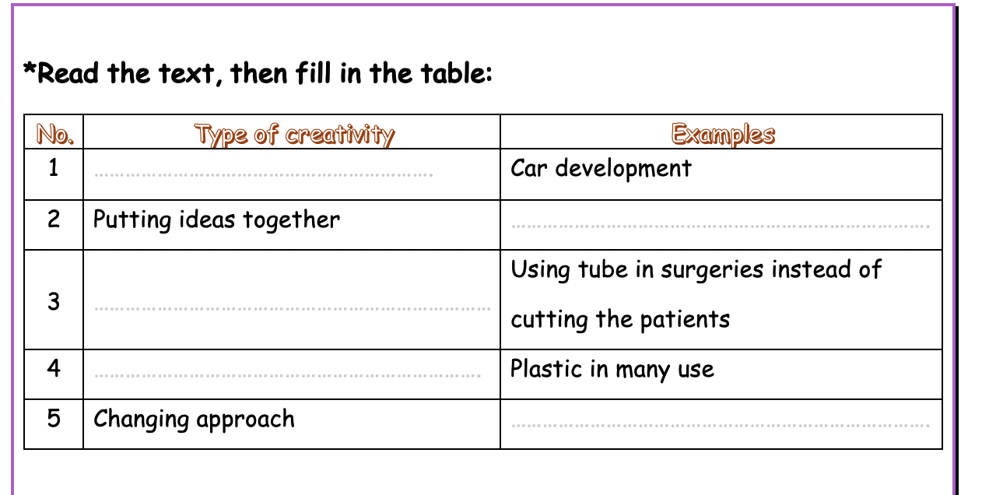

Slide 24
The evoluation of ideas
The internet
Changing how we do things
Finding a new use of things
No signs and traffic
restrictions

Slide 25
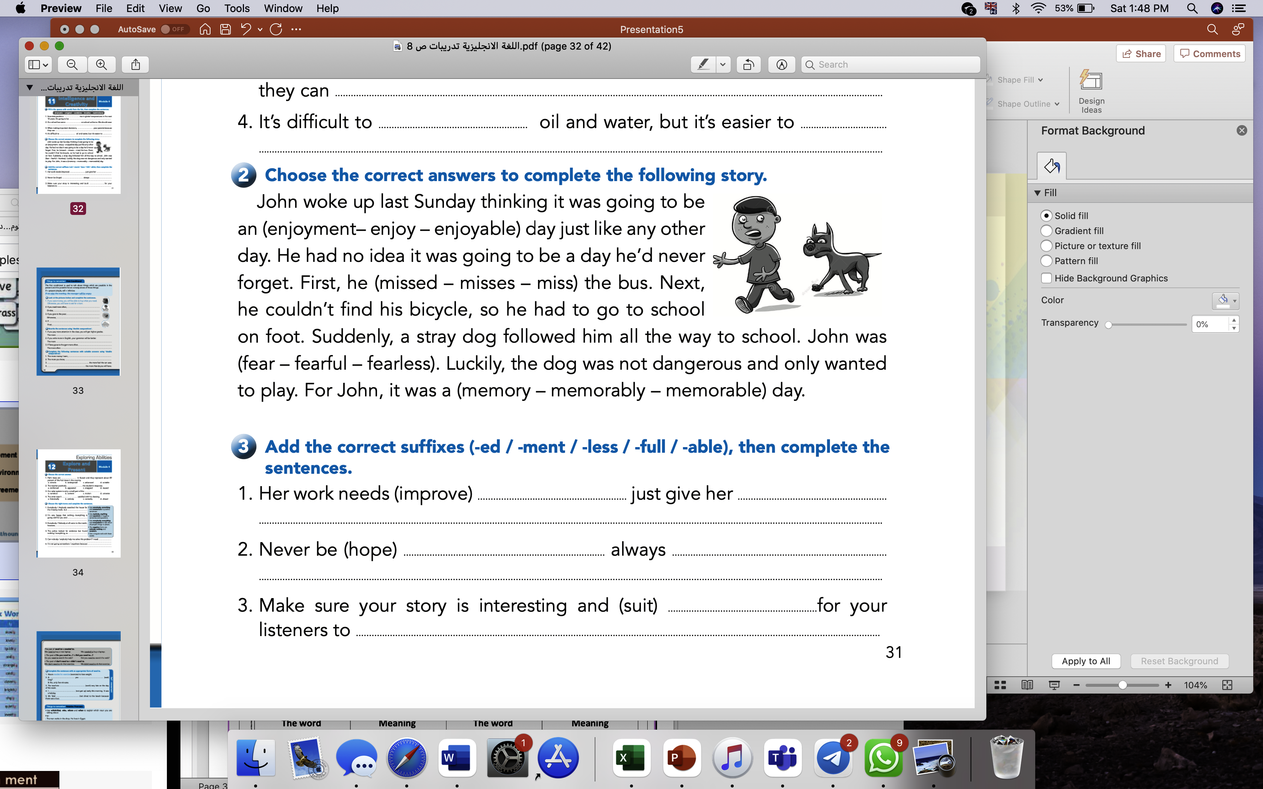

Slide 27
improvement
more ideas
hopeless
be hopefull
suitable
get more listeners

Slide 28
New voc:-
1. appearance (n)
the way that someone or something looks.
"she checked her appearance in the mirror
Unit 11
lesson 2
grammar
Indefinite pronouns

Slide 29
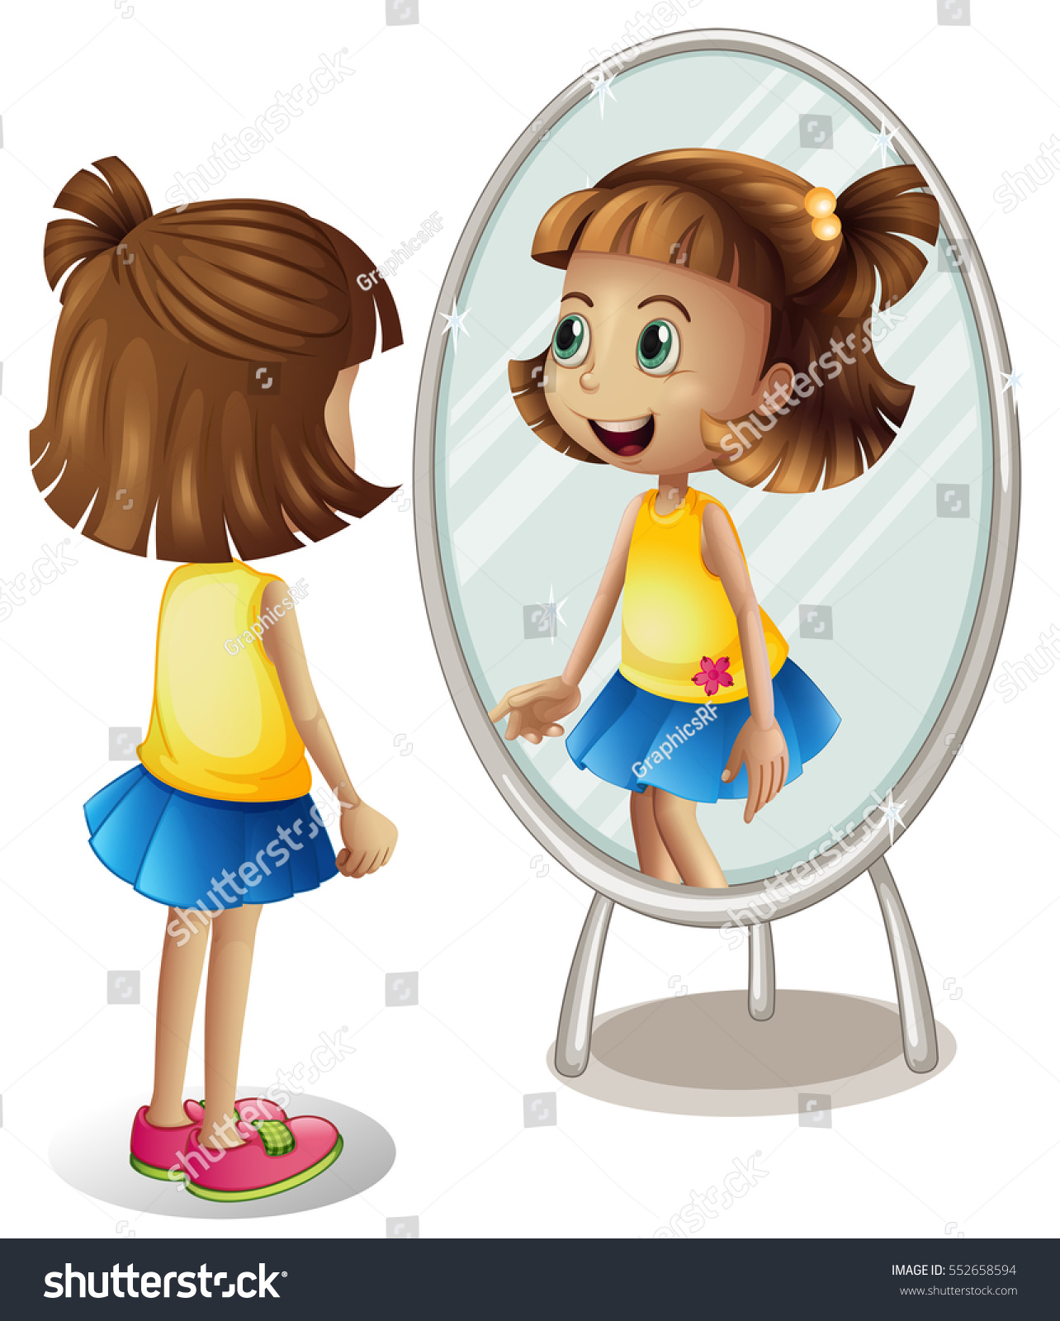
She checked her appearance in
the mirror.
Unit 11
lesson 2
grammar
Indefinite pronouns

Slide 30
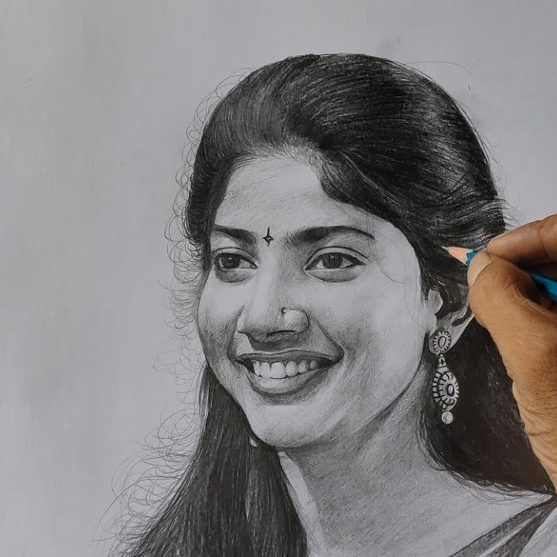
2. expert (n)

Slide 31

expert
a person with a high level of knowledge or skill in something

Slide 32
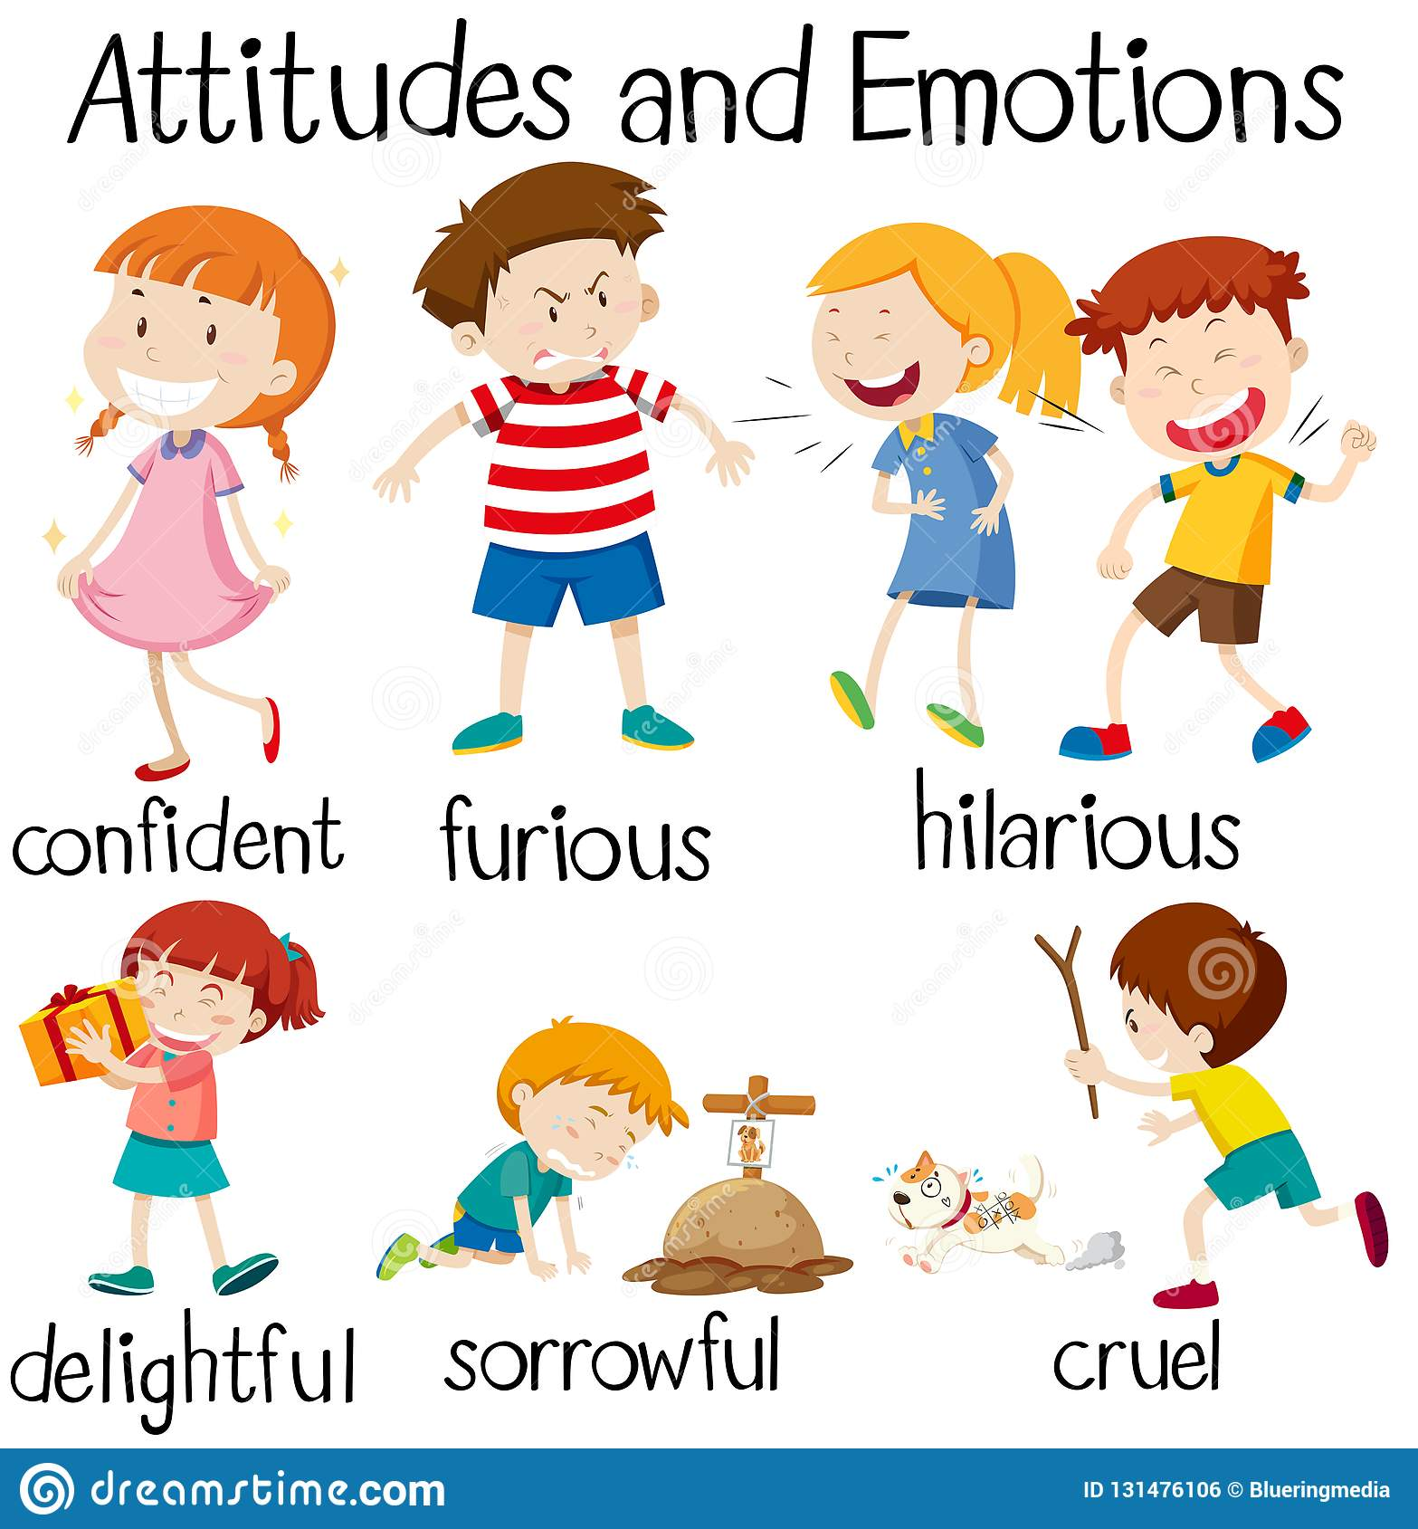
3.attitude (n)
It's often very difficult to change people's attitudes.

Slide 33
attitude
a feeling or opinion about
something or someone,
or a way of behaving

Slide 34
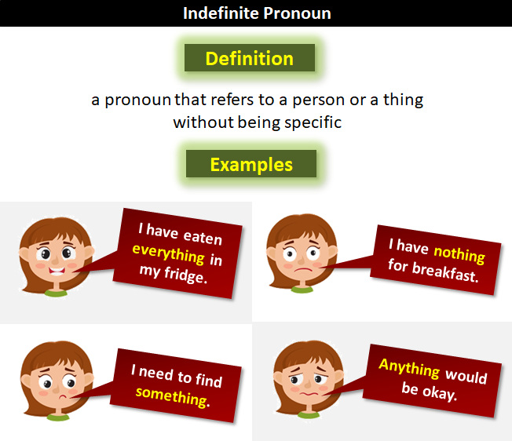

Slide 35
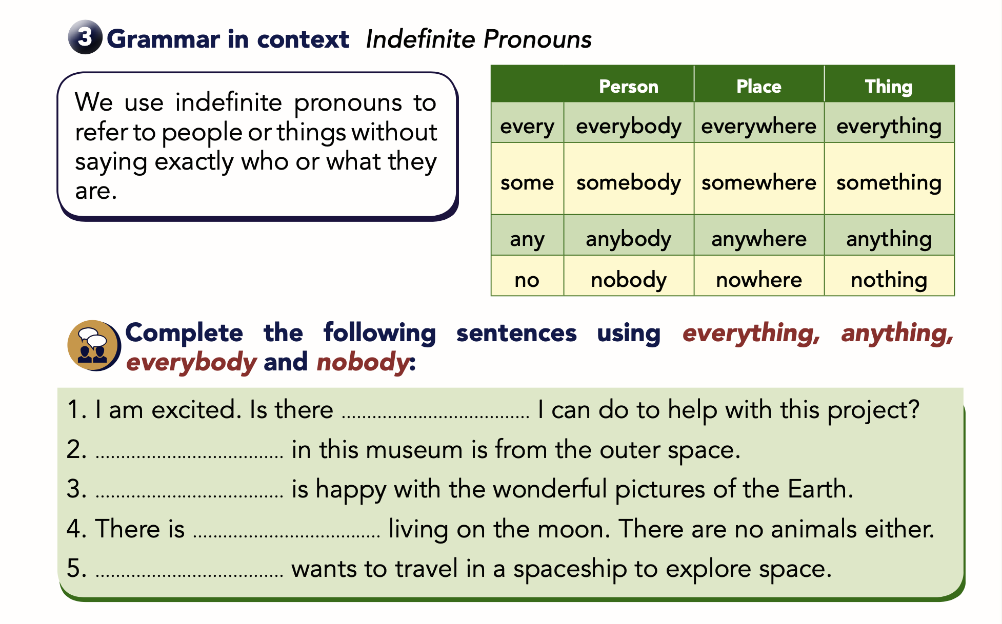

Slide 37
Unit 11
lesson 3
grammar
S.B p82
W.B p31

Slide 38
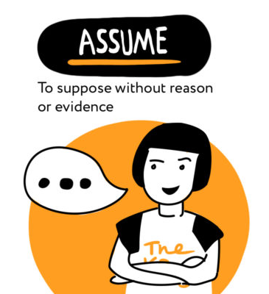
The teacher assumed that the students have great ideas to do the.

Slide 39
assume (v)
to accept or believe that something is true without question or proof

Slide 40
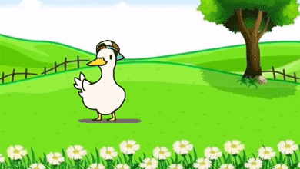

Slide 41
What did you see
previously?

Slide 42

Previously (adv)
before the present time

Slide 43
Unusual (adj)
different from others of the same type in a way that is surprising, interesting, or attractive

Slide 44
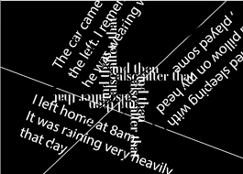
detail (n)
a single piece of information or fact about something

Slide 45
generally (adv)
usually, or in most situations

Slide 46
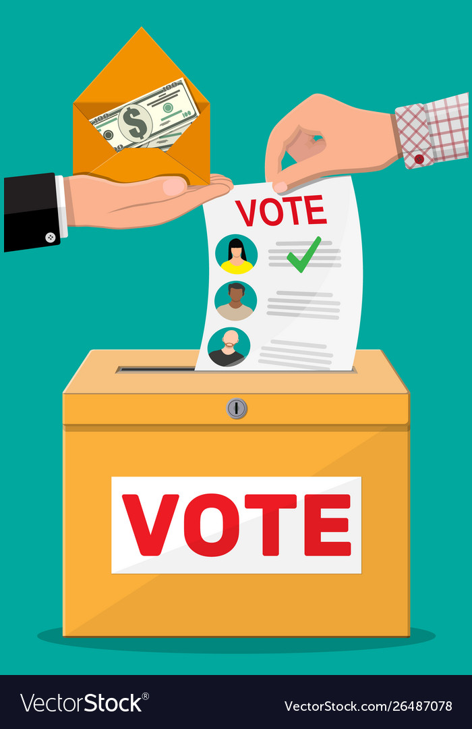
vote (v)

Slide 47
People generally smile back if you smile at them.

Slide 48
generally
usually, or in most situations

Slide 49


Slide 51
(The + comparative adjective, the + comparative adjective)

Slide 52
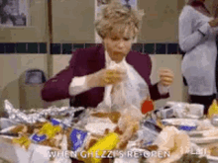
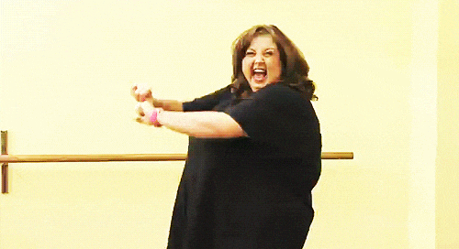
The more you eat, the more weight you gain.

Slide 53
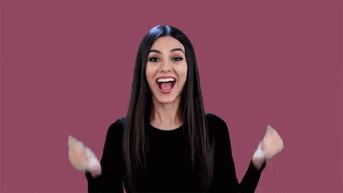
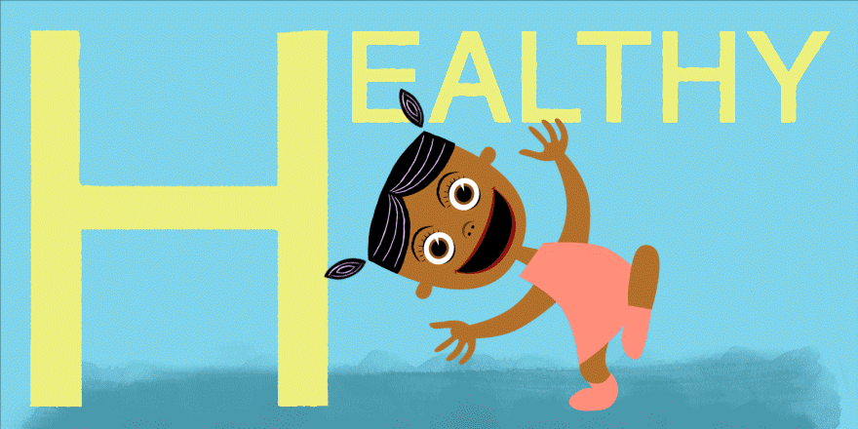
The happier you are, the healthier you get.

Slide 54

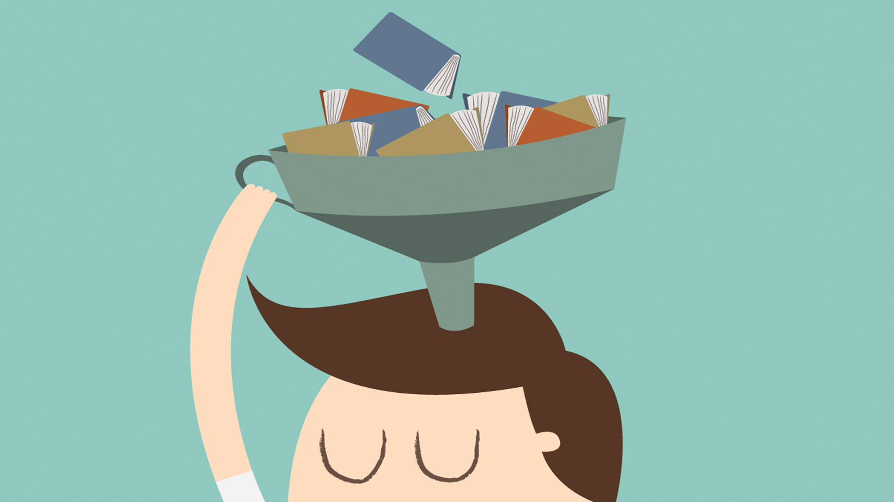
The more you study, the more you learn.

Slide 55
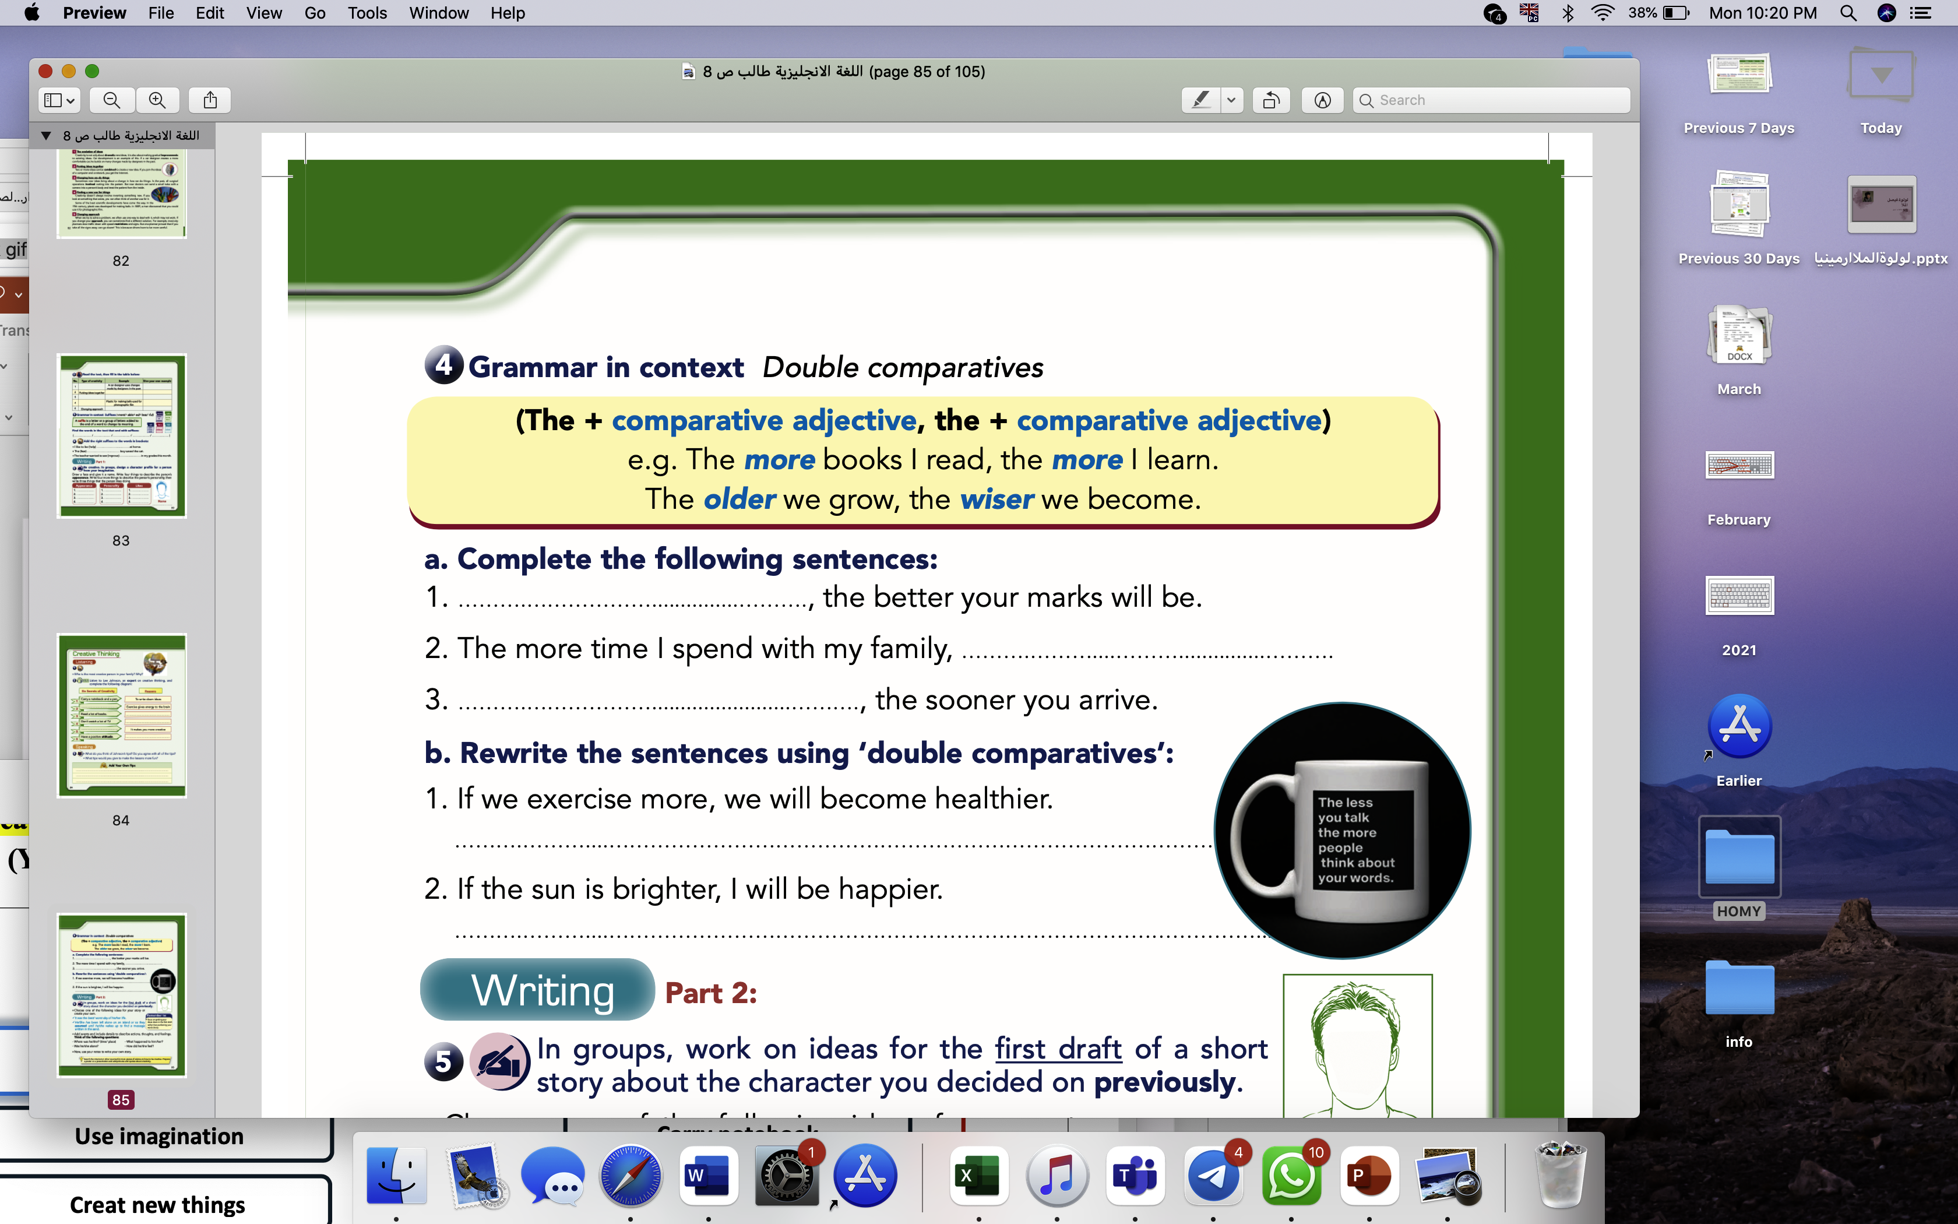
S.B p85

Slide 56
S.B p85
The more you study
the happier I will be.
The earlier you leave

Slide 57
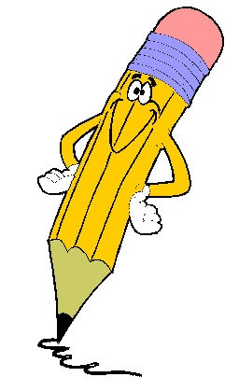
W.B p32

Slide 58
the better life I will have.
the more you will learn.
The faster you drive,
The more you smile,

Slide 59


Slide 60
The more you exercise, the healthier you will become.
The more you exercise, the healthier you will become.

Slide 61
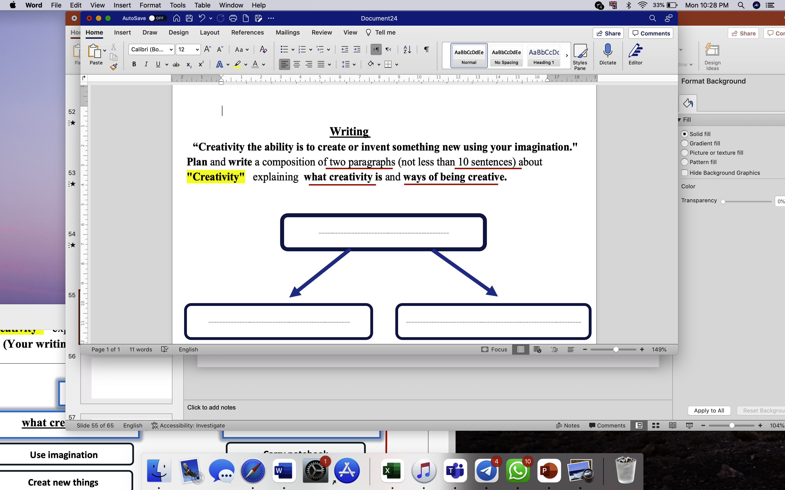
Creativity
What creativity is
Ways of being creative

Slide 62
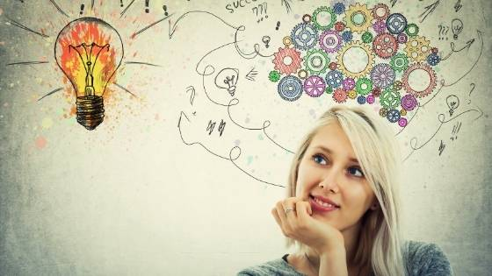
Use imagination

Slide 63

Make new things

Slide 64
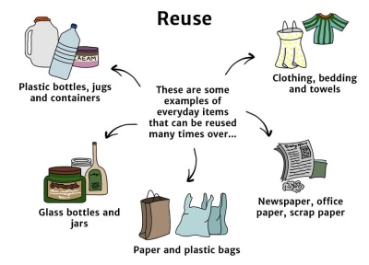
Reuse things

Slide 65

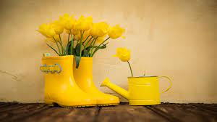
Find new use

Slide 66
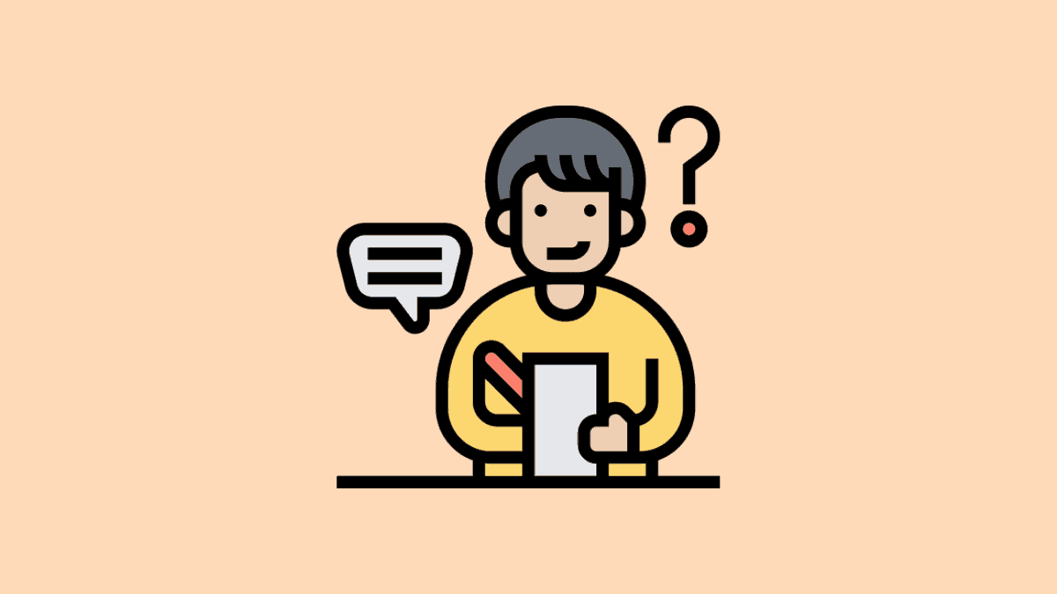
Write notes

Slide 67
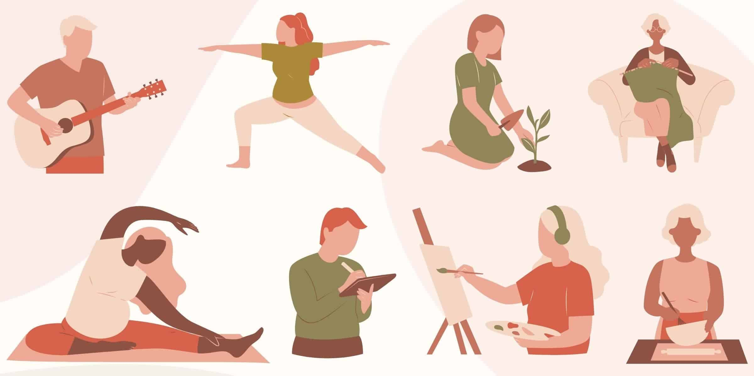
Start a hobby

Slide 68

Read more

Slide 69
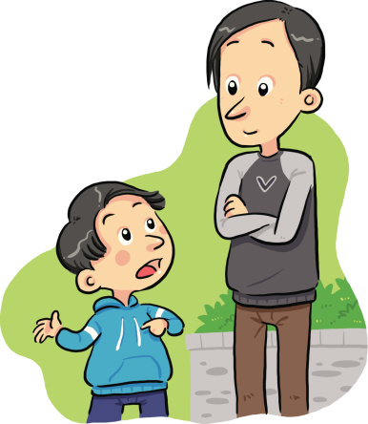
Ask my teachers and parents

Slide 70
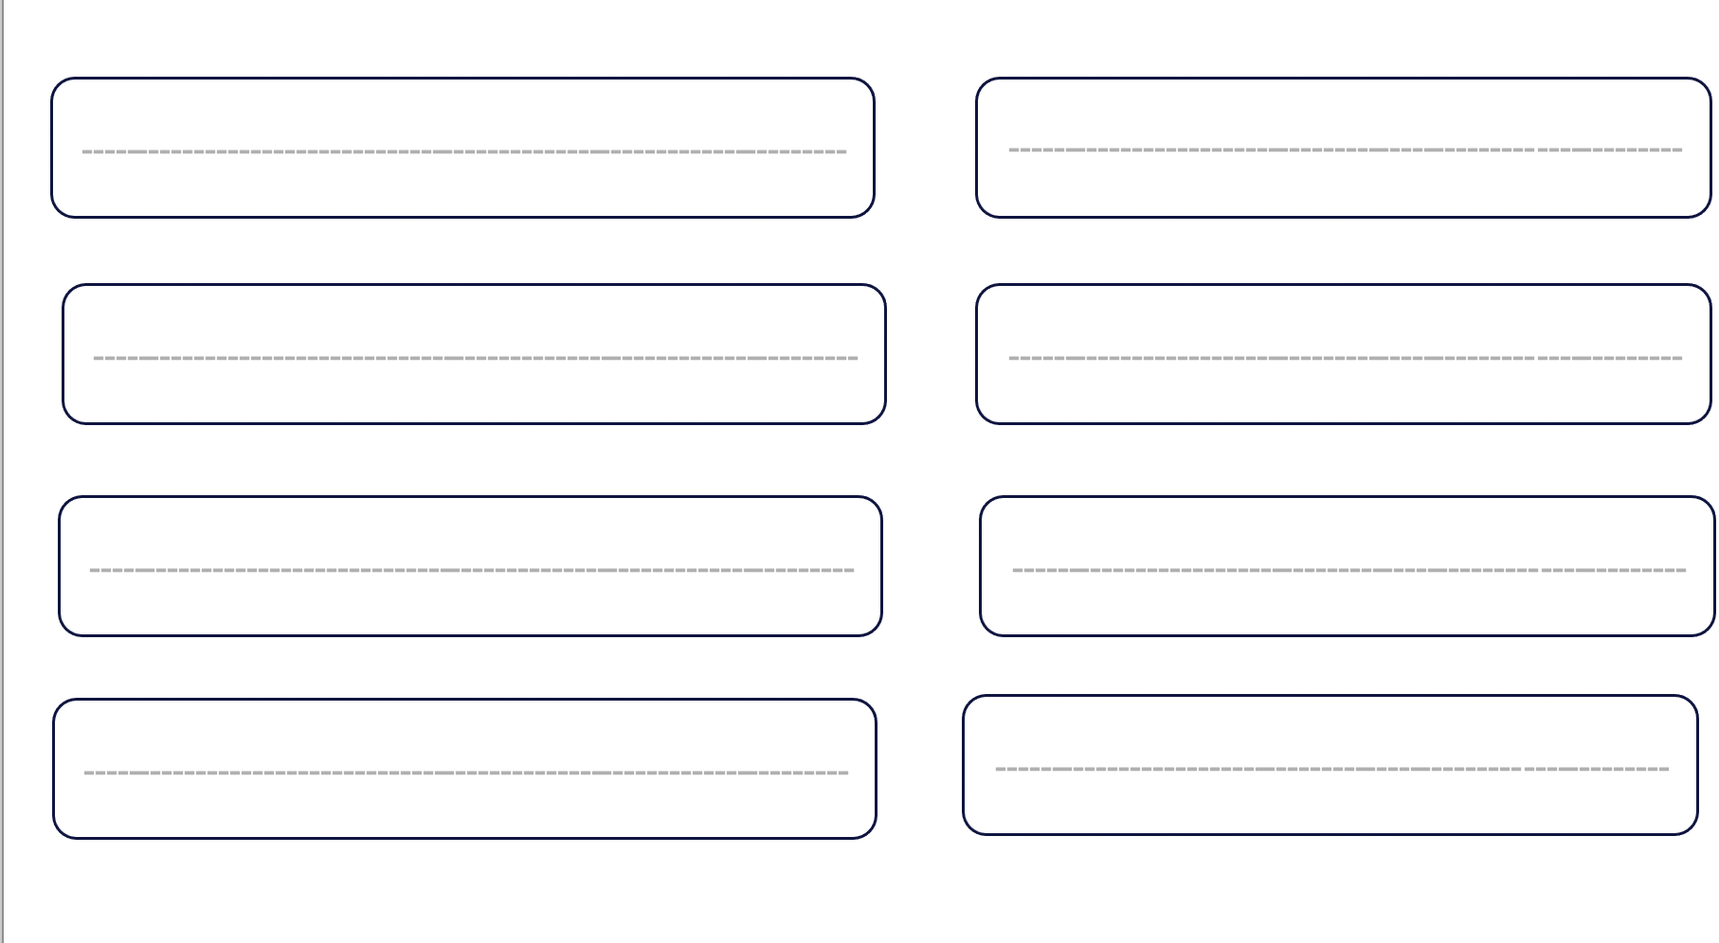
Use imagination
Make new things
Reuse things
Find new use

Slide 71
3
Write notes
Start a hobby
Read more
Ask my teachers and
parents

Slide 72
Creativity
Today I will write about creativity. I can use my imagination. I can reuse things to make new things. I can find a new use for something, for example, I can use empty bottles as vase.
I need to write notes. I need to start a hobby. I need to read more. I need to search for new things. I need to ask my teachers and my parents.

Slide 73
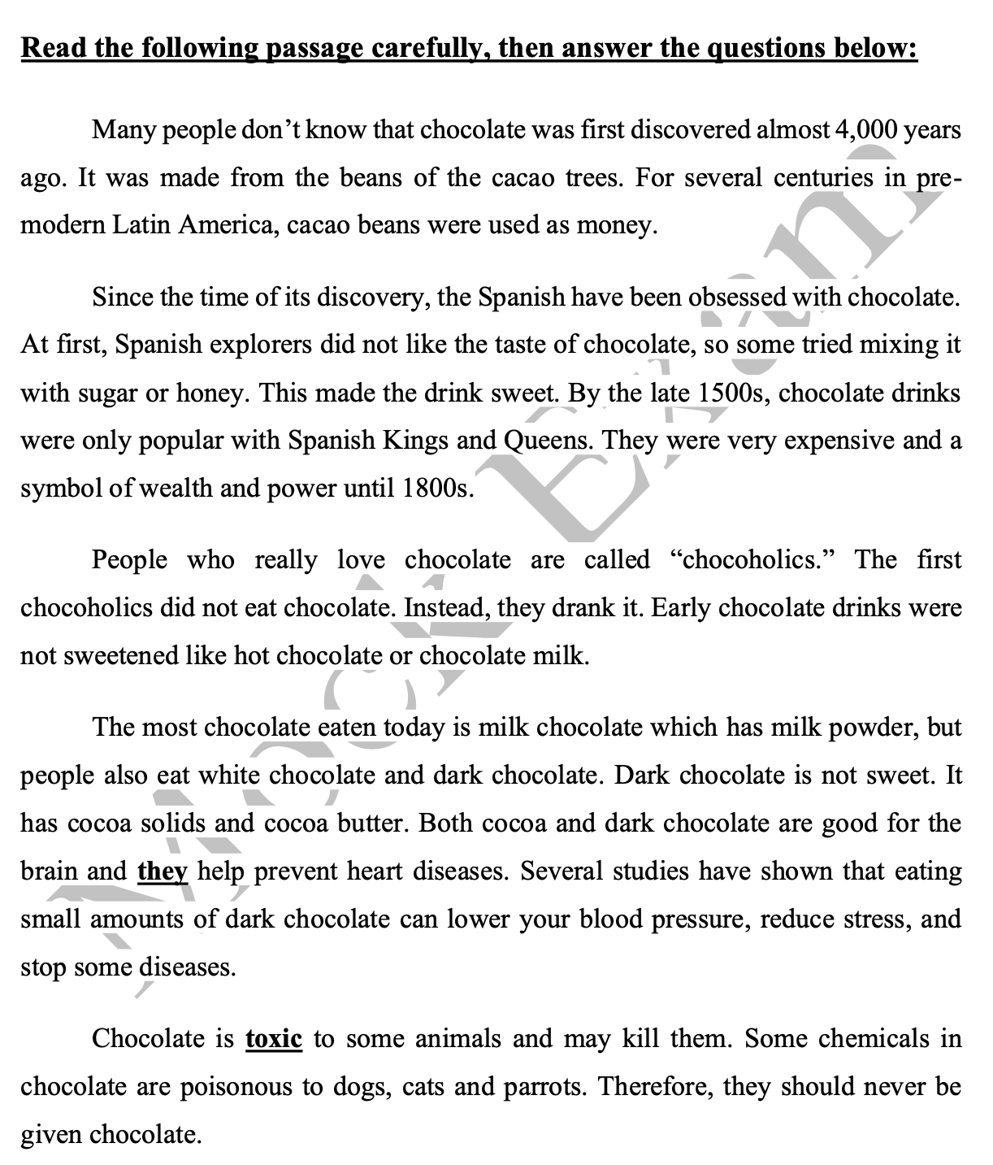

Slide 74
1
2
3
4
5

Slide 75
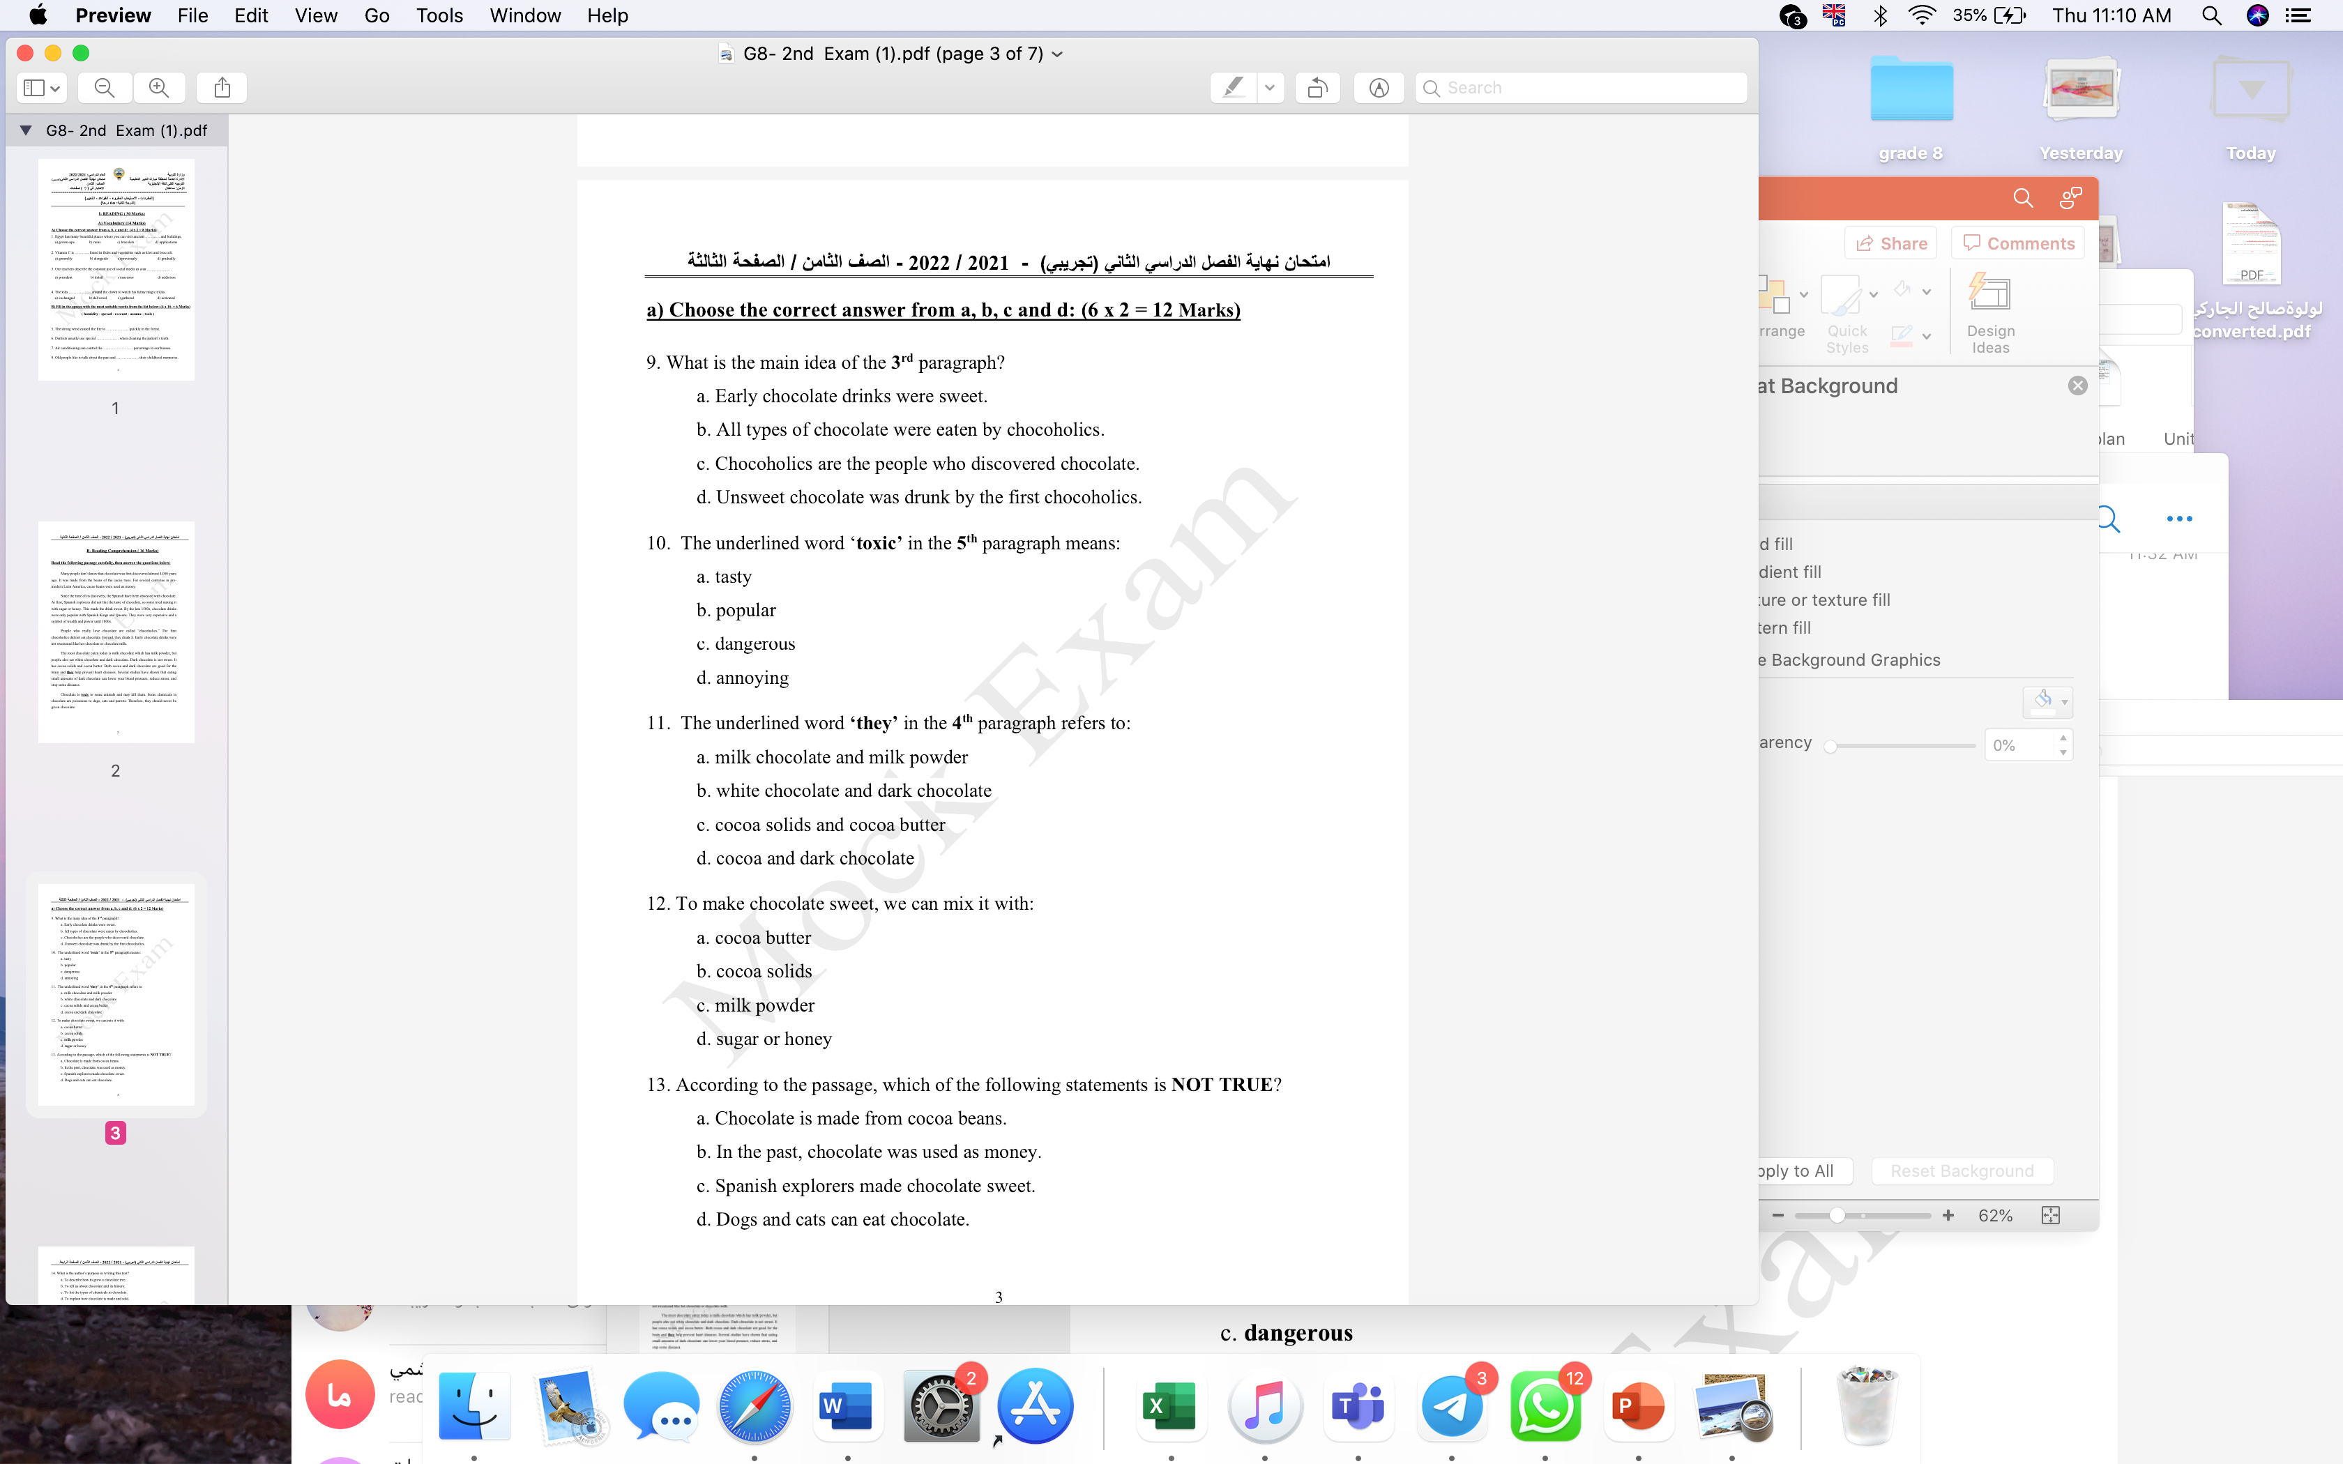

Slide 76
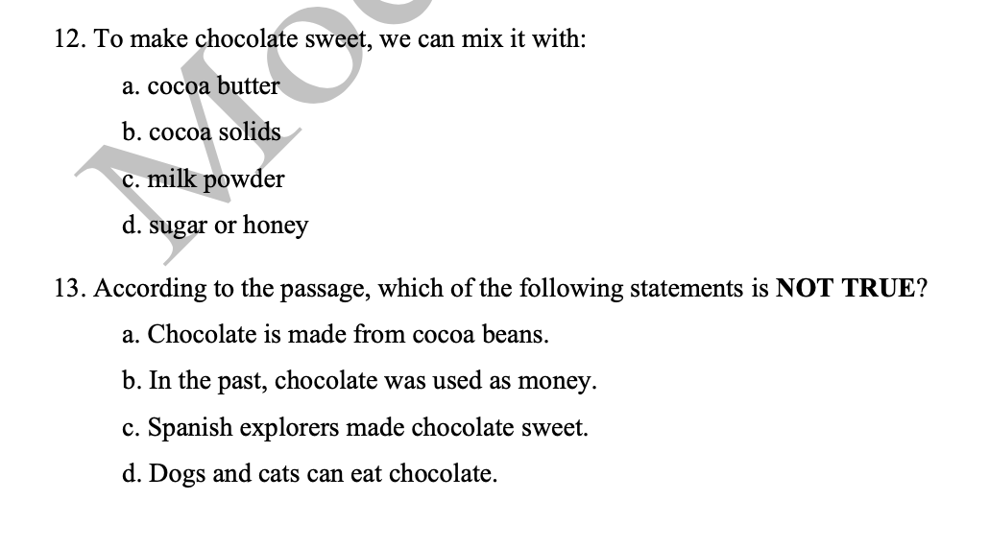

Slide 77
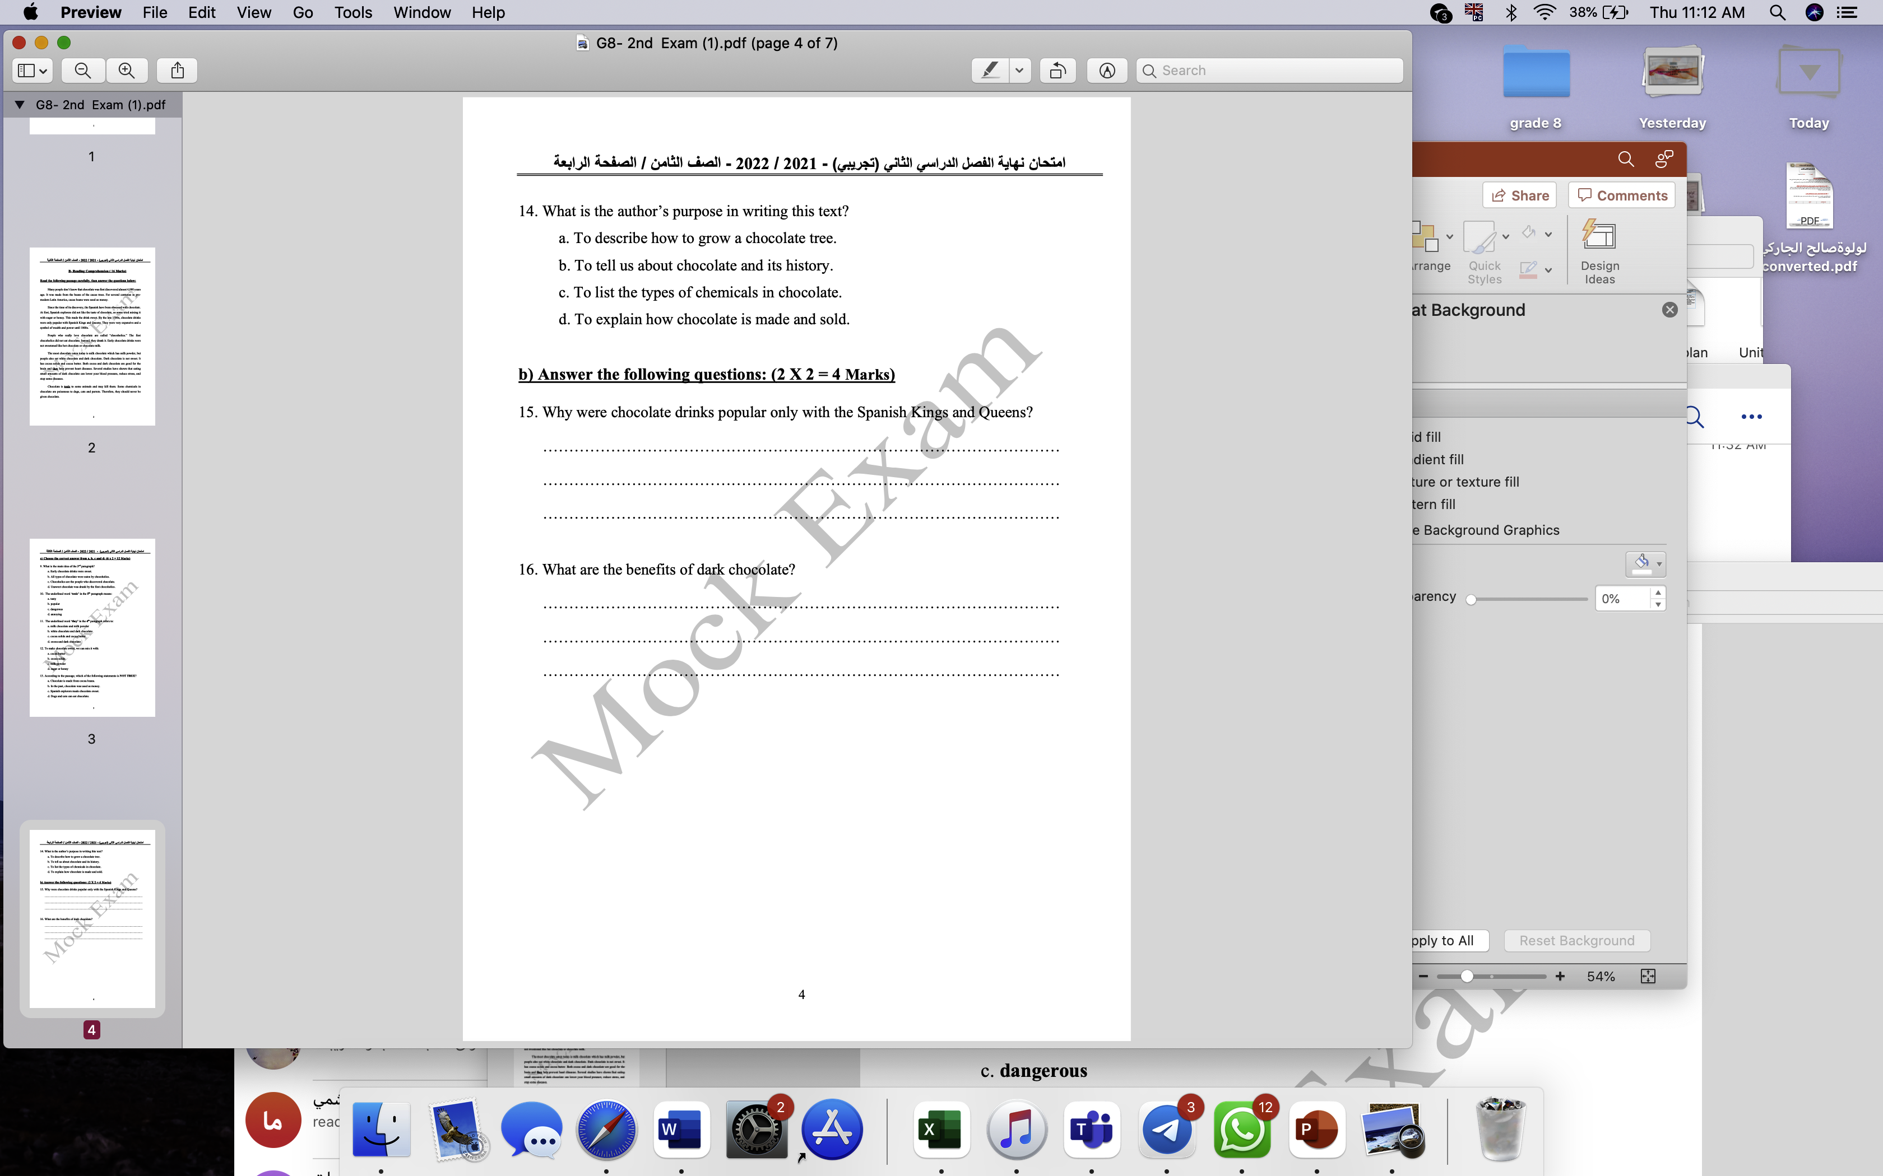
Because chocolate drinks were very expensive/Chocolatr was a symbol of wealth and power.
It is good for the brain/ it helps prevent heart attack.
Eating small amounts of dark chocolate can lower your blood pressure/ it can reduce stress/ it stops some diseases.

Slide 78
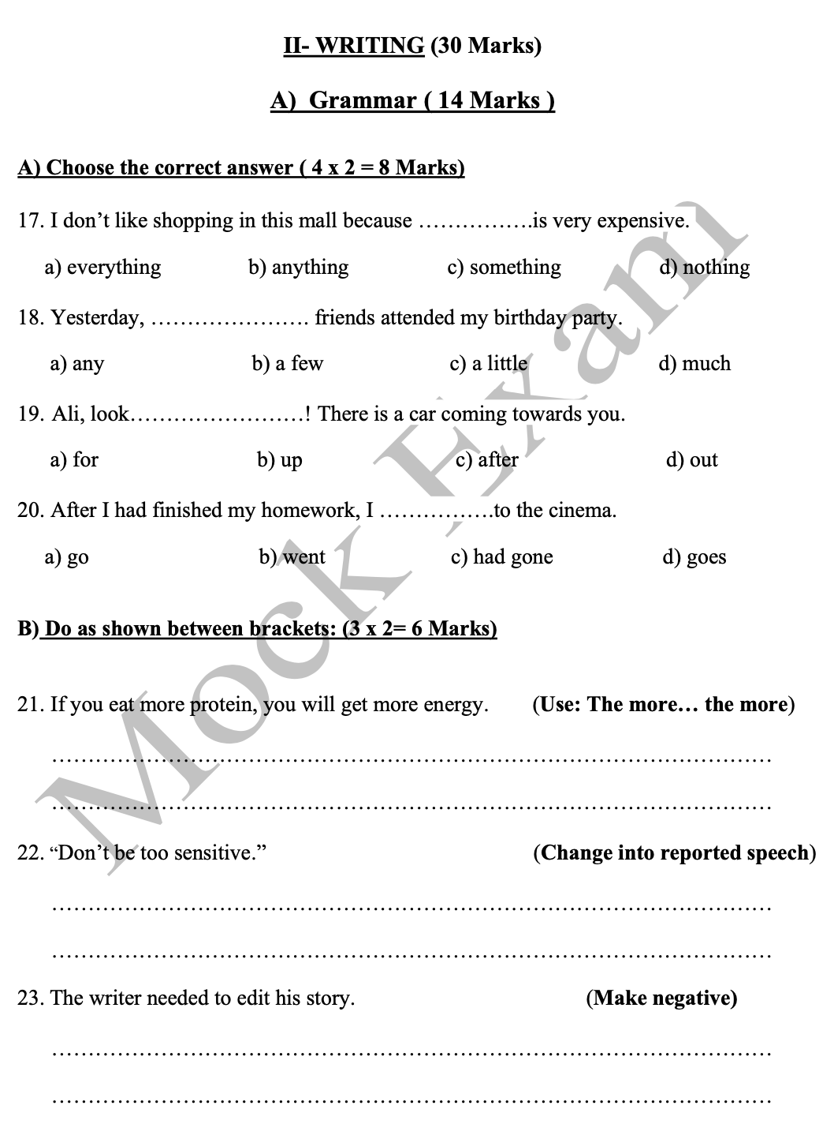

Slide 79
