Slide 1



Module 1
Unit 3

Slide 2

Listening
SB./ P. 29
People’s Stories

Slide 3
Do you enjoy reading stories? Why?
Which kind of stories do you prefer reading? Why ?

Slide 4
1- Describe the two pictures.
2- What is the difference between the two pictures ?
3- Guess what the story will be about.

Slide 5

Notice the following story
to guess the meanings of
the new vocabulary.
New Vocabulary

Slide 6
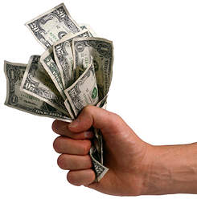

stingy (Adj)
unwilling to
spend money.

Slide 7
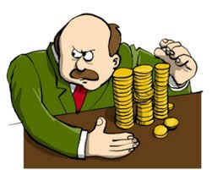
Example
There was a rich man
but he was very stingy.

Slide 8
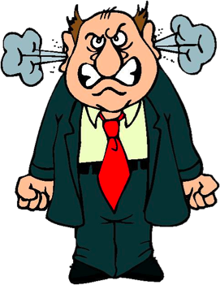
furious (Adj)
extremely angry.

Slide 9
Example
All the time, the stingy man
is furious and nervous.

Slide 10
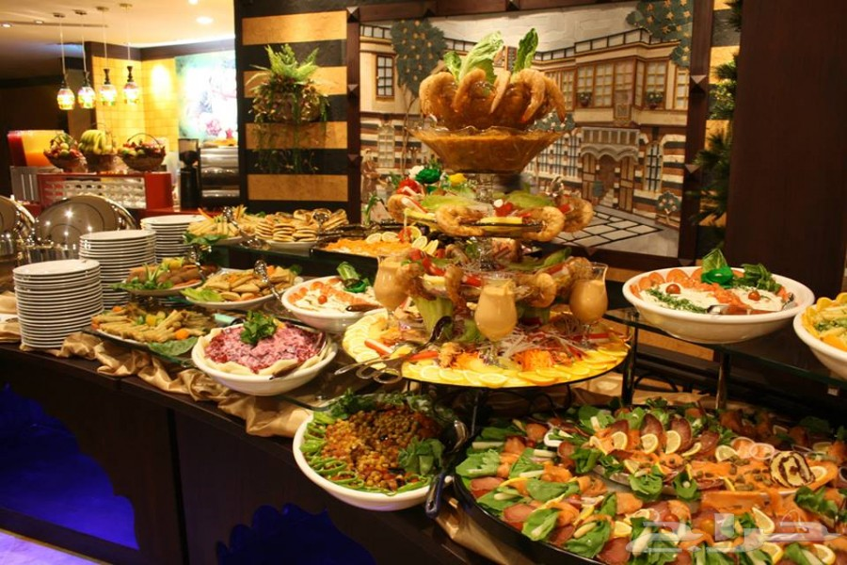
hearty (Adj)
large or in large amounts
(specially of food)

Slide 11
Example
The stingy man always eats
very hearty meals.

Slide 12
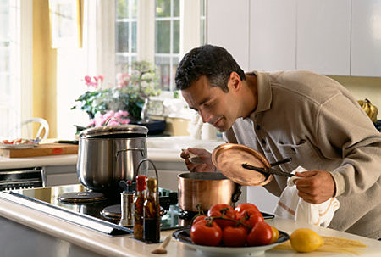
inhale (V)
to breathe air, smoke,
or gas into your lungs.

Slide 13
Example
The stingy man doesn’t allow
anyone to inhale his food.

Slide 14
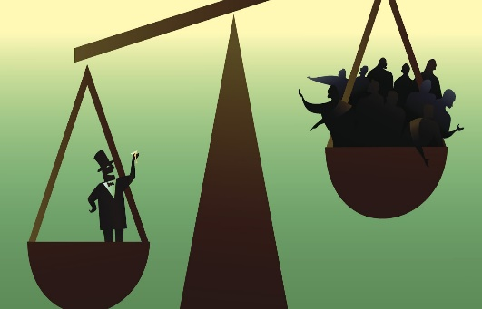
unfairly (Adv)
not treating people in an equal way, or not morally right.

Slide 15
Example
This man treats the villagers
unfairly.

Slide 16
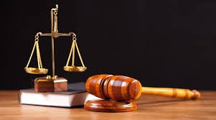
justice (N)
fairness in the way
people are dealt with.

Slide 17
Example
This man doesn’t treat people
with justice.

Slide 18
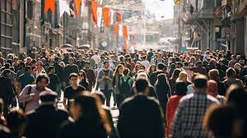
crowd (N)
a large group of people who have come together.

Slide 19
Example
The crowd in his village
don’t love him.

Slide 20
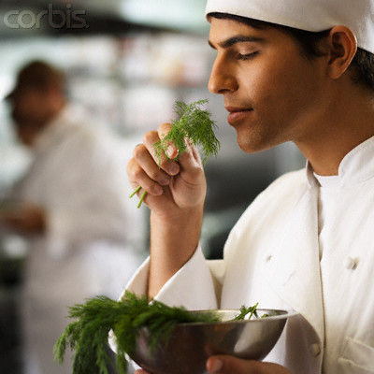
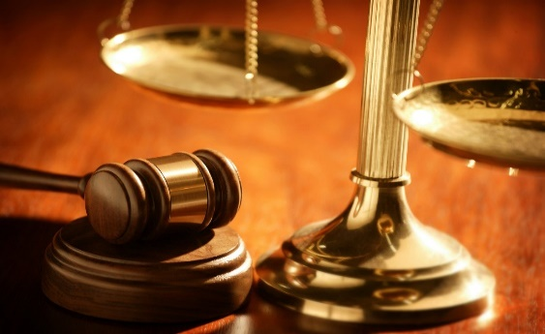
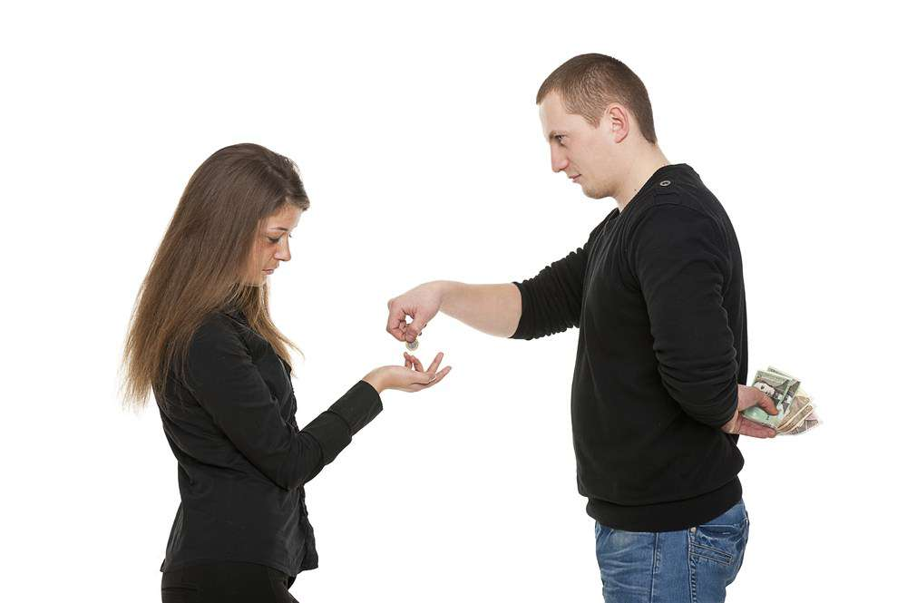
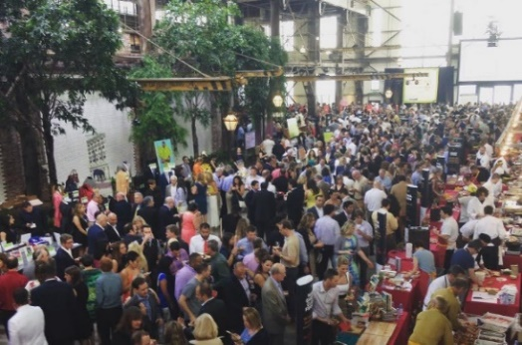
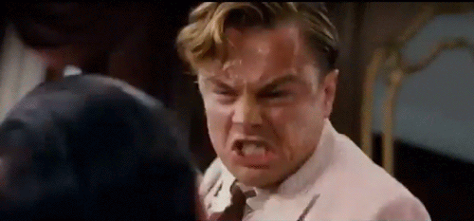
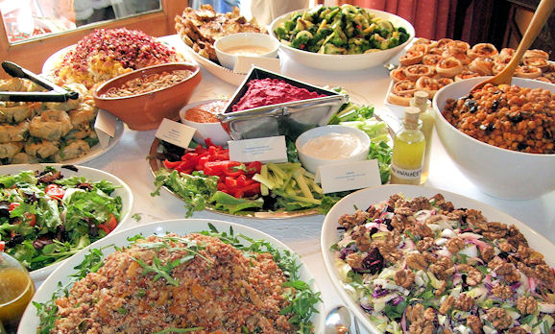
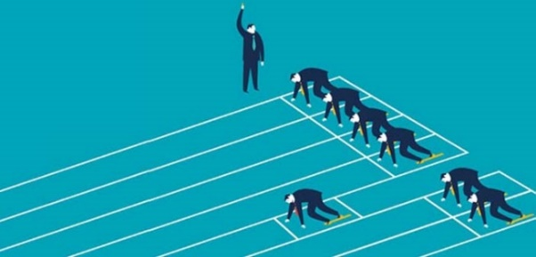
inhale (v.)
stingy (adj.)
furious (adj.)
hearty (adj.)
justice (n.)
crowd (n.)
unfairly (adv.)

Slide 21

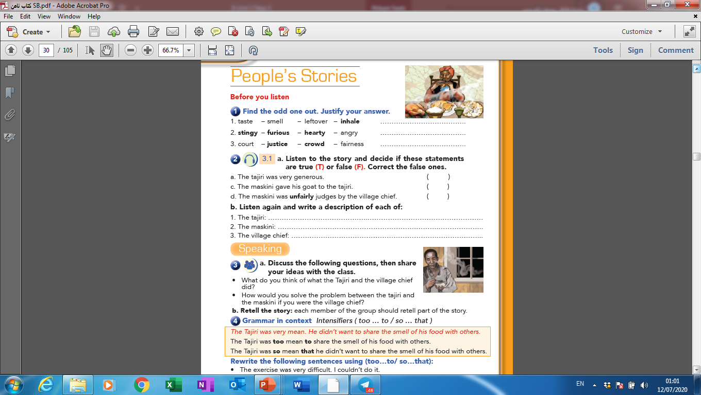

Slide 22



Slide 23
leftover
hearty
crowd

Slide 24


Slide 25

Activity 1 :
Listen and get the main idea
of the text:

Slide 26
Activity 2 :
Listen again to get the main
characters of the story :
The main
characters

Slide 28
Listen again to get the main
characters of the story :
The main
characters
The
tajiri
The village
chief
The
maskini

Slide 29

Activity 3 :

Slide 31
He was stingy and unfair.
He was poor and needy.
He was fair and good.

Slide 32

Activity 4 :

Slide 34

Correction
a- The tajiri was very stingy.
b- The maskini didn’t give his goat to the Tajiri.
c- The maskini was fairly judged by the village chief.

Slide 35


Slide 36


