Slide 1


Unit 8

Slide 2

البوابة الكويتية لصعوبات التعلم (redsoft.org)

Slide 3


Slide 4
Pinterest

Slide 5
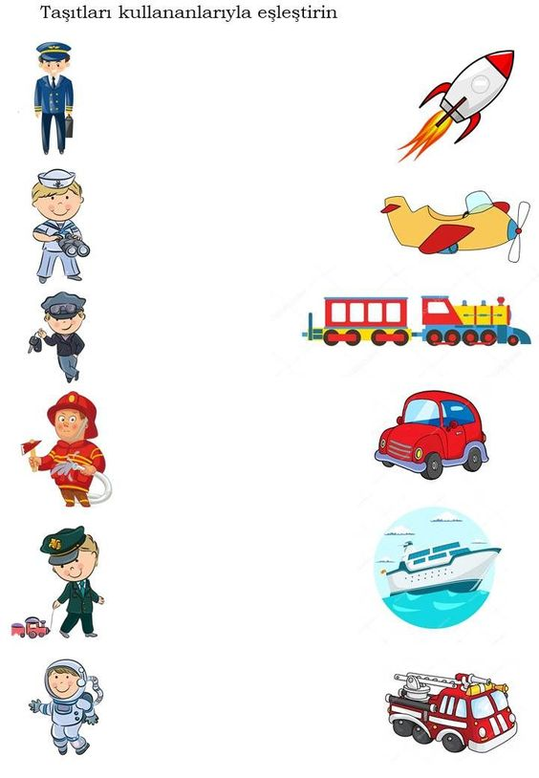

Slide 6


Slide 7
document.pdf

Slide 8
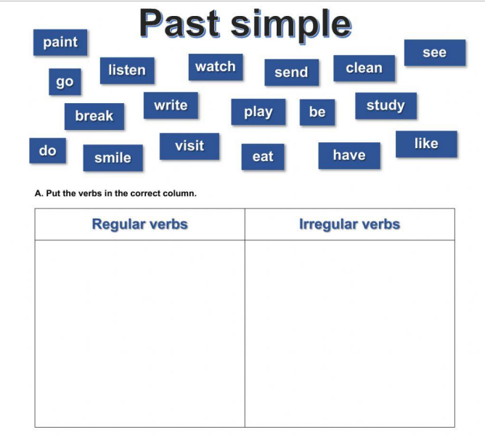

Slide 9


Slide 10
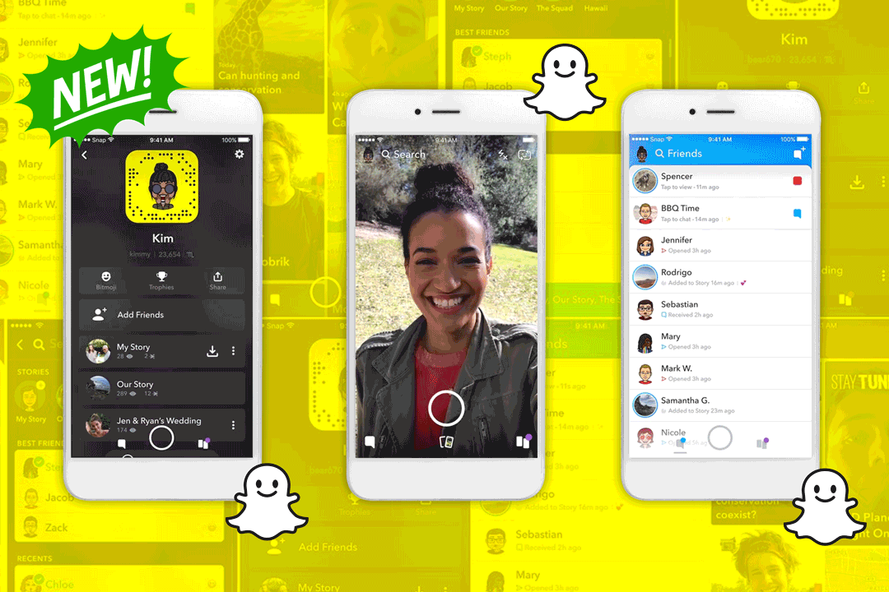
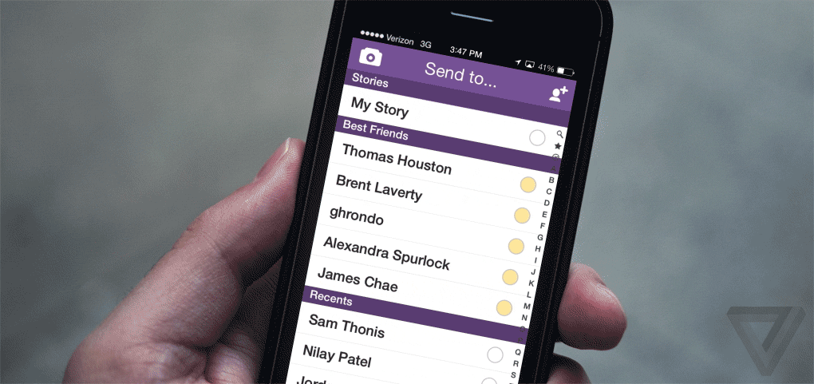
How do people communicate nowadays?

Slide 11
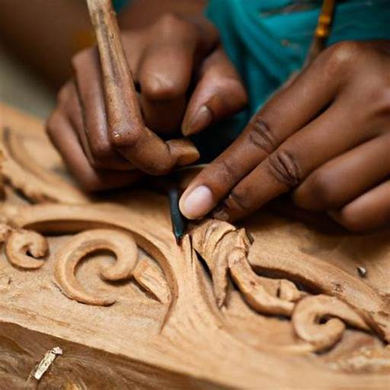
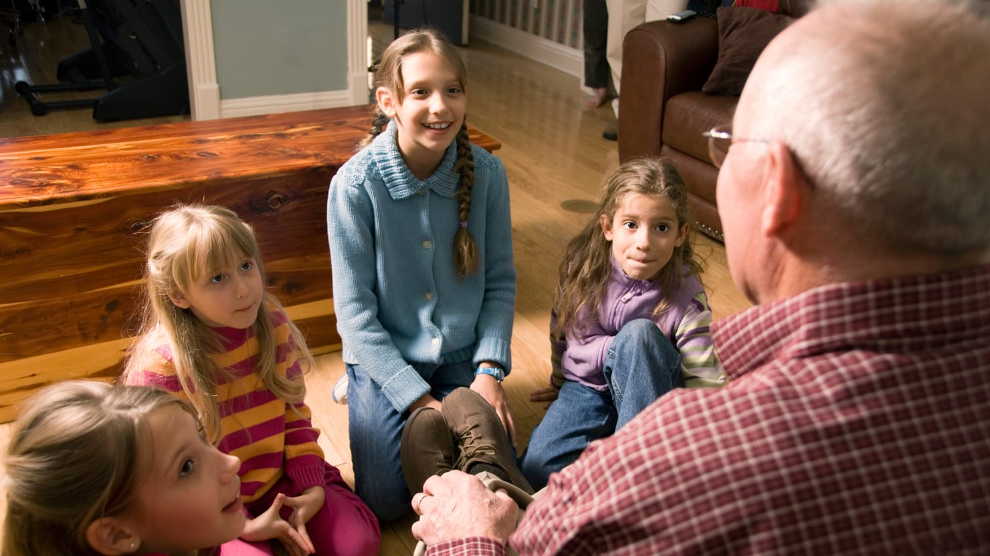
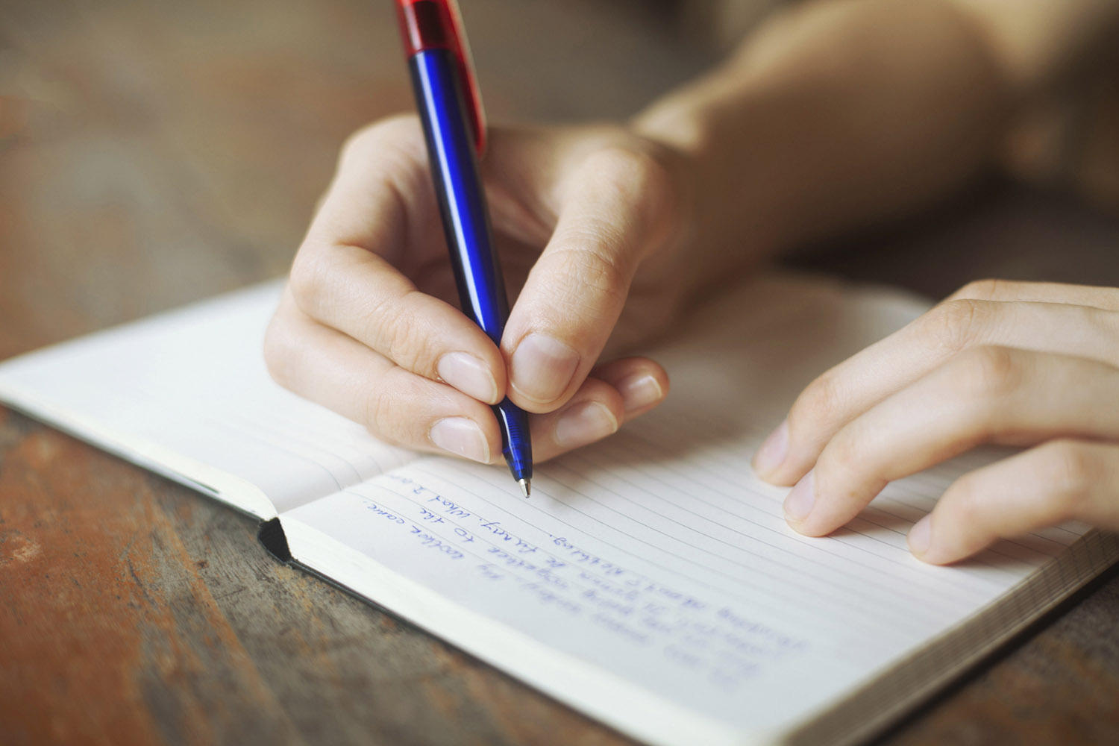
How did people communicate in the past?

Slide 12
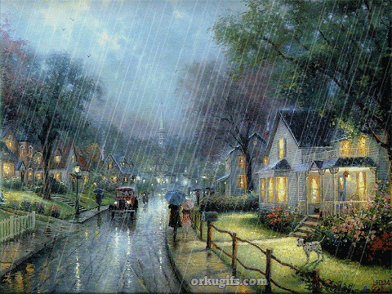
Workbook
Page 25

Slide 13
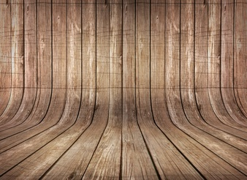



Slide 14

Check your answers.

Slide 15
gradually various skillful carve consequently access
skillful
1. The captain of the ship is so ---------------- that he was able to avoid the iceberg.

Slide 16
gradually various skillful carve consequently access
2. People in some poor countries are unable to get ---------------- to what they need.
access

Slide 17
gradually various skillful carve consequently access
3. Only professional artists are able to
---------------- pictures on metals.
carve

Slide 18
gradually various skillful carve consequently access
gradually
4. The weather is ------------------------ getting hotter these days.

Slide 19
gradually various skillful carve consequently access
5. Air consists of ---------------- gases like Oxygen and Nitrogen.
various

Slide 20
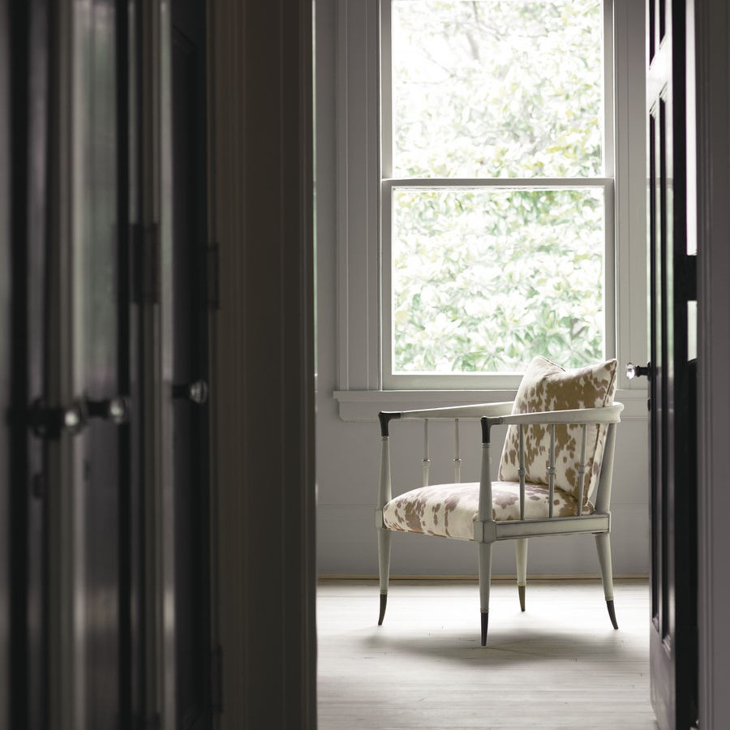
Workbook
Page 26

Slide 21


Slide 22

Check your answers.

Slide 23
started
had gotten
1. It …………………..……….. to rain after we ……………………….………. to the station.
(start / get)

Slide 24
reached
2. By the time we …………………..……….. the party, all the guests ……………………….………..
(reach/ leave)
had left

Slide 25
3. Why didn’t you go to bed after you …………………..……….. supper?
(have)
had had

Slide 26
4. Your letter …………………..……….. five minutes after
he ……………………….………..
(come / leave)
came
had left

Slide 27
5. I …………………..……….. my aunt for the flowers she ……………………….………. me.
(thank / send)
thanked
had sent

Slide 28
open
6. Ali couldn’t …………………..……….. the door because he ……………………….………. his keys.
(open / lose)
had lost

Slide 29
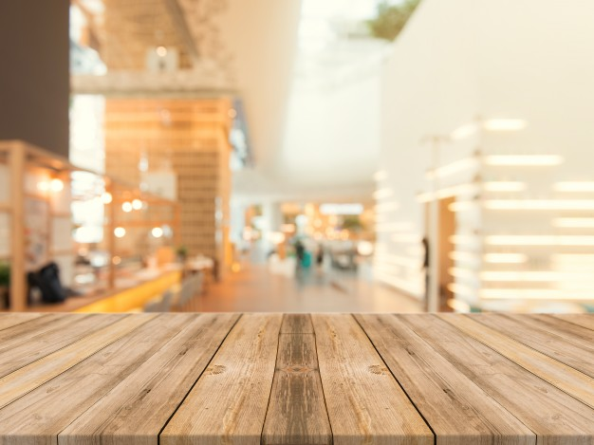

Slide 30

Read your answers.

Slide 31
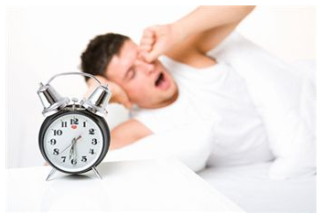

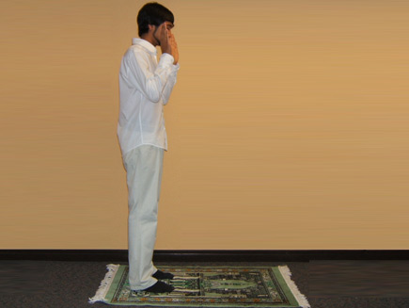

1. After I had woken up, I ……………………….……………
After I had woken up, I had a shower and prayed.

Slide 32


2. I had been in New York before six years before ……………………….……………
I had been in New York before six years before I moved to London.

Slide 33
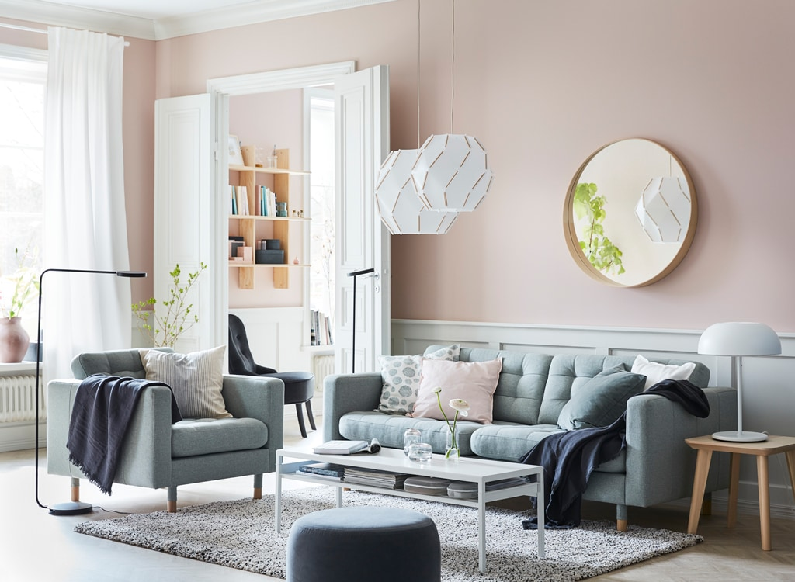
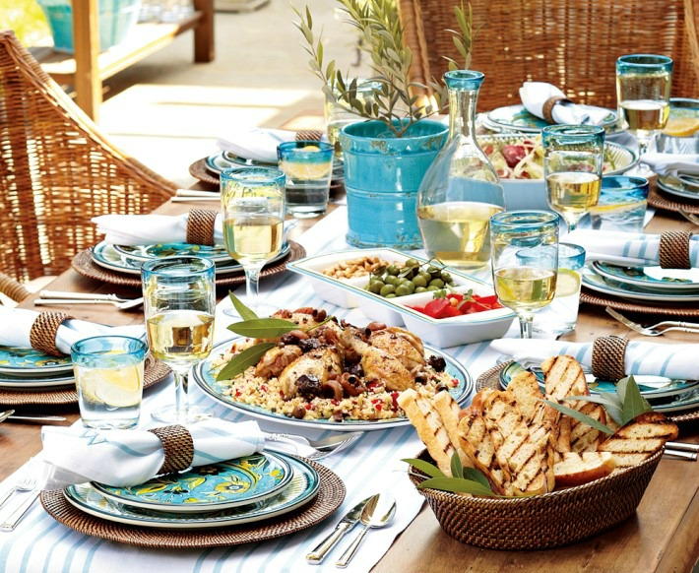
3. By the time we arrived home ………….……………
By the time we arrived home our mother had cooked lunch.

Slide 34
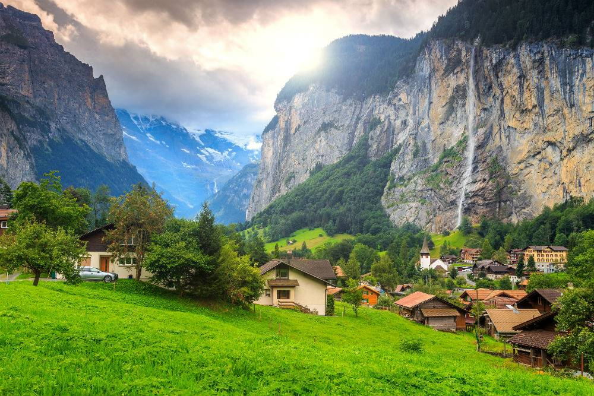
Closure

Slide 35

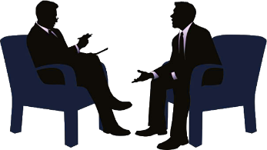

Slide 36
Read your answers.

Slide 37





Slide 38
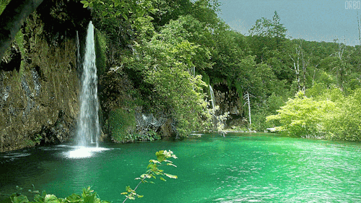
Thank you

Slide 39
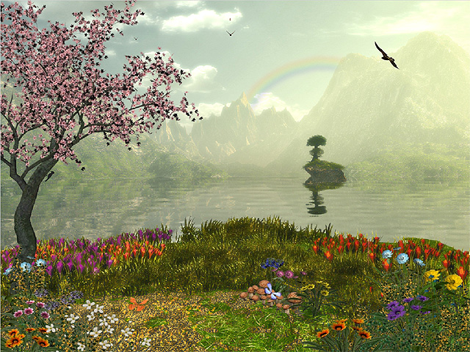
Student’s Book
Page 66

Slide 40



Slide 43
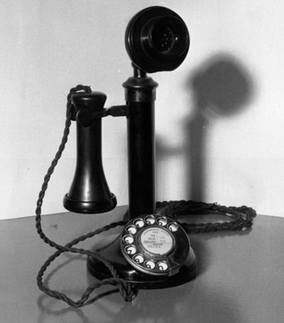
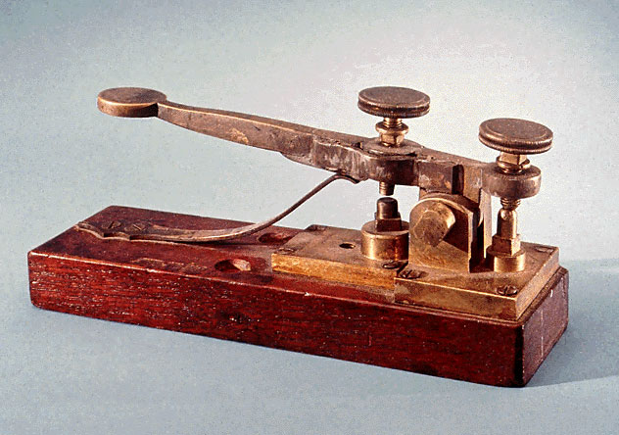
Examples:
• The telephone was invented in the 19th century. The telegraph was invented in the 19th century.
• Both the telephone and the telegraph were invented in the 19th century.

Slide 44
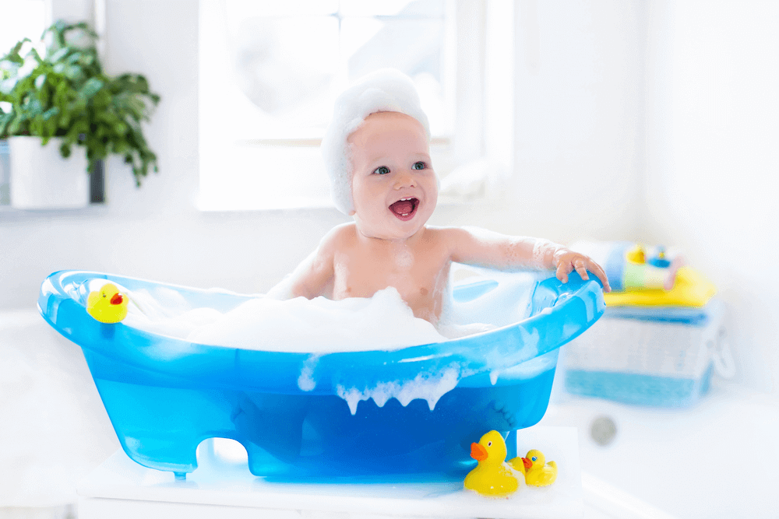
• The baby is smart. The baby is sensitive
• The baby is both smart and sensitive.

Slide 46
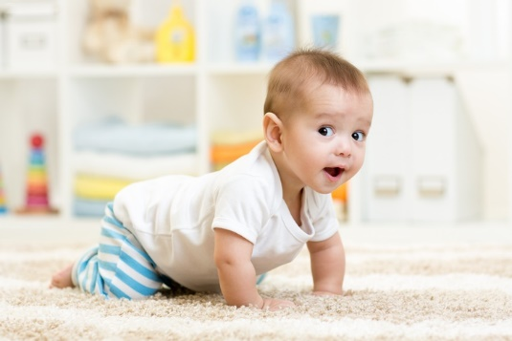
Check your answers.

Slide 47
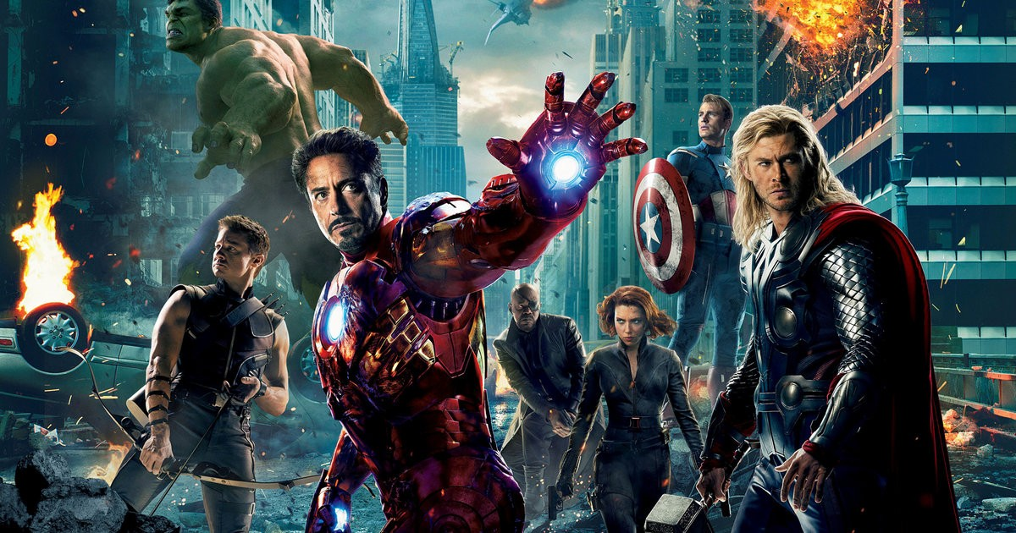
• Famous actors/talented/skillful
Famous actors are both talented and skillful.

Slide 48
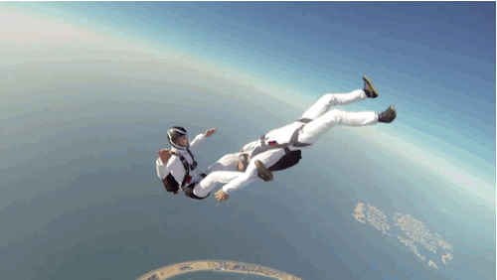
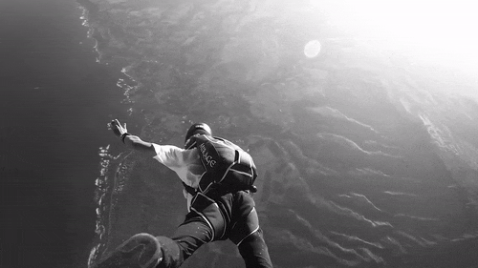
• Sky diving/interesting/dangerous.
Sky diving is both interesting and dangerous.

Slide 49


. • British people/American people/English
Both British and American people speak English.

Slide 51
Read your answers.

Slide 52

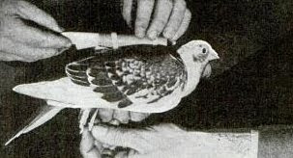
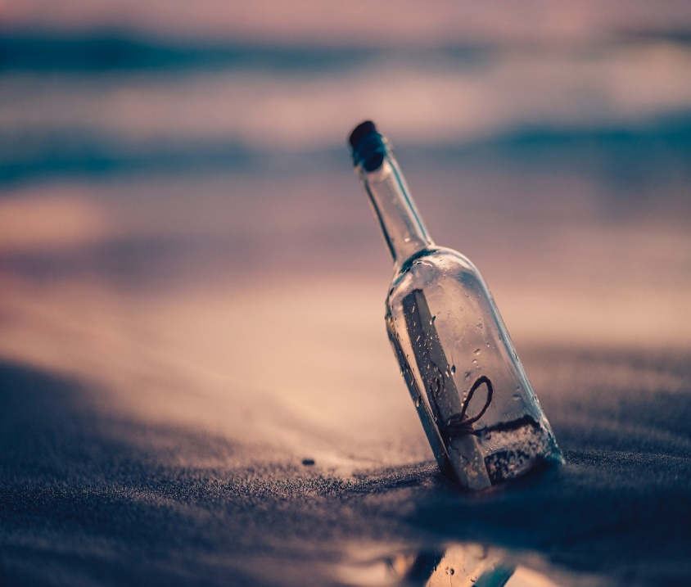
Both pigeons and bottles were used to send messages.

Slide 53

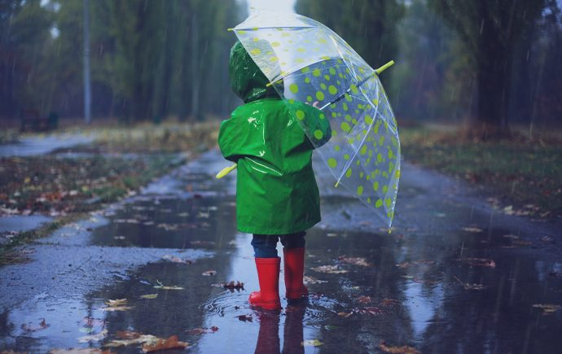
The weather is both rainy and cold.

Slide 54

Both google and books can help us get
a lot of information.

Slide 55

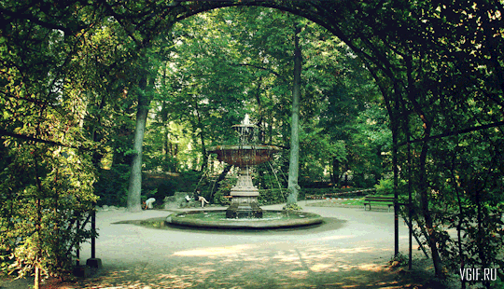
The park is both clean and quiet.

Slide 56
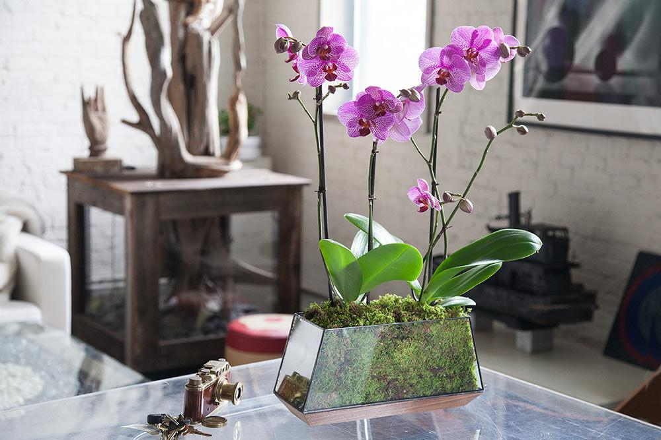
Thank you

Slide 57

Thank you

