Slide 1
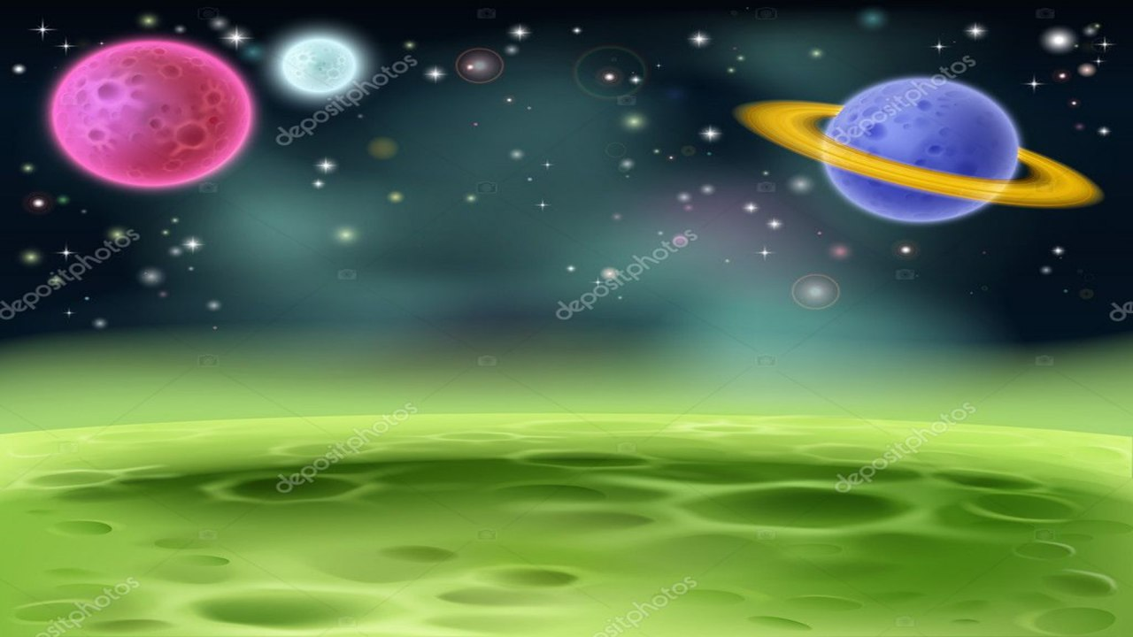


Module 1
Unit 3

Slide 2

SB. / P. 28

Slide 3


PRESENT PERFECT with
How long……?
SINCE and FOR

Slide 4
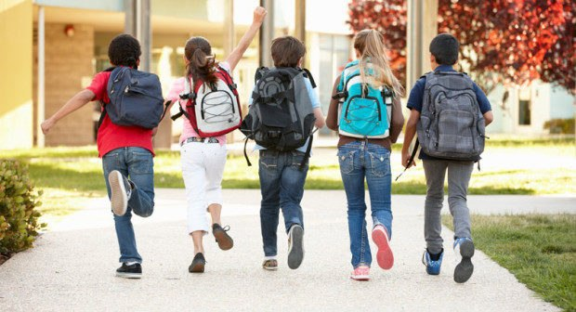
How long have you studied in this school?
I have studied in this school for three years.
I have studied in this school since 2017.

Slide 5
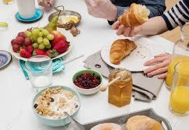
How long have you had your breakfast?
I have had my breakfast for three hours.
I have had my breakfast since six O’clock.

Slide 6

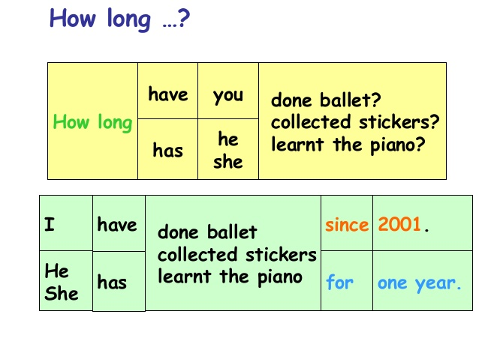

Slide 7
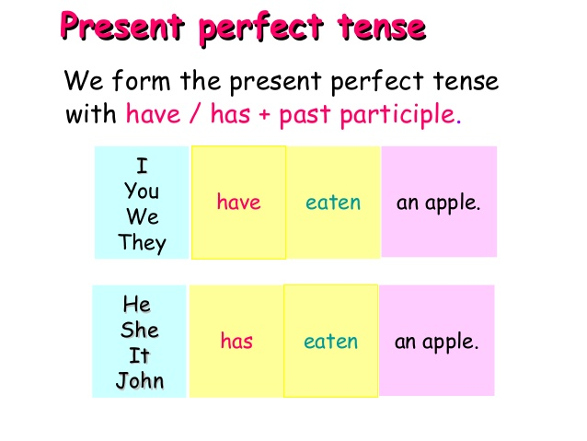

Slide 8
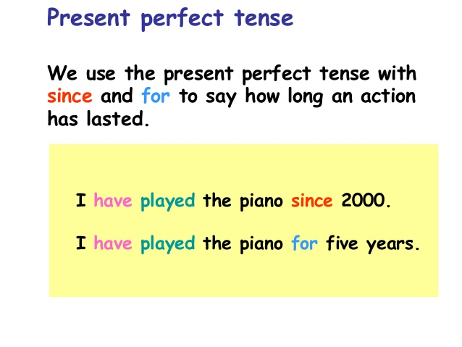

Slide 9
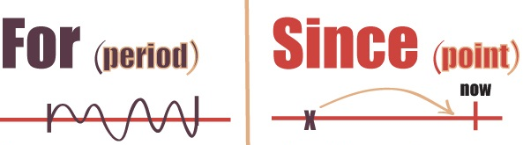
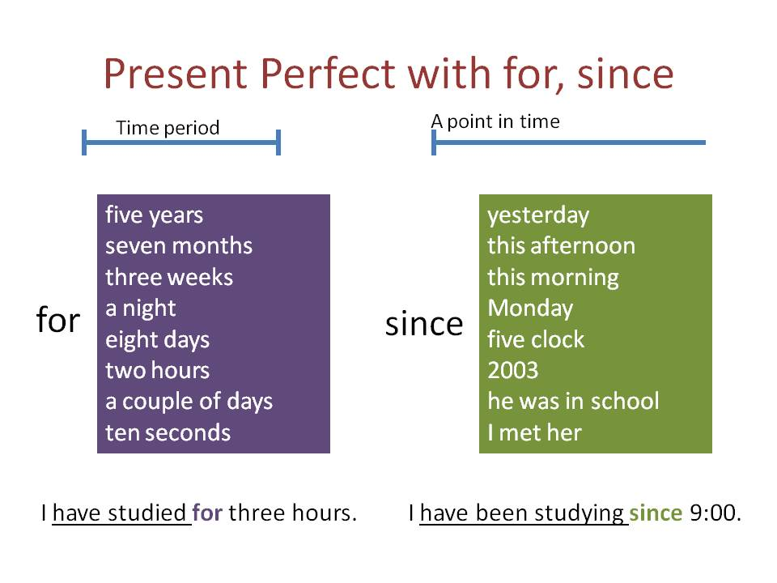

Slide 10

Examples
How long has Mona read this book ?
She has read this book for two hours.
She has read this book since this afternoon.

Slide 11
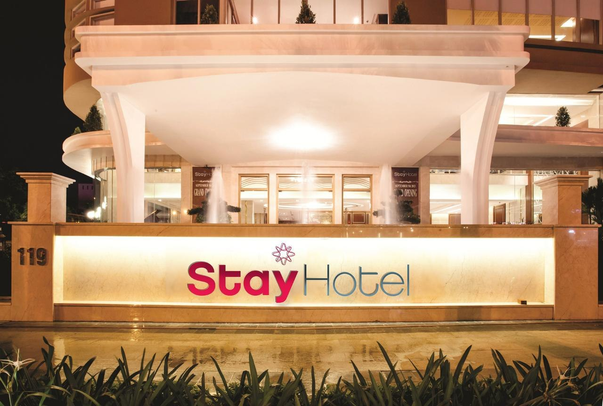
Examples
How long have the tourists stayed in the hotel?
They have stayed in the hotel for eight days.
They have stayed in the hotel since Monday.

Slide 12
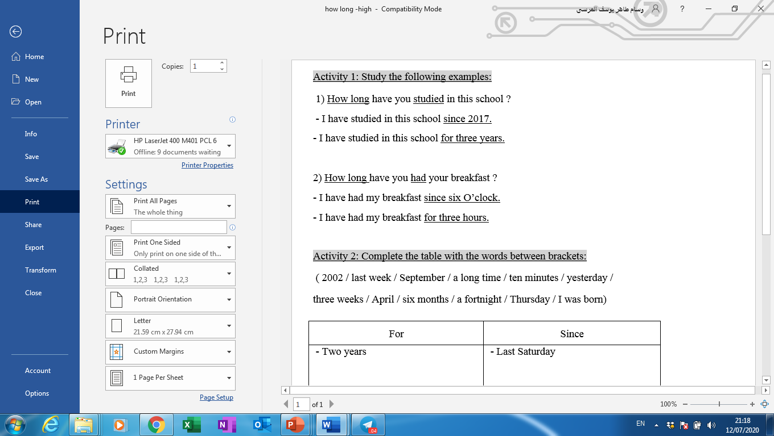
Complete the table with the words
between the brackets:
Activity 1 :
since
for

Slide 13



Slide 14
since
for
2002
last week
September yesterday
April
Thursday
I was born
a long time
ten minutes
three weeks
six months
a fortnight

Slide 15
Activity 2 :

Slide 17
has been
for
has increased
since
has worked
for

Slide 18
Activity 3 :

Slide 20
haven’t had
since
have
been
have been
for
hasn’t spent
since
has had
since

Slide 21
Activity 4 :
Do as shown between brackets:
1- Nada has just arrived to her home. ( Make negative)
2- My father has already finished his work. (Make negative)
3- Huda has joined a club since last month. (Ask a question)
4- I have stayed in London for three years. (Ask a question)

Slide 23
1- Nada hasn’t arrived to her home yet.
2- My father hasn’t finished his work yet.
3- How long has Huda joined a club ?
4- How long have you stayed in London ?

Slide 24


Slide 25


