Slide 1

Module 1
Unit 2
Life Events

Slide 2

SB.
P. 22 & 23

Slide 3
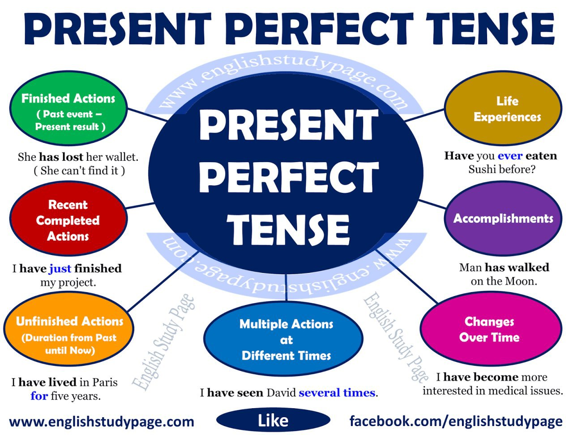

Slide 4
verbs

Slide 5
Classify the following verbs:
bought
lose
buy
visited
go
lost
acted
make
visit
eat
gone
visited
act
made
went
bought
eaten
lost
made
acted
ate

Slide 6
Present
Past
Past
Participle
eat
ate
eaten

Slide 7



Slide 8
Present
Past
Past
Participle
eat
ate
eaten
buy
bought
bought
lose
lost
lost
go
went
gone
act
acted
acted
make
made
made
visit
visited
visited

Slide 9

Have you ever created a blog?
Yes , I have. No , I haven't.

Slide 10


Slide 11
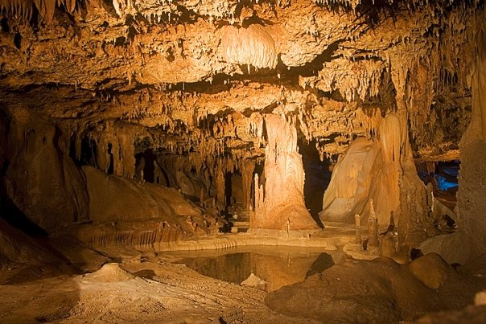

cavern (N)
a large cave.

Slide 12
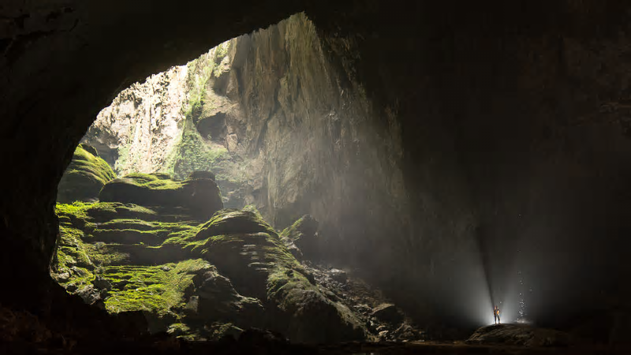
Example
Have you ever visited a cavern?

Slide 13
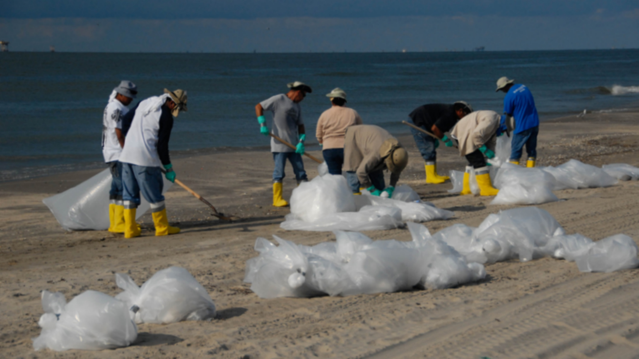
voluntary (Adj)
done , made or given willingly, without being forced or paid to do it.

Slide 14
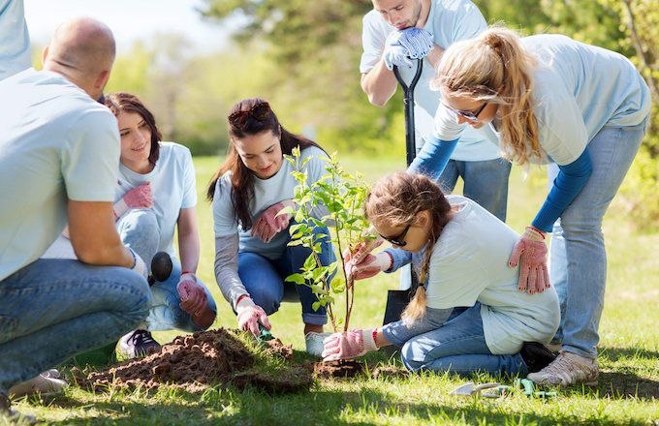
Example
Have you ever participated in
a voluntary work?

Slide 15
native (Adj)
relating to or describing someone’s country or place of birth

Slide 16

Example
Have you ever spoken to
a native speaker of English?

Slide 17
recently (Adv)
not long ago , or at a time that started not long ago

Slide 18
Example
I have travelled to London
recently.

Slide 19
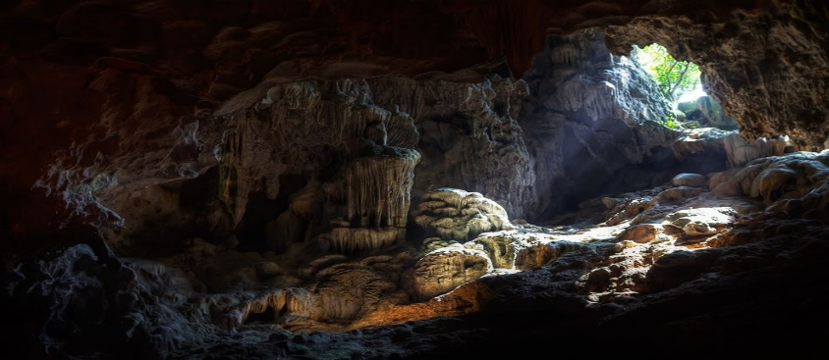
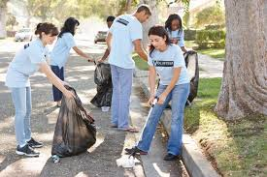


cavern (N)
voluntary (Adj)
native (Adj)
recently (Adv)

Slide 20
Present Perfect Tense
• Use the present perfect to talk about experiences when you don’t say exactly when
they happened:
- I have visited Europe.
- I haven’t visited Europe.
- Have you visited Europe?

Slide 21
Present Perfect Tense
Key words | Questions | Negative | The present perfect Tense
ever – never just – already yet lately - recently since - for | Has he ….….? Have you…...? | hasn’t + V3 haven’t + V3 | (He , she , it )------- has + V3 ( I , We, you , they )-----have + V3

Slide 22
Examples

Slide 23
Activity 1 :
Ask and answer the following questions :
Questions
Yes
No
1- Have you ever eaten Italian food ?
Yes, I have
No, I haven’t
2- Have you ever visited
a museum ?
3- Have you ever gone to another country ?
4- Have you ever acted in a play ?

Slide 24
Activity 2 :
Choose the correct answers:
Have you ever ( do – done – did ) a voluntary work ? My father ( has – have – had ) worked for a charity organisation for many years. We (helped – has helped – have helped) many poor people recently. We (haven’t – hasn’t – doesn’t ) got money for helping them.

Slide 26
Activity 2 :
Choose the correct answers:
Have you ever ( do – done – did ) a voluntary work ? My father ( has – have – had ) worked for a charity organisation for many years. We (helped – has helped – have helped) many poor people recently. We (haven’t – hasn’t – doesn’t ) got money for helping them.

Slide 27
Activity 3 :
Do as shown between brackets:
1- The boy (not eat) his meal yet. ( Correct)
2- The teachers (just arrive) to the school. ( Correct)
3- I (already) ride a bike. ( Correct )
4- Ali has already bought a new car. ( Make negative)
5- Yes , she has been to France. (Ask a question)

Slide 29
1- The boy hasn’t eaten his meal yet.
2- The teachers have just arrived to the school.
3- I have already ridden a bike.
4- Ali hasn’t bought a new car yet.
5- Has she been to France ?

Slide 30
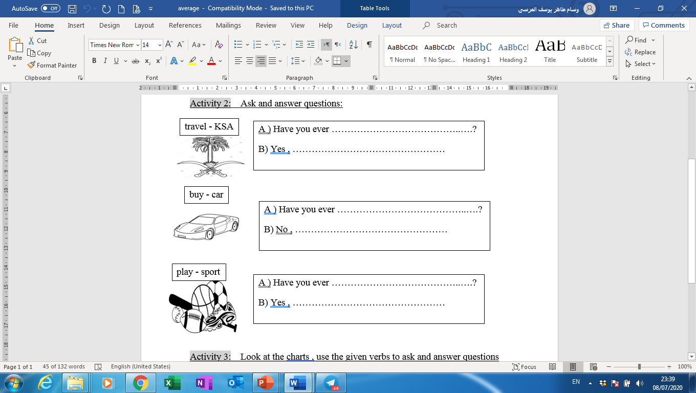
Activity 4 :
Complete the following task :

Slide 31
Practise speaking about your experiences following the given model:

Slide 32
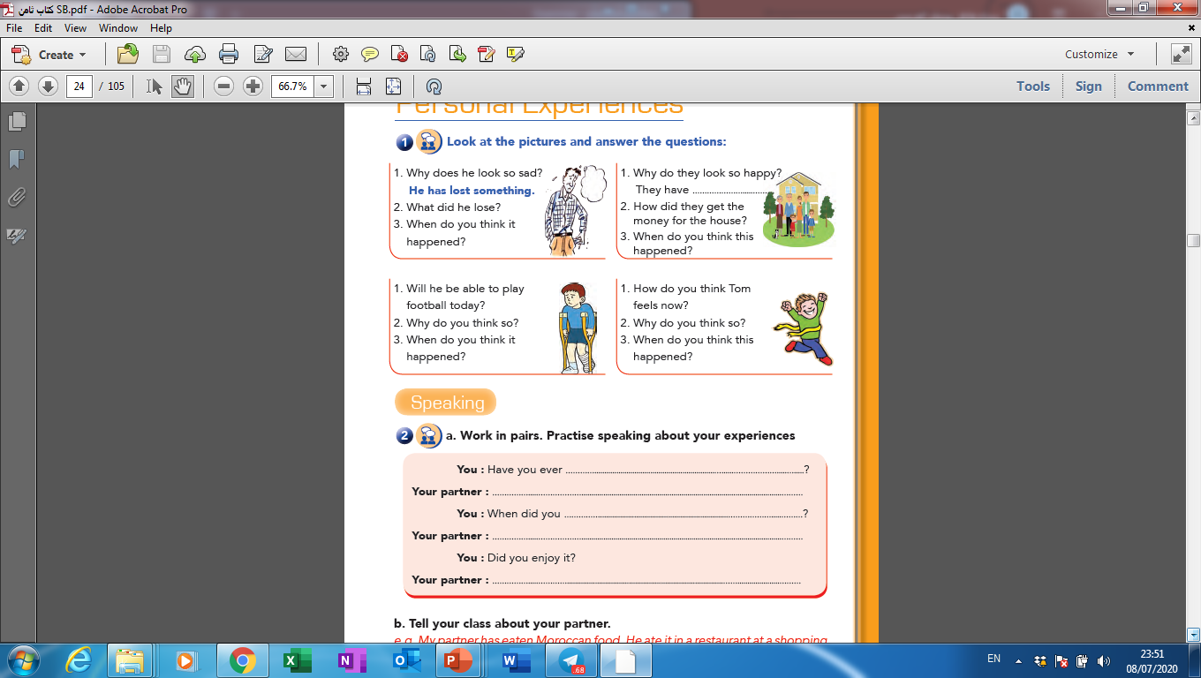

Slide 33


