Slide 1
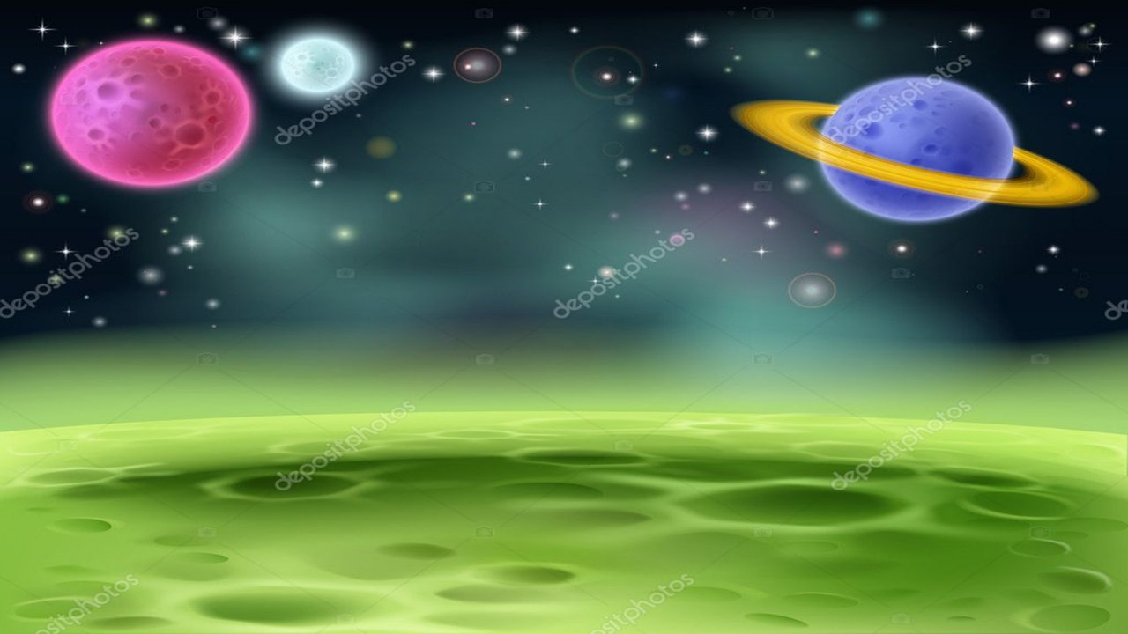
Module 1
Unit 3

Slide 2
Reading
SB. / P.31

Slide 3
Guess
the topic.

Slide 4
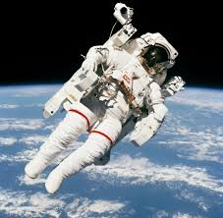
1- What do you think life is on a space station?
(easy / difficult / enjoyable ……)
2- Would you like to travel to space? Why?

Slide 5
Activity 1 :
Read the text and give it another title:

Slide 6
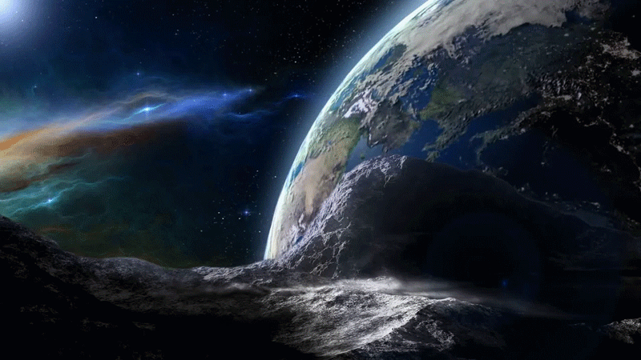
New
Vocabulary

Slide 7
dispose of (PhV)
to get rid of something; throw out

Slide 8
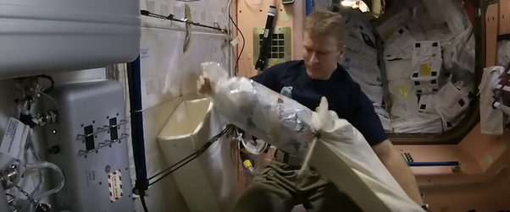
Example
Astronauts have to dispose of rubbish

Slide 9
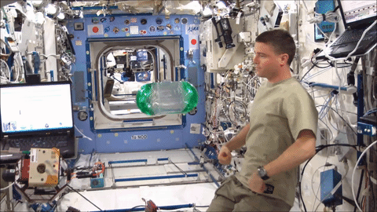
float (V)
to move slowly through
the air

Slide 10
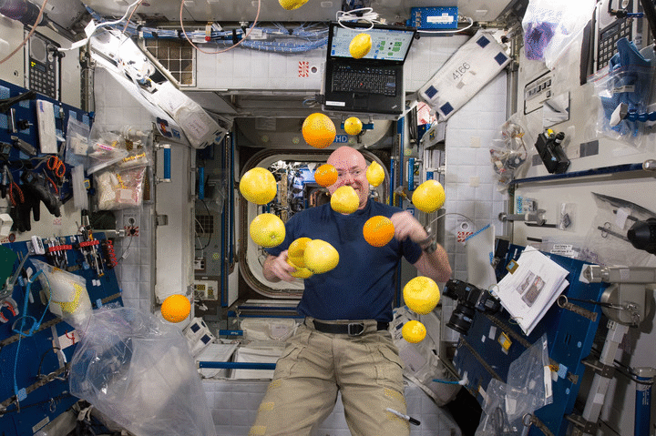
Example
Everything floats in space.

Slide 11
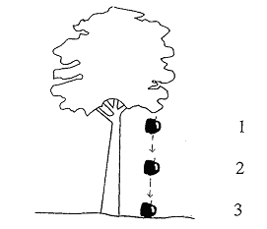
gravity (N)
the force that makes things fall to the ground.

Slide 12
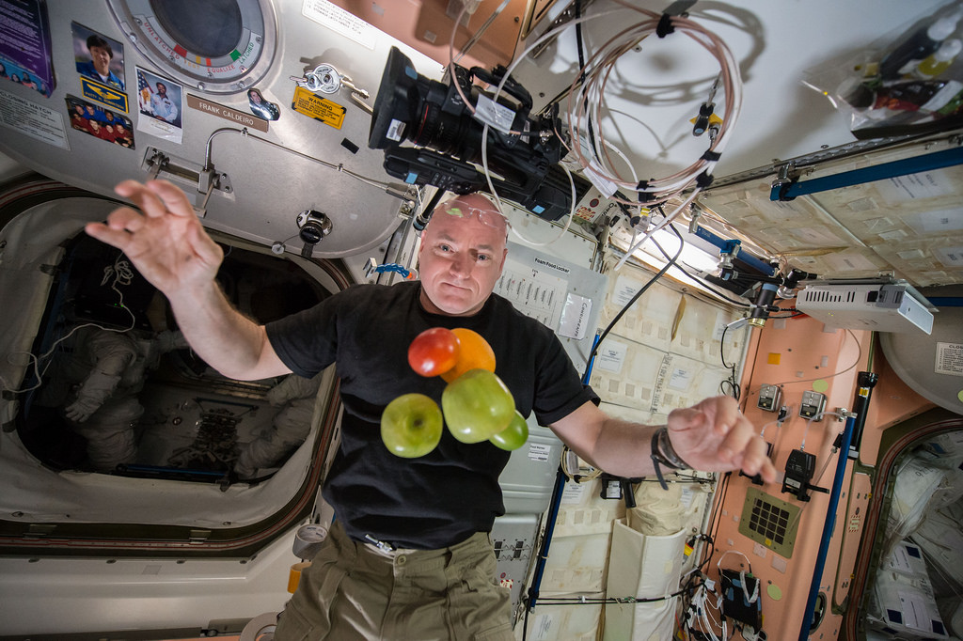
Example
There is no gravity in space .

Slide 13
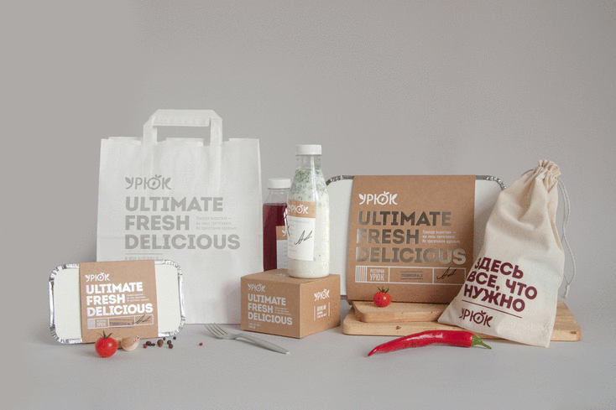
Package (N)
a box or container in which something is put especially to be sent, kept or sold.

Slide 14
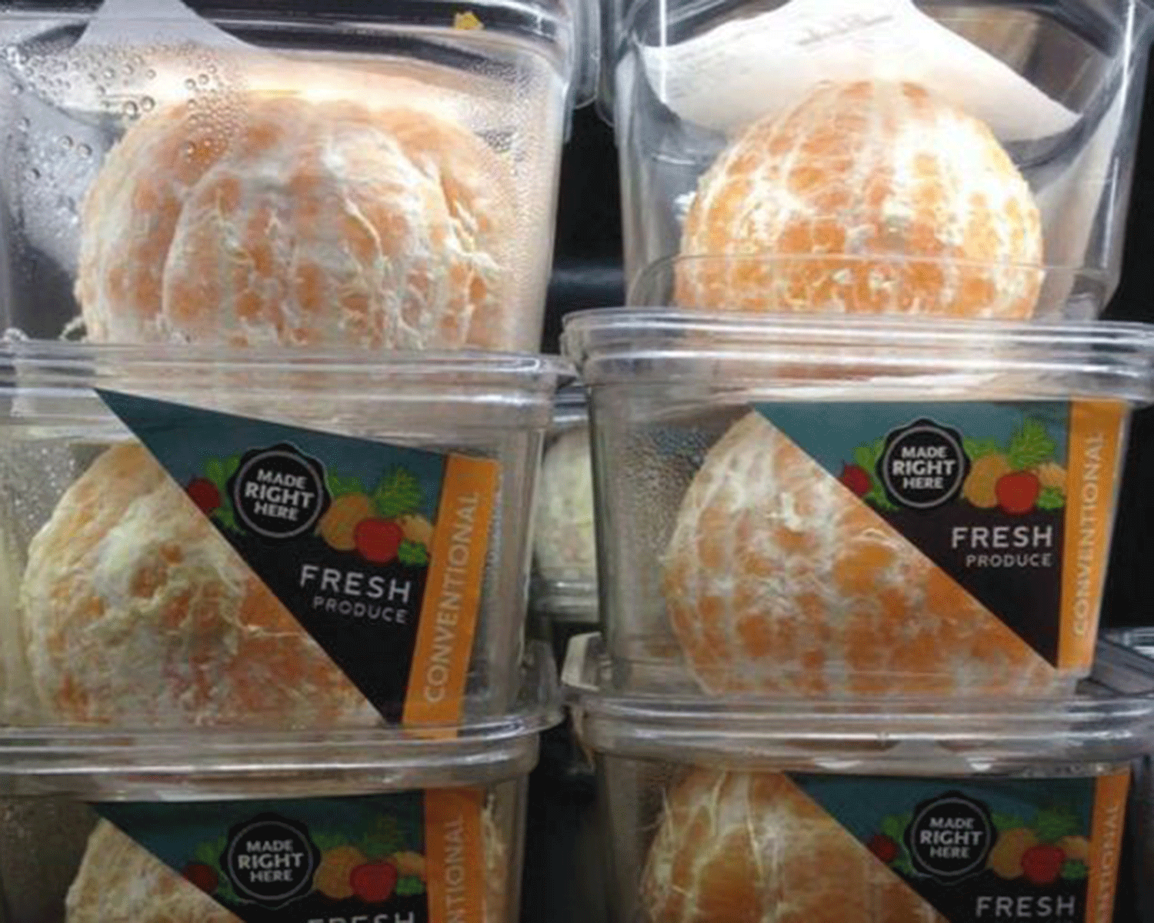
Example
Astronauts keep food in
packages in space.

Slide 15
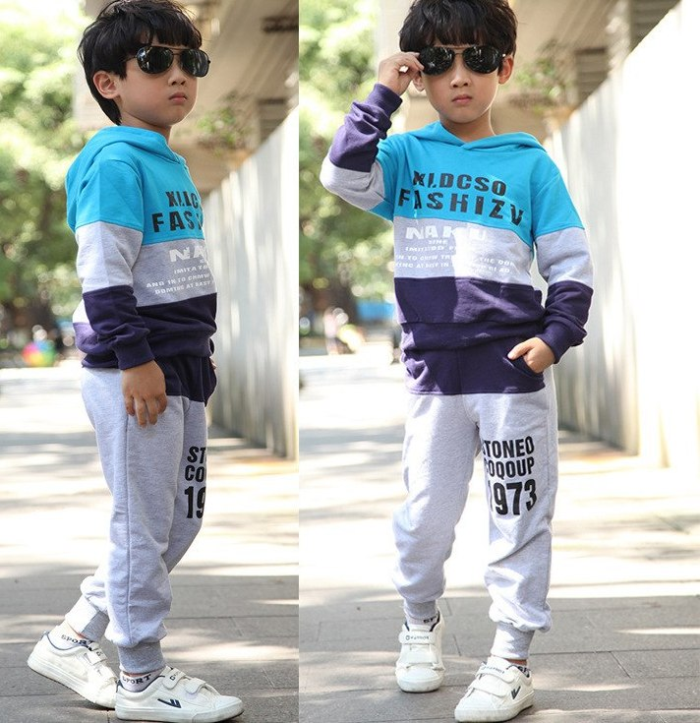
casual (Adj)
(informal)
casual clothes are not formal or not suitable for special occasions.

Slide 16
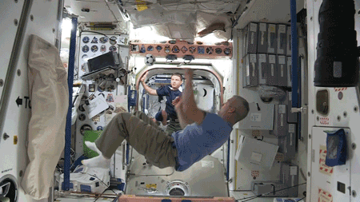
Example
Inside the station, astronauts wear casual
clothes with lots of pockets.

Slide 17
specialised (Adj)
designed for
a particular purpose.

Slide 18
Example
Astronauts wear specialised spacesuits
in space.

Slide 19
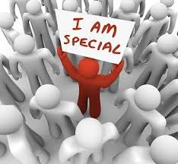
dispose of (PhV)
float (V)
package (N)
gravity (N)
casual (Adj)
specialised (Adj)

Slide 21
Activity 2 :
Read the text again and answer the following questions :
1 - The main idea of the 1st paragraph is :
a- Food in space.
b- Clothes in space.
c- Space special equipment.
d- Space is like camping.

Slide 22
2 - What is the antonym (opposite) of the word “dried” in the second paragraph ?
c- fresh
a- hot
b- frozen
d- cold

Slide 23
3 – Find out words in the 3rd paragraph
that mean “ air-filled / flame”:
inflatable
flare

Slide 24
4- The purpose of the writer in writing this text is to :
a- explain how astronauts live in space.
b- persuade us to travel to space.
c- compare life in space with life on Earth.
d- advise us not to eat dried food.

Slide 25
Activity 3
Read the text again then answer the questions below :
1- Give three reasons why being in space is like camping.
2- What do astronauts eat in space?
3- Astronauts wear special clothes in space. Discuss.

Slide 27
1- Give three reasons why being in space is like camping.
You use special
equipment
You have to take
everything you
need.
You have to
dispose of your
own rubbish.

Slide 28
2- What do astronauts eat in space?

Slide 29
3- Astronauts wear special clothes in space. Discuss.

Slide 30
Activity 4
Compare life in space with life on Earth:
Space
Earth
Food
Clothes
Place of living

Slide 31
Would you like to be an astronaut in the future? Why? Why not?

Slide 32
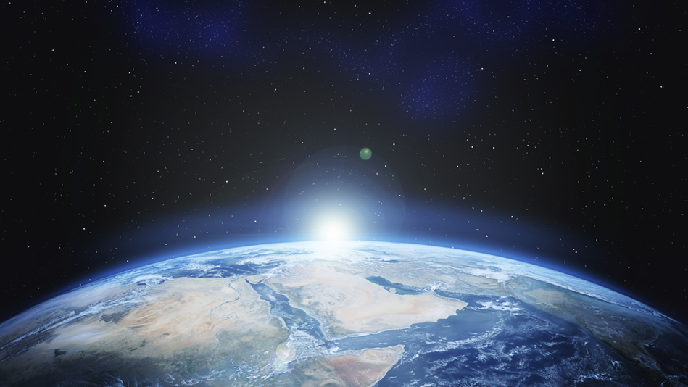
Thank you

