Slide 1
Module 1
Unit 2
Life Events

Slide 2
Writing
SB./P. 26

Slide 3
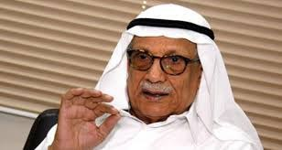
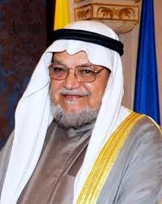
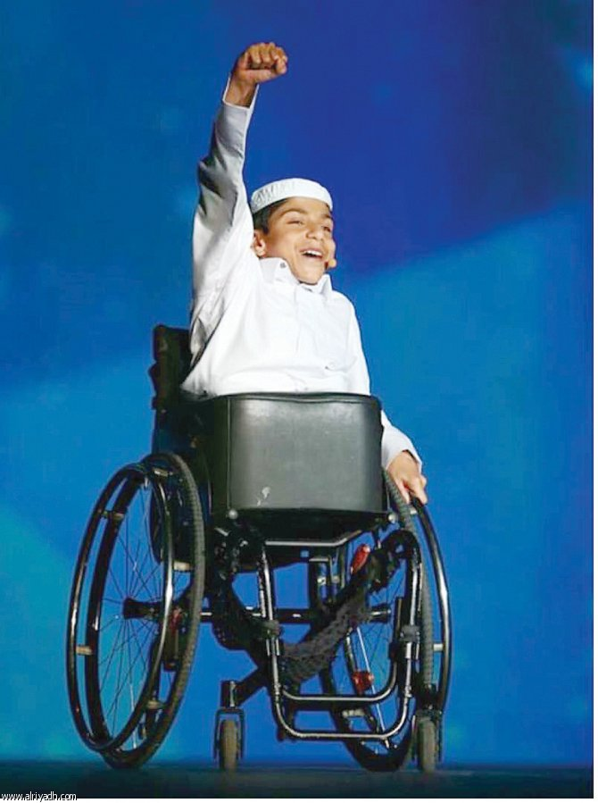
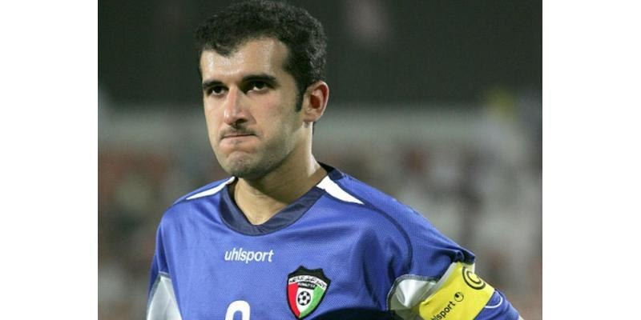
What do you think of these people?
*Are they famous ? Why?
* How did they inspire you ?

Slide 4
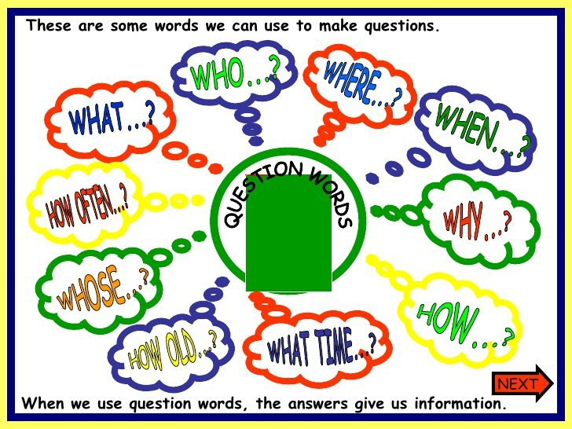
If you are asked to write about the person who
inspired you, what information will you include?

Slide 5
Fill in the following diagram with information
about the person who inspired you:
Name :
Picture

Slide 6
Fill in the following diagram with information
about the person who inspired you:
Name :
Juri Al-Azmi
From our English book.
Her determination to succeed.
She read fifty books in Braille.
First place in Kuwait at the “Arab Reading Challenge” contest.

Slide 7
Interesting facts :
1- Always :
2- Never :
3- Best known for :

Slide 8
Interesting facts :
1- Always :
2- Never :
3- Best known for :
motivated & successful
gives up
*determination & hope
*love reading books & poetry

Slide 9
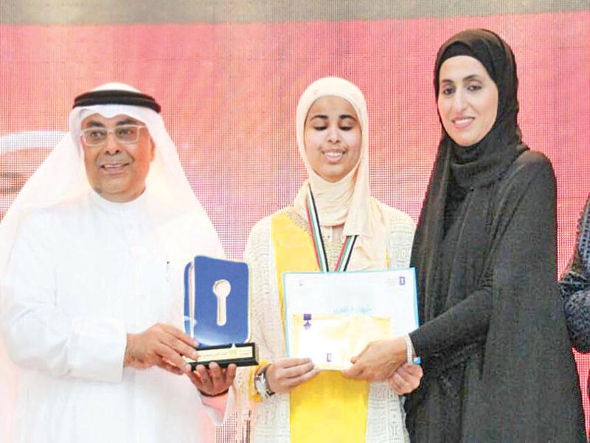
Juri AL-Azmi
A great Kuwaiti girl
Why do Juri inspire and surprise people?

Slide 10
…………………
…………………
…………………
…………………
…………………
…………………
…………………
…………………

Slide 11
intelligent
cultivated
motivated
determined
Never
gives up
fighter
successful
ambitious

Slide 13
“Inspiring persons are those who can break all the barriers to change the world around them.”
Plan and write a report of two paragraphs (not less than 10 sentences) about:
(An inspiring person you admire)
describing his / her life and concluding his / her achievements.

Slide 14
Plan your
topic first

Slide 15
Inspiring Person
Her life
Her achievements
Juri AL-Azmi
Never
gives up
Kuwaiti
50 books
Blind
Reading
champions
Love
reading
Be famous

Slide 17
Plan your
topic first

