Slide 1

Module 1
Unit 2
Life Events

Slide 2

Reading
SB./P. 25

Slide 3
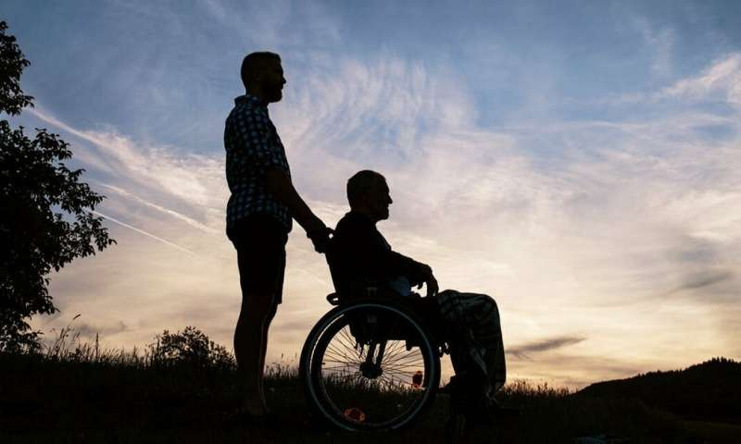
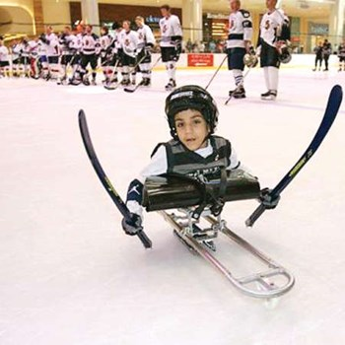
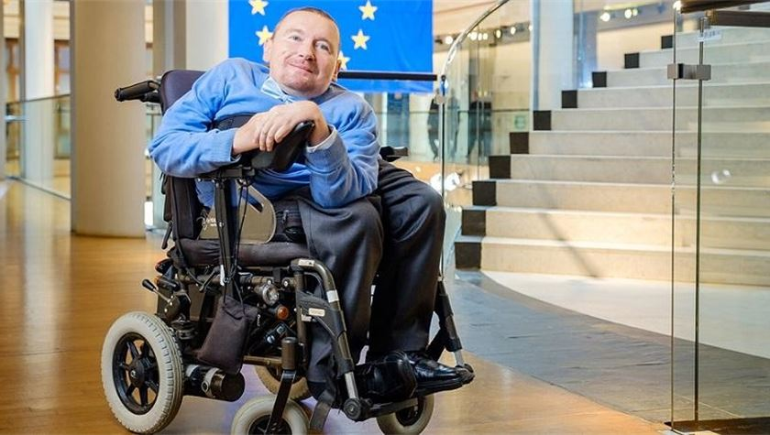

Slide 4

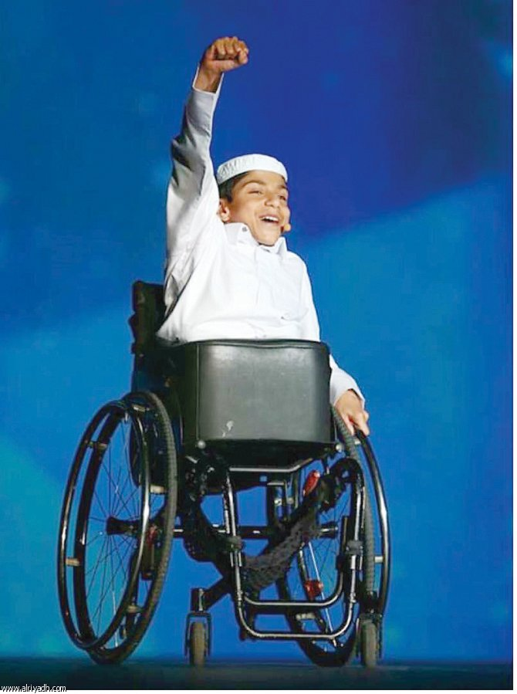
1- What is his
disability?
2- In your opinion ,
what challenges
is he facing?

Slide 5


Slide 6
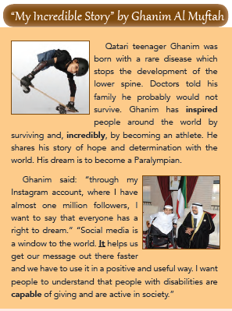
Activity 1 :
Read the following text and choose the correct answers:
1- The best title of this text is :
a- Inspiring people
b- Paralympians
c- Rare diseases
d- Social media

Slide 7

New
Vocabulary

Slide 8


inspire (V)
to fill someone with confidence and desire to do something

Slide 9
Example
Ghanim has inspired people around
the world by becoming an athlete.

Slide 10
incredibly (Adv)
used for saying that something is very difficult to believe.

Slide 11
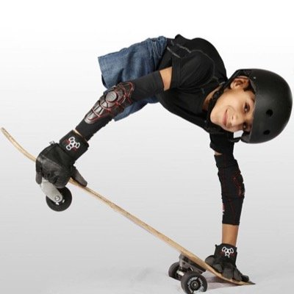
Example
Ghanim incredibly becomes
an athlete.

Slide 12
capable (Adj)
having the ability or power to be able to do something.

Slide 13
Example
People with disabilities
are capable of improving
our society.

Slide 14
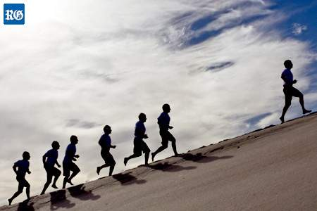


inspire (V)
incredibly (Adv)
capable (Adj)

Slide 15
Activity 2 :
Read the text again and choose the correct answers:
2- The main idea of the 1st paragraph is :
a- Losing dreams.
b- Defying the odds.
c- Helping the poor.
d- Becoming an athlete.

Slide 16
3- The underlined pronoun “It” in
the 16th line refers to :
c- The world
a- Ghanim’s dream
b- Social media
d- The society

Slide 17
4- The opposite of the word “positive”
in the 18th line is :
c- useful
a- difficult
b- important
d- negative

Slide 18
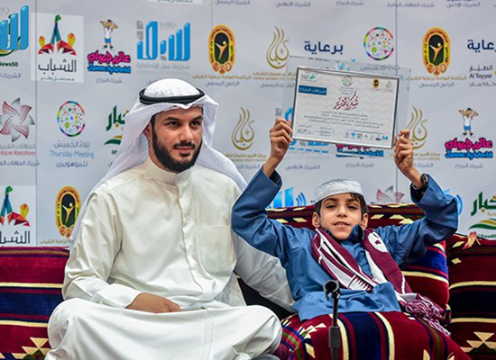
Activity 3
Read the text again and answer the questions blow:
1- How did Ghanim inspire and surprise people?
2- How can social media help us?
3- What is the purpose of this story ?

Slide 19



Slide 20
1- He incredibly inspired people around the world by surviving and becoming an athlete.
2- It helps us get our message out there faster and we
have to use it in a positive and useful way.
3- To inspire people to work hard to achieve their goals.
To inspire people to defy the odds.

Slide 21

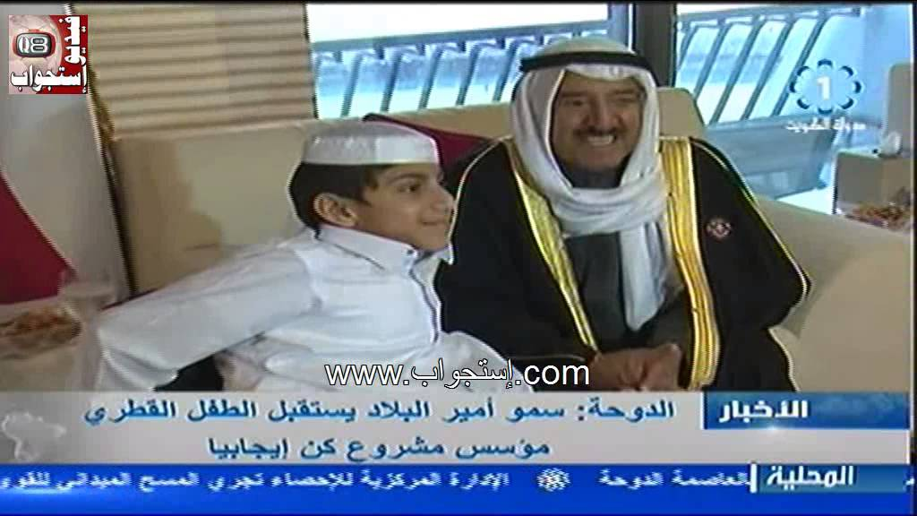
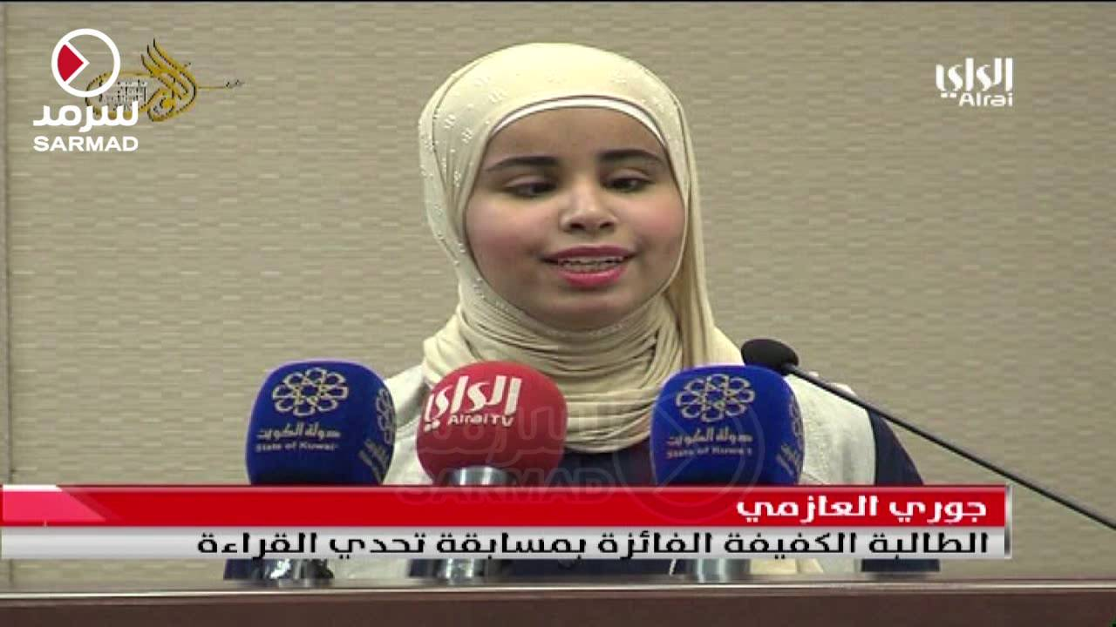

Slide 22


