Slide 1
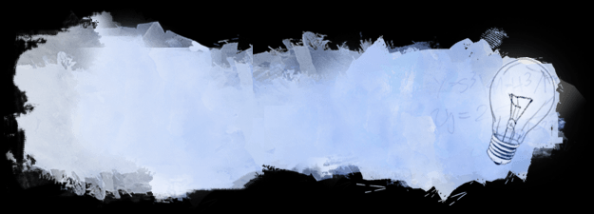

Intelligence and creativity

Slide 2

البوابة الكويتية لصعوبات التعلم (redsoft.org)

Slide 3


Slide 4
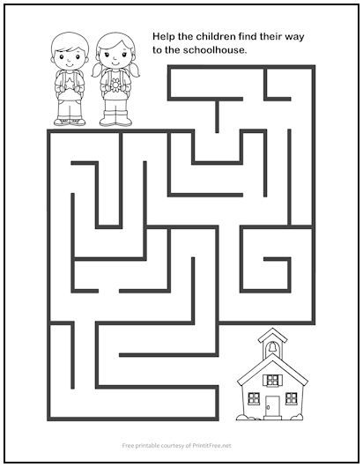

Slide 5
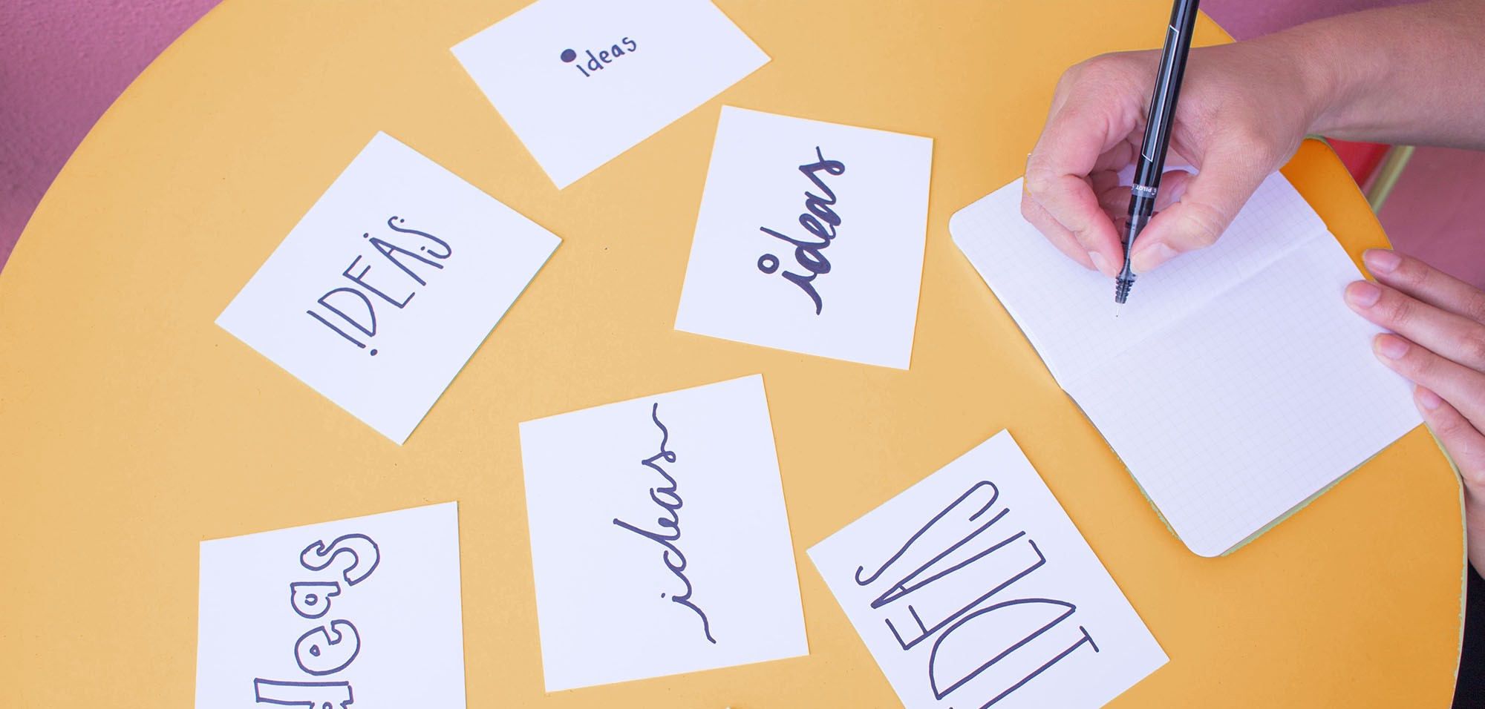
How do you think can someone be more creative?

Slide 6
Mention the ways of being creative.
1- Evolution of ideas
2- Putting ideas together
3- Changing how we do things
4- Finding a new use for things
5- Changing approach

Slide 7


Slide 8
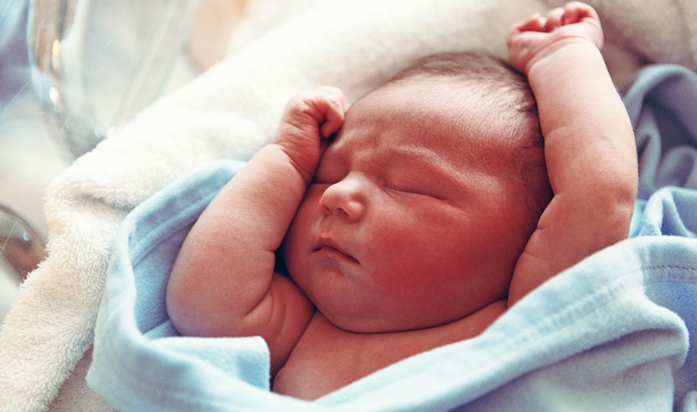
What will the baby look like when he grows up?
Parents care about their baby’s appearance.

Slide 9
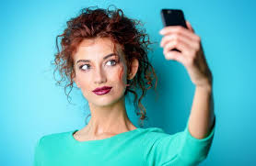
Your appearance is how you look: your clothes, hair and facial expression.

Slide 10
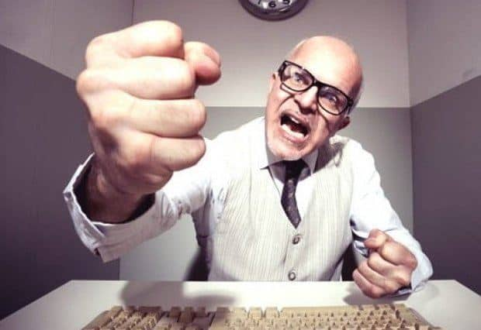
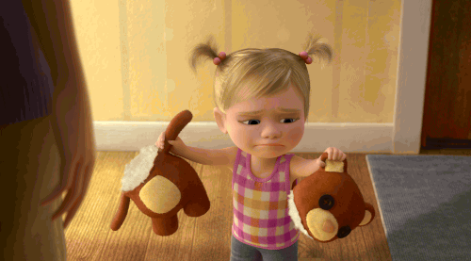
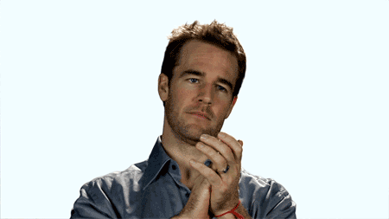
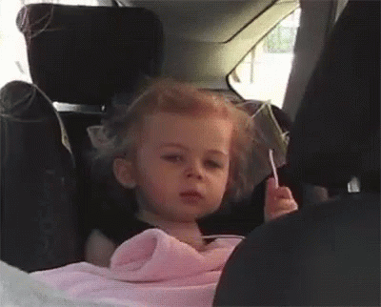
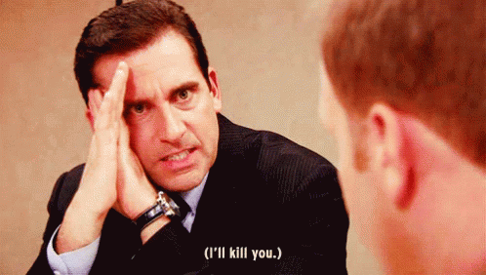
It's often very difficult to change people's attitudes.

Slide 11
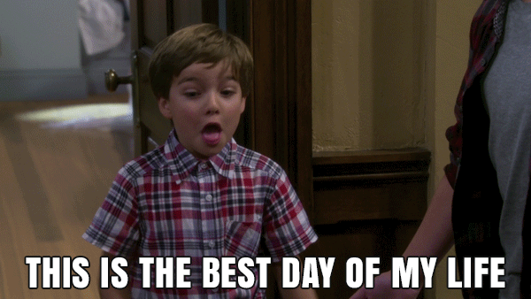
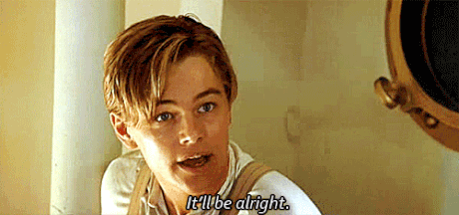

attitude
a feeling or opinion about something or someone, or a way of behaving that is caused by this

Slide 12
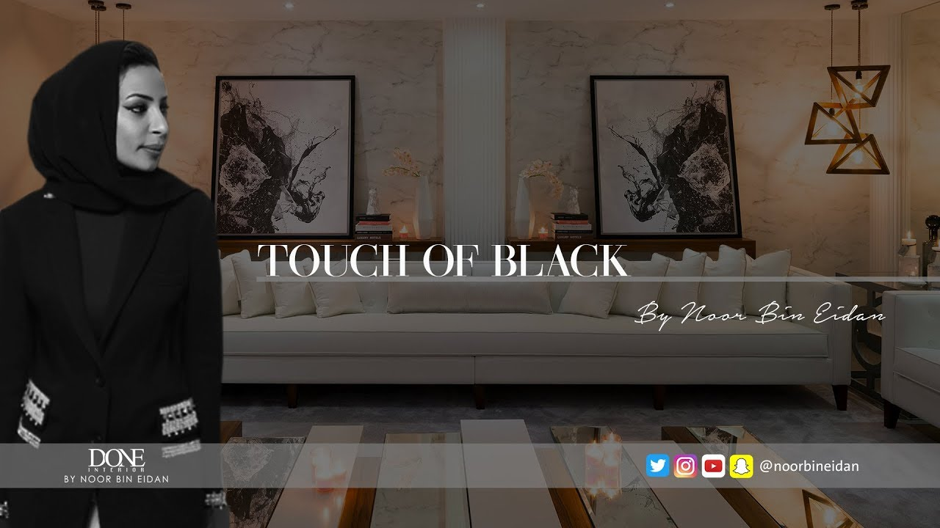
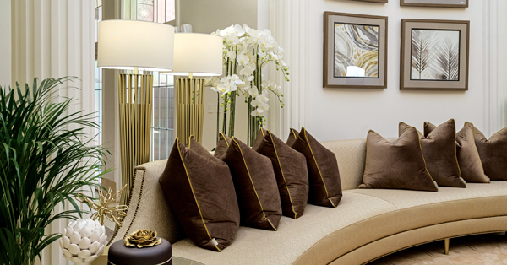
Noor Bin Eidan is so creative. She’s an expert in interior designing.

Slide 13



expert
a person with a high level of knowledge or skill relating to a particular subject or activity

Slide 14

New Vocabulary

Slide 15


expert (n.)
attitude (n.)
appearance (n.)

Slide 16
Vocabulary
Check

Slide 17
Fill in the spaces with words from the list:
(appearance – expert – attitudes )
1. It's not easy to change people's.................................
2. Her splendid...................................shows that she is very wealthy.
attitudes
appearance

Slide 18
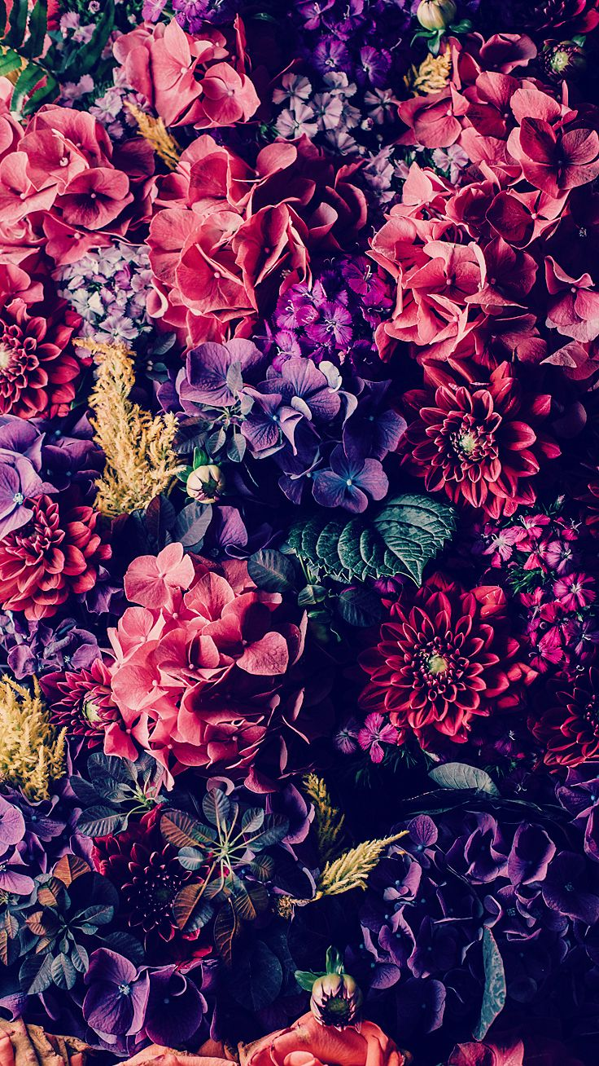
Student’s Book
Page 84
Before you listen

Slide 19


Before Listening strategies

Slide 20

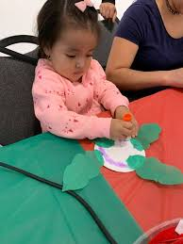
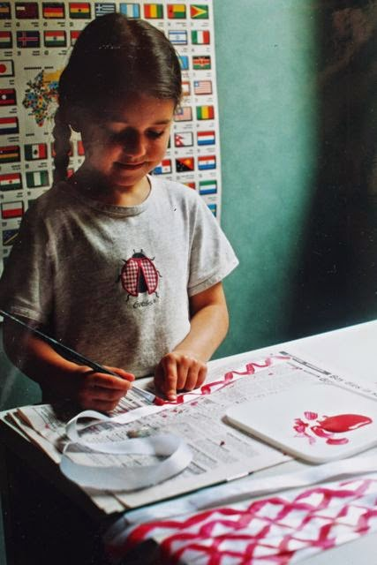
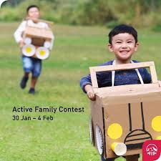
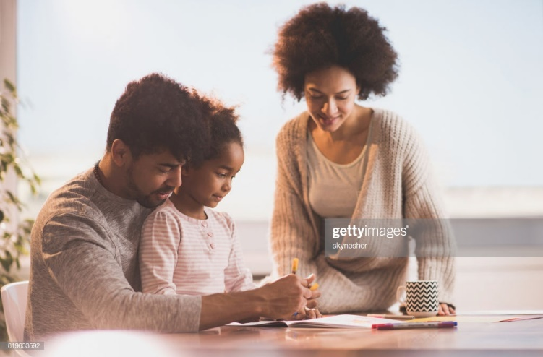
Before you listen

Slide 21


During Listening strategies

Slide 22


Slide 23



Slide 24

Check your answers.

Slide 25


Six Secrets of Creativity
Carry a notebook and a pen.
Reasons
To write down

Slide 26
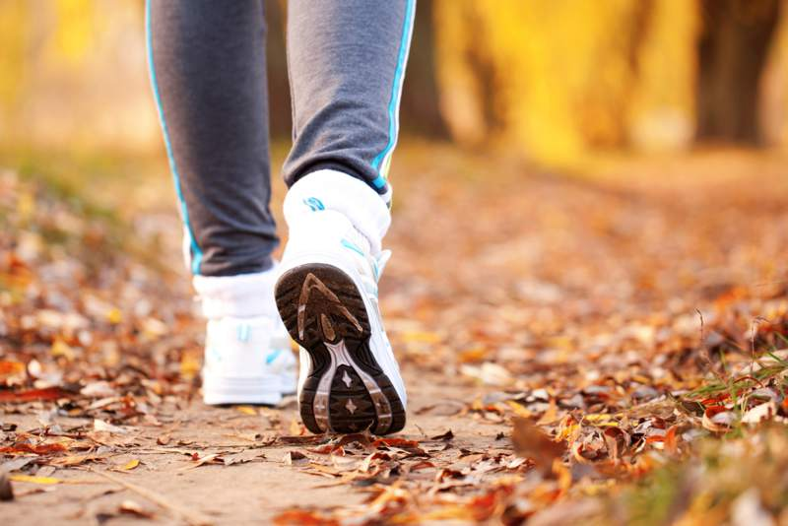

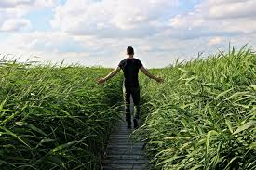
Six Secrets of Creativity
Go for a walk.
Reasons
Exercise gives energy to the brain

Slide 27
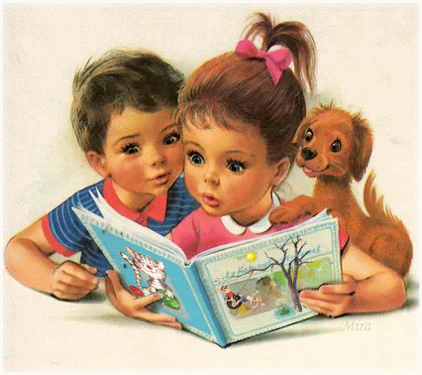


Six Secrets of Creativity
Read a lot of books.
Reasons
Reading gives a lot of information

Slide 28
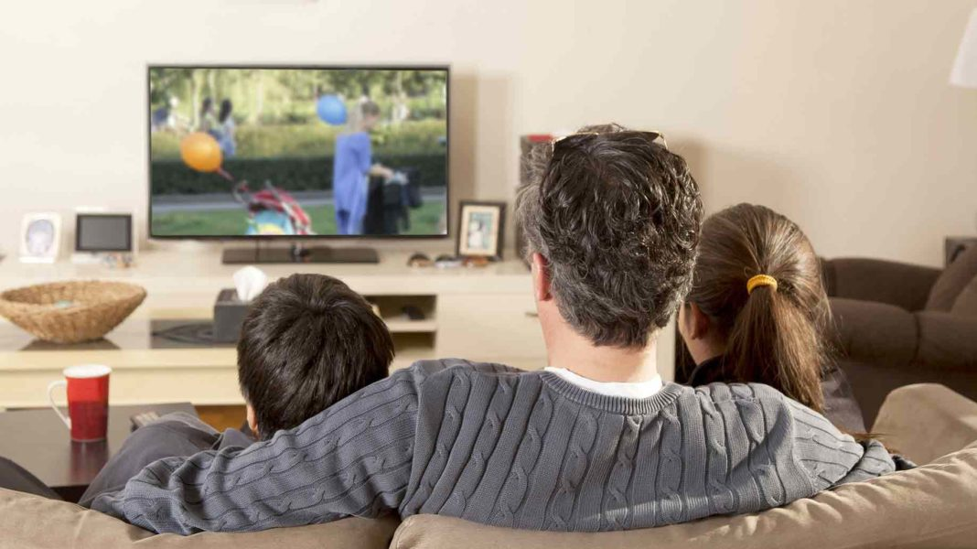

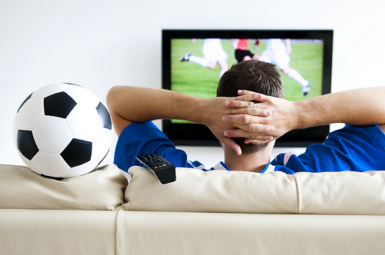
Six Secrets of Creativity
Don’t watch a lot of TV.
Reasons
The brain needs exercise

Slide 29
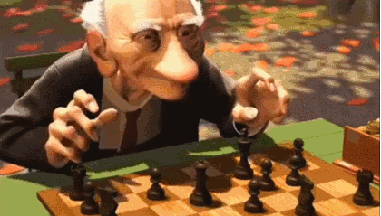

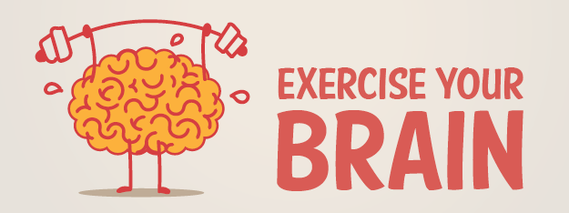
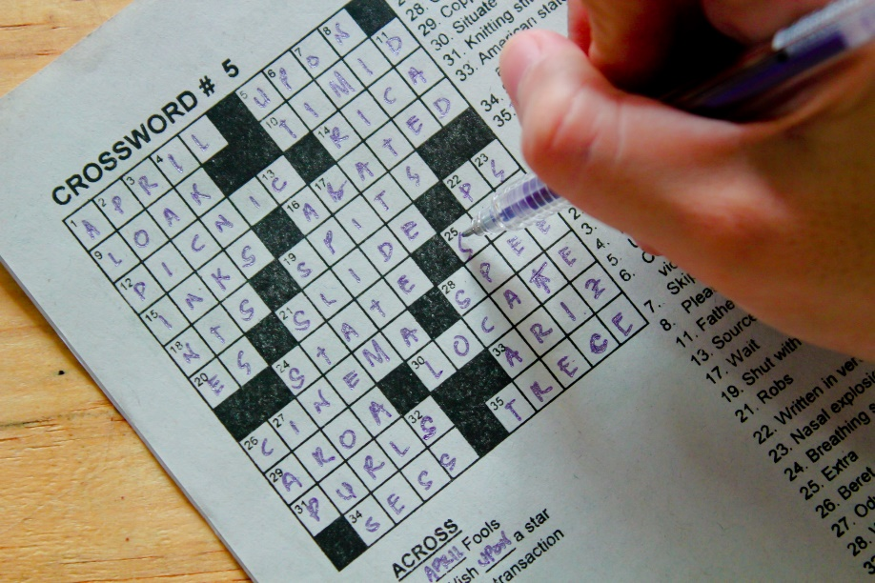
Six Secrets of Creativity
Exercise your brain.
Reasons
It makes you more creative

Slide 30
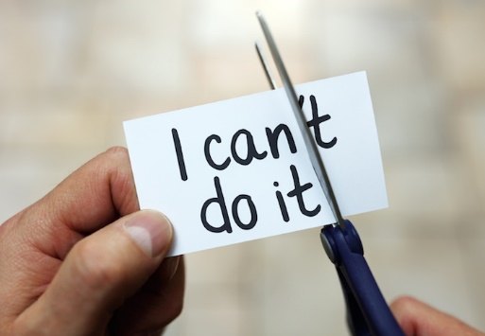



Six Secrets of Creativity
Have a positive attitude.
Reasons
To be able to do lots of different things

Slide 31
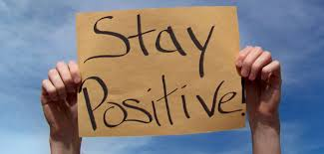
After Listening strategies

Slide 32

What are the secrets of creativity?

Slide 33

Student’s Book
Page 83

Slide 34

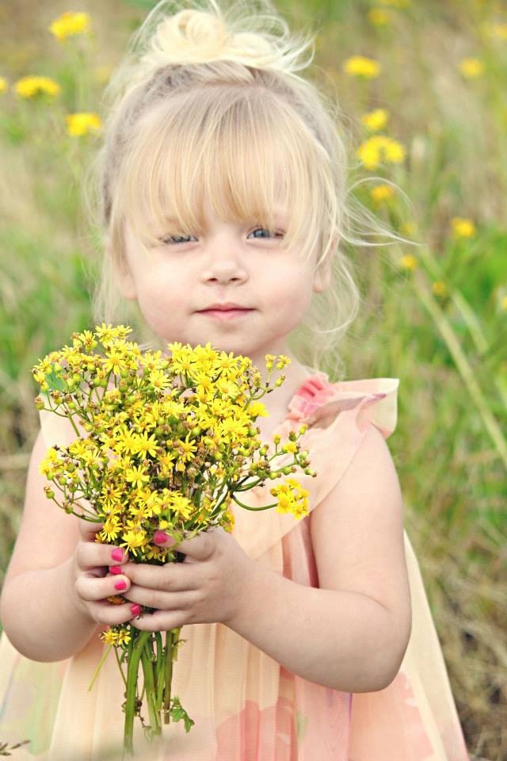


Grammar in context Suffixes
(-ment/- able/- ed/- less/ -ful)

Slide 35
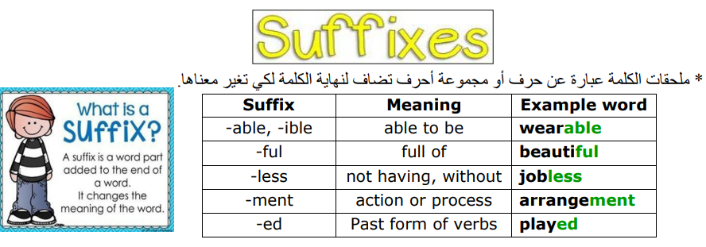

Slide 36




A suffix is a letter or a group of letters added to the end of a word to change its meaning.
fashion
-able

Slide 37
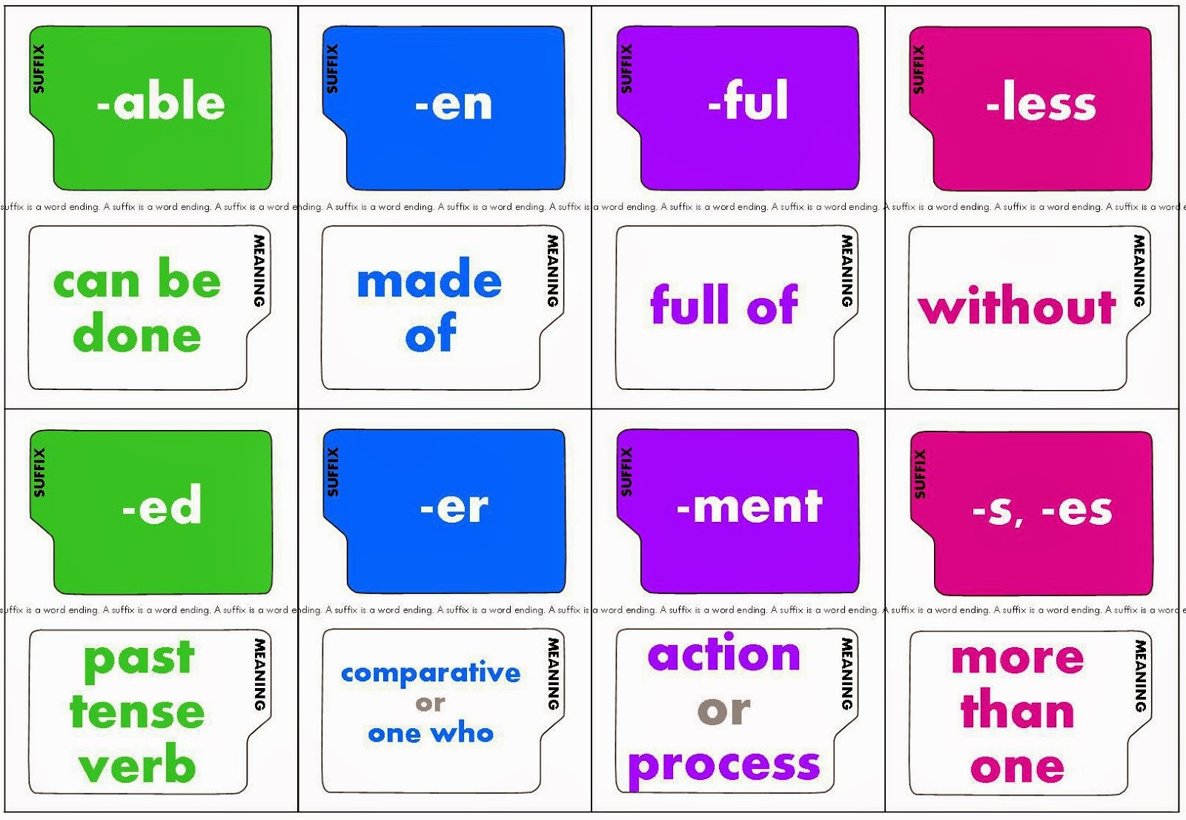

Slide 38
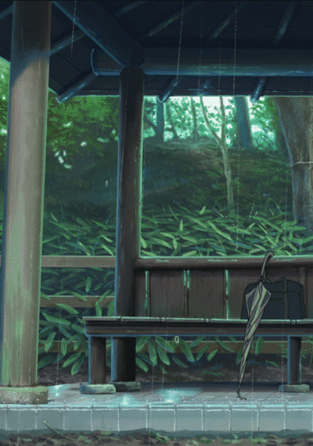
Let’s watch a movie to learn more about suffixes.

Slide 39


Slide 40








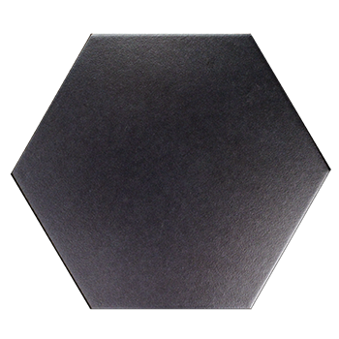

-ment
-able
action or process
can be done
-ful
-less
-ed
full of
without
Past tense verb

Slide 41

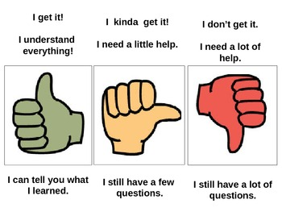

Slide 42


Add the right suffixes to the words in brackets:
( comfort - develop – use - care - combine )
(-ment/- able/- ed/- less/ -ful)
( comfort - develop – use - care - combine )

Slide 43

Check your answers.

Slide 44
Add the right suffixes to the words in brackets:
( comfort - develop – use - care - combine )
(-ment/- able/- ed/- less/ -ful)
……….….......……
……….….......……
……….….......……
……….….......……
……….….......……
development
comfortable
combined
useless
careless
useful
careful

Slide 45


Slide 46
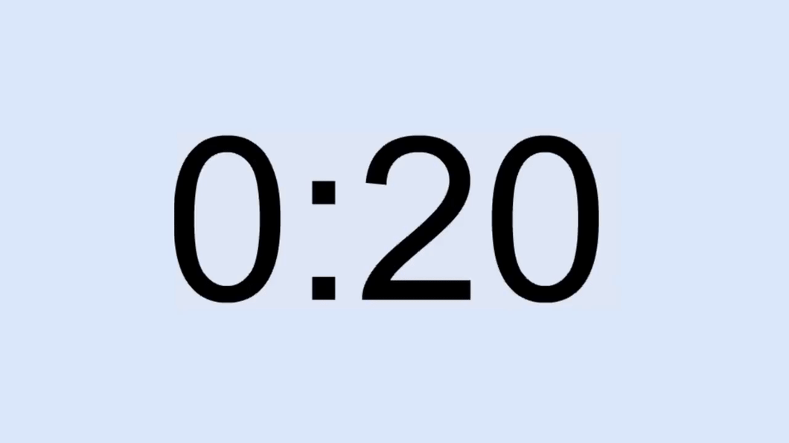
Write the correct suffix for each root word below.

Slide 47
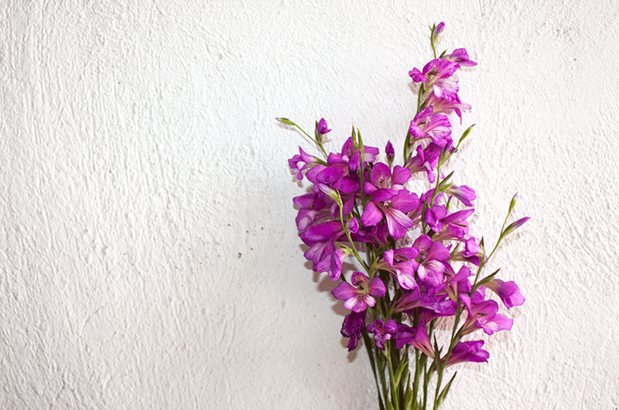
Check your answers.

Slide 48
Find the words in the text that end with suffixes:
• I like to be (help) ……….………...………. at home.
• The (fear) ……….………………......……. boy saved the cat.
• The teacher wanted to see (…………...........………………………..) in my grades this month.
helpful
fearless
Improvements

Slide 49


