Slide 1

Module 1
Unit 1
Healthy living

Slide 2
Reading
P.19

Slide 3
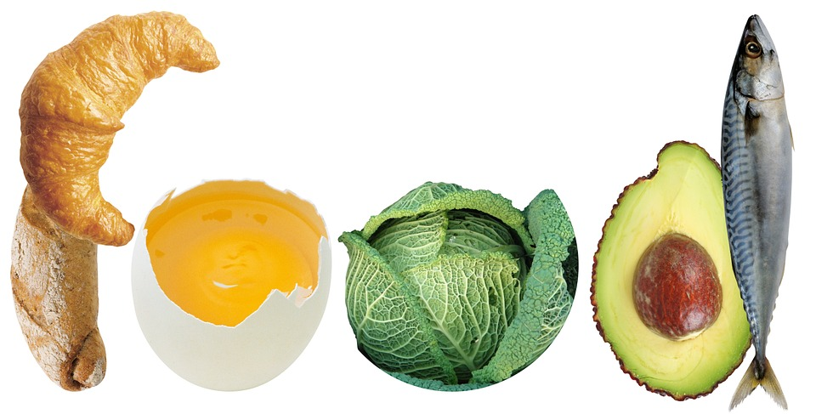
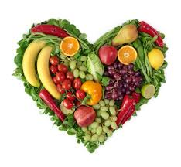
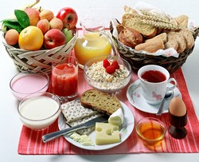
What kind of food do you prefer eating? Why?

Slide 4
Read the following text and
choose the best title.
Activity 1 :
a- Sports
b- Vitamins
c- Vegetarians
d- Athletes

Slide 5
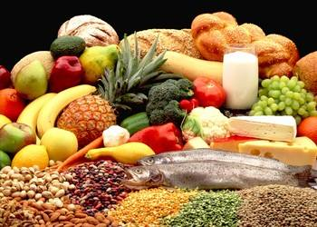
New Vocabulary

Slide 6
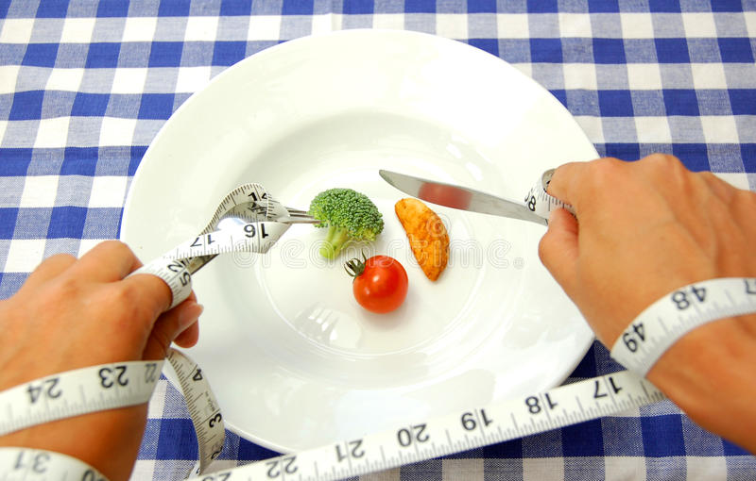

strict (Adj)
exactly correct
and limited

Slide 7
Example
Some people follow a strict diet
to lose weight.

Slide 8
risk (N)
the possibility of something bad happening

Slide 9
Example
Overweight may cause
the risk of many health problems.

Slide 10
obesity (N)
eating too much and moving too little

Slide 11
Example
Eating too much fast food
leads to obesity.

Slide 12
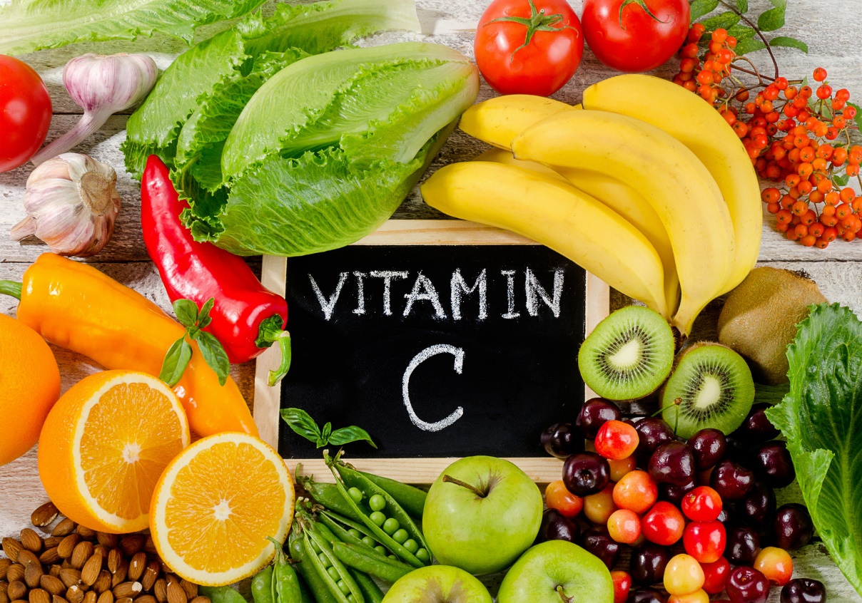
amount (N)
how much
something is

Slide 13
Example
Fruits and vegetables have
high amounts of vitamins.

Slide 14
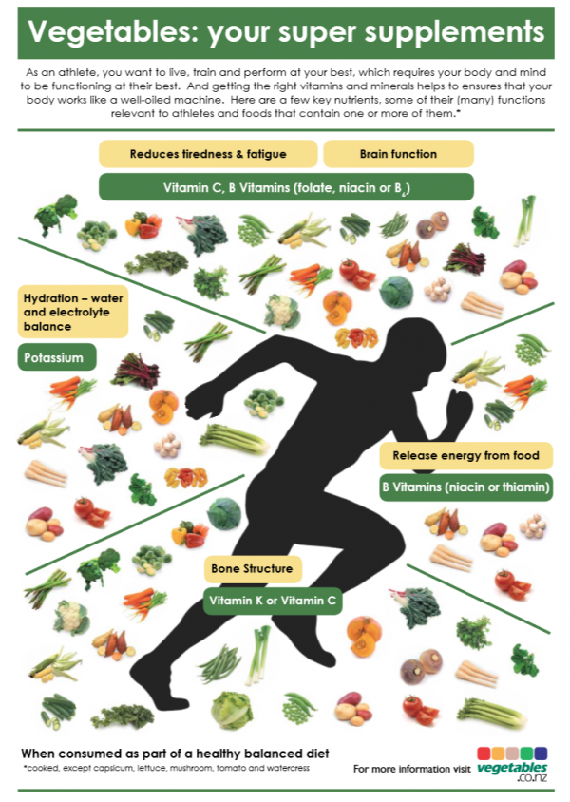
gain (V)
to get something that is useful

Slide 15
Example
We can gain more energy
from vegetables.

Slide 16
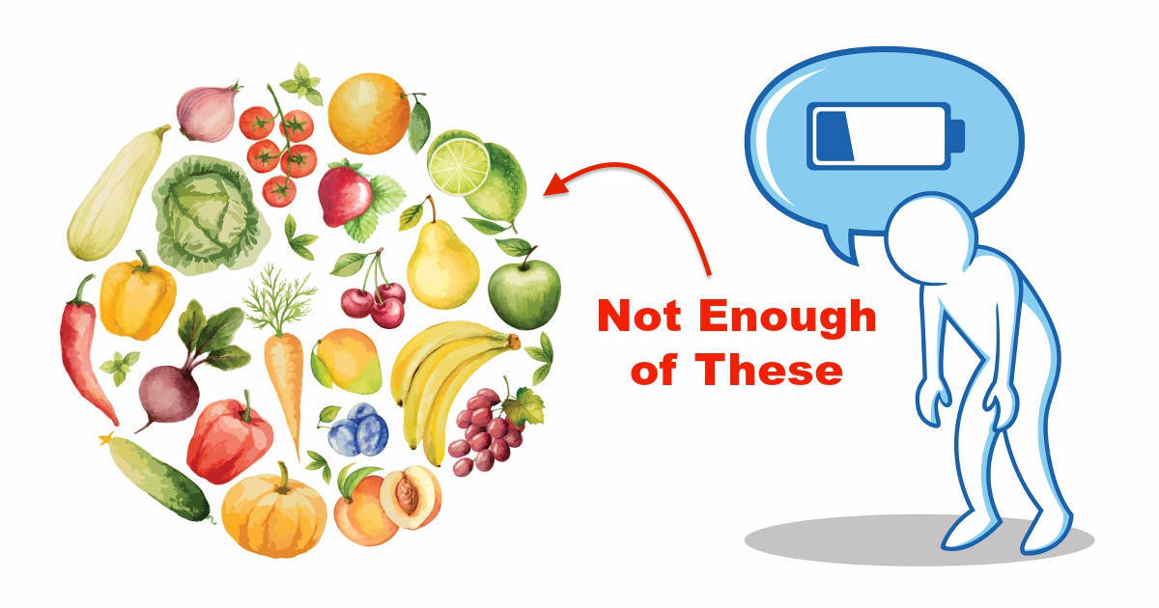
lack (V)
not have enough of something that is needed or wanted

Slide 17
Example
People who don’t eat fruits
and vegetables lack vitamins.

Slide 18
adequate (Adj)
enough

Slide 19
Example
We should have adequate amounts
of fruits and vegetables daily.

Slide 20
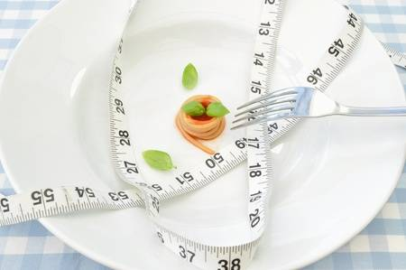

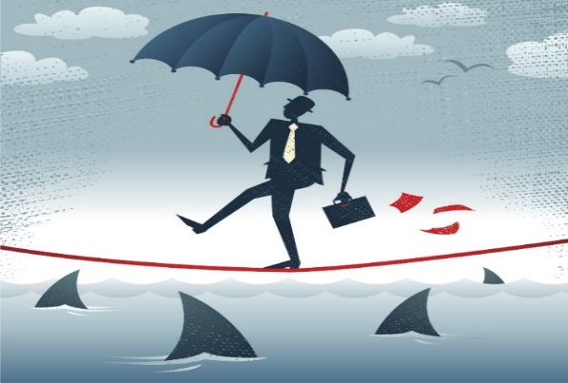
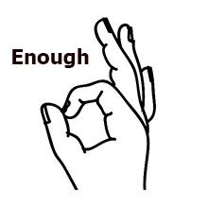
amount (N)
gain (V)
lack (V)
Adequate
(Adj)
strict (Adj)
risk (N)
obesity (N)

Slide 21
Activity 2
Read the following paragraphs and
choose the main idea of each one:

Slide 22
The main idea of the (1st ) paragraph is :
a- Vegetarians’ diet b- Healthy life
c- Strict diet d- Dairy products

Slide 23
2-The main idea of the (2nd ) paragraph is :
a- The risk of obesity.
b- The high amount of vitamins.
c- Advantages of the vegetarian diet
d- Disadvantages of the vegetarian diet

Slide 24
3-The main idea of the (3rd ) paragraph is :
a- The huge amount of protein.
b- The lack of vitamins.
c- The importance of eating meat.
d- The negative effects of the vegetarian diet.

Slide 25
4-The main idea of the (4th) paragraph is :
a- The importance of the vegetarian diet.
b- The importance of having a balanced diet.
c- Keeping our bodies fit.
d- Eating less amounts of food.

Slide 26
Activity 3 :
What is the purpose of
the writer in writing this text?
a- To inform us about the main food groups.
b- To persuade us to be vegetarians.
c- To advise us to have a balanced diet.
d- To tell us about the risk of obesity.

Slide 27


What is the importance of having
a balanced diet?

Slide 28
What is the importance of having
a balanced diet?
Keeping the body
in top condition
Maintaining a
good health
Keeping us energized
and motivated

Slide 29


