Slide 1

Module 1
Unit 1
Healthy living

Slide 2

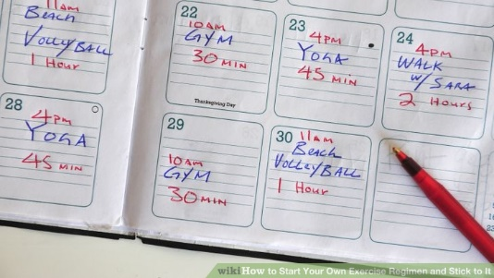
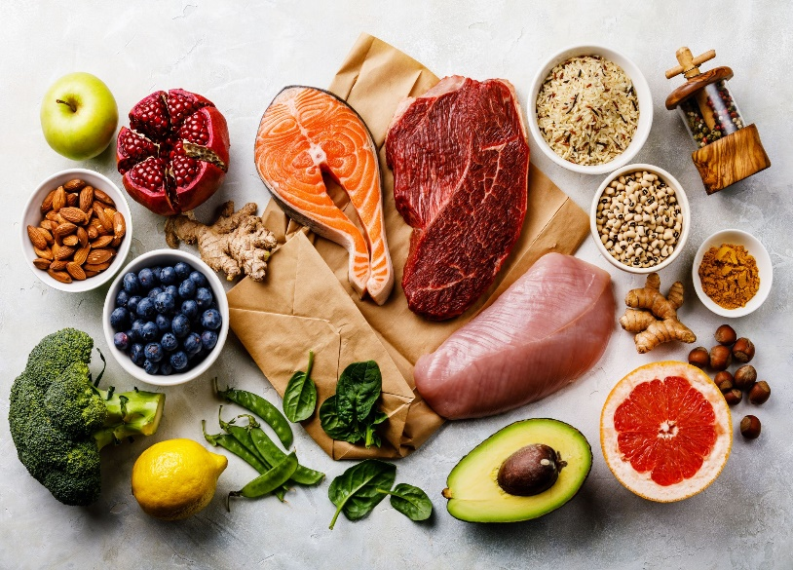
What comes to your mind
when you see these pictures?

Slide 3

Complete the following diagram
with your own ideas:

Slide 4
Complete the following diagram
with your own ideas:
Eating healthy food
Doing exercises
Losing weight
Sleeping well
Keeping fit
Drinking water
Taking the stairs

Slide 5

1- What is the importance of having
a healthy lifestyle ?
2- How can you have a healthy lifestyle?

Slide 6

What is the importance of having a healthy lifestyle ?
healthy
strong
study better
do tasks better

Slide 7
How can you have a healthy lifestyle?
Playing sports
Doing exercises
Eating healthy food
Drinking a lot of water
Using the stairs rather than the lift

Slide 8
“To maintain a happy life, you need to be healthy.”
Plan and write a report of two paragraphs (not less than 10 sentences) about:
“The importance of having a healthy lifestyle and how you can be healthy.”

Slide 9

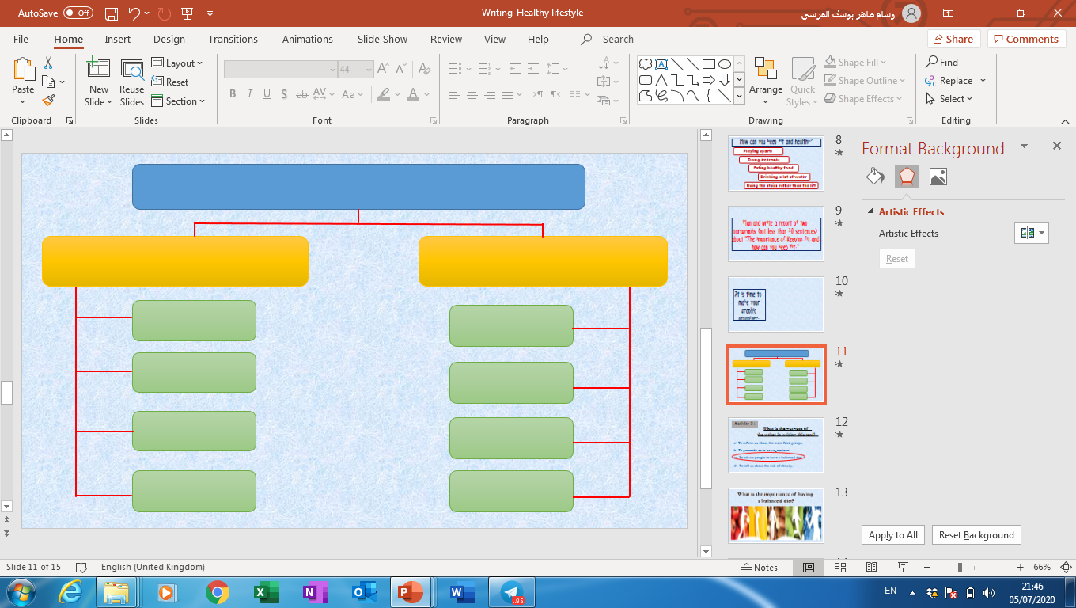
It’s time to
make your
graphic organizer.

Slide 10
Healthy lifestyle
The importance of
having a healthy lifestyle
How you can be healthy
Fit
Doing
exercises
Strong
Healthy
food
Study better
Drinking
water
Sleeping
well
Live happily

Slide 11
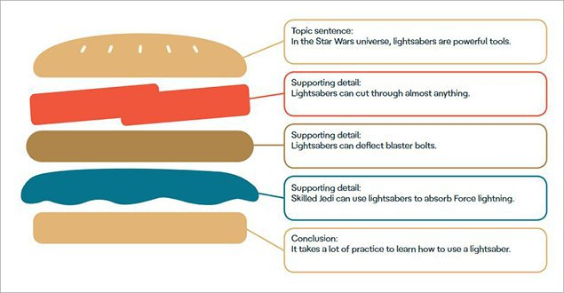
Topic sentence :
…………………………
It’s helpful
to follow the
(Burger Sandwich Strategy) to express ideas in writing.
Supporting details :
…………………………
Supporting details :
…………………………
Supporting details :
…………………………
Conclusion :
…………………………

Slide 12
Paragraph 1
Topic sentence :
……………….…………………
Supporting details :
………………………….……………
Supporting details :
………………………….……………
Supporting details :
………………………….……………
Conclusion :
……………………………….………

Slide 13
Paragraph 1
Topic sentence :
It is important to have a healthy lifestyle.
Supporting details :
It makes me fit and strong.
Supporting details :
It helps me study better.
Supporting details :
It helps me do tasks better.
Conclusion :
Healthy life leads to a happy life.

Slide 14
Paragraph 2
Topic sentence :
……………….…………………
Supporting details :
……………………….………………
Supporting details :
……………………….………………
Supporting details :
………………………….……………
Conclusion :
…………………………….…………

Slide 15
Paragraph 2
Topic sentence :
It is not difficult to be healthy.
Supporting details :
I can play sports .
Supporting details :
I should sleep well.
Supporting details :
I should eat healthy food.
Conclusion :
We should do our best to be healthy.

Slide 16


Slide 17
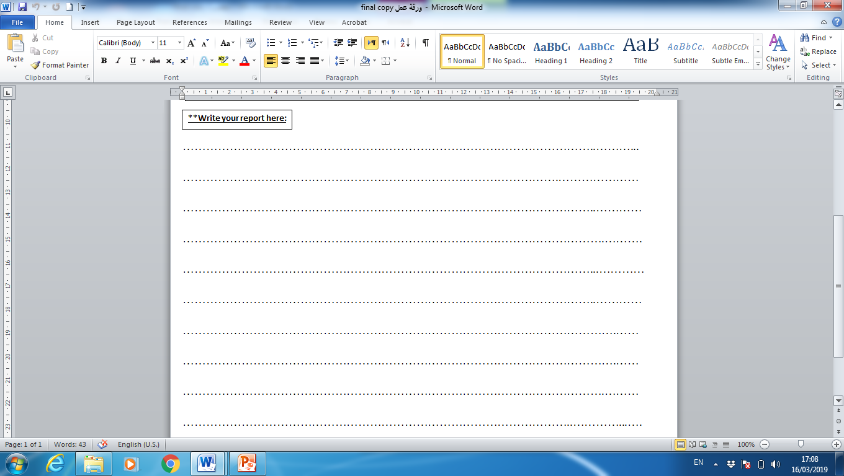


Slide 18


