Slide 1
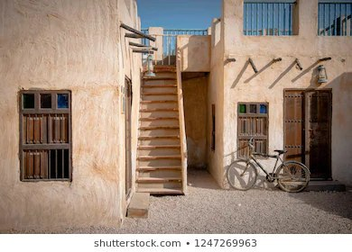

Module 2
Unit 4
Unforgettable past

Slide 2

SB. / P. 38

Slide 3
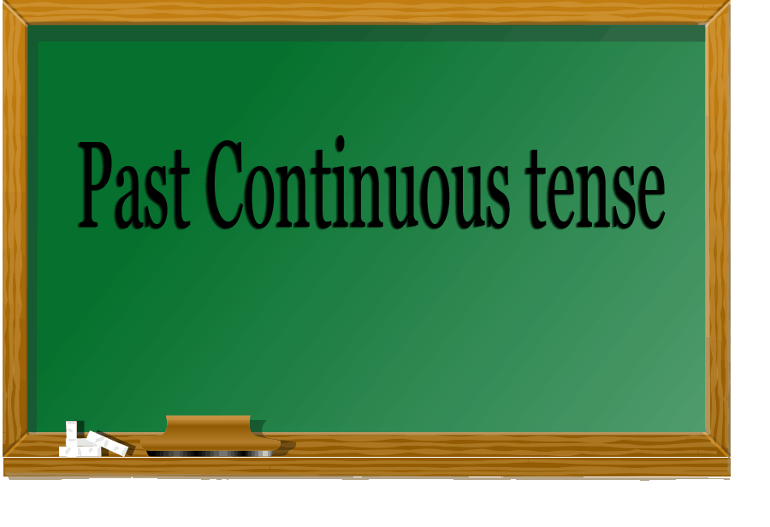

Slide 4

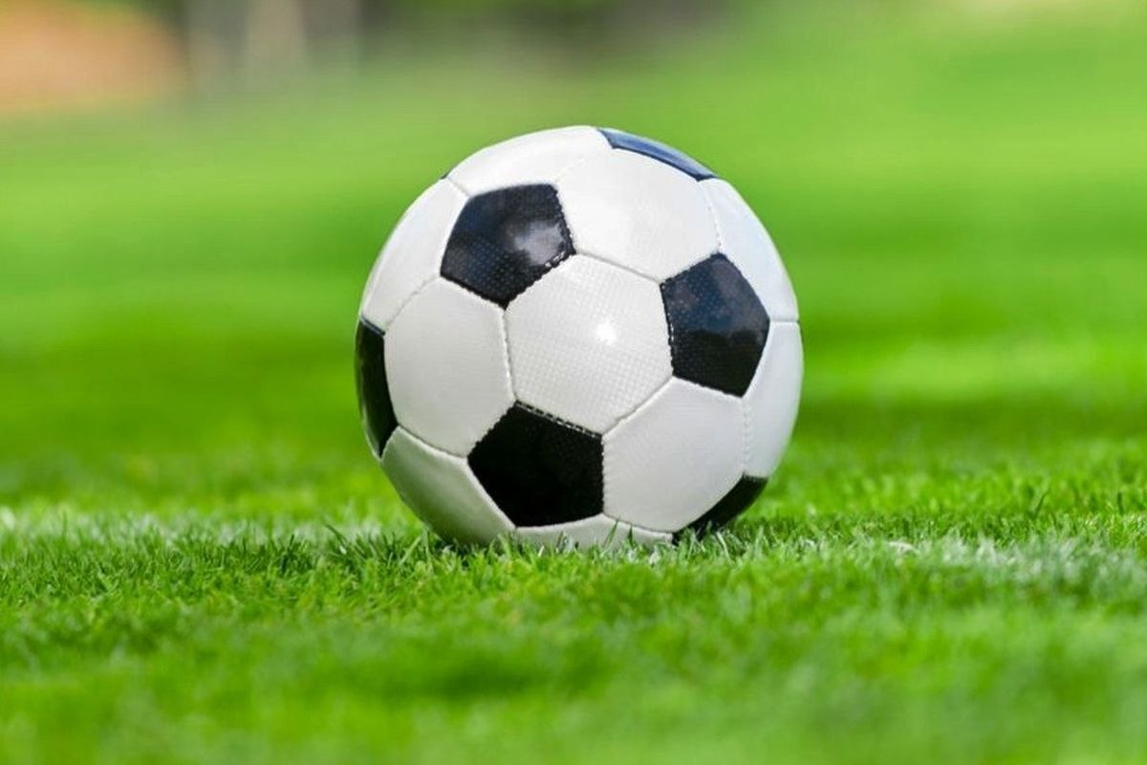
What did your friends do yesterday?
They played sports.
What were your friends doing
yesterday evening?
They were playing football
yesterday evening.

Slide 5
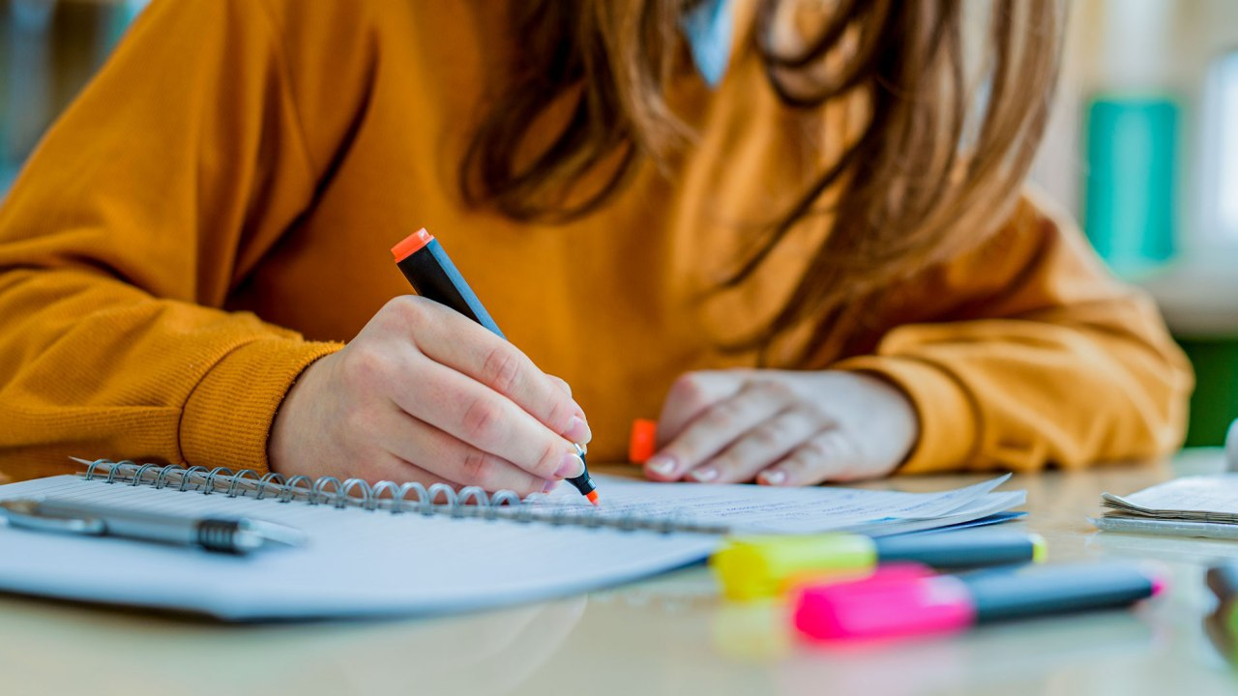
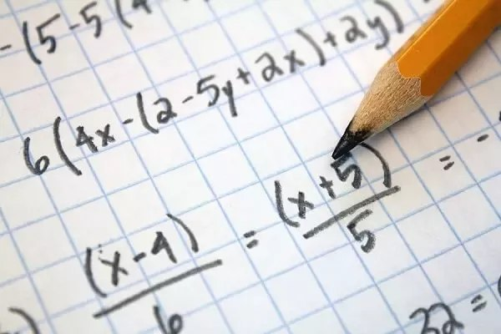
What did you do last Friday?
I studied my lessons.
What were you doing last Friday
when I called you?
I was studyingd Maths
when you called me.

Slide 6
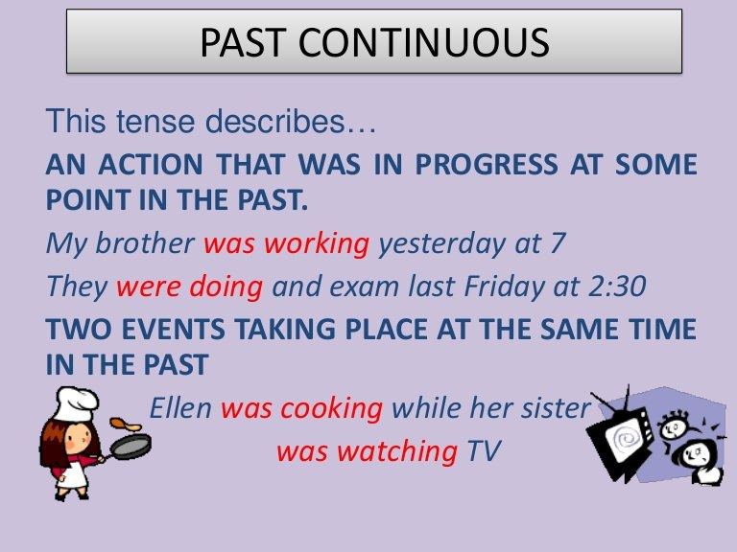
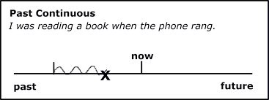

Slide 7
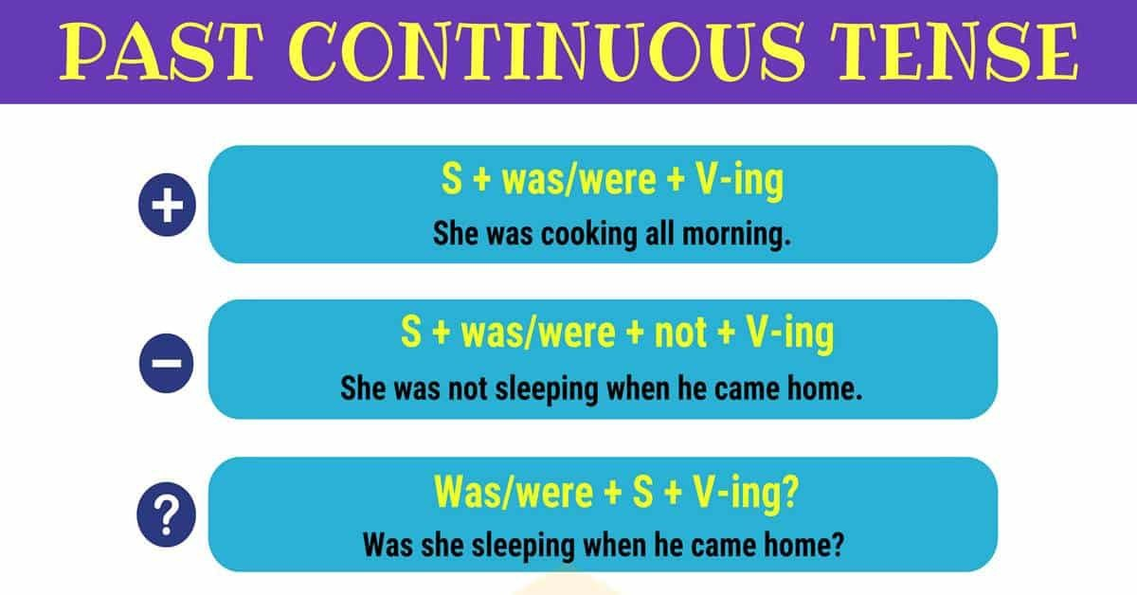

Slide 8
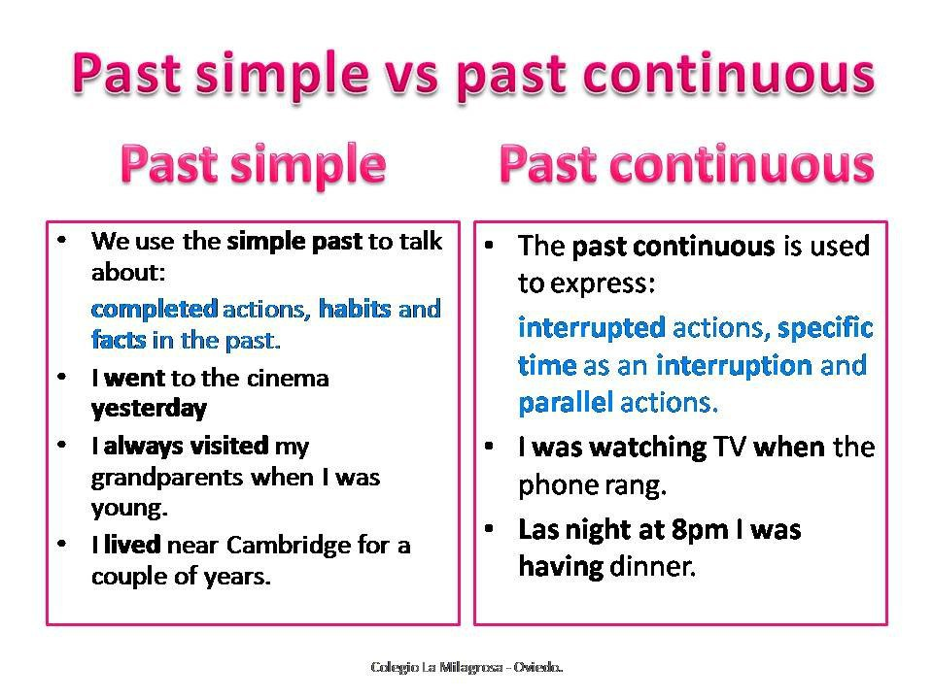

Slide 9
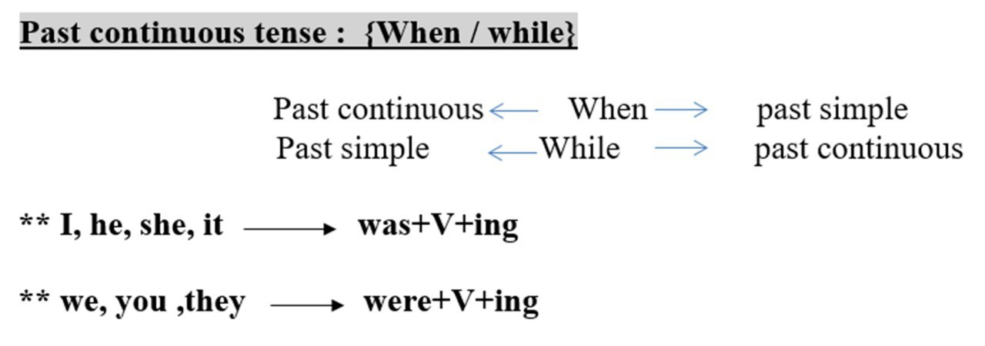

Slide 10
Activity 1 :

Slide 11



Slide 13
Activity 2 :
Choose the correct answers:
Last Friday , we ( enjoys – enjoy – enjoyed ) a nice time on the beach. (While – When – What ) we were walking on the beach , we (collect – collected – collecting) some shells. They were pretty. I (fall – falls – fell ) down while I was ( run – ran – running) on the beach. While my brother ( swam – was swimming – were swimming) , he ( saw – see – seen ) a shark.

Slide 15
Last Friday , we ( enjoys – enjoy – enjoyed ) a nice time on the beach. (While – When – What ) we were walking on the beach , we (collect – collected – collecting) some shells. They were pretty. I (fall – falls – fell ) down while I was ( run – ran – running) on the beach. While my brother ( swam – was swimming – were swimming) , he ( saw – see – seen ) a shark.

Slide 16
Activity 3 :

Slide 18
was waiting
happened
saw
were attending
started
was/ were
training

Slide 19

Activity 4 :
Do as shown between brackets:
1- While my mother (cook) , the doorbell (ring). (Correct)
2- We (stay) at home when the weather ( be) dusty.
(Correct)
3- Sara was eating her meal with her friend.
(Make negative)
4- I was sleeping when my father came to home.
(Ask a question)
5- We were playing tennis . It started to rain.
(Join using : While)

Slide 20
Activity 5 :

Slide 21


