Slide 1

Module 1
Unit 2
Life Events

Slide 2

SB. P. 24

Slide 3



Slide 4

Why do people create their own blogs ?
To share their experiences.
In order to share their experiences.
So that they can share their experiences.

Slide 5


Slide 6

achieve (V)
to succeed in finishing something or reaching a goal.

Slide 7

Example
Why did your brother join
a football club?
To achieve his dream.

Slide 8

improve (V)
to get better or to make something better.

Slide 9
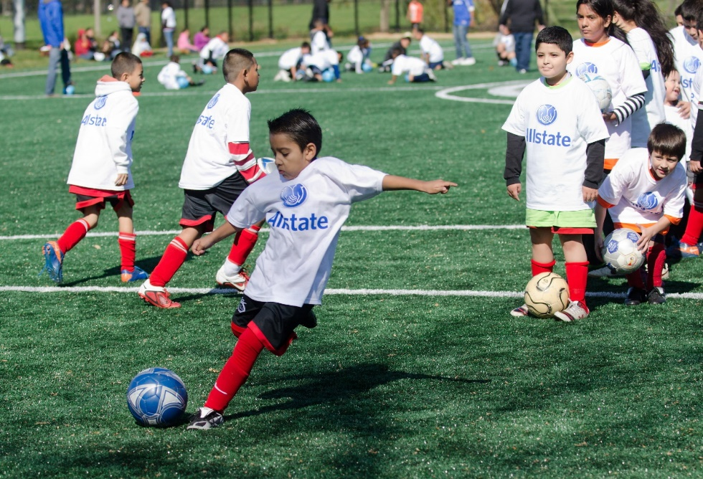
Example
My brother keeps
training in order to
improve his skills.

Slide 10
master (V)
to learn how to do something well.

Slide 11

Example
The students should study English hard so that they could master the skills of the language .

Slide 12
frequently (Adv)
often

Slide 13
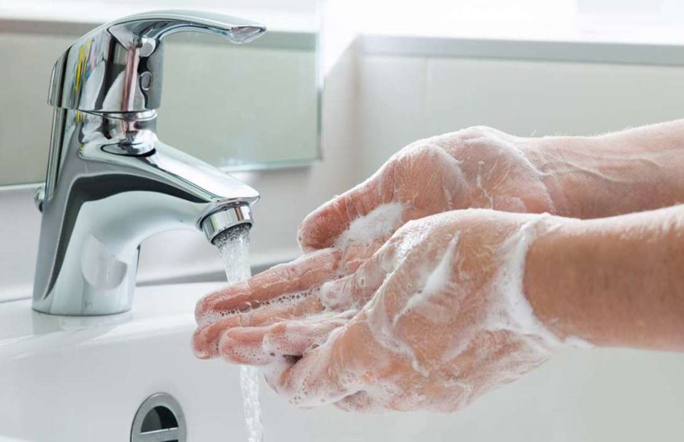
Example
You must wash your hands frequently to kill the bacteria.

Slide 14

infection (N)
A disease in a part of your body that is caused by bacteria or a virus.

Slide 15
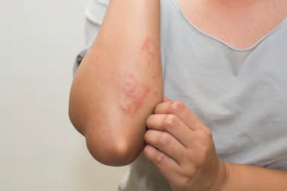
Example
If you don’t wash your hands frequently , you may catch an infection.

Slide 16




achieve (V)
improve (V)
master (V)
frequently (Adv)
infection (N)

Slide 17



Slide 18

Conjunctions

Slide 19
We can use the to+infinitive in a clause with a verb that has no subject .
The to+infinitive focuses on the idea of an action or the results of an action, rather than the action itself.
We use in order to with an infinitive form of a verb to express
the purpose of something.
We use so that to talk about purpose. We often use them with modal verbs (can, could, will, would).

Slide 20
Let’s study some examples.

Slide 21


I study hard.
I want to pass the exam.
* I study hard to pass the exam.
* I study hard in order to pass the exam.
* I study hard so that I can pass the exam.

Slide 22

I give you the book.
I want you to read it.
* I give you the book to read it.
* I give you the book in order to read it.
* I give you the book so that you can read it.

Slide 23

She took the umbrella with her.
She wanted to keep her dry.
*She took the umbrella with her to keep her dry.
*She took the umbrella with her in order to keep her dry.
*She took the umbrella with her so that it could keep her dry.

Slide 24
Activity 1 :

Slide 25



Slide 26
in order to / to
so that
so that
in order to / to
in order to / to
in order to / to
in order to / to

Slide 27

Activity 2 :

Slide 29
Ali joined a sports club so that he could improve his skills.
My father went to the travel agency in order to book a flight.
My sister travelled to the UK so that she could practise speaking English.
Ghanim AL Muftah created his Instagram account to inspire other people.

Slide 30

Write some sentences for the following
pictures using ( to / in order to / so that ) :

Slide 31


