Slide 1

Unit 10
Inventors who changed the world

Slide 2

البوابة الكويتية لصعوبات التعلم (redsoft.org)

Slide 3


Slide 4
Pinterest

Slide 5
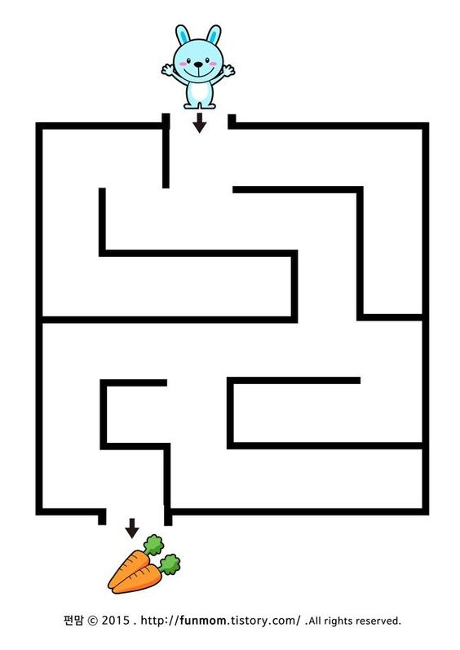

Slide 6


Slide 7
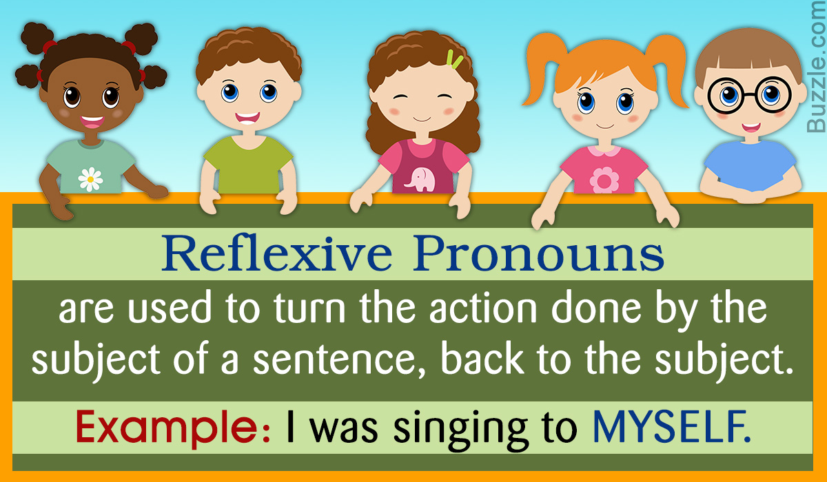

Slide 8
Choose the correct answer from a, b, c, & d:
1.I'm not very busy today. I haven't got ......................... things to do.
a) much b) a little c) many d) a few
2.Tomorrow is my exam; I need to study.....................more.
a) much b) a little c) many d) a few

Slide 9
Choose the correct answer from a, b, c, & d:
3.There is ………………….water in this bottle. You need more.
a) much b) a little c) many d) a few
4. How........................sugar do you take in your tea?
a) much b) a little c) many d) a few

Slide 10
Choose the correct answer from a, b, c, & d:
5. she was.........................sad at the meeting.
a) much b) a little c) many d) a few

Slide 11


Slide 12

Do you think that we need more inventions or not?

Slide 13
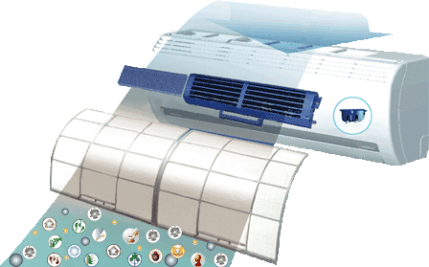
Mention some electrical inventions.

Slide 14



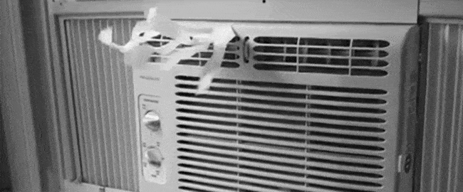
electrical
relating to electricity

Slide 15

humidity
the quality of being humid

Slide 16
An American inventor founded the first company that sells air conditioning systems.

Slide 17


found
to bring something into existence

Slide 18

There are many important and highly influential inventions such as mobile phones and social media.

Slide 19
influential
having a lot of influence on someone or something

Slide 20
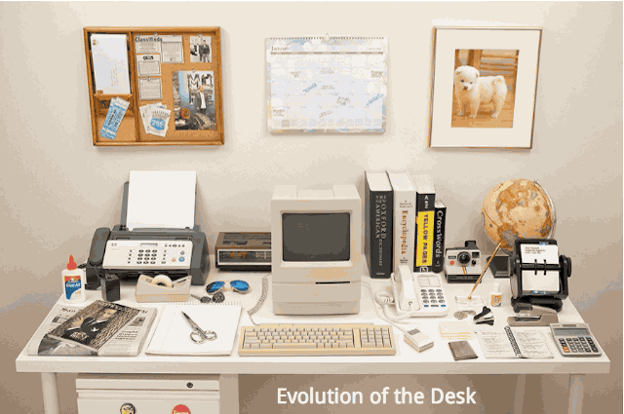
New Vocabulary

Slide 21

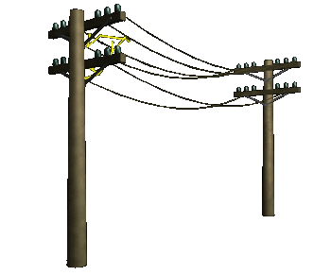
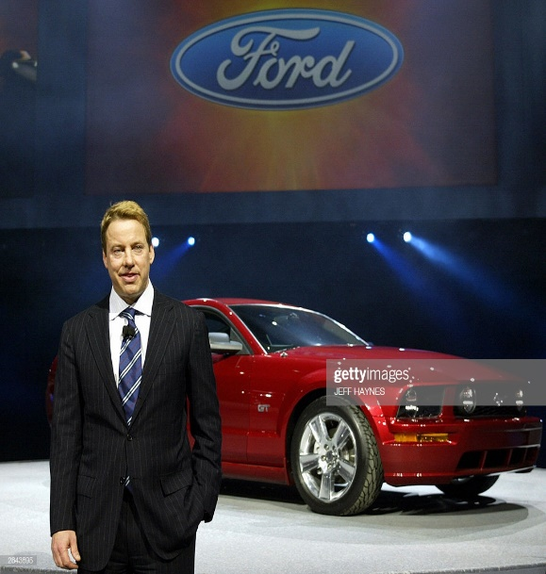
electrical (adj.)
humidity (n.)
found (v.)
influential (adj.)

Slide 23
Vocabulary Check

Slide 24
Fill in the spaces with words from the list:-
(humidity – found – influential – electrical)
1. These plants need heat and ………………………… to grow well.
humidity

Slide 25
Fill in the spaces with words from the list:-
(humidity – found – influential – electrical)
2. Abdul Aziz Hussein is an………………………………Kuwaiti writer
influential

Slide 26
Fill in the spaces with words from the list:-
(humidity – found – influential – electrical)
3. Using the ..............................devices at home saves time and effort.
electrical

Slide 27

Inventors who changed the world
Student’s Book
Page 80

Slide 28



Slide 29



Slide 30
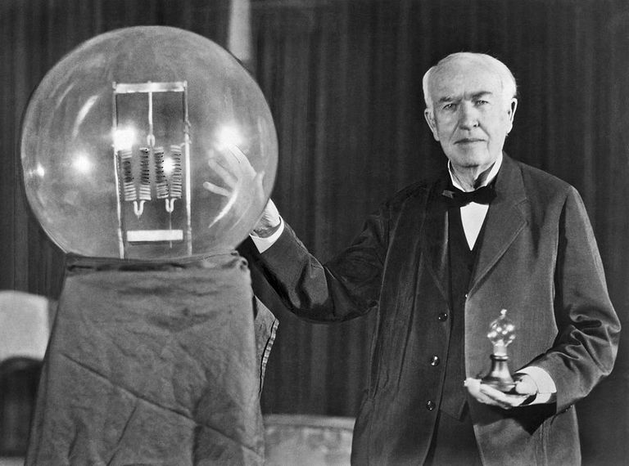
Read your answers.

Slide 31
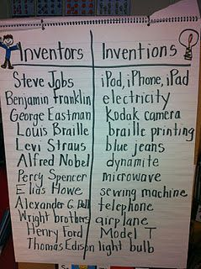
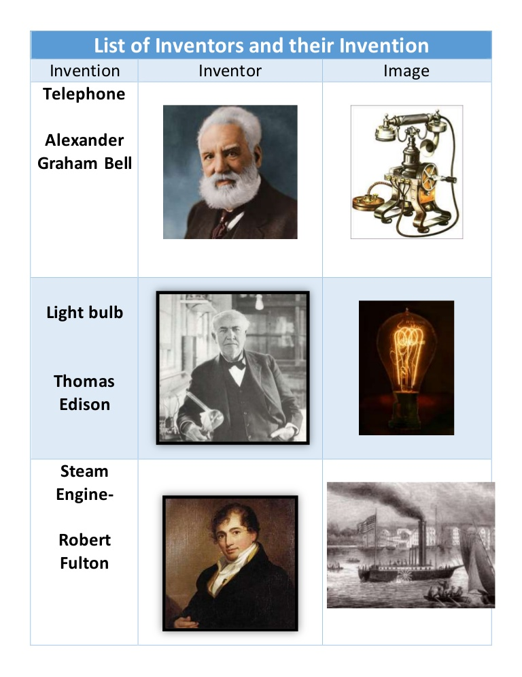

Slide 32
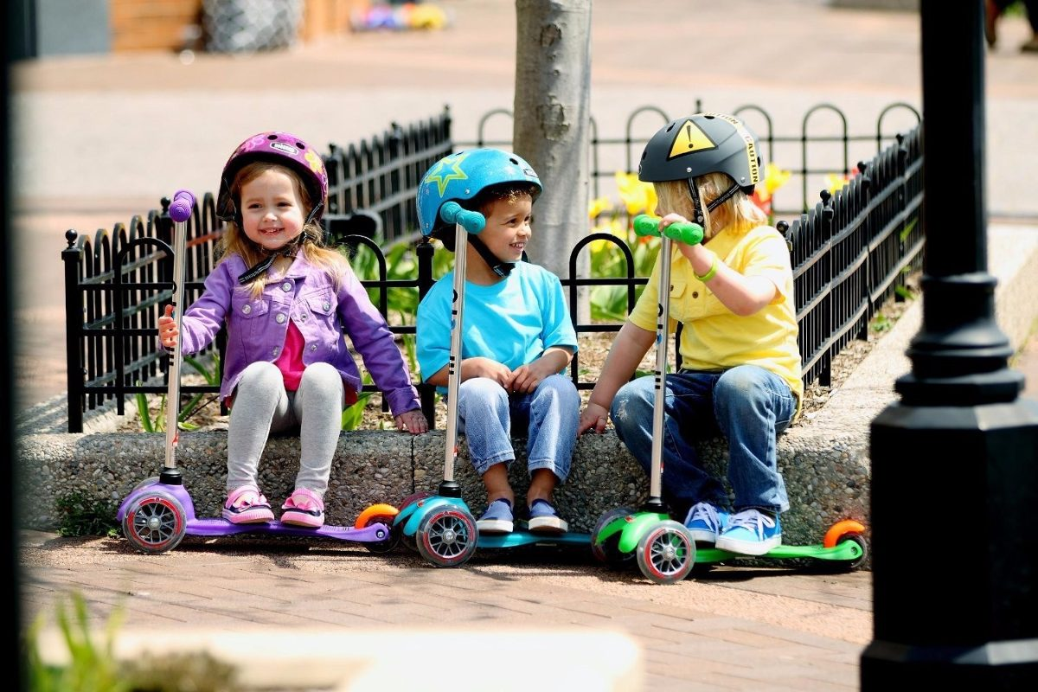


Slide 33




Slide 34
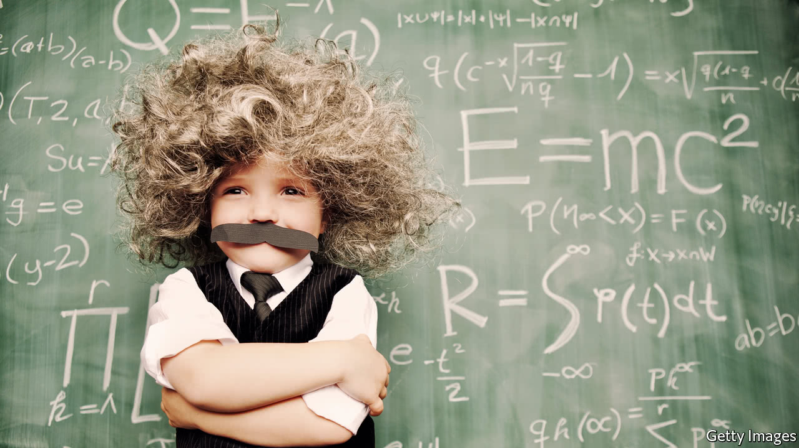
Read your answers.

Slide 35


Slide 36
Choose the correct answer from a, b, c and d:
1. The writer’s purpose is to …………….........….........................………
a. compare the three inventors.
b. explain how genius can strike anywhere.
c. give information about great inventors.
d. describe how people become inventors.

Slide 37
2. The underlined pronoun ‘it’ in the 1st paragraph refers to …………….........…………
a. genius
b. day
c. idea
d. air conditioner
He used this idea to invent the first electrical air conditioner. It was not created for people, he wanted to control the humidity at his printing company because the water was ruining paper.

Slide 38
3. The underlined word ‘profitable’ in the last paragraph means …………….........…………
a. powerful
b. advanced
c. helpful
d. beneficial
When Jobs died, at the age of 50 in 2011, he was worth $10.2 billion, and Apple was one of the largest, most profitable and most influential tech companies on the planet.

Slide 39

Student’s Book
Page 81

Slide 40


Slide 41
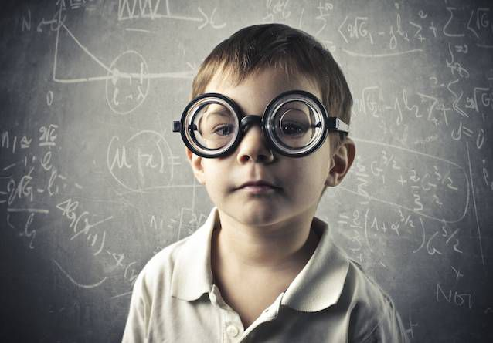
Read your answers.

Slide 42
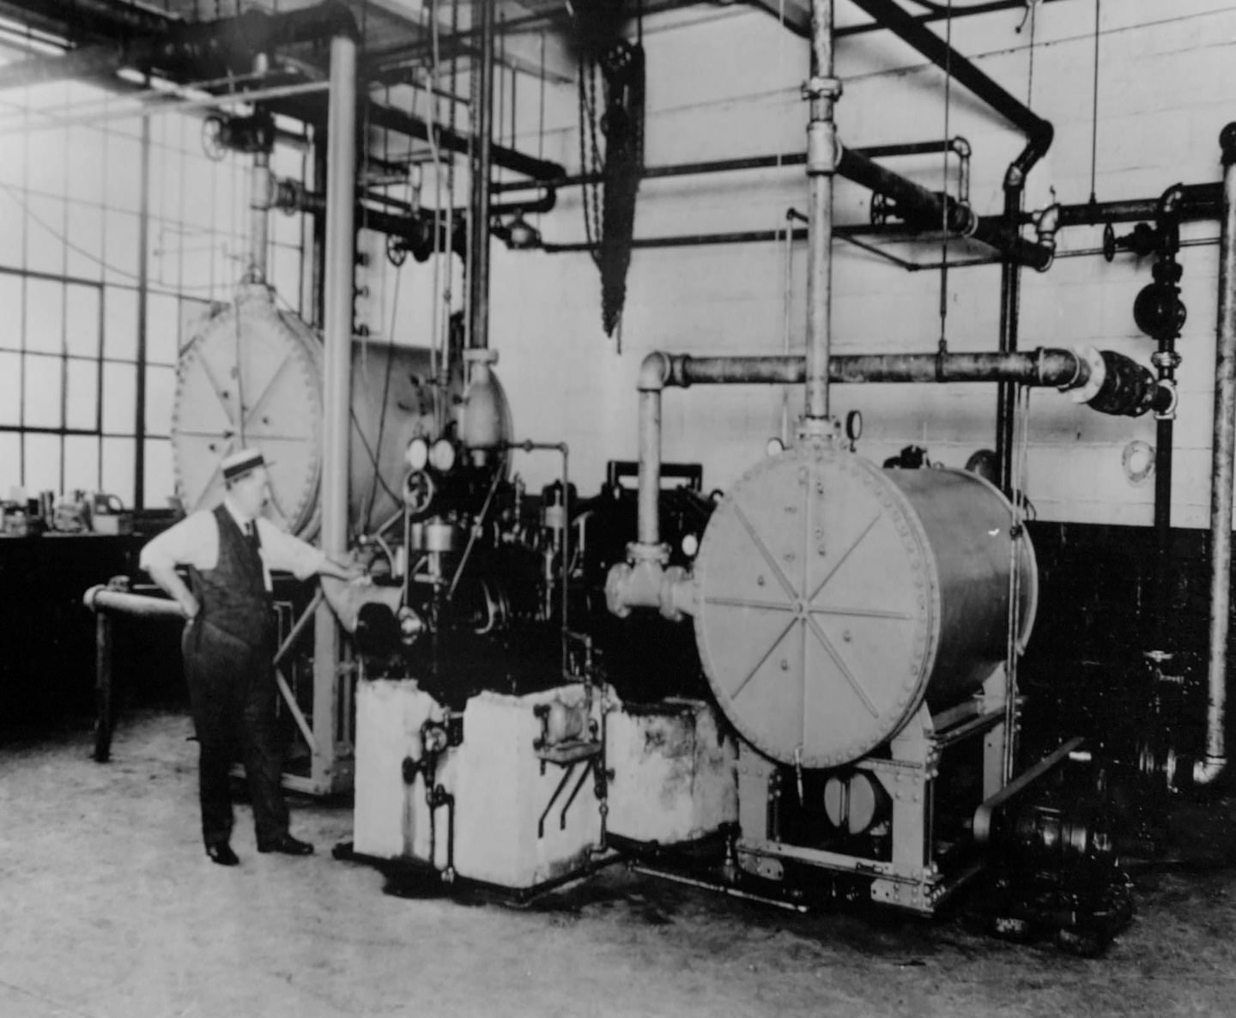
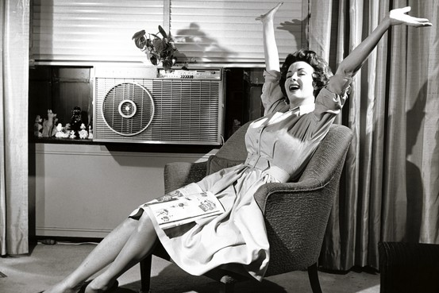
1. Why did Willis Carrier invent the first air conditioner?
He invented it to control the humidity at his printing company because the water was ruining paper.

Slide 43
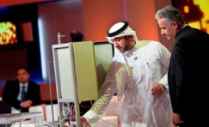
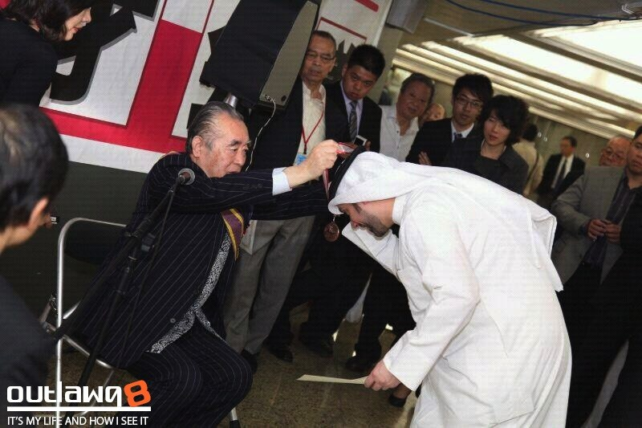
2. What did Sadeq Qasem receive the title of “Arab Inventor” for?
He received the title of “Arab Inventor” for his invention ‘Alchemist’, a machine that scientists use to work with chemicals.

Slide 44
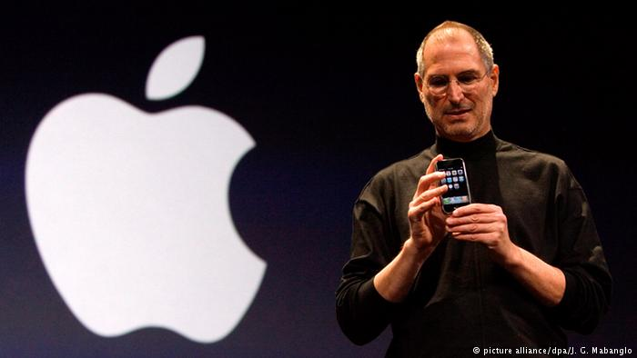
3. How did Steve Jobs contribute to the development of Apple?
He played a key role in the creation of the Apple II, MacBook, iPod, iPhone, and iPad.

Slide 45
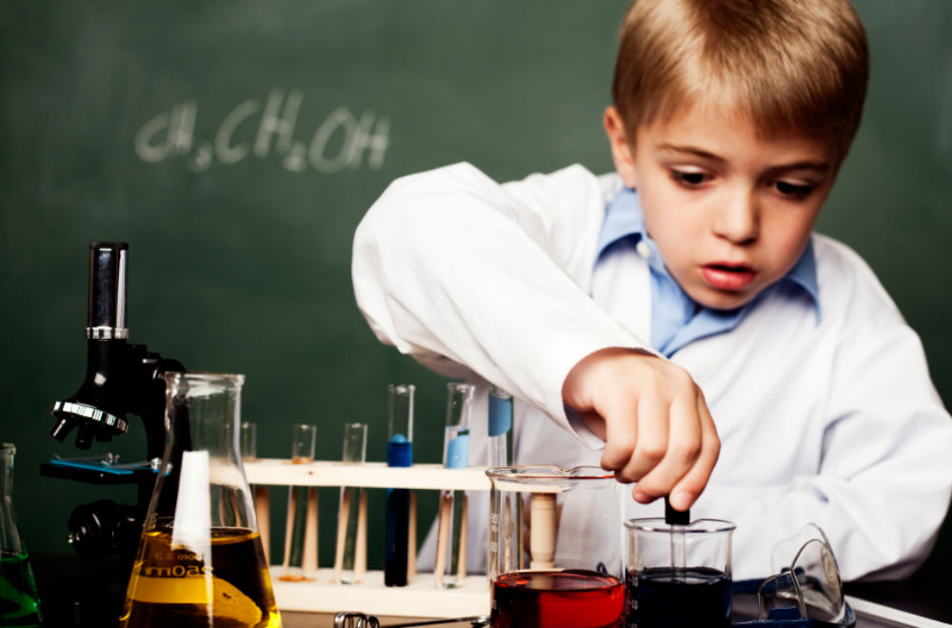


Slide 46
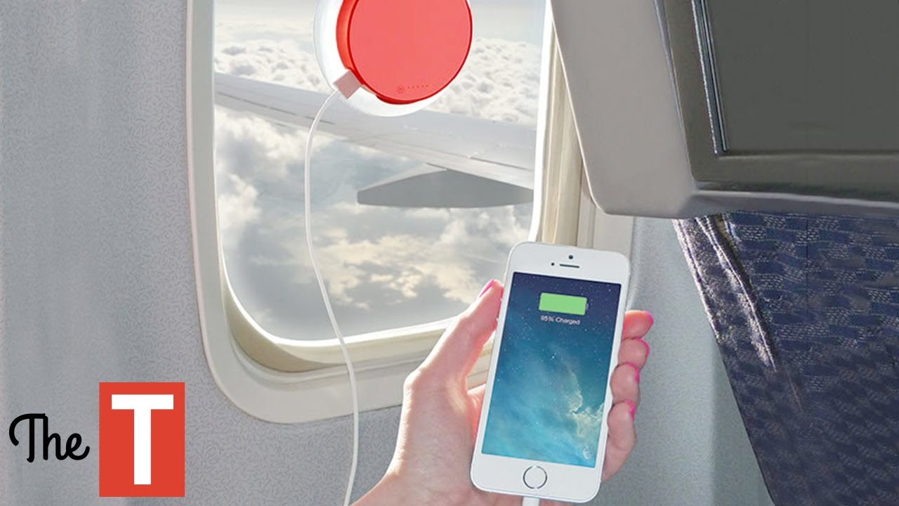

How did inventions change our way of life?

Slide 47

Closure

Slide 48
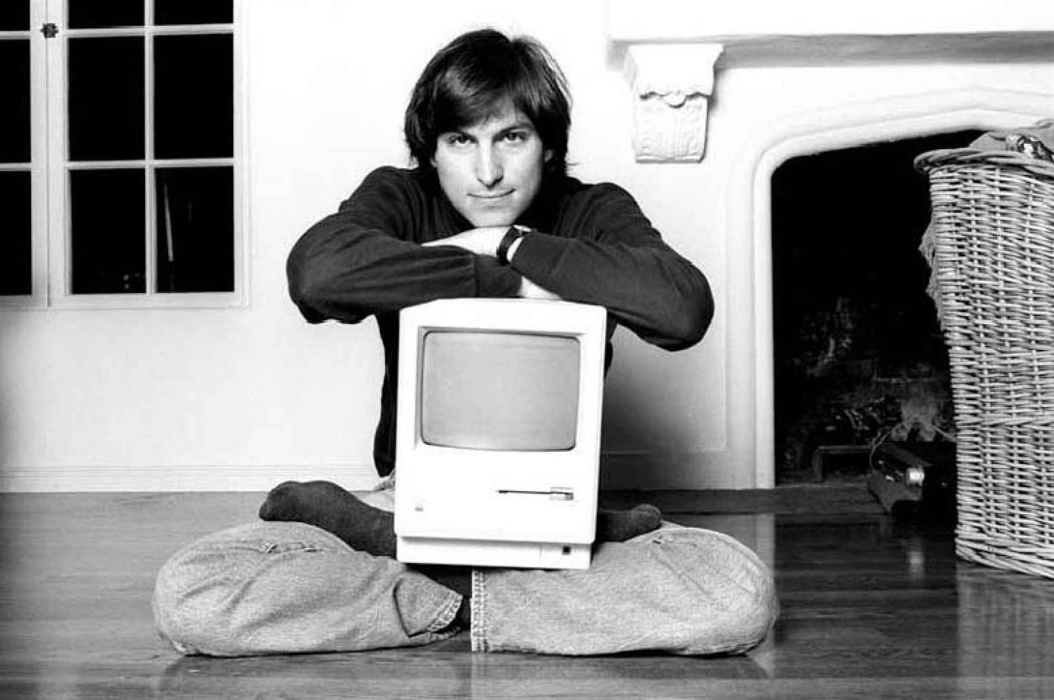
Thank you

Slide 49
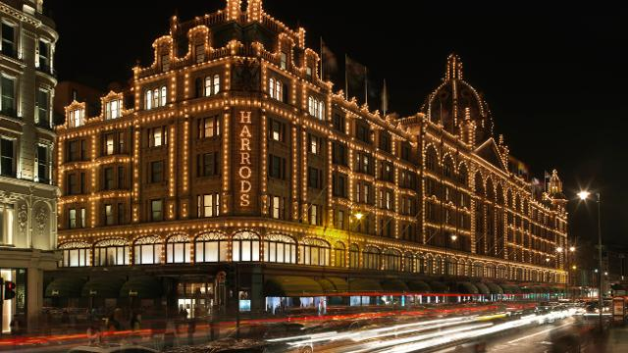
Harrods is the most famous department store in the world which is lit up by 12000 light bulbs and 300 bulbs have to be changed every day.

Slide 50

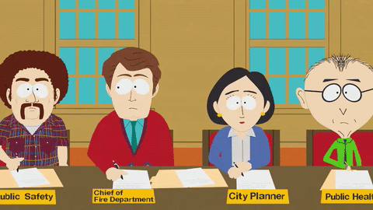
department
a part of an organisation such as a school, business, or government

Slide 51
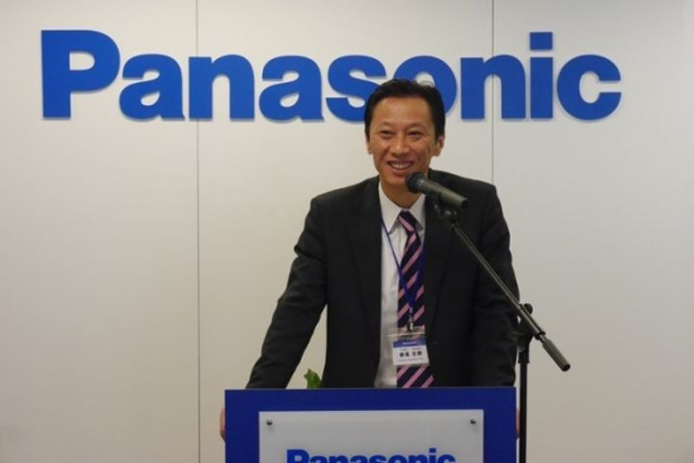
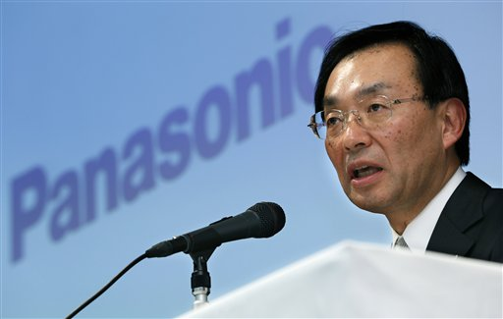
The chairman of Panasonic is one of the founders of the company.

Slide 52
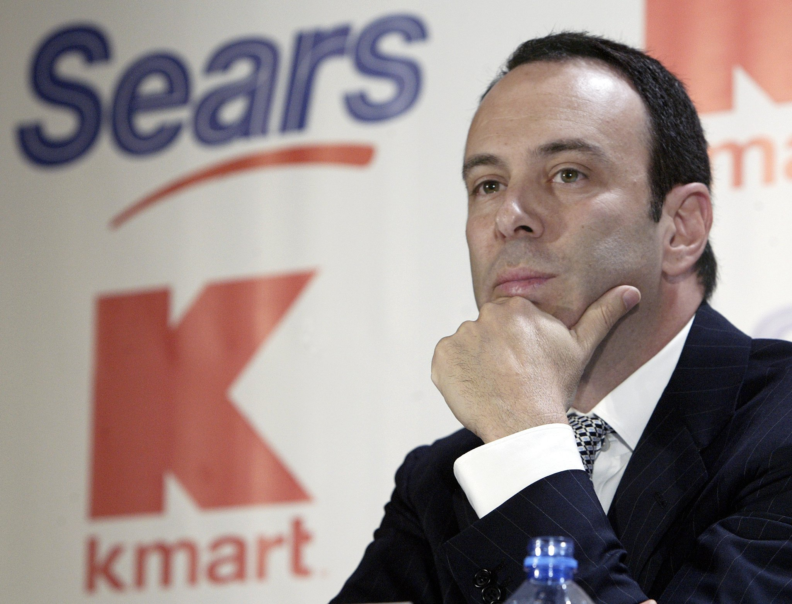
chairman
a person in charge of a meeting or organisation

Slide 53
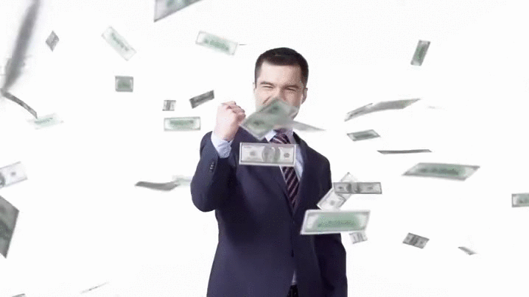
Over the years, the company has developed into a highly profitable business.

Slide 54

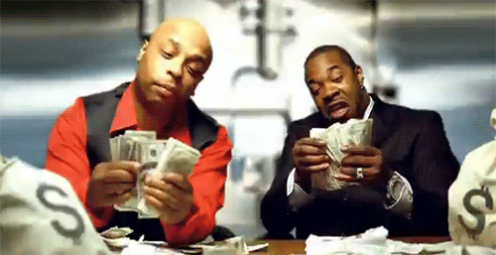
profitable
resulting in or likely to result in a profit or an advantage

