Slide 1

Unit 8
Step 4
S.B p 66

Slide 2
(had + past participle)
*Complete the sentence with the correct form of the verbs: -
He failed the test because he…………….... . (not study)
The baby ……………. (cry) before his mother came.
She …………..…. (wash) her hands before she cooked the dinner
I returned home because I ……………....(forget) my notebook there.
When we arrived to the train, the train ……………..……..(leave).
When we reached school the bell ……………….……(ring)

Slide 3
(had + past participle)
*Complete the sentence with the correct form of the verbs: -
He failed the test because he hadn’t studied . (not study)
The baby had cried (cry) before his mother came.
She had washed (wash) her hands before she cooked the dinner
I returned home because I had forgotten (forget) my notebook there.
When we arrived to the train, the train had left.(leave).
When we reached school the bell had rung (ring)

Slide 4
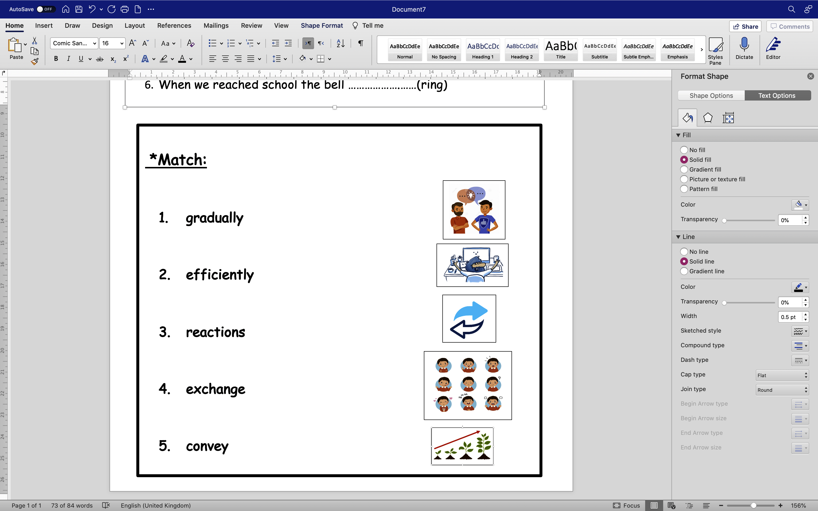

Slide 6
New voc:-
1- means (n)
way of doing something

Slide 7
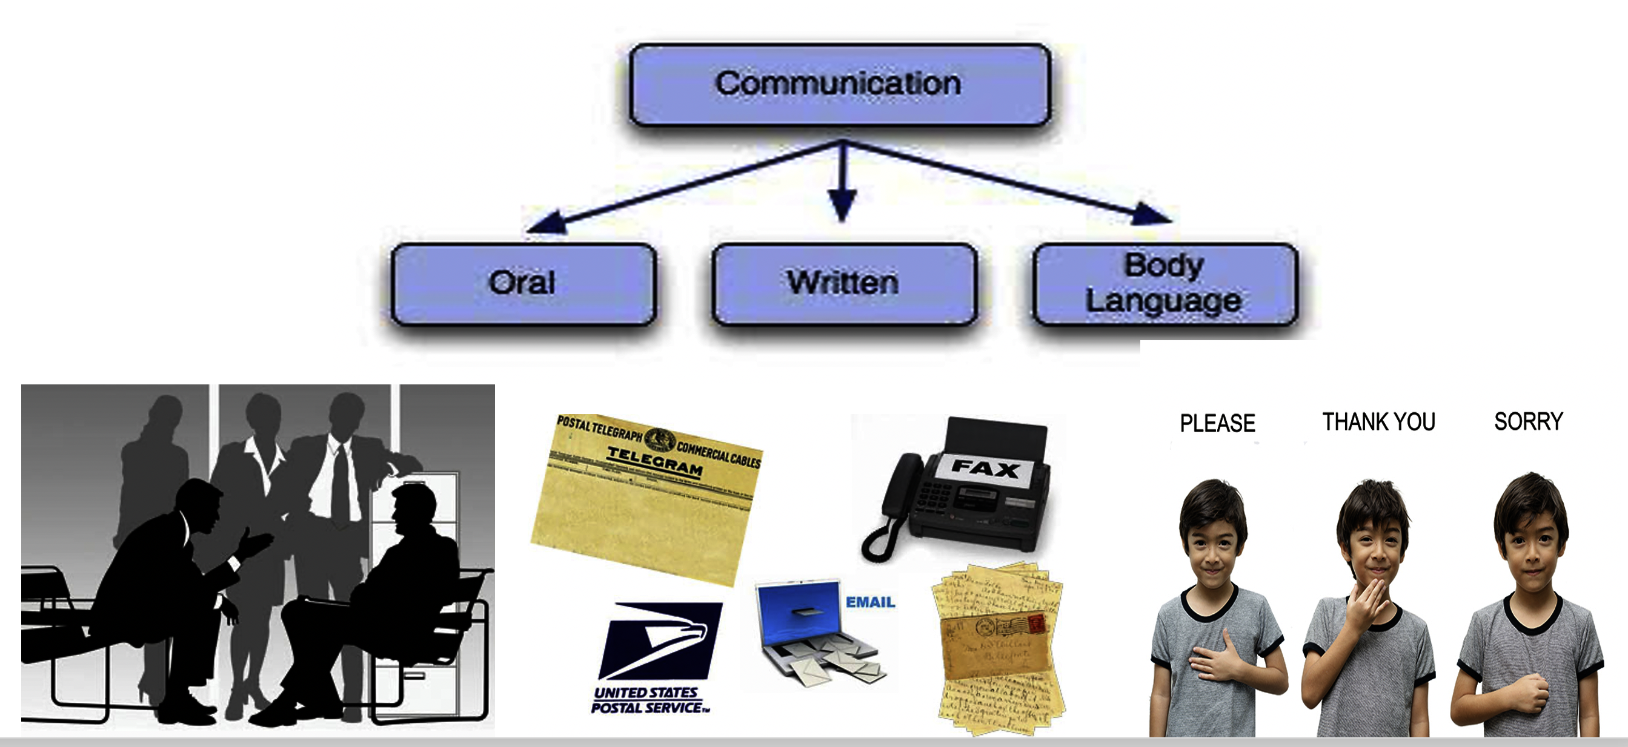
Means of communication

Slide 8
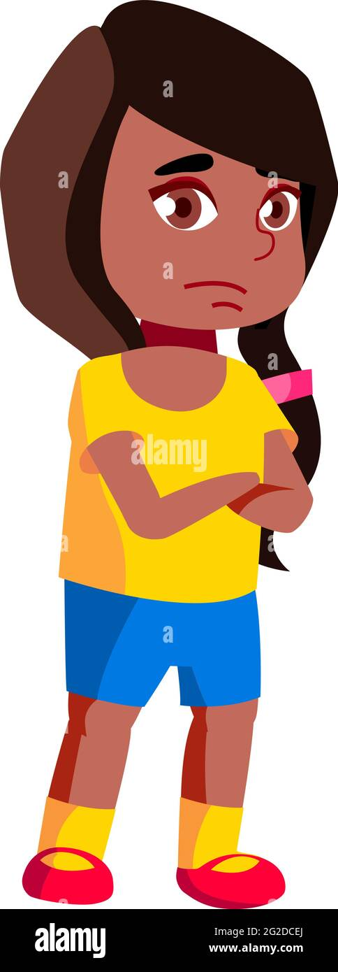
2- sensitive (adj)
easily upset by the things people say or do

Slide 9
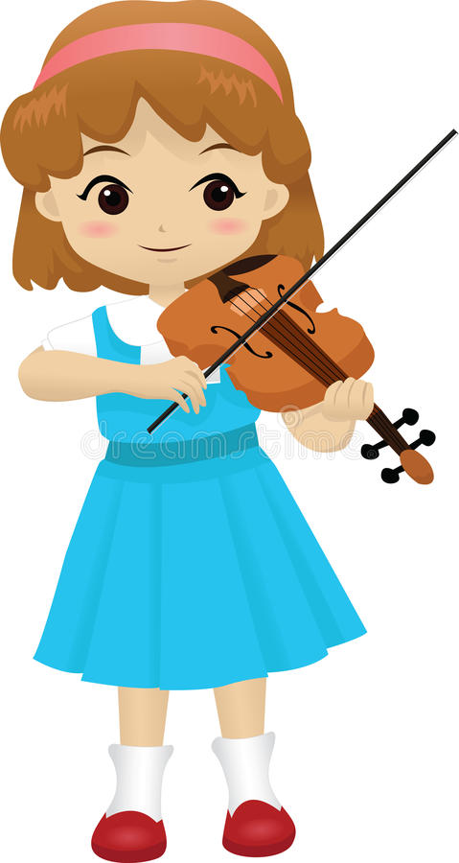
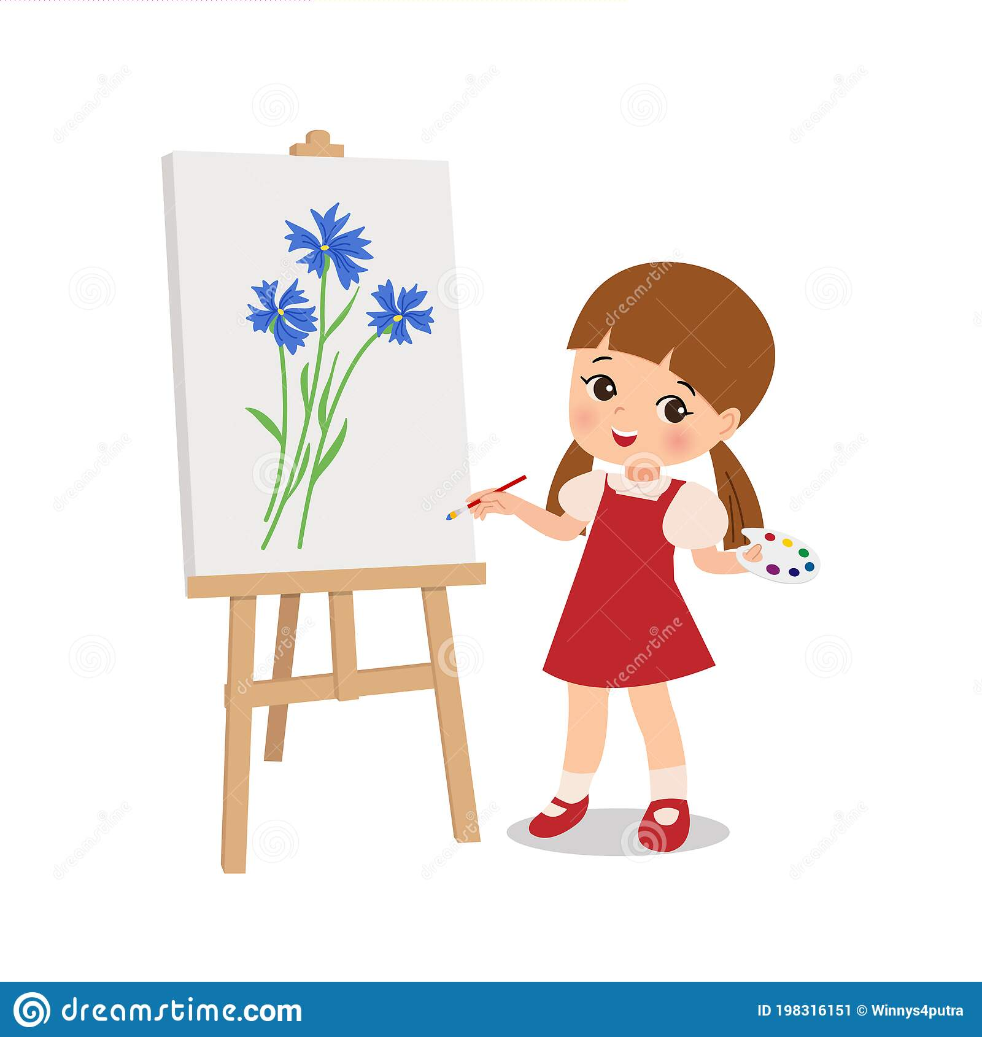
3- talented (adj)
with talent

Slide 10
This girl is very talented.

Slide 11
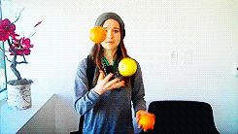
4- skillful (adj)
good at doing something

Slide 12
New voc:-
1- means (n)
2- sensitive (adj)
3- talented (adj)
4- skillful (adj)

Slide 13
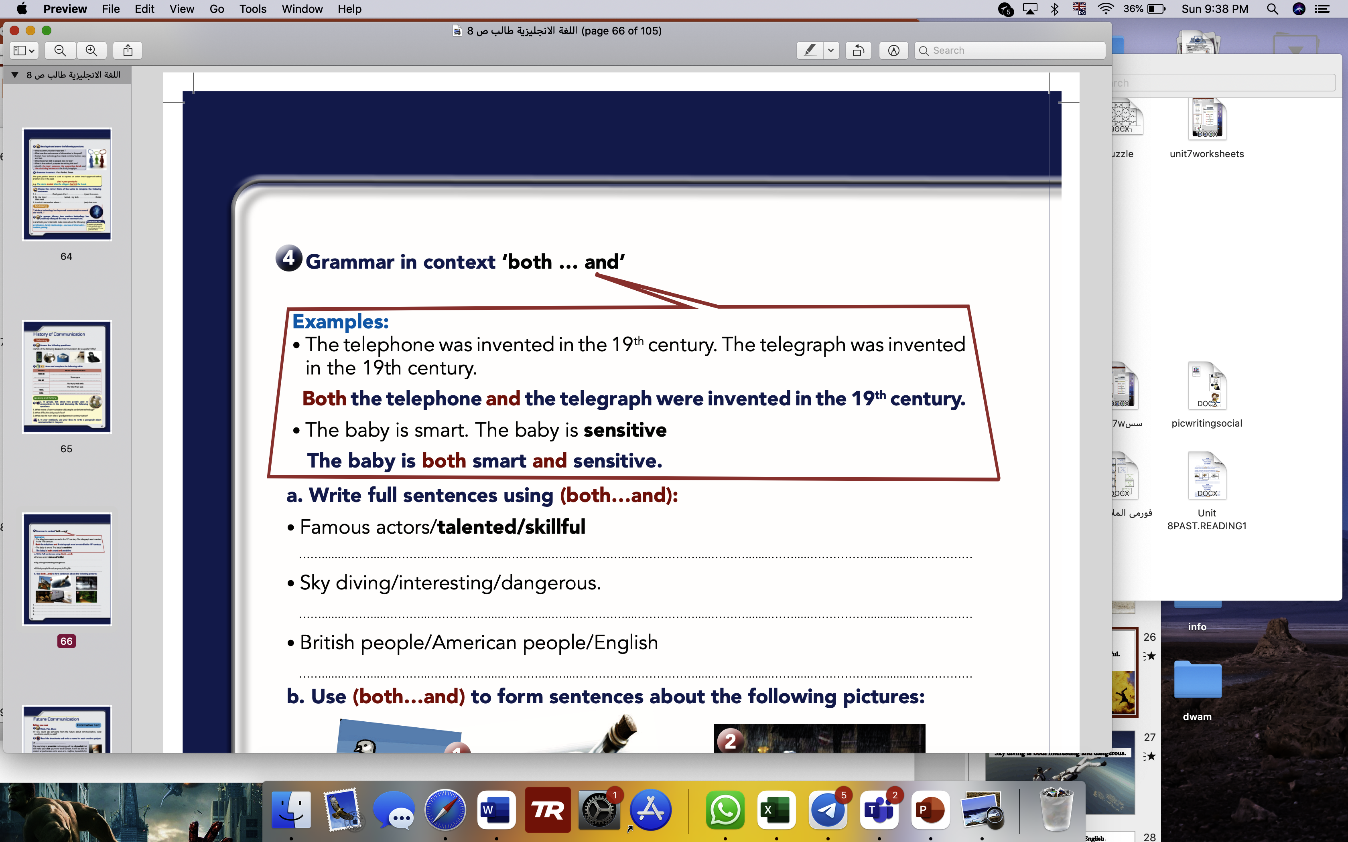
S.B page 66

Slide 14
S.B page 66
Famous actors are both talented and skillful.
Sky diving is both interesting and dangerous.
Both British and American people speak English.

Slide 15
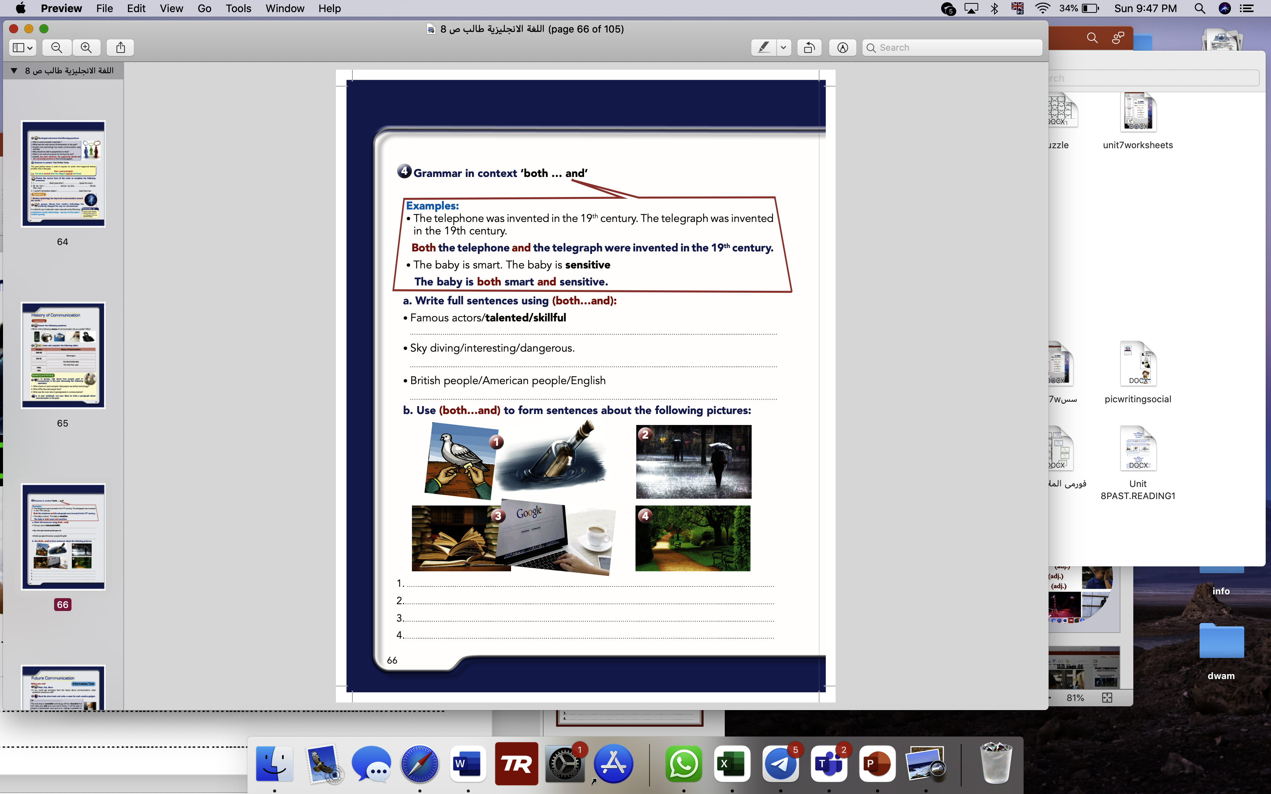
S.B page 66

Slide 16
S.B page 66
Both pigeons and bottles were used to send messages.
The weather is both rainy and cold.
Both google and books can help us get a lot of information.
4. The park is both clean and quiet.

Slide 17
Work book p 25

Slide 18
Work book p 25
skillful
access
crave
gradually
various

