Slide 1
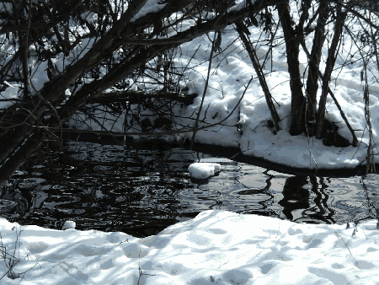
Unit 11
Intelligence & Creativity

Slide 2

البوابة الكويتية لصعوبات التعلم (redsoft.org)

Slide 3


Slide 4
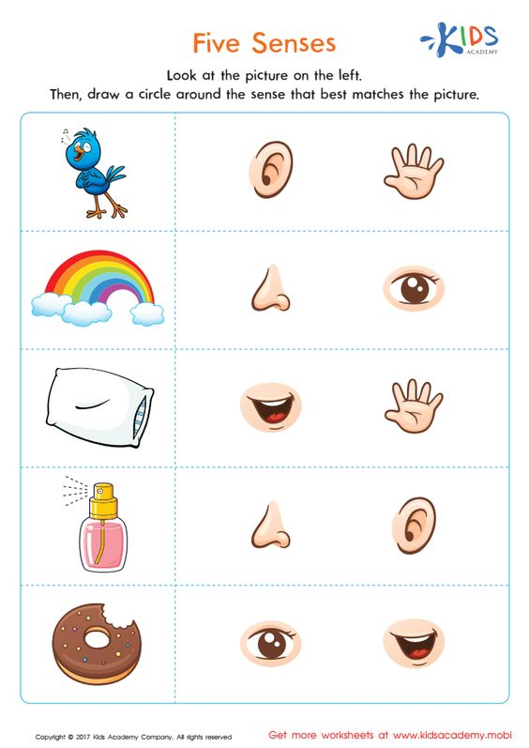

Slide 5


Slide 6

Fill in the spaces with words from the list.
assume – expert – attitude – approach - suffer
1- You need an ---------------------------- to fix your computer.
2- My brother has a positive -------------------------------------------- about the changes.
3- What ------------------------------------------ do you think we should take to solve this problem?
4- The people in this village --------------------------------------------- from many illnesses.

Slide 7
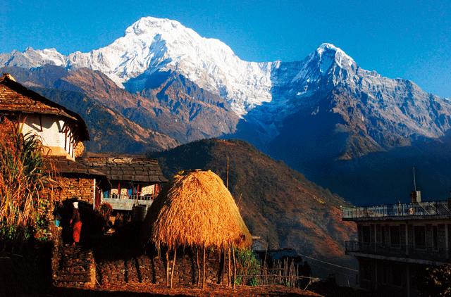
Check your answers.

Slide 8
Fill in the spaces with words from the list.
assume – expert – attitude – approach - suffer
expert
1- You need an ---------------------------- to fix your computer.
attitude
2- My brother has a positive -------------------------------------------- about the changes.
approach
3- What ----------------------------------------- do you think we should take to solve this problem?
suffer
4- The people in this village ------------------------------------------ from many illnesses.

Slide 9
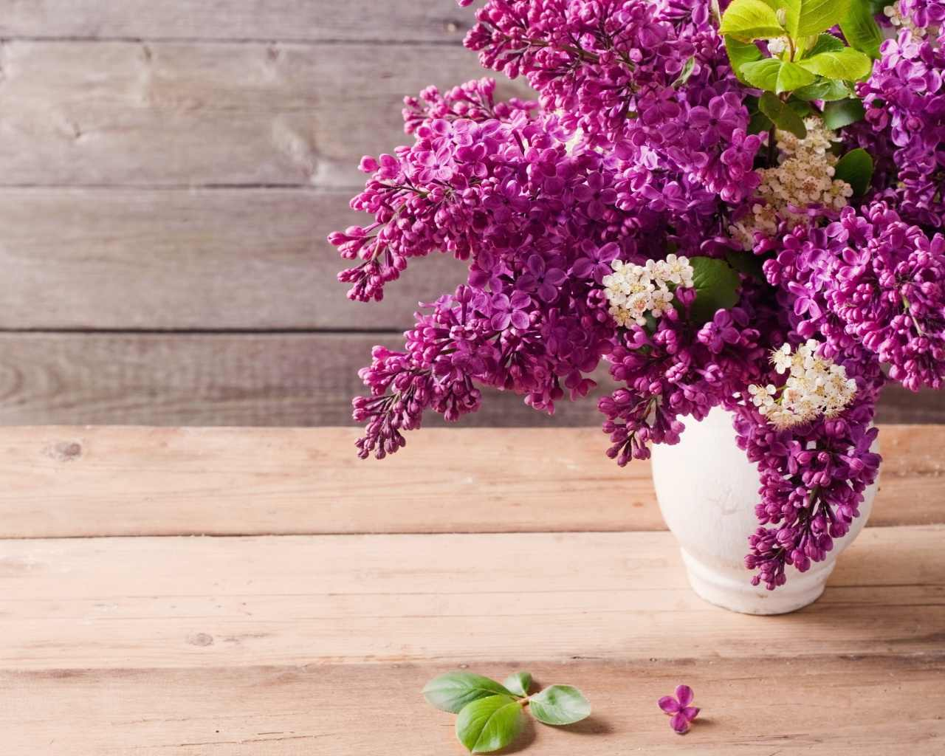
Grammar
Review

Slide 10

Do as shown between brackets:
1. We’ll travel to Spain tomorrow.
( make negative)
2. Ali created a great invention last week.
( ask a question)

Slide 11
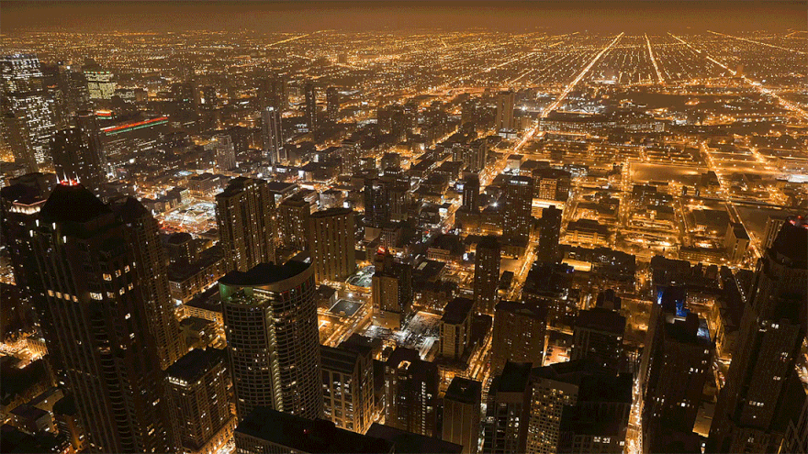
Check your answers.

Slide 12
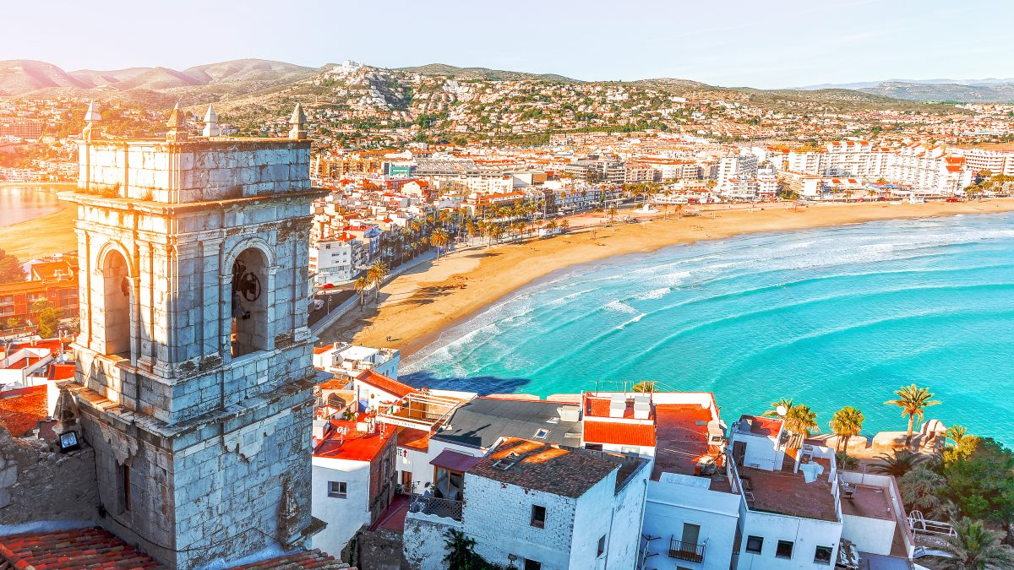
Do as shown between brackets:
1. We’ll travel to Spain tomorrow.
( make negative)
We will not travel to Spain tomorrow.
We won’t travel to Spain tomorrow.

Slide 13
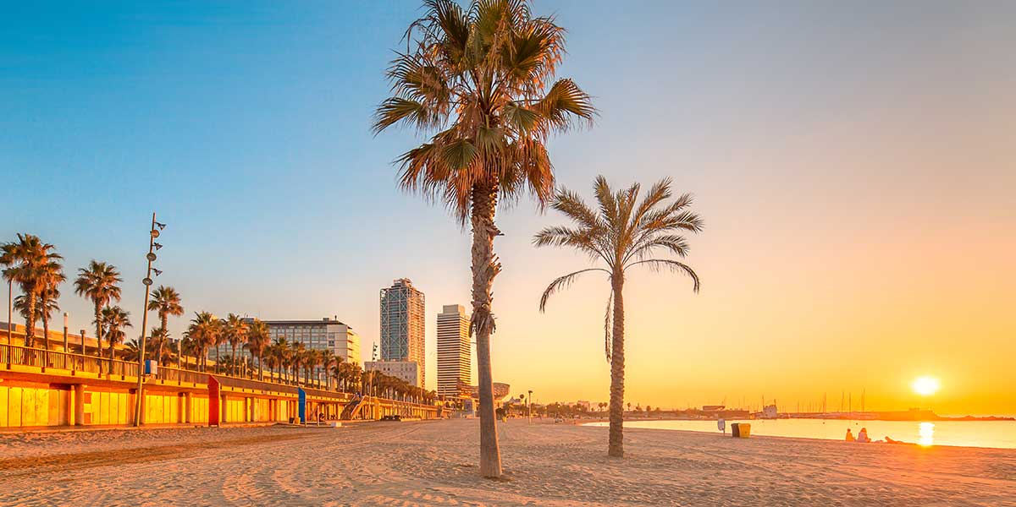
Do as shown between brackets:
2. Ali created a great invention last week.
( ask a question)
What did Ali create last week?
When did Ali create a great invention?

Slide 14
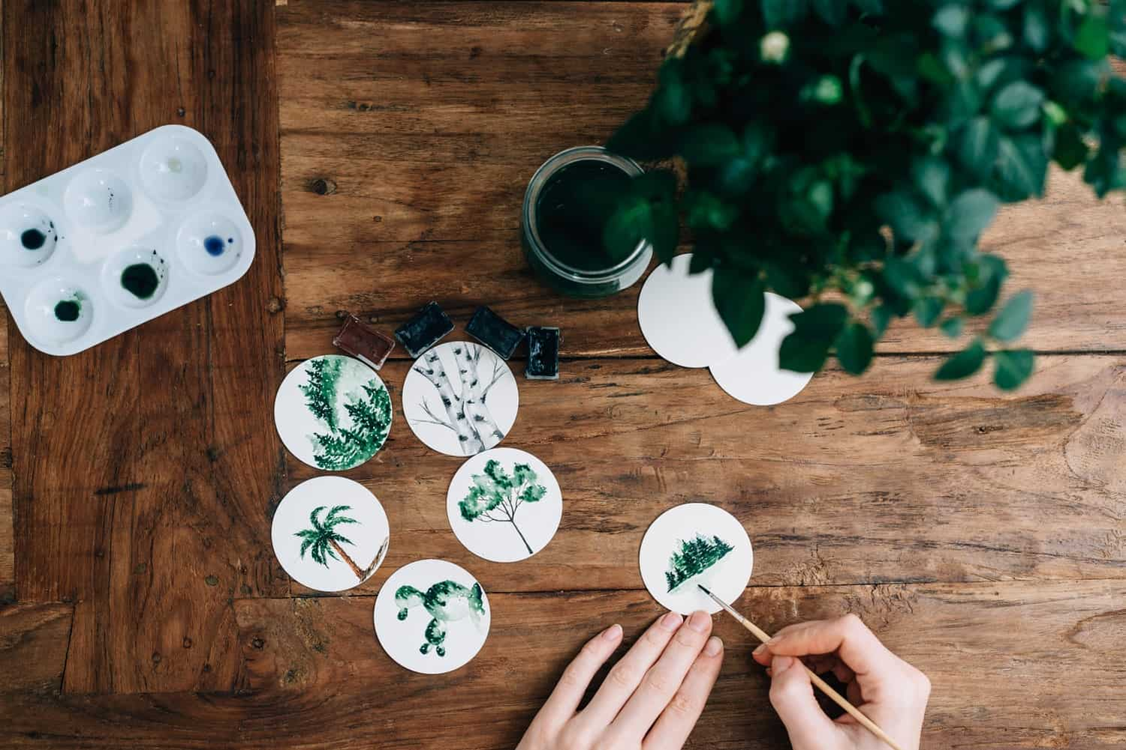
What is your favourite hobby?

Slide 15
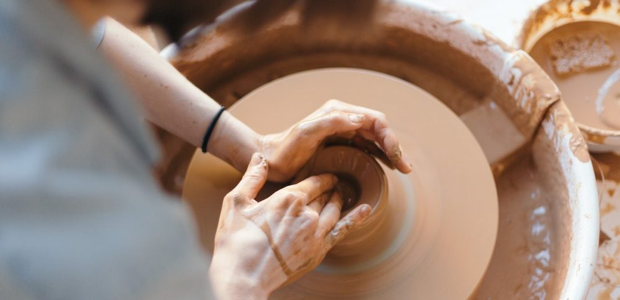
Do you think that taking up a hobby can improve creativity? How?

Slide 16
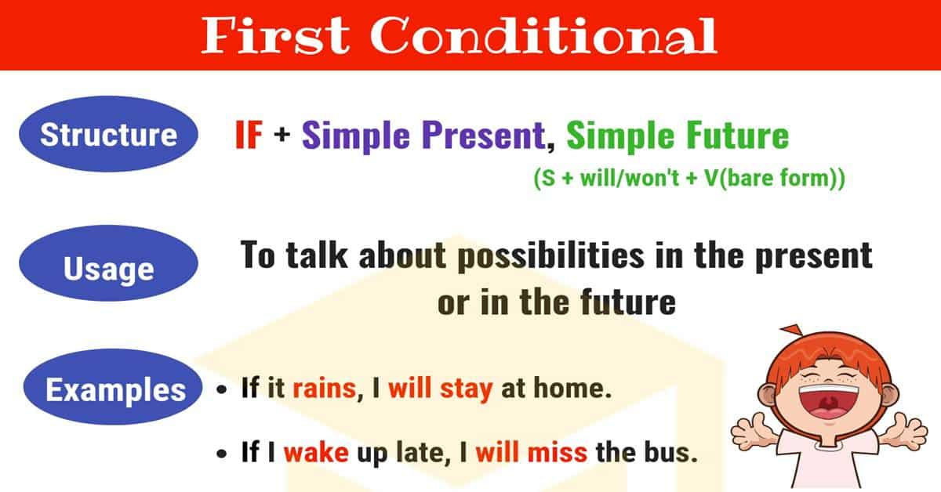

Slide 18
Things to remember: First Conditional
The first conditional is used to talk about things which are possible in the present and the possible future consequences of those things.
If + present simple, will + infinitive

Slide 19
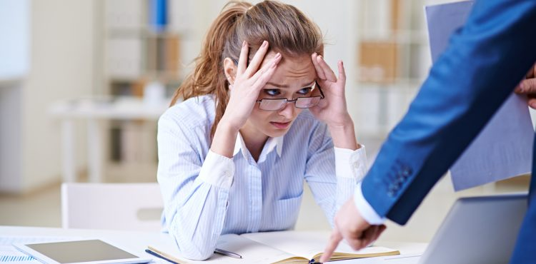

If we miss the meeting, the manager will be angry.

Slide 20

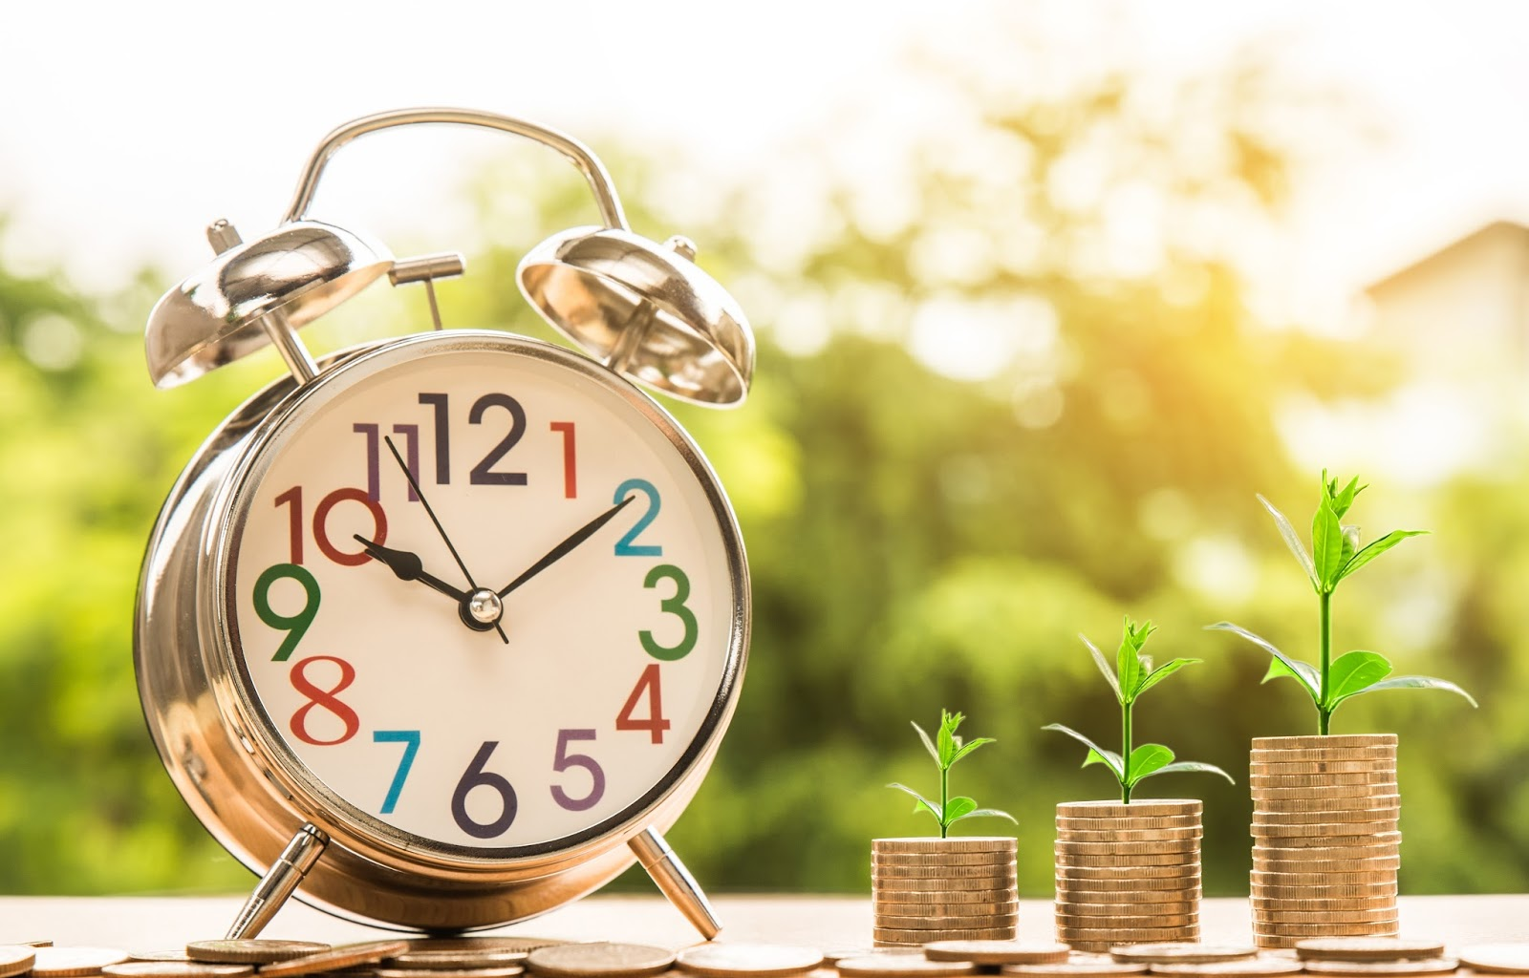
Another example:
1. If you save money, you will be able to buy what you need. Otherwise, you will have to ask for a loan.

Slide 21
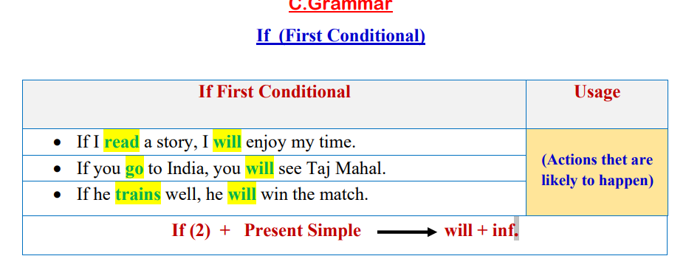

Slide 22
Grammar
Review

Slide 23
EX. (1) Choose the correct answer from a, b, c & d:
1- We ..................if we live a simple life.
a) would enjoy b) enjoyed c) will enjoy d) enjoy
2- If they want to be healthy, they ..................fresh vegetables and fruits.
had b) would have c) will have d) have

Slide 24
3- If children like to enjoy their time, grandparents ..............them stories.
a) would tell b) tell c) will tell d) told
4- Children .................the Internet if they want to play games.
will surf b) surf c) would surf d) surfed

Slide 25


Slide 26
EX. (2) Do as shown between brackets:
1.If you get enough sleep, …………………………….......................
................................................ (Complete)

Slide 27
2. Salma will join a sports club if she ...................………………………........................…................................................................................(Complete)

Slide 28
3. If I want to win the race, I (train) well to achieve my goals. (Correct the verb)
................................................................................

Slide 29

Workbook
Page 32

Slide 30
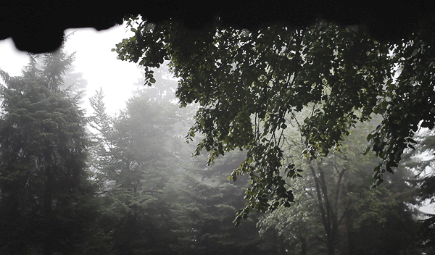
CHECK YOUR UNDERSTANDING!

Slide 31


Slide 32
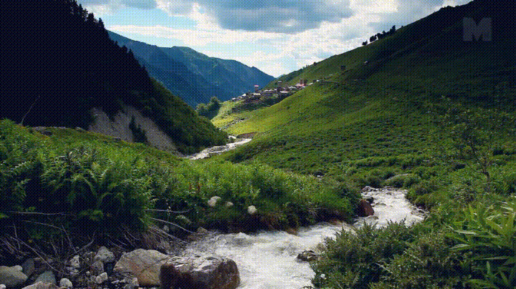
Read your answers!

Slide 33
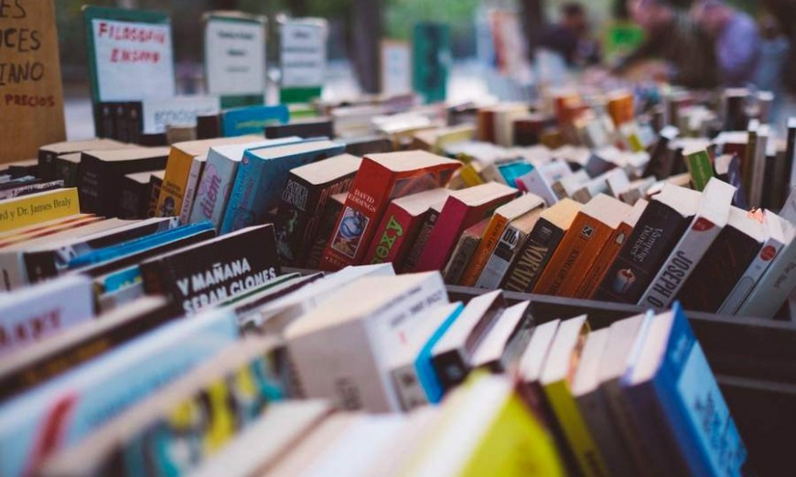

2. If you read more often, ………………………………………………………………..
Or else, …………………………………………………………………
2. If you read more often, you will get a lot of information and widen your imagination. Or else, you won’t be smart.

Slide 34
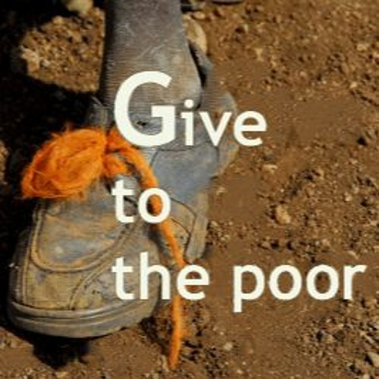
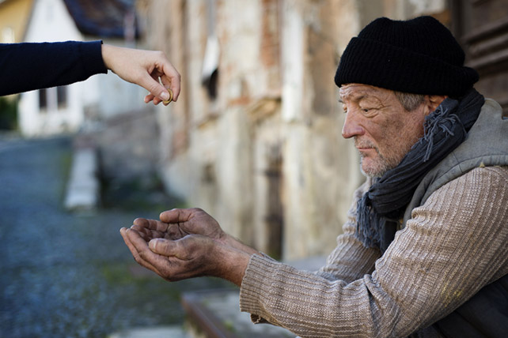
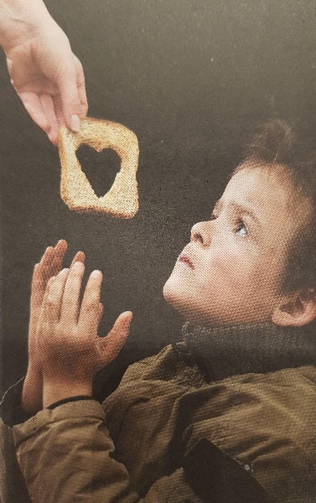
3. If you give to the poor, ………………………………………………………………..
Otherwise, …………………………………………………………………
3. If you give to the poor, you will feel happy to save people’s lives. Otherwise, many people will suffer from hunger.

Slide 35


4. If ……………………………………………………..…………………………………..
If not, …………………………………………………..…………………………………………
4. If you take an umbrella with you, you will protect yourself from the rain. Otherwise, you will get wet.

Slide 36
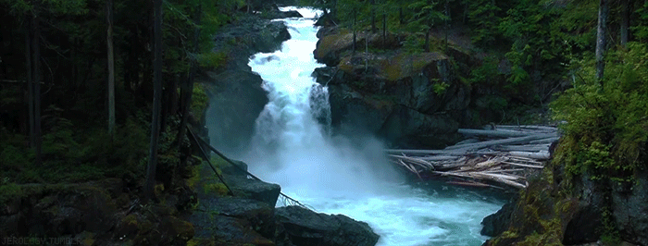
Closure

Slide 37

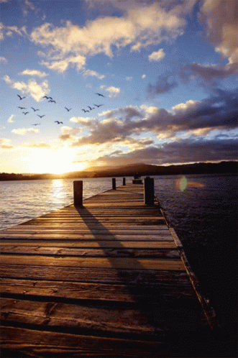
Listen to the following song, and then write down the four parts of creativity.

Slide 38


Slide 39
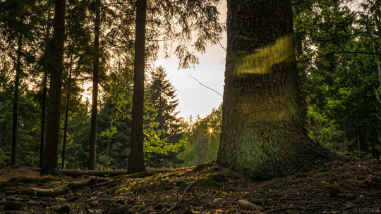
Thank you

