Slide 1
Module 1
Unit 3

Slide 2
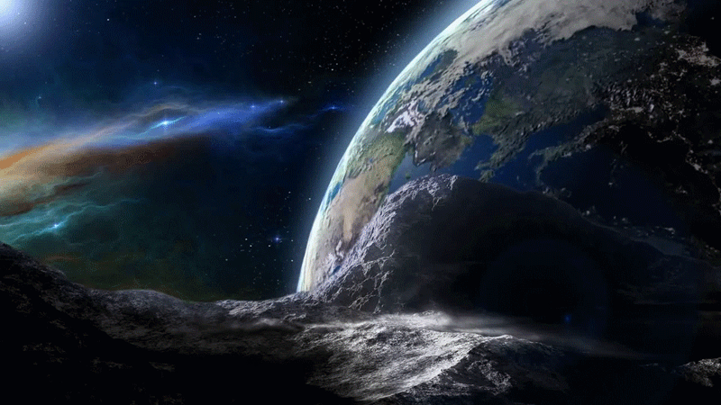
Writing
SB. / P.32

Slide 3
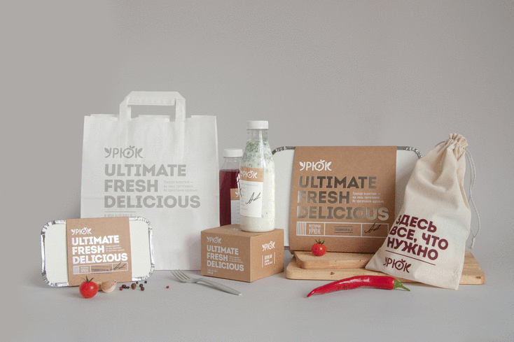
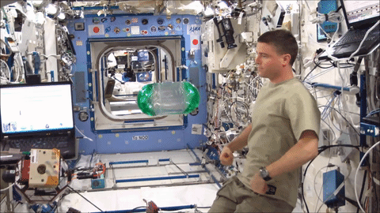
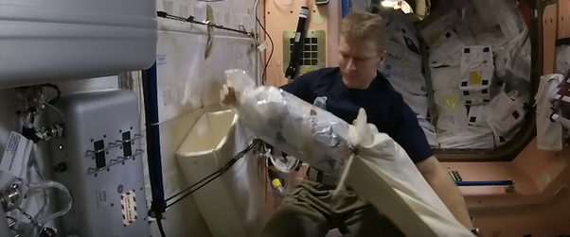
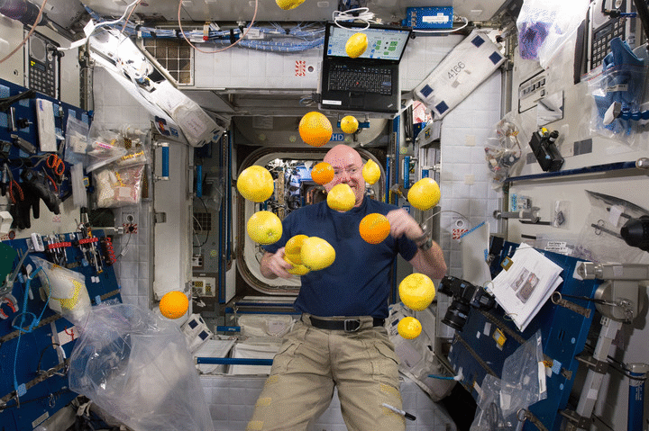
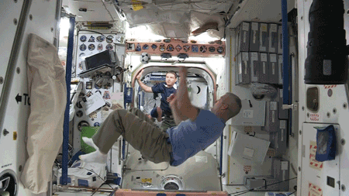
What comes to your mind when you see these pictures?

Slide 4
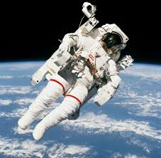
1- What do you think life is on a space station?
(easy / difficult / enjoyable ……)
2- Would you like to travel to space? Why?

Slide 5
1- Give three reasons why being in space is like camping.
2- What do astronauts eat in space ?
3- Astronauts wear special clothes in space . Discuss.
4- What are the most difficult things astronauts face
in space?

Slide 6
1- Give three reasons why being in space is like camping.
You use special
equipment
You have to take
everything you
need.
You have to
dispose of your
own rubbish.

Slide 7
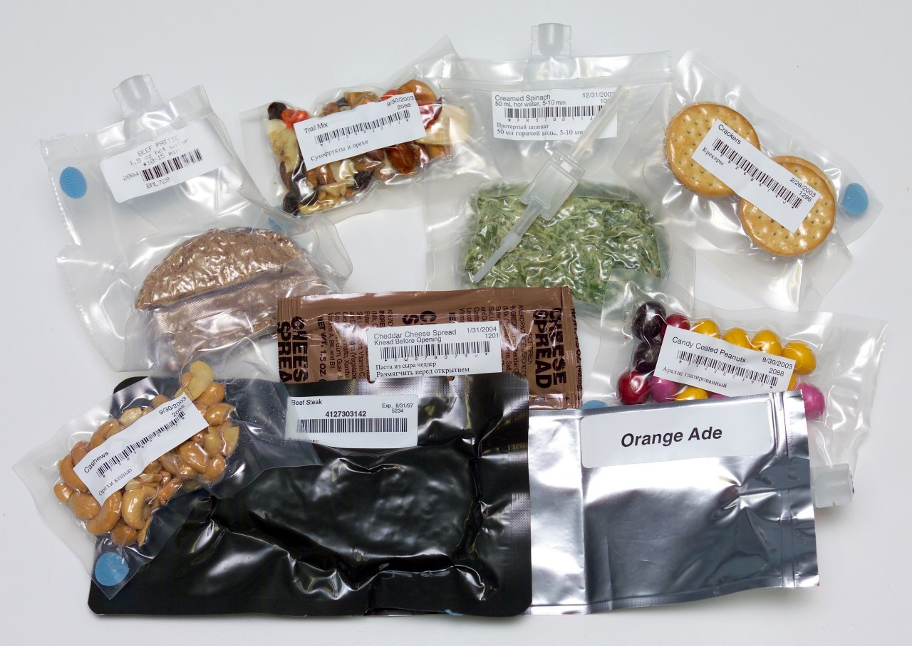
2-What do astronauts eat in space ?
dried
food
tins
vegetables & fruits
bread & meat

Slide 8
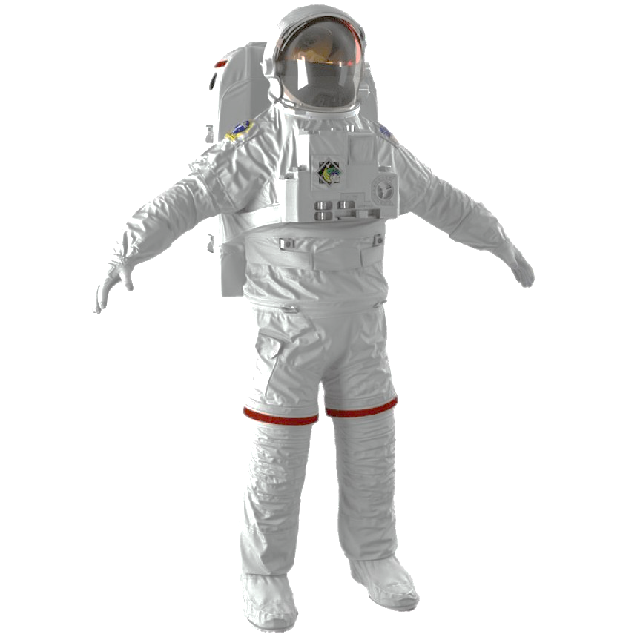
3-Astronauts wear special clothes in space. Discuss.
spacesuits with
finger heaters
gloves
casual
clothes
special suits (LES)

Slide 9
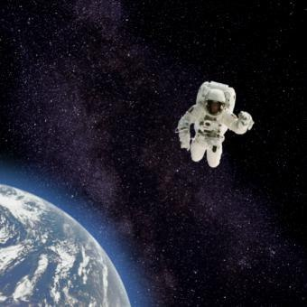
4- What are the most difficult things astronauts face in space?
cold
weather
zero
gravity
darkness

Slide 10
Try to fill in this diagram:
Equipment
astronauts
need
Food & Drinks
in space
Clothes
astronauts
need
The most difficult things in space

Slide 11
everything you need like camping
special equipment
dried
&
tinned
packages
& containers
Equipment
astronauts
need
Food & Drinks
in space
packages of food & drinks
-use straw
-don’t use forks & knives
special suits (LES)
zero gravity
Clothes
astronauts
need
The most difficult things in space
spacesuits with finger heaters gloves
Casual clothes
cold weather
darkness

Slide 13
“Life in space is very dangerous and without protection. Can you imagine yourself living in that strange and dark world?”
Plan and write a report of two paragraphs (not less than 10 sentences) about:
(Space)
describing life in space and what astronauts eat and wear there.

Slide 14
Plan your
topic first

Slide 15
Space
Life in space
Food & clothes in space
difficult /
enjoyable
dried & tinned
camping
no fridges
special
equipment
spacesuits
outside
dispose of
rubbish
casual clothes
inside

Slide 17
Plan your
topic first

Slide 19
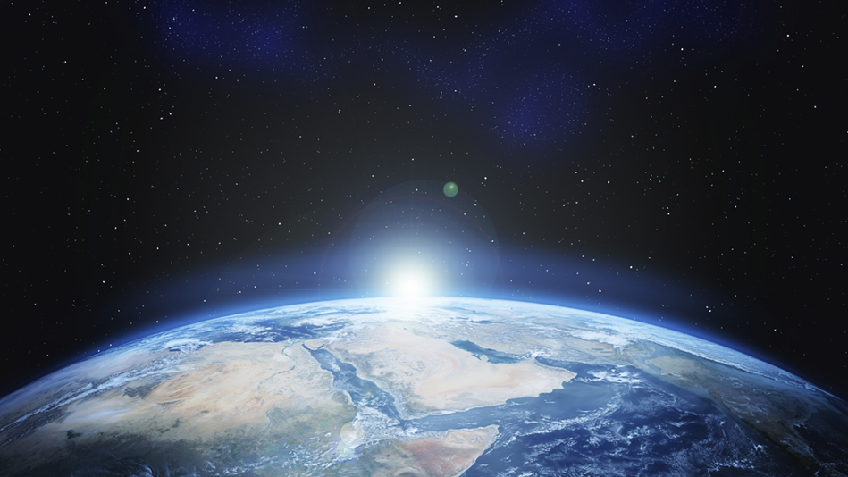
Thank you

