Slide 1
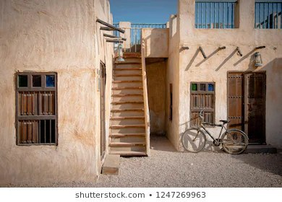

Module 2
Unit 4
Unforgettable past

Slide 2

SB. / P. 36

Slide 3
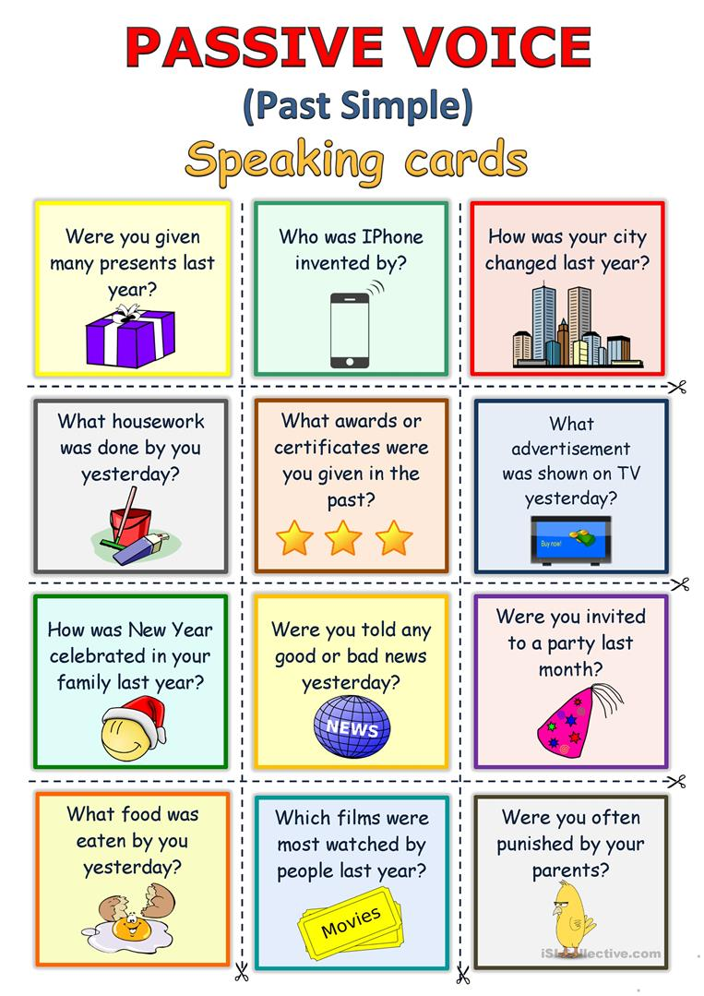

Slide 4
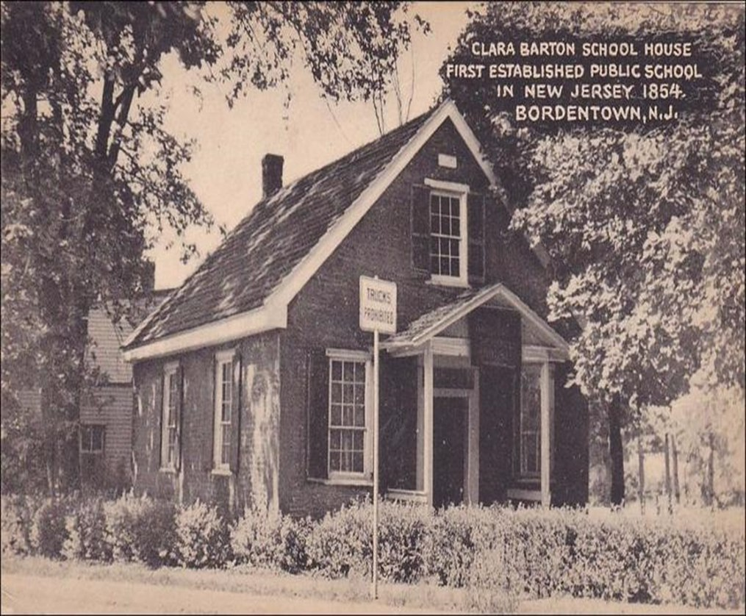
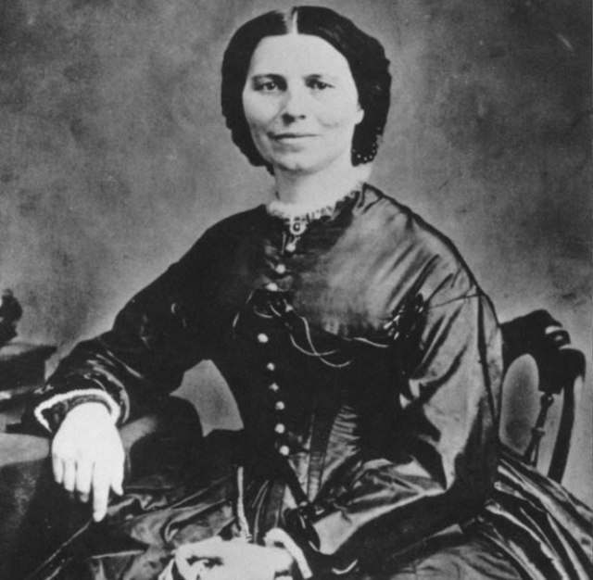

Who opened a free school?
Clara opened a free school.
(Active Voice)

Slide 5
What was opened by Clara?
A free school was opened by Clara.
(Passive Voice)

Slide 6
Active :
Clara opened a free school.
Passive :
A free school was opened by Clara.

Slide 7
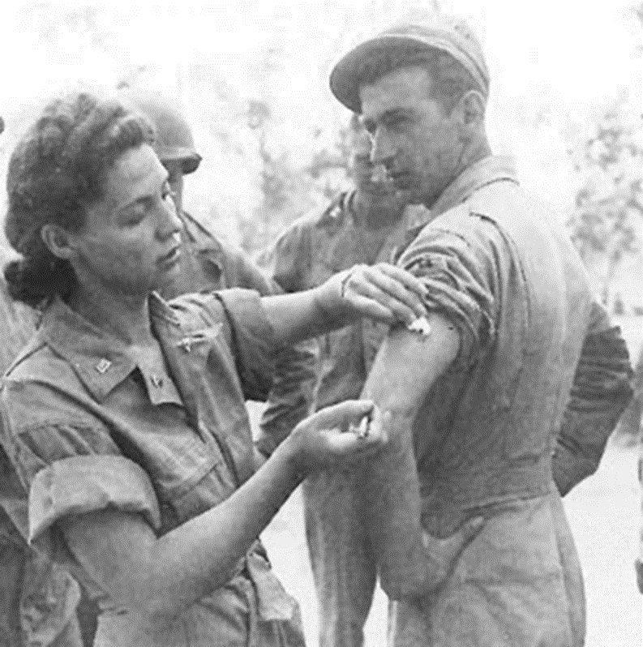
Who cleaned the soldiers’ wounds.
Clara cleaned the soldiers’ wounds.
(Active Voice)

Slide 8
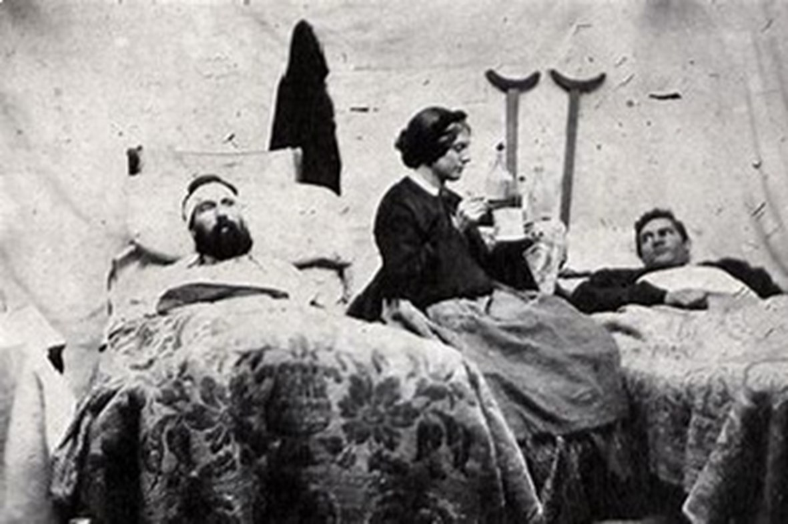
What were cleaned by Clara ?
The soldiers’ wounds were cleaned by Clara.
(Passive Voice)

Slide 9
Active :
Clara cleaned the soldiers’ wounds.
Passive :
The soldiers’ wounds were cleaned by Clara.

Slide 10


Slide 11
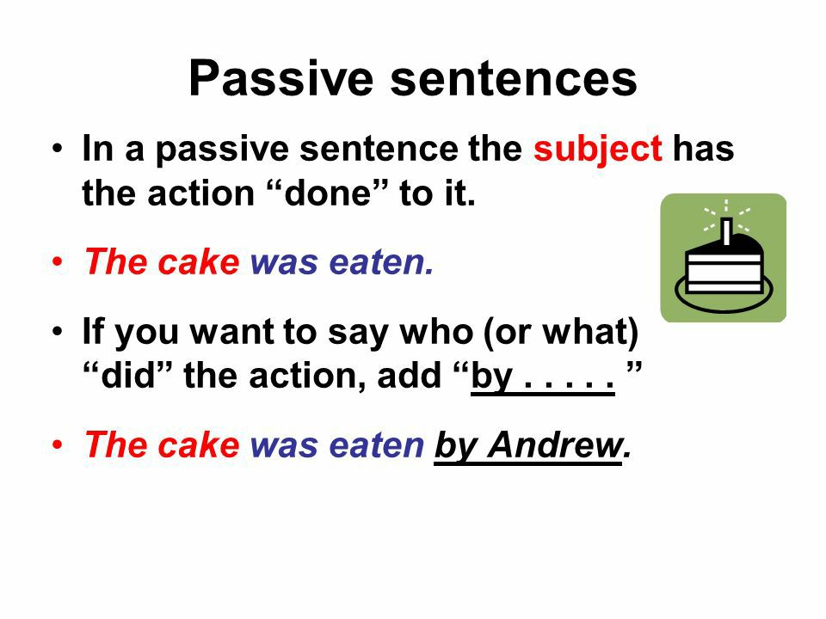

Slide 12
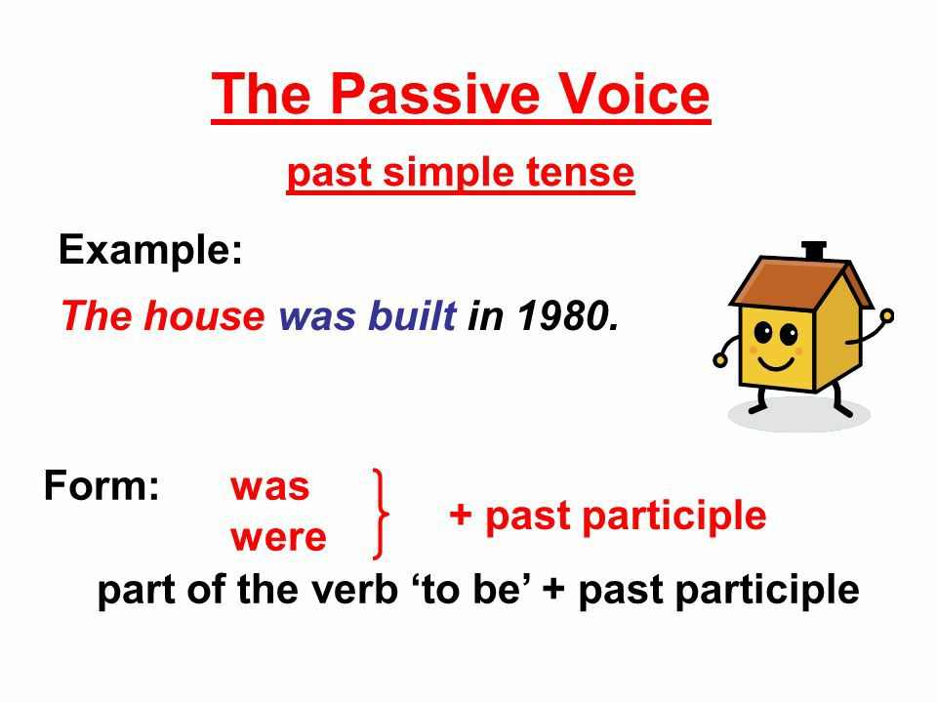

Slide 13
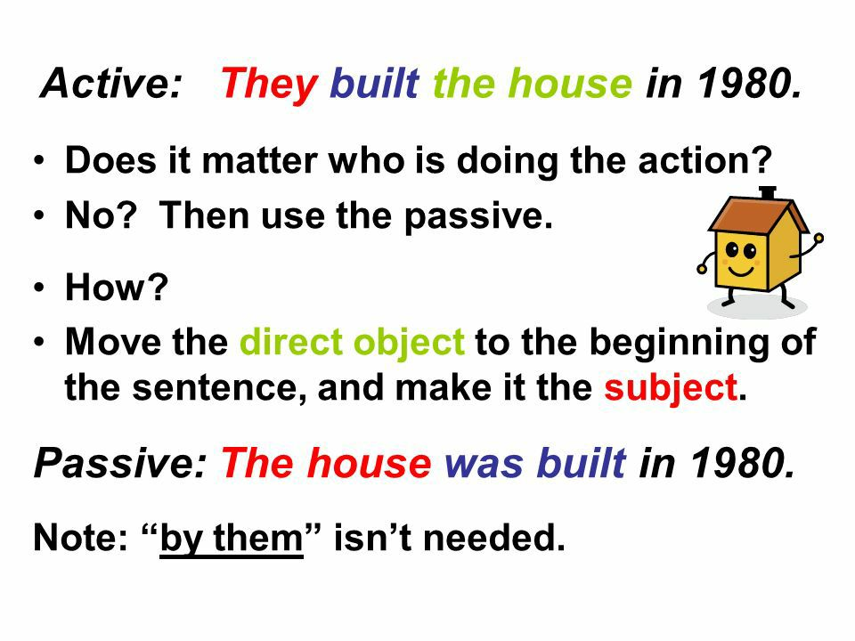

Slide 14
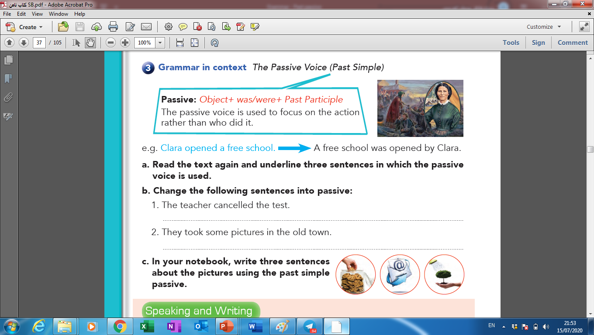

Slide 15
Activity 1 :
Read the text again and underline three
sentences in which the passive voice is used.

Slide 16



Slide 18
Activity 2 :
Choose the correct answers:
In the past , a free school ( opened – were opened – was opened ) by Clara Barton. Some teachers ( were hired – hired – was hired ) to help her teach. A lot of money (were raised – raised – was raised) by Clara to open a new school.Then she worked as a nurse. The soldiers’ wounds (cleaned – were cleaned – was cleaned ) by Clara.

Slide 20
In the past , a free school ( opened – were opened – was opened ) by Clara Barton. Some teachers ( were hired – hired – was hired ) to help her teach. A lot of money (were raised – raised – was raised) by Clara to open a new school.Then she worked as a nurse. The soldiers’ wounds (cleaned – were cleaned – was cleaned ) by Clara.

Slide 21
Activity 3 :

Slide 23
The test was cancelled by the teacher.
Some pictures were taken in the old town.

Slide 24
Activity 4 :

Slide 26
An important speech was made by the president.
The doorbell was rung by some children.
An interesting story was written by Noura.
Some photos were taken by my friend.

Slide 27

Activity 5 :
Do as shown between brackets:
1- People used camels in the past. (Complete)
Camels ……………………………………
2- My grandma wore Abaya in the past. (Complete)
Abaya ……………………………………….
3- People used radios in the past to know the news.
(Change into passive)

Slide 28


Slide 29


