Slide 1

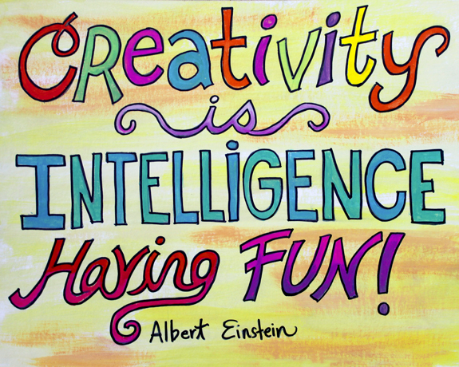
Unit 11
Intelligence and creativity

Slide 2

البوابة الكويتية لصعوبات التعلم (redsoft.org)

Slide 3


Slide 4
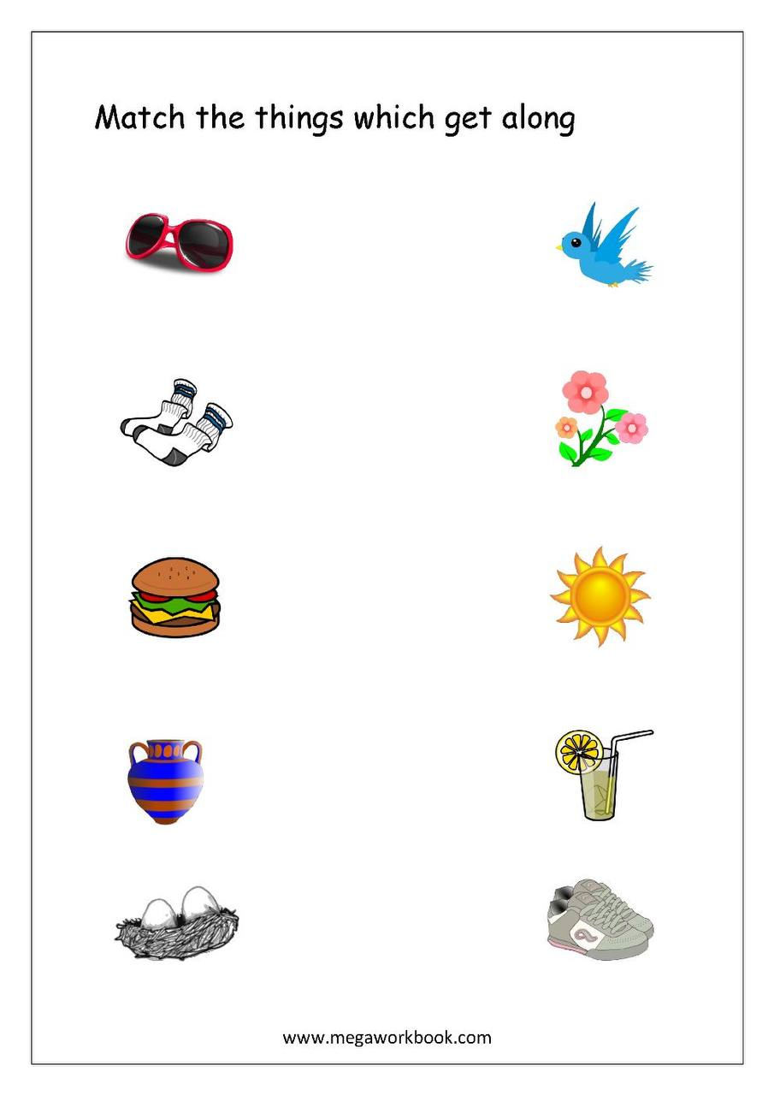

Slide 5

What is creativity?

Slide 6
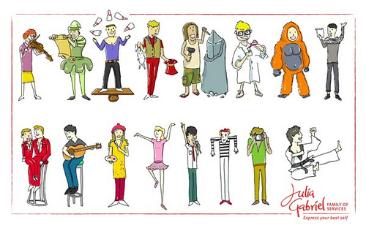
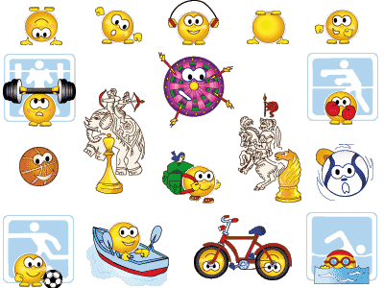
Creativity is the ability to use imagination to produce new ideas or make things.

Slide 7


Slide 8


Read your answers.

Slide 9



How creative are you? Think of as many things as possible to do with these objects.
pencils empty plastic bottle shoes cardboard box

Slide 10
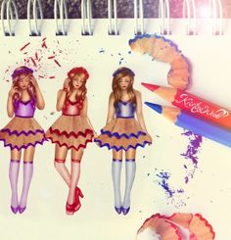

You can design dresses or beautiful shapes out of pencil shaving.
You can use pencils for writing or drawing.

Slide 11

You can use pencils for decoration.

Slide 12
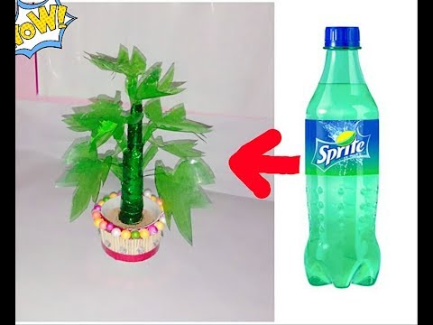
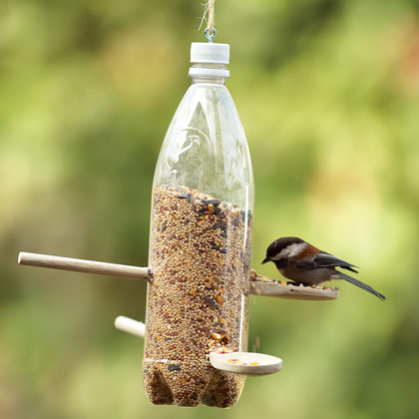
Be creative and reuse an empty plastic bottle in a wonderful way.

Slide 13
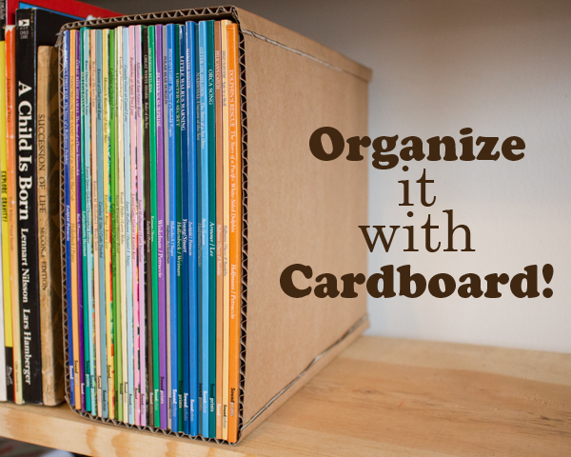
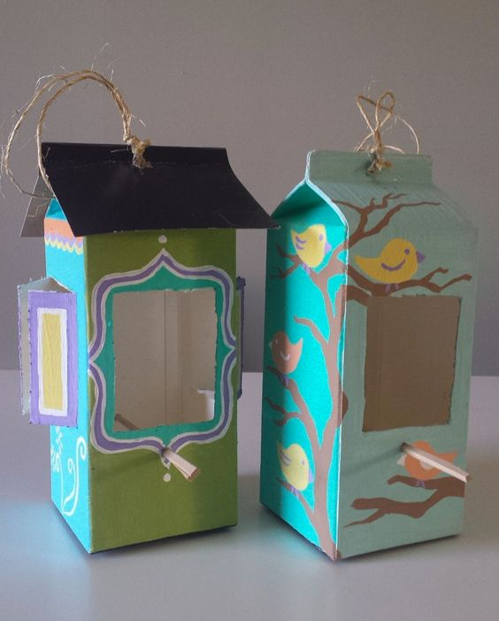

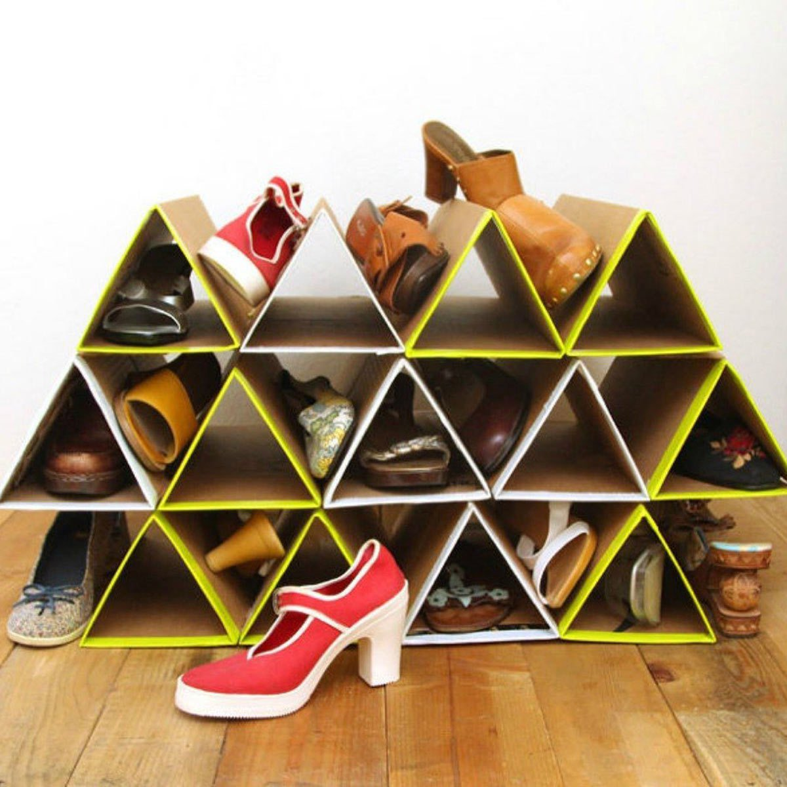
Be creative and reuse a cardboard box in
a wonderful way.

Slide 14
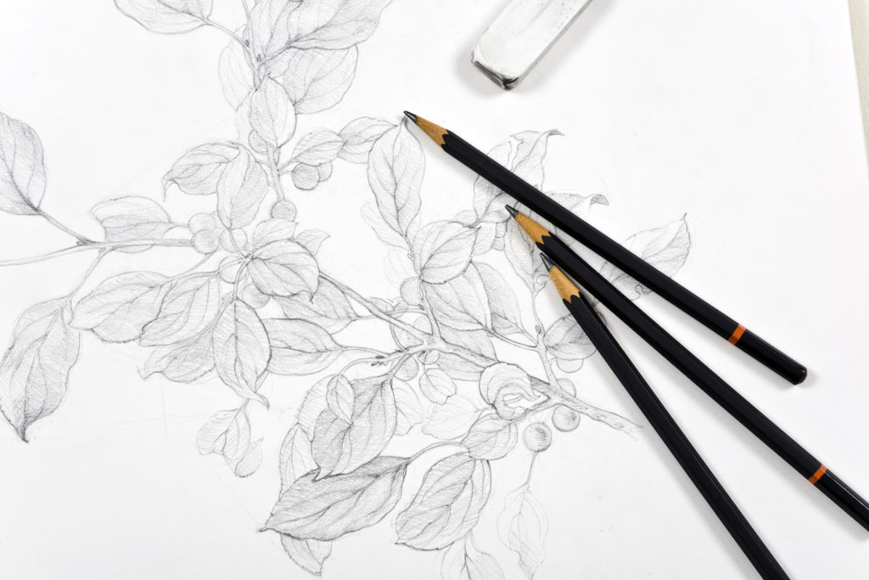
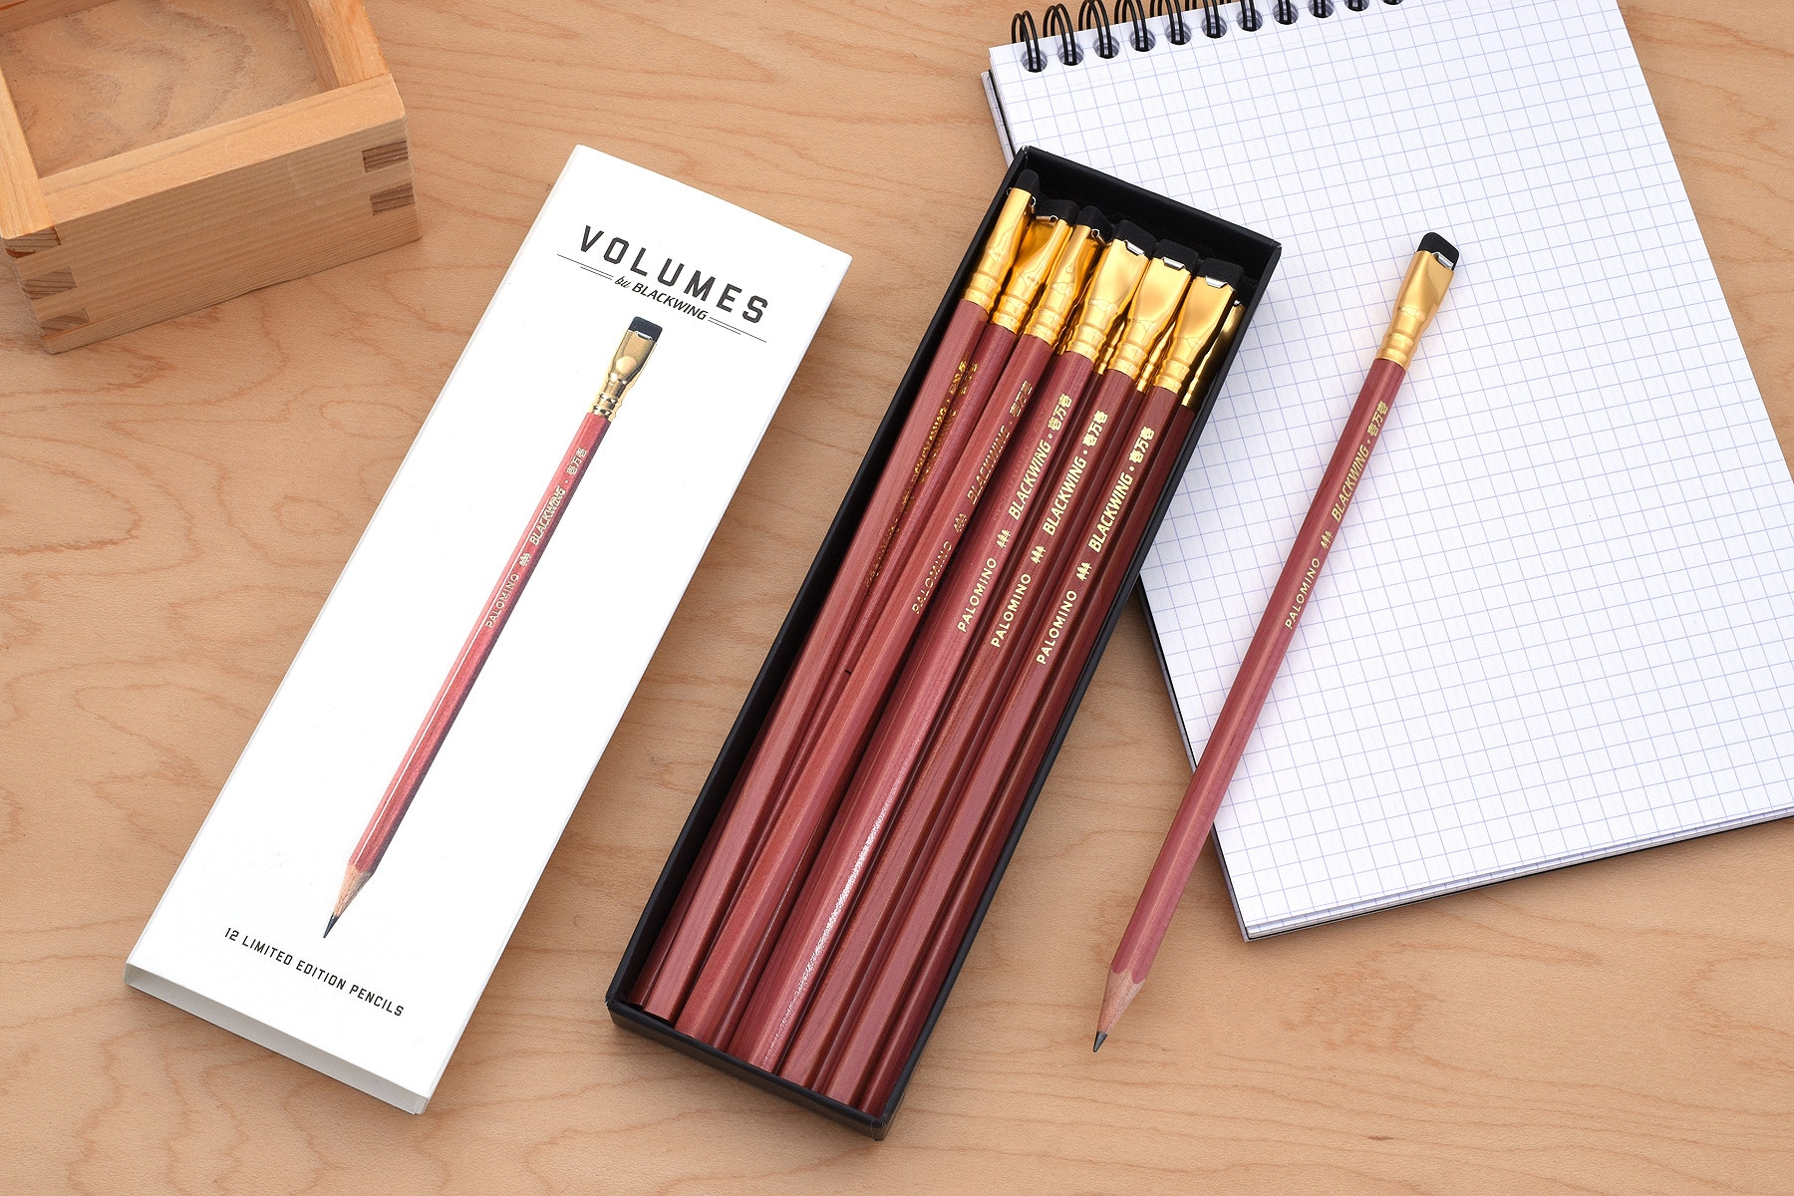
The intended purpose of a pencil is to write or draw.

Slide 15
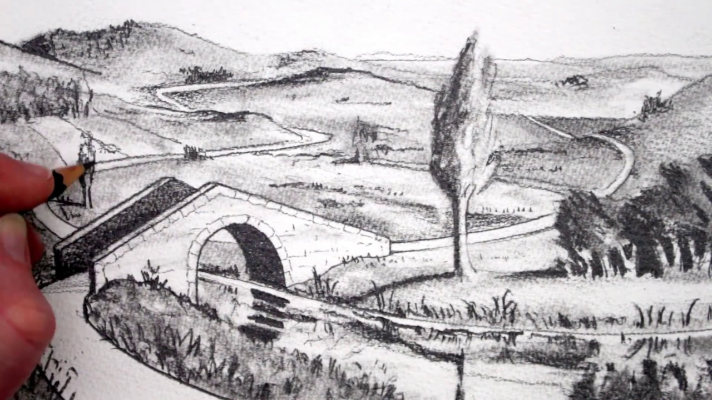

intended
purposed, expected, designed or planned

Slide 16

Creativity is using your imagination to create something original.

Slide 17

original
existing since the beginning

Slide 18
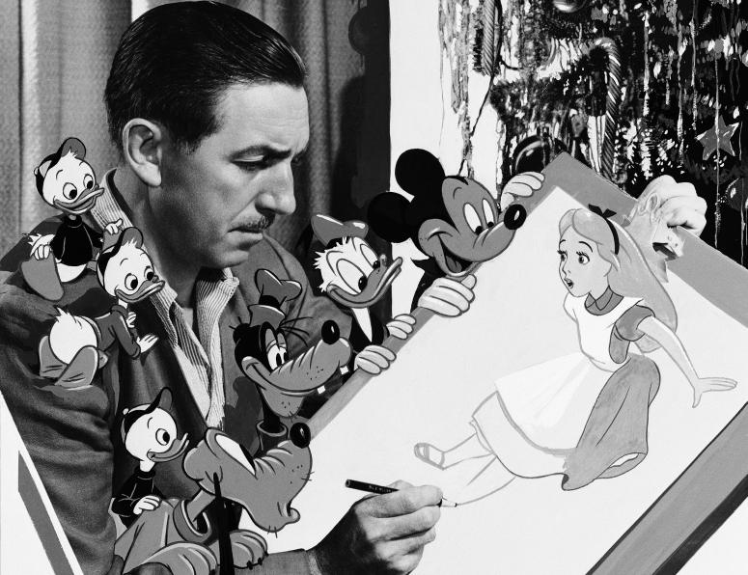
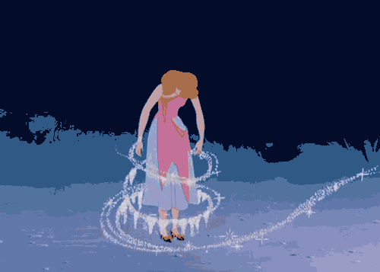
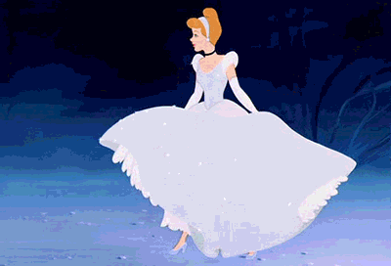
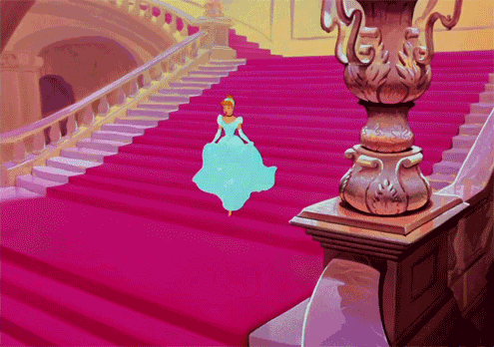
Walt Disney is creative. His drawings are so dramatic.

Slide 19
dramatic
very sudden or noticeable; or full of action and excitement

Slide 20

If you combine two or more different things, they begin to exit or work together.

Slide 21

combine computer + network = Internet

Slide 22
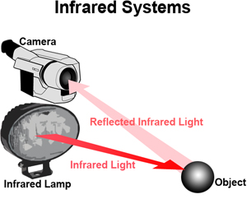
combine
to join together

Slide 23
In the past, surgical operations involved cutting the patient.

Slide 24
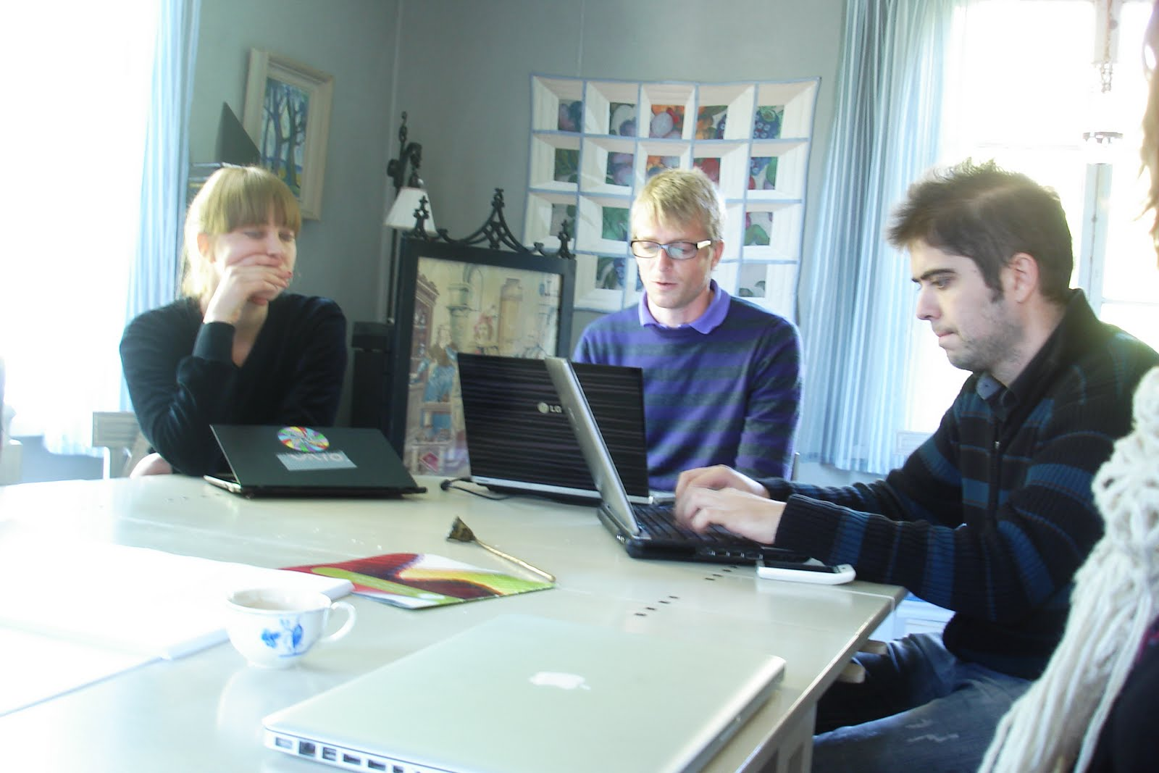
involve
to make necessary

Slide 25


New Vocabulary

Slide 26
intended (adj.)
original (adj.)
dramatic (adj.)
combine (v.)
involve (v.)

Slide 27


Slide 28
Fill in the spaces with words from the list:-
(original – combine – dramatic – involve)
1. The two countries……………………………against their common enemy.
combine

Slide 29
Fill in the spaces with words from the list:-
(original – combine – dramatic – involve)
2. Teachers……………………. all the students in their activities.
involve

Slide 30
Fill in the spaces with words from the list:-
(original – combine – dramatic – involve)
3. Walt Disney is creative. His drawings are so ………………...
dramatic

Slide 31

Student’s Book
Page 82

Slide 32

Creativity is using your imagination to create something original. Everyone is creative, but some people act on their ideas and others don’t.
There are many ways of being creative and creativity can help us solve many different
problems.

Slide 33
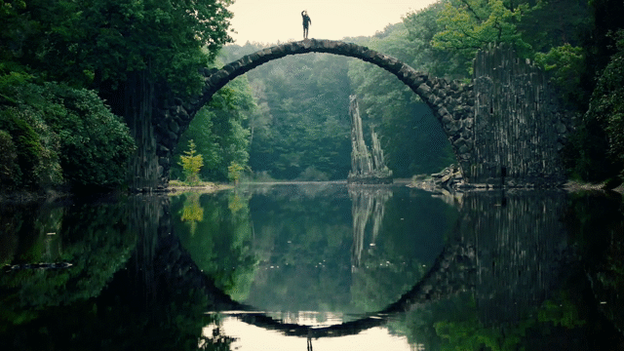
Student’s Book
Page 83

Slide 34



Slide 35




Slide 36

Check your answers.

Slide 37
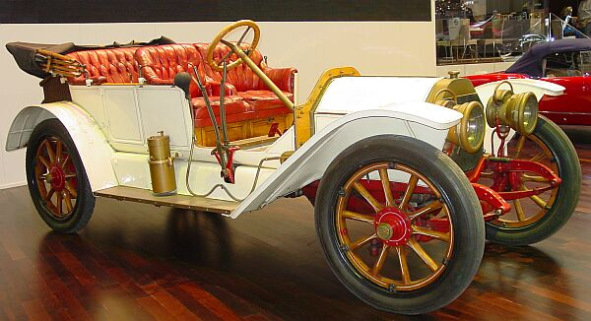
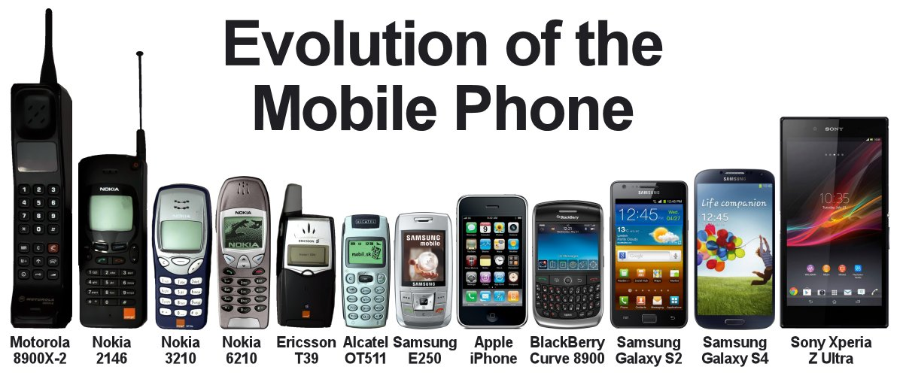
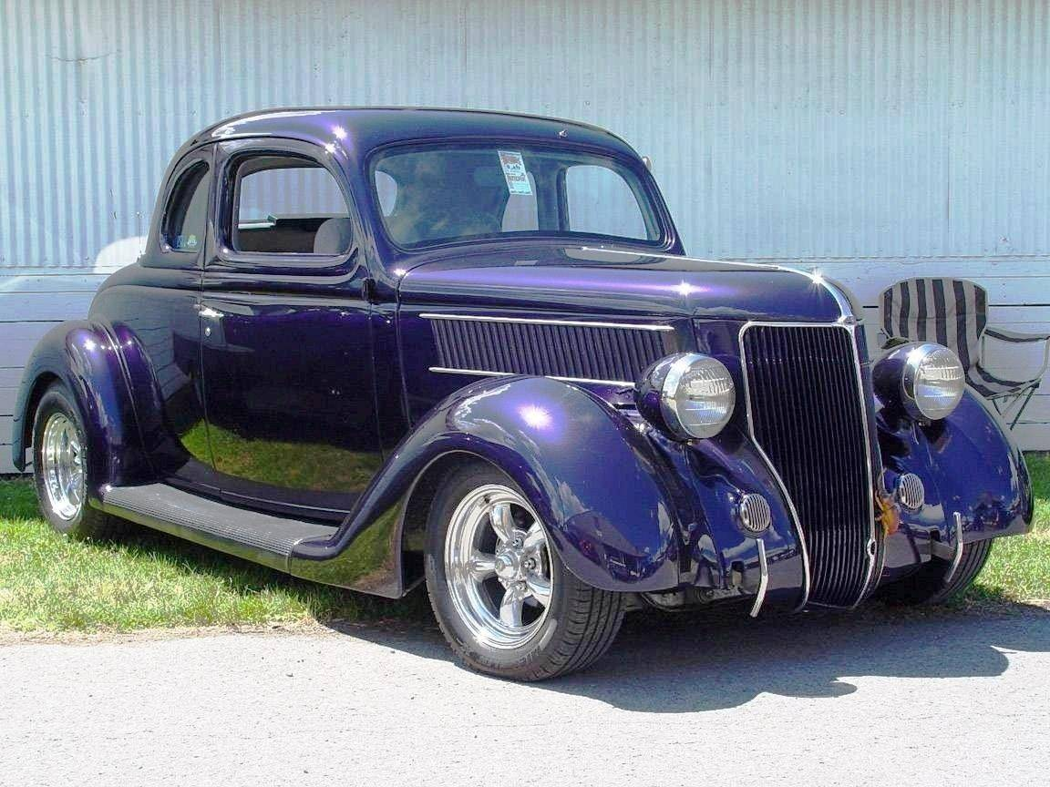
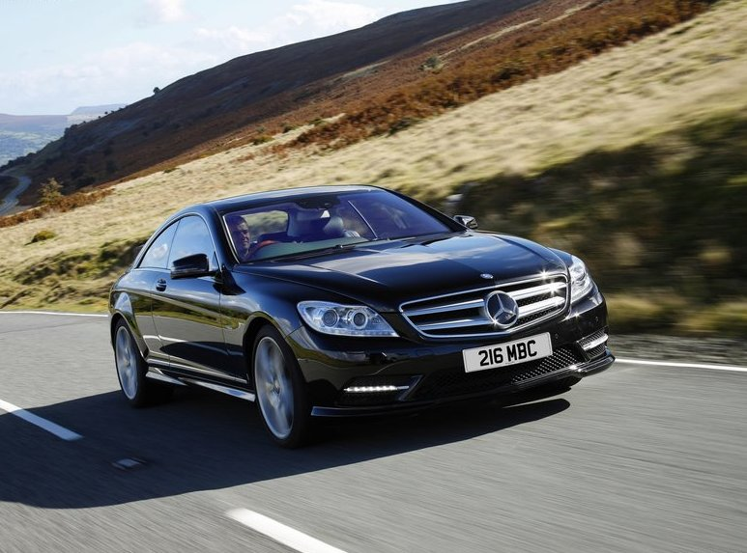
Evolution of ideas
Mobile phones

Slide 38
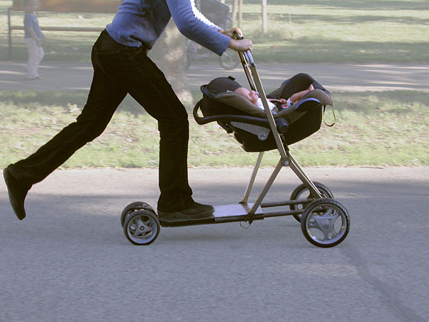
Combining a computer and a network to get Internet
Combining a baby stroller and a scooter

Slide 39
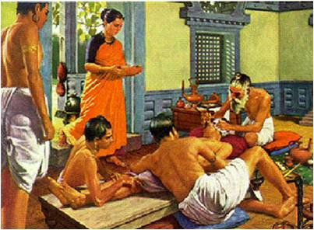

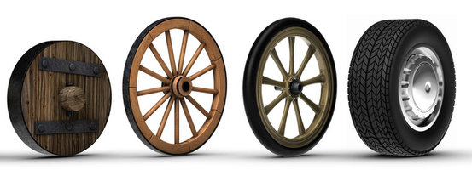

Changing how we do things
The invention of the wheels
Example
Surgical operations involved cutting into the patient. But now doctors can send a small tube with a camera into a person’s body.

Slide 40

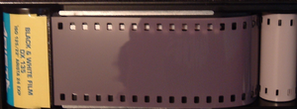
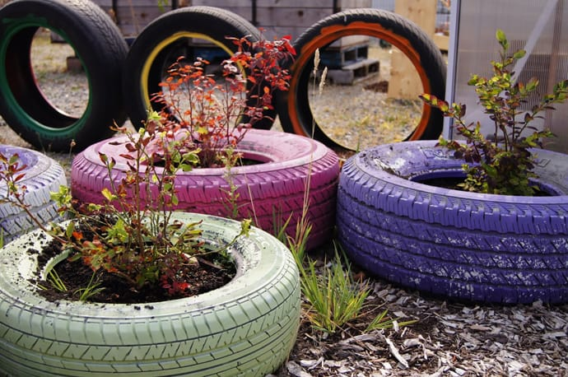
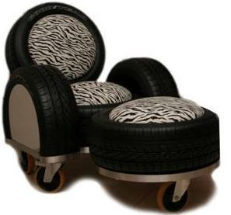

Finding a new use for things
Changing how we use wheels

Slide 41


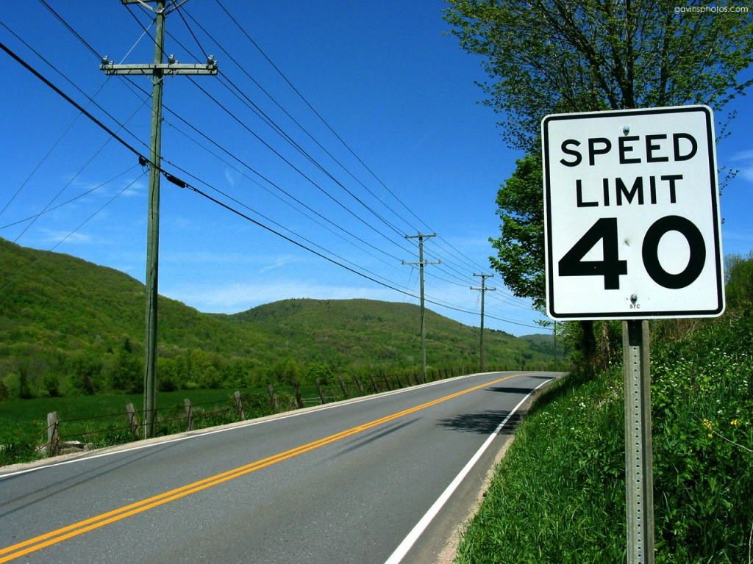


If you take all the road signs away, cars go slower!
Cancelling homework

Slide 42



Slide 43
1) The evolution of ideas
Creativity is not only about dramatic new ideas, it is also about making gradual improvements to existing ideas. Car development is an example of this. If a car designer creates a more comfortable car, he builds on many changes made by designers in the past.

Slide 44
2) Putting ideas together
Two or more ideas can be combined to create
a new idea. If you join the ideas of a computer and a network, you get the Internet.

Slide 45
3) Changing how we do things
Sometimes new ideas bring about a change in how we do things. In the past, all surgical
operations involved cutting into the patient. But now doctors can send a small tube with a
camera into a person’s body and treat the patient from the inside.

Slide 46
4) Finding a new use for things
Creativity doesn’t always involve inventing something new. If you look at something that exists, you can often think of another use for it.
Some of the best scientific developments have come this way. In the 19th century, plastic was developed for making balls. In 1889, a man discovered that you could use it for photographic film.

Slide 47
5) Changing approach
When we try to solve a problem, we often use one way to approach it, which may not work.
If you change your approach, you can sometimes find a different solution. For example, most city planners slow traffic down with speed restrictions and signs. But one planner proved that if you take all the signs away, cars go slower! This is because drivers have to be more careful.

Slide 48



Slide 49
What is the purpose of the text?

Slide 50

Closure

Slide 51
There are many ways of being creative.
Mention them.
1- Evolution of ideas
2- Putting ideas together
3- Changing how we do things
4- Finding a new use for things
5- Changing approach

Slide 52

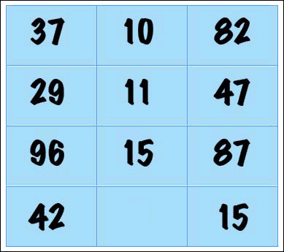

Slide 53

Thank you

Slide 54
Nowadays, many surgical operations involve many tiny machines.

Slide 55
Focusing on solutions rather than problems is a great approach.

Slide 56

approach
a way of doing something

Slide 57
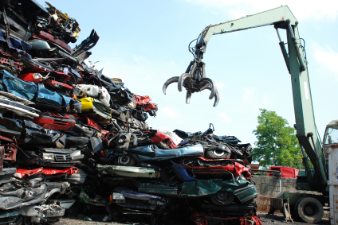
It’s a creative approach to take the old cars away for recycling.

Slide 58

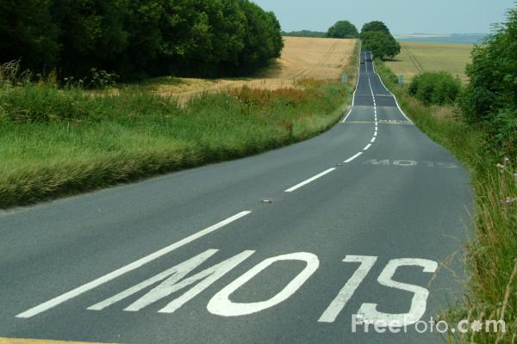
Most city planners slow traffic down with speed restrictions and signs.

Slide 59

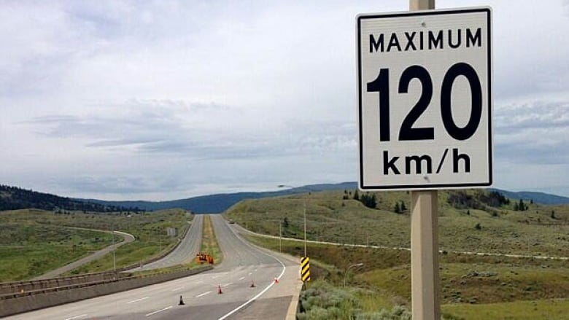
restriction
an official limit on something

Slide 60
involve (v.)
approach (v.)
restriction (n.)

