Slide 1


Module 2
Unit 4
Unforgettable past

Slide 2
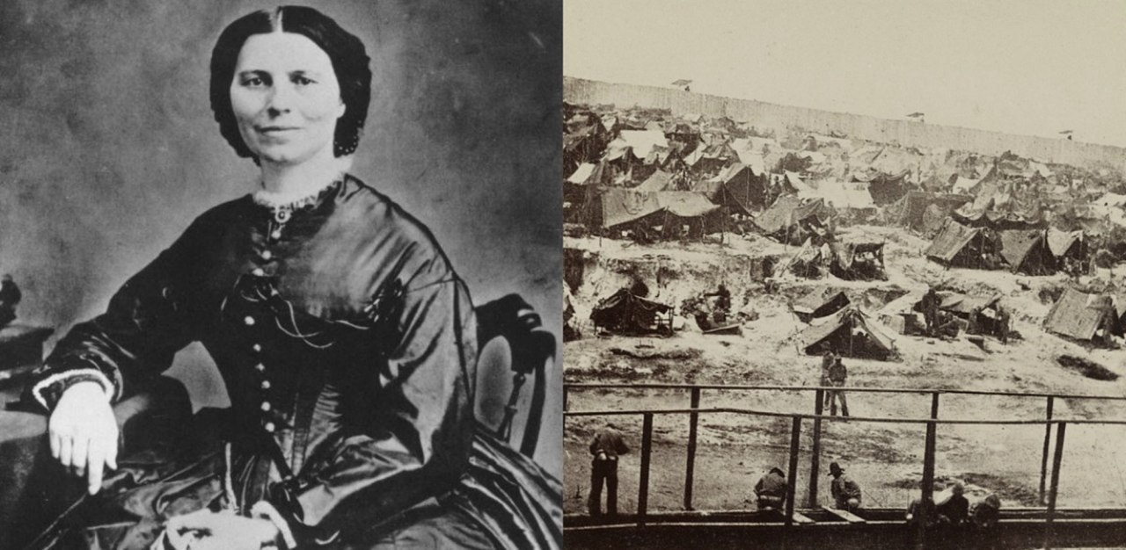
Reading
SB./ P. 35

Slide 3
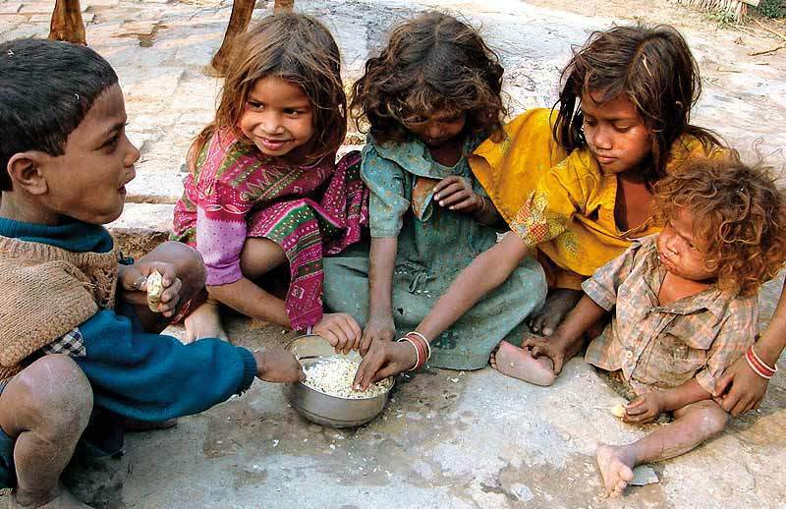
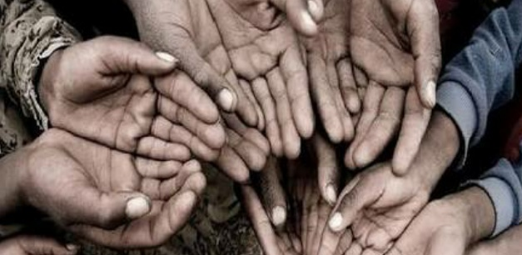
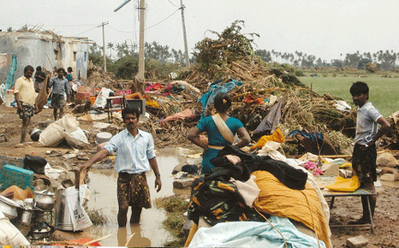
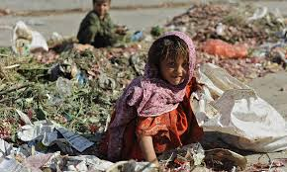
Describe the pictures
&
Guess the topic.

Slide 4

1- Poor people suffer from
many problems. What are they?
2- How can we help them?
3- Why should we help them?

Slide 5

Marie Curie
Organisation
Kuwait Red Crescent Society
Voluntary Work Center
Zakat House

Slide 6
What is the importance of
charity organisations?

Slide 7
Activity 1 :
Read the text and give it a suitable title :

Slide 8


Slide 9


hire (V)
(to rent)
to employ someone
or pay someone to do
a particular job..

Slide 10
Example
Clara hired some teachers
to work in her new school.

Slide 11

raise (V)
to cause something to increase or become bigger , better , higher , etc…

Slide 12
Example
Clara raised a lot of money
to open another school.

Slide 13

community (N)
the people living in one particular area.

Slide 14
Example
Clara helped her community a lot.

Slide 15

demote (V)
to lower someone or something in rank or position.

Slide 16
Example
Clara wasn’t allowed to be a principal
and she was demoted to an assistant.

Slide 17
wound (N)
a damaged area of the body ,such as cut or hole in the skin or flesh made by a weapon.

Slide 18
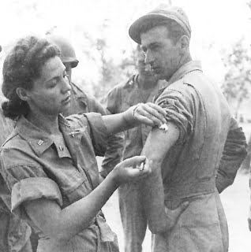
Example
Clara fed soldiers and cleaned
their wounds.

Slide 19

compelled (Adj)
having to do something, because you are forced to or feel it is necessary.

Slide 20
Example
Clara was compelled to face
danger to help people.

Slide 21
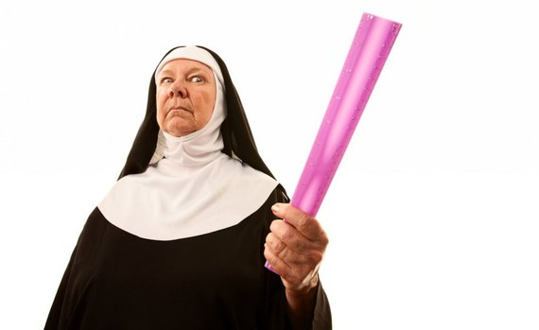
harsh (Adj)
unkind or cruel.

Slide 22
Example
Clara was suffering in
a harsh environment.

Slide 23


quit (V)
to stop doing something or leave a job or a place.

Slide 24
Example
Clara quit her job because she
suffered from many health problems.

Slide 25




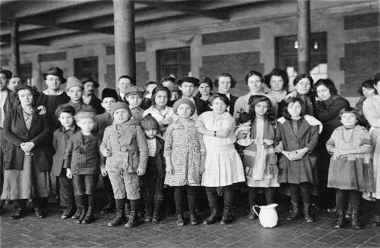


hire (V)
raise (V)
community (N)
demote (V)
harsh (Adj)
quit (V)
wound (N)
compelled
(Adj)

Slide 26


Slide 27
Activity 2 :
Read the text again and match the headings with
the right paragraphs:
* Helping soldiers in the war. (Paragraph………..)
* A very special woman. (Paragraph………..)
* Suffering from health problems. (Paragraph………..)
* The unfair community. (Paragraph………..)

Slide 28



Slide 29
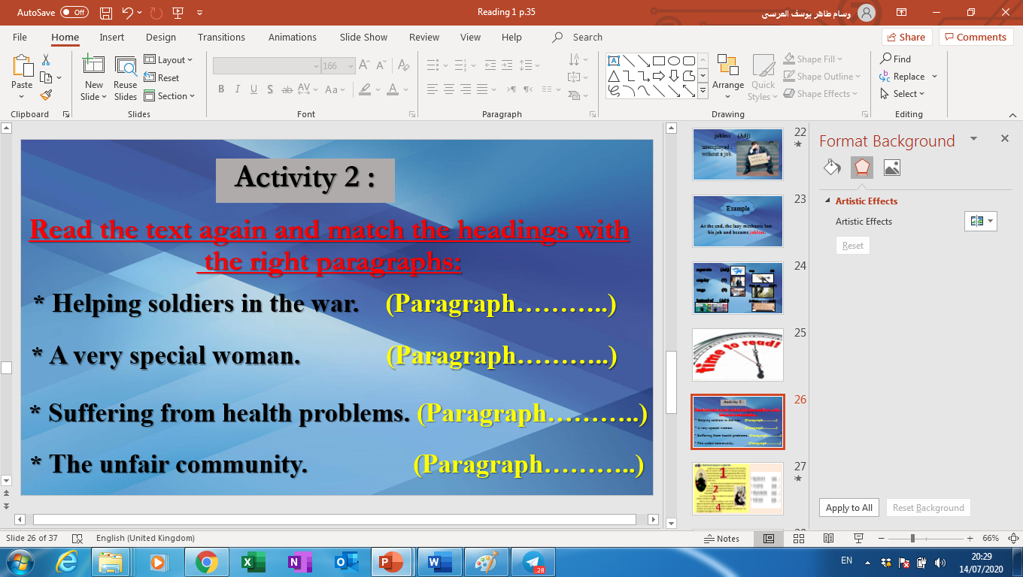
4
1
1
2
3
3
2
4

Slide 30
Activity 3 :
Read the text again and choose the correct answers:
1- What is the opposite of the word “let” in the 2nd paragraph?
a- give
b- evoke
c- prevent
d- help

Slide 31
2- According to the text, all the following statements are TRUE except:
a- Clara was the principal of the new school she opened.
b- Clara was a teacher and worked as a nurse.
c- Clara suffered a lot from many health problems.
d- Clara founded an international organisation.

Slide 32
3- The purpose of the writer in writing this text is to:
a- inform us about the early history of the United States.
b- tell us about wars and battlefields in the past.
c- compare doctors and nurses in the past with ones nowadays.
d- explain the great role of Clara in helping her community.

Slide 33
Activity 4:
Read the text and answer the following questions:
1- How would you describe Clara Barton?
2- Women were not treated as equal to men during the 19th century, explain.
3- How did Clara help her community?

Slide 35
1- Clara was brave. She didn’t give up hope.
She did her best to help people.
2- Women were not allowed to hold high
positions like men.
3- Clara opened a free school. She raised a lot of money to open another school. She worked as a nurse and helped the soldiers. She founded an international organisation.

Slide 36

1- Think of a great Kuwaiti woman and compare her to Clara Barton.
2- What does Kuwait do to help poor people ?

Slide 37


