Slide 1

Module 1
Unit 1
Healthy living

Slide 2

SB. / P.18

Slide 3
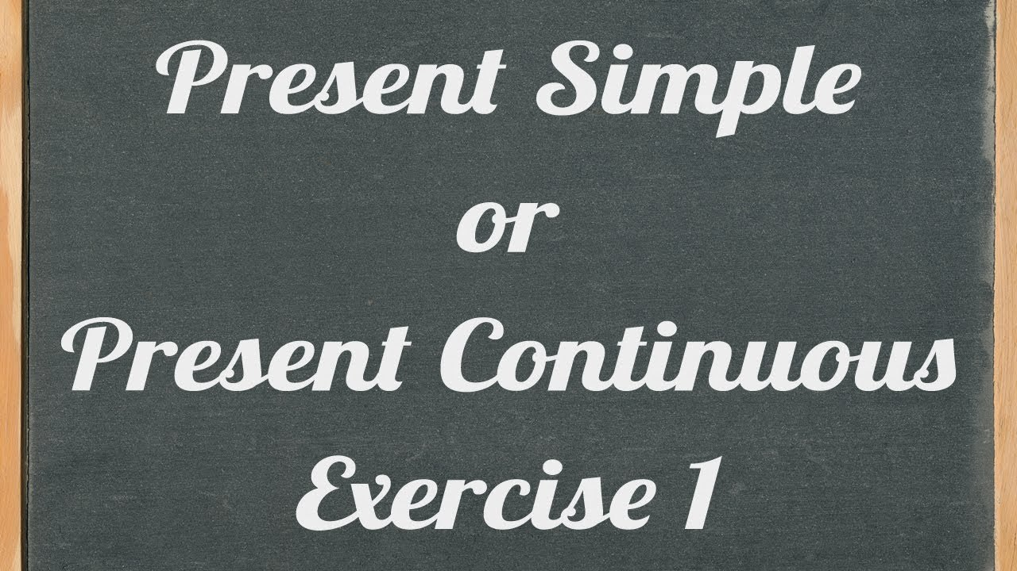

Slide 4
*What do you usually do
on Friday?
*What are you doing now?

Slide 5

*I usually study my lessons.
*I am studying English now.

Slide 6
*Which sport does your sister always play?
*What is she playing at this moment?

Slide 7
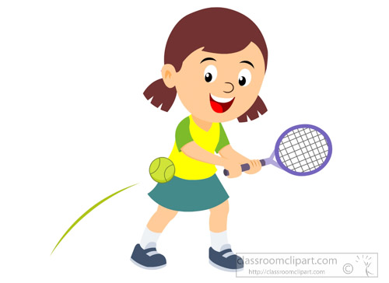
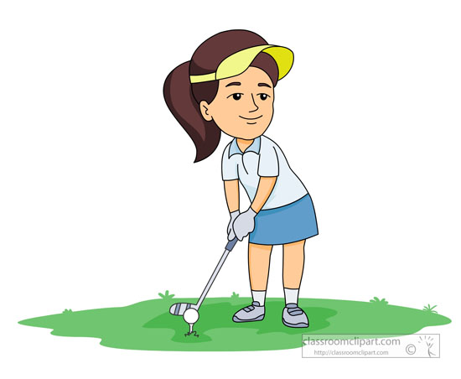
*She always plays tennis.
*She is playing golf at this moment.

Slide 8
Present simple tense
Key words
always – never – often – sometimes – usually – every
Form
He / she / it
V. + S
I / we / you / they
V.

Slide 9
Present simple tense
Examples:
1- Ali always goes to school late. Ali never goes to school late.
negative
2- They usually travel on holidays. They never travel on holidays.
negative
3- She gets up at six O’clock. She doesn’t get up at six O’clock.
negative
4- I play tennis everyday. I don’t play tennis everyday.
negative

Slide 10
Present continuous tense
Key words
now – at this moment – at the present – today – still – look ! – listen !
Form
* I am + v. + ing
*he / she / it is + v. + ing
*we / you / they are + v. + ing

Slide 11
Present continuous
tense
Examples:
I am reading a story at this moment .
I am not reading a story at this moment.
negative
Ahmed is playing football now.
Ahmed isn’t playing football now.
negative
They are doing their homework today.
They aren’t doing their homework today.
negative

Slide 12
Activity 1 :
Choose the correct answer:
Mona always ( do – does – did ) exercises to be fit. She and her friends ( go – goes – going ) to the club everyday. Today, they (playing – is playing – are playing ) tennis. Mona (is practising – am practising – are practising) many sports.

Slide 13



Slide 14
Activity 1 :
Choose the correct answer:
Mona always ( do – does – did ) exercises to be fit. She and her friends ( go – goes – going ) to the club everyday. Today, they (playing – are playing – is playing ) tennis. Mona (is practising – am practising – are practising) many sports.

Slide 15
Activity 2:
Do as shown between brackets:

Slide 17
Activity 2:
Do as shown between brackets:
walks
He isn’t listening to music at the moment.
Omar doesn’t go camping during his holidays.
Where do your friends travel every year ?
When do your friends travel to Italy ?
What are the students doing now?
When are the students working on the science project ?

Slide 18


Slide 19


