Slide 1
Unit 8 Step 3 S.B p 64 grammar

Slide 4
Sort the words into the correct boxes
Communication nowadays
Communication in the past

Slide 5
Sort the words into the correct boxes
Communication nowadays
Communication in the past

Slide 7
Our teacher is not taking us on a journey by bus.
We are not visiting the USA on holiday.
I am not having a course after school.
Are Ali and Sami meeting their cousins in the mosque?
Is Dana preparing herself?
Are you preparing yourself to the collage next year?
I am having a staff meeting on Monday.
My uncle is running on a big company in Holland next year?
Maha is washing his car tomorrow.

Slide 9
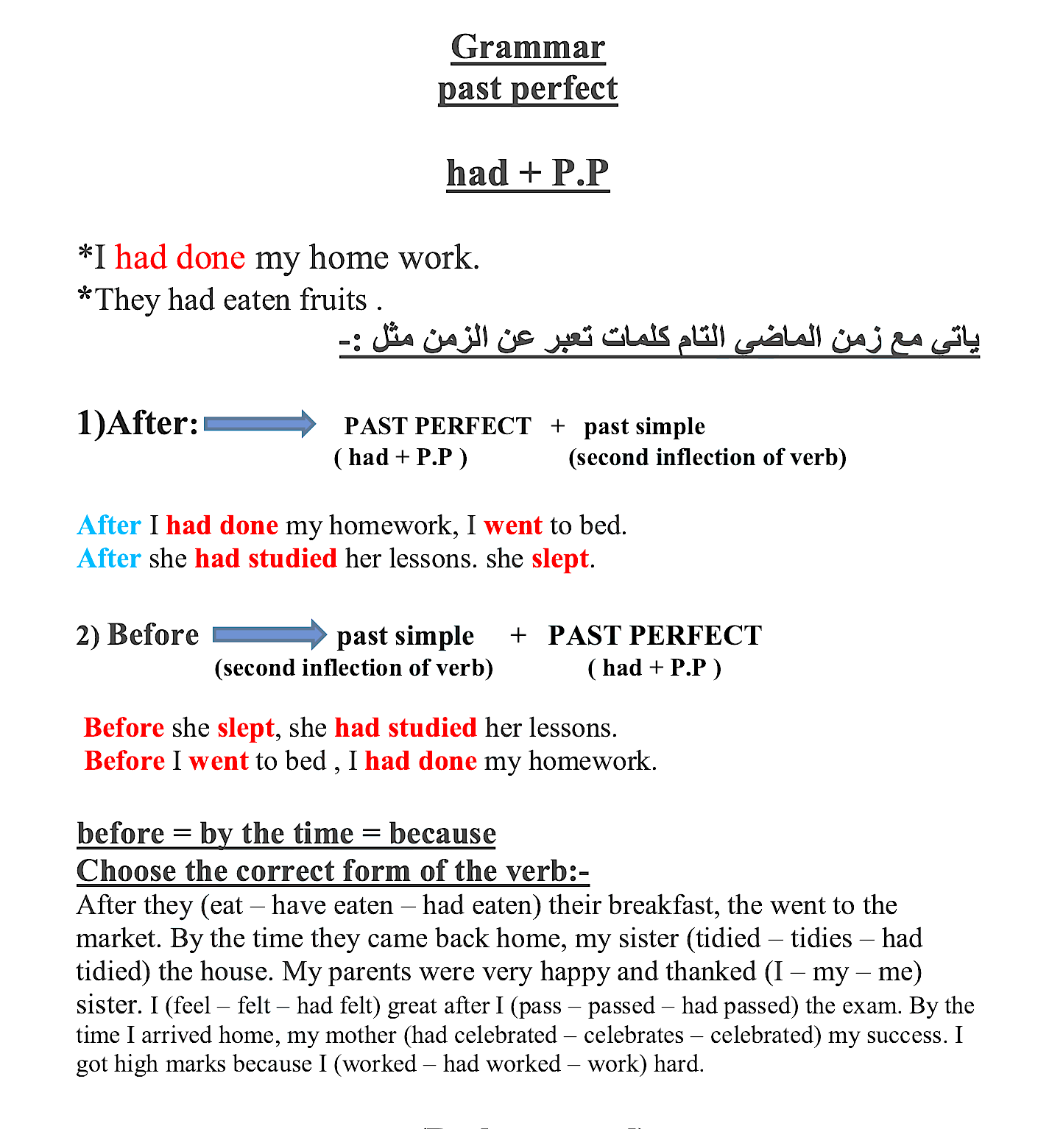

Slide 10
1
2

Slide 12
1
2

Slide 13
2
1

