Slide 1
Unit 10
Inventors who changed the world

Slide 2
البوابة الكويتية لصعوبات التعلم (redsoft.org)

Slide 4
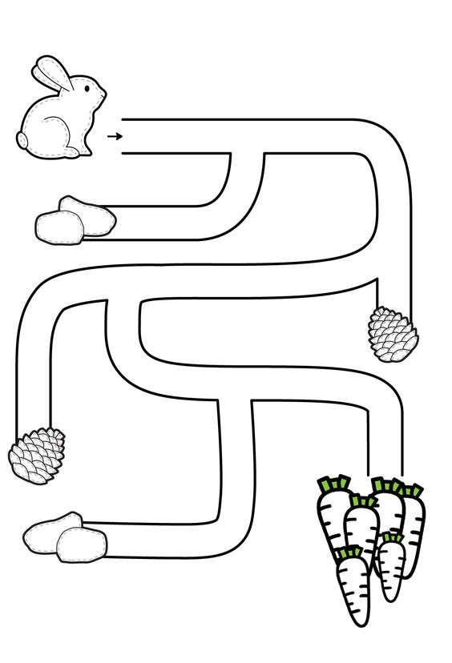

Slide 6
Fill in the spaces with words from the list:
(profitable – humidity – influential – presidents)
1- Sports has a / an ............................. role to keep our body healthy and strong. .
influential

Slide 7
Fill in the spaces with words from the list:
(profitable – humidity – influential – presidents)
2- Actually, trade is a ............................... business..
profitable

Slide 8
Fill in the spaces with words from the list:
(profitable – humidity – influential – presidents)
3- All the ................................ always meet in conferences to discuss important issues.
presidents

Slide 10
How did inventions change our way of life?

Slide 12
Inventions that changed the world

Slide 13
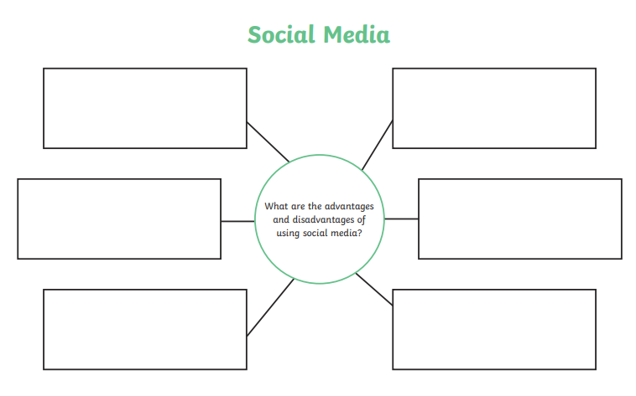
inventions
Why are inventions important to us?

Slide 14
Read your answers

Slide 15
Inventions are created to help make life easier and better.

Slide 16
Many inventions save times and effort.

Slide 17
Other inventions are made to solve problems.

Slide 18
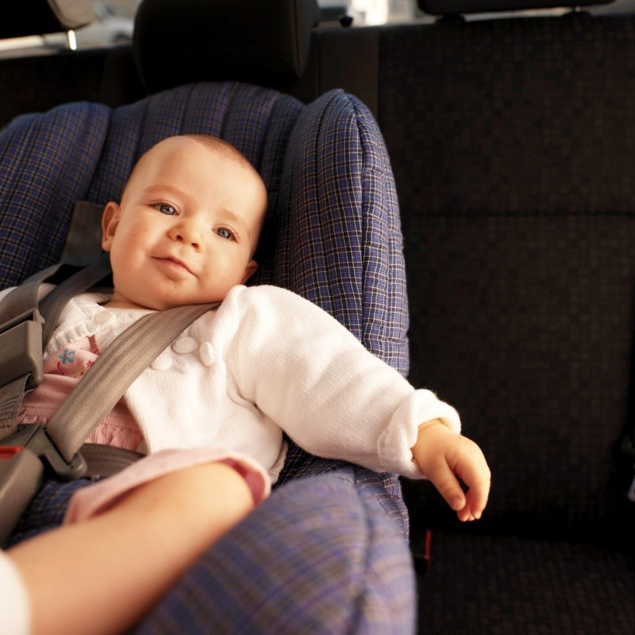
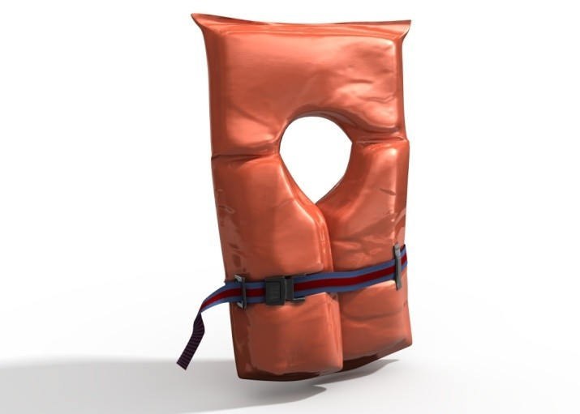
Many inventions keep people safe.

Slide 19
ورقة عمل الصف الثامن المتوسط مادةاللغة الانجليزية ::writing -7 (redsoft.org)

Slide 20
Writing
" The inventors are great people who have wonderful contributions that changed the world and helped the humanity."
Plan and write a report of two paragraphs (not less than 10
sentences) about " Inventions" explaining why inventions are important to us and some well-known inventors' great works.

Slide 22
Inventions have changed our life completely. It makes our life easier . It makes it more comfortable. It saves our time and effort. It help us travel around the world faster.

Slide 23
There are many great inventions in our life. People drive cars to move from a place to another. People travel by planes. People use smartphones to chat. I think inventions are great.

Slide 24
Thank you

