Slide 1
Unit 8 Step 1 S.B p 63

Slide 5
am having
are going
is coming
are having
is traveling

Slide 6
How do people communicate in the past?

Slide 7
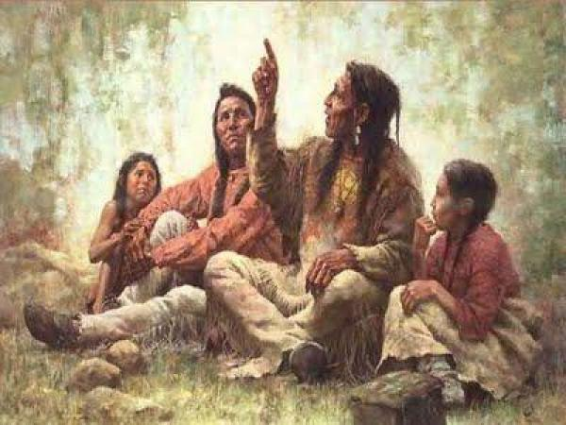
1) By telling stories and facts to younger generation.

Slide 8
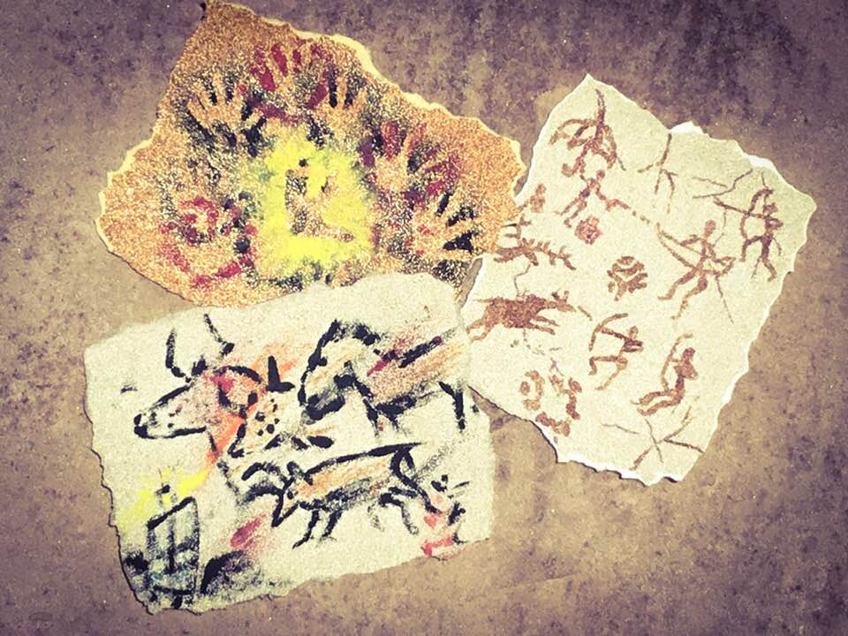
2) By carving and painting on stones.

Slide 9
3) By writing.

Slide 10
How do you usually communicate with your friends?

Slide 12
New voc:-
1- gradually (ADJ)
slowly

Slide 13
The ways people communicate have changed gradually.
1- gradually (ADJ)
slowly

Slide 14
2- convey (v)

Slide 15
3- exchange (v)
Swap, switch
share ideas, information

Slide 18
By communication.
Story telling.
Carve and paint pictures on the stones
3. Writing .

Slide 19
Unit 8 Step 1 S.B p 63

Slide 25
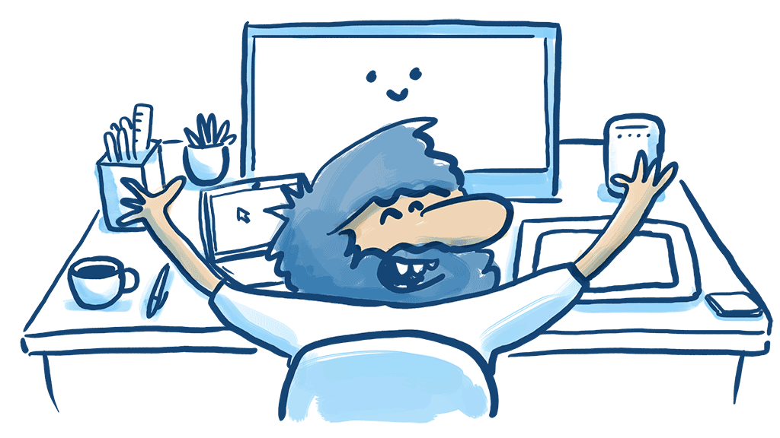
New voc:-
1-efficiently (ADV)
accurately

Slide 26
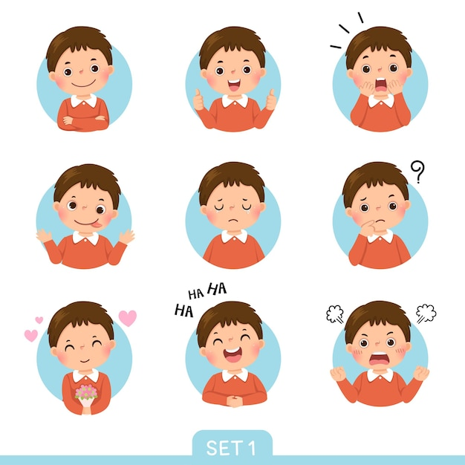
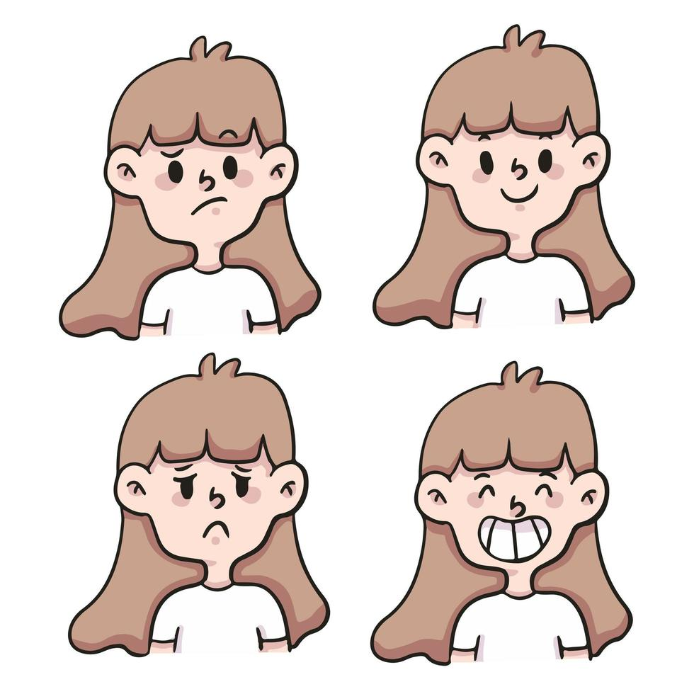
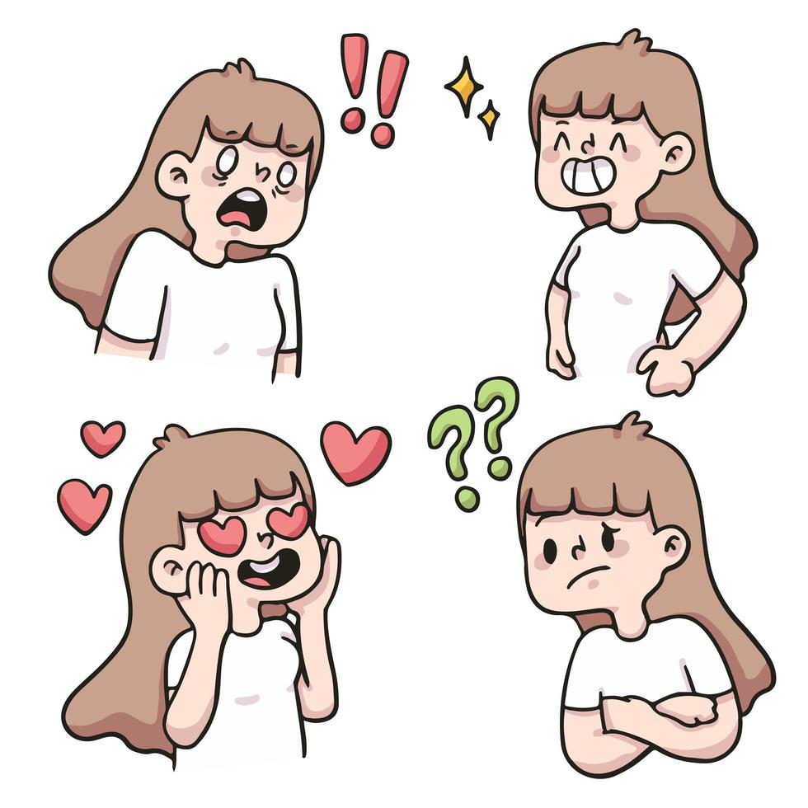
2-reaction (N)
response

Slide 28
You can call everyone, everywhere ,whenever you like . You can watch news
around the world on TV.
Because it make us more real and show emotions and reactions.
BY telephone.

Slide 29
Unit 8 Step 3 S.B p 64 grammar

Slide 32
Sort the words into the correct boxes
Communication nowadays
Communication in the past

Slide 33
Sort the words into the correct boxes
Communication nowadays
Communication in the past

Slide 36
Our teacher is not taking us on a journey by bus.
We are not visiting the USA on holiday.
I am not having a course after school.
Are Ali and Sami meeting their cousins in the mosque?
Is Dana preparing herself?
Are you preparing yourself to the collage next year?
I am having a staff meeting on Monday.
My uncle is running on a big company in Holland next year?
Maha is washing his car tomorrow.

Slide 38
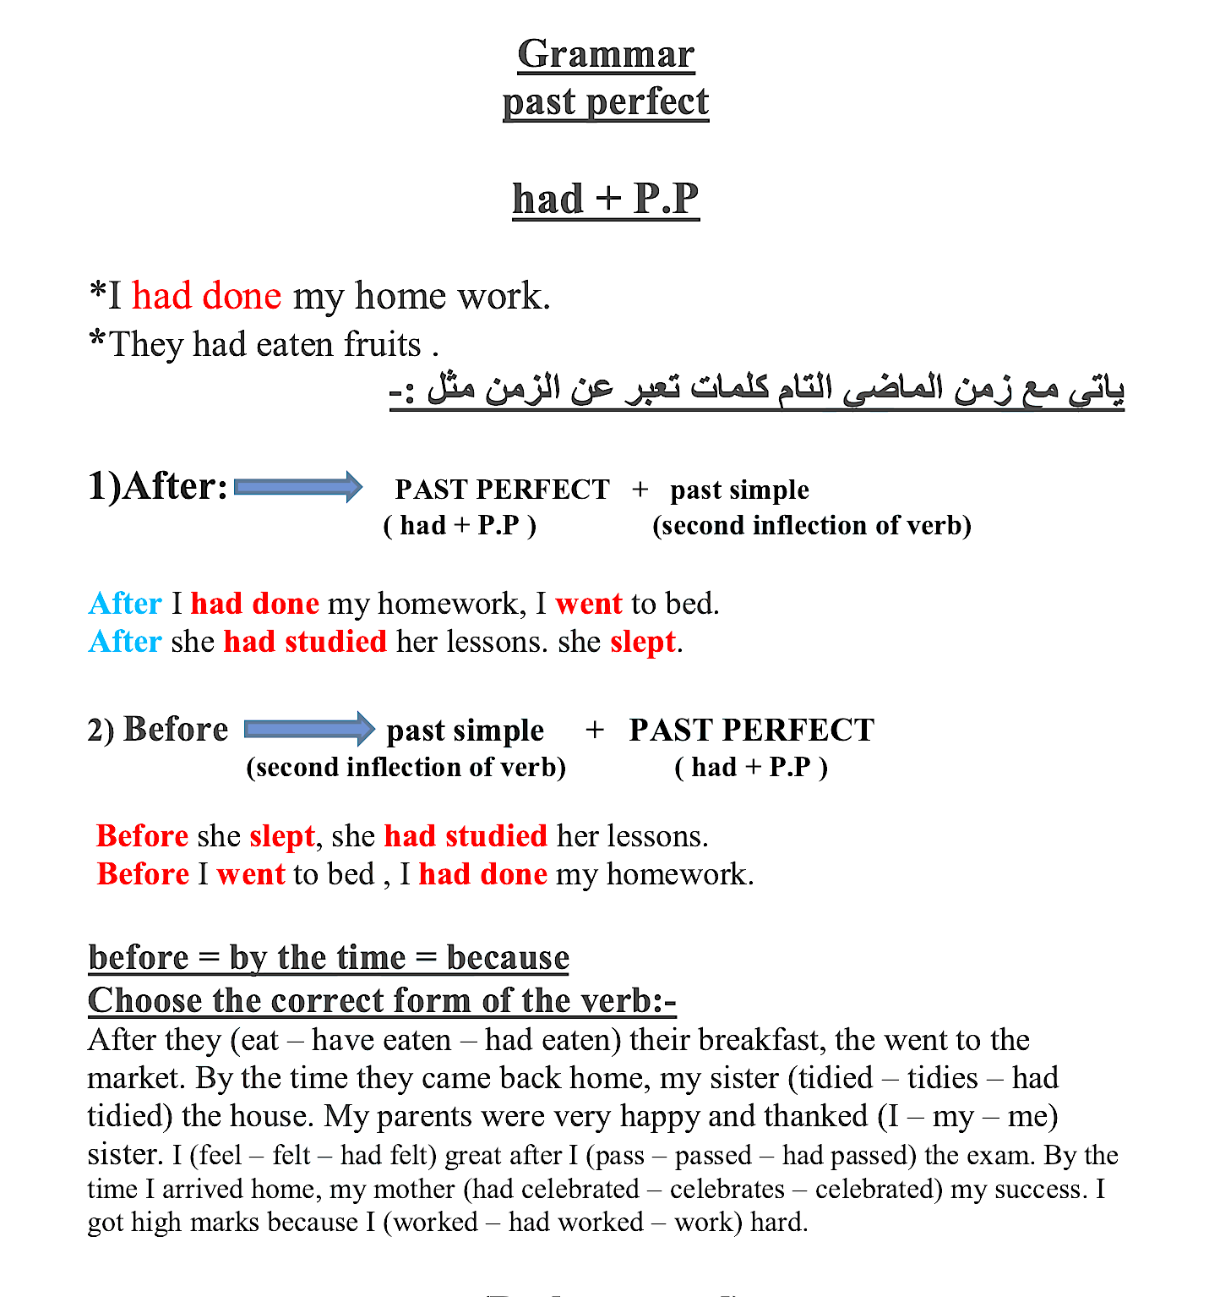

Slide 39
1
2

Slide 41
1
2

Slide 42
2
1

Slide 45
Unit 8 Step 3 S.B p 66

Slide 46
(had + past participle)
*Complete the sentence with the correct form of the verbs: -
He failed the test because he…………….... . (not study)
The baby ……………. (cry) before his mother came.
She …………..…. (wash) her hands before she cooked the dinner
I returned home because I ……………....(forget) my notebook there.
When we arrived to the train, the train ……………..……..(leave).
When we reached school the bell ……………….……(ring)

Slide 47
(had + past participle)
*Complete the sentence with the correct form of the verbs: -
He failed the test because he hadn’t studied . (not study)
The baby had cried (cry) before his mother came.
She had washed (wash) her hands before she cooked the dinner
I returned home because I had forgotten (forget) my notebook there.
When we arrived to the train, the train had left.(leave).
When we reached school the bell had rung (ring)

Slide 50
New voc:-
1- means (n)
way

