Slide 1
Module 1
Unit 3

Slide 2
SB. / P. 29

Slide 3
INTENSIFIERS
too ------- to
so ------- that

Slide 4
Adjectives

Slide 5
Why can’t you drink the tea ?
The tea is too hot to drink.
The tea is so hot that I can't drink it.

Slide 6
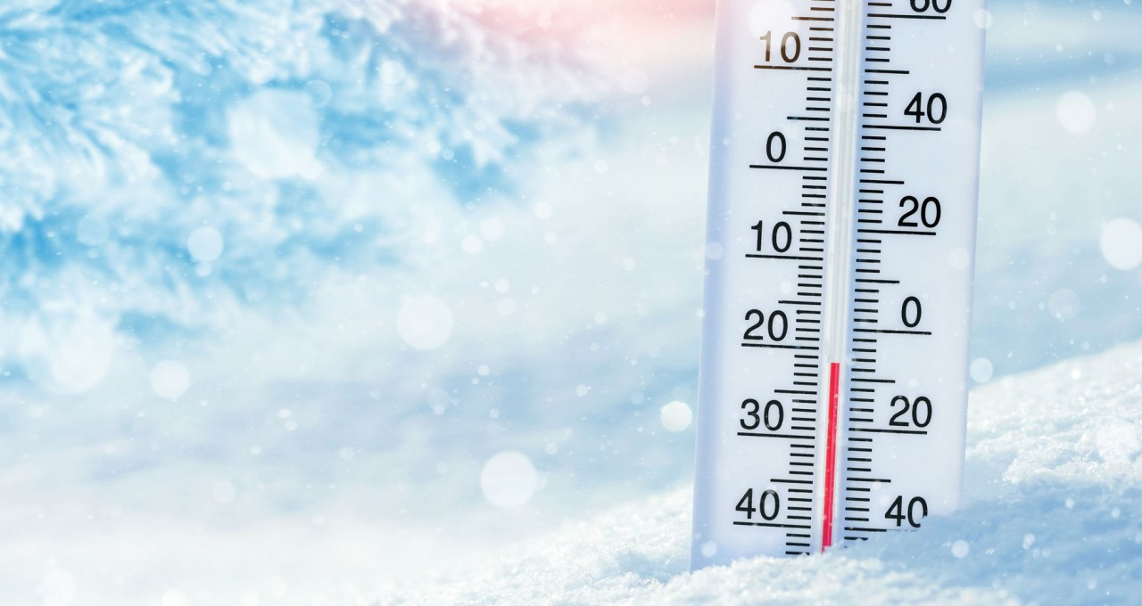
Why didn’t you come to school yesterday?
The weather was too cold to come to school.
The weather was so cold that I couldn’t
come to school.

Slide 7
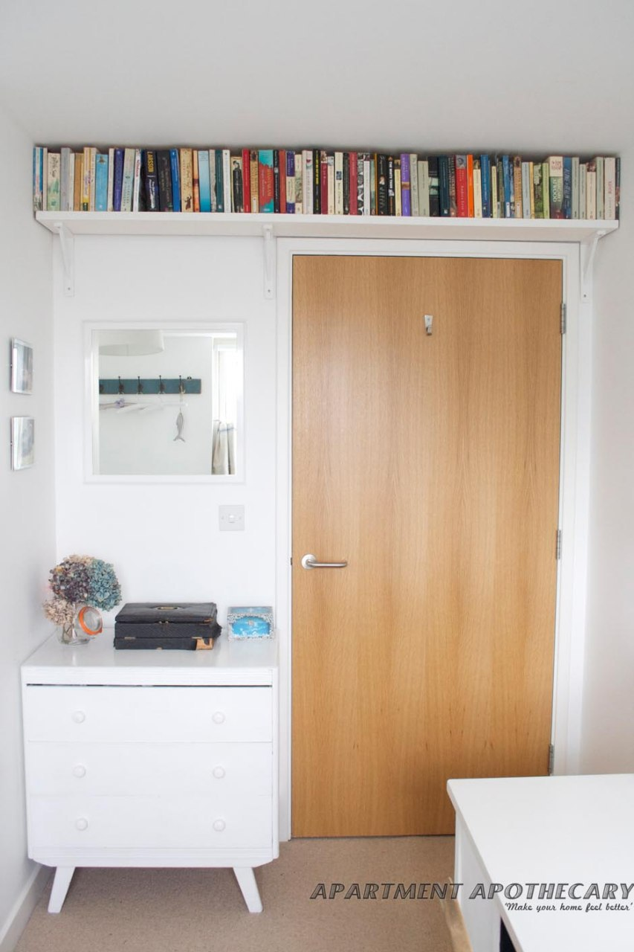
too … to
too + Adj. + to + infinitive verb
We use (too…to) when we want to show
that something is impossible and to show
why it is impossible.
e.g: The books are too high to reach.

Slide 8
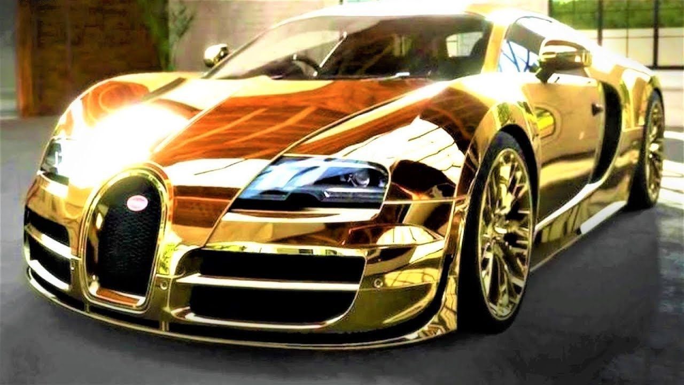
so … that
so + Adj. + that + complete sentence
We use (so…that) to express an effect of
the remarkable situation mentioned in
the main clause.
e.g: The car is so expensive that I can’t buy it.

Slide 9
Activity 1 :
Choose the correct answers:
Yesterday, it was ( too – as – so ) boring to stay at home so I decided to go out. I was so hungry ( that – too – to ) I went to a restaurant. My brother was so (busier – busiest – busy) that he couldn’t come with me. I went alone and the food was too hot to (ate – eat – eaten ) .

Slide 11
Yesterday, it was ( too – as – so ) boring to stay at home so I decided to go out. I was so hungry ( that – too – to ) I went to a restaurant. My brother was so (busier – busiest – busy) that he couldn’t come with me. I went alone and the food was too hot to (ate – eat – eaten ).

Slide 12
Activity 2 :
Do as shown between brackets:
1- The box is very heavy . I can’t carry it.
( Use : too .. to )
2- The story was very interesting . I read it many times.
( Use : so .. that )
3- The exercise is very difficult . I can’t do it.
( Use : too .. to )
4- This mobile is very expensive . I cannot afford it.
( Use : so .. that )

Slide 14
1- The box is too heavy to carry.
2- The story was so interesting that I
read it many times.
3- The exercise is too difficult to do.
4- This mobile is so expensive that I cannot afford it.

Slide 15
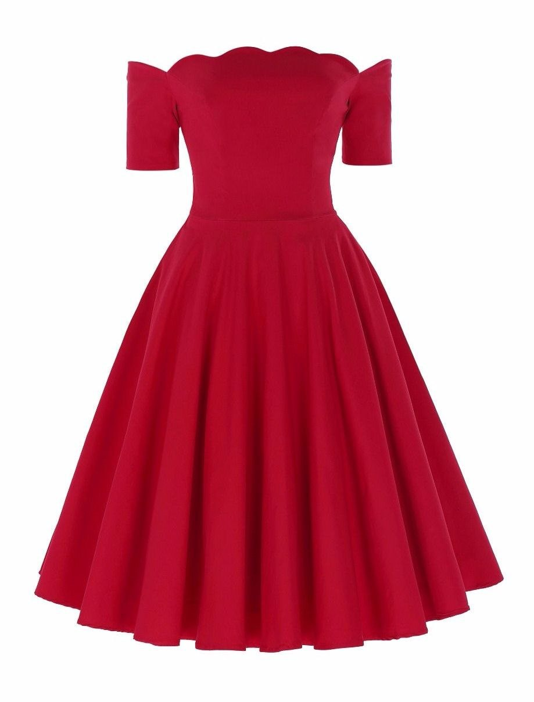
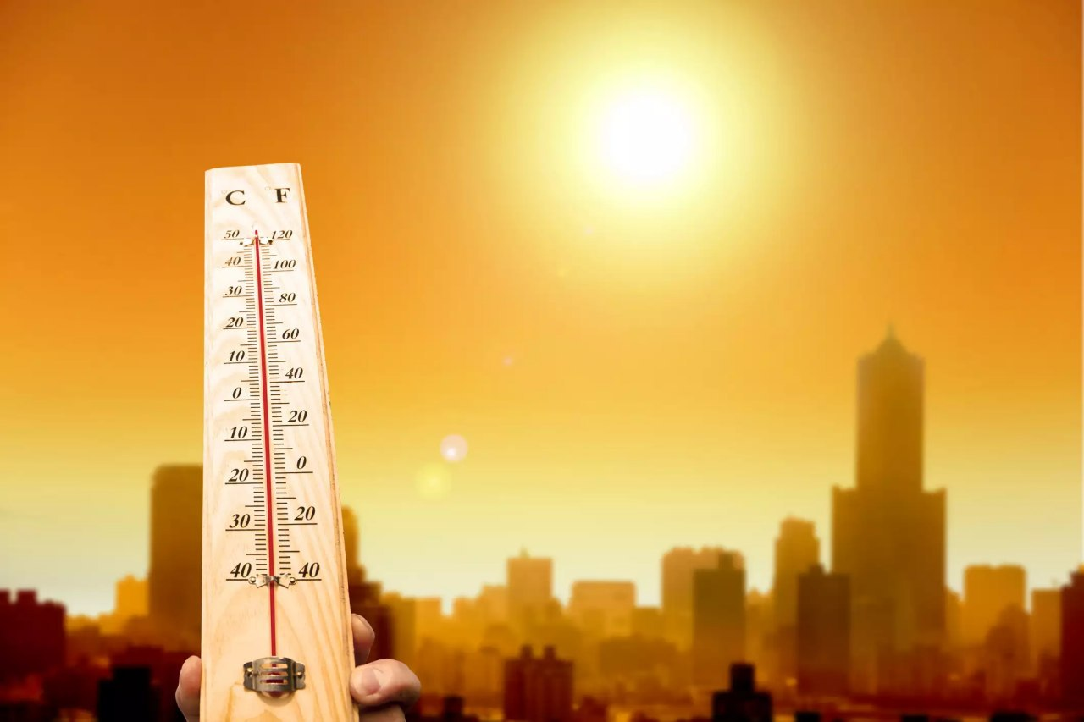
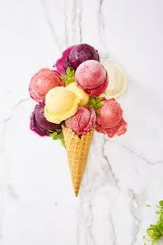
Use the given pictures to form some sentences including too .. to / so ..that:

