Slide 1

Module 1
Unit 2
Life Events

Slide 2

Reading
SB./P. 21

Slide 3

1- Mention some important
events in your life.
2- Would you like to connect to the world to share your life events?
3- How about creating your own blog?

Slide 4
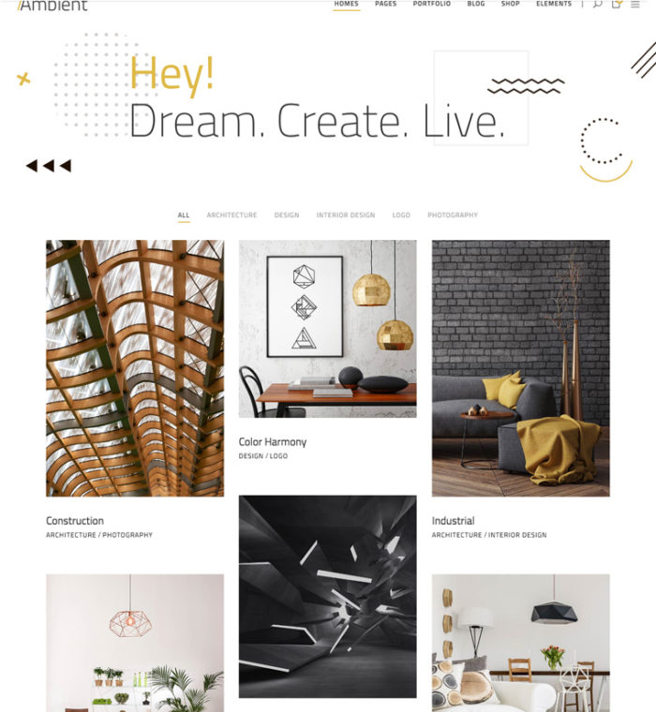
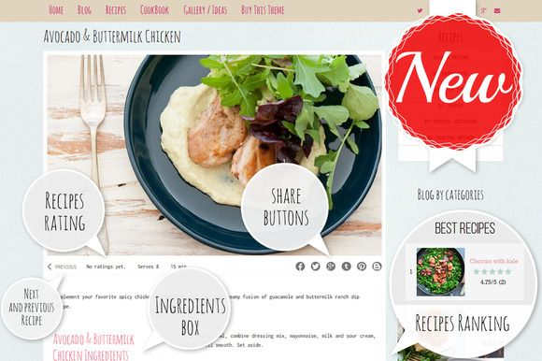

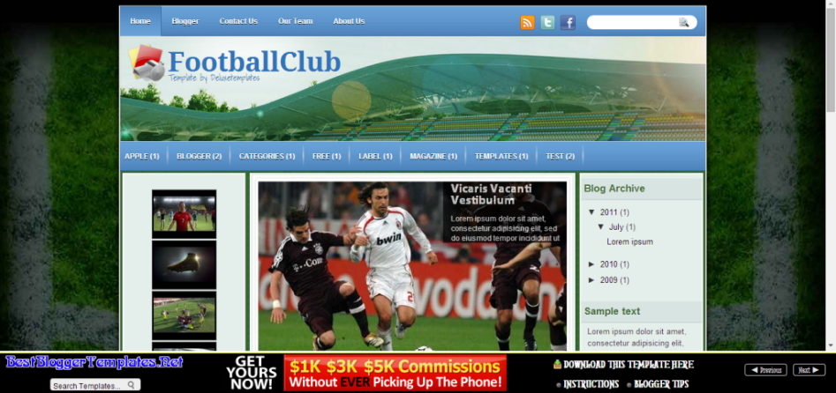

Slide 5
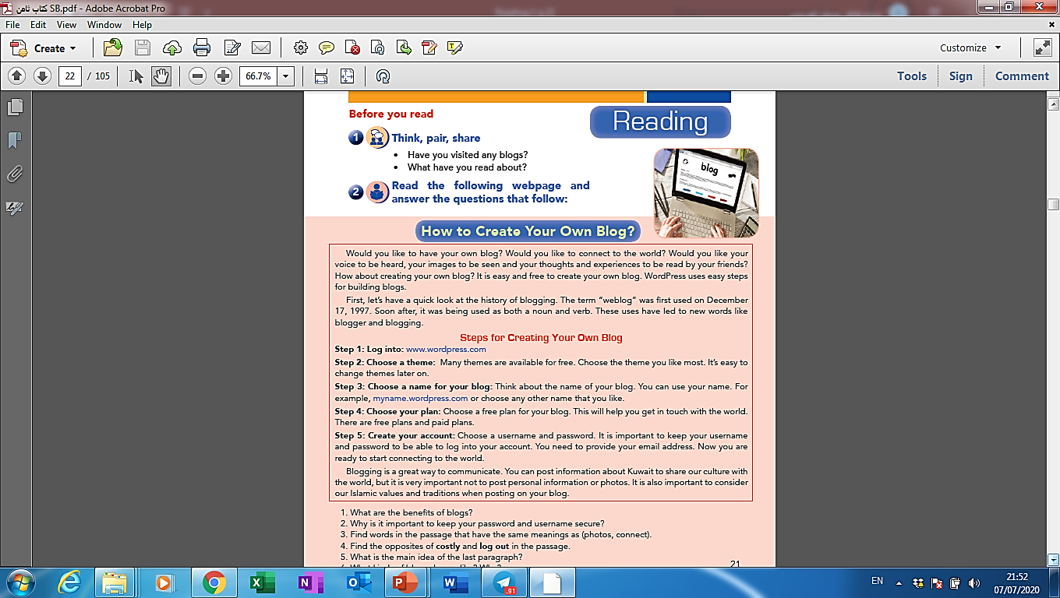
Activity 1 :
Read the following webpage and
get the main idea of each paragraph:

Slide 6
Paragraph 1
The main idea of this paragraph is :
Sharing thoughts and experiences through blogs.

Slide 7
Paragraph 2
The main idea of this paragraph is :
The history of blogging.

Slide 8
Paragraph 3
The main idea of this paragraph is :
How to make a blog.

Slide 9
Paragraph 4
The main idea of this paragraph is :
The importance of blogging.

Slide 10

New
Vocabulary

Slide 11


lead / led (V)
to conduct by holding and guiding

Slide 12
Example
Making your own blog
leads you to fame .

Slide 13

theme (N)
The main subject
of a talk , book ,
film , etc

Slide 14
Example
To create your own blog ,
choose the theme you like most.

Slide 15
provide (V)
to give someone something that they need

Slide 16
Example
You need to provide your email
address in making a Facebook account.

Slide 17
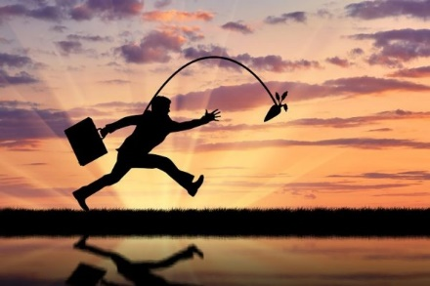
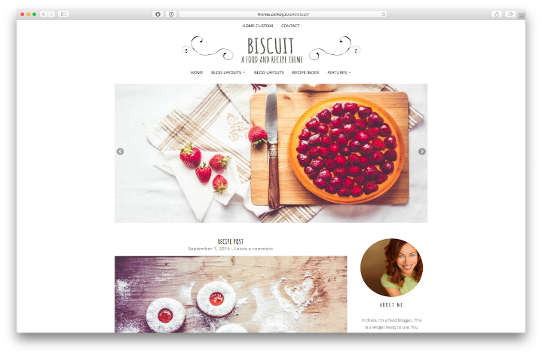
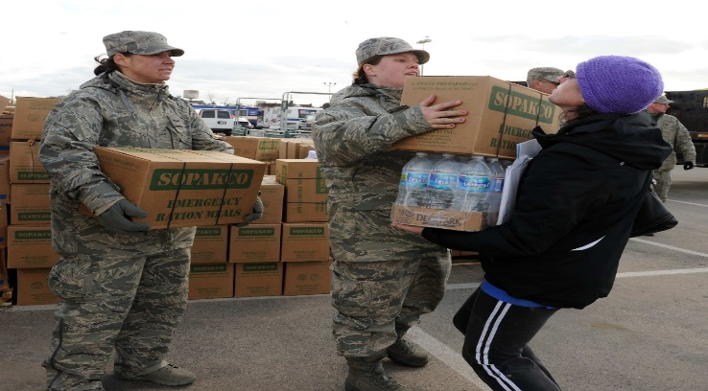
lead (V)
theme (N)
provide (V)

Slide 18
Activity 2 :
Read the webpage again and
answer the following questions:
1. What are the benefits of blogs?
2. Why is it important to keep your password and username?
3. Find words in the passage that have the same meanings as (photos, connect).
4. Find the opposites of these words in the passage (costly, log out).

Slide 19



Slide 20
1. What are the benefits of blogs?

Slide 21
2. Why is it important to keep your password and username?

Slide 22
3. Find words in the passage that have the same meanings as (photos, connect).
images
Communicate
get in touch with

Slide 23
4. Find the opposites of these words in the passage (costly, log out).
free
log into

Slide 24

Activity 3
What kinds of blogs do you like ?
Why ?

Slide 25
Try to follow the given steps in
the webpage to make your own blog.

Slide 26


