Slide 1
Module 1
Unit 3

Slide 2
Reading
SB./ P. 27

Slide 3
Do you enjoy reading stories? Why?
Name a story you know. What is it about?
Which kind of stories do you prefer reading? Why ?

Slide 4
Activity 1 :
Read this story and give it a title :

Slide 5
Notice the following story
to guess the meanings of
the new vocabulary.
New Vocabulary

Slide 6
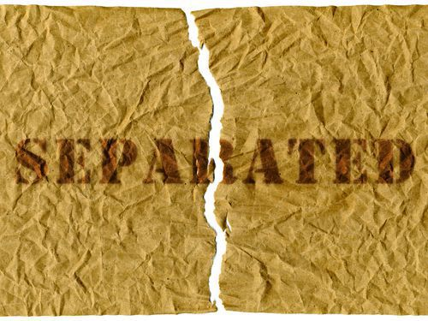
separate (Adj)
existing or happening independently or in a different physical space

Slide 7
Example
My father has three
separate workshops.

Slide 8
employ (V)
to have someone work or to do a job for you and pay them for it.

Slide 9
Example
He employs many mechanics
in his workshops.

Slide 10
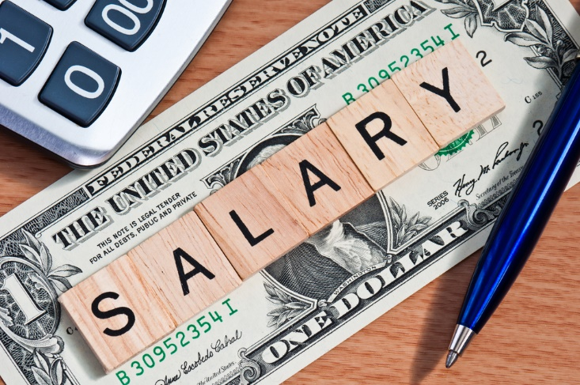
wage (N)
an amount of money that is paid to an employee

Slide 11
Example
My father pays the mechanics’ wages
at the end of each month.

Slide 12
instead of (Adv)
in place of someone or something

Slide 13
Example
I always help my father in his work
instead of staying at home.

Slide 14
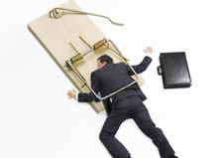
trap (N)
a device or hole for catching animals or people and preventing their escape.

Slide 15
Example
One day, I set a trap for a lazy
mechanic who was sitting on
a tree instead of working.

Slide 16
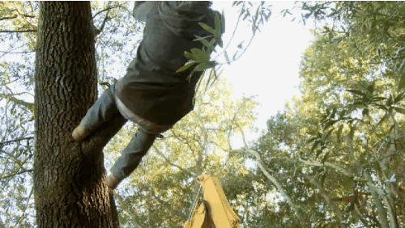
drop out (PhV)
to fall out
of something

Slide 17
Example
Badly , the lazy mechanic dropped out
of the tree and broke his leg.

Slide 18
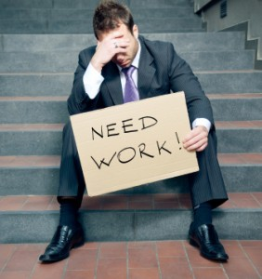
jobless (Adj)
unemployed ; without a job.

Slide 19
Example
At the end, the lazy mechanic lost
his job and became jobless.

Slide 20
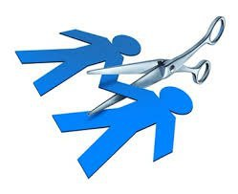
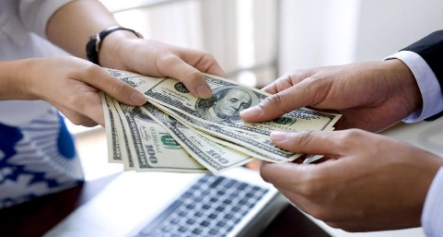
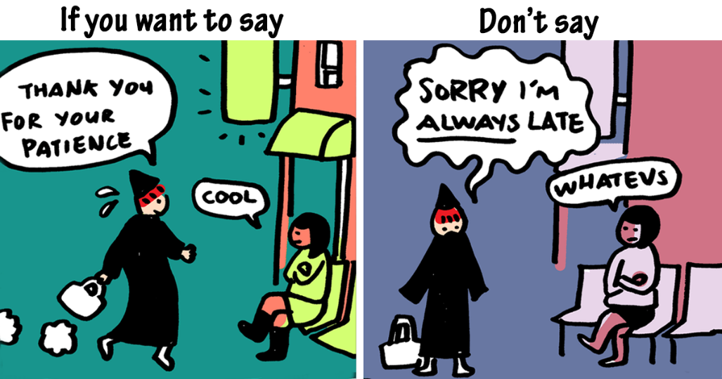
separate (Adj)
employ (V)
wage (N)
instead of (Adv)
trap (N)
drop out (PhV)
jobless (Adj)

Slide 22
Activity 2 :
Read the story again and answer the following questions :
1 - The main idea of the 1st paragraph is :
a- Dad’s garage and work.
b- Family and brothers.
c- Jobless people problems.
d- The unexpected trap.

Slide 23
2 - What is the antonym (opposite) of the word “separate” in the second paragraph ?
c- united
a- flexible
b- adequate
d- strict

Slide 24
3 – What does the underlined pronoun
“ him” in the 4th paragraph refers to ?
a- Antonio
b- Don
c- Dad
d- Mechanic

Slide 25
4 – Find out words in the story that mean
“ repaired / fell down”:
fixed
dropped out

Slide 26
5- The purpose of the writer in writing this story is :
a- To inform us about mechanics.
b- To advise us to work hard .
c- To compare between different jobs.
d- To persuade us not to be mechanics.

Slide 27
Activity 3

Slide 29
1- He was young, tall , slim and quick with his hands. He fixed the cars faster and better than anyone.
2- Because he became too proud of himself.
3- He set a trap. He climbed up the tree and waited for Don to arrive. While Don was singing as usual , Antonio dropped out of the tree and looked him in the eye.

Slide 30
Activity 4
Fill in this table with the required information
from the story:
Characters
Setting
Problem
End

Slide 31
What message do you think
the writer of the story
is trying to share ?

