Slide 1
Unit 7
Ideas and Thoughts
lesson 1
Reading
S.B p57 +58

Slide 3
help
likes
works
eat
need
live
leaves

Slide 4
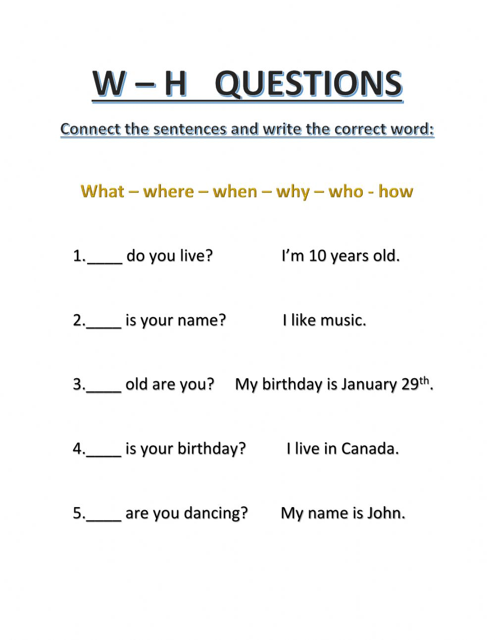

Slide 5
1.Where
2. What
3.How
4.When
5.Why

Slide 6
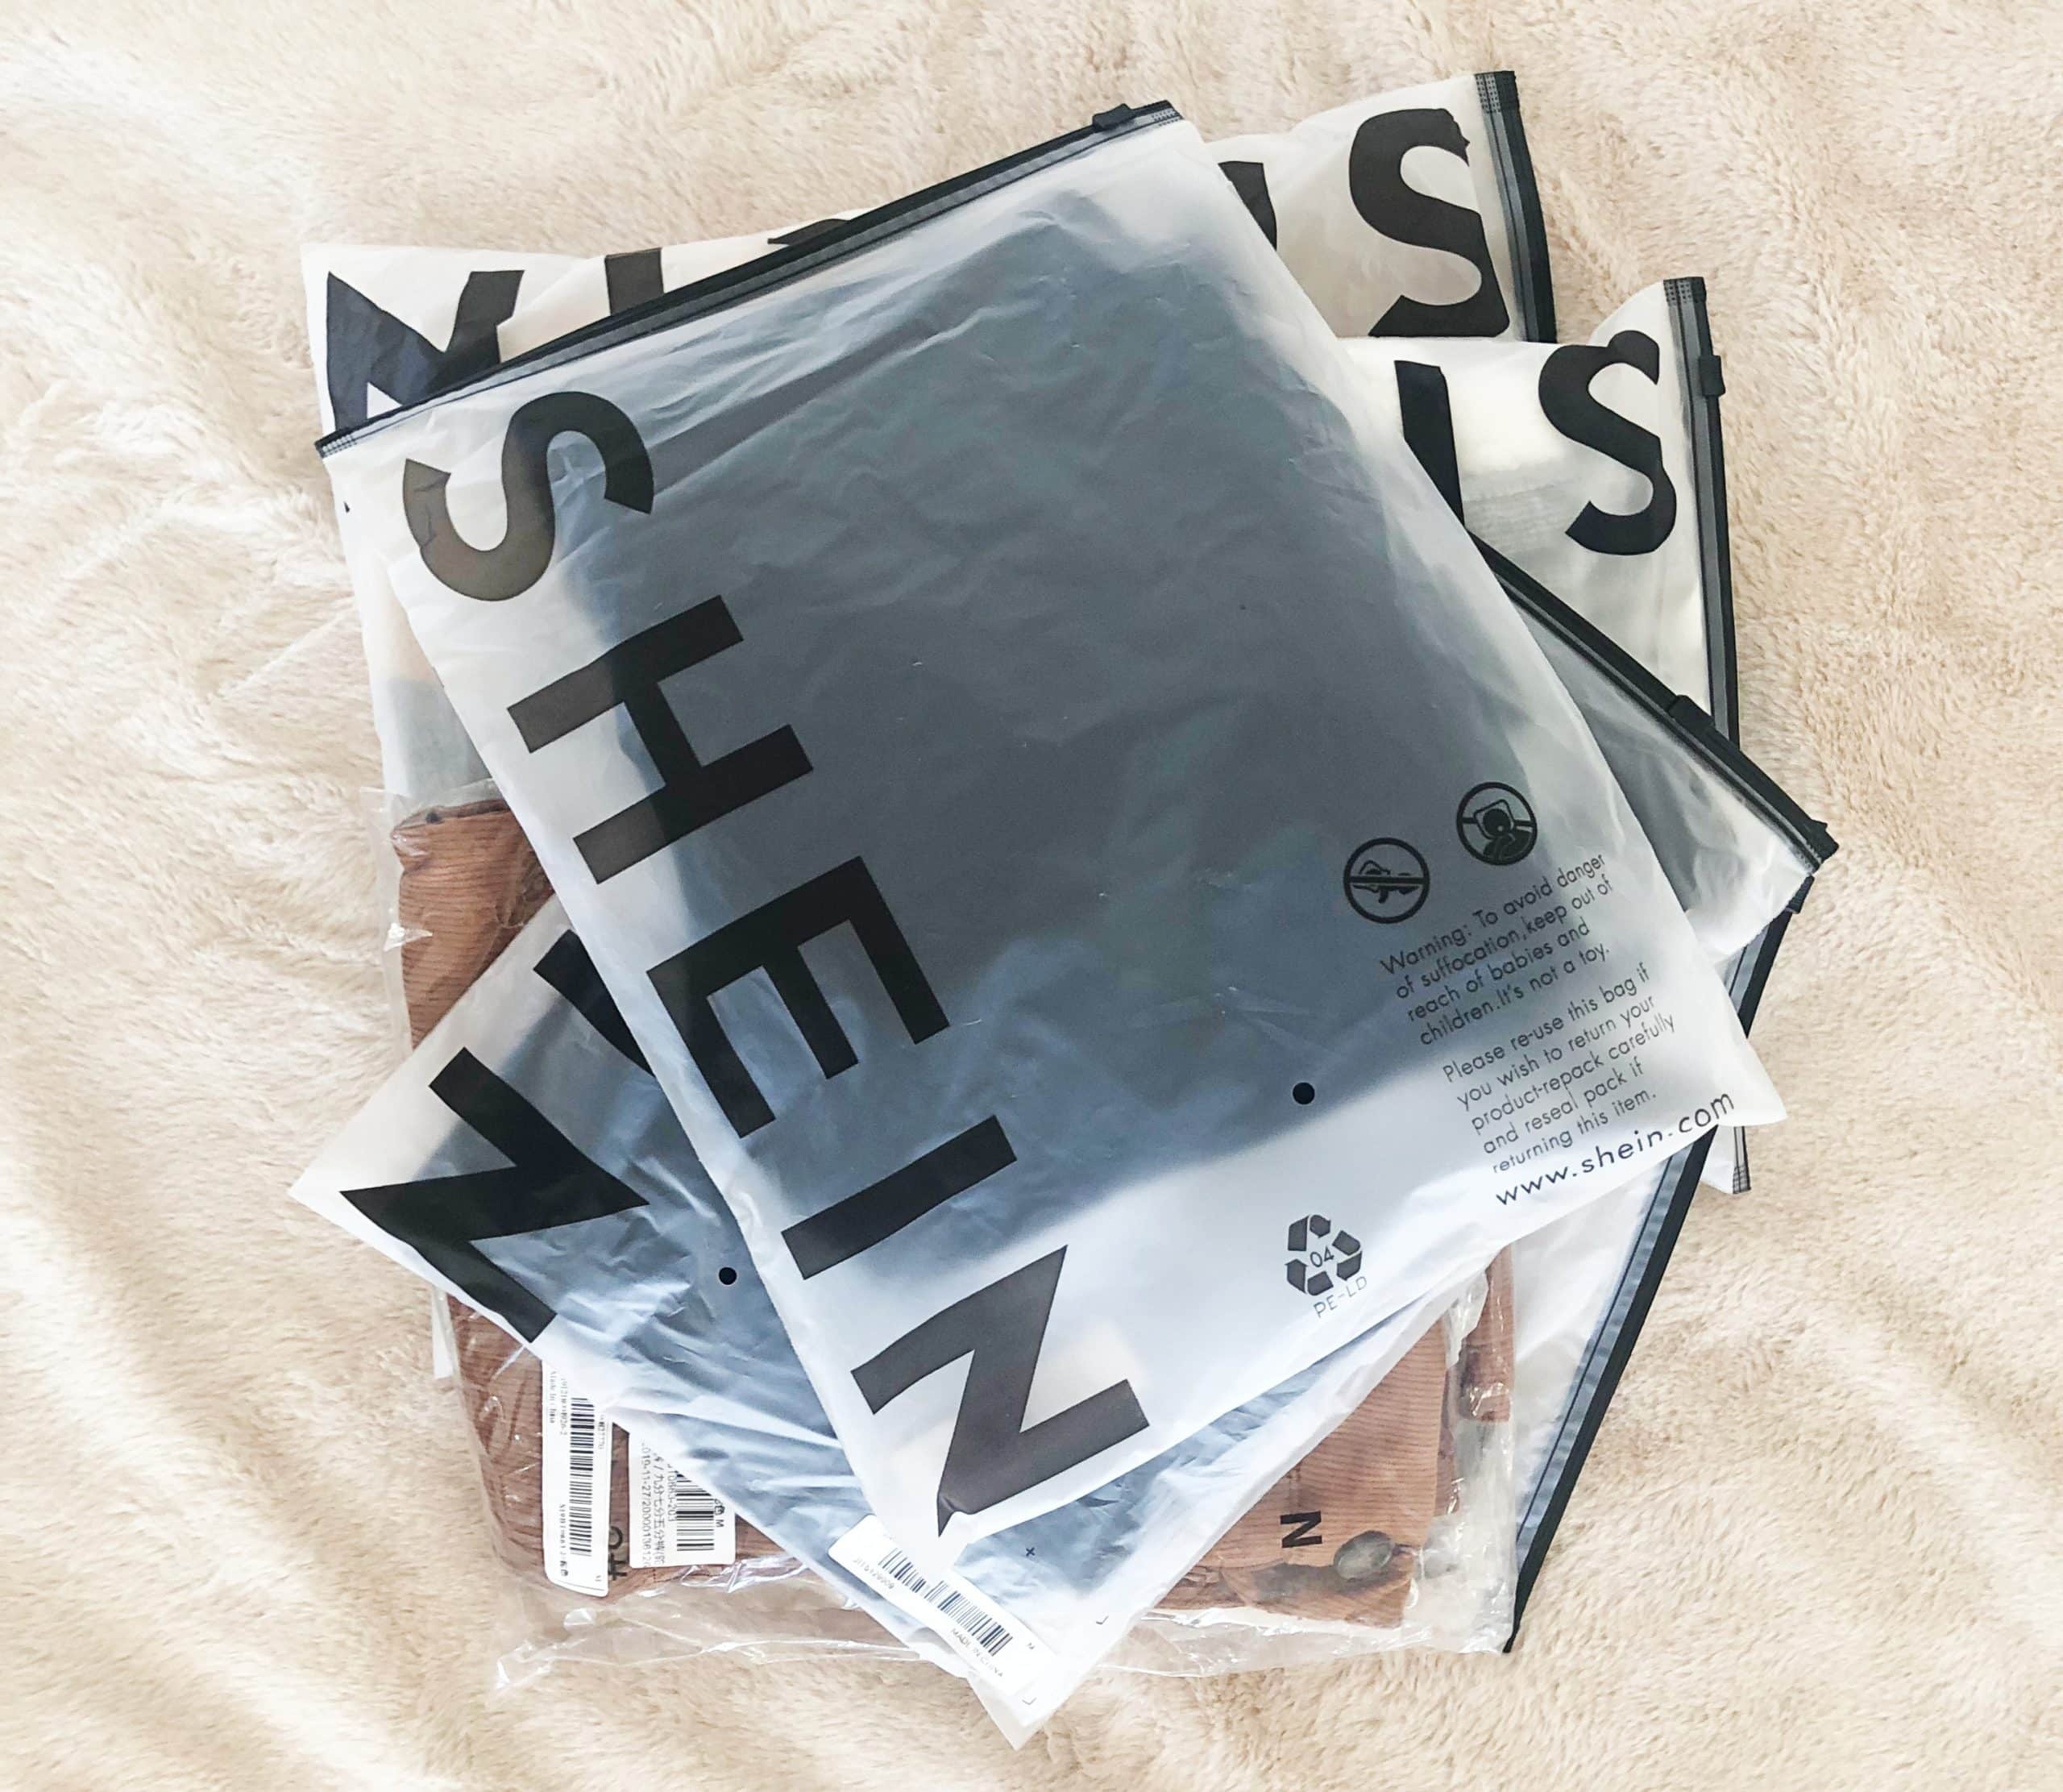
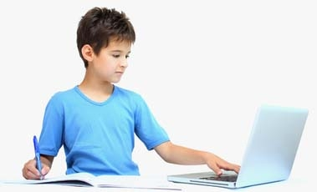
Social media can help us to……
Send messages
Buy online
Play games
Do homework
Read books
Book tickets online
Search information

Slide 7
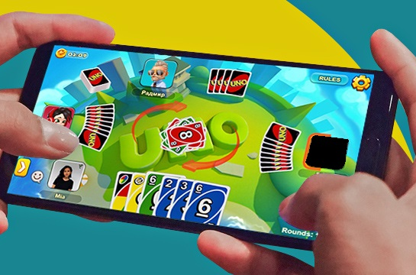
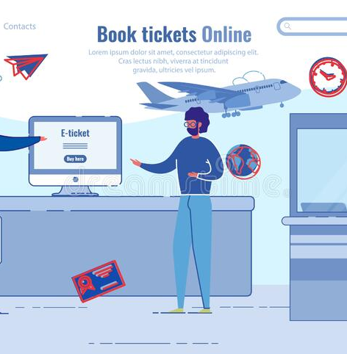
Social media can help us to……
Send messages
Buy online
Play games
Do homework
Read books
Book tickets online
Search information

Slide 8
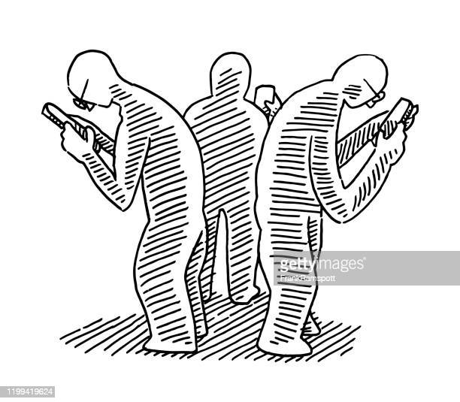
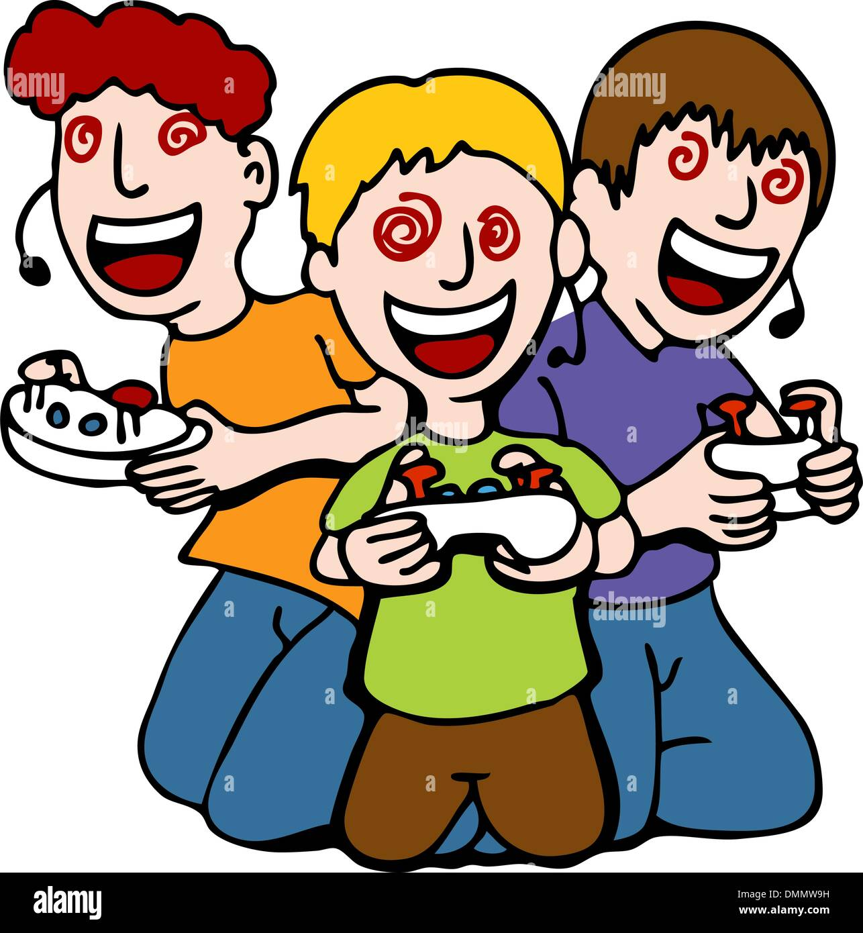
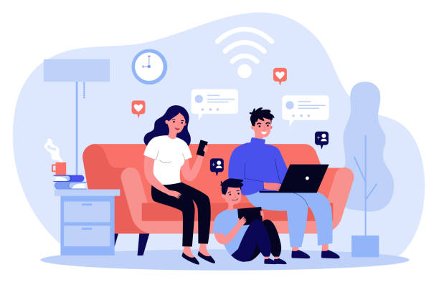
New vocabulary:-
1- addiction (N)

Slide 9
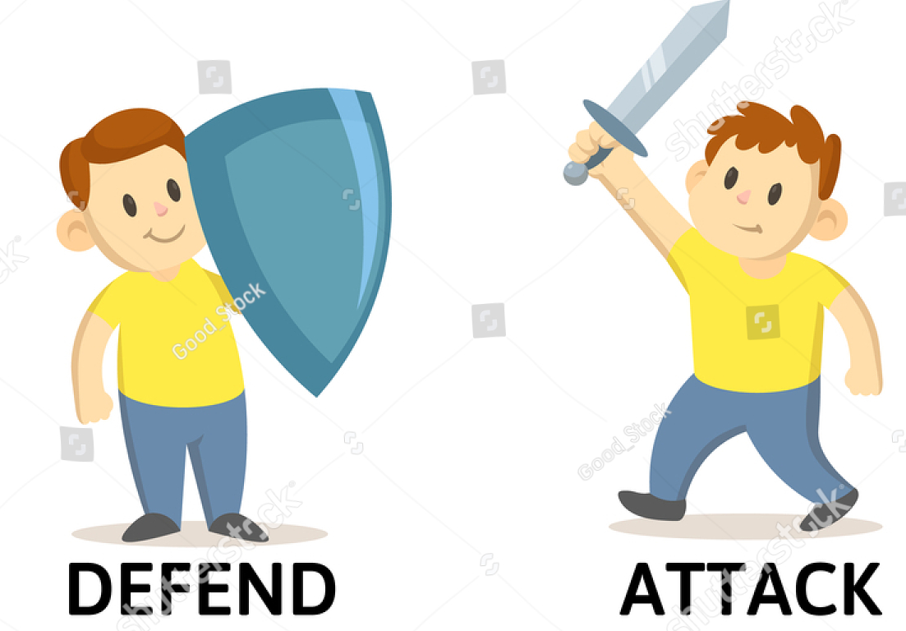
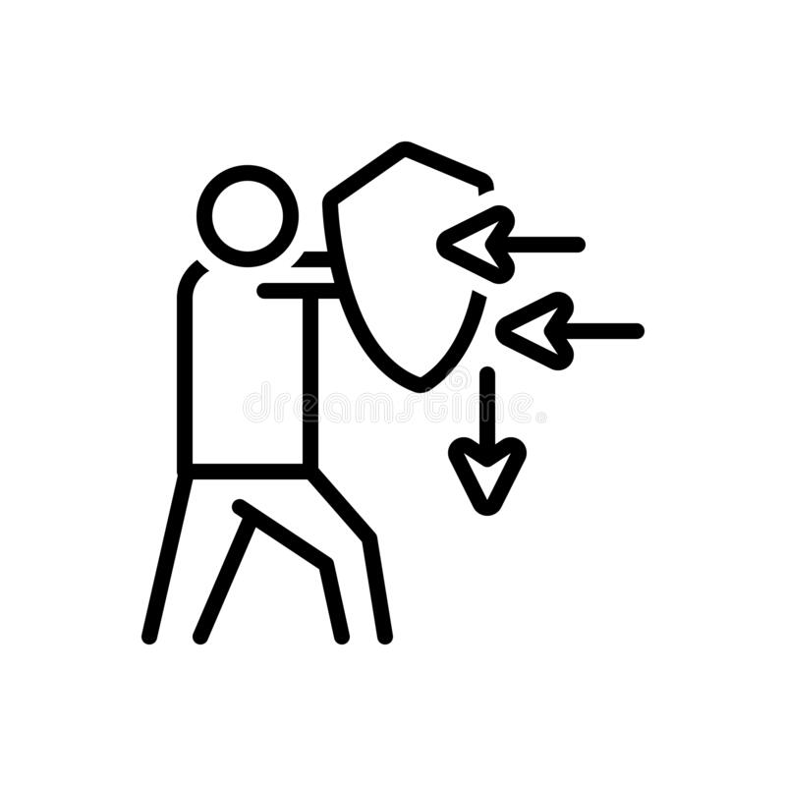
2-defend (V)

Slide 10
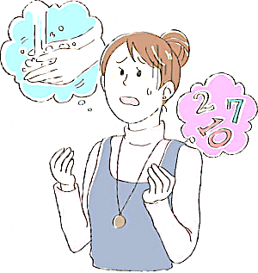
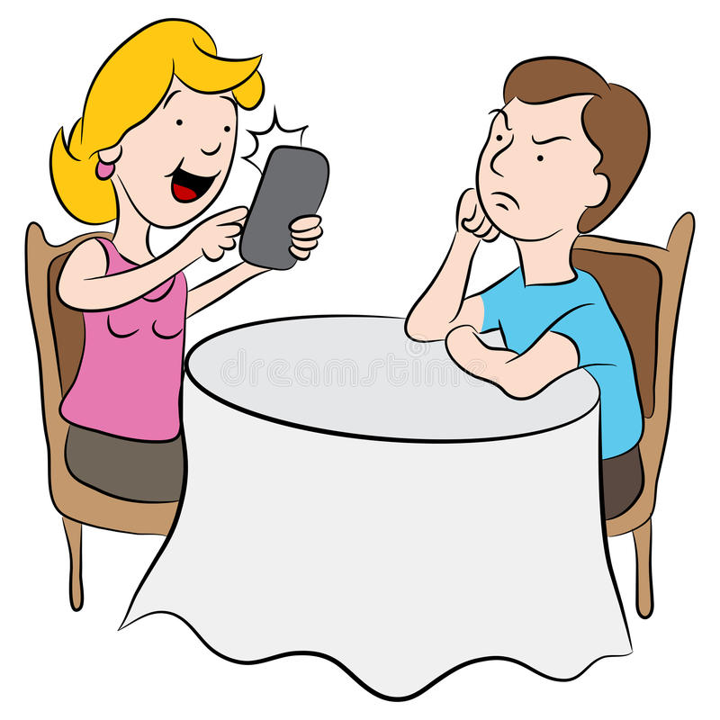
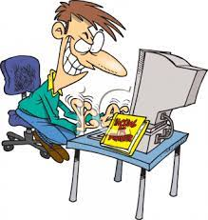
3- obsessed (Adj)

Slide 11
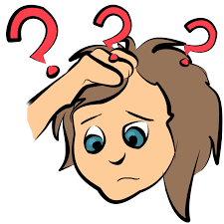
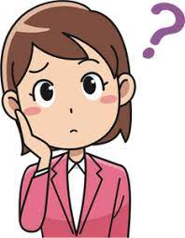
4- confused (V)

Slide 12
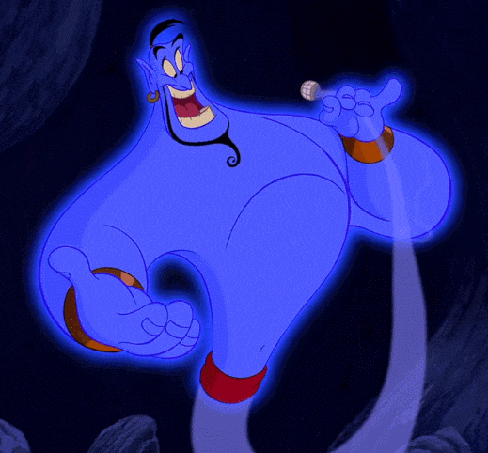
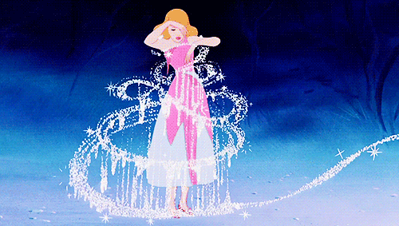
5- unrealistic (Adj)

Slide 13
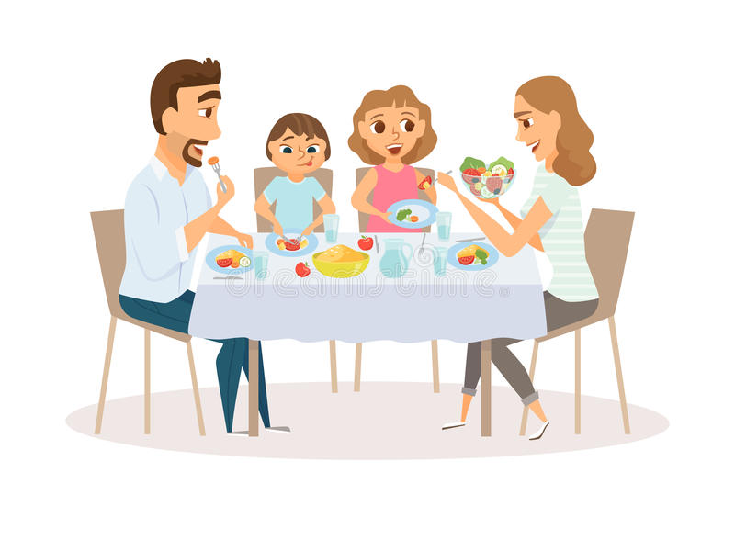
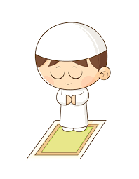
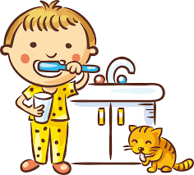
6- necessarily (ADV)

Slide 14
Name some of the social media application you use?

Slide 15
Pre- reading:
What is your favorite?
How much time you spend on social media?

Slide 16
-S.B p 57
1
2

Slide 17
-S.B p 57
3
4

Slide 18
-S.B p58
The biggest problem is that using social media makes us less social in real life.

Slide 19
-S.B p58
The second paragraph argues against social media, The third paragraph argues for social media.

Slide 20
-S.B p58
In his opinion, social media is not necessarily a bad thing. Although using technology too much is unhealthy, using it in the right way is good for living in modern times.

Slide 21
-S.B p58
Social media has become part of everyday life. Some people think using social media for long time is an addiction, but others think it is normal part of modern life and communication.

Slide 22
Unit 7
Ideas and Thoughts
STE 2
Grammar
S.B p58

Slide 23
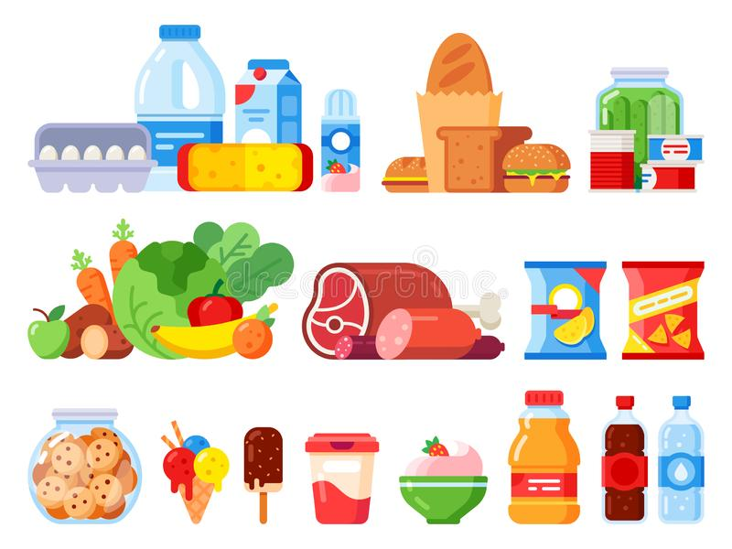
New vocabulary:-
1- product (N)
something that is made to
be sold

Slide 24
2-feature (N)
What are the features of the mobile phone?

Slide 25
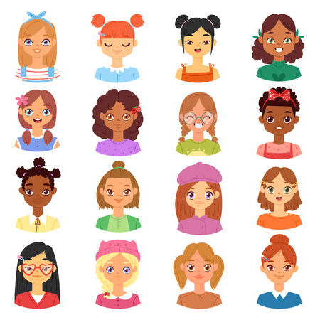
2-feature (N)
What are the features of these girls?

Slide 26
2-feature (N)
What are the features of the social media?

Slide 27
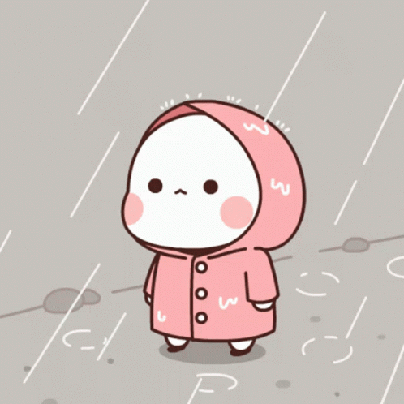
Although / however
She went outside, although it was raining.

Slide 28
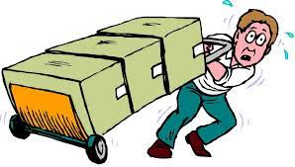
Although / however
The boxes were heavy, however, he carried them.

Slide 29
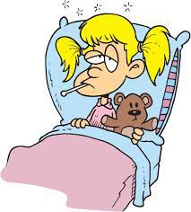
Although / however
Although Sara was sick, she studied.

Slide 30
S.B page 58
He is good
They went outside
she didn’t say sorry
my sister liked it

Slide 31
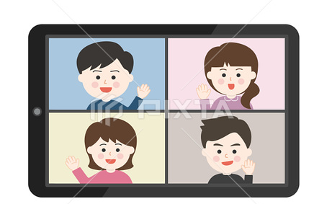
For .
1) Making friendships

Slide 32
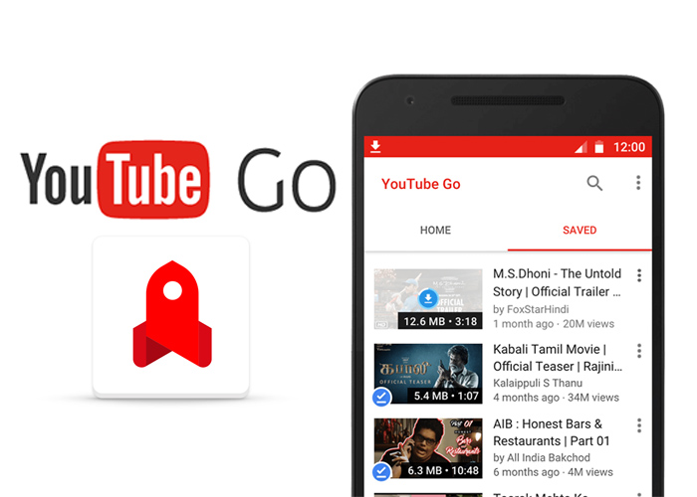
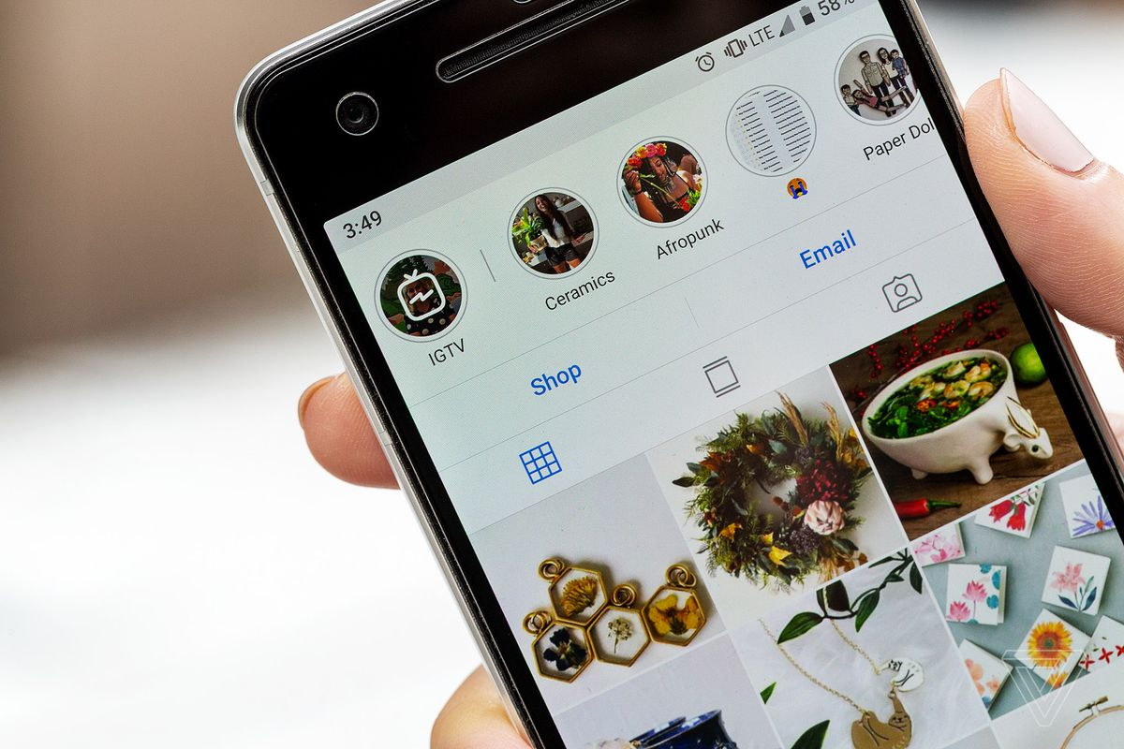
For .
2) Sharing videos, pictures and information.

Slide 33
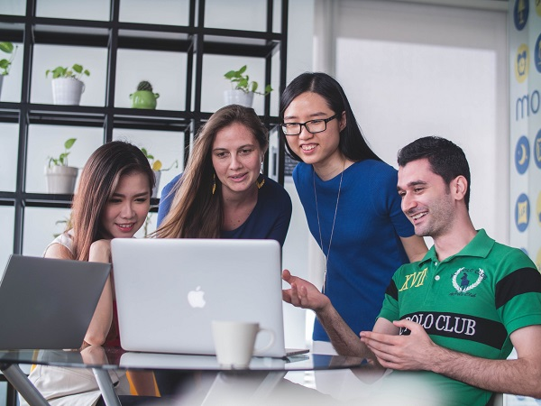
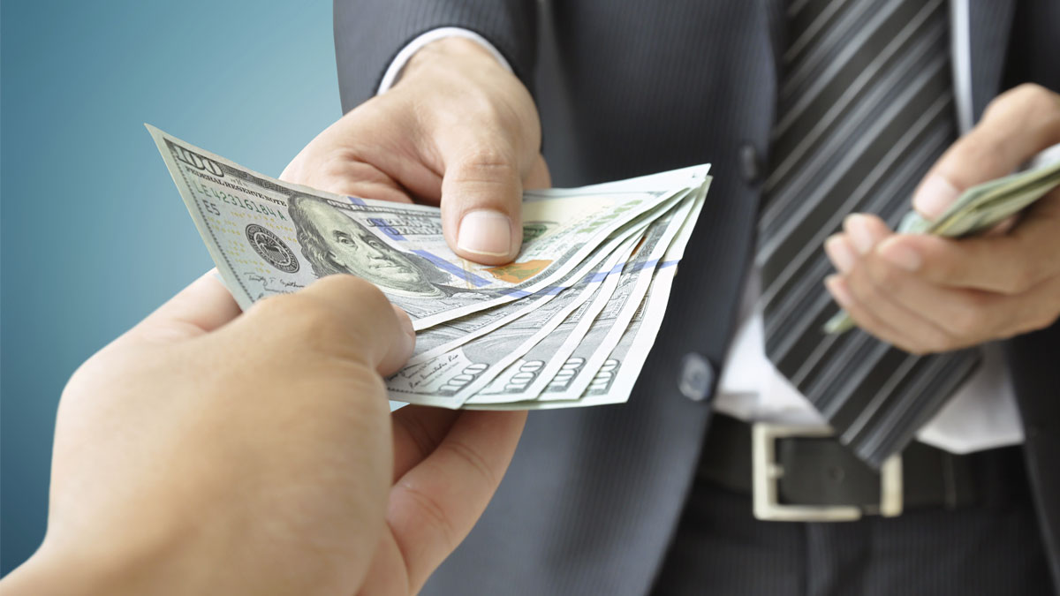
For .
3) Raising money for charity,

Slide 34
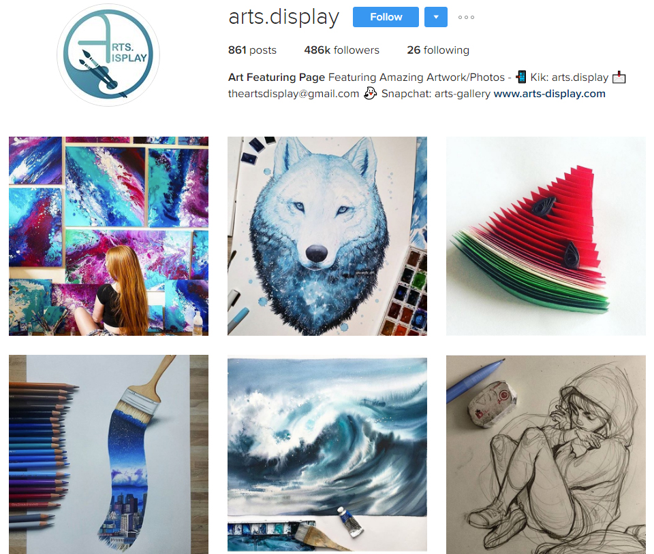
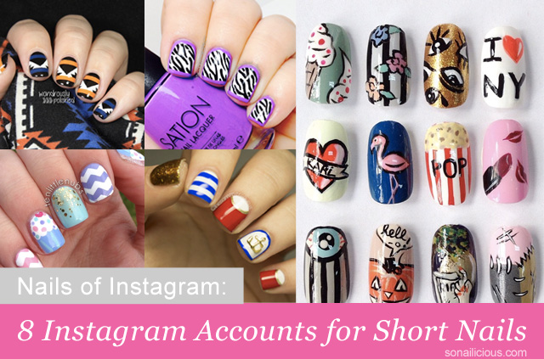
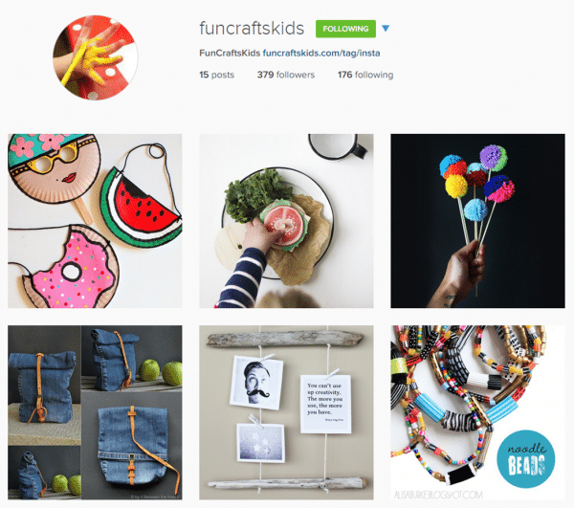
For .
4) Sharing interests and hobbies.

Slide 35
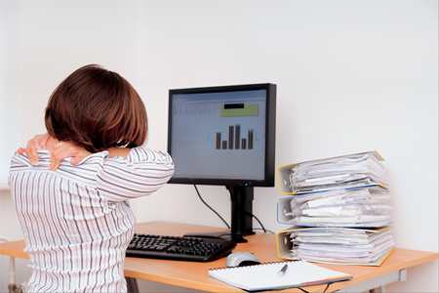
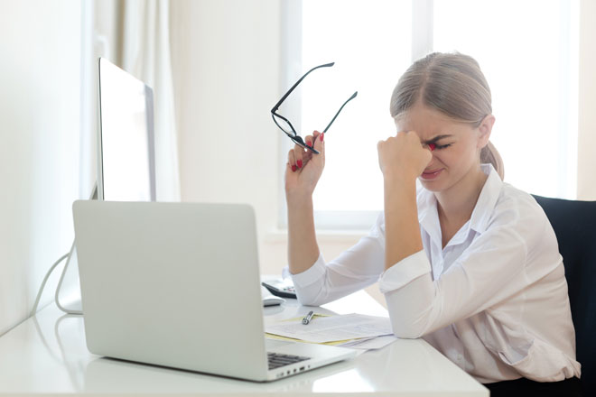
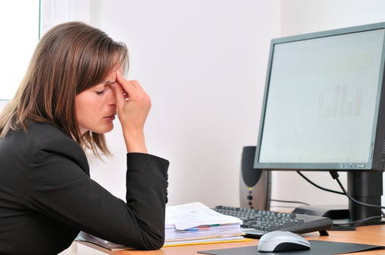
Against
1) Health problem

Slide 36
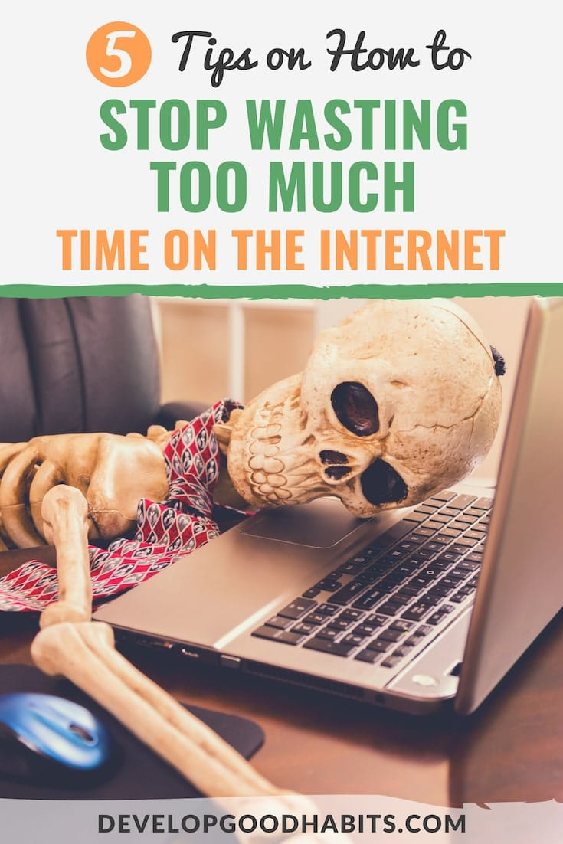
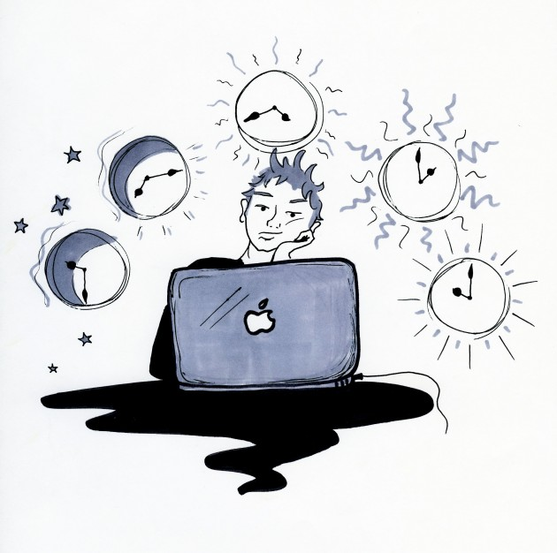
Against
2) Wasting time.

Slide 37
Against
3) Not all websites are secured.

Slide 38
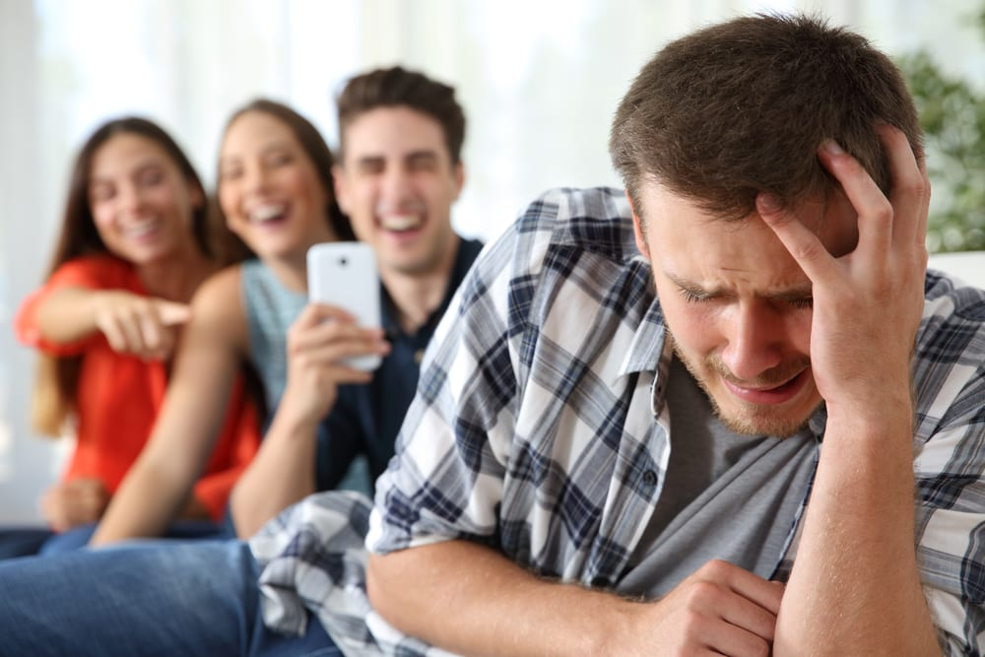
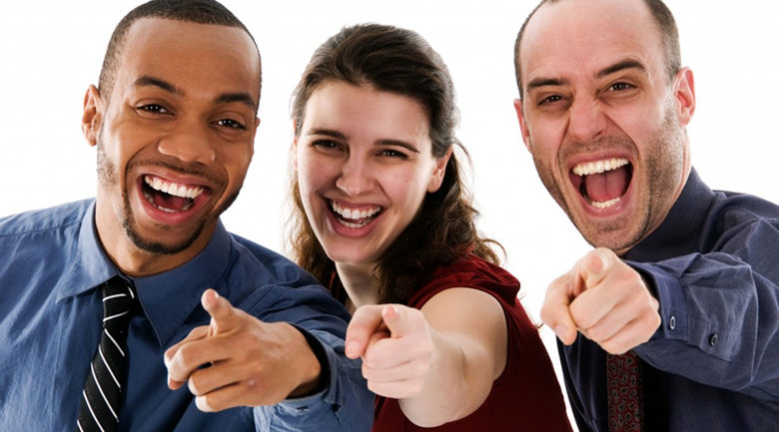
Against
4) Can be missused.

Slide 39
For Against
1) I can call my friends and family. | 1)We may become lonely in our life
2) I can send messages | 2)We may waste much time
3) I can learn online | 3)We may watch bad video
4) I can get information 5) I can do business | 4) It is also bad for our health 5)We may be lazy

