Slide 1

Module 1
Unit 2
Life Events

Slide 2

Reading
SB./P. 25

Slide 3
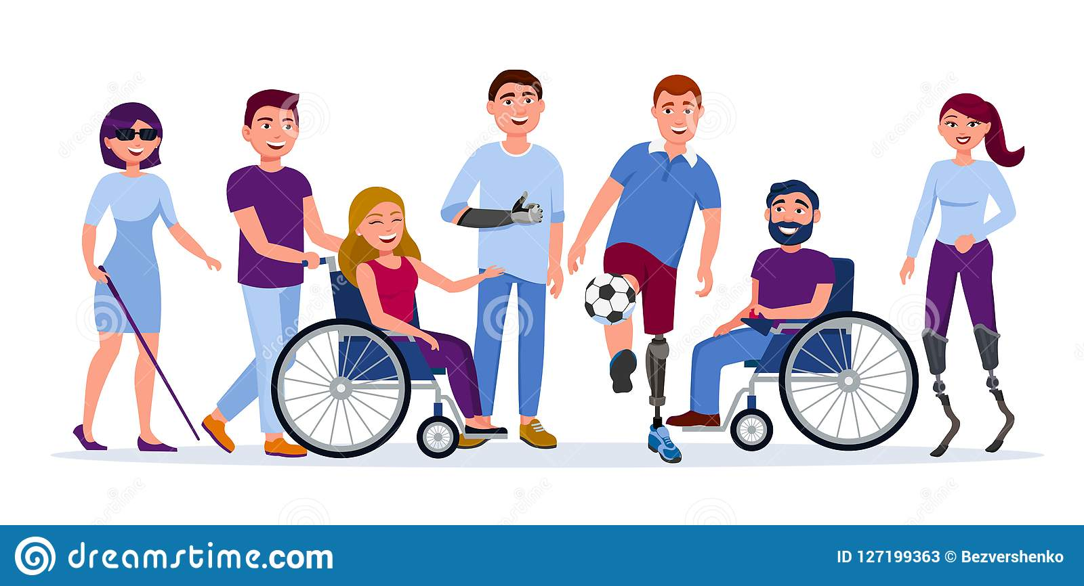
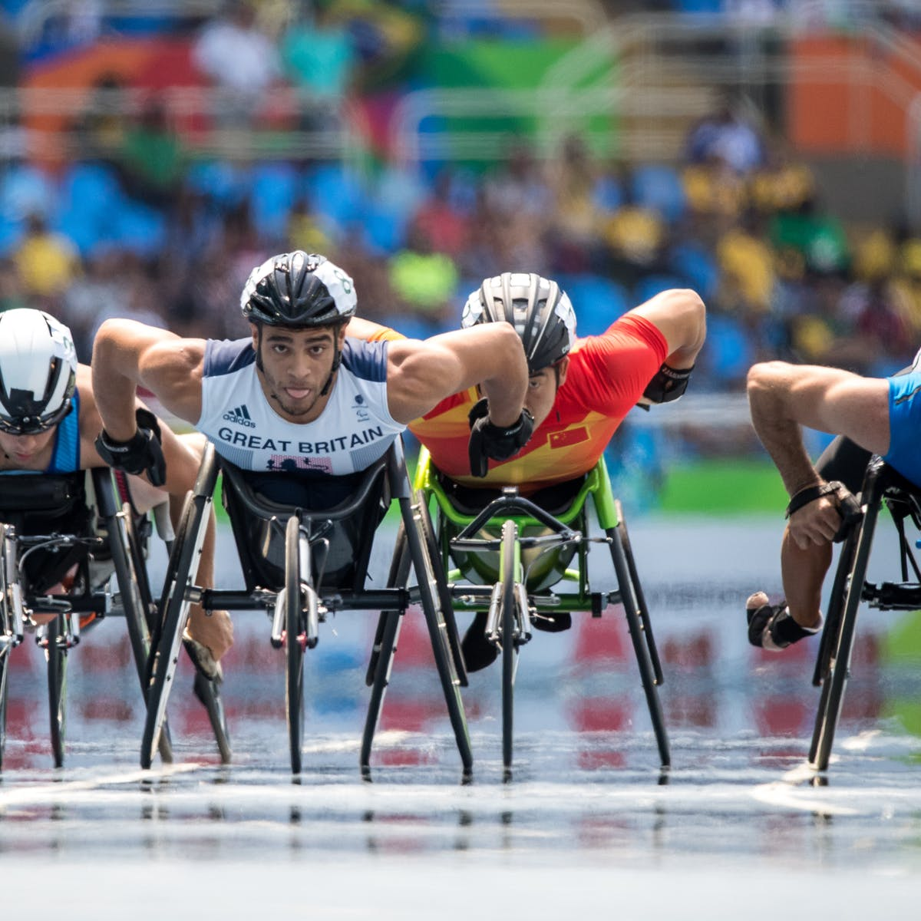
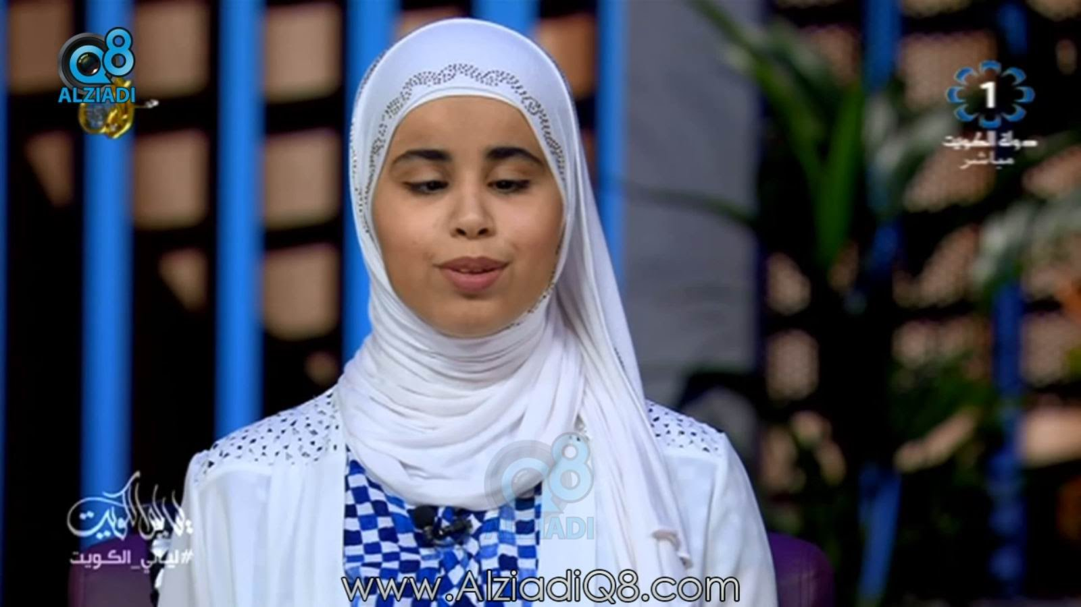

Slide 4

1- What is her
disability?
2- In your opinion ,
what challenges
is she facing?

Slide 5


Slide 6
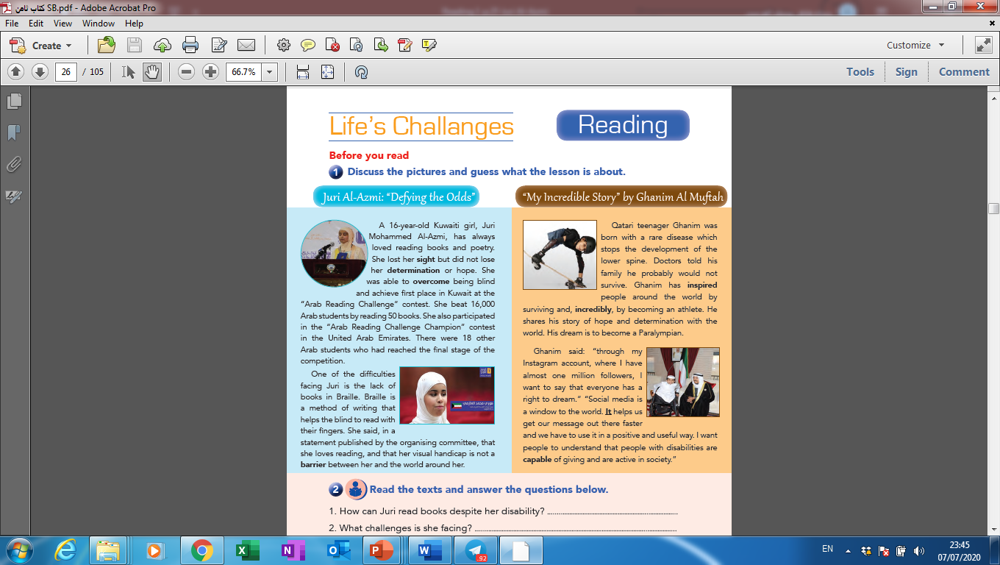
Activity 1 :
Read the following text and choose the correct answers:
1- The best title of this text is :
a- Playing sports
b- Competitions
c- Reading books
d- Life challenges

Slide 7
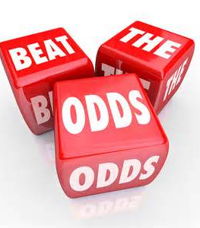
New
Vocabulary

Slide 8


sight (N)
the ability to see

Slide 9
Example
Juri can’t see .
She lost her sight.

Slide 10

determination (N)
the ability to continue trying to do something, although it is very difficult.

Slide 11
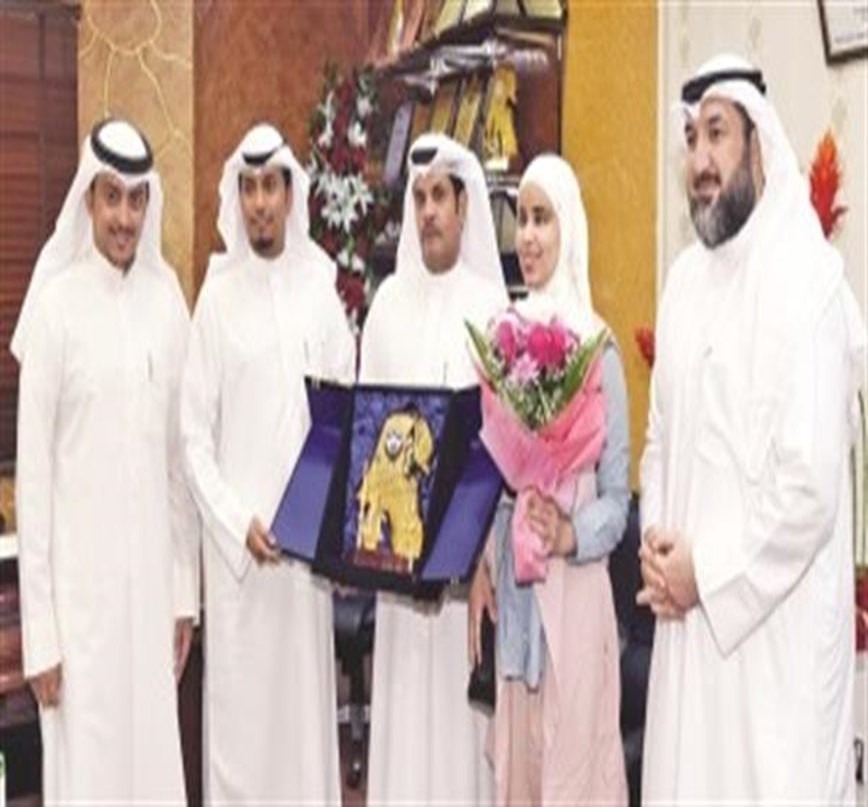
Example
She lost her sight but she
didn’t lose her determination.

Slide 12

overcome (V)
to defeat or succeed in controlling or dealing with something.

Slide 13
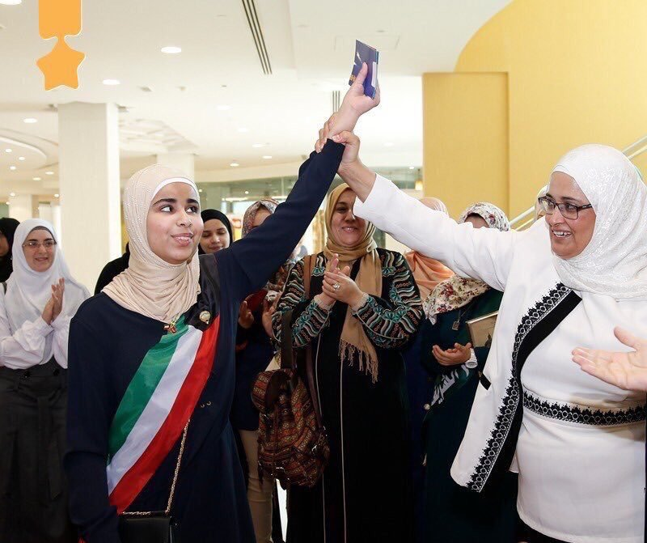
Example
Juri could overcome
her problems.

Slide 14
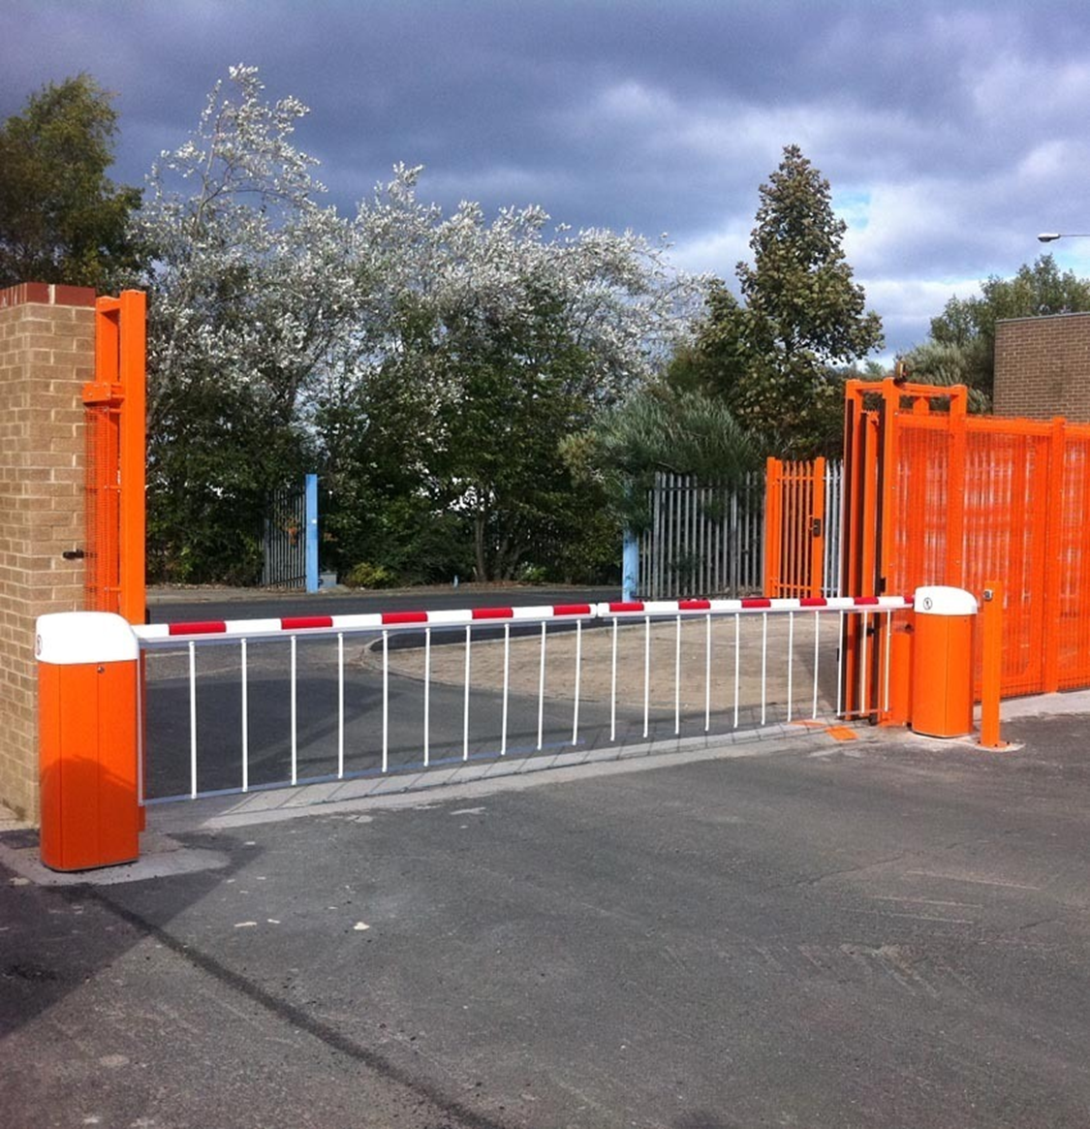
barrier (N)
something that prevents something else from happening or makes it more difficult.

Slide 15
Example
Juri’s disability didn’t become
a barrier between her and her dreams.

Slide 16
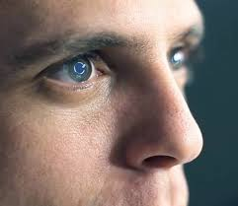



sight (N)
determination (N)
overcome (V)
barrier (N)

Slide 17
Activity 2 :
Read the text again and choose the correct answers:
2- The main idea of the 2nd paragraph is :
a- Participating in the reading champion.
b- How blind people read.
c- How Juri lose her hope.
d- The final stage of the competition.

Slide 18
3- The word “participate” in
the 9th line means :
c- reach.
a- solve
b- search
d- share

Slide 19
4- The opposite of the word “final”
in the 12th line is :
c- first
a- hard
b- middle
d- long

Slide 20
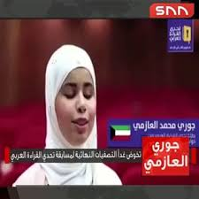
Activity 3
Read the text again and answer the questions blow:
1- How can Juri read books despite her disability?
2- What challenges is she facing ?

Slide 21



Slide 22
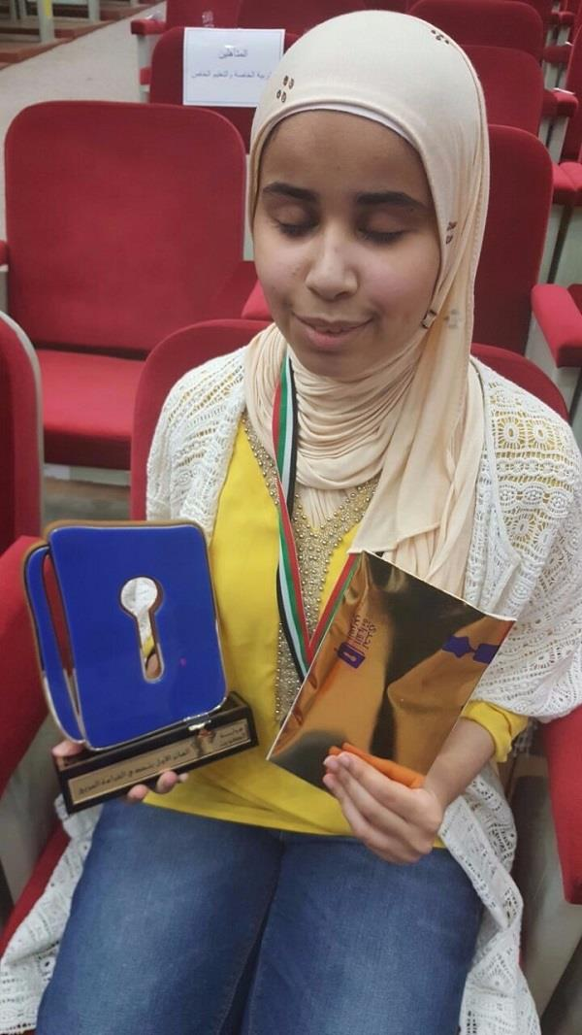
1- She can read books in Braille, a method of writing invented to help the blind to read.
2- Her visual handicap and the
lack of many books in Braille.

Slide 23

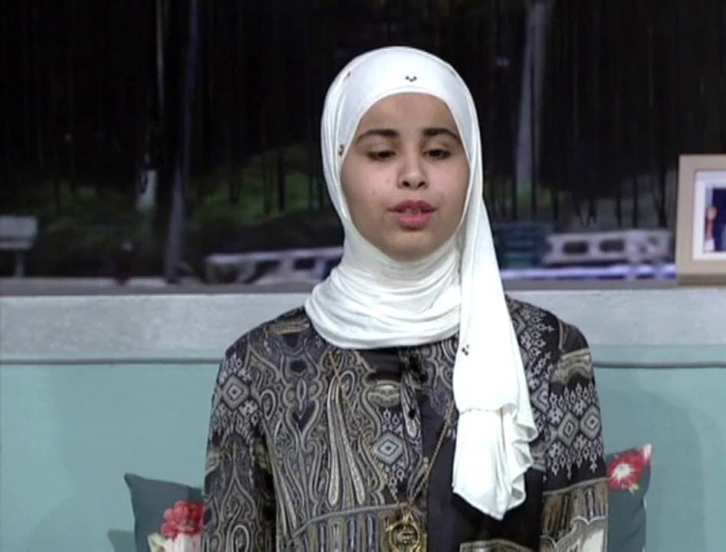
1- What did you learn from
the story of Juri ?
2- How can we help the disabled people in our society ?

Slide 24


