Slide 1

Module 1
Unit 1
Healthy living

Slide 2
Reading
P.15

Slide 3


What should we do to have a healthy life?

Slide 4
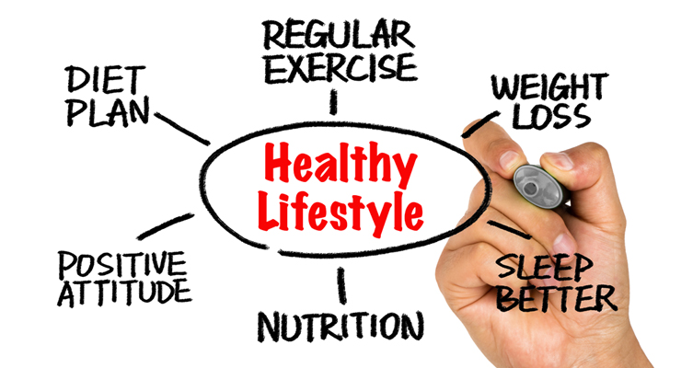

Slide 6



Slide 7








1
2
5
Basketball
Skiing
Throwing the javelin
3
Weightlifting
4
6
7
Skating
High jump
Sprinting
Cycling

Slide 8

Read the following text and
give a suitable title.
Activity 1 :

Slide 9
Activity 2 :

Slide 12

New Vocabulary

Slide 13

sprinting (N)
running very fast over a short distance.

Slide 14
Example
Sprinting helps to keep you fit.

Slide 15
extremely (Adv)
very , to a very great degree

Slide 16
Example
It is not extremely difficult
to have a healthy lifestyle.

Slide 17
resistance (N)
The opposition offered by one thing , force , etc., to another.

Slide 18
Example
Resistance training like weight-lifting
and push-ups can build muscles.

Slide 19
flexible (Adj)
able to bend or to be bent easily without breaking.

Slide 20
Example
Playing sport makes our body
more flexible.

Slide 21
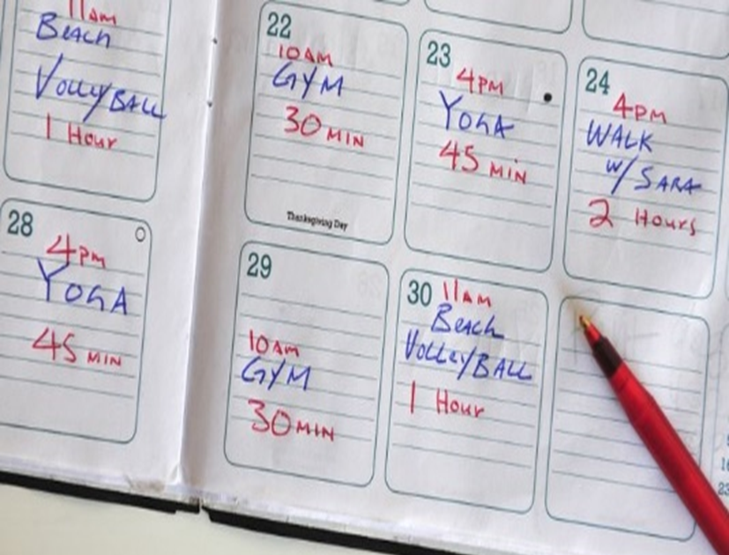
regimen (N)
any set of rules about exercise that someone follows, especially in order to improve their health.

Slide 22
Example
You should have a good exercise
regimen to be fit.

Slide 23
session (N)
a period of time arranged
for a particular activity.

Slide 24
Example
A good exercise session has a warm-up
of about 5-10 minutes.

Slide 25
Cool down (PhV)
To bring the body back to its normal physiological level after fast exercise.

Slide 26
Example
Sleeping well helps you cool down.

Slide 27
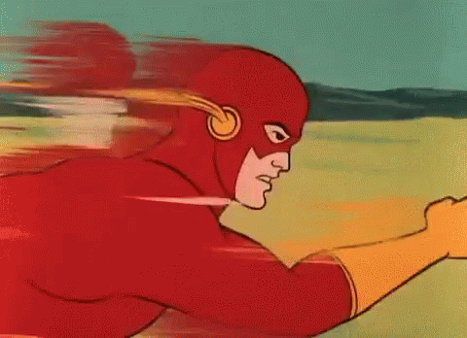

sprinting (n.)
extremely (adv.)
resistance (n.)
flexible (adj.)
regimen (n.)
session (n.)
cool down (ph v.)

Slide 28
Activity 3
Read the following paragraphs and
answer the given questions:

Slide 29
How can you keep fit ?

Slide 30
How can you keep fit ?

Slide 31
What are the three main
types of exercise?

Slide 32
What are the three main
types of exercise?

Slide 33
How can you exercise well?

Slide 34
How can you exercise well?

Slide 35
Read the second paragraph and write the missing information about each pictures.
Activity 4 :

Slide 36
Press-ups
Yoga
Aerobic
Stretching
Making
Building
heart and lungs
work hard.
muscles.

Slide 37


