Slide 1

Module 1
Unit 1
Healthy living

Slide 2


Listening
P.17

Slide 3
What is your favourite sport ?
How often do you practise it?

Slide 4


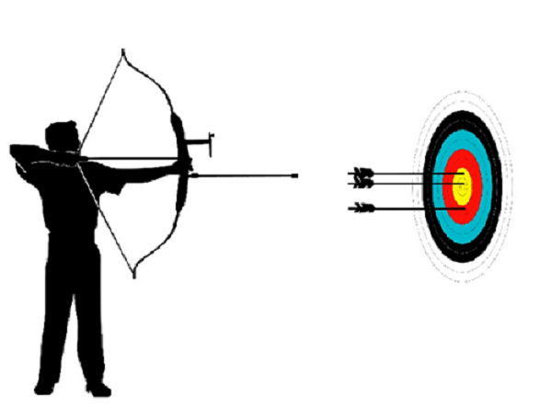
New Vocabulary
arrow (N)
A weapon consisting of a thin straight stick with a sharp point, designed to be shot from a bow.

Slide 5
Example
Are you good at throwing
the arrow?

Slide 6
Match the pictures with the right equipment and write the name of the sports.

Slide 7



Slide 8
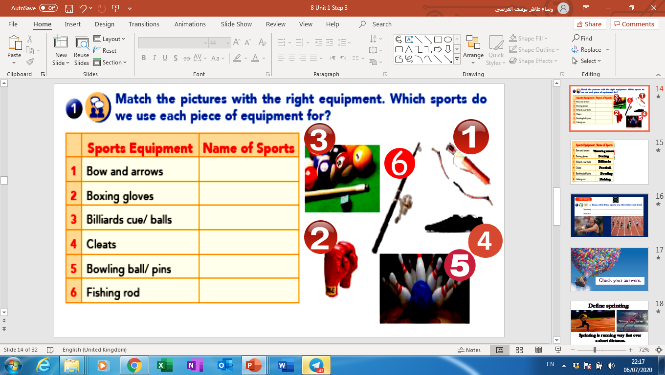
Throwing arrows
Boxing
Billiards
Football
Bowling
Fishing

Slide 9


Slide 10
Activity 1 :
Listen and get the main idea
of the text:

Slide 12
Activity 1 :
Listen and get the main idea
of the text:
Doing sports

Slide 13
Activity 2 :
Listen and write the sports
mentioned in the text
Sports

Slide 15
Activity 2 :
Listen and write the sports
mentioned in the text
Sports
jumping
throwing
running

Slide 16

Activity 3 :

Slide 18
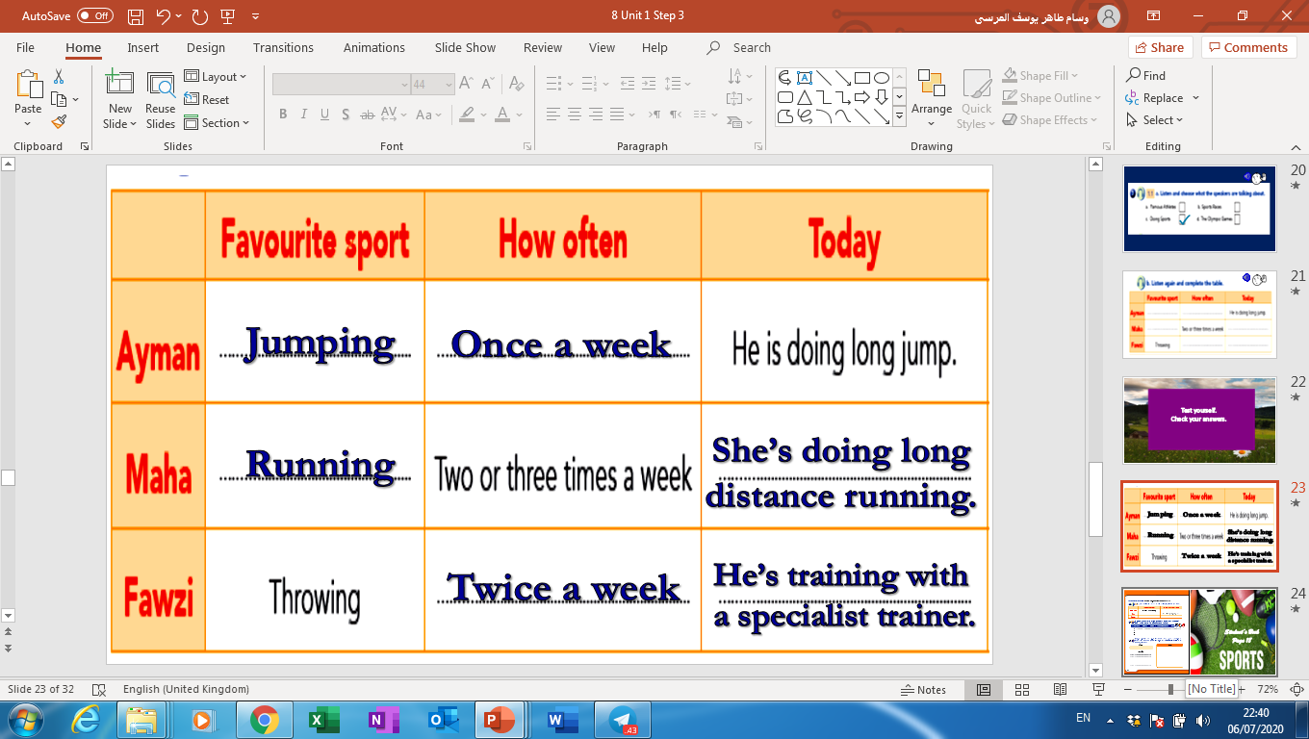
Activity 3 :

Slide 19

Sports has a great impact
on our health.
(Explain)
Sport has a great impact
on our health.
(Explain)

Slide 20


